Slide 1
Team 09
Members:
Viswanadham Killamsetty
Parag Tekade
Apoorva Singh
Dheepan Babu
Rishabh Saluja
Mentor:
Shibin Nair

Slide 2
ClaimWise – Smart Insurance Claim Assistant
AI-driven Claim Status Update Agent
Date: 12-09-2025

Slide 3
Problem Statement
Challenge:
High volume of customer inquiries about claim status causes delays and increased operational costs
Impact:
Slow response times and overloaded support teams
Need:
Automated, real-time, conversational AI agent for quick claim status updates and guidance

Slide 4
Solution Overview
Understands and interprets claim-related questions naturally
Provides instant claim status updates, next steps, and guidance
Handles follow-up queries contextually using conversational memory

Slide 5
Software Architecture
User Interface: Streamlit web app providing chat interface, claim status lookup etc.
Claims Database: Simulated CSV files storing sample claim records and statuses.
Knowledge Base: Document repository (Markdown) on claim processes, used with Retrieval-Augmented Generation (RAG) to improve answer relevance. Supports chat history.
AI Engine: LangChain framework integrated with OpenAI LLM for natural language understanding and conversational management.
Tools: Claim Status Lookup Tool – Retrieves claim details by claim ID.
Knowledge Base Q&A Tool – Uses RAG to answer FAQs from claim process documents.
Memory: ConversationBufferMemory to maintain context and handle follow-up queries.
Authentication: Simple username/password login system to restrict access.

Slide 6
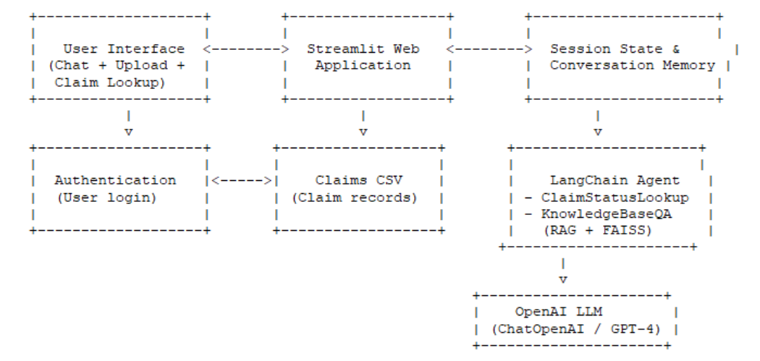
Flow Diagram

Slide 7
Benefits & Impact
Reduces support workload & operational costs
Improves customer satisfaction with instant responses
Enhances transparency and trust in claim processing
Scalable solution adaptable to real insurance systems
Foundation for future enhancements: multi-channel support, notifications

