Slide 1
Python @ searchcode
Ben Boyter www.boyter.org @boyter

Slide 2
What?
searchcode is a free source code and documentation search engine. API documentation, code snippets and open source (free software) repositories are indexed and searchable.
Github, Bitbucket, Sourceforge, Codeplex, Google Code, Fedora Project, Minix3, Tizen and others…
Similar to Google Code Search

Slide 3
Why?
Story Time!
2010-2011
Looking for a side project
How hard can it be?

Slide 4
Code search is hard!
Word boundaries and special characters
Duplicate code and minified code
Searches for =~ or List<object> are valid
i++ should match
for(i=10; i++; i<50) {
for(i=0;i++;i<100) {
spliti++;

Slide 5
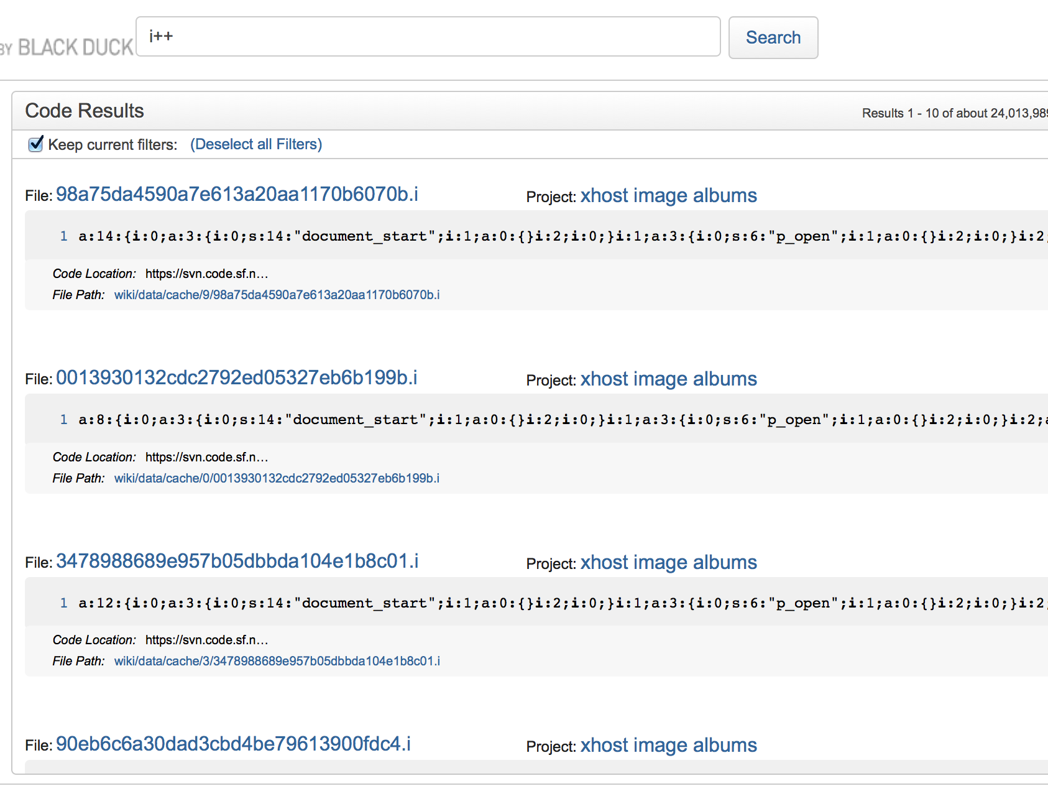

Slide 6
Version 1
Database 1 GB
About 500,000 lines of code
Hideously ugly (design)
Horribly slow
5000 projects

Slide 7
LAMP
LAMP stack with Python backend tasks
CodeIgniter 2.1.3 PHP 5
Sphinx Search
Single server 1 vCPU 256 MB RAM 50 GB hard disk

Slide 8
Version 2.0
Database about 500 GB (compressed)
About 21 billion lines of code (duplicates, and non indexed)
Less ugly and not quite as slow
90+ languages identified
Python tasks (queued and otherwise)
5,000,000+ projects, 75+ million code files
$225,000,000,000 estimated code cost

Slide 9
LNMP
Linux Nginx MySQL Python
Django Gunicorn Fabric Celery Pathos Pygments
Sphinx-Search RabbitMQ Memcached
Two Dedicated Servers
Web/DB i7 16 GB RAM
Index i7 32 GB RAM (mostly does nothing)
Many parsers (DigitalOcean using Fabric and DOP)

Slide 10
The Rewrite
Defied Joel Spolsky by rewriting
Considered PHP Laravel
Considered NancyFx C# Mono
Considered GoLang
Started with Play! Java/Scala JVM
Settled with Python and Django
Kept MySQL and Sphinx

Slide 11
Why Python / Django?
Using Python already for backend processes
Every plugin/library required existed
searchcode is a string matching problem
Lack of typing hasn't hurt… yet
Django used by iconfinder.com
Admin interface!!!!!

Slide 12
Results / Stats
Load average down
Searches returned 10x faster on average
3,500,000 searches
40,000,000 result pages (mostly bots)
150,000 monthly visitors
230,000 monthly page views

Slide 13
Lessons
Cache hit rate
Regular Expressions are fast!
Python makes things easy!
RabbitMQ / Celery does not like large queues
Not everything should be in a queue

Slide 14
Lessons
PHP makes you lazy and Python will punish you for it
The database is not always the bottleneck
Nor is the search index
Nor are Django’s templates
Celery is awesome
I still don’t like most ORM’s
I miss compile time checks, but not compile times

Slide 15
Thank You!
SyPy Organisers
Erik van Zijst @erikvanzijst (Atlassian)
Mark Groves (Splunk originally Codeplex)
Anyone who publishes to public code repositories

