Slide 1
When to consider neural networks
Input is high-dimensional discrete or raw-valued
Output is discrete or real-valued
Output is a vector of values
Possibly noisy data
Form of target function is unknown
Human readability of the result is not important
Examples:
Speech phoneme recognition
Image classification
Financial prediction

Slide 2
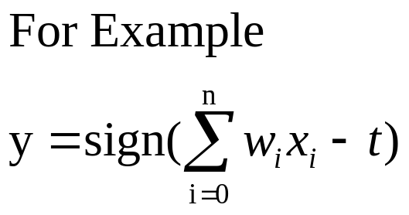
A Neuron (= a perceptron)
-
t
x₀
w₀
x₁
w₁
∑
f
output y
x_{n}
w_{n}
Input
vector x
weight
vector w
weighted
sum
Activation
function
The n-dimensional input vector x is mapped into variable y by means of the scalar product and a nonlinear function mapping
Data Mining: Concepts and Techniques

Slide 3
Perceptron
Basic unit in a neural network
Linear separator
Parts
  N inputs, x₁ ... x_{n}
  Weights for each input, w₁ ... w_{n}
  A bias input x₀ (constant) and associated weight w₀
  Weighted sum of inputs, y = w₀x₀ + w₁x₁ + ... + w_{n}x_{n}
  A threshold function or activation function,
    i.e 1 if y > t, -1 if y <= t

Slide 4
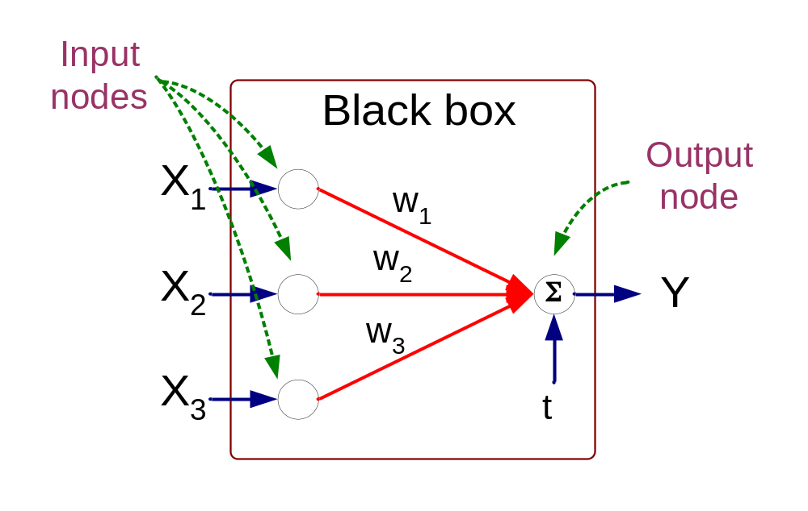
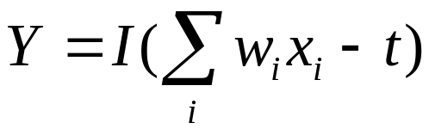
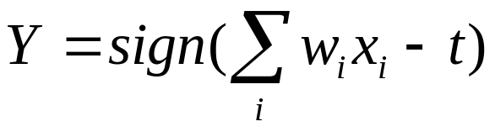
Artificial Neural Networks (ANN)
Model is an assembly of inter-connected nodes and weighted links
Output node sums up each of its input value according to the weights of its links
Compare output node against some threshold t
Perceptron Model
or

Slide 5
Types of connectivity
output units
Feedforward networks
  These compute a series of transformations
  Typically, the first layer is the input and the last layer is the output.
Recurrent networks
  These have directed cycles in their connection graph. They can have complicated dynamics.
  More biologically realistic.
hidden units
input units

Slide 6
Different Network Topologies
Single layer feed-forward networks
  Input layer projecting into the output layer
Single layer
network
Input Output
layer layer

Slide 7
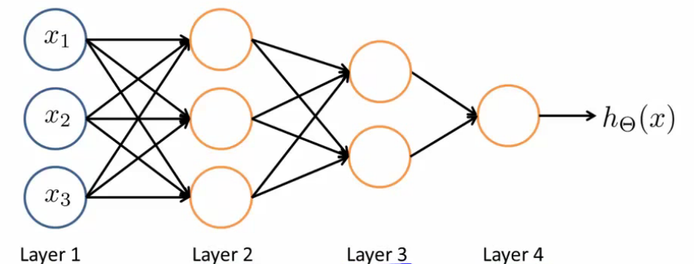
Different Network Topologies
Multi-layer feed-forward networks
Input Hidden Output
layer layers layer

Slide 8
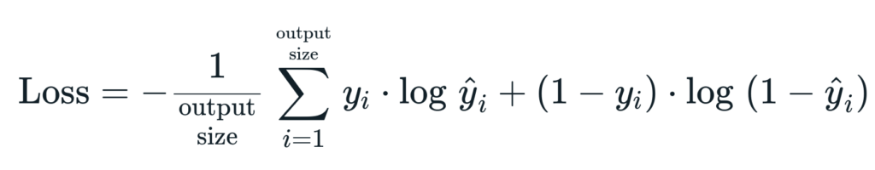
Algorithm for learning ANN
Initialize the weights (w₀, w₁, …, w_{k})
Adjust the weights in such a way that the output of ANN is consistent with class labels of training examples
  Error function:
  Find the weights w_{i}’s that minimize the above error function
    e.g., gradient descent, backpropagation algorithm

Slide 9
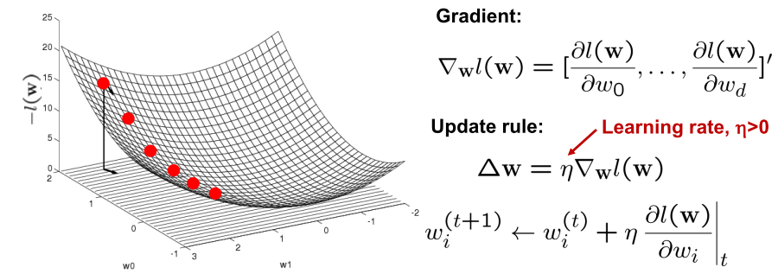
Optimizing concave/convex function
Maximum of a concave function = minimum of a convex function
Gradient ascent (concave) / Gradient descent (convex)
Gradient ascent rule

Slide 10
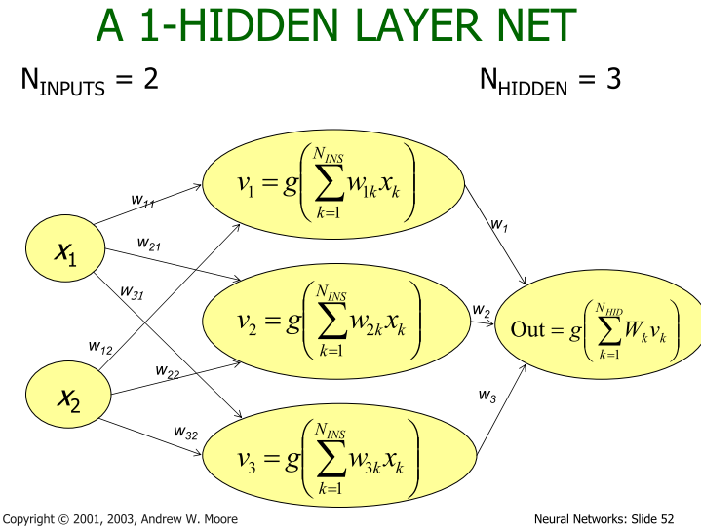

Slide 11
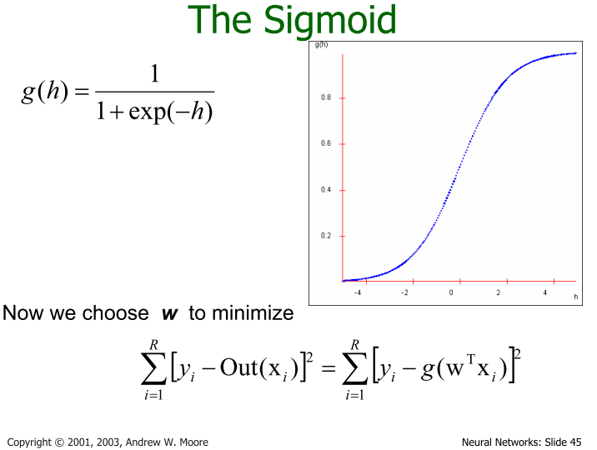

Slide 12
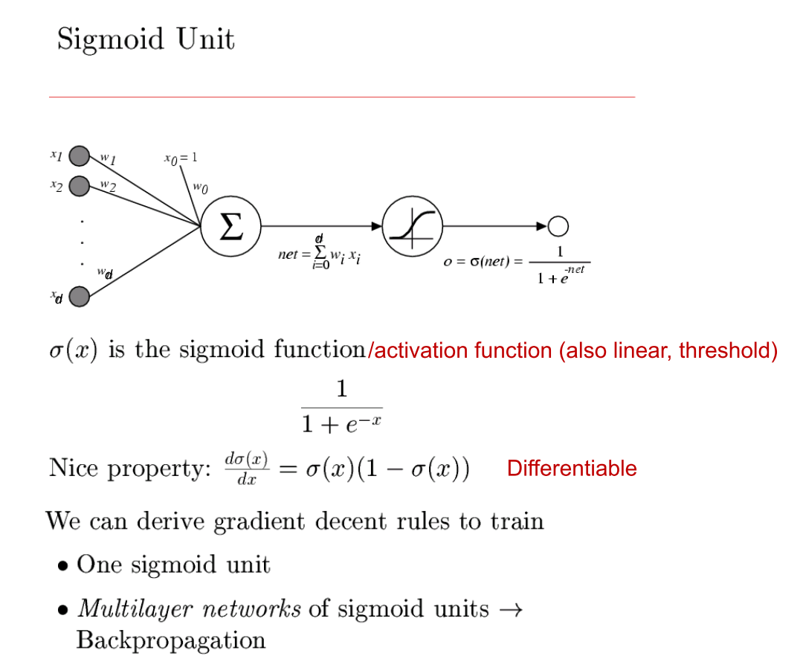

Slide 13
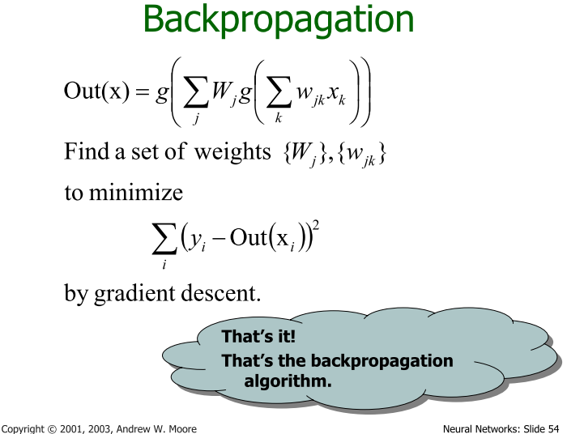

Slide 14
Backpropagation
Iteratively process a set of training tuples & compare the network's prediction with the actual known target value
For each training tuple, the weights are modified to minimize the mean squared error between the network's prediction and the actual target value
Modifications are made in the “backwards” direction: from the output layer, through each hidden layer down to the first hidden layer, hence “backpropagation”
Steps
  Initialize weights (to small random #s) and biases in the network
  Propagate the inputs forward (by applying activation function)
  Backpropagate the error (by updating weights and biases)
  Terminating condition (when error is very small, etc.)
Data Mining: Concepts and Techniques

Slide 15
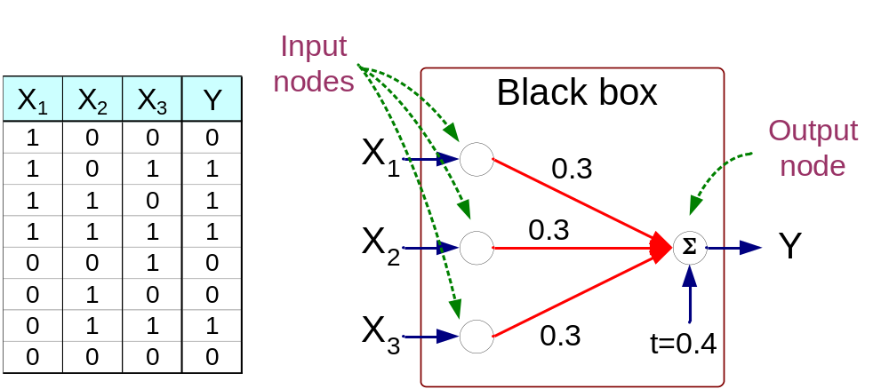
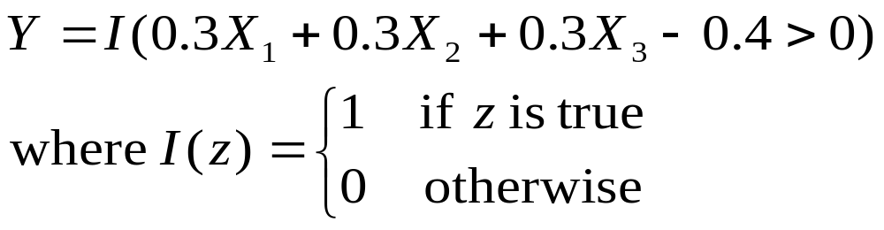
Artificial Neural Networks (ANN)

Slide 16
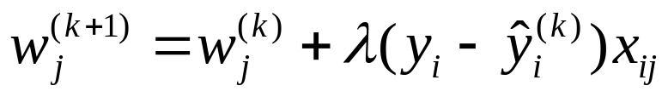
A Multi-Layer Feed-Forward Neural Network
Output vector
Output layer
Hidden layer
w_{ij}
Input layer
Input vector: X
Data Mining: Concepts and Techniques

Slide 17
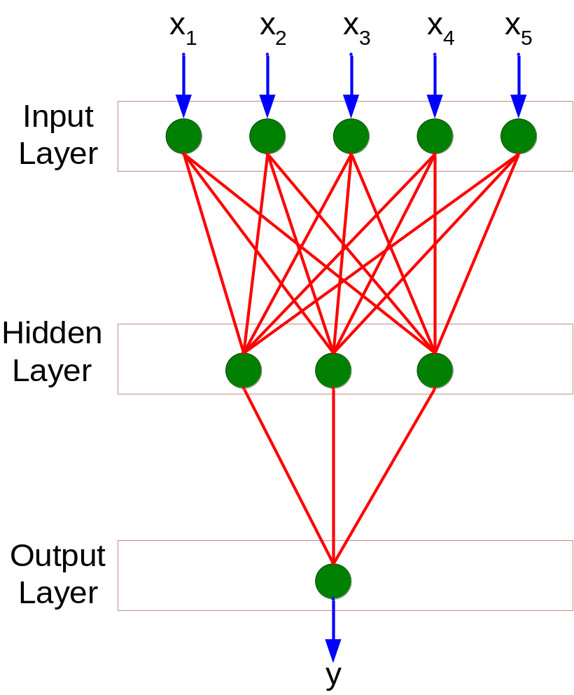
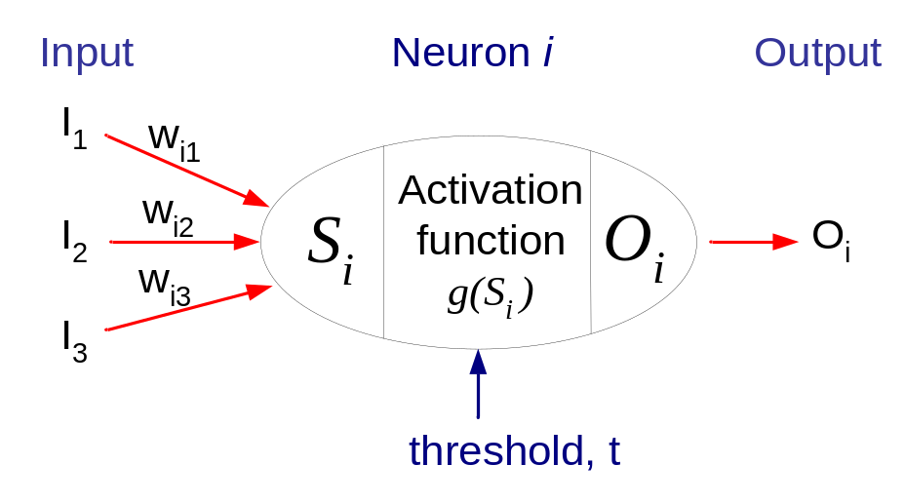
General Structure of ANN
Training ANN means learning the weights of the neurons

