Slide 1
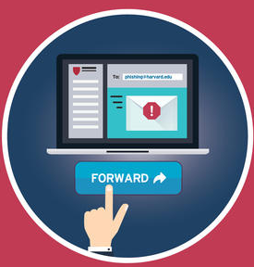
Report Phishing
Forward phishing emails to
phishing@harvard.edu

Slide 2
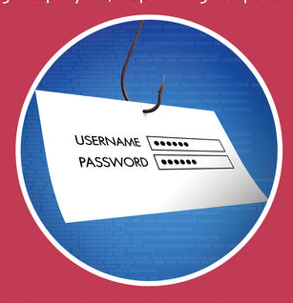
What is it?
Why phishing?
What can I do?

Slide 3
Phishing is the most common way attackers illegally access systems.

Slide 4


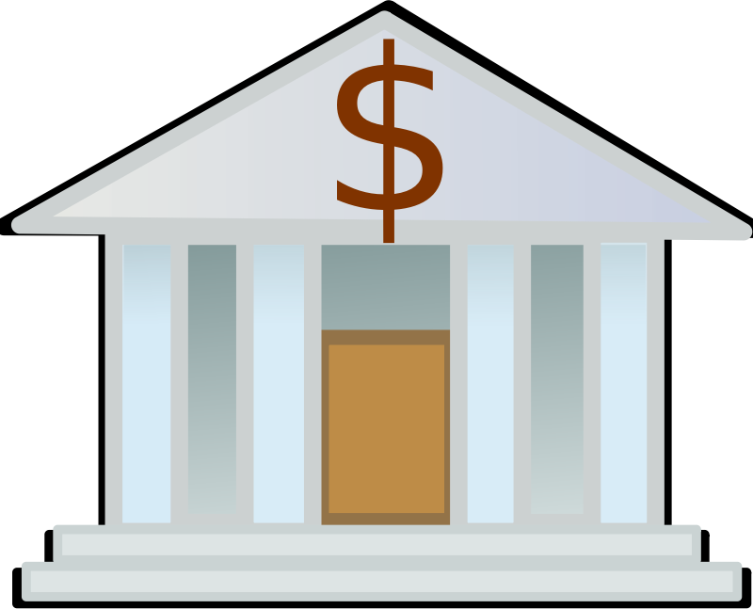
A phishing message is designed to trick you
Into doing one of these four things.
Click Here!
USERNAME
************
Click an
Unsafe Link
Open an
Unsafe File
Type your
Password
Transfer
Funds

Slide 5
Cyber attackers phish for different reasons,
But they all phish.

Slide 6



Cyber attackers phish for different reasons,
But they all phish.
Criminals
Intelligence
Hacktivists
Money
Fraud
Identity Theft
Sensitive Data
Network Access
Infrastructure
Public Web Pages
Social Media

Slide 7
Phishing messages are designed to get you to react quickly without thinking too much.

Slide 8






Phishing messages are designed to get you to react quickly without thinking too much.
Sense of Urgency
Offers of Money
Confirmations
Odd Requests
Rewards
IT Support

Slide 9
What happens when I get a phishing email?

Slide 10



What happens when I get a phishing email?
Click
Delete
Report

Slide 11
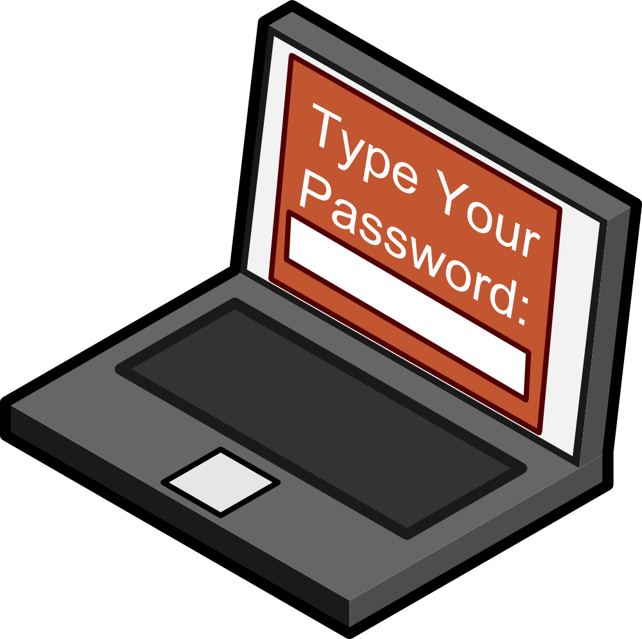
What happens if I click? (1/2)
Identity Theft
Data Leak
Data Destruction
Account Takeover
Password Stolen

Slide 12

What happens if I click? (2/2)
Stolen
Password
Ransomware
Remote Access
Network
Compromise
Malware Installed

Slide 13

What happens if I delete?
You’re safe…

Slide 14
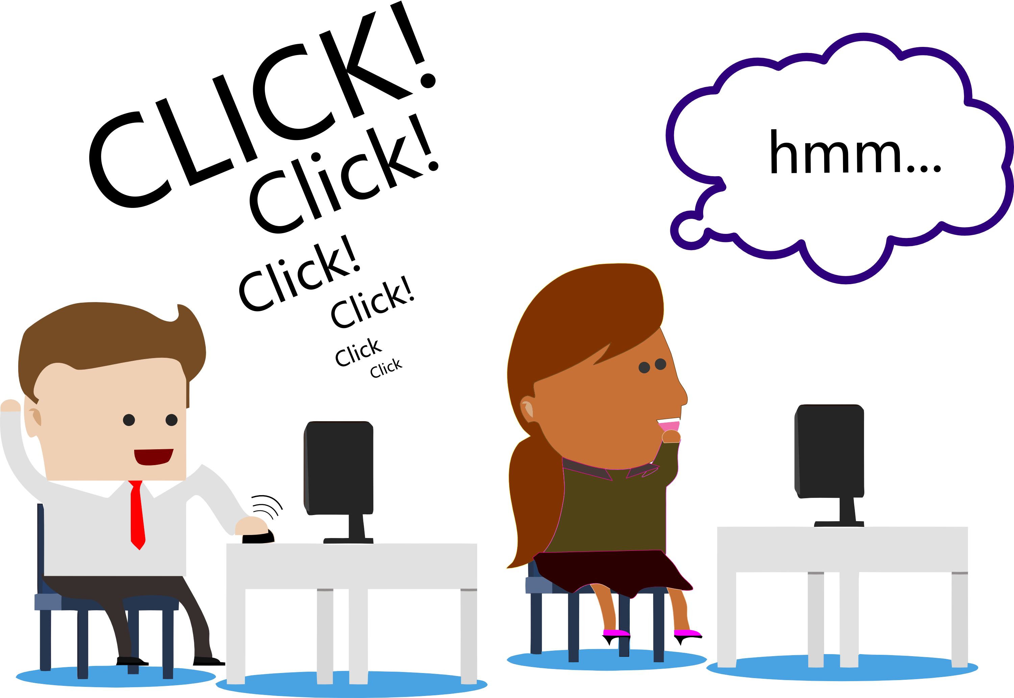

What happens if I delete?
You’re safe…for now.
Notes:
Deleting keeps you safe from cyber attackers. Reporting keeps you safe from your coworkers.

Slide 15

What happens if I report?
Review
Links
Block
Domains
Check
Accounts
Remove
Messages
Notes:
“When you report a phish, we review it and take appropriate actions based on risk.”
"No harm, no foul if the email message wasn't phishing."
"Forward to phishing account, not to your friends. Never send malicious links or malware to others."

Slide 16

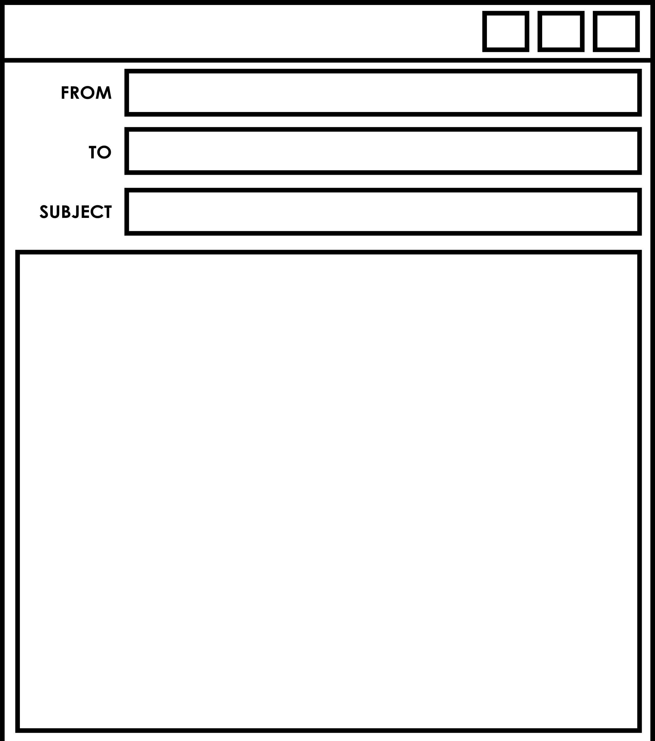

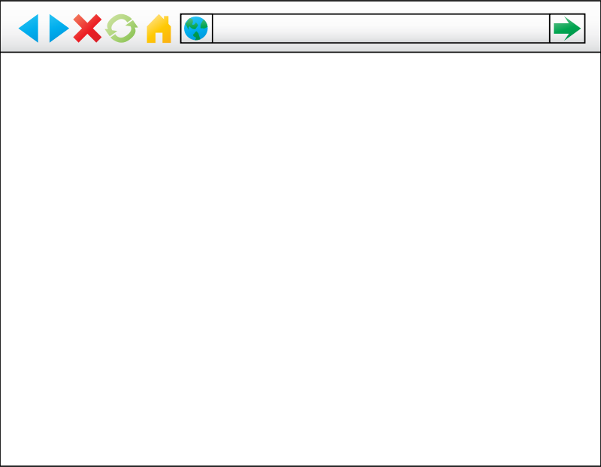

If you aren’t sure…
Please
Or
Click Here
To Confirm.
Skip the Link
Ignore the File
Go to The Source

Slide 17


In Closing:
Forward phishing emails to phishing@harvard.edu
Not sure? Go to the source.
Notes:
Closing
Phishing is a significant risk, so If you get a phishing message, report it.
If you’re not sure- go to the source

Slide 18
Let’s Practice!
Notes:
Closing
Phishing is a significant risk, so If you get a phishing message, report it.
If you’re not sure- go to the source

Slide 19
Rebecca Requestersen
Francine Moneybags
#1
The Wire Transfer
Transfer Problem
Hello Francine,
I am trying to get payment to
a vendor. It is important they get paid by close of business. Can you please wire 7,540 to…
Notes:
Closing
Phishing is a significant risk, so If you get a phishing message, report it.
If you’re not sure- go to the source

Slide 20
IT Help
Wendel Windowson
#2
The IT Support
Alert
Suspicious Activity
Hello Wendel,
Your computer has been infected with the RealBad2.0 Malware that you saw on the news. You must to use our scan
Within 12 hours.
Click Here
Notes:
Closing
Phishing is a significant risk, so If you get a phishing message, report it.
If you’re not sure- go to the source

Slide 21
Super Shoppers, LLC
Sonia Shopper
#3
Confirm
Now!
Package Damaged
Dear Sonia,
We apologize in advance, but your recent order was damaged in delivery. We are unable to issue a refund until you confirm
Account details
with this form.
Notes:
Closing
Phishing is a significant risk, so If you get a phishing message, report it.
If you’re not sure- go to the source

Slide 22
Security@CrazyMail.Net
Malia Mailer
#4
Password
Reset
Password Compromise
Dear Malia,
Your account has been locked due to potential compromise. You must go to this site to secure your account.
CrazyMail Secure Reset
Notes:
Closing
Phishing is a significant risk, so If you get a phishing message, report it.
If you’re not sure- go to the source

Slide 23
N.Trouble@g.Harvard.edu
Gary Goodegg
#5
Cry for Help
HELP!!!
HI,
I need to submit this file for class but it won’t open on my computer. Can you PLEASE (!) save it as a PDF and send to me???
Notes:
Closing
Phishing is a significant risk, so If you get a phishing message, report it.
If you’re not sure- go to the source

Slide 24
eFaxService@proserv.ly
Sandy Scanner
#6
Attach
And Attack
Your
efax Premium User,
Your electronic fax is attached. This file is intended only for the recipient and is considered confidential.
This is not my document.
Notes:
Closing
Phishing is a significant risk, so If you get a phishing message, report it.
If you’re not sure- go to the source

