Slide 1
Rational Secret Sharing with and without Synchronous Broadcast, Conspicuous Secrets, Malicious Players and Unbounded Opponents
Craig Gidney
Masters Presentation
Notes:
Wait
Hi
Name
Title
Or as I’d like to have titled it…

Slide 2
Rational Secret Sharing with/without Various Things
Craig Gidney
Masters Presentation
Notes:
Title
because my thesis is about rational secret under different sets of assumptions

Slide 3
What is Rational Secret Sharing?
Secret Sharing
Split a secret into n shares so that any t shares can reconstruct the secret
Solved in 70s by Shamir using polynomials over finite fields
Rational Secret Sharing
Players (share holders) are selfish
Notes:
What is secret sharing?
Better name secret splitting
Split a secret into pieces, called shares
Need a minimum number of those pieces to recreate the secret
Obvious use: keeping a secret safe without risking losing it
Cryptographic voting schemes never have secret key in the clear
Basic solved by Shamir in 70s using polynomials over finite fields
Shamir’s secret sharing scheme
Pick a random polynomial, with degree one high than your threshold, with the secret at its origin
The pieces are points on the polynomial
If you have the threshold number of points, or more, you can recover the polynomial by interpolating it
If you have less, no information about the secret
Problem with shamir’s scheme is that selfish players can take advantage of it
Rational secret sharing is about recombining secrets held by selfish players
No one wants others to learn the secret
A better name would be selfish secret sharing
Name due to halpern and teague
They proved selfish protocols can only terminate probabilistically

Slide 4
Various Things?
Interactive Dealer
Coalitions
Malicious Players
Synchronous Broadcast
Unbounded Opponents
Conspicuous Secret
Notes:
There are a lot of things we worry about when designing secret sharing protocols
Early protocols used an interactive dealer. Halpern and Teague
What about wills? Why not just count votes?
Coalitions of selfish players can share their private information and work together
Halpern and Teague, Kol and Naor
Malicious players don’t care about learning the secret
Halpern and Teague, Kol and Naor, Fuchsbauer
Synchronous broadcast is an assumption that players can synchronize when they send messages
Recent work about async, Fuchsbauer, Shareef
Unbounded
Conspicuousness is a term I introduce in the thesis
Existing work assumes the secret is an arbitrary value that has no grounding in reality
They assume player’s can’t check if a given value is the secret, they need to rely on the protocol
In practice this is not always true, like if you have a combination lock you can easily check if a combination is correct
By far the most common assumption in existing protocol are about communication. Most protocols, including some of the ones in this thesis, assume players can synchronize when messages are sent. Relaxing these types assumption is an active area of research.
For example, a 2 player protocol proposed by Kol and Naor in 2008 is based on giving each player a list of messages. They take turns sending messages from their list. When a player has no more messages to send, the last message sent by the other player was the secret. This protocol doesn’t assume sending a message is synchronized, although it has other issues especially when you extend it to multiple players. If you try to do the same basic thing with 3 players, 2 of them can form a coalition and compare their lists to see if they have the short one. They might learn the secret whether or not the other player participates.
In 2010, Fuchsbauer et al. published a fantastic protocol that works without an interactive dealer, doesn’t need synchronous broadcast, and guarantees coalitions of selfish players do no better than individual selfish players. It’s based on, among other things, hiding the secret as an offset. Each player sends a sequence of verifiable random numbers, seeded by the dealer, and the offset is chosen so that on a round chosen by the dealer all the shares are revealed and all players learn the secret.
But Fuchsbauer’s protocol is vulnerable to a different type of challenge: malicious players who don’t care about learning the secret. They incentivize selfish players into participating, but a single malicious players can cause the protocol to abort and the obvious tweaks create vulnerabilities to coalitions of selfish players.
Fuchsbauer’s protocol also relies very heavily on cryptographic primitives. If they are chosen to be too weak then an opponent with enough computational power could potentially break them. Ideally the protocol would be just as secure against opponents with unbounded computational power, like shamir’s scheme is.
The last various thing here, conspicuousness, is actually introduced by this thesis. All the existing protocols I found implicitly assumed players won’t recognize the secret when they see it, but this is not always the case. For example, it’s easy to check if a given password decrypts a file, because every other password tends to produce gibberish.

Slide 5
Thesis Results
Limits on asynchronous protocols
Coalitions may pre-emptively learn the secret
Conspicuousness requires sacrifice
Conspicuousness prevents immunity to rational coalitions
Protocols for different types of challenges
SBP: Provides malicious coalition immunity
SUIP: Improves on existing list-based protocols
ABCP: Sacrifices fewer players
ABIP: Provides resilience against malicious coalitions
Notes:
My thesis extends the state of the art in several different ways.
I prove limits on what protocols without sync can achieve
- Any Async: coalition might learn the secret earlier than any player should be able to. (contain last few players needed)
- Consp Async: In the ideal case, at least one player is sacrificed. Last sender.
- Consp Async Many: coalitions can learn the secret early enough to prevent other players from learning it
I also present four protocols, each applying to different cases and contributing their own piece.
Naming scheme: S:Sync, A:Async, B:Bounded, U:Unbounded, I:Inconspicuous, C:Conspicuous, P:Protocol
SBP: Improves on Fuchsbauer by defeating malicious players and coalitions
SUIP: Improves on list based protocols, like Kol and Naor’s, I’ll get into it
ABCP: Existing protocols tend to rely on inconspicuousness and so always sacrifice t-1 players. ABCP can sacrifice less.
ABIP: Improves on Fuchsbauer by defeating malicious players and coalitions up to a certain size

Slide 6
Synchronous Unbounded Inconspicuous Protocol
SUIP
Notes:
The thesis covers a lot and I only have a half hour
So I will only present the protocol I think improves on the existing work the most: SUIP

Slide 7
Where does SUIP fit?
Unbounded opponents
Synchronous broadcast
Inconspicuous secret
Notes:
SUIP’s goal is security against unbounded opponents.
We can’t rely on computational difficulty, only on missing information.
We do assume synchronous broadcast.
We assume the secret is inconspicuous.
The protocol doesn’t actually rely on this assumption.
Brute force attack on conspicuous secrets.

Slide 8
Overall structure
Dealer generates shares and goes away then players try to combine them
Player part divided into rounds
All players learn the secret during a random definitive round
Dealer tells players what to send and expect
“Short case” definitive round may be forced by running out of instructions
Notes:
Follows standard round-based structure of rational secret sharing protocols
The dealer generates shares then the players try to combine them
The player protocol is divided into rounds.
There’s a bunch of check rounds, to encourage cooperating, followed by a definitive round, where everyone learns the secret
More specifically to SUIP
The dealer tells players what they will say and when they will say it.
That information is in a list of messages, which is why I call it list-based.
The message lists have a minimum size but are extended by random amounts so that none of them have the same length.
This prevent small coalitions from determining if they contain the smallest list
Since message lists are finite, the definitive round is forced to happen when any of them ends.

Slide 9
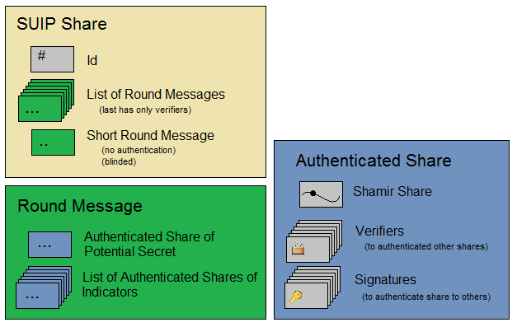
What’s in a SUIP Share?
Notes:
So what exactly are these instructions to the players?
They have a message for each round, as well as a short message for the short case.
Each message is made up of several authenticated shares.
Each round the messages combine to form a potential secret and a number of indicators
Players accept the potential secret as the true secret when all of the indicators come out to 0
One of the hairy issues here is how authentication is done.
The standard mechanisms rely on computational difficult, but our players might be unbounded.
So how do we do authentication with perfect security

Slide 10
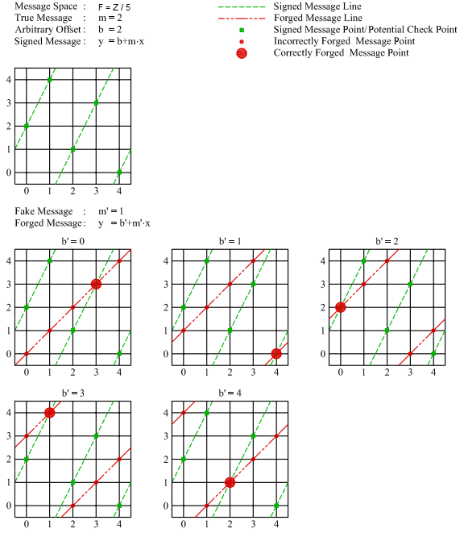
How does authentication work?
A forged message fools only 1 of the many possible verifiers
Value becomes slope of a line in finite field
A random offset of the line is the signature
A random point on the line is the verifier
Notes:
I figured out how to do this, and was pretty pleased with it, then found out it was done by Ron Rivest over a decade ago.
Treat the message as the slope of a line in a finite field.
Lines in a finite field loop around. One green one red.
The dealer picks a random offset for the line, and also a random point on that line.
The dealer gives the line to the sender and the point to the receiver.
Sender can’t safely change the message, by changing the slope of the line.
Only one of the original points is preserved.
Receiver only tricked if sender picks correct point.
Very unlikely if field is very large.
Can use multiple authentications to increase certainty.
Verifier can’t predict what the message will be.
For each possible message/slope, there’s an offset that creates a line passing through the verifier’s point.
The verifier knows a relation between the offset and the slope, but not the message.
The sender knows the message, but not the relation.

Slide 11
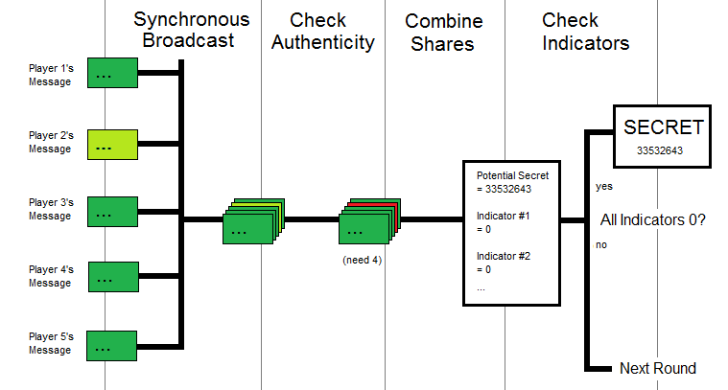
How does a normal round work?
Notes:
Last two slides described data. Now what we do with it.
This slide shows what occurs in rounds before any player runs out of messages.
- Broadcast messages for round. Player 2 tries to trick.
- Players check authenticity and discard. When caught left out.
- Combine shares, since we have enough to get indicators and the potential secret.
- If all indicators are 0, accept the secret. Otherwise next.

Slide 12
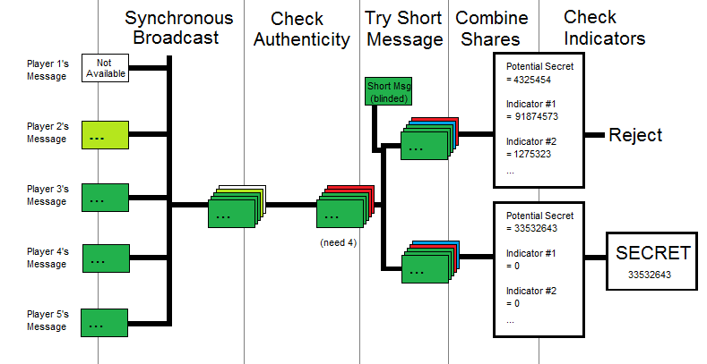
How does the short round work?
Notes:
Things happen a bit differently when there is just barely not enough messages.
This happens when one player runs out of messages and there was already the minimum number of players.
A player running out of messages is called the short case, and happens in the short round.
- Player 1 has run out of messages.
Player 2 still sending a fake message
Only 3 good messages, but need 4
Remember short message, given to every player in their share
Short message is ‘blinded’, has to be added to previous message of short player
Don’t know who short player is, must try all possibilities
Indicators come out 0 for true short player
Otherwise they are random, very unlikely to be 0

Slide 13
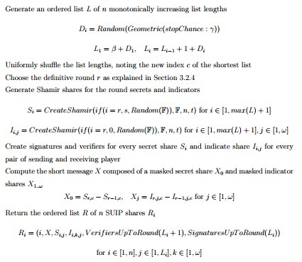
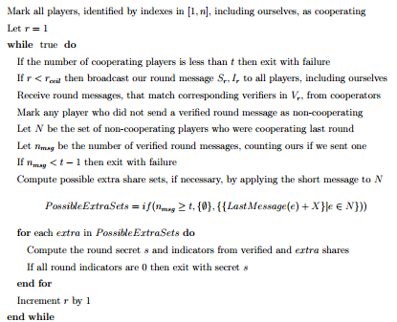
SUIP Pseudo-Code
Dealer
Player
Notes:
What I’ve talked about covers the basics of the protocol
There details I’ve left out to save time
how many indicators you need
how exactly are the list lengths chosen
etc
You could probably implement the protocol based on the last 5 slides
The thesis has the complete pseudo-code, shown here for squinters
Also implemented and tested in C#, real running code
Let’s leave the details here and go on to analysis

Slide 14
Why Cooperate?
Send Correct Message
Small Payoff if definitive round
Potential for later payoff
Send Fake Message / No Message
Large payoff if definitive round
Ignored later on
Notes:
Suppose you are a selfish player
You can either send the right message or not
You don’t know if this round is the definitive round
right + definitive -> small payoff, keep playing
Fake + definitive -> large payoff, kicked out
The dealer can make the probability of the definitive round arbitrarily small
Makes these definitive round payoffs approach 0, without affecting this aggregate later payoff
If this payoff is non-zero and the definitive round can’t be predicted, we’re set. Just need to figure out how small probability needs to be.
But sometimes these two assumptions, non-zero future payoff chance and unpredictability, are violated

Slide 15
The Short Case Issues
The short player anticipates the short round
Coalitions of size t-1 anticipate the short round
When t=2, all players anticipate the short round
When t=2, short player expects no reciprocation in short round
All of these can be made arbitrarily unlikely
Notes:
When a player runs out of messages, they know the next round is the definitive round
That player can’t defect, but other players colluding with that player can defect
Coalitions of size t-1, even those that don’t have the short player, can simulate applying the short message and defect
If t=2 every player is a coalition of size t-1
So when the definitive round is forced by a player running out of messages, players may defect in that round
Even worse, this moves backwards a bit. When t=2 when and you have one message left to send you know that if this round is not definitive then you are the short player. Even if you cooperateed this round, everyone will defect next round. You have no incentive to cooperate, so you might as well defect.
Luckily the problem doesn’t move further backwards, because of players having different list lengths.
Even better, we can make the probability of a player running out of messages, or reaching their last message, exponentially small by making the lists longer. All of these bad cases can be made arbitrarily unlikely.

Slide 16
Security of SUIP
Defeats rational coalitions as often as needed
Short case causes issues
Short case issues can be made arbitrarily unlikely
Increase sizes of lists to increase security
Defeats malicious coalitions as often as needed
Authentication prevents fake messages
Indicators prevent “fake” short cases
Increase amount of indicators and authentication to increase security
Notes:
So SUIP isn’t 100% guaranteed secure, it’s only as-close-to-100%-as-you-ask-for secure.
I didn’t mention malicious coalitions much, but suffice it to say that they are defeated by the indicators and authentication.
I think that’s still pretty good, especially against unbounded opponents.
It might be possible to eliminate the short case in some clever way.
Careful not to create another short case.

Slide 17
Summary
Rational Secret Sharing
Dealer splits a secret into pieces, selfish players try to recombine their pieces
Thesis
4 protocols, 3 limitations on protocols
SUIP
Synchronized Broadcast, Unbounded Players, Inconspicuous Secrets, Protocol
Dealer tells players exactly what to say
As close to 100% secure as desired

Slide 18
Questions?

