Slide 1

Introduction to Machine Learning
Sentiment Analysis Model
Group members-
IIT2021125: Radhika Gupta
IIT2021139: Naman Gupta
IIT2021140: Naysha Singh
IIT2021168: Kaushik Mullick
IIT2021170: Viraj Jagtap
IIT2021172: Shruti Bilolikar
Group members-
IIT2021125: Radhika Gupta
IIT2021139: Naman Gupta
IIT2021140: Naysha Singh
IIT2021168: Kaushik Mullick
IIT2021170: Viraj Jagtap
IIT2021172: Shruti Bilolikar
Guided by- Prof. Shekhar Verma
Guided by- Prof. Shekhar Verma
Professor
Ph.D .
Notes:
Entered text
Machine learning model for Sentiment Analysis:
In an era dominated by vast amounts of textual data generated across various online platforms, understanding and interpreting the sentiments expressed by individuals has become a crucial task. Sentiment analysis, also known as opinion mining, is a powerful natural language processing (NLP) technique that involves extracting and analyzing sentiments, opinions, and emotions from text data. This process enables us to gain valuable insights into the attitudes and feelings of users towards a particular subject, product, or event.
The aim of our sentiment analysis project is to harness the capabilities of machine learning and NLP to automatically categorize and understand the sentiment conveyed in textual content. By utilizing advanced algorithms and techniques, we can transform unstructured text into valuable information, providing businesses, researchers, and individuals with actionable insights.

Slide 2
PROBLEM STATEMENT
Design a sentiment analysis model that accurately classifies text into sentiment categories.

Slide 3
WHY Sentiment Analysis?
PROBLEM STATEMENT
Sentiment analysis aids in understanding public opinion, guiding business decisions, and gauging brand perception across various platforms, enhancing market strategies and customer engagement.
In education, sentiment analysis on student feedback aids in improving course content, identifying areas for enhancement, and gauging student satisfaction.

Slide 4
LITERATURE REVIEW 1
Paper Title | Objective | Method | Result and Conclusion
Real-time Sentiment Analysis of Tweets using Naive Bayes by Ankur Goel, Jyoti Gautam and Sitesh Kumar | The objective of the paper is to present a comprehensive approach to real-time sentiment analysis of tweets on Twitter using Naive Bayes and SentiWordNet. | The study employs Naive Bayes and SentiWordNet for real-time sentiment analysis of tweets, training on a 1.6 million-tweet dataset. The workflow includes training the system, tokenizing, preprocessing the testing corpus, determining posterior probability and SentiWordNet score, and computing class conditional probability with the Naive Bayes classifier. | The approach achieves 58.40% efficiency in testing, demonstrating its practicality in dynamically assessing movie sentiments based on Twitter data.

Slide 5
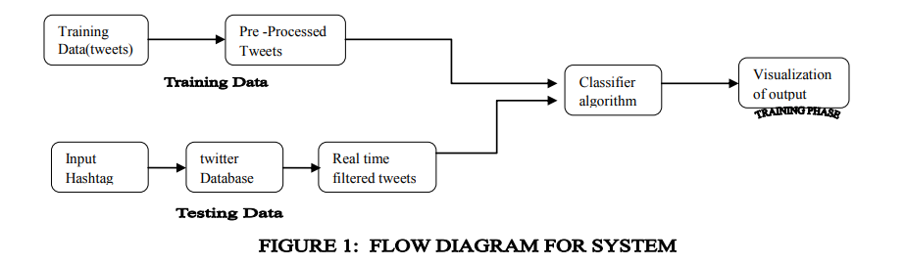
LITERATURE REVIEW 1

Slide 6
LITERATURE REVIEW 2
Paper Title | Objective | Method | Result and Conclusion
An Ensemble Classification System for Twitter Sentiment Analysis by Ankit and Nabizath Saleen. (Department of Computer Science and Engineering , NIT Calicut) | Sentiment Analysis (SA) emerges as a vital tool for discerning and categorizing the polarity of text, spanning documents, sentences, and phrases.This paper introduces a weighted ensemble classifier specifically designed for tweet sentiment analysis. | Various base classi- fiers were employed to discern sentiments from tweets including Naive Bayes classifier, Random Forest, Support Vector Machine (SVM) and Logistic Regression.hese base classifiers were integrated into an ensemble classifier, leveraging their collective strengths to bolster performance. | On the Sentiment140 dataset: Naive Bayes: 75.19% Random Forest: 71.76% Support Vector Machine: 75.61% Logistic Regression: 74.15% Majority Voting: 74.80% Proposed Ensemble: 75.81% The proposed ensemble method outperformed individual classifiers, achieving the highest accuracy of 75.81%, highlighting its effectiveness in sentiment analysis for this dataset.

Slide 7
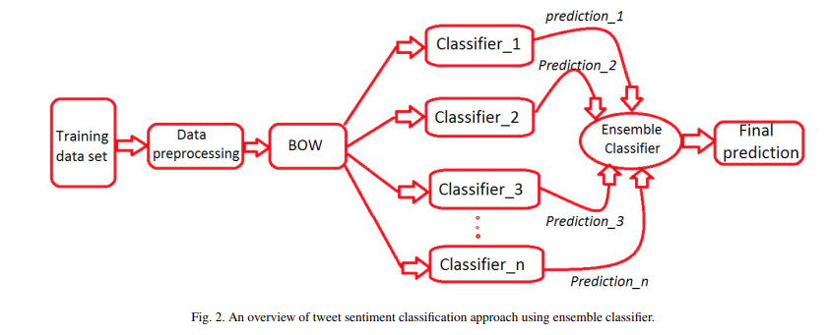
LITERATURE REVIEW 2

Slide 8
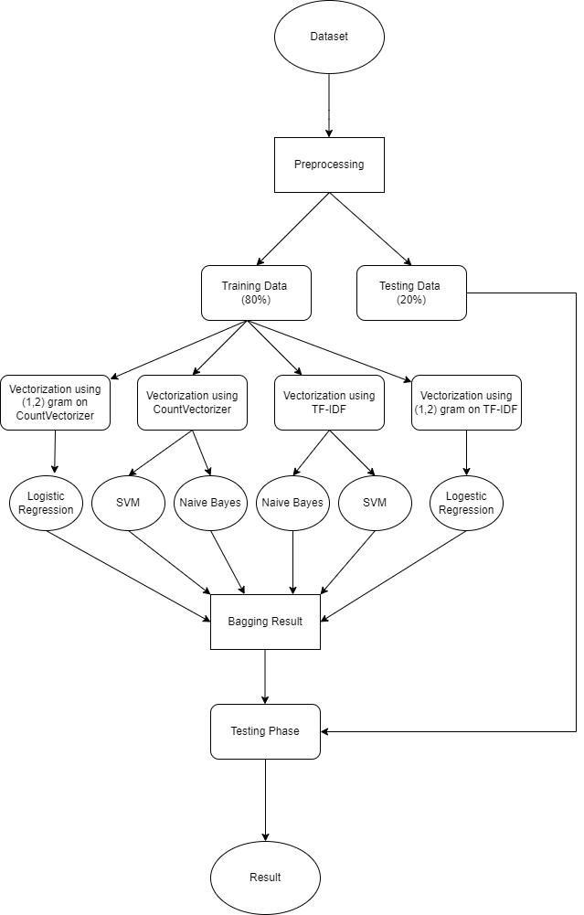
Flow
Chart of the Proposed Methodology:

Slide 9
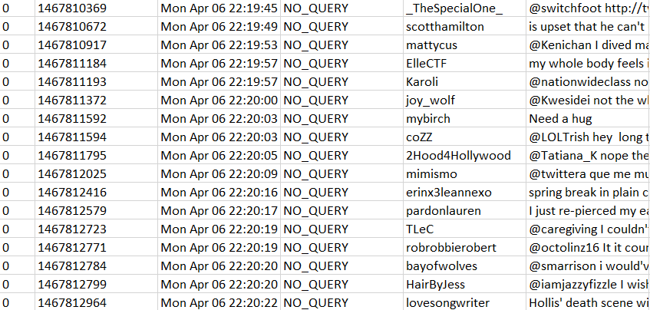
ANALYSIS OF PROPOSED METHODOLOGY
DATASET USED : Sentiment140
Dataset Overview:
1,600,000 tweets from Twitter API
Classified into 0 (negative) and 4 (positive)
6 fields: target, ids, date, flag, user, text

Slide 10
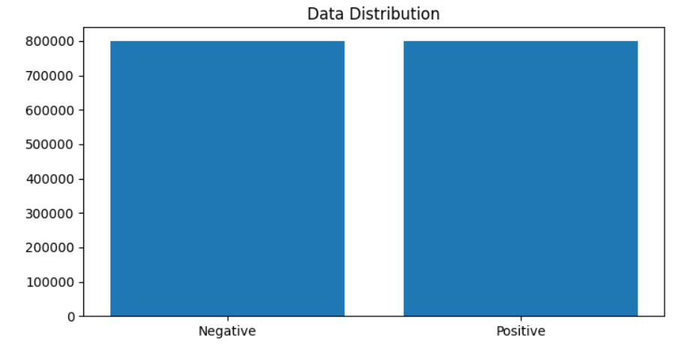
DATASET ANALYSIS
Character Analysis:
Counted characters per tweet
Max characters: 189, Min characters: 1, Mean: 42.78, Std Dev: 24.16
Word Analysis:
Counted words per tweet
Max words: 50, Min words: 1, Mean: 7.24, Std Dev: 4.03
Distribution of positive and negative entries

Slide 11
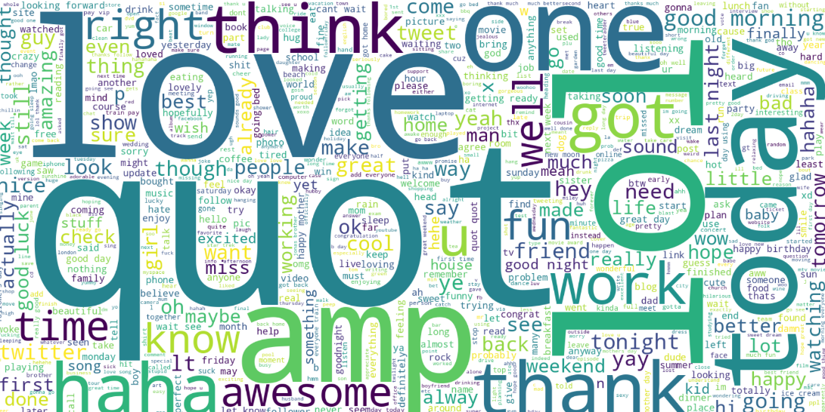
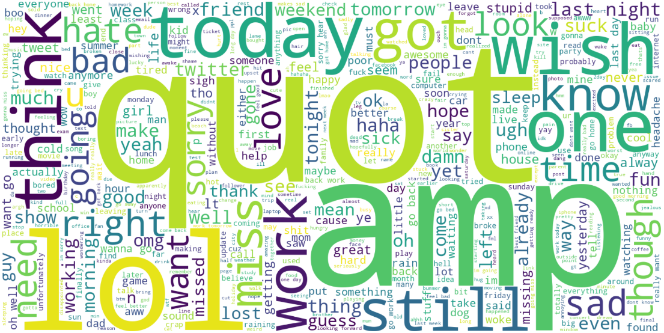
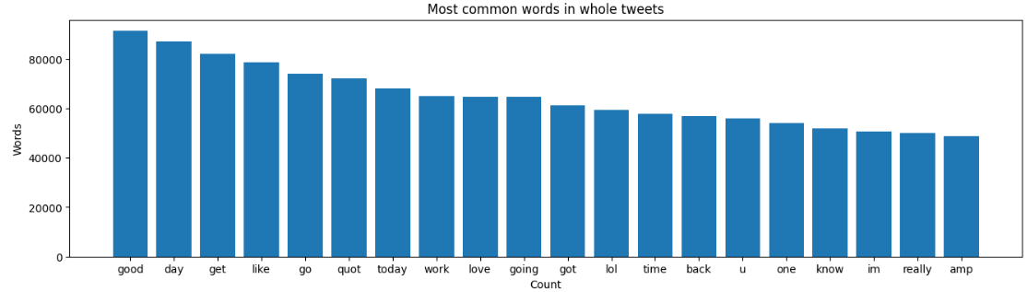
DATASET ANALYSIS
Most frequently used words in positive tweets
Most frequently used words in negative tweets

Slide 12
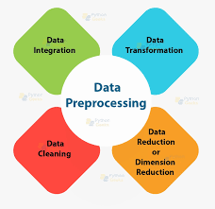
PRE-PROCESSING
Extracting Necessary Fields - For training of our model we need to know about the sentiment and the text only , so the other columns corresponding to flag, id, user and date can be discarded.
StopWord Removal - Some english words like “is,and,the “ occur very frequently in a sentence , however they do not have any significant information. So these words can be dropped from the statements.
Stemming - To reduce words to the root form by removing suffix and prefix. (For example : Running is reduced to its root word run)
Removal of URLS and Emails - A regular expression matching is done to remove the URL and Emails from text as they act as noise in the data.
Removal of 0 length tweets - 0 length text has no significance.

Slide 13
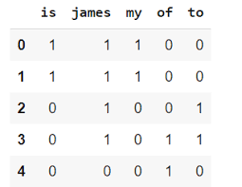
COUNT VECTORIZATION
Count vectorization is a method used in natural language processing (NLP) to convert text data into numerical format based on the count of words in a statement.
For Example :
Vocabulary: ["the", "cat", "is", "on", "table"]
Document: "The cat is on the table. The cat"
Count Vector: [3, 2, 1, 1, 1]

Slide 14
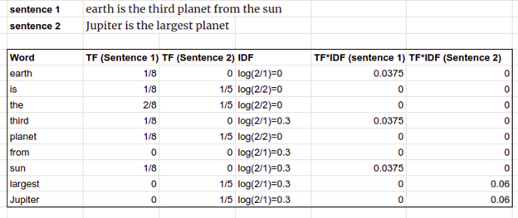

TF-IDF VECTORIZATION
TF-IDF (Term Frequency-Inverse Document Frequency) vectorization is a method used in natural language processing to represent text data numerically, emphasizing the importance of words in a statement relative to a collection of statements.

Slide 15
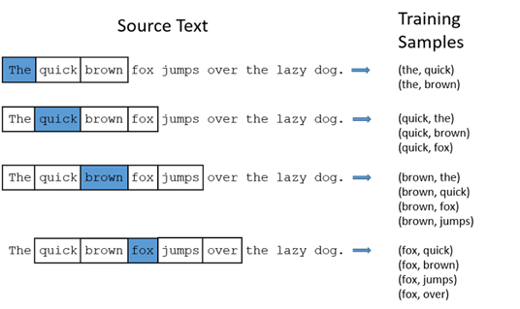
N - GRAM
N-grams are a way to represent sequences of words in text data by considering sequences of 'n' consecutive words. They are utilized in both TF-IDF vectorization and count vectorization for capturing contextual information beyond individual words.

Slide 16
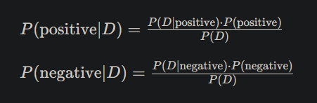
NAIVE BAYES CLASSIFIER
Naive Bayes is a probabilistic classification technique based on Bayes' theorem, assuming independence between features, commonly used in text classification like sentiment analysis.
We have applied Naive Bayes on the 2 different vectors generated by TF-IDF vectorization and Count Vectorization.

Slide 17
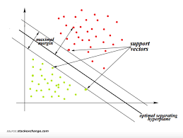
SUPPORT VECTOR MACHINE (SVM)
SVM (Support Vector Machine) is a powerful supervised machine learning algorithm used for classification and regression tasks by finding the optimal hyperplane that separates data into different classes.
We have applied SVM on the TF-IDF and Count Vectorization vectors generated from the dataset.

Slide 18
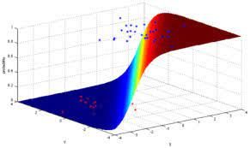
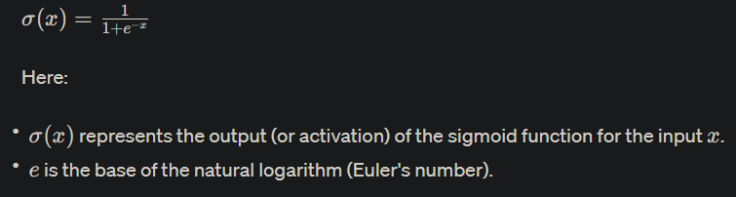
LOGISTIC REGRESSION
Logistic Regression is a statistical method used for binary classification, estimating the probability of an outcome based on input features using a logistic function.
We have applied N-gram on the Countvectorizer and TF-IDF vectors to enhance the accuracy.

Slide 19
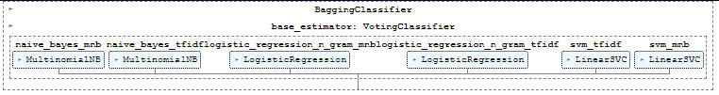
MAJORITY VOTING CLASSIFIER
We applied a majority voting classifier on the models that we have trained to obtain our final result.

Slide 20
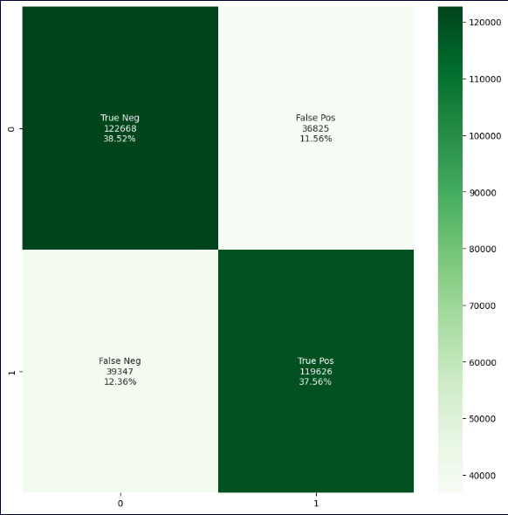
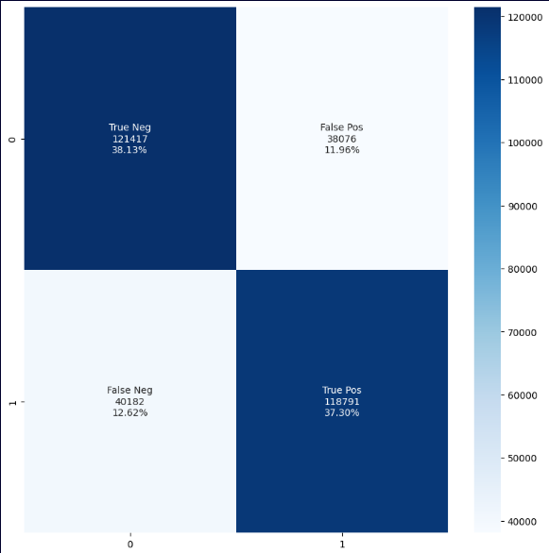


NAIVE BAYES CLASSIFIER RESULT
Countvectorizer
TF-IDF

Slide 21
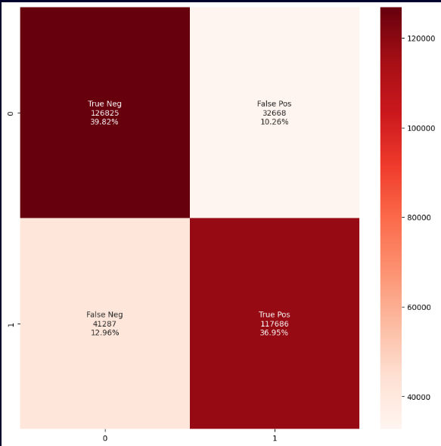
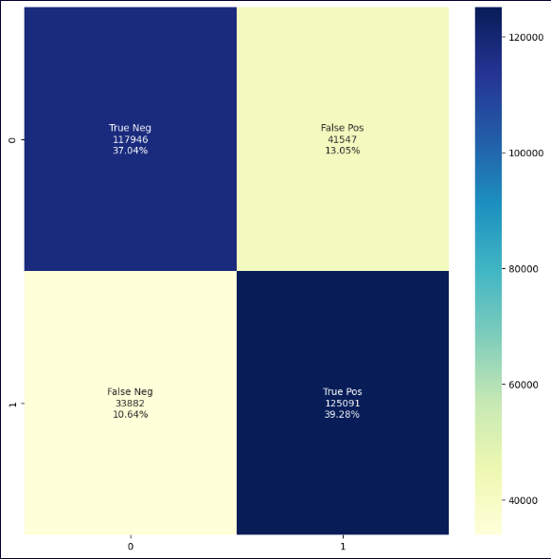


SUPPORT VECTOR MACHINE CLASSIFIER RESULT
TF-IDF
Countvectorizer

Slide 22
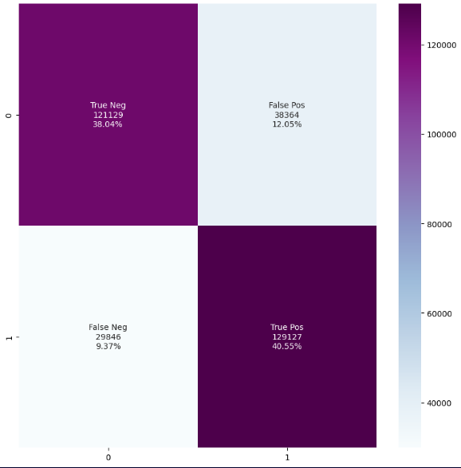
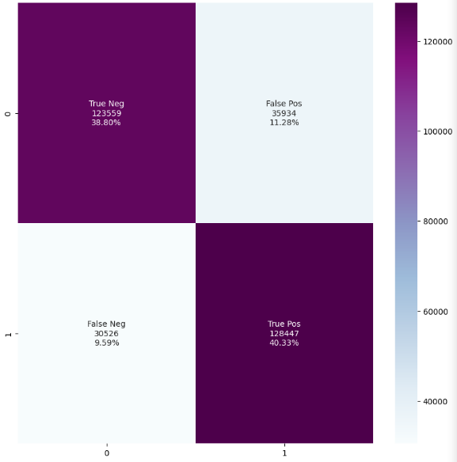


LOGISTIC REGRESSION CLASSIFIER RESULT
Countvectorizer
TF-IDF

Slide 23
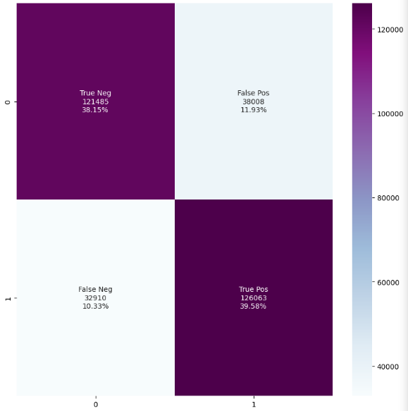
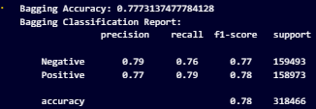
MAJORITY VOTING CLASSIFIER

Slide 24
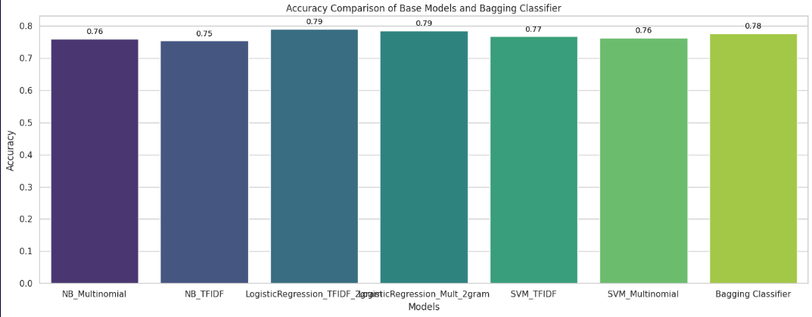
ACCURACY COMPARISON

Slide 25
COMPARISON WITH OTHER MODELS
An Ensemble Classification
System for Twitter Sentiment Analysis by Ankit and Nabizath Saleen.
(Department of Computer Science and Engineering , NIT Calicut)
Model Name | Their Accuracy % | Our Accuracy %
Naive Bayes | 74% | 76%
Support Vector Machine | 74% | 77%
Logistic Regression | 73% | 79%
Majority Voting Classifier | 74% | 77.7%

Slide 26
COMPARISON WITH OTHER MODELS
Real-time Sentiment Analysis of Tweets using Naive Bayes
by Ankur Goel, Jyoti Gautam and Sitesh Kumar
Model Name | Their Accuracy % | Our Accuracy %
Final Ensembled Model | 58.4% | 77.7%

Slide 27
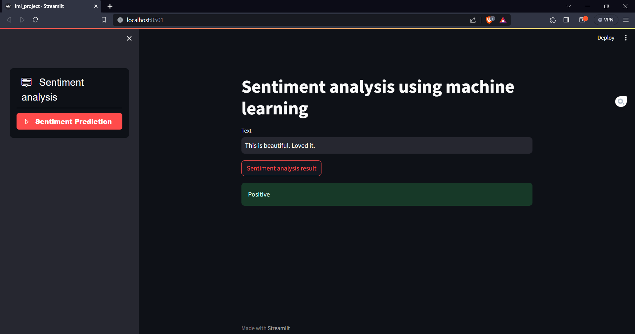
INTERFACE
We have implemented an interactive interface to put our model to use …

Slide 28
CONCLUSION AND FUTURE SCOPE
We can observe that the Final Ensembled Model has an accuracy of 77.7% and the best model out of the 3 base models is the Logistic Regression Model trained on the TF-IDF vector generation method using (1,2) gram giving an accuracy of 79.13%.
We can extend the dataset to have emojis and apply suitable preprocessing to understand the context of those emojis in the statement.
Besides Binary Classification we can implement multiple classes of Sentiments like Positive, Negative, Neutral, etc..

Slide 29
Thank you !

