Slide 1

Fun with
Bash & Azure
Marcel Kornegoor
ATypical Director / parttime nerd

Slide 2
$ whoami
Director @ AT Computing
Trainer/consultant
Open Source Enthusiast
10+ years in IT
Amateur Bash-scripter

Slide 3



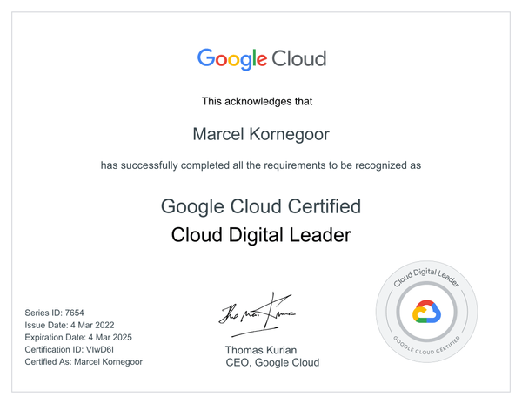
Why am I here?
In 2019, AT Computing moved to the cloud
The team chose Google Cloud Platform
I firmly believe a director should keep learning
So I decided to challenge myself
That got out of hand a (tiny little) bit...

Slide 4
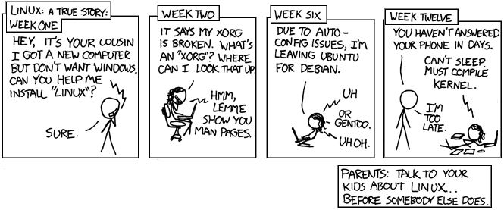
Why bash and Azure?
I give demos during training courses and workshops
I got bored of manually repeating stuff during preperation
I wanted to give my team some resistance in the field of cloud
Becasue of XKCD456
https://imgs.xkcd.com/comics/cautionary.png

Slide 5
Why?
What makes Open Source fanatics do this stuff?
What makes mankind do this?
What makes us, humans, so incredibly curious?

Slide 6
Why?
Curiosity is a fundamental property of (intelligent) organisms
Organisms have the innate habit of exploring the world around them
It is at the core of our ability to learn
Curiosity and exploration improve intelligence
Curiosity influences dicision making and our mental health
We are not hunting for food anymore, so we have lots of time to be curious
It seems to be (tightly) related to motivation

Slide 7
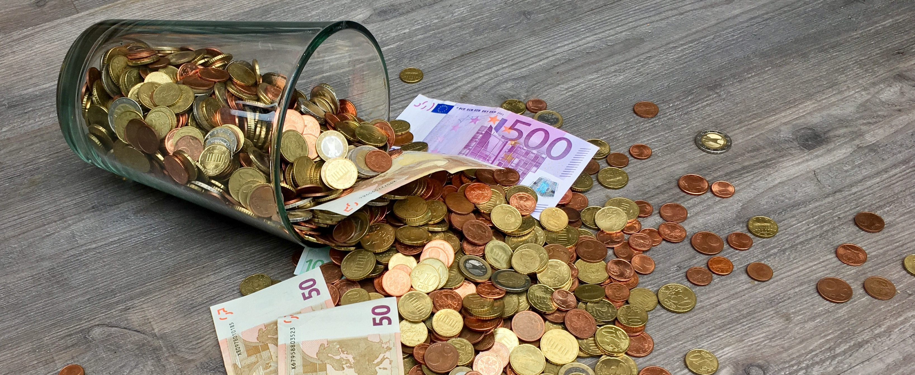
What is our motivation?
Photo by Pixabay: https://www.pexels.com/photo/bills-capital-cash-cent-210679/

Slide 8
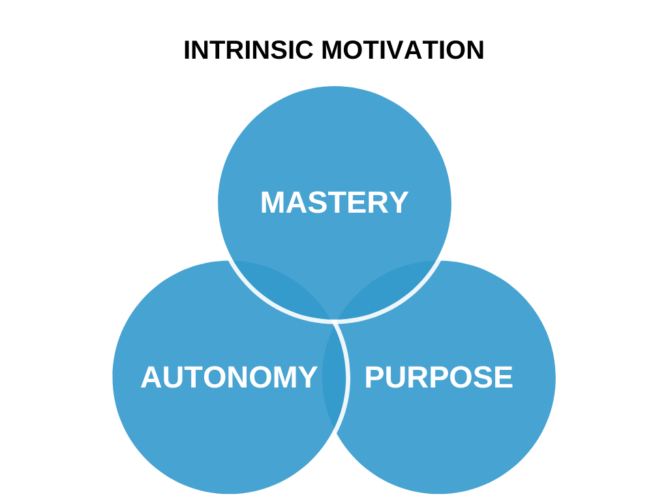

Why are we motivated?

Slide 9
Why is it so important to us?
“Curiosity is defined as a need, thirst or desire for knowledge”^{π}
There is not too much research done in this area
Various researchers contradict eachother
It’s hard to measure curiosity on it’s own (in a lab)
We know what it is, but it’s hard to define it in a scientific way
It might have to do with our changes of survival (because of adaptation skills)
^{π}http://www.csun.edu/~vcpsy00h/students/explore.htm

Slide 10


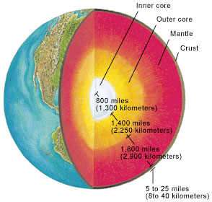


What curiosity leads to...
Level #1: just underneath the grass
Start using a human friendly GNU/Linux distribution
Level #2: digging deeper into the crust
Use the terminal every now and then
Level #3: reaching the mantle
Using the CLI starts to feel comfortable
Level #4: drilling into the outer core
writing #!/bin/bash for the very first time
Level #5: getting burned to ashes at the inner core
$ declare suffering="AAAAAAAAAAAARRRGGGHH"
$ for i in {0..∞}; do printf "%s\n" "$suffering"; done

Slide 11
Lessons learned
Starting
(the easy part)
Thinking you nailed it

Slide 12
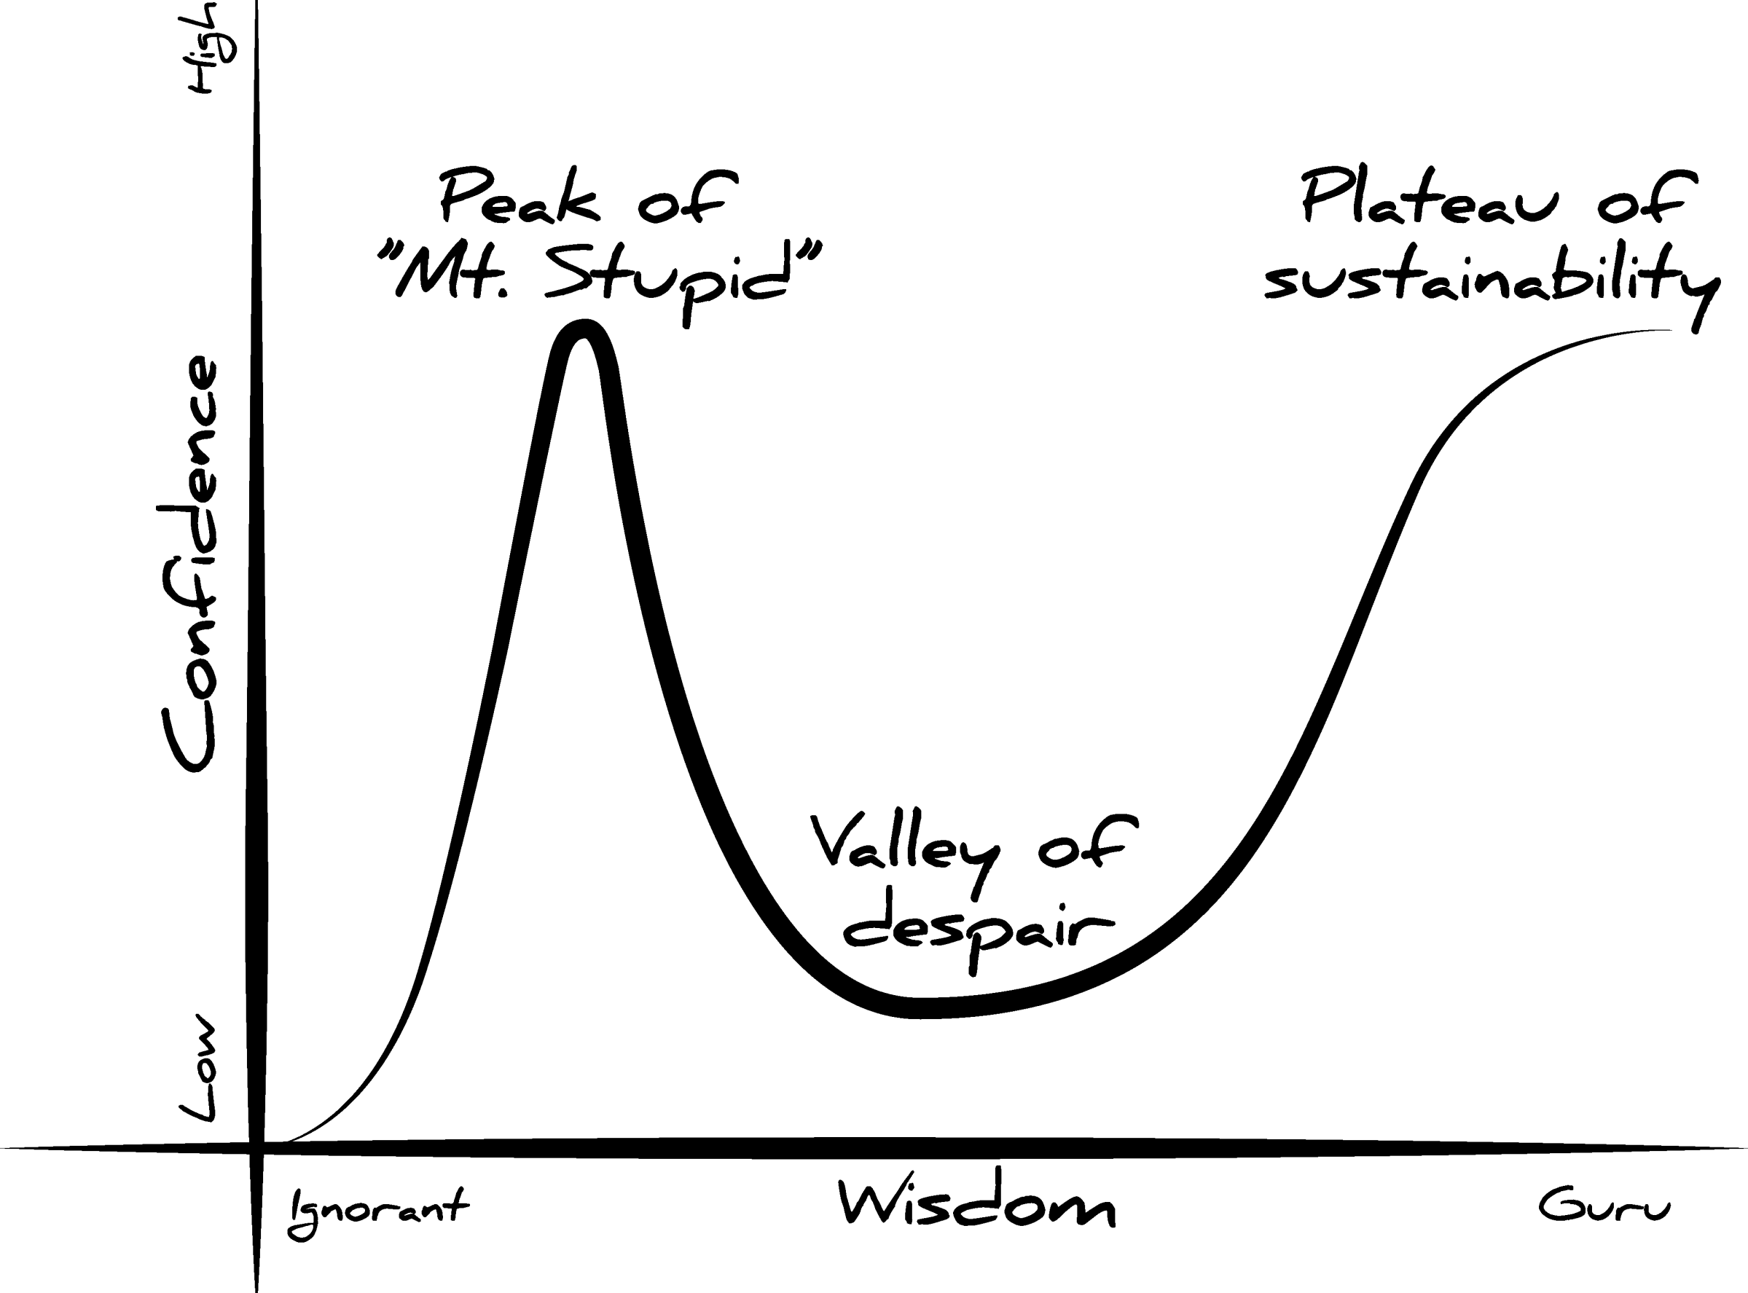
Dunning-Kruger
https://jardenberg.se/godis/dunning-kruger-illustrated/ CC BY 4.0

Slide 13
Lessons learned
Figuring out why
Starting
(the easy part)
Thinking you nailed it
Getting stuck
Trying to fix
Improving stuff
Congratulations: you've discovered the infinite loop.

Slide 14
Mission
Deploy a simple html/css webapp
In a container
On a Virtual Server
In Microsoft Azure

Slide 15
"Why don’t you just automate that?"
- random manager

Slide 16
I use Microsoft Azure for this presentation,
but my rant goes way beyond.
It also has GCP, AWS and (many) other cloud providers in scope.
And also also automation in general...
Disclaimer

Slide 17
The fun
Provisioning a virtual server in Azure using bash is easy.
$ az vm create \
--name "t-dose" \
--resource-group "t-dose" \
--image "Ubuntu2204" \
--size "Standard_b1ls"

Slide 18
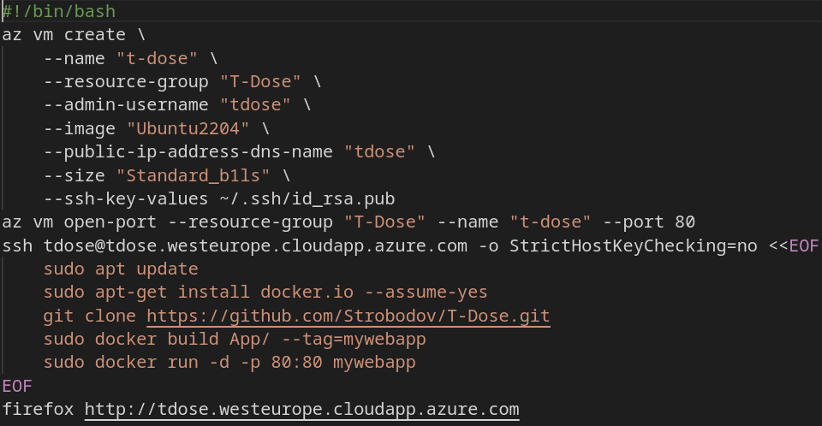
The fun

Slide 19
The fun
DEMO

Slide 20

The fun
Random manager was right!
- End of presentation -
https://www.youtube.com/watch?v=MCapEm8Nu7c

Slide 21
The reality
Before it’s easy, there are (many) prerequisites...
Create an Azure account with sufficient privileges to...
Create a Service Principal (because that’s a best practice)
Login with Service Principal via the CLI
Set correct tenant and/or subscription
Create a Resource Group
Figure out which flags you need and which are mandatory...

Slide 22
Now it looks like this to create a VM...
The reality
$ az login --service-principal \
--username "<SOME GUID>" \
--password "<NOT GONNA TELL YOU>" \
--tenant "<SOME GUID>"
$ az group create \
--name "t-dose" \
--location "westeurope"
$ az vm create \
--name "t-dose" \
--resource-group "t-dose" \
--image "Ubuntu2204" \
--size "Standard_b1ls" \
--generate-ssh-keys \
--admin-username "tdose"

Slide 23
The reality
This leads to using variables pretty soon...

Slide 24

More fun
Creating a variable in Bash is easy: $ VARIABLE=$(date)
What about storing and using credentials in a script?
What about secure scripting practices?
What if you need some variable value you don’t know yet?
warning: this is the automation point of no return

Slide 25
More reality
Example: stuff needed to automate login
- Service Principal Application ID
- Certificate for authentication
- Tenant ID
Stuff to consider at this point:
- learning more about the Bash syntax
- making use of version control
- diving deep(er) into Azure CLI documentation

Slide 26

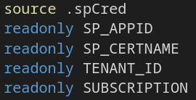
Security stuff
Never put credentials directly in your Bash script
Set strict file permission(s) like 600 to sensitive stuff
Source credentials into readonly variables
When using version control software like git
  Make use of .gitignore or..
  Change .git/info/index/exclude
  Be extra carefull with things like:
  $ git commit -am "yolo" && git push (--> github )
$ chmod 600 .spCred

Slide 27
Now it looks like this to create a VM...
And even more reality
$ source ".spCred"
$ readonly SP_APPID
$ readonly SP_CERTNAME
$ readonly TENANT_ID
$ readonly SUBSCRIPTION
$ az login --service-principal \
--username "$SP_APPID" \
--password "$CERTNAME" \
--tenant "$TENANT_ID"
$ az group create \
--name "$GROUPNAME" \
--location "$LOCATION"
$ az vm create \
--name "$VMNAME" \
--resource-group "$GROUPNAME" \
--image "Ubuntu2204" \
--size Standard_b1ls \
--generate-ssh-keys \
--admin-username "$ADMIN"

Slide 28
But what if...
it doesn’t work...
Make sure you test whether execution of a command has succeeded
If statements are great for this
Make sure you write clear error messages (including line number)
Make sure you provide exit codes if things break...

Slide 29
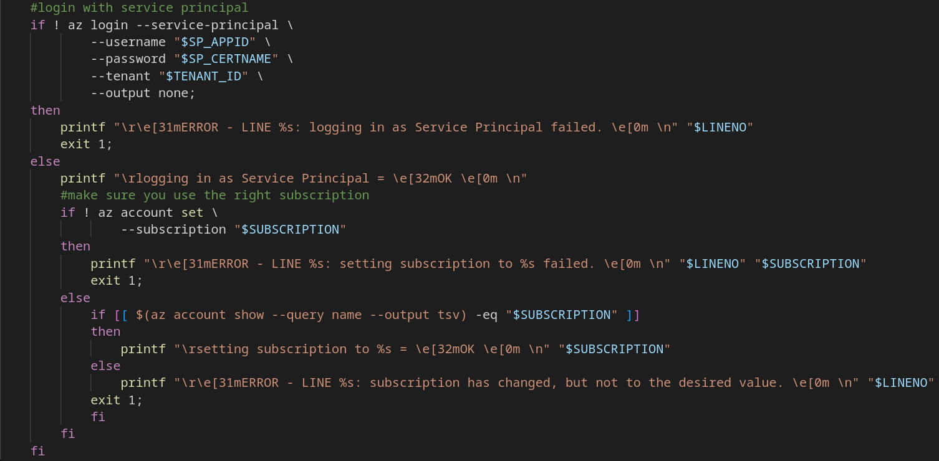
Testing stuff

Slide 30
More security stuff
Check integrity of software you want to use / install
E.g. you can use gpg or sha256sum to check/compare digests
Make sure you use official sources where possible
docker and podman provide flags for digest checking
$ az acr repository show \
--name "$REGISTRYNAME" \
--image "${IMAGENAME}:${IMAGETAG}" \
--query "digest"

Slide 31
We have created some resources (resource group, virtual machine)
We got some output containing the IP-address of the server
We want to use that output in the ssh command for automated login
By default, the az command spits out in JSON format and...
az vm get-instance-view doesn’t show the public IP addres tough...
Getting info & output formatting
$ az vm get-instance-view \
--name "t-dose" \
--resource-group "t-dose"
$ PUBIP=$(az network public-ip show \
--name "t-dosePublicIP" \
--resource-group "t-dose" \
--output tsv \
--query ipAddress)
This also works: az vm list-ip-addresses --name "t-dose" --query [].virtualMachine.network.publicIpAddresses[?*].ipAddress --output tsv

Slide 32
Back to the fun

Slide 33
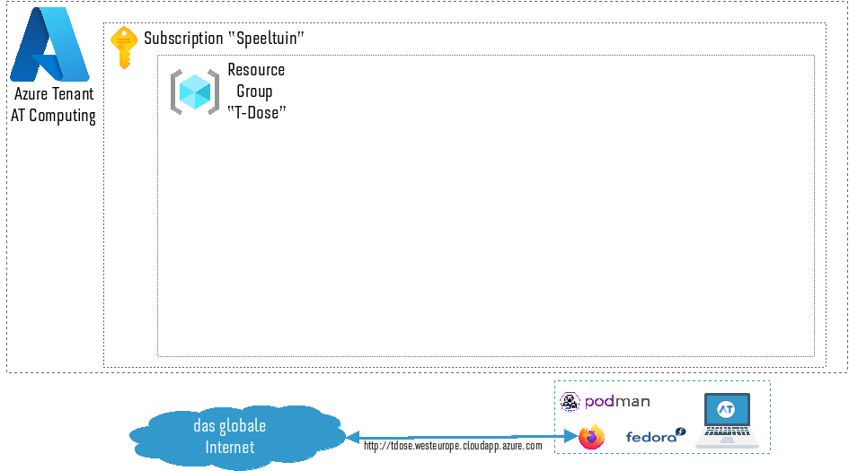

Slide 34
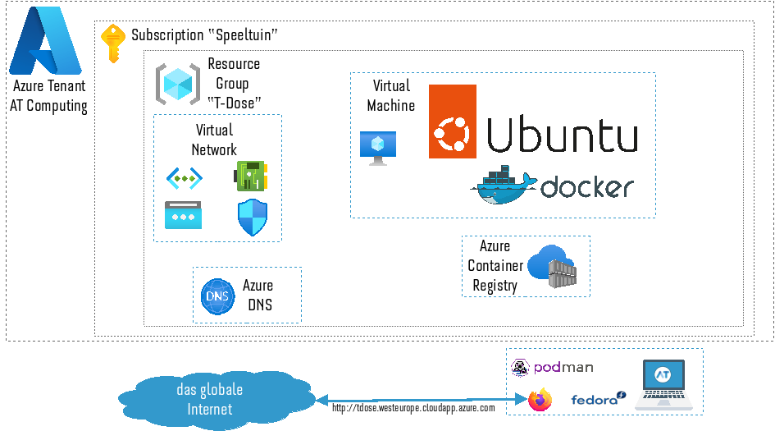

Slide 35
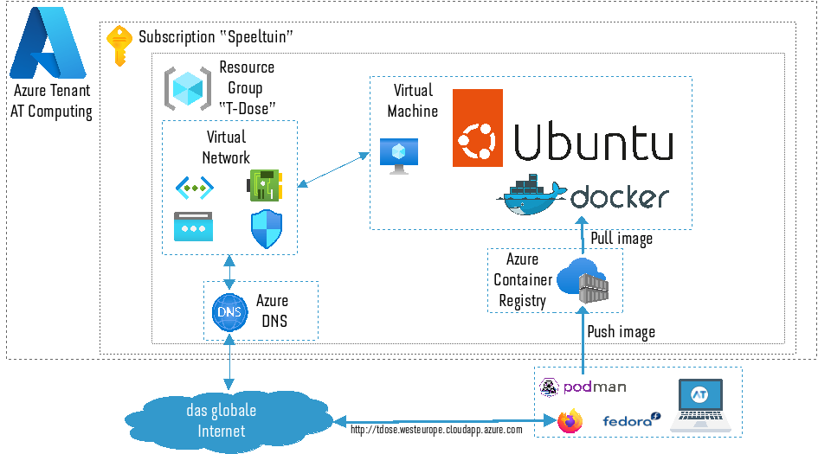

Slide 36
Cleaning up
In the cloud, nearly everything costs money
Make sure you write code to tear down everything you build up
The CLI tools of the major cloud provides help you do this
$ RES_IS=$(az resource list \
--resource-group "t-dose" \
--query "[].id" \
--output tsv)
$ az resource delete \
--id "$RES_ID"
$ az group delete \
--name "t-dose" \
--yes

Slide 37


The next level?
It’s April 23, 2023
My Bash "program" is now over 500 lines long (and counting)
It still doesn’t work the way I would like it to...
It has been fun, educational and it took sleep
I’ve gone down the rabbit hole. Maybe now it’s time to look up...

Slide 38
$ printf "that’s all folks\041\n"
Questions?
https://github.com/Strobodov/T-Dose
https://atcomputing.nl linkedin.com/in/mkornegoor
d2lsIGppaiBvb2sgamUgYmVyb2VwIG1ha2VuIHZhbiBoZXQga2xpZXJlbiBtZXQgYmFzaCBlbi9vZiBhenVyZT8gY2hlY2sgZGFuIGh0dHBzOi8vYXRjb21wdXRpbmcubmwvdmFjYXR1cmVzCg==

Slide 39
For the truly curious among us
aHR0cHM6Ly9nb29nbGUuZ2l0aHViLmlvL3N0eWxlZ3VpZGUvc2hlbGxndWlkZS5odG1sCmh0dHBz
Oi8vd3d3LnNoZWxsY2hlY2submV0LwpodHRwczovL2RldmhpbnRzLmlvL2Jhc2gKaHR0cHM6Ly9k
ZXZlbG9wZXJzLnJlZGhhdC5jb20vY2hlYXQtc2hlZXRzL2Jhc2gtc2hlbGwtY2hlYXQtc2hlZXQK
aHR0cHM6Ly9sZWFybi5taWNyb3NvZnQuY29tL2VuLXVzL2NsaS9henVyZS9yZWZlcmVuY2UtaW5k
ZXgKaHR0cHM6Ly9oYnIub3JnLzIwMTgvMDkvdGhlLWZpdmUtZGltZW5zaW9ucy1vZi1jdXJpb3Np
dHkKaHR0cHM6Ly93d3cubmNiaS5ubG0ubmloLmdvdi9wbWMvYXJ0aWNsZXMvUE1DNDYzNTQ0My8K
aHR0cHM6Ly93d3cubmNiaS5ubG0ubmloLmdvdi9wbWMvYXJ0aWNsZXMvUE1DMjUzMzU4OS8KaHR0
cHM6Ly93d3cuc2NpZW5jZWRpcmVjdC5jb20vc2NpZW5jZS9hcnRpY2xlL3BpaS9TMDg5NjYyNzMx
NTAwNzY3OQpodHRwOi8vd3d3LmNzdW4uZWR1L352Y3BzeTAwaC9zdHVkZW50cy9leHBsb3JlLmh0
bQo=

