Slide 1


Workshop Linux Server 101
Marcel Kornegoor

Slide 2
$ whoami
Marcel Kornegoor
Director @ AT Computing
Trainer/Consultant
  DevOps
  Cloud
Linux enthusiast / hobbyist
Father, husband & cyclist

Slide 3
Agenda
What is a server?
Creating a ssh key
Provisioning a Ubuntu server (in Microsoft Azure)
Connecting with ssh
Installing updates
Installing Apache web server
Configuring firewall
Test the web server
Configure DNS
Install Let’s Encrtypt TLS Certificate (if there is time...)
Build our own web page (if there still is time left...)

Slide 4
What is a server?
Like the name suggests: it’s a computer that serves something
  It doesn’t serve coffee, but some application
Things server could be serving:
  A database
  A Website
  File storage
  Networking capabilities (DNS, DHCP, IPAM, Firewall, Load balancing)
  Identity & Access Management capabilities (LDAP and/or IPA)
It enables others (humans and machines) to use it’s capabilities to build IT systems

Slide 5





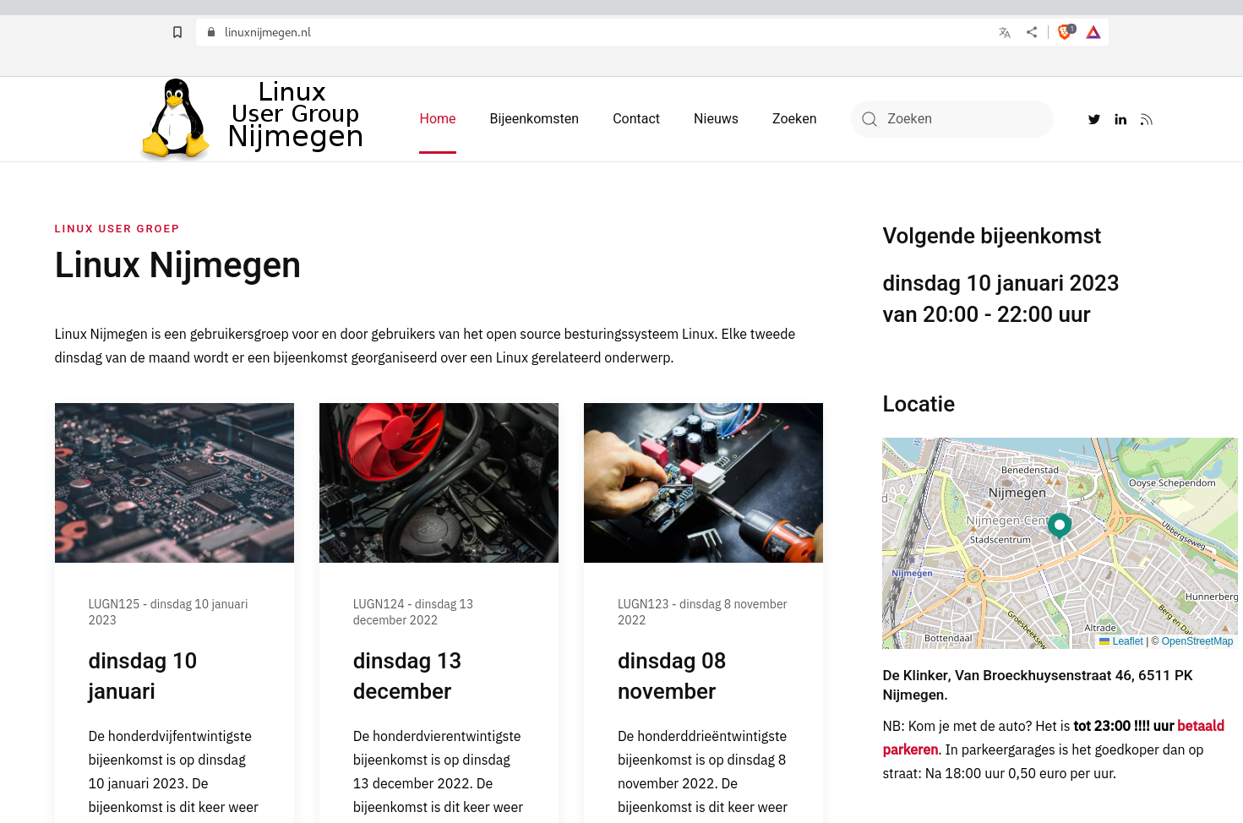

Example: web server
Internet provider
Web server
DNS
Internet connection
$ dig +short linuxnijmegen.nl
23.88.98.40
DNS = Domain Name System

Slide 6
Where do servers live?
On your desktop computer or laptop
On some computer anywhere else in your home (or in your garage or fuse box)
In your office or production site
In a data center (your own or hosted in that of someone else)

Slide 7
How do you make a server?
Get compute resources
  CPU
  RAM
  Disk
  Networking
Get the necessary software
  Many, many Linux distributions are build for this
  Windows Server is also an option (for some, apparently)
Install software for desired functionality
Notes:
Genereer een sleutelpaar:
ssh-keygen
Creer de compute resources in Azure:
az vm create --name testvm --resource-group rg_mkornegoor --admin-user atypicalguru --ssh-key-values ~/.ssh/jumpboxkey.pub --image UbuntuLTS --size Standard_B2ms --output none

Slide 8






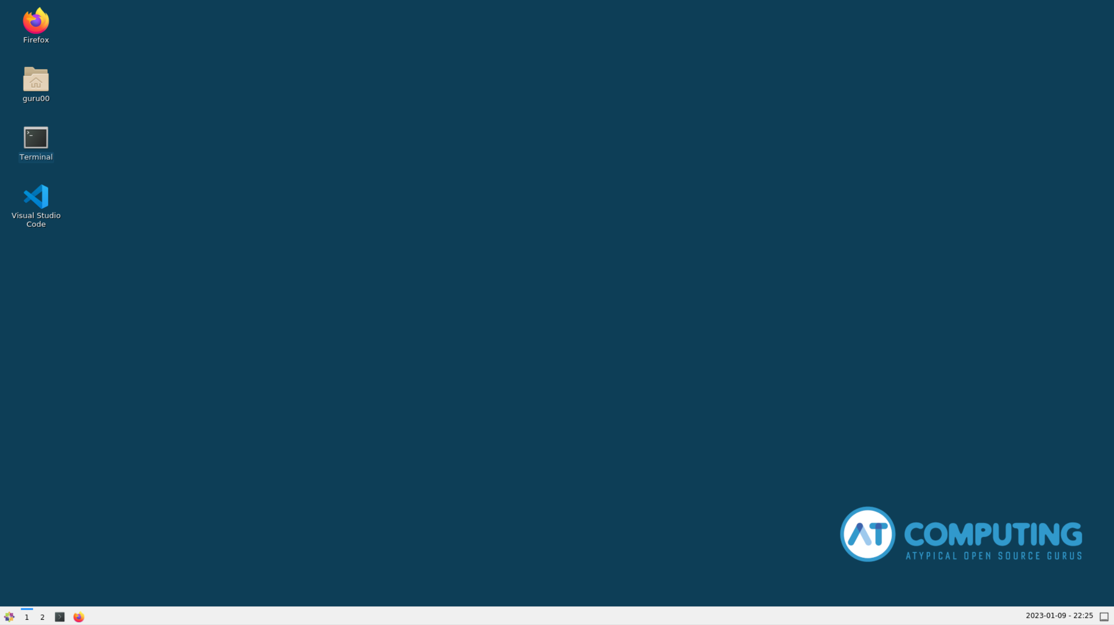

Let’s build a web server!

Slide 9
First: let’s make a set of keys
$ ssh-keygen -t rsa -b 4096 -N <password> -f ~/.ssh/mysshkey
$ ls -l ~/.ssh
-rw------- 1 guru00 guru00 3381 Jan 7 12:00 mysshkey
-rw-r--r-- 1 guru00 guru00 742 Jan 7 12:00 mysshkey.pub
$ cat ~/.ssh/mysshkey.pub
ssh-rsa <lots of charachters>== guru00@desktop

Slide 10
Provision a virtual server in Azure
$ az vm create \
--name <give it a nice name>
--resource-group rg_linuxnijmegen
--admin-user <give it a nice name>
--ssh-key-values <path to the ssh public key just created>
--image Canonical:0001-com-ubuntu-server-jammy:22_04-lts:22.04.202204200
--size Standard_B2ms
{
"fqdns": "",
"id": "/subscriptions/xxxxxxxx-xxxx-xxxx-xxxx-xxxxxxxxxxxx/resourceGroups/rg_linuxnijmegen/providers/Microsoft.Compute/virtualMachines/myvm",
"location": "westeurope",
"macAddress": "00-0D-3A-AC-22-6C",
"powerState": "VM running",
"privateIpAddress": "10.0.0.4",
"publicIpAddress": "000.00.00.000",
"resourceGroup": "rg_linuxnijmegen",
"zones": ""
}
Notes:
Genereer een sleutelpaar:
ssh-keygen
Creer de compute resources in Azure:
az vm create --name testvm --resource-group rg_mkornegoor --admin-user atypicalguru --ssh-key-values ~/.ssh/jumpboxkey.pub --image UbuntuLTS --size Standard_B2ms --output none

Slide 11
Connecting to the remote server
$ ssh myadmin@000.00.00.000
The authenticity of host '000.000.000.000 (000.000.000.000)' can't be established.
ED25519 key fingerprint is SHA256:uYcIF6xP6MshX73IncXkt9J0Yx7QY9XMvK+l/V6cNAw.
This key is not known by any other names
Are you sure you want to continue connecting (yes/no/[fingerprint])? yes
Warning: Permanently added '000.000.000.000' (ED25519) to the list of known hosts.
Welcome to Ubuntu 22.04
myadmin@myvm:~$

Slide 12
Installing OS updates
Command depends on distribution and package manager
  Red Hat, Fedora, CentOS, Rocky Linux and Alma Linux etc. use dnf
  Debian, Ubuntu, Linux Mint, Elementary OS etc. use apt
  SUSE uses zypper
myadmin@myvm:~$ sudo apt update
Reading package lists... Done
Building dependency tree... Done
Reading state information... Done
169 packages can be upgraded. Run 'apt list --upgradable' to see them.
myadmin@myvm:~$ sudo apt upgrade -y

Slide 13
Installing software
We need web server software to enable the server to host a website
  Apache is one of the most used web server software on the planet
  Alternatives are nginx or lighttpd
myadmin@myvm:~$ sudo apt install apache2 -y

Slide 14
Check web server status
myadmin@myvm:~$ sudo systemctl status apache2
● apache2.service - The Apache HTTP Server
Loaded: loaded (/lib/systemd/system/apache2.service; enabled; vendor preset: enabled)
Active: active (running) since Sun 2023-01-01 12:00:01 UTC; 5min 00s ago
Docs: https://httpd.apache.org/docs/2.4/
Main PID: 24154 (apache2)
Tasks: 55 (limit: 9532)
Memory: 8.9M
CPU: 50ms
CGroup: /system.slice/apache2.service
├─24154 /usr/sbin/apache2 -k start
├─24156 /usr/sbin/apache2 -k start
└─24157 /usr/sbin/apache2 -k start
Jan 01 12:00:00 myvm systemd[1]: Starting The Apache HTTP Server...
Jan 01 12:00:01 myvm systemd[1]: Started The Apache HTTP Server.

Slide 15
Check if it is actually serving...
We can open the (public) IP-address of the web server in our browser
  Open Firefox, Chromium or whatever browser you’re using
  Type the IP-address in the address bar
Alternatively, use curl
myadmin@myvm:~$ curl 000.000.000.000

Slide 16
Check web server status
myadmin@myvm:~$ sudo systemctl status apache2
● apache2.service - The Apache HTTP Server
Loaded: loaded (/lib/systemd/system/apache2.service; enabled; vendor preset: enabled)
Active: active (running) since Sun 2023-01-01 12:00:01 UTC; 5min 00s ago
Docs: https://httpd.apache.org/docs/2.4/
Main PID: 24154 (apache2)
Tasks: 55 (limit: 9532)
Memory: 8.9M
CPU: 50ms
CGroup: /system.slice/apache2.service
├─24154 /usr/sbin/apache2 -k start
├─24156 /usr/sbin/apache2 -k start
└─24157 /usr/sbin/apache2 -k start
Jan 01 12:00:00 myvm systemd[1]: Starting The Apache HTTP Server...
Jan 01 12:00:01 myvm systemd[1]: Started The Apache HTTP Server.

Slide 17



Firewall
Blocks unwanted traffic to the server
http://000.000.000.000

Slide 18

Configuring the Firewall
There are 2 firewalls in our environment
  In Azure (called Network Security Group, or nsg)
  On the Ubuntu server
We need to configure them both
We need 2 ports open
  80 and 443 for the web server (80 is HTTP, 443 is HTTPS)
  22 for our ssh connection (opened by default in Azure)
$ az vm open-port \
--resource-group rg_linuxnijmegen \
--name myvm \
--port 80,443
This command needs to be executed from your client machine.
Exit the ssh-connection by typing exit or open a new Terminal window.

Slide 19
Configuring the Firewall
#check firewall status
myadmin@myvm:~$ sudo ufw status
Status: inactive
#configure settings for Apache
myadmin@myvm:~$ sudo ufw allow in "Apache Full"
Rules updated
Rules updated (v6)
#configure SSH access
myadmin@myvm:~$ sudo ufw allow ssh
Rules updated
Rules updated (v6)
This command needs to be executed on the remote server.

Slide 20
Configuring the Firewall
#enable the firewall
myadmin@myvm:~$ sudo ufw --force enable
Firewall is active and enabled on system startup
myadmin@myvm:~$ sudo ufw status
Status: active
To Action From
-- ------ ----
22/tcp ALLOW Anywhere Apache Full ALLOW Anywhere
22/tcp (v6) ALLOW Anywhere (v6) Apache Full (v6) ALLOW Anywhere (v6)
This command needs to be executed on the remote server.

Slide 21
Check if the web server is working now
myadmin@myvm:~$ curl 000.000.000.000
This command can be executed on both the client and remote server.

Slide 22
Configure DNS
$ az network public-ip show \
-–name myvmPublicIP \
-–resource-group rg_linuxnijmegen
{
"ddosSettings": null,
"deleteOption": null,
"dnsSettings": null,
"etag": "W/\"07cd84dd-c538-429d-b446-1e8c9bb84849\"",
"extendedLocation": null,
"id": "/subscriptions/XXXXXXXX-XXXX-XXXX-XXXX-XXXXXXXXXXXX/resourceGroups/rg_linuxnijmegen/providers/Microsoft.Network/publicIPAddresses/myvmPublicIP",
"idleTimeoutInMinutes": 4,
"ipAddress": "000.000.000.000",
"ipConfiguration": {
"etag": null,
"id": "/subscriptions/XXXXXXXX-XXXX-XXXX-XXXX-XXXXXXXXXXXX/resourceGroups/rg_linuxnijmegen/providers/Microsoft.Network/networkInterfaces/myvmVMNic/ipConfigurations/ipconfigmyvm",
"name": null,
"privateIpAddress": null,
"privateIpAllocationMethod": null,
"provisioningState": null,
"publicIpAddress": null,
"resourceGroup": "rg_linuxnijmegen",
"subnet": null
},

Slide 23
Configure DNS
$ az network public-ip update \
-–name myvmPublicIP \
-–resource-group rg_linuxnijmegen \
--dns-name <uniquename>
{
"ddosSettings": null,
"deleteOption": null,
"dnsSettings": {
"domainNameLabel": "linuxnijmegen",
"fqdn": "linuxnijmegen.westeurope.cloudapp.azure.com",
"reverseFqdn": null
},
$ dig +short linuxnijmegen.westeurope.cloudapp.azure.com
000.000.000.000
By default, Azure will add <location>.cloudapp.azure.com as DNS suffix

Slide 24
Install Let’s Encrypt TLS Certificate
We will install and use CertBot to obtain a TLS certificate from Let’s Encrypt
  We will use our FQDN
  We will use our @atcomputing.net e-mail address
  We will move it to the right directory for Apache to use it
#install snap core
myadmin@myvm:~$ sudo snap install core
#refresh snap
myadmin@myvm:~$ sudo snap refresh core
#install certbot
myadmin@myvm:~$ sudo snap install --classic certbot
#prepare certbot command
myadmin@myvm:~$ sudo ln -s /snap/bin/certbot /usr/bin/certbot

Slide 25

Install Let’s Encrypt TLS Certificate
#get and install the certificate
myadmin@myvm:~$ sudo certbot \
--apache \
-d linuxnijmegen.westeurope.cloudapp.azure.com \
-m linuxnijmegen@atcomputing.net \
--agree-tos \
--no-eff-email

Slide 26
Build your own website
We will use vi to write a very simple html file
<html>
<head>
<title>Linux Nijmegen</title>
</head>
<body>
<h1>Hallo, Linux Nijmegen!</h1>
<img src=”https://atcomputing.nl/assets/img/atcomputing_white.png>
</body>
</html>

Slide 27
Build your own website
Now, we need to copy the file to the Apache web server
#copy files to web server
$ scp -i ~/.ssh/mysshkey index.html myadmin@XXX.XXX.XXX.XXX:~
#connect to web server
$ ssh -i ~/.ssh/mysshkey myadmin@XXX.XXX.XXX.XXX
#move index.html to Apache html directory
myadmin@myvm:~$ sudo mv index.html /var/www/html

Slide 28
That’s all folks!
https://atcomputing.nl

