Slide 1
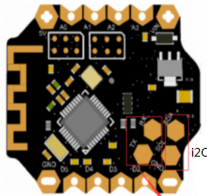
I2c Screen 128x64
Heart
Beat
Touch A1
Fogyasztás
- screen: 20mA
Df BLE 10-20 mA/2qA
Heartbeat 4mA
Gy-91 multisensor: 1mA
össz: 32-42mA
A d4 HIGH = biomonitor bekapcs
Multisensor i2c
vibro
Touch A2
piezo
Touch A3
Usb aljzat/ software serial
switch
Battery:350 -1600mAh
charger

Slide 2
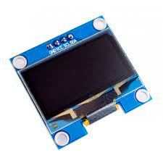
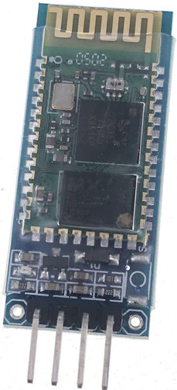
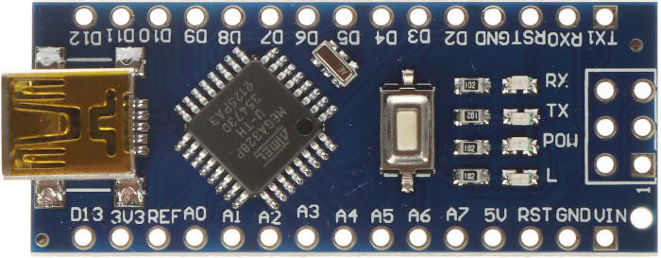
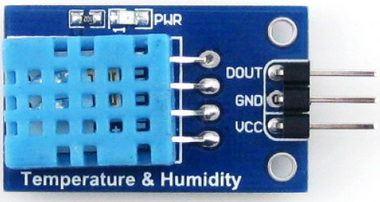
My configuration
+1-30V
Gnd
TP4056+lipo akku+switch
10K
100K
Diode
Parts:
Arduino nano
SSD1306 0.96 128x64
Tp4056 charger
Switch
280+ mAh akku
Mhc-05/4 BT module
DHT11 sensor
10K and 100K resistor
1n4007 diode (polarity safer)
Lens
Mirror
Transparent plastic
3d printed smartglass case
Jack socket (for volt meter cable)
Old headphone (make volt meter cable)

