Slide 1

i am not a robot.
project presented by
Erik Dolejš
Anežka Lhotáková
© 2022, CTU, Faculty of Nuclear Sciences and Physical Engineering

Slide 2
Project goal
In 1997 was firstly presented Completly Automated Public Turing test to tell Computer and Humans Apart (CAPTCHA), which requieres someone to correctly evaluate and enter a sequence of letters or numbers perceptible in a distorted image displayed on the screen.
Can we create a model, which is able to deceive CAPTCHA?

Slide 3
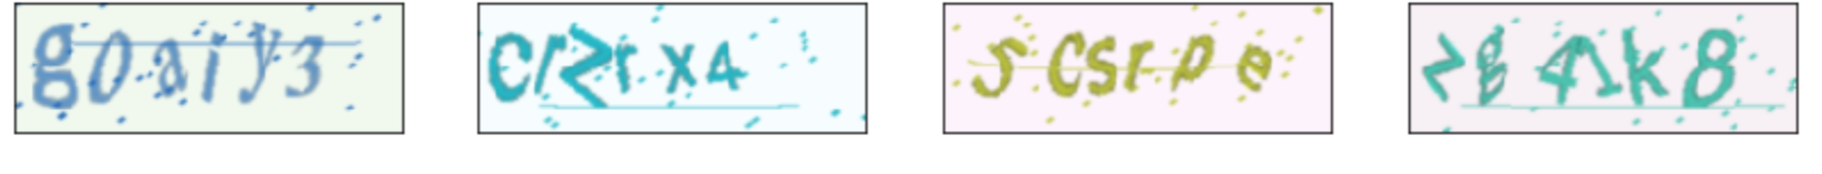
Data source
w
f
n
e
8
We decided to generate our own CAPTCHA codes using following two sets of symbols
digits (0-9);
ascii lowercase letters (a,b,c…);
written in three different fonts (Times New Roman, Arial, Calibri).
0

Slide 4



What were we looking for?
pretrained neural network
customization of the pretrained NN
(transfer learning)
suitable loss function

Slide 5
What we found:
pretrained neural network
customization of the pretrained NN
(transfer learning)
suitable loss function
resnet18
CRNN approach
CTC loss
What?

Slide 6

What we found:
ResNet18
ResNet-18 is a convolutional neural network that is 18 layers deep
pretrained version is trained on more than a million images from the ImageNet database
pretrained network can classify images into 1000 object categories
image input is the size of 224-by-224.
OK

Slide 7
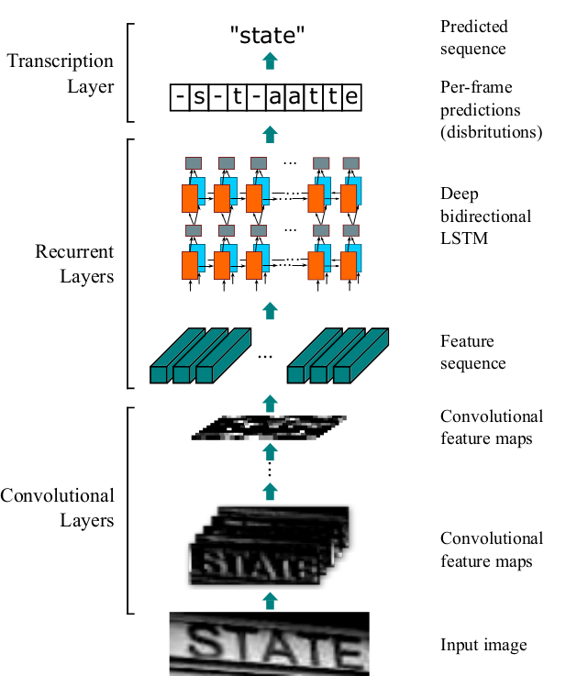

What we found:
Convolutional Recurrent Neural Network (CRNN)
combination of two of the most prominent (convolutional & recurrent) neural networks
input image
Convolutional Layers
Recurrent Layers
Transcription Layers
OK

Slide 8
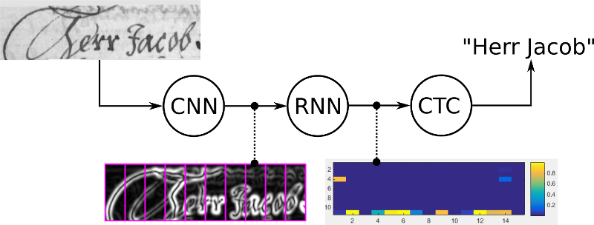
What we found:
Connectionist Temporal Classification (CTC) loss
CTC loss tries all possible alignments of the ground-truth text in the image and takes the sum of all scores. This way, the score of a ground truth text is high if the sum over the alignment-scores has a high value.
OK

Slide 9
Model
What?

Slide 10
Results: basic model

Slide 11
Results: smart model

Slide 12
Conclusion

