Slide 1

i am not a robot.
project presented by
Erik Dolejš
Anežka Lhotáková
© 2022, CTU, Faculty of Nuclear Sciences and Physical Engineering
Notes:
A

Slide 2
Project goal
In 1997 was firstly presented Completly Automated Public Turing test to tell Computer and Humans Apart (CAPTCHA), which requieres someone to correctly evaluate and enter a sequence of letters or numbers perceptible in a distorted image displayed on the screen.
Can we create a model, which is able to deceive CAPTCHA?
Notes:
A

Slide 3
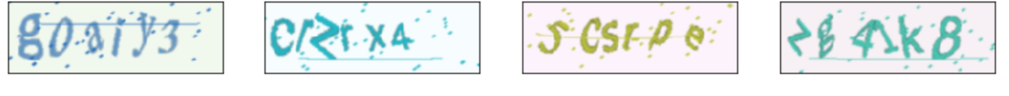
Data source
w
f
n
e
8
We decided to generate our own CAPTCHA codes using following two sets of symbols
digits (0-9);
ascii lowercase letters (a,b,c…);
written in three different fonts (Times New Roman, Arial, Calibri) and with deformations.
We choose CAPTCHA codes with 6 symbols.
0
Notes:
A

Slide 4



What were we looking for?
pretrained neural network
customization of the pretrained NN
(transfer learning)
suitable loss function
Notes:
E

Slide 5
What we found:
pretrained neural network
customization of the pretrained NN
(transfer learning)
suitable loss function
resnet18
CRNN approach
CTC loss
What?
Notes:
E

Slide 6

What we found:
ResNet18
ResNet-18 is a convolutional neural network that is 18 layers deep
pretrained version is trained on more than a million images from the ImageNet database
pretrained network can classify images into 1000 object categories
image input is the size of 224-by-224.
OK
Notes:
E

Slide 7
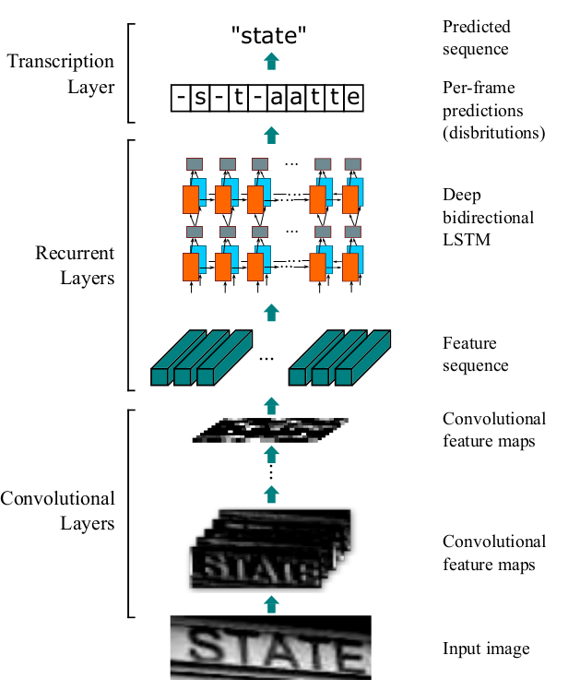

What we found:
Convolutional Recurrent Neural Network (CRNN)
combination of two of the most prominent (convolutional & recurrent) neural networks
input image
Convolutional Layers
Recurrent Layers
Transcription Layers
OK
Notes:
E

Slide 8
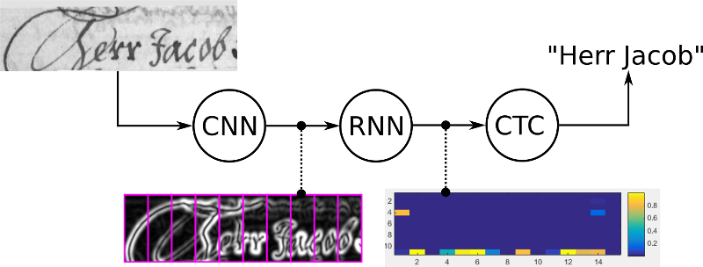
What we found:
Connectionist Temporal Classification (CTC) loss
CTC loss tries all possible alignments of the ground-truth text in the image and takes the sum of all scores. This way, the score of a ground truth text is high if the sum over the alignment-scores has a high value.
OK
Notes:
A - pogooglim

Slide 9
Model
CNN part #1
- first 15 layers from resnet18
CNN part #2
Conv2d layer
BatchNorm2d layer
ReLu layer
Linear layer
RNN
GRU layer
GRU layer
Linear layer
Notes:
A

Slide 10
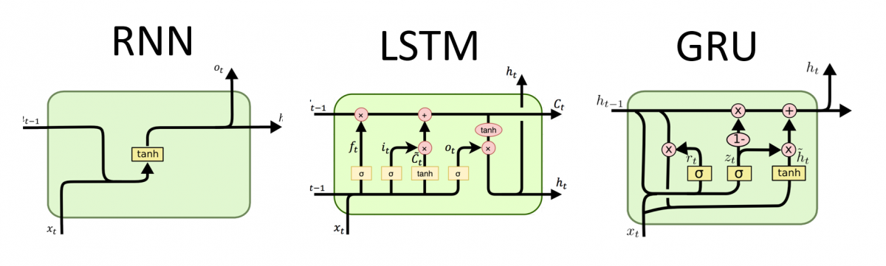
Gated recurrent unit (GRU)
Gating mechanism in RNN – reset and update gate.
GRU is similar to LSTM, but computationally more efficient and without memory unit
no relations between symbols in CAPTCHA
Notes:
A+E

Slide 11
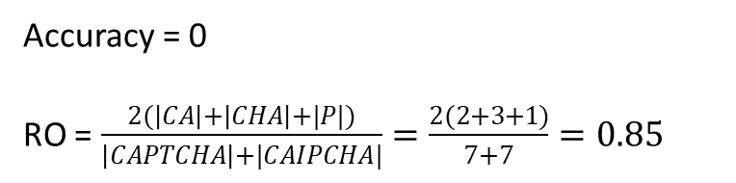
Accuracy vs. RO similarity
Even if only one symbol in the whole CAPTCHA code prediction is wrong, accuracy takes the whole prediction as wrong. This approach might be especially in text-recognizing models bit too harsh.
From this reason, we added to the evaluation also Retcliff-Obershelp similarity, which takes in account matching characters in comparison to the total number of characters.
Accuracy = 0
RO = $\frac{2(\left|CA\right|+\left|CHA\right|+|P|)}{\left|CAPTCHA\right|+|CAIPCHA|}=\frac{2(2+3+1)}{7+7}=0.85$
Ground truth: | C | A | P | T | C | H | A
Prediction: | C | A | I | P | C | H | A
Notes:
A

Slide 12

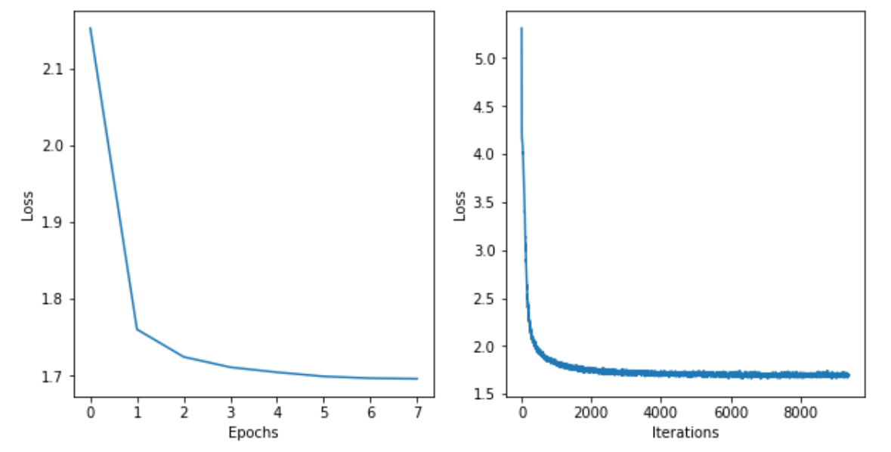
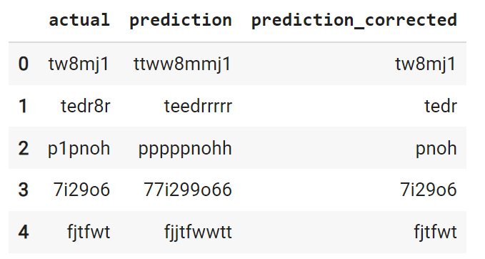
Results: basic model
02:00
Dataset | Size (#img) | Accuracy | RO
Train | 299 975 | 0.80 | 0.97
Test | 50 000 | 0.79 | 0.97
Notes:
E

Slide 13

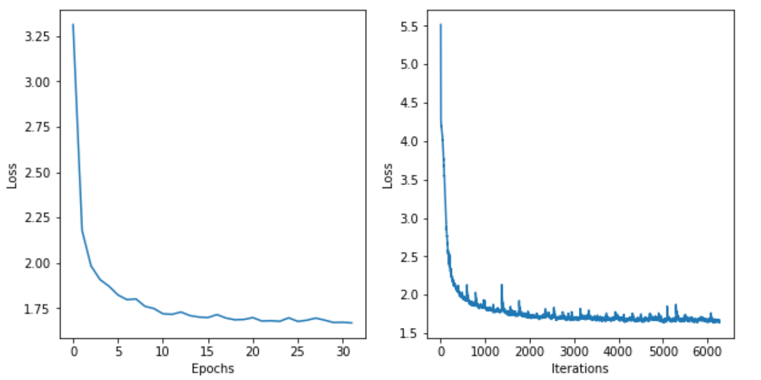
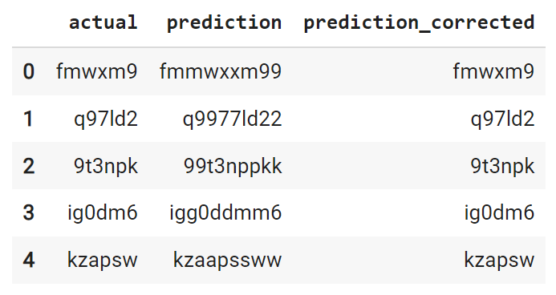
Results: smart model
08:00
Dataset | Size (#img) | Accuracy | RO
Train | Every couple of iteration new dataset is generated. | - | -
Test | 50 000 | 0.90 | 0.98
Notes:
E

Slide 14
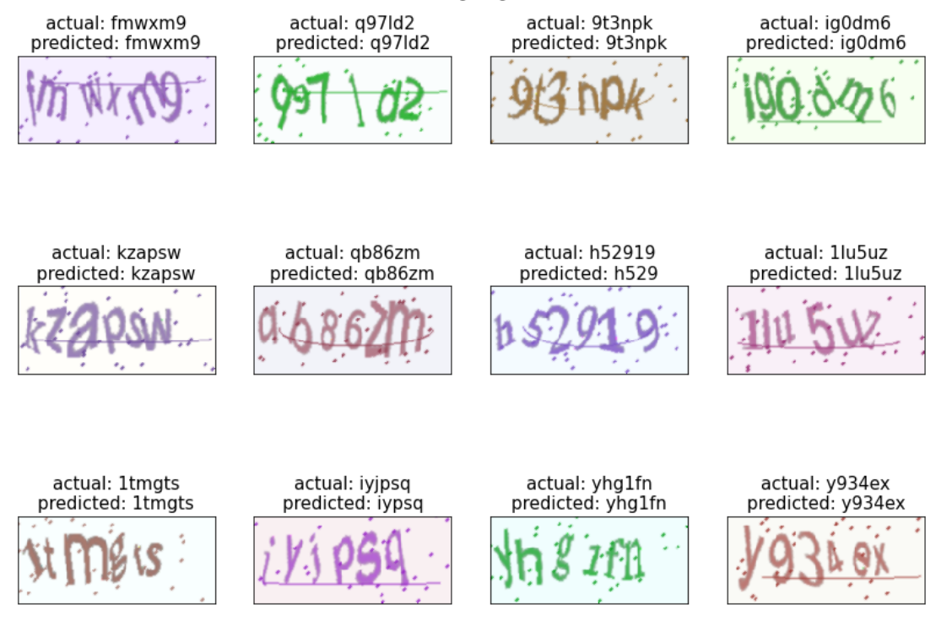


Notes:
E

Slide 15
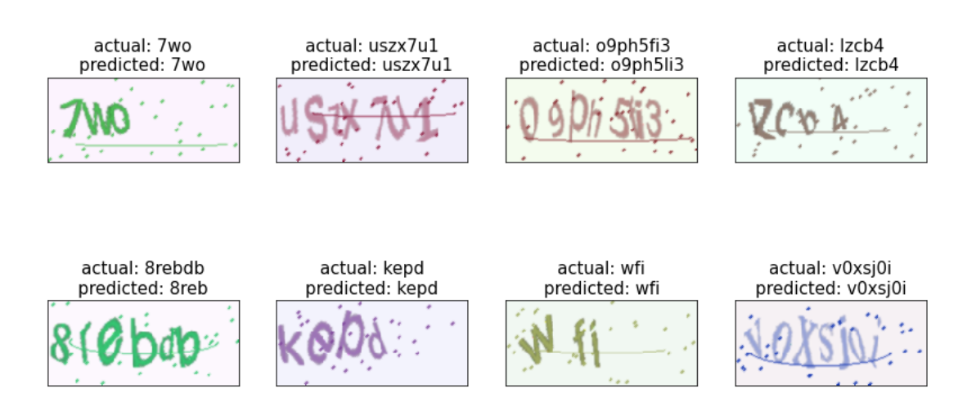
Robustness
Check how model reacts to CAPTCHA codes with different length (3-8).
Accuracy = 0.90
Notes:
E

Slide 16
Conclusion
We found efficient solution to CAPTCHA recognition problem and created a model with very high accuracy.
Neck-to-neck with CAPTCHA recognition models we found on the internet.
Model is capable of finding predictions for even longer/shorter CAPTCHA‘s. (robustness)
During research we came across many interesting approaches to text recognition, which will surely come handy in the future.
So…
Notes:
A

Slide 17
Conclusion
We found efficient solution to CAPTCHA recognition problem and created a model with very high accuracy.
Neck-to-neck with CAPTCHA recognition models we found on the internet.
Model is capable of finding predictions for even longer/shorter CAPTCHA‘s. (robustness)
During research we came across many interesting approaches to text recognition, which will surely come handy in the future.
So…

Slide 18
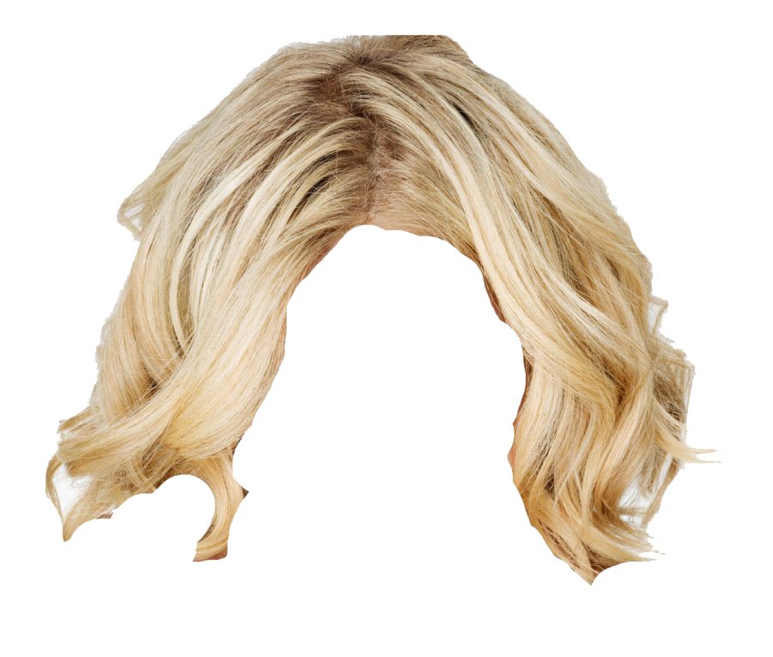


Conclusion
We found efficient solution to CAPTCHA recognition problem and created a model with very high accuracy.
Neck-to-neck with CAPTCHA recognition models we found on the internet.
Model is capable of finding predictions for even longer/shorter CAPTCHA‘s. (robustness)
During research we came across many interesting approaches to text recognition, which will surely come handy in the future.
So…

