Slide 1

i am not a robot.
project presented by
Erik Dolejš
Anežka Lhotáková
© 2022, CTU, Faculty of Nuclear Sciences and Physical Engineering

Slide 2
Project goal
In 1997 was firstly presented Completly Automated Public Turing test to tell Computer and Humans Apart (CAPTCHA), which requieres someone to correctly evaluate and enter a sequence of letters or numbers perceptible in a distorted image displayed on the screen.
Can we create a model, which is able to decieve CAPTCHA?

Slide 3
Machine Learning approach

Slide 4
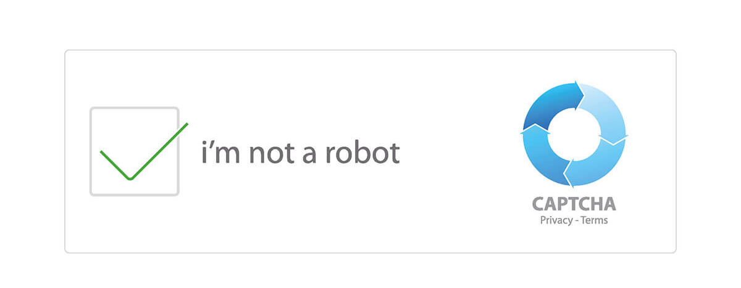
Conclusion

