Slide 1

i am not a robot.
project presented by
Erik Dolejš
Anežka Lhotáková
© 2022, CTU, Faculty of Nuclear Sciences and Physical Engineering

Slide 2
Project goal
In 1997 was firstly presented Completly Automated Public Turing test to tell Computer and Humans Apart (CAPTCHA), which requieres someone to correctly evaluate and enter a sequence of letters or numbers perceptible in a distorted image displayed on the screen.
Can we create a model, which is able to deceive CAPTCHA?

Slide 3
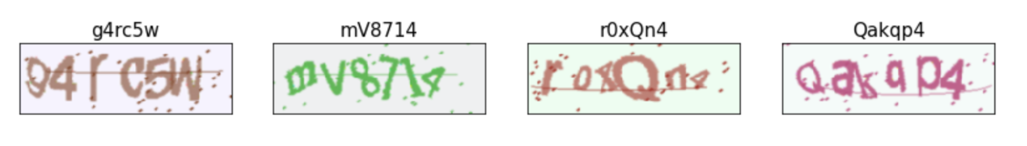
Data source
We decided to generate our own CAPTCHA codes using following three sets of symbols
digits (0-9);
ascii lowercase letters (a,b,c…), different fonts;
ascii uppercase letters (A,B,C,…), different fonts.

Slide 4
Train / Test samples

Slide 5
Machine Learning approach

Slide 6
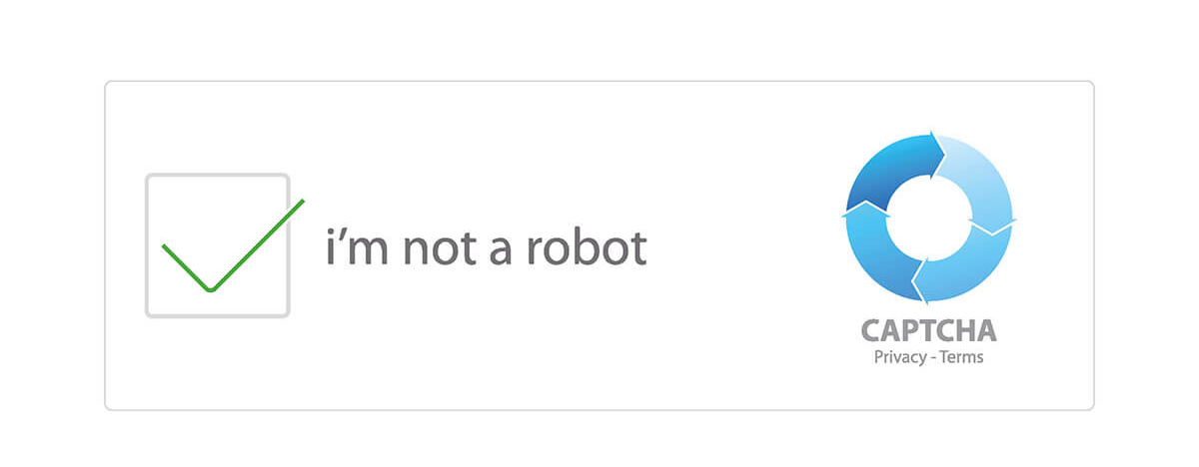
Conclusion

