Slide 1
STORYBOARD · BR
How BlackRock Came to Own a Piece of Everything
Working title: The Company That Owns Everything but Makes Nothing
85 frames · 11 acts · 1752 words · runtime 12:08
Running device: An 'AUM METER' (assets under management) in the corner: a stack of gold coins that grows from $0 in 1988 to $15.3 trillion, with a date tag that ticks as the story moves through the years.
Style: Calm serious business documentary in the house 2D style. Night-time Manhattan painted plates, 1980s trading floors in smoky amber, clean ledger-paper charts for the money mechanics, 3D props (bond certificates, a server rack for Aladdin, coin stacks, a courthouse). Real people drawn as round-headed ink characters; company names shown as plain text tiles, no logos.

Slide 2
ACT 0 · COLD OPEN
9 frames · 1:11

Slide 3
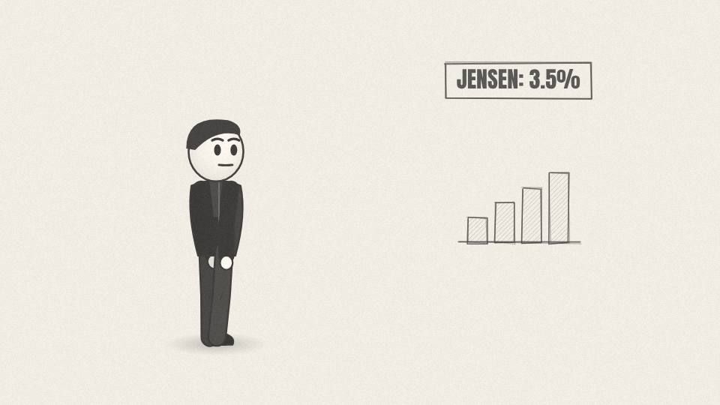
BR 0.01 CU · 7.2 s
Act 0 · Cold open
VISUAL
Ink portrait of Jensen in a leather jacket beside a share-of-company bar filling to 3.5%.
ON-SCREEN TEXT
JENSEN HUANG: ~3.5%
ANIMATION NOTES
Ink portrait fades up; the share bar fills from 0 to 3.5% with a counter; light tick SFX.
VO
Jensen Huang started Nvidia in 1993. Today he owns about three and a half percent of it.
Notes:
VO: Jensen Huang started Nvidia in 1993. Today he owns about three and a half percent of it.
Visual: Ink portrait of Jensen in a leather jacket beside a share-of-company bar filling to 3.5%.
On-screen: JENSEN HUANG: ~3.5%
Animation: Ink portrait fades up; the share bar fills from 0 to 3.5% with a counter; light tick SFX.

Slide 4
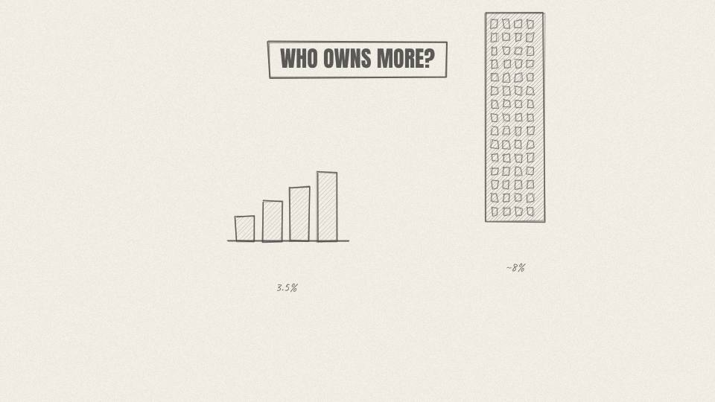
BR 0.02 CU · 7.9 s
Act 0 · Cold open
VISUAL
A second bar, labeled with a dark tower silhouette, fills past Jensen's to ~8%.
ON-SCREEN TEXT
BLACKROCK: ~8%
ANIMATION NOTES
A second bar topped with a tower silhouette fills past his, slowly, to about 8%; low string swell.
VO
There is a company that owns more than twice that. About eight percent. It never designed a single chip.
Notes:
VO: There is a company that owns more than twice that. About eight percent. It never designed a single chip.
Visual: A second bar, labeled with a dark tower silhouette, fills past Jensen's to ~8%.
On-screen: BLACKROCK: ~8%
Animation: A second bar topped with a tower silhouette fills past his, slowly, to about 8%; low string swell.

Slide 5
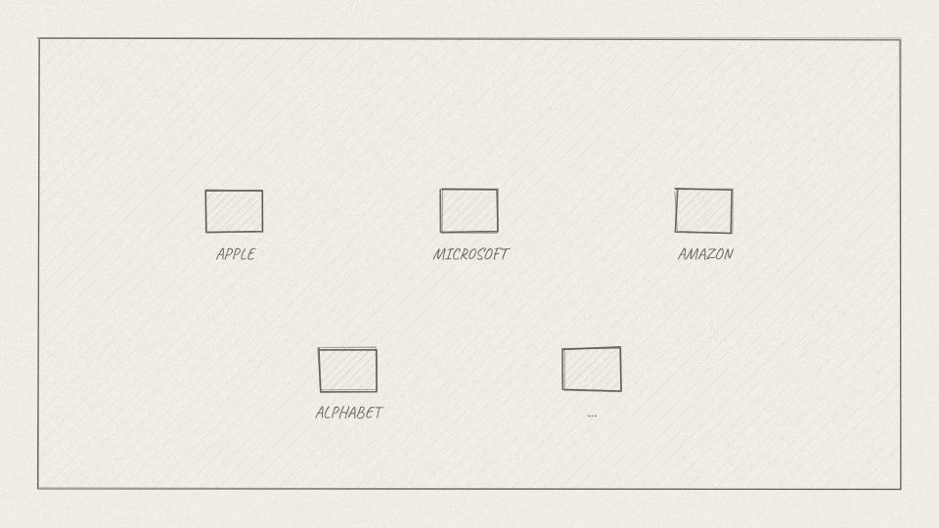
BR 0.03 MED · 9.1 s
Act 0 · Cold open
VISUAL
Grid of plain company tiles (APPLE, MICROSOFT, AMAZON, ALPHABET...) each getting a small dark ownership wedge.
ON-SCREEN TEXT
—
ANIMATION NOTES
Company tiles pop in on a stagger; a dark wedge grows in the corner of each, one after another.
VO
It holds roughly seven to eight percent of Apple and Microsoft too, and a stake in almost every big company in America.
Notes:
VO: It holds roughly seven to eight percent of Apple and Microsoft too, and a stake in almost every big company in America.
Visual: Grid of plain company tiles (APPLE, MICROSOFT, AMAZON, ALPHABET...) each getting a small dark ownership wedge.
On-screen: -
Animation: Company tiles pop in on a stagger; a dark wedge grows in the corner of each, one after another.

Slide 6
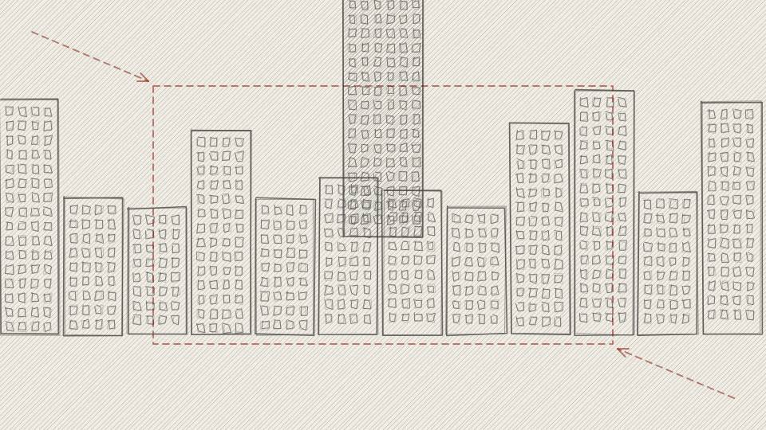
BR 0.04 WIDE · 6.8 s
Act 0 · Cold open
VISUAL
Night skyline of Manhattan; a black glass tower; the camera pushes in on the lit top floors.
ON-SCREEN TEXT
BLACKROCK
ANIMATION NOTES
Night skyline with parallax layers; slow push in on the lit top floors of the black tower; city hum.
VO
Its name is BlackRock. It has no factory, no product you can hold, and no shop.
Notes:
VO: Its name is BlackRock. It has no factory, no product you can hold, and no shop.
Visual: Night skyline of Manhattan; a black glass tower; the camera pushes in on the lit top floors.
On-screen: BLACKROCK
Animation: Night skyline with parallax layers; slow push in on the lit top floors of the black tower; city hum.

Slide 7
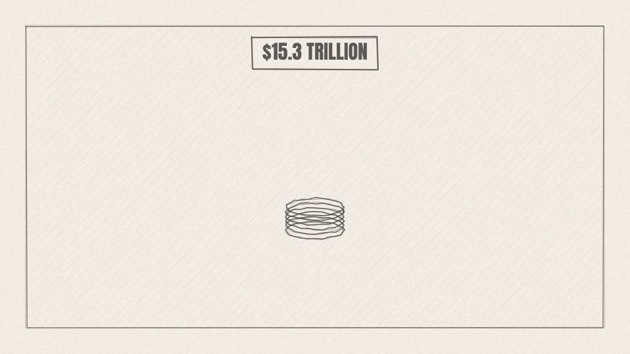
BR 0.05 CHART · 7.9 s
Act 0 · Cold open
VISUAL
AUM meter coin stack shoots up to $15.3T.
ON-SCREEN TEXT
$15.3 TRILLION
ANIMATION NOTES
Coin stack shoots up with eased overshoot as the counter races to $15.3T; coin cascade SFX.
VO
And yet by the middle of 2026 it was managing fifteen point three trillion dollars of other people's money.
Notes:
VO: And yet by the middle of 2026 it was managing fifteen point three trillion dollars of other people's money.
Visual: AUM meter coin stack shoots up to $15.3T.
On-screen: $15.3 TRILLION
Animation: Coin stack shoots up with eased overshoot as the counter races to $15.3T; coin cascade SFX.

Slide 8

BR 0.06 MAP · 6.4 s
Act 0 · Cold open
VISUAL
World map: India, Japan and France light up; their GDP bars stack beside BlackRock's single taller bar.
ON-SCREEN TEXT
> INDIA + JAPAN + FRANCE
ANIMATION NOTES
India, Japan, France light up in turn; their GDP bars stack beside one taller BlackRock bar.
VO
That is more than the yearly economic output of India, Japan and France put together.
Notes:
VO: That is more than the yearly economic output of India, Japan and France put together.
Visual: World map: India, Japan and France light up; their GDP bars stack beside BlackRock's single taller bar.
On-screen: > INDIA + JAPAN + FRANCE
Animation: India, Japan, France light up in turn; their GDP bars stack beside one taller BlackRock bar.

Slide 9
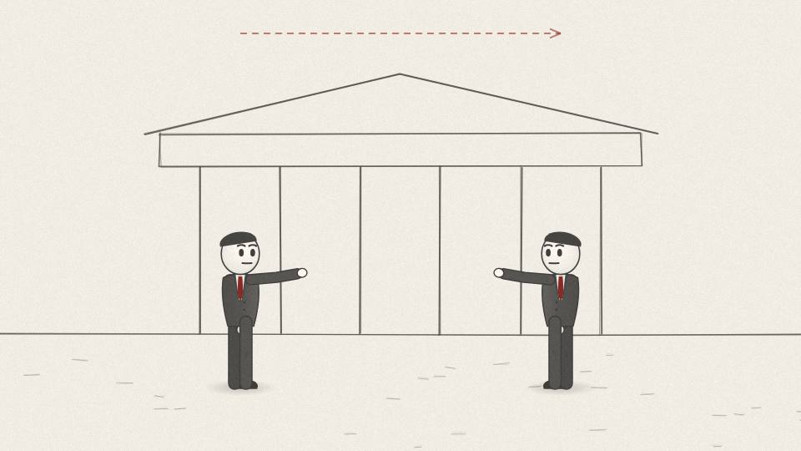
BR 0.07 MED · 11.7 s
Act 0 · Cold open
VISUAL
Split frame of two podiums with silhouetted speakers, then a courthouse.
ON-SCREEN TEXT
—
ANIMATION NOTES
Two podium silhouettes argue (talk mouths, pointing); pan right to the courthouse steps.
VO
Politicians on the right accuse it of pushing a climate agenda. Critics on the left call it a symbol of Wall Street's reach. States have taken it to court.
Notes:
VO: Politicians on the right accuse it of pushing a climate agenda. Critics on the left call it a symbol of Wall Street's reach. States have taken it to court.
Visual: Split frame of two podiums with silhouetted speakers, then a courthouse.
On-screen: -
Animation: Two podium silhouettes argue (talk mouths, pointing); pan right to the courthouse steps.

Slide 10
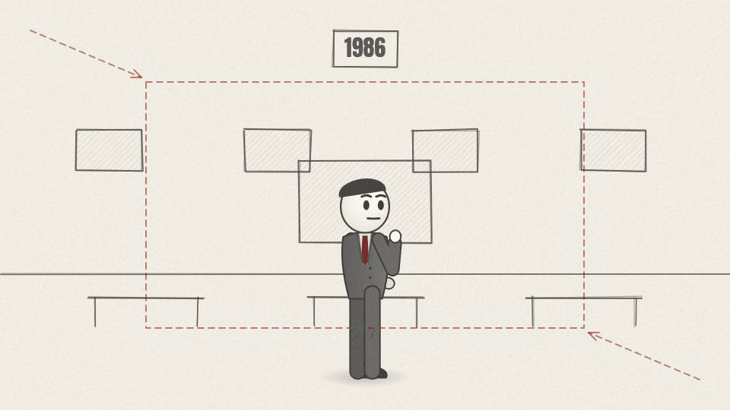
BR 0.08 CU · 10.2 s
Act 0 · Cold open
VISUAL
A trading screen in 1980s green text flashes a red loss; push into a worried face.
ON-SCREEN TEXT
-$100,000,000
ANIMATION NOTES
Green-text screen flashes a red loss; push into a worried face; a phone keeps ringing.
VO
So how does a company that makes nothing end up owning a piece of everything? It starts with one banker losing a hundred million dollars.
Notes:
VO: So how does a company that makes nothing end up owning a piece of everything? It starts with one banker losing a hundred million dollars.
Visual: A trading screen in 1980s green text flashes a red loss; push into a worried face.
On-screen: -$100,000,000
Animation: Green-text screen flashes a red loss; push into a worried face; a phone keeps ringing.

Slide 11

BR 0.09 TITLE · 4.0 s
Act 0 · Cold open
VISUAL
Title card over the black tower at night.
ON-SCREEN TEXT
THE COMPANY THAT OWNS EVERYTHING
ANIMATION NOTES
Title scales in over the tower at night; window lights flicker on; deep hit.
VO
Notes:
VO:
Visual: Title card over the black tower at night.
On-screen: THE COMPANY THAT OWNS EVERYTHING
Animation: Title scales in over the tower at night; window lights flicker on; deep hit.

Slide 12
ACT 1 · ACT 1: THE MONEY MACHINE
10 frames · 1:33

Slide 13
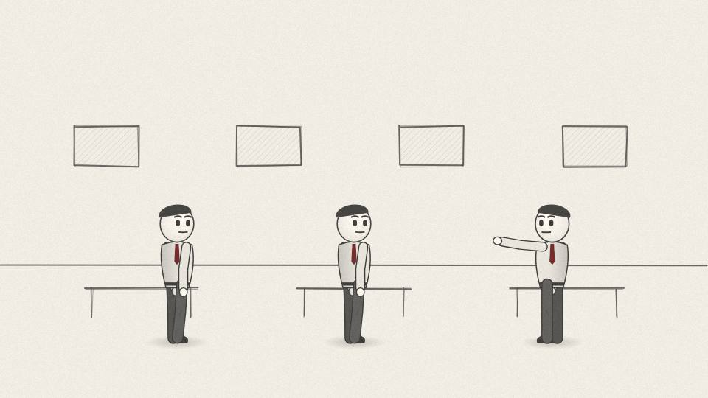
BR 1.01 WIDE · 9.4 s
Act 1 · Act 1: The Money Machine
VISUAL
Smoky 1980s trading floor, phones, paper tickets; young Fink in shirt sleeves at the center desk.
ON-SCREEN TEXT
FIRST BOSTON · 1980s
ANIMATION NOTES
Smoky 1980s floor; traders gesture and shout on phones (looping arm moves); paper slips flutter down.
VO
New York, the early 1980s. Larry Fink is a young bond trader at the investment bank First Boston, and he is a star.
Notes:
VO: New York, the early 1980s. Larry Fink is a young bond trader at the investment bank First Boston, and he is a star.
Visual: Smoky 1980s trading floor, phones, paper tickets; young Fink in shirt sleeves at the center desk.
On-screen: FIRST BOSTON · 1980s
Animation: Smoky 1980s floor; traders gesture and shout on phones (looping arm moves); paper slips flutter down.

Slide 14
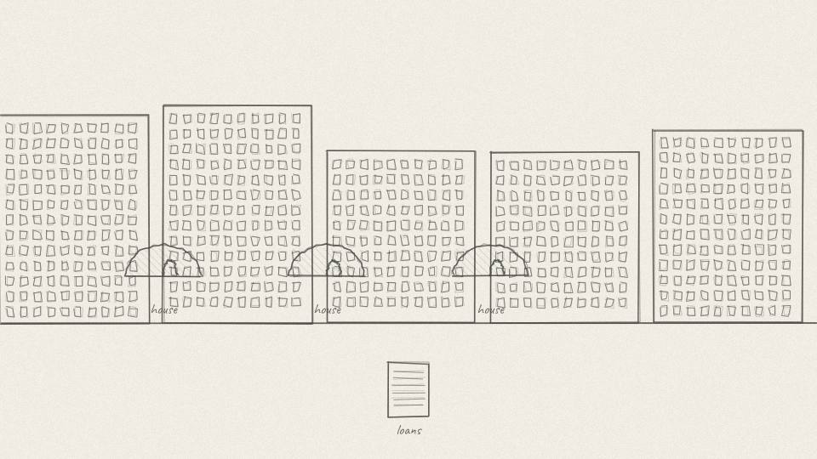
BR 1.02 MED · 6.8 s
Act 1 · Act 1: The Money Machine
VISUAL
A suburban street of houses; each house drops a small loan document into a funnel.
ON-SCREEN TEXT
—
ANIMATION NOTES
Each house drops a loan document that slides along a path into a funnel at the bottom.
VO
His desk helps build a new kind of product out of something very ordinary: home loans.
Notes:
VO: His desk helps build a new kind of product out of something very ordinary: home loans.
Visual: A suburban street of houses; each house drops a small loan document into a funnel.
On-screen: -
Animation: Each house drops a loan document that slides along a path into a funnel at the bottom.

Slide 15
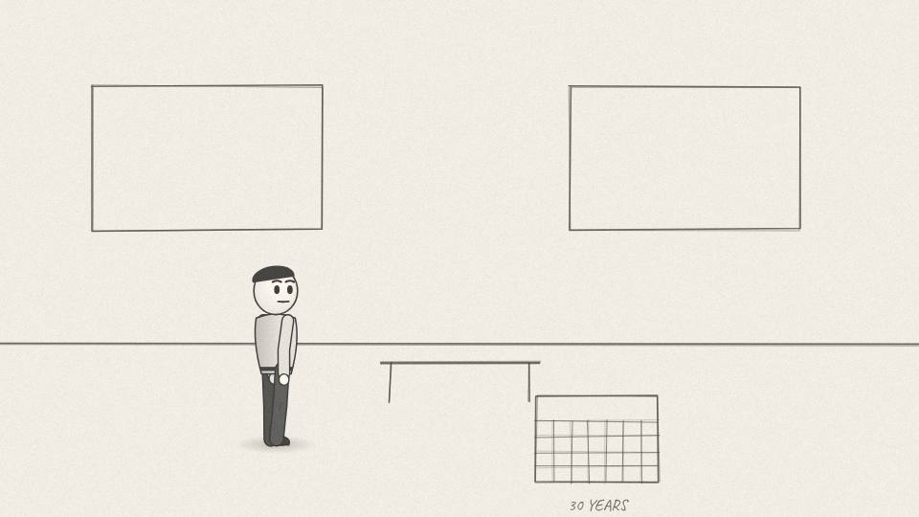
BR 1.03 MED · 9.4 s
Act 1 · Act 1: The Money Machine
VISUAL
Bank clerk stares at a 30-year calendar that unrolls across the floor.
ON-SCREEN TEXT
30 YEARS
ANIMATION NOTES
The calendar unrolls across the floor with a paper whoosh; the clerk's head follows it.
VO
A bank that lends out a hundred million dollars in mortgages has to wait up to thirty years to get it all back.
Notes:
VO: A bank that lends out a hundred million dollars in mortgages has to wait up to thirty years to get it all back.
Visual: Bank clerk stares at a 30-year calendar that unrolls across the floor.
On-screen: 30 YEARS
Animation: The calendar unrolls across the floor with a paper whoosh; the clerk's head follows it.

Slide 16
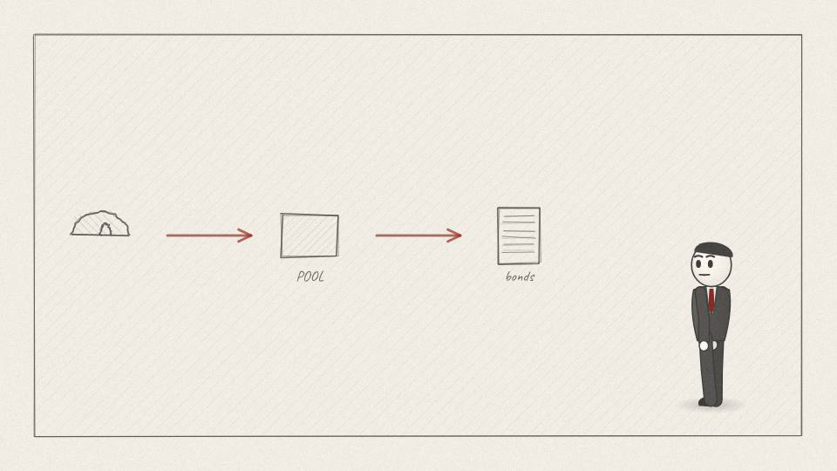
BR 1.04 CHART · 10.9 s
Act 1 · Act 1: The Money Machine
VISUAL
Diagram: houses → pool → bond certificates → investors; money flows back to the bank.
ON-SCREEN TEXT
MORTGAGE-BACKED BONDS
ANIMATION NOTES
Diagram draws left to right on each word; arrows animate; coins loop back to the bank.
VO
So Wall Street buys those loans, pools them, and sells bonds backed by the monthly payments. Investors get the interest; the bank gets its cash back today.
Notes:
VO: So Wall Street buys those loans, pools them, and sells bonds backed by the monthly payments. Investors get the interest; the bank gets its cash back today.
Visual: Diagram: houses → pool → bond certificates → investors; money flows back to the bank.
On-screen: MORTGAGE-BACKED BONDS
Animation: Diagram draws left to right on each word; arrows animate; coins loop back to the bank.

Slide 17

BR 1.05 CARD · 5.7 s
Act 1 · Act 1: The Money Machine
VISUAL
Ledger-paper card titled 'SIMPLIFIED EXAMPLE'.
ON-SCREEN TEXT
SIMPLIFIED EXAMPLE
ANIMATION NOTES
Ledger card slides up with a paper SFX and holds.
VO
Here is a simplified version of the trick that made it so profitable.
Notes:
VO: Here is a simplified version of the trick that made it so profitable.
Visual: Ledger-paper card titled 'SIMPLIFIED EXAMPLE'.
On-screen: SIMPLIFIED EXAMPLE
Animation: Ledger card slides up with a paper SFX and holds.

Slide 18
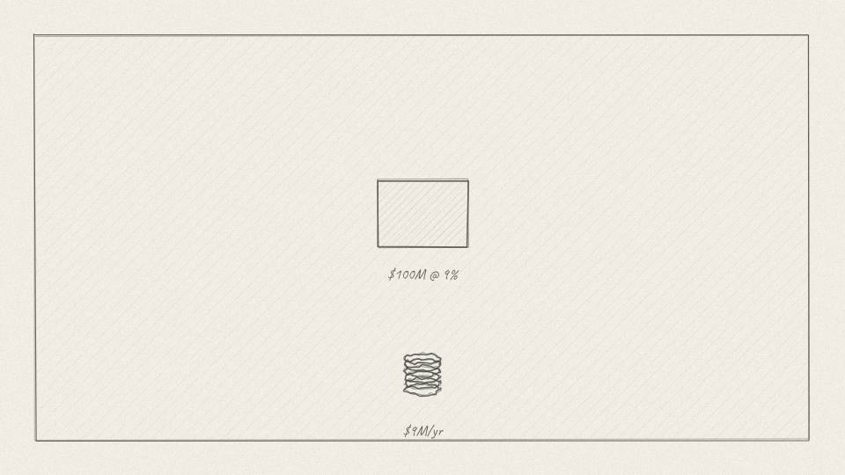
BR 1.06 CHART · 9.1 s
Act 1 · Act 1: The Money Machine
VISUAL
Pool block labeled $100M at 9% with $9M of coins dripping out.
ON-SCREEN TEXT
$100M · 9%
ANIMATION NOTES
Coins drip out of the pool block and pile up below, counter to $9M.
VO
Take a hundred million dollars of home loans paying nine percent. That's about nine million dollars of interest in the first year.
Notes:
VO: Take a hundred million dollars of home loans paying nine percent. That's about nine million dollars of interest in the first year.
Visual: Pool block labeled $100M at 9% with $9M of coins dripping out.
On-screen: $100M · 9%
Animation: Coins drip out of the pool block and pile up below, counter to $9M.

Slide 19
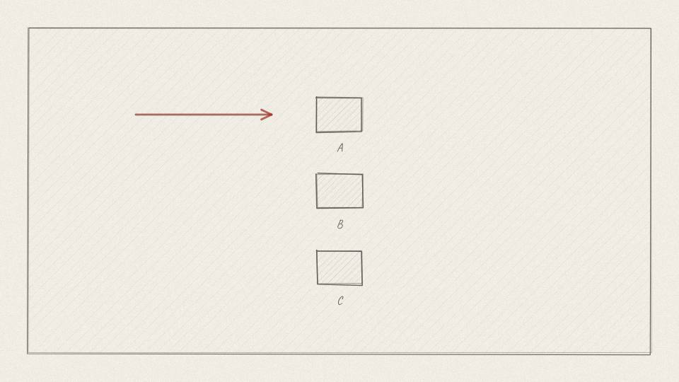
BR 1.07 CHART · 10.9 s
Act 1 · Act 1: The Money Machine
VISUAL
Three stacked blocks A, B, C form a queue; principal coins flow to A first.
ON-SCREEN TEXT
A → B → C
ANIMATION NOTES
Blocks stack into a queue; principal coins flow to A first, then B, then C.
VO
Now cut the pool into three bonds that stand in a queue. When homeowners pay back their loans, bond A is paid first, then B, then C.
Notes:
VO: Now cut the pool into three bonds that stand in a queue. When homeowners pay back their loans, bond A is paid first, then B, then C.
Visual: Three stacked blocks A, B, C form a queue; principal coins flow to A first.
On-screen: A → B → C
Animation: Blocks stack into a queue; principal coins flow to A first, then B, then C.

Slide 20
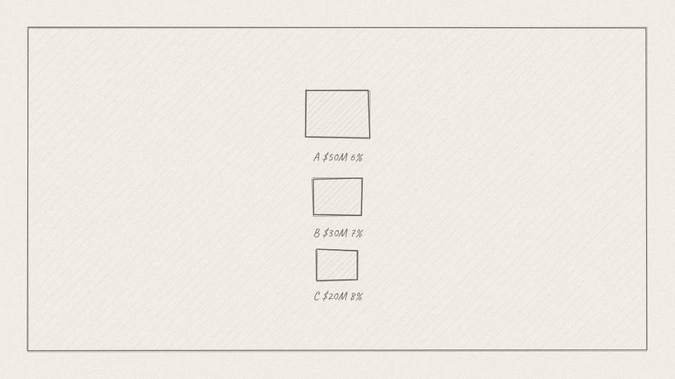
BR 1.08 CHART · 9.4 s
Act 1 · Act 1: The Money Machine
VISUAL
Blocks resize: A $50M 6%, B $30M 7%, C $20M 8%.
ON-SCREEN TEXT
A 6% · B 7% · C 8%
ANIMATION NOTES
Blocks resize smoothly to their amounts; labels type on.
VO
A is safest, so it gets the lowest rate, say six percent. B gets seven. C takes the most risk and gets eight.
Notes:
VO: A is safest, so it gets the lowest rate, say six percent. B gets seven. C takes the most risk and gets eight.
Visual: Blocks resize: A $50M 6%, B $30M 7%, C $20M 8%.
On-screen: A 6% · B 7% · C 8%
Animation: Blocks resize smoothly to their amounts; labels type on.

Slide 21
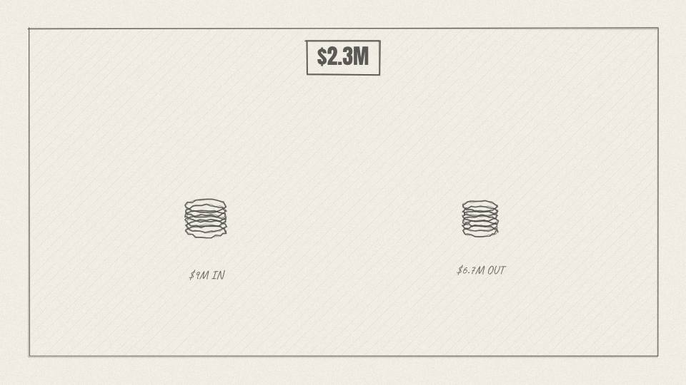
BR 1.09 CHART · 13.2 s
Act 1 · Act 1: The Money Machine
VISUAL
Two coin stacks compared: $9M in, $6.7M out; the $2.3M difference glows gold.
ON-SCREEN TEXT
$2.3M GAP
ANIMATION NOTES
Two stacks compared side by side; the $2.3M gap glows gold and pulses.
VO
Add it up and the three bonds pay out about six point seven million. The homeowners still pay nine. The gap, more than two million a year, is the packager's to share out.
Notes:
VO: Add it up and the three bonds pay out about six point seven million. The homeowners still pay nine. The gap, more than two million a year, is the packager's to share out.
Visual: Two coin stacks compared: $9M in, $6.7M out; the $2.3M difference glows gold.
On-screen: $2.3M GAP
Animation: Two stacks compared side by side; the $2.3M gap glows gold and pulses.

Slide 22
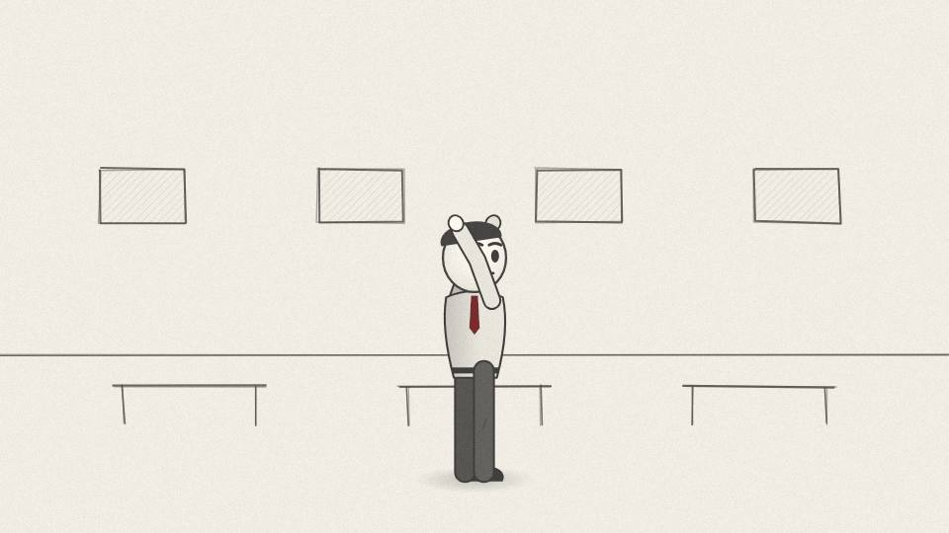
BR 1.10 CU · 8.3 s
Act 1 · Act 1: The Money Machine
VISUAL
Fink smiles as gold ticker tape rains on the trading floor.
ON-SCREEN TEXT
—
ANIMATION NOTES
Fink smiles; gold ticker tape rains down; a crowd cheer under the music.
VO
Nothing was built. The same payments were just sliced and arranged. Fink's desk made First Boston a fortune doing it.
Notes:
VO: Nothing was built. The same payments were just sliced and arranged. Fink's desk made First Boston a fortune doing it.
Visual: Fink smiles as gold ticker tape rains on the trading floor.
On-screen: -
Animation: Fink smiles; gold ticker tape rains down; a crowd cheer under the music.

Slide 23
ACT 2 · ACT 2: THE LOSS
8 frames · 1:04

Slide 24
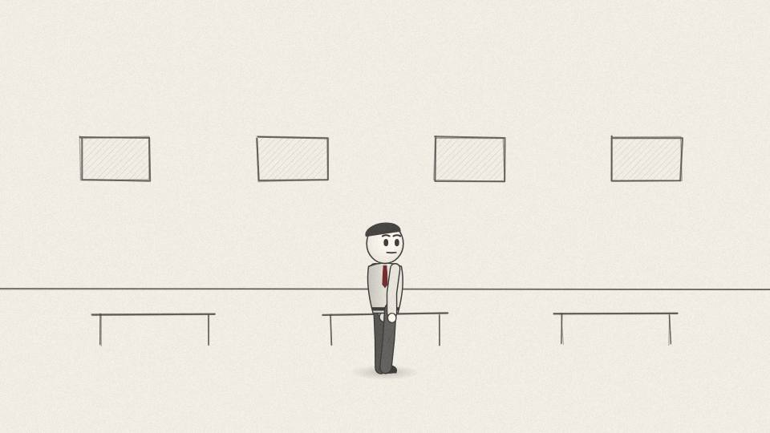
BR 2.01 MED · 5.7 s
Act 2 · Act 2: The Loss
VISUAL
The trading floor lights shift from gold to cold blue.
ON-SCREEN TEXT
1986
ANIMATION NOTES
Light grade shifts from warm gold to cold blue over 2 s; the room slows down.
VO
Then in 1986, it went wrong in a way most people wouldn't expect.
Notes:
VO: Then in 1986, it went wrong in a way most people wouldn't expect.
Visual: The trading floor lights shift from gold to cold blue.
On-screen: 1986
Animation: Light grade shifts from warm gold to cold blue over 2 s; the room slows down.

Slide 25
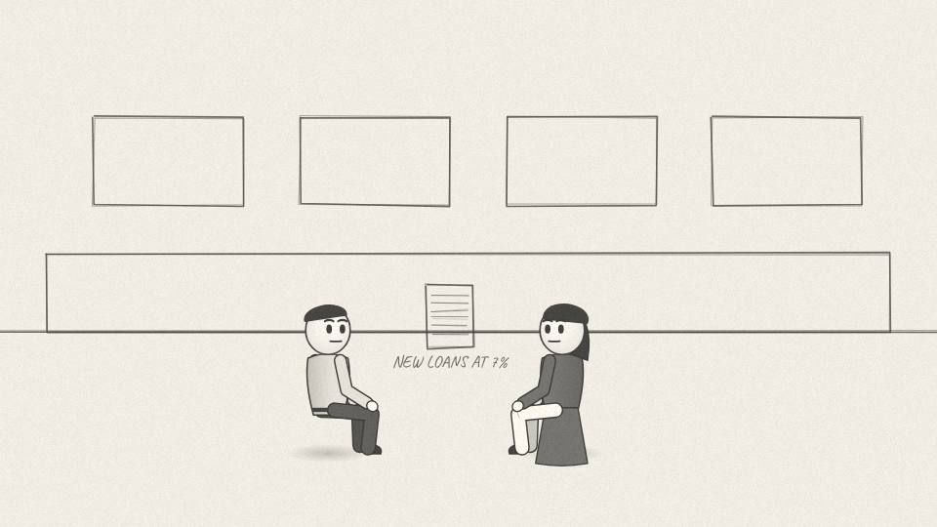
BR 2.02 MED · 9.1 s
Act 2 · Act 2: The Loss
VISUAL
A family at a kitchen table reads a bank ad: NEW LOANS AT 7%.
ON-SCREEN TEXT
—
ANIMATION NOTES
Family at the table reads the ad; they look at each other; ad text circles in red.
VO
The danger everyone watched for was homeowners who stopped paying. Fink's problem was the opposite. Rates fell, and homeowners paid back early.
Notes:
VO: The danger everyone watched for was homeowners who stopped paying. Fink's problem was the opposite. Rates fell, and homeowners paid back early.
Visual: A family at a kitchen table reads a bank ad: NEW LOANS AT 7%.
On-screen: -
Animation: Family at the table reads the ad; they look at each other; ad text circles in red.

Slide 26
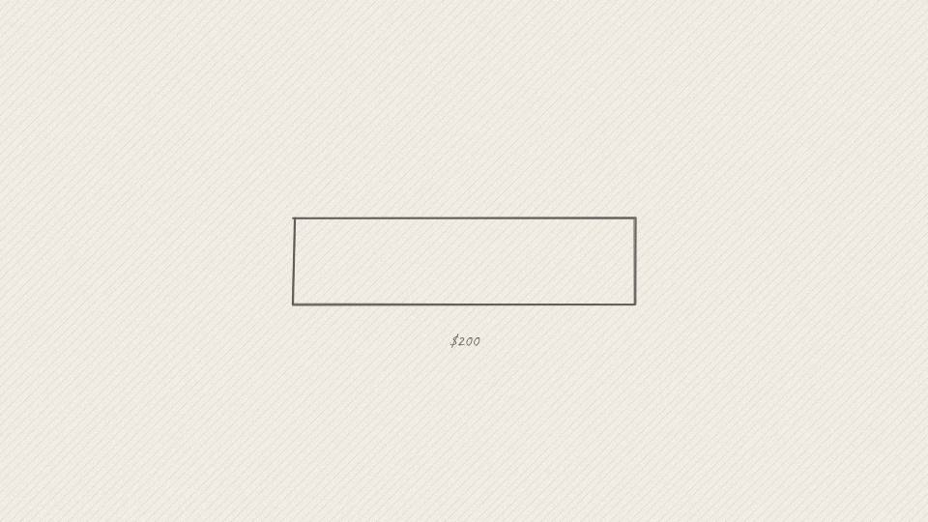
BR 2.03 CHART · 10.2 s
Act 2 · Act 2: The Loss
VISUAL
Loan card: $200,000 · 9% · $1,609/month.
ON-SCREEN TEXT
$1,609 / MONTH
ANIMATION NOTES
Loan card slides in; numbers type on one at a time.
VO
Picture a family with a two hundred thousand dollar loan at nine percent. Their payment is about sixteen hundred dollars a month for thirty years.
Notes:
VO: Picture a family with a two hundred thousand dollar loan at nine percent. Their payment is about sixteen hundred dollars a month for thirty years.
Visual: Loan card: $200,000 · 9% · $1,609/month.
On-screen: $1,609 / MONTH
Animation: Loan card slides in; numbers type on one at a time.

Slide 27
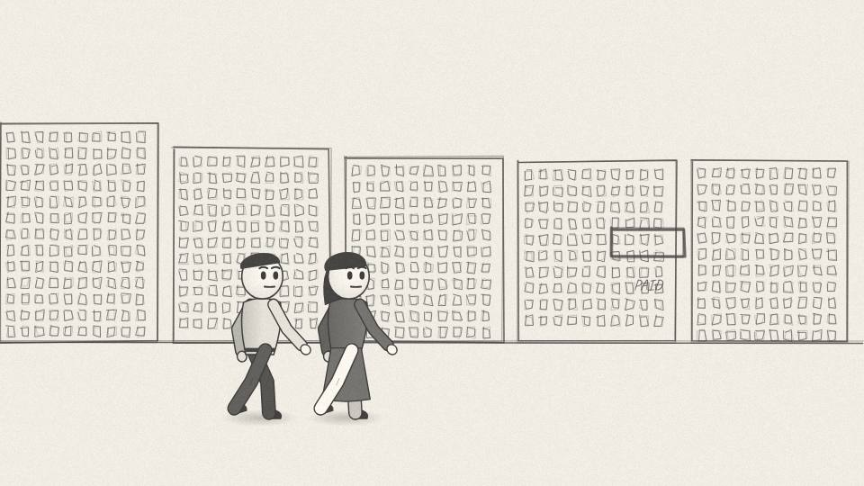
BR 2.04 MED · 9.1 s
Act 2 · Act 2: The Loss
VISUAL
The family walks from one bank to another with a briefcase; the old loan document is stamped PAID.
ON-SCREEN TEXT
—
ANIMATION NOTES
Family walks bank to bank (walk cycles); the old document gets a PAID stamp slam.
VO
When a bank down the road offers seven percent, they take a new loan, pay off the old one, and walk out.
Notes:
VO: When a bank down the road offers seven percent, they take a new loan, pay off the old one, and walk out.
Visual: The family walks from one bank to another with a briefcase; the old loan document is stamped PAID.
On-screen: -
Animation: Family walks bank to bank (walk cycles); the old document gets a PAID stamp slam.

Slide 28
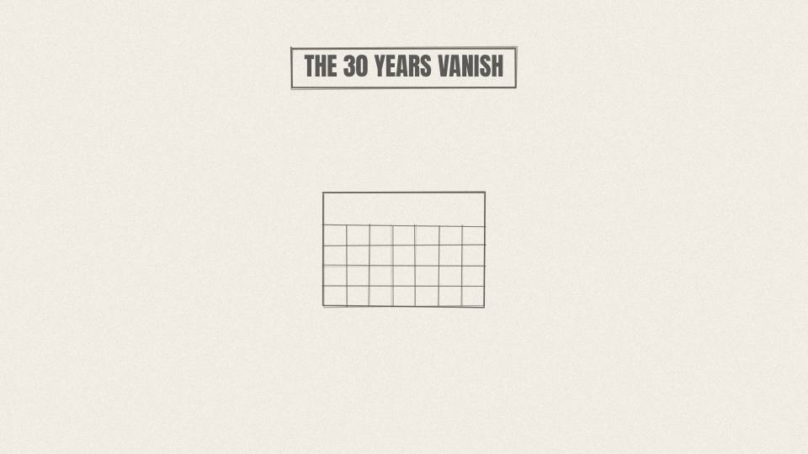
BR 2.05 CU · 6.0 s
Act 2 · Act 2: The Loss
VISUAL
The 30-year calendar from Act 1 burns away from the end.
ON-SCREEN TEXT
—
ANIMATION NOTES
The calendar burns from the end toward the start (ember edge, smoke).
VO
For whoever owned that old loan, thirty years of nine percent interest simply disappears.
Notes:
VO: For whoever owned that old loan, thirty years of nine percent interest simply disappears.
Visual: The 30-year calendar from Act 1 burns away from the end.
On-screen: -
Animation: The calendar burns from the end toward the start (ember edge, smoke).

Slide 29
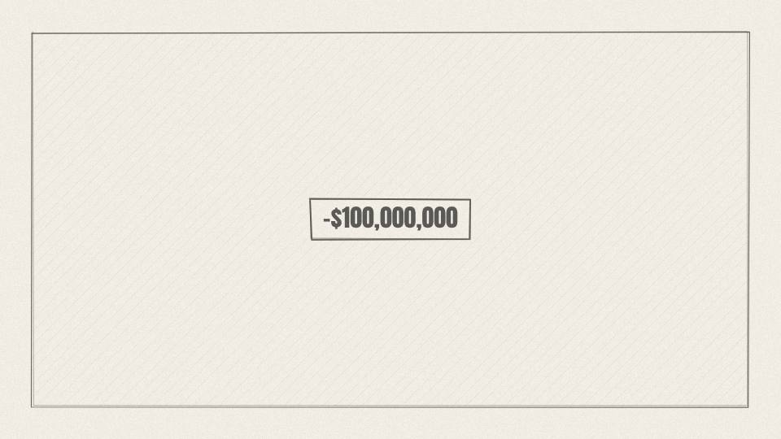
BR 2.06 CHART · 6.8 s
Act 2 · Act 2: The Loss
VISUAL
The red loss figure from the cold open, now full screen.
ON-SCREEN TEXT
-$100M
ANIMATION NOTES
Red loss number fills the screen; quick shake on impact; alarm drone.
VO
Fink's desk had bet the wrong way on rates. It lost about a hundred million dollars.
Notes:
VO: Fink's desk had bet the wrong way on rates. It lost about a hundred million dollars.
Visual: The red loss figure from the cold open, now full screen.
On-screen: -$100M
Animation: Red loss number fills the screen; quick shake on impact; alarm drone.

Slide 30
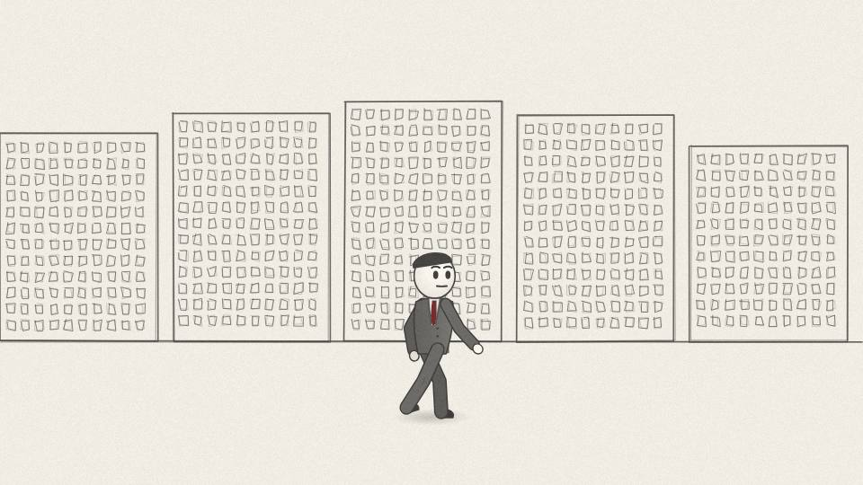
BR 2.07 MED · 7.2 s
Act 2 · Act 2: The Loss
VISUAL
Fink walks out of the building alone with a box under his arm, rain on the street.
ON-SCREEN TEXT
1988
ANIMATION NOTES
Rain falls; Fink walks out with a box, alone; puddle reflections; slow.
VO
The star became the man who lost a hundred million. Within two years, he left First Boston.
Notes:
VO: The star became the man who lost a hundred million. Within two years, he left First Boston.
Visual: Fink walks out of the building alone with a box under his arm, rain on the street.
On-screen: 1988
Animation: Rain falls; Fink walks out with a box, alone; puddle reflections; slow.

Slide 31
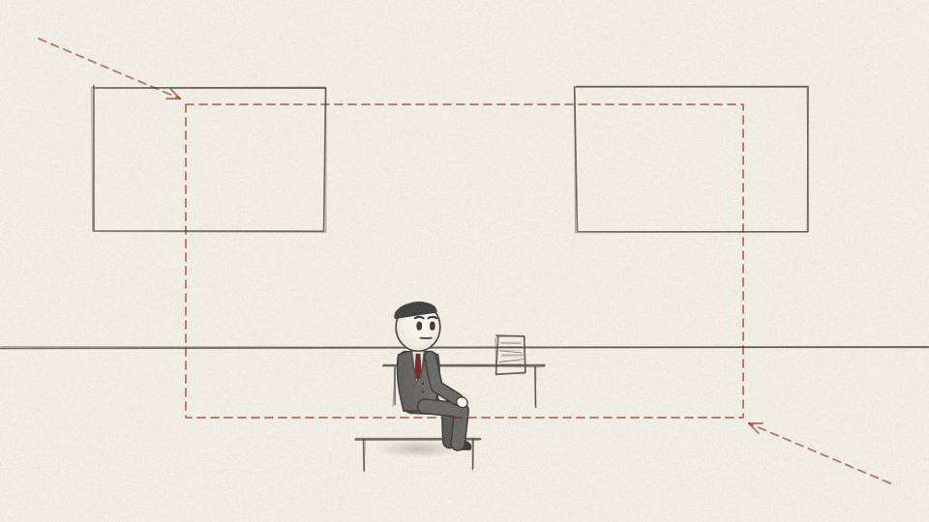
BR 2.08 CU · 10.6 s
Act 2 · Act 2: The Loss
VISUAL
Close on Fink in a dim office, looking at a blank notepad.
ON-SCREEN TEXT
RISK
ANIMATION NOTES
Dim office, slow push in; he stares at a blank notepad; a pen taps.
VO
He later said the lesson was simple. His team had been brilliant at making money and had no real idea how much risk it was carrying.
Notes:
VO: He later said the lesson was simple. His team had been brilliant at making money and had no real idea how much risk it was carrying.
Visual: Close on Fink in a dim office, looking at a blank notepad.
On-screen: RISK
Animation: Dim office, slow push in; he stares at a blank notepad; a pen taps.

Slide 32
ACT 3 · ACT 3: THE RISK MACHINE
8 frames · 1:04

Slide 33
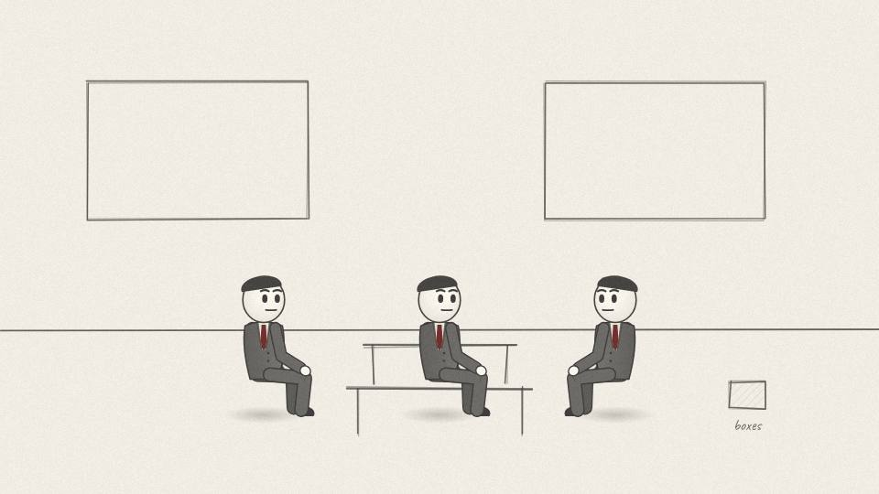
BR 3.01 WIDE · 9.4 s
Act 3 · Act 3: The Risk Machine
VISUAL
Late-80s office with boxes still packed; eight founders around a table.
ON-SCREEN TEXT
1988 · NEW YORK
ANIMATION NOTES
Eight founders around a table; heads turn to each speaker; boxes still taped.
VO
In 1988, Fink and a small group of partners set up a new firm inside the offices of the private equity company Blackstone.
Notes:
VO: In 1988, Fink and a small group of partners set up a new firm inside the offices of the private equity company Blackstone.
Visual: Late-80s office with boxes still packed; eight founders around a table.
On-screen: 1988 · NEW YORK
Animation: Eight founders around a table; heads turn to each speaker; boxes still taped.

Slide 34
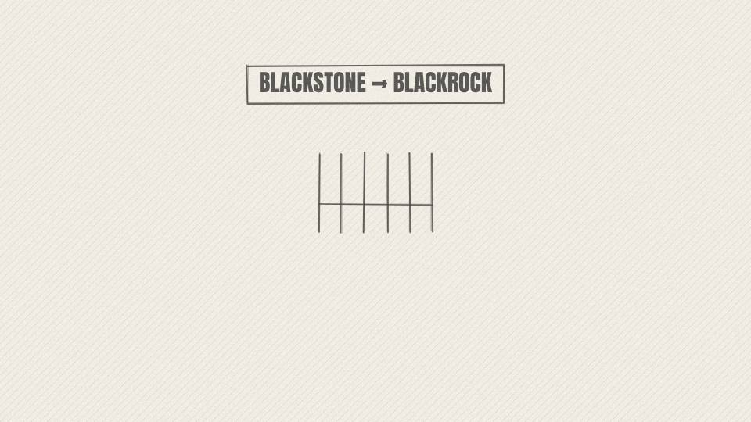
BR 3.02 CARD · 6.8 s
Act 3 · Act 3: The Risk Machine
VISUAL
Name plate on a door; 'BLACKSTONE FINANCIAL MANAGEMENT' is painted over with 'BLACKROCK'.
ON-SCREEN TEXT
BLACKROCK · 1992
ANIMATION NOTES
Painter's brush wipes the old name off the door; BLACKROCK paints in.
VO
It was called Blackstone Financial Management. A few years later it took a new name: BlackRock.
Notes:
VO: It was called Blackstone Financial Management. A few years later it took a new name: BlackRock.
Visual: Name plate on a door; 'BLACKSTONE FINANCIAL MANAGEMENT' is painted over with 'BLACKROCK'.
On-screen: BLACKROCK · 1992
Animation: Painter's brush wipes the old name off the door; BLACKROCK paints in.

Slide 35
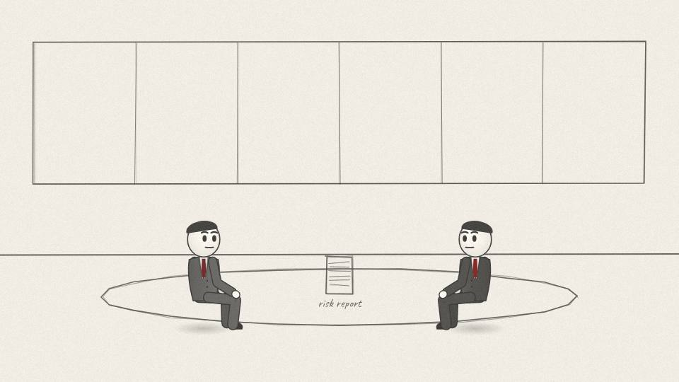
BR 3.03 MED · 9.8 s
Act 3 · Act 3: The Risk Machine
VISUAL
Fink at a client meeting, sliding a printed risk report across the table.
ON-SCREEN TEXT
—
ANIMATION NOTES
Fink slides the report across; the client picks it up and reads.
VO
The pitch to clients was about protection more than prediction: we will show you what could go wrong with your money before it happens.
Notes:
VO: The pitch to clients was about protection more than prediction: we will show you what could go wrong with your money before it happens.
Visual: Fink at a client meeting, sliding a printed risk report across the table.
On-screen: -
Animation: Fink slides the report across; the client picks it up and reads.

Slide 36
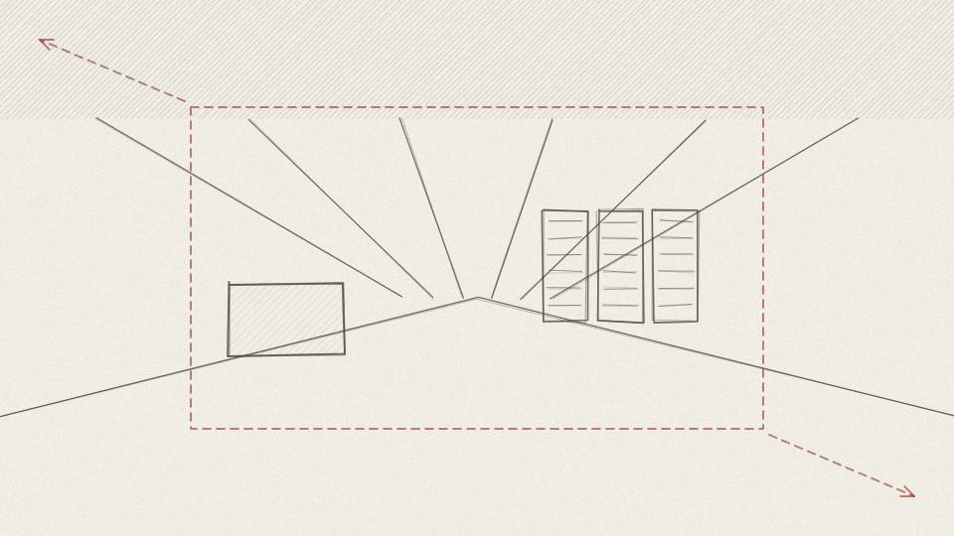
BR 3.04 PROP3D · 7.5 s
Act 3 · Act 3: The Risk Machine
VISUAL
3D early computer workstation on a desk, green text scrolling; then it multiplies into a modern server hall.
ON-SCREEN TEXT
ALADDIN
ANIMATION NOTES
Workstation rotates in 3D; green text scrolls; pull back as it multiplies into rows of servers.
VO
To do that, they built software that ran on a single workstation at first. They called it Aladdin.
Notes:
VO: To do that, they built software that ran on a single workstation at first. They called it Aladdin.
Visual: 3D early computer workstation on a desk, green text scrolling; then it multiplies into a modern server hall.
On-screen: ALADDIN
Animation: Workstation rotates in 3D; green text scrolls; pull back as it multiplies into rows of servers.

Slide 37
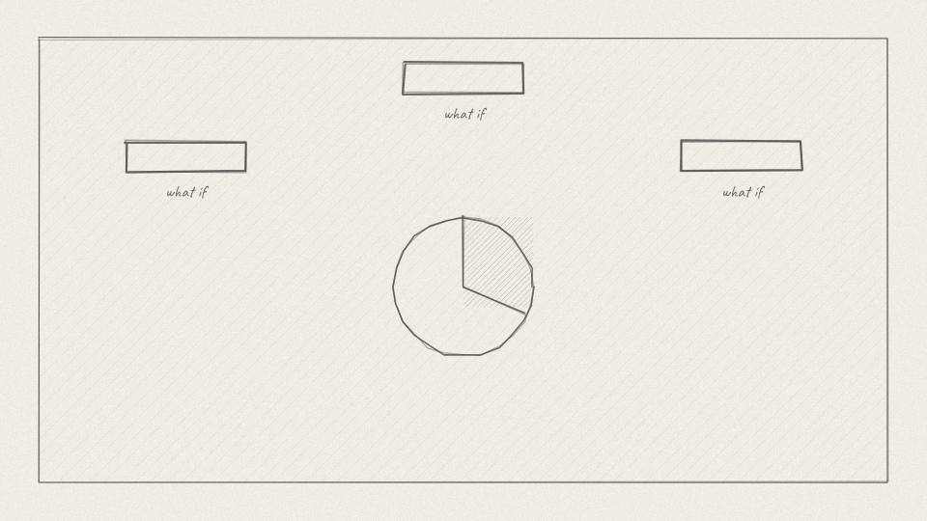
BR 3.05 MED · 9.1 s
Act 3 · Act 3: The Risk Machine
VISUAL
Three what-if cards orbit a portfolio pie; each card makes a slice shrink or grow.
ON-SCREEN TEXT
WHAT IF?
ANIMATION NOTES
Three what-if cards orbit the pie; each touch makes a slice shrink or grow.
VO
Aladdin asks 'what if?' across every holding. What if interest rates jump? What if oil collapses? What if borrowers stop paying?
Notes:
VO: Aladdin asks 'what if?' across every holding. What if interest rates jump? What if oil collapses? What if borrowers stop paying?
Visual: Three what-if cards orbit a portfolio pie; each card makes a slice shrink or grow.
On-screen: WHAT IF?
Animation: Three what-if cards orbit the pie; each touch makes a slice shrink or grow.

Slide 38
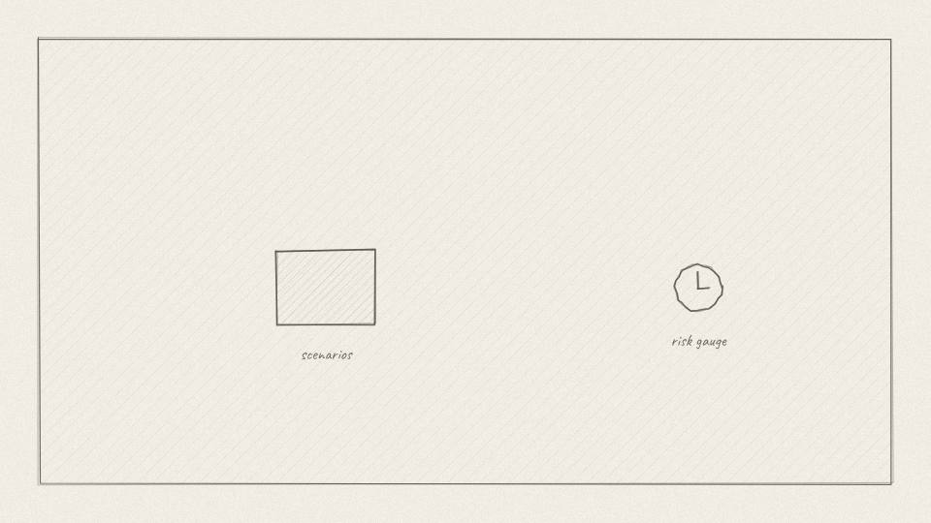
BR 3.06 CHART · 8.7 s
Act 3 · Act 3: The Risk Machine
VISUAL
A grid of tiny scenario tiles lights up, feeding a single risk gauge.
ON-SCREEN TEXT
—
ANIMATION NOTES
Hundreds of tiny tiles light up in waves and feed the gauge, whose needle swings.
VO
It runs thousands of scenarios and shows how each one would hit a portfolio, loan by loan and bond by bond.
Notes:
VO: It runs thousands of scenarios and shows how each one would hit a portfolio, loan by loan and bond by bond.
Visual: A grid of tiny scenario tiles lights up, feeding a single risk gauge.
On-screen: -
Animation: Hundreds of tiny tiles light up in waves and feed the gauge, whose needle swings.

Slide 39
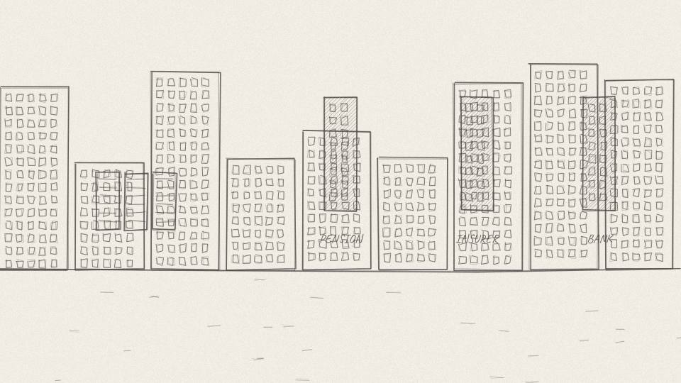
BR 3.07 MED · 6.8 s
Act 3 · Act 3: The Risk Machine
VISUAL
Lines spread from the server hall to buildings labeled PENSION FUND, INSURER, BANK.
ON-SCREEN TEXT
—
ANIMATION NOTES
Glowing lines spread from the server hall to each building, one by one.
VO
Over time BlackRock began renting Aladdin to other investors: pension funds, insurers, even rival asset managers.
Notes:
VO: Over time BlackRock began renting Aladdin to other investors: pension funds, insurers, even rival asset managers.
Visual: Lines spread from the server hall to buildings labeled PENSION FUND, INSURER, BANK.
On-screen: -
Animation: Glowing lines spread from the server hall to each building, one by one.

Slide 40
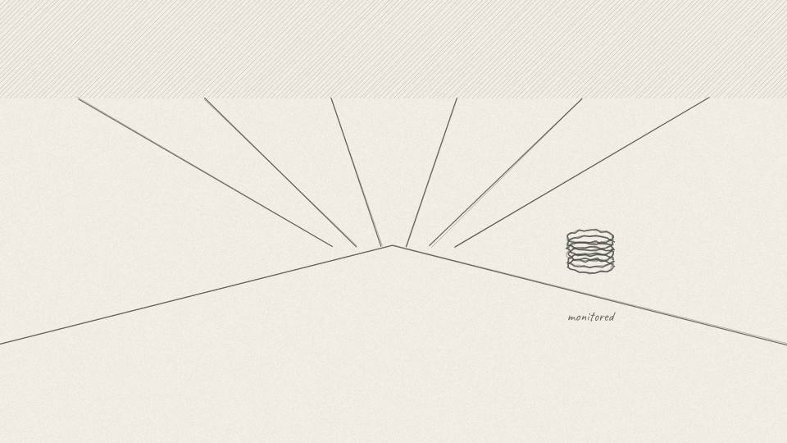
BR 3.08 CU · 6.0 s
Act 3 · Act 3: The Risk Machine
VISUAL
The server hall glows; the AUM meter adds a separate translucent stack for 'monitored'.
ON-SCREEN TEXT
TRILLIONS MONITORED
ANIMATION NOTES
The hall glows; a translucent second stack rises next to the AUM meter.
VO
Today it helps watch over trillions of dollars, much of it not BlackRock's own.
Notes:
VO: Today it helps watch over trillions of dollars, much of it not BlackRock's own.
Visual: The server hall glows; the AUM meter adds a separate translucent stack for 'monitored'.
On-screen: TRILLIONS MONITORED
Animation: The hall glows; a translucent second stack rises next to the AUM meter.

Slide 41
ACT 4 · ACT 4: 2008
8 frames · 1:08

Slide 42
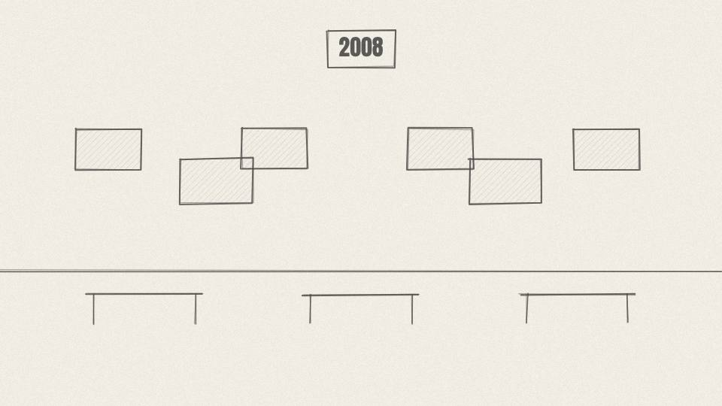
BR 4.01 WIDE · 6.8 s
Act 4 · Act 4: 2008
VISUAL
Wall Street at dusk; screens across a trading floor flash red.
ON-SCREEN TEXT
2008
ANIMATION NOTES
Screens flip to red in a cascade left to right; alarm tones; dusk light.
VO
In 2008, the same family of products Fink had helped pioneer blew up the world's banks.
Notes:
VO: In 2008, the same family of products Fink had helped pioneer blew up the world's banks.
Visual: Wall Street at dusk; screens across a trading floor flash red.
On-screen: 2008
Animation: Screens flip to red in a cascade left to right; alarm tones; dusk light.

Slide 43
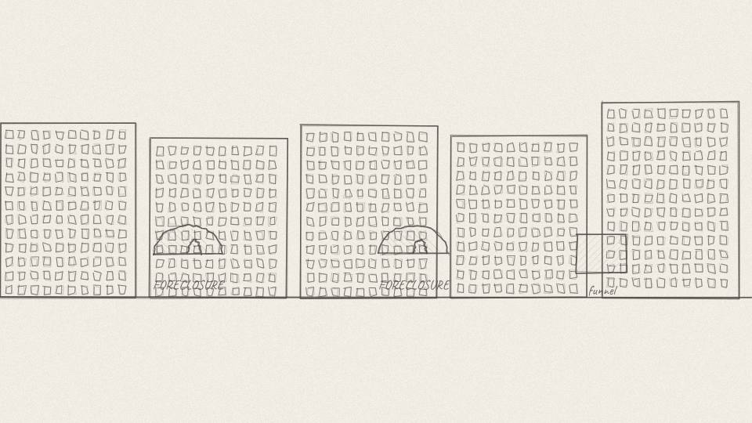
BR 4.02 MED · 7.9 s
Act 4 · Act 4: 2008
VISUAL
Houses with FORECLOSURE signs; the pool funnel from Act 1 now pours out torn certificates.
ON-SCREEN TEXT
—
ANIMATION NOTES
Signs pop up house by house; the funnel now spits out torn certificates.
VO
Millions of American mortgages had been pooled, sliced and resold, many of them to borrowers who couldn't keep paying.
Notes:
VO: Millions of American mortgages had been pooled, sliced and resold, many of them to borrowers who couldn't keep paying.
Visual: Houses with FORECLOSURE signs; the pool funnel from Act 1 now pours out torn certificates.
On-screen: -
Animation: Signs pop up house by house; the funnel now spits out torn certificates.

Slide 44
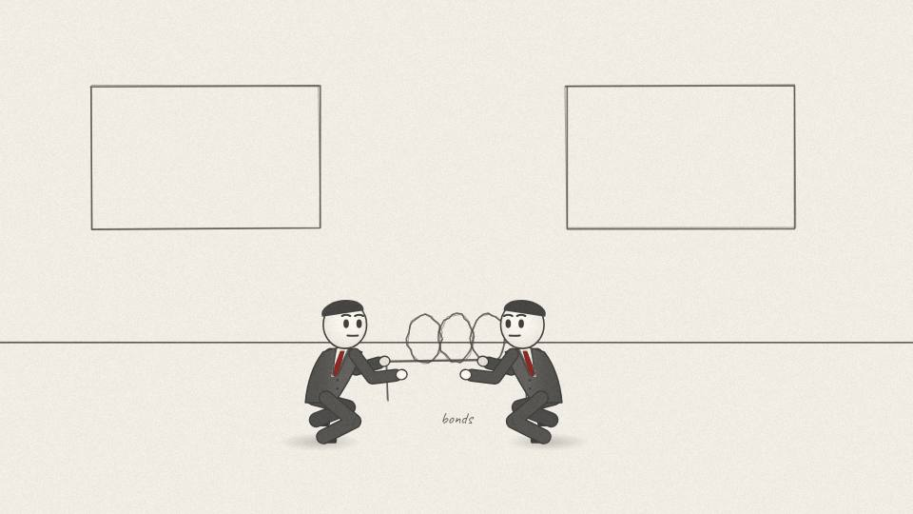
BR 4.03 MED · 7.2 s
Act 4 · Act 4: 2008
VISUAL
Bankers rifle through mountains of identical bond papers with magnifying glasses.
ON-SCREEN TEXT
WHAT IS IT WORTH?
ANIMATION NOTES
Bankers dig through paper mountains with magnifiers; paper flies.
VO
When house prices fell, nobody could tell which slices were still worth something and which were worthless.
Notes:
VO: When house prices fell, nobody could tell which slices were still worth something and which were worthless.
Visual: Bankers rifle through mountains of identical bond papers with magnifying glasses.
On-screen: WHAT IS IT WORTH?
Animation: Bankers dig through paper mountains with magnifiers; paper flies.

Slide 45
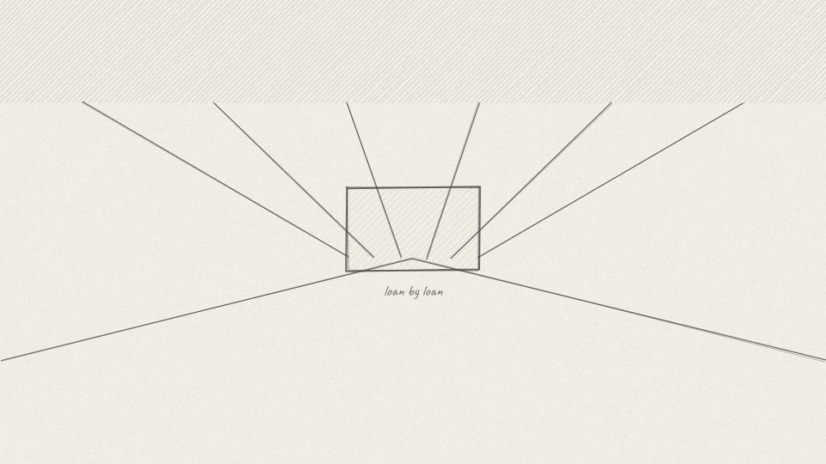
BR 4.04 CU · 8.3 s
Act 4 · Act 4: 2008
VISUAL
The Aladdin server hall hums; one screen shows a loan-by-loan breakdown.
ON-SCREEN TEXT
—
ANIMATION NOTES
One screen zooms to a loan-by-loan list scrolling fast; hum SFX.
VO
BlackRock had something almost nobody else had: twenty years of data and a machine built to answer exactly that question.
Notes:
VO: BlackRock had something almost nobody else had: twenty years of data and a machine built to answer exactly that question.
Visual: The Aladdin server hall hums; one screen shows a loan-by-loan breakdown.
On-screen: -
Animation: One screen zooms to a loan-by-loan list scrolling fast; hum SFX.

Slide 46
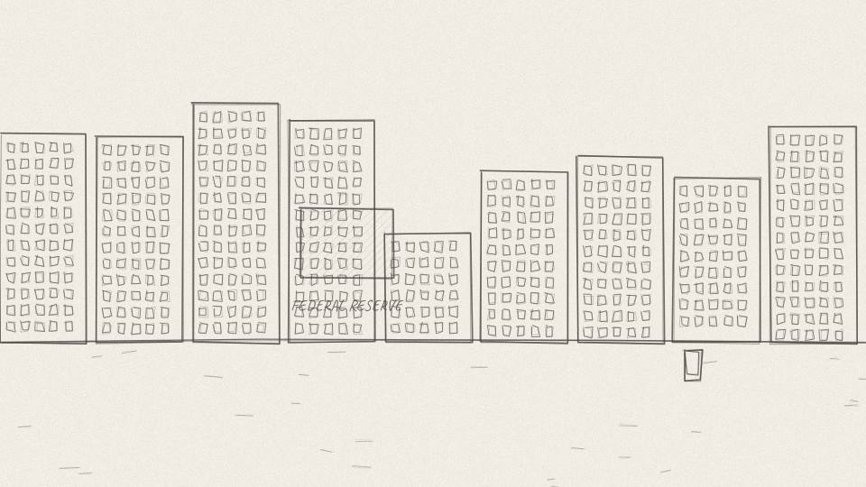
BR 4.05 MED · 12.8 s
Act 4 · Act 4: 2008
VISUAL
Painted Federal Reserve building; a phone rings on Fink's desk.
ON-SCREEN TEXT
HIRED BY WASHINGTON
ANIMATION NOTES
Painted Fed building; cut to the phone on Fink's desk ringing and shaking.
VO
So the US government hired it. The Federal Reserve and the Treasury brought BlackRock in to value and manage the toxic assets of Bear Stearns and AIG, and to advise on others.
Notes:
VO: So the US government hired it. The Federal Reserve and the Treasury brought BlackRock in to value and manage the toxic assets of Bear Stearns and AIG, and to advise on others.
Visual: Painted Federal Reserve building; a phone rings on Fink's desk.
On-screen: HIRED BY WASHINGTON
Animation: Painted Fed building; cut to the phone on Fink's desk ringing and shaking.

Slide 47
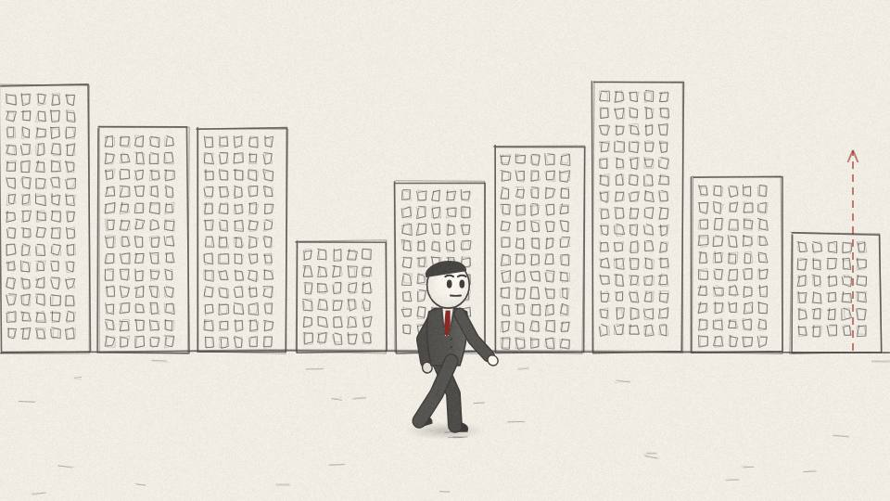
BR 4.06 CU · 8.3 s
Act 4 · Act 4: 2008
VISUAL
Fink walks up the steps of a federal building.
ON-SCREEN TEXT
—
ANIMATION NOTES
Fink walks up the steps; tilt up with him to the columns.
VO
The firm that had grown out of one banker's loss became the firm Washington called to clean up the losses.
Notes:
VO: The firm that had grown out of one banker's loss became the firm Washington called to clean up the losses.
Visual: Fink walks up the steps of a federal building.
On-screen: -
Animation: Fink walks up the steps; tilt up with him to the columns.

Slide 48
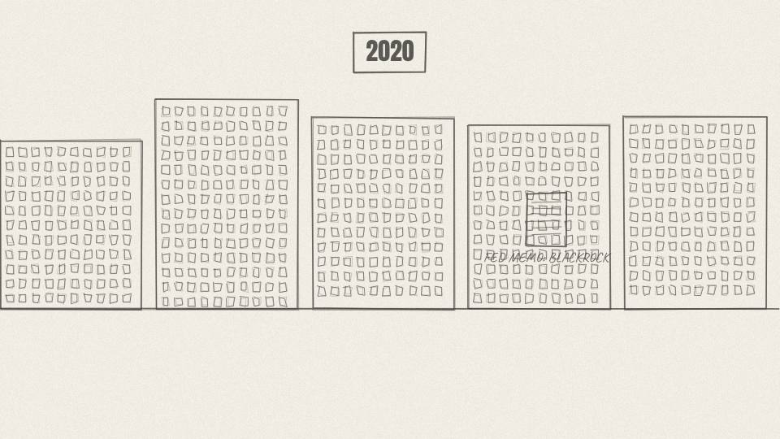
BR 4.07 MED · 9.8 s
Act 4 · Act 4: 2008
VISUAL
2020 empty city streets; a Fed memo with 'BLACKROCK' as manager; masks on the trading floor.
ON-SCREEN TEXT
2020
ANIMATION NOTES
Empty streets; a memo slides in with BLACKROCK highlighted; masked traders.
VO
It happened again in 2020. When Covid froze the markets, the Federal Reserve hired BlackRock to run its emergency programme for buying corporate bonds.
Notes:
VO: It happened again in 2020. When Covid froze the markets, the Federal Reserve hired BlackRock to run its emergency programme for buying corporate bonds.
Visual: 2020 empty city streets; a Fed memo with 'BLACKROCK' as manager; masks on the trading floor.
On-screen: 2020
Animation: Empty streets; a memo slides in with BLACKROCK highlighted; masked traders.

Slide 49
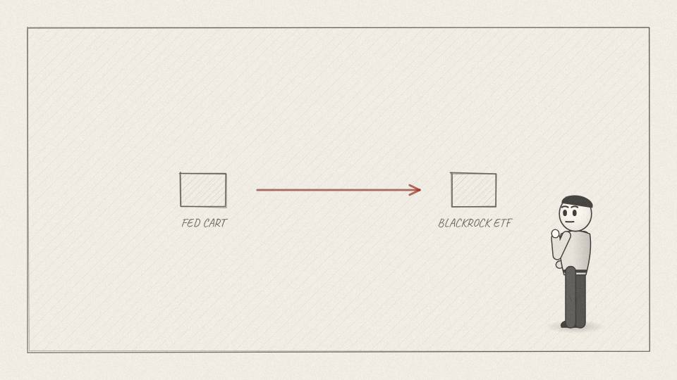
BR 4.08 CU · 7.5 s
Act 4 · Act 4: 2008
VISUAL
A thin line connects the Fed's shopping cart to a BlackRock ETF tile; a raised-eyebrow cartoon reporter.
ON-SCREEN TEXT
—
ANIMATION NOTES
A thin line draws from the cart to the ETF tile; a cartoon reporter raises one eyebrow.
VO
Some of that buying went into BlackRock's own bond ETFs, under rules the Fed had approved. Critics noticed.
Notes:
VO: Some of that buying went into BlackRock's own bond ETFs, under rules the Fed had approved. Critics noticed.
Visual: A thin line connects the Fed's shopping cart to a BlackRock ETF tile; a raised-eyebrow cartoon reporter.
On-screen: -
Animation: A thin line draws from the cart to the ETF tile; a cartoon reporter raises one eyebrow.

Slide 50
ACT 5 · ACT 5: THE DEAL THAT CHANGED EVERYTHING
5 frames · 0:37

Slide 51
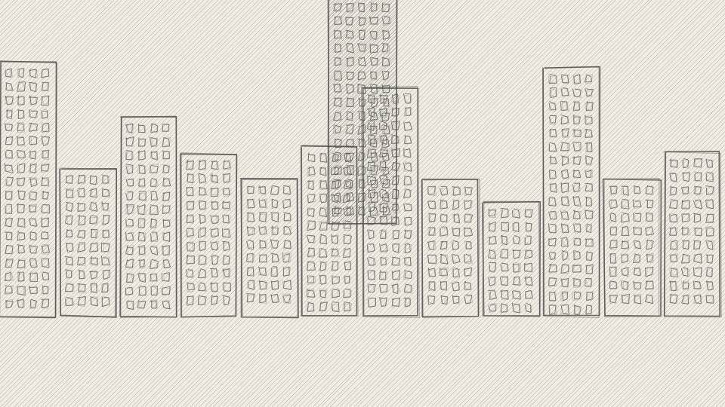
BR 5.01 MED · 8.7 s
Act 5 · Act 5: The Deal That Changed Everything
VISUAL
Empty trading floors; BlackRock's tower is the only one lit.
ON-SCREEN TEXT
2009
ANIMATION NOTES
Other towers go dark one by one; only BlackRock stays lit.
VO
Then, in 2009, while most of Wall Street was still on its knees, BlackRock made the biggest bet in its history.
Notes:
VO: Then, in 2009, while most of Wall Street was still on its knees, BlackRock made the biggest bet in its history.
Visual: Empty trading floors; BlackRock's tower is the only one lit.
On-screen: 2009
Animation: Other towers go dark one by one; only BlackRock stays lit.

Slide 52
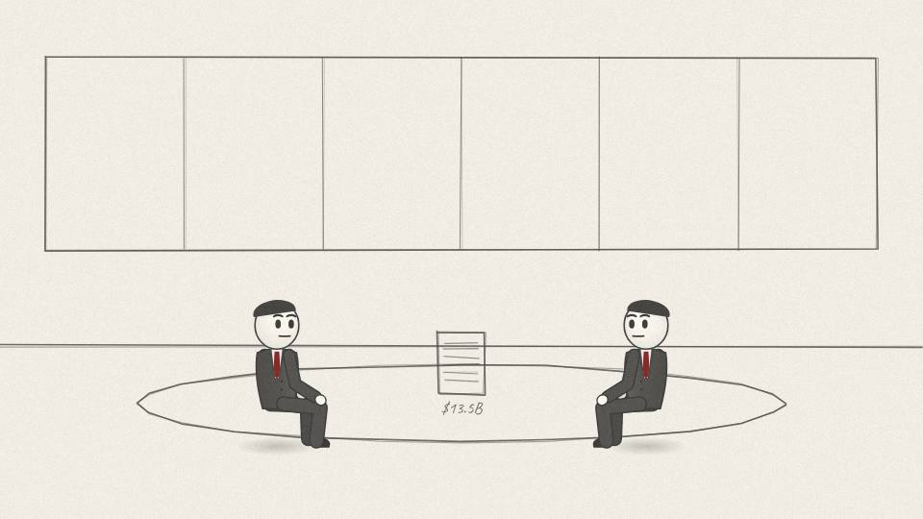
BR 5.02 MED · 7.5 s
Act 5 · Act 5: The Deal That Changed Everything
VISUAL
Two negotiating tables join; a contract with '$13.5B' is signed.
ON-SCREEN TEXT
$13.5 BILLION
ANIMATION NOTES
Two tables slide together; a pen signs the contract; signature draws on.
VO
It bought Barclays Global Investors from the British bank Barclays for about thirteen and a half billion dollars.
Notes:
VO: It bought Barclays Global Investors from the British bank Barclays for about thirteen and a half billion dollars.
Visual: Two negotiating tables join; a contract with '$13.5B' is signed.
On-screen: $13.5 BILLION
Animation: Two tables slide together; a pen signs the contract; signature draws on.

Slide 53
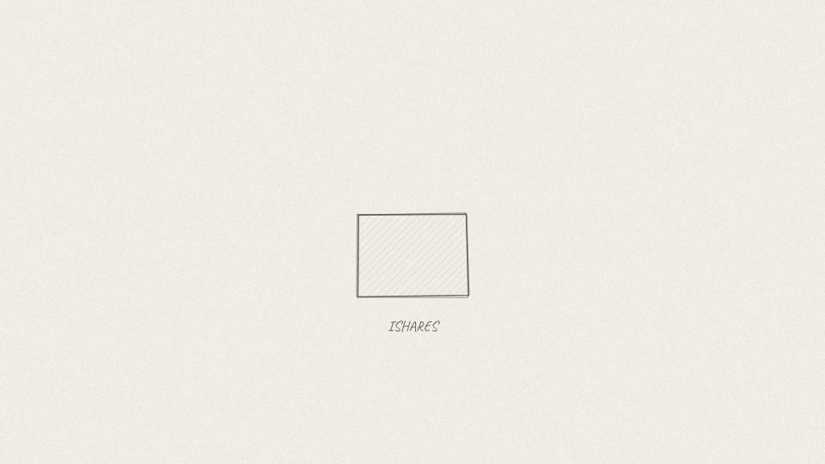
BR 5.03 CU · 7.9 s
Act 5 · Act 5: The Deal That Changed Everything
VISUAL
A 3D box labeled ISHARES opens to reveal rows of ETF tiles.
ON-SCREEN TEXT
iSHARES
ANIMATION NOTES
3D box lid opens; ETF tiles rise out in rows.
VO
Inside that deal was a business called iShares, the biggest maker of exchange-traded funds, or ETFs, in the world.
Notes:
VO: Inside that deal was a business called iShares, the biggest maker of exchange-traded funds, or ETFs, in the world.
Visual: A 3D box labeled ISHARES opens to reveal rows of ETF tiles.
On-screen: iSHARES
Animation: 3D box lid opens; ETF tiles rise out in rows.

Slide 54
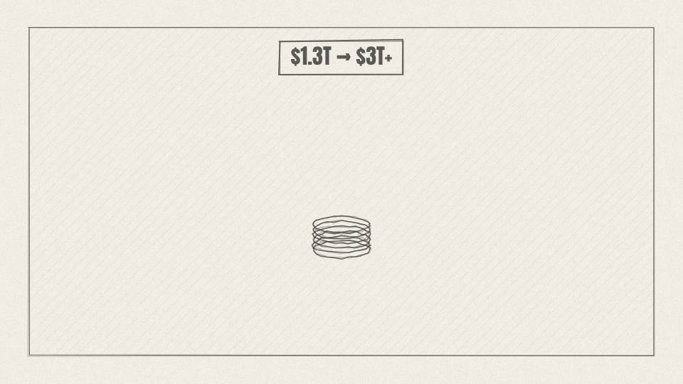
BR 5.04 CHART · 6.8 s
Act 5 · Act 5: The Deal That Changed Everything
VISUAL
AUM meter jumps from ~$1.3T to $3T+.
ON-SCREEN TEXT
$3 TRILLION
ANIMATION NOTES
AUM meter jumps with a big counter roll; coin rush SFX.
VO
Overnight, BlackRock went from managing about one point three trillion dollars to more than three trillion.
Notes:
VO: Overnight, BlackRock went from managing about one point three trillion dollars to more than three trillion.
Visual: AUM meter jumps from ~$1.3T to $3T+.
On-screen: $3 TRILLION
Animation: AUM meter jumps with a big counter roll; coin rush SFX.

Slide 55
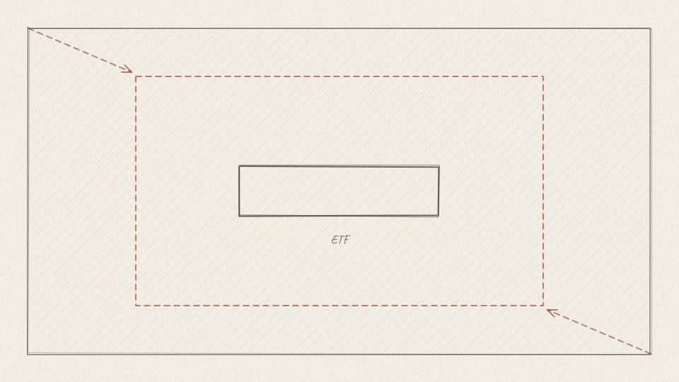
BR 5.05 CU · 6.8 s
Act 5 · Act 5: The Deal That Changed Everything
VISUAL
Push into a single ETF tile.
ON-SCREEN TEXT
—
ANIMATION NOTES
Push into a single ETF tile until it fills the frame (transition).
VO
To see why that mattered so much, you need to understand what an ETF actually is.
Notes:
VO: To see why that mattered so much, you need to understand what an ETF actually is.
Visual: Push into a single ETF tile.
On-screen: -
Animation: Push into a single ETF tile until it fills the frame (transition).

Slide 56
ACT 6 · ACT 6: HOW AN ETF WORKS
9 frames · 1:18

Slide 57
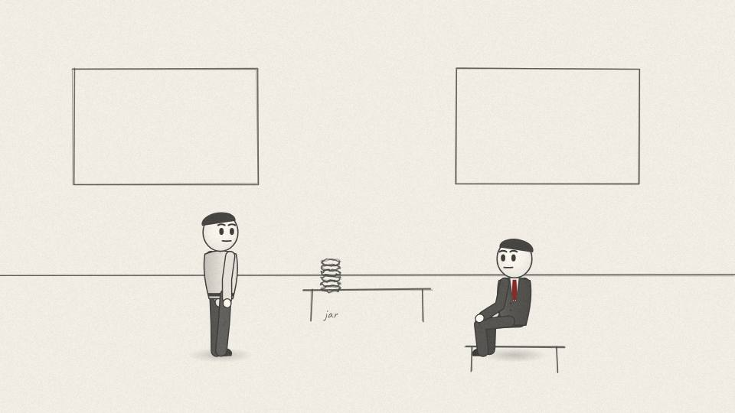
BR 6.01 MED · 8.7 s
Act 6 · Act 6: How an ETF Works
VISUAL
An investor hands a jar of coins to a fund manager in a suit behind a big desk.
ON-SCREEN TEXT
—
ANIMATION NOTES
Investor hands the coin jar over the desk; manager takes it with a smile.
VO
For decades, the normal way to invest was to hand your savings to a fund manager who picked stocks for you.
Notes:
VO: For decades, the normal way to invest was to hand your savings to a fund manager who picked stocks for you.
Visual: An investor hands a jar of coins to a fund manager in a suit behind a big desk.
On-screen: -
Animation: Investor hands the coin jar over the desk; manager takes it with a smile.

Slide 58
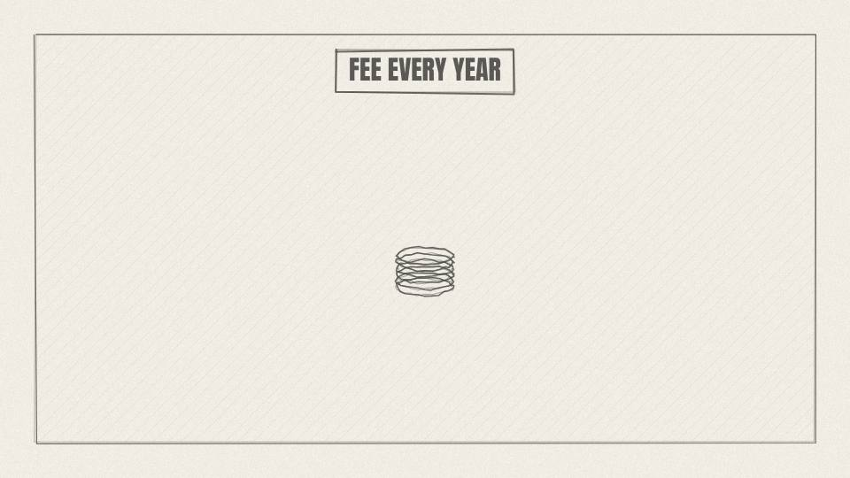
BR 6.02 CHART · 7.5 s
Act 6 · Act 6: How an ETF Works
VISUAL
A fee meter takes a slice off the coin jar every year.
ON-SCREEN TEXT
~1%+ A YEAR
ANIMATION NOTES
A slice is cut out of the jar each year; a calendar ticks 1, 2, 3.
VO
You paid a yearly fee, often around one percent or more, whether the manager did well or not.
Notes:
VO: You paid a yearly fee, often around one percent or more, whether the manager did well or not.
Visual: A fee meter takes a slice off the coin jar every year.
On-screen: ~1%+ A YEAR
Animation: A slice is cut out of the jar each year; a calendar ticks 1, 2, 3.

Slide 59
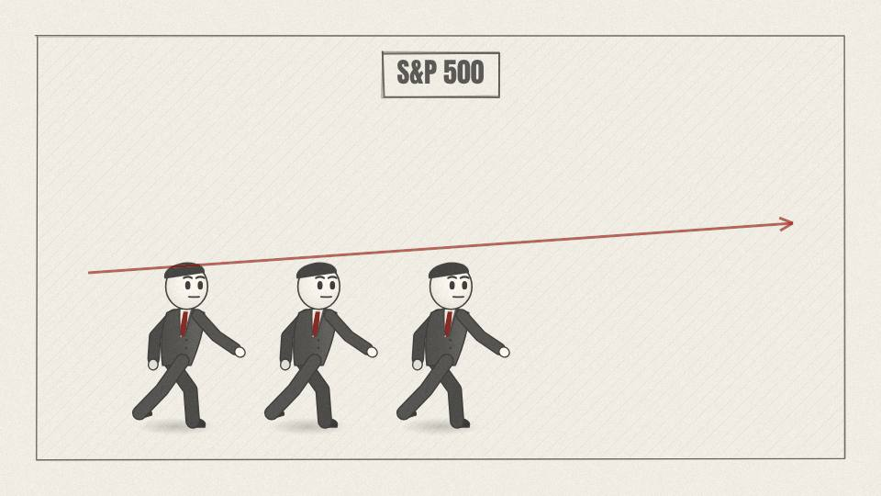
BR 6.03 CHART · 10.6 s
Act 6 · Act 6: How an ETF Works
VISUAL
Ten little fund-manager figures race a line labeled S&P 500; nine fall behind.
ON-SCREEN TEXT
~9 IN 10 LOSE
ANIMATION NOTES
Ten managers run beside the index line; nine slow and drop behind (run cycles).
VO
And most managers didn't beat the market. Over fifteen years, around nine in ten large US stock funds did worse than the S&P 500 index.
Notes:
VO: And most managers didn't beat the market. Over fifteen years, around nine in ten large US stock funds did worse than the S&P 500 index.
Visual: Ten little fund-manager figures race a line labeled S&P 500; nine fall behind.
On-screen: ~9 IN 10 LOSE
Animation: Ten managers run beside the index line; nine slow and drop behind (run cycles).

Slide 60
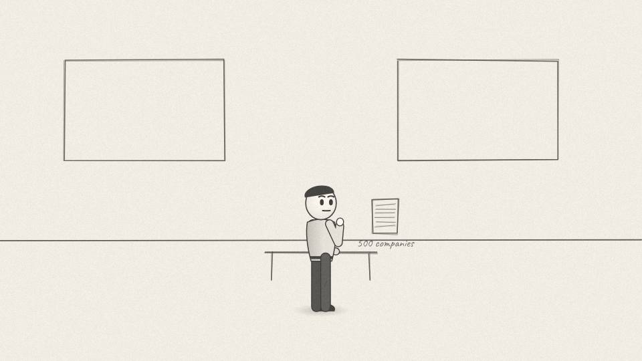
BR 6.04 MED · 8.3 s
Act 6 · Act 6: How an ETF Works
VISUAL
A light bulb over a figure holding a list of 500 companies.
ON-SCREEN TEXT
—
ANIMATION NOTES
A bulb flicks on above his head; he holds up the list.
VO
So someone asked an obvious question. If the index is so hard to beat, why not just buy the index?
Notes:
VO: So someone asked an obvious question. If the index is so hard to beat, why not just buy the index?
Visual: A light bulb over a figure holding a list of 500 companies.
On-screen: -
Animation: A bulb flicks on above his head; he holds up the list.

Slide 61
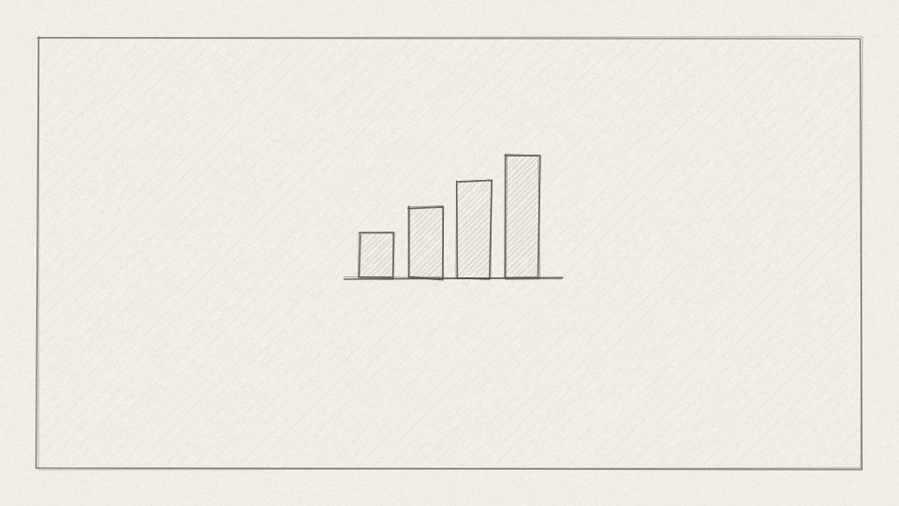
BR 6.05 CHART · 10.2 s
Act 6 · Act 6: How an ETF Works
VISUAL
A tall list scrolls; the top entries have the widest bars.
ON-SCREEN TEXT
S&P 500
ANIMATION NOTES
A tall list scrolls upward; top entries have the widest bars.
VO
The S&P 500 is a list of five hundred of the biggest US companies, each with a weight. Bigger companies get a bigger share.
Notes:
VO: The S&P 500 is a list of five hundred of the biggest US companies, each with a weight. Bigger companies get a bigger share.
Visual: A tall list scrolls; the top entries have the widest bars.
On-screen: S&P 500
Animation: A tall list scrolls upward; top entries have the widest bars.

Slide 62

BR 6.06 CHART · 10.2 s
Act 6 · Act 6: How an ETF Works
VISUAL
$10,000 pours into a funnel and splits into 500 thin streams of different widths.
ON-SCREEN TEXT
$10,000 → 500 COMPANIES
ANIMATION NOTES
Money pours into the funnel and splits into 500 thin streams.
VO
An index fund copies that list exactly. Put in ten thousand dollars, and a program splits it by those weights. No meetings. No stock picking.
Notes:
VO: An index fund copies that list exactly. Put in ten thousand dollars, and a program splits it by those weights. No meetings. No stock picking.
Visual: $10,000 pours into a funnel and splits into 500 thin streams of different widths.
On-screen: $10,000 → 500 COMPANIES
Animation: Money pours into the funnel and splits into 500 thin streams.

Slide 63

BR 6.07 MED · 7.2 s
Act 6 · Act 6: How an ETF Works
VISUAL
The investor's jar rises and falls in lockstep with the index line.
ON-SCREEN TEXT
—
ANIMATION NOTES
The jar rises and falls in step with the index line.
VO
If the market rises five percent, you rise five percent. If it falls, everyone falls with you.
Notes:
VO: If the market rises five percent, you rise five percent. If it falls, everyone falls with you.
Visual: The investor's jar rises and falls in lockstep with the index line.
On-screen: -
Animation: The jar rises and falls in step with the index line.

Slide 64

BR 6.08 CHART · 10.2 s
Act 6 · Act 6: How an ETF Works
VISUAL
Fee comparison: 1% vs 0.03%; at $1 million, $10,000 a year vs $300.
ON-SCREEN TEXT
1% vs 0.03%
ANIMATION NOTES
Two fee bars grow; the cheap one stays tiny; numbers count.
VO
Because there's no star manager to pay, the fee can be tiny. BlackRock's main S&P 500 ETF charges about three hundredths of one percent.
Notes:
VO: Because there's no star manager to pay, the fee can be tiny. BlackRock's main S&P 500 ETF charges about three hundredths of one percent.
Visual: Fee comparison: 1% vs 0.03%; at $1 million, $10,000 a year vs $300.
On-screen: 1% vs 0.03%
Animation: Two fee bars grow; the cheap one stays tiny; numbers count.

Slide 65

BR 6.09 CU · 5.3 s
Act 6 · Act 6: How an ETF Works
VISUAL
The ETF tile glows; a line of ordinary savers forms behind it.
ON-SCREEN TEXT
—
ANIMATION NOTES
The tile glows; ordinary savers walk in and form a line behind it.
VO
That's the whole product. Cheap, simple, and very hard to argue with.
Notes:
VO: That's the whole product. Cheap, simple, and very hard to argue with.
Visual: The ETF tile glows; a line of ordinary savers forms behind it.
On-screen: -
Animation: The tile glows; ordinary savers walk in and form a line behind it.

Slide 66
ACT 7 · ACT 7: OWNING A PIECE OF EVERYTHING
8 frames · 1:09

Slide 67

BR 7.01 WIDE · 8.7 s
Act 7 · Act 7: Owning a Piece of Everything
VISUAL
Rivers of coins flow from houses, pension funds and phones into the black tower.
ON-SCREEN TEXT
—
ANIMATION NOTES
Rivers of coins flow from houses, funds and phones into the tower (particle streams).
VO
Over the next fifteen years, Americans moved trillions of dollars into index funds. A big share of it went to BlackRock.
Notes:
VO: Over the next fifteen years, Americans moved trillions of dollars into index funds. A big share of it went to BlackRock.
Visual: Rivers of coins flow from houses, pension funds and phones into the black tower.
On-screen: -
Animation: Rivers of coins flow from houses, funds and phones into the tower (particle streams).

Slide 68

BR 7.02 CHART · 4.5 s
Act 7 · Act 7: Owning a Piece of Everything
VISUAL
AUM meter: the iShares portion fills to $6T+.
ON-SCREEN TEXT
iSHARES: $6T+
ANIMATION NOTES
The iShares slice of the meter fills to $6T+.
VO
By 2026, iShares alone held more than six trillion dollars.
Notes:
VO: By 2026, iShares alone held more than six trillion dollars.
Visual: AUM meter: the iShares portion fills to $6T+.
On-screen: iSHARES: $6T+
Animation: The iShares slice of the meter fills to $6T+.

Slide 69

BR 7.03 CU · 8.3 s
Act 7 · Act 7: Owning a Piece of Everything
VISUAL
A single small coin multiplies into a mountain.
ON-SCREEN TEXT
—
ANIMATION NOTES
One coin multiplies, doubling on beats, into a mountain.
VO
Each fee is tiny. But a tiny fee on trillions of dollars, running automatically every day, is an enormous business.
Notes:
VO: Each fee is tiny. But a tiny fee on trillions of dollars, running automatically every day, is an enormous business.
Visual: A single small coin multiplies into a mountain.
On-screen: -
Animation: One coin multiplies, doubling on beats, into a mountain.

Slide 70

BR 7.04 MED · 9.4 s
Act 7 · Act 7: Owning a Piece of Everything
VISUAL
One dollar splits into 500 slivers that fly into company tiles.
ON-SCREEN TEXT
—
ANIMATION NOTES
A dollar splits into slivers that fly into company tiles.
VO
And here's the part that matters. Every dollar that goes into an index fund buys a slice of every company in the index.
Notes:
VO: And here's the part that matters. Every dollar that goes into an index fund buys a slice of every company in the index.
Visual: One dollar splits into 500 slivers that fly into company tiles.
On-screen: -
Animation: A dollar splits into slivers that fly into company tiles.

Slide 71

BR 7.05 CHART · 10.2 s
Act 7 · Act 7: Owning a Piece of Everything
VISUAL
Ownership wedges grow on the three tiles from the cold open.
ON-SCREEN TEXT
~7-8% EACH
ANIMATION NOTES
The ownership wedges from the cold open grow bigger.
VO
That's how BlackRock ends up holding around seven to eight percent of Nvidia, Microsoft and Apple. Nobody at BlackRock chose those stocks. The index did.
Notes:
VO: That's how BlackRock ends up holding around seven to eight percent of Nvidia, Microsoft and Apple. Nobody at BlackRock chose those stocks. The index did.
Visual: Ownership wedges grow on the three tiles from the cold open.
On-screen: ~7-8% EACH
Animation: The ownership wedges from the cold open grow bigger.

Slide 72

BR 7.06 MED · 8.3 s
Act 7 · Act 7: Owning a Piece of Everything
VISUAL
Three towers stand side by side on the skyline.
ON-SCREEN TEXT
THE BIG THREE
ANIMATION NOTES
Three towers rise from the ground side by side.
VO
It isn't alone. Two other giants, Vanguard and State Street, grew the same way. Together they're called the Big Three.
Notes:
VO: It isn't alone. Two other giants, Vanguard and State Street, grew the same way. Together they're called the Big Three.
Visual: Three towers stand side by side on the skyline.
On-screen: THE BIG THREE
Animation: Three towers rise from the ground side by side.

Slide 73

BR 7.07 CHART · 11.7 s
Act 7 · Act 7: Owning a Piece of Everything
VISUAL
S&P 500 grid of 500 dots; about 88% turn dark.
ON-SCREEN TEXT
~88% OF THE S&P 500
ANIMATION NOTES
Grid of 500 dots; about 88% turn dark in a ripple.
VO
Researchers at the University of Amsterdam found that, taken together, the Big Three were the largest shareholder in about nine out of ten companies in the S&P 500.
Notes:
VO: Researchers at the University of Amsterdam found that, taken together, the Big Three were the largest shareholder in about nine out of ten companies in the S&P 500.
Visual: S&P 500 grid of 500 dots; about 88% turn dark.
On-screen: ~88% OF THE S&P 500
Animation: Grid of 500 dots; about 88% turn dark in a ripple.

Slide 74

BR 7.08 CU · 7.9 s
Act 7 · Act 7: Owning a Piece of Everything
VISUAL
A shareholder meeting hall; a giant ballot box; the Big Three drop in thick stacks of ballots.
ON-SCREEN TEXT
VOTES
ANIMATION NOTES
Three thick ballot stacks drop into the box with heavy thuds.
VO
And shareholders get votes. On who sits on company boards, on how executives are paid, on big strategy questions.
Notes:
VO: And shareholders get votes. On who sits on company boards, on how executives are paid, on big strategy questions.
Visual: A shareholder meeting hall; a giant ballot box; the Big Three drop in thick stacks of ballots.
On-screen: VOTES
Animation: Three thick ballot stacks drop into the box with heavy thuds.

Slide 75
ACT 8 · ACT 8: THE LETTERS
6 frames · 0:55

Slide 76

BR 8.01 MED · 7.2 s
Act 8 · Act 8: The Letters
VISUAL
Fink at a desk writing; envelopes fly out to hundreds of company towers.
ON-SCREEN TEXT
THE ANNUAL LETTER
ANIMATION NOTES
Fink writes; envelopes fly out to hundreds of tiny towers.
VO
Every January, Larry Fink writes a public letter to the bosses of the companies BlackRock invests in.
Notes:
VO: Every January, Larry Fink writes a public letter to the bosses of the companies BlackRock invests in.
Visual: Fink at a desk writing; envelopes fly out to hundreds of company towers.
On-screen: THE ANNUAL LETTER
Animation: Fink writes; envelopes fly out to hundreds of tiny towers.

Slide 77

BR 8.02 CARD · 9.8 s
Act 8 · Act 8: The Letters
VISUAL
Letter page close-up with that line highlighted.
ON-SCREEN TEXT
CLIMATE RISK IS INVESTMENT RISK
ANIMATION NOTES
Letter close-up; a highlighter sweeps the key line.
VO
In 2020, the letter said that climate risk is investment risk, and that BlackRock would put sustainability at the centre of how it invests.
Notes:
VO: In 2020, the letter said that climate risk is investment risk, and that BlackRock would put sustainability at the centre of how it invests.
Visual: Letter page close-up with that line highlighted.
On-screen: CLIMATE RISK IS INVESTMENT RISK
Animation: Letter close-up; a highlighter sweeps the key line.

Slide 78

BR 8.03 MED · 5.3 s
Act 8 · Act 8: The Letters
VISUAL
Boardroom of executives reading the letter, nervous glances.
ON-SCREEN TEXT
—
ANIMATION NOTES
Executives read and glance at each other nervously.
VO
When the biggest owner in the market says that, every boardroom listens.
Notes:
VO: When the biggest owner in the market says that, every boardroom listens.
Visual: Boardroom of executives reading the letter, nervous glances.
On-screen: -
Animation: Executives read and glance at each other nervously.

Slide 79

BR 8.04 MED · 11.3 s
Act 8 · Act 8: The Letters
VISUAL
A state treasurer's office; coins flow out of the black tower back to a state building.
ON-SCREEN TEXT
FLORIDA: -$2B
ANIMATION NOTES
Coins flow out of the tower back to the state building.
VO
Then the backlash came from the other side. Republican-led states called it political, and some pulled money out. Florida alone moved about two billion dollars away in 2022.
Notes:
VO: Then the backlash came from the other side. Republican-led states called it political, and some pulled money out. Florida alone moved about two billion dollars away in 2022.
Visual: A state treasurer's office; coins flow out of the black tower back to a state building.
On-screen: FLORIDA: -$2B
Animation: Coins flow out of the tower back to the state building.

Slide 80

BR 8.05 MED · 10.9 s
Act 8 · Act 8: The Letters
VISUAL
A voting slip passes from BlackRock's hand to many small hands; a NET ZERO banner is rolled up.
ON-SCREEN TEXT
2025
ANIMATION NOTES
Voting slip passes to many small hands; the banner rolls up.
VO
BlackRock changed its tone. It let more of its fund investors cast their own votes, and in 2025 it left the climate alliance Net Zero Asset Managers.
Notes:
VO: BlackRock changed its tone. It let more of its fund investors cast their own votes, and in 2025 it left the climate alliance Net Zero Asset Managers.
Visual: A voting slip passes from BlackRock's hand to many small hands; a NET ZERO banner is rolled up.
On-screen: 2025
Animation: Voting slip passes to many small hands; the banner rolls up.

Slide 81

BR 8.06 CU · 10.6 s
Act 8 · Act 8: The Letters
VISUAL
The tower stands between two crowds holding opposite signs.
ON-SCREEN TEXT
—
ANIMATION NOTES
Two crowds with opposite signs; the tower stands between them; slow push.
VO
Attacked from the left for not doing enough, and from the right for doing too much. That's what happens when you own a slice of everyone.
Notes:
VO: Attacked from the left for not doing enough, and from the right for doing too much. That's what happens when you own a slice of everyone.
Visual: The tower stands between two crowds holding opposite signs.
On-screen: -
Animation: Two crowds with opposite signs; the tower stands between them; slow push.

Slide 82
ACT 9 · ACT 9: THE COAL CASE
7 frames · 1:06

Slide 83

BR 9.01 MED · 9.1 s
Act 9 · Act 9: The Coal Case
VISUAL
Painted Texas courthouse; a thick complaint lands on a judge's bench.
ON-SCREEN TEXT
TEXAS v. BLACKROCK · 2024
ANIMATION NOTES
Painted Texas courthouse; the thick complaint lands on the bench with a thud.
VO
That voting power is where the trouble starts. In late 2024, Texas and ten other states sued BlackRock, Vanguard and State Street.
Notes:
VO: That voting power is where the trouble starts. In late 2024, Texas and ten other states sued BlackRock, Vanguard and State Street.
Visual: Painted Texas courthouse; a thick complaint lands on a judge's bench.
On-screen: TEXAS v. BLACKROCK · 2024
Animation: Painted Texas courthouse; the thick complaint lands on the bench with a thud.

Slide 84

BR 9.02 CHART · 12.8 s
Act 9 · Act 9: The Coal Case
VISUAL
Three columns of tiles: MINERS, BURNERS, BUYERS, each with Big Three wedges.
ON-SCREEN TEXT
MINERS · BURNERS · BUYERS
ANIMATION NOTES
Three columns build; Big Three wedges appear on each tile.
VO
The states pointed out that the three firms held big stakes in America's largest coal producers, in the power companies that burn coal, and in the tech giants that buy the electricity.
Notes:
VO: The states pointed out that the three firms held big stakes in America's largest coal producers, in the power companies that burn coal, and in the tech giants that buy the electricity.
Visual: Three columns of tiles: MINERS, BURNERS, BUYERS, each with Big Three wedges.
On-screen: MINERS · BURNERS · BUYERS
Animation: Three columns build; Big Three wedges appear on each tile.

Slide 85

BR 9.03 MED · 6.8 s
Act 9 · Act 9: The Coal Case
VISUAL
Conference room with a banner 'NET ZERO 2050'; Big Three logos replaced by plain name cards.
ON-SCREEN TEXT
—
ANIMATION NOTES
Banner unfurls; plain name cards slide onto the table.
VO
At the same time, the firms had joined climate groups that pushed companies to cut emissions.
Notes:
VO: At the same time, the firms had joined climate groups that pushed companies to cut emissions.
Visual: Conference room with a banner 'NET ZERO 2050'; Big Three logos replaced by plain name cards.
On-screen: -
Animation: Banner unfurls; plain name cards slide onto the table.

Slide 86

BR 9.04 CHART · 10.6 s
Act 9 · Act 9: The Coal Case
VISUAL
Coal output line dips; coal price and electricity bill lines rise.
ON-SCREEN TEXT
THE CLAIM
ANIMATION NOTES
Coal output line dips while price and bill lines rise.
VO
The lawsuit argues that this worked like a cartel: owners of competing coal companies using their influence to cut output, which pushed up prices for everyone.
Notes:
VO: The lawsuit argues that this worked like a cartel: owners of competing coal companies using their influence to cut output, which pushed up prices for everyone.
Visual: Coal output line dips; coal price and electricity bill lines rise.
On-screen: THE CLAIM
Animation: Coal output line dips while price and bill lines rise.

Slide 87

BR 9.05 MED · 7.9 s
Act 9 · Act 9: The Coal Case
VISUAL
A spokesperson figure at a podium with a printed statement.
ON-SCREEN TEXT
THE DEFENSE
ANIMATION NOTES
Spokesperson reads the statement; camera flashes.
VO
The firms deny it. They say index funds simply own what the index holds and don't run the companies.
Notes:
VO: The firms deny it. They say index funds simply own what the index holds and don't run the companies.
Visual: A spokesperson figure at a podium with a printed statement.
On-screen: THE DEFENSE
Animation: Spokesperson reads the statement; camera flashes.

Slide 88

BR 9.06 CARD · 9.8 s
Act 9 · Act 9: The Coal Case
VISUAL
Two document cards: VANGUARD: SETTLED $29.5M · BLACKROCK & STATE STREET: ONGOING.
ON-SCREEN TEXT
VANGUARD SETTLED $29.5M
ANIMATION NOTES
Two document cards slide in; SETTLED stamp on the first.
VO
In February 2026, Vanguard settled for twenty-nine and a half million dollars without admitting wrongdoing. BlackRock and State Street are still fighting the case.
Notes:
VO: In February 2026, Vanguard settled for twenty-nine and a half million dollars without admitting wrongdoing. BlackRock and State Street are still fighting the case.
Visual: Two document cards: VANGUARD: SETTLED $29.5M · BLACKROCK & STATE STREET: ONGOING.
On-screen: VANGUARD SETTLED $29.5M
Animation: Two document cards slide in; SETTLED stamp on the first.

Slide 89

BR 9.07 CU · 9.8 s
Act 9 · Act 9: The Coal Case
VISUAL
The three towers cast long shadows over the whole board of company tiles.
ON-SCREEN TEXT
WHO OWNS THE COMPETITION?
ANIMATION NOTES
Long shadows from three towers sweep over a board of company tiles.
VO
Whoever wins, the case asks a real question. What happens when the same few investors own a slice of every competitor in an industry?
Notes:
VO: Whoever wins, the case asks a real question. What happens when the same few investors own a slice of every competitor in an industry?
Visual: The three towers cast long shadows over the whole board of company tiles.
On-screen: WHO OWNS THE COMPETITION?
Animation: Long shadows from three towers sweep over a board of company tiles.

Slide 90
ACT 10 · ACT 10: TWO SIDES OF THE SAME MACHINE
7 frames · 0:59

Slide 91

BR 10.01 MED · 6.0 s
Act 10 · Act 10: Two Sides of the Same Machine
VISUAL
The black tower in daylight now, ordinary people walking past.
ON-SCREEN TEXT
—
ANIMATION NOTES
Daylight; ordinary people walk past (walk cycles); calm.
VO
It's easy to tell this as a villain story. It's more complicated than that.
Notes:
VO: It's easy to tell this as a villain story. It's more complicated than that.
Visual: The black tower in daylight now, ordinary people walking past.
On-screen: -
Animation: Daylight; ordinary people walk past (walk cycles); calm.

Slide 92

BR 10.02 CHART · 9.1 s
Act 10 · Act 10: Two Sides of the Same Machine
VISUAL
A teacher figure watches her savings jar keep a much bigger share as the fee slice shrinks.
ON-SCREEN TEXT
LOW FEES FOR SAVERS
ANIMATION NOTES
Teacher watches her jar; the fee slice shrinks and she keeps more.
VO
Index funds have saved ordinary savers huge amounts in fees. A teacher's pension can now own the whole market for almost nothing.
Notes:
VO: Index funds have saved ordinary savers huge amounts in fees. A teacher's pension can now own the whole market for almost nothing.
Visual: A teacher figure watches her savings jar keep a much bigger share as the fee slice shrinks.
On-screen: LOW FEES FOR SAVERS
Animation: Teacher watches her jar; the fee slice shrinks and she keeps more.

Slide 93

BR 10.03 CU · 7.5 s
Act 10 · Act 10: Two Sides of the Same Machine
VISUAL
Coins from millions of jars flow into just three towers.
ON-SCREEN TEXT
—
ANIMATION NOTES
Coins from millions of jars flow into three towers.
VO
But the same money that makes investing cheap also gathers ownership into a very small number of hands.
Notes:
VO: But the same money that makes investing cheap also gathers ownership into a very small number of hands.
Visual: Coins from millions of jars flow into just three towers.
On-screen: -
Animation: Coins from millions of jars flow into three towers.

Slide 94

BR 10.04 MED · 7.9 s
Act 10 · Act 10: Two Sides of the Same Machine
VISUAL
Flashback: 1986 trading floor, red loss.
ON-SCREEN TEXT
—
ANIMATION NOTES
Flashback grade (sepia); the red loss flashes.
VO
It began with a young banker who lost a hundred million dollars because he didn't understand his own risk.
Notes:
VO: It began with a young banker who lost a hundred million dollars because he didn't understand his own risk.
Visual: Flashback: 1986 trading floor, red loss.
On-screen: -
Animation: Flashback grade (sepia); the red loss flashes.

Slide 95

BR 10.05 MED · 10.2 s
Act 10 · Act 10: Two Sides of the Same Machine
VISUAL
Quick recap: Aladdin hall, Federal Reserve steps, the iShares box opening.
ON-SCREEN TEXT
—
ANIMATION NOTES
Quick recap montage, 1 s each: Aladdin hall, Fed steps, the iShares box.
VO
He built a machine to measure risk, used it to win Washington's trust in 2008, and bought the right business at exactly the right moment.
Notes:
VO: He built a machine to measure risk, used it to win Washington's trust in 2008, and bought the right business at exactly the right moment.
Visual: Quick recap: Aladdin hall, Federal Reserve steps, the iShares box opening.
On-screen: -
Animation: Quick recap montage, 1 s each: Aladdin hall, Fed steps, the iShares box.

Slide 96

BR 10.06 CU · 9.4 s
Act 10 · Act 10: Two Sides of the Same Machine
VISUAL
Final shot: the AUM meter at $15.3T beside the skyline at night.
ON-SCREEN TEXT
$15.3 TRILLION
ANIMATION NOTES
The AUM meter at $15.3T beside the night skyline; slow pull back.
VO
Now the question isn't how BlackRock got so big. It's who should keep watch over a company that owns a piece of everything.
Notes:
VO: Now the question isn't how BlackRock got so big. It's who should keep watch over a company that owns a piece of everything.
Visual: Final shot: the AUM meter at $15.3T beside the skyline at night.
On-screen: $15.3 TRILLION
Animation: The AUM meter at $15.3T beside the night skyline; slow pull back.

Slide 97

BR 10.07 WIDE · 9.8 s
Act 10 · Act 10: Two Sides of the Same Machine
VISUAL
End card with the channel name.
ON-SCREEN TEXT
STROMHELL
ANIMATION NOTES
End card; music resolves.
VO
If you want to see what happens when one company's product does change the world, watch our story on how Nvidia was built next.
Notes:
VO: If you want to see what happens when one company's product does change the world, watch our story on how Nvidia was built next.
Visual: End card with the channel name.
On-screen: STROMHELL
Animation: End card; music resolves.

