Slide 1
STORYBOARD · AH
What Did Ancient Humans Actually Do All Day?
Working title: They Found Food in 15 Hours a Week. Where Did Your Time Go?
97 frames · 10 acts · 1812 words · runtime 12:40
Running device: A running 'HOURS THAT ARE YOURS' clock in the corner: it shows a full free afternoon for the hunter-gatherer, then shrinks act by act as farming arrives, ending on the viewer's alarm.
Style: Calm serious documentary. Warm firelight palette for the camp, cold blue-grey for the modern office and the alarm. Painted savanna and Kalahari plates, parchment maps, 3D props (spear, hide, skeleton bones, shell beads, flute, plough, grain sacks, alarm clock).

Slide 2
ACT 0 · COLD OPEN
11 frames · 1:17

Slide 3
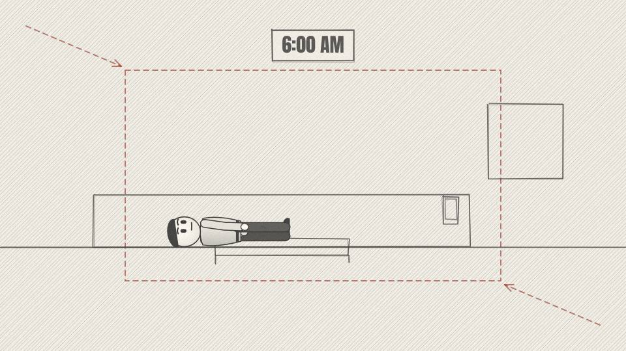
AH 0.01 CU · 4.9 s
Act 0 · Cold open
VISUAL
Dark bedroom, phone alarm lights up a sleeping face; the screen reads 6:00. Cold blue light.
ON-SCREEN TEXT
6:00 AM
ANIMATION NOTES
Dark, cold blue room. Phone screen flashes on the alarm beat (SFX alarm), slow push-in on the sleeping face; eyes snap open on 'screamed'.
VO
This morning, a machine screamed at you until you got up.
Notes:
VO: This morning, a machine screamed at you until you got up.
Visual: Dark bedroom, phone alarm lights up a sleeping face; the screen reads 6:00. Cold blue light.
On-screen: 6:00 AM
Animation: Dark, cold blue room. Phone screen flashes on the alarm beat (SFX alarm), slow push-in on the sleeping face; eyes snap open on 'screamed'.

Slide 4
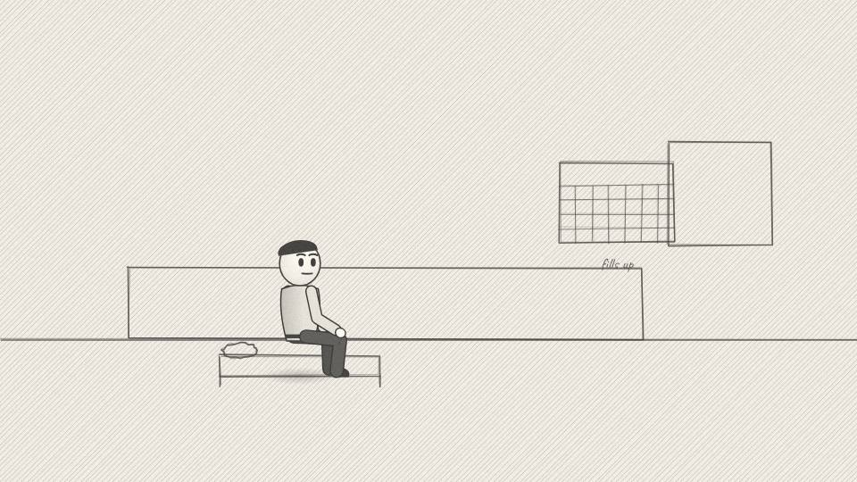
AH 0.02 MED · 10.6 s
Act 0 · Cold open
VISUAL
Modern figure sits up, rubs eyes; a calendar fills with blocks behind him, one by one, on each phrase.
ON-SCREEN TEXT
—
ANIMATION NOTES
He sits up and rubs his eyes (2-beat arm move). Calendar blocks pop in one per phrase: 'where to be', 'what to finish', 'whose hours'.
VO
You silenced it, and from that second the day was already spoken for. Where to be. What to finish. How many hours belong to someone else.
Notes:
VO: You silenced it, and from that second the day was already spoken for. Where to be. What to finish. How many hours belong to someone else.
Visual: Modern figure sits up, rubs eyes; a calendar fills with blocks behind him, one by one, on each phrase.
On-screen: -
Animation: He sits up and rubs his eyes (2-beat arm move). Calendar blocks pop in one per phrase: 'where to be', 'what to finish', 'whose hours'.

Slide 5
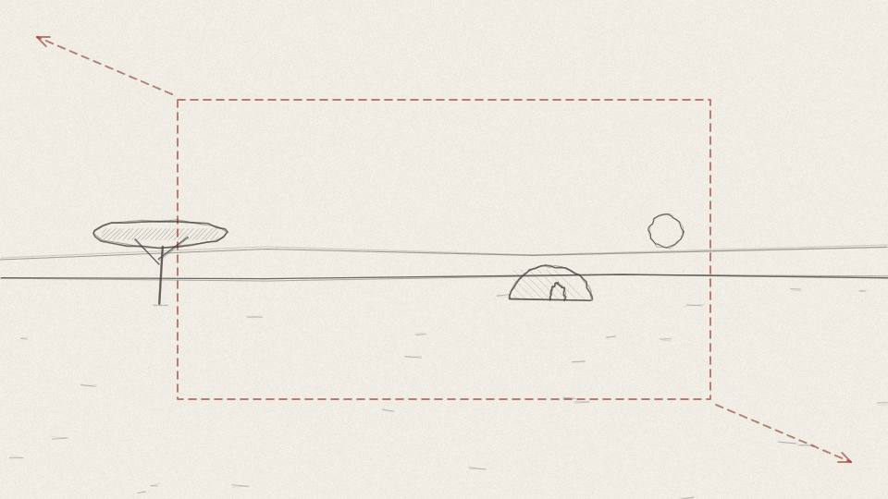
AH 0.03 WIDE · 3.0 s
Act 0 · Cold open
VISUAL
Hard cut: the calendar dissolves into dawn mist over an African savanna camp; painted golden light.
ON-SCREEN TEXT
50,000 YEARS AGO
ANIMATION NOTES
Calendar dissolves into dawn mist (0.8 s cross-dissolve). Slow pull-back reveals the camp; mist layers drift at different speeds (parallax).
VO
Now go back fifty thousand years.
Notes:
VO: Now go back fifty thousand years.
Visual: Hard cut: the calendar dissolves into dawn mist over an African savanna camp; painted golden light.
On-screen: 50,000 YEARS AGO
Animation: Calendar dissolves into dawn mist (0.8 s cross-dissolve). Slow pull-back reveals the camp; mist layers drift at different speeds (parallax).

Slide 6
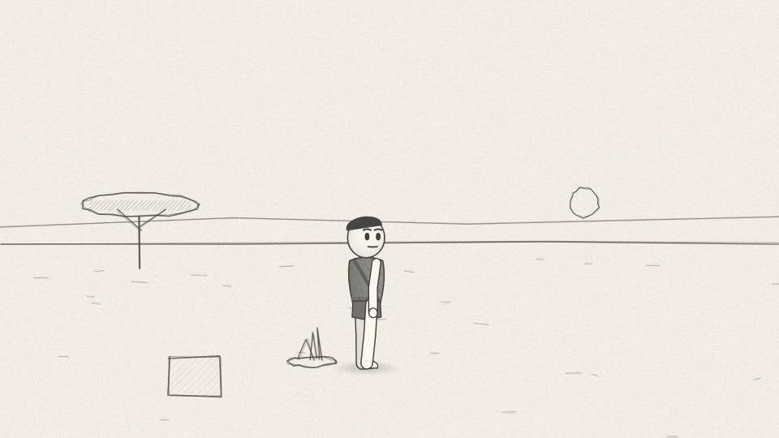
AH 0.04 MED · 6.4 s
Act 0 · Cold open
VISUAL
Hunter-gatherer wakes beside a smouldering fire, stretches slowly; birds cross the sky.
ON-SCREEN TEXT
—
ANIMATION NOTES
He rises from the hides and stretches, arms up, eased; birds cross the sky; the fire smoulders and smoke curls.
VO
A man wakes with the light. No alarm, no shift, no one waiting for him.
Notes:
VO: A man wakes with the light. No alarm, no shift, no one waiting for him.
Visual: Hunter-gatherer wakes beside a smouldering fire, stretches slowly; birds cross the sky.
On-screen: -
Animation: He rises from the hides and stretches, arms up, eased; birds cross the sky; the fire smoulders and smoke curls.

Slide 7
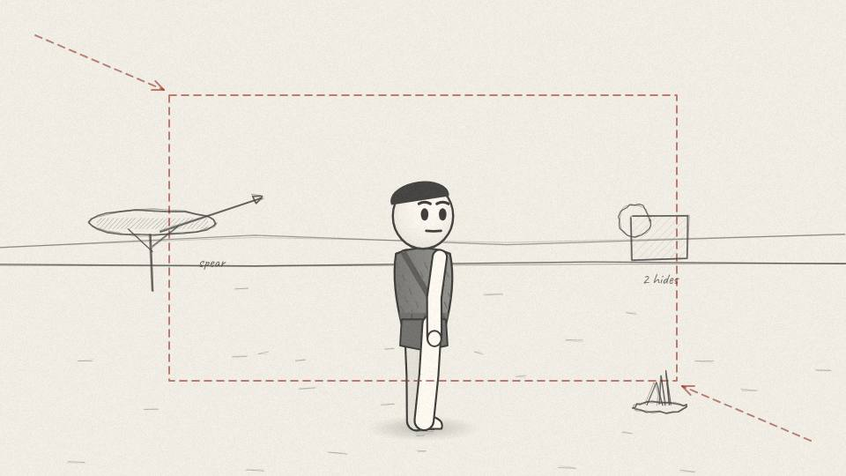
AH 0.05 CU · 10.9 s
Act 0 · Cold open
VISUAL
Push in on his face; 3D props pop around him: spear, two hides, embers.
ON-SCREEN TEXT
—
ANIMATION NOTES
Push-in to medium close. The spear, hides and fire pop in around him with a small overshoot, each on its word.
VO
He owns a spear, two hides and a fire. And he gets to ask a question most of us never get to ask on a weekday morning.
Notes:
VO: He owns a spear, two hides and a fire. And he gets to ask a question most of us never get to ask on a weekday morning.
Visual: Push in on his face; 3D props pop around him: spear, two hides, embers.
On-screen: -
Animation: Push-in to medium close. The spear, hides and fire pop in around him with a small overshoot, each on its word.

Slide 8
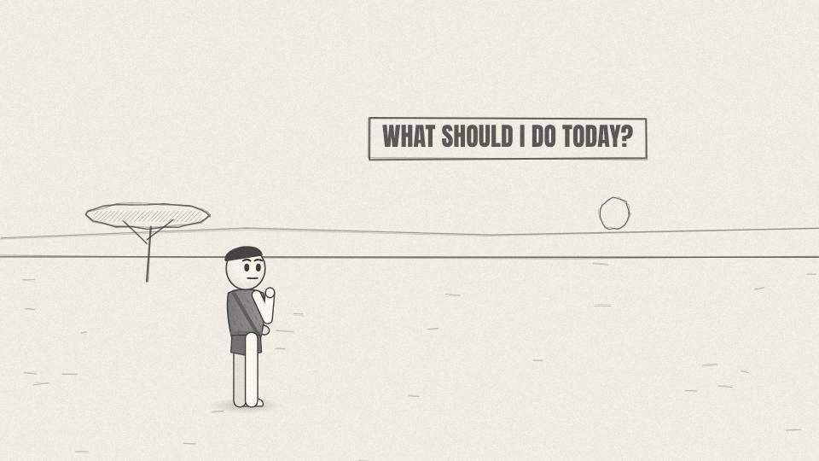
AH 0.06 CARD · 3.4 s
Act 0 · Cold open
VISUAL
Handwritten callout card, rotated -4 degrees, over the camp.
ON-SCREEN TEXT
WHAT SHOULD I DO TODAY?
ANIMATION NOTES
Handwritten card scales in at -4 degrees beside him as he looks out across the plain; a soft hold.
VO
What do I feel like doing today?
Notes:
VO: What do I feel like doing today?
Visual: Handwritten callout card, rotated -4 degrees, over the camp.
On-screen: WHAT SHOULD I DO TODAY?
Animation: Handwritten card scales in at -4 degrees beside him as he looks out across the plain; a soft hold.

Slide 9
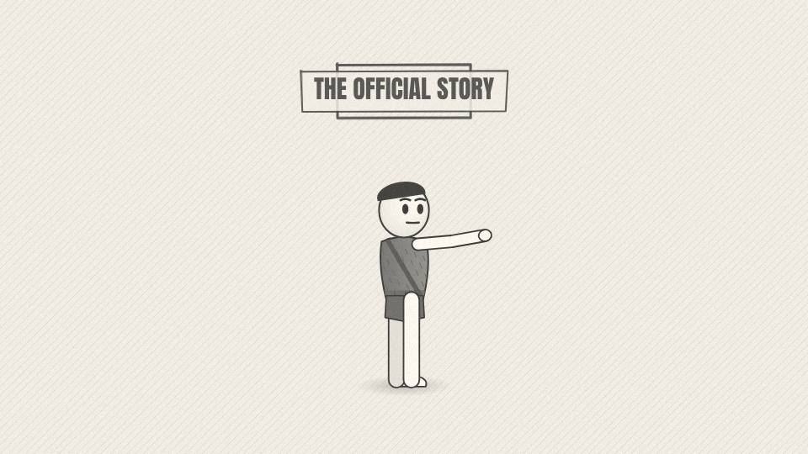
AH 0.07 MED · 9.1 s
Act 0 · Cold open
VISUAL
Old textbook illustration style: a desperate caveman fighting a beast, stamped 'THE OFFICIAL STORY'.
ON-SCREEN TEXT
THE OFFICIAL STORY
ANIMATION NOTES
Old textbook-print look (halftone). A caveman fights a beast in a frozen illustration; 'THE OFFICIAL STORY' stamp slams in (SFX stamp).
VO
Your brain is already pushing back. Ancient life was short, brutal and hungry, wasn't it? Every hour a fight to stay alive.
Notes:
VO: Your brain is already pushing back. Ancient life was short, brutal and hungry, wasn't it? Every hour a fight to stay alive.
Visual: Old textbook illustration style: a desperate caveman fighting a beast, stamped 'THE OFFICIAL STORY'.
On-screen: THE OFFICIAL STORY
Animation: Old textbook-print look (halftone). A caveman fights a beast in a frozen illustration; 'THE OFFICIAL STORY' stamp slams in (SFX stamp).

Slide 10
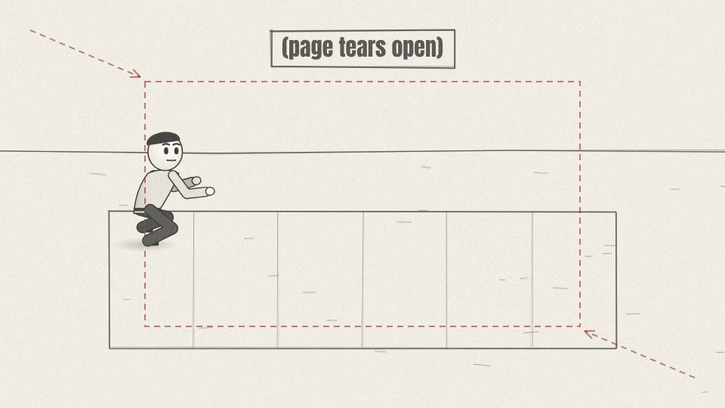
AH 0.08 WIDE · 8.7 s
Act 0 · Cold open
VISUAL
The textbook page tears; behind it, an excavation trench with string grid lines.
ON-SCREEN TEXT
—
ANIMATION NOTES
The textbook page tears down the middle (paper SFX) and the camera pushes through into an excavation trench with string grid lines.
VO
For a long time, that was the version in every textbook. Then scientists started counting, and digging, and the story cracked.
Notes:
VO: For a long time, that was the version in every textbook. Then scientists started counting, and digging, and the story cracked.
Visual: The textbook page tears; behind it, an excavation trench with string grid lines.
On-screen: -
Animation: The textbook page tears down the middle (paper SFX) and the camera pushes through into an excavation trench with string grid lines.

Slide 11
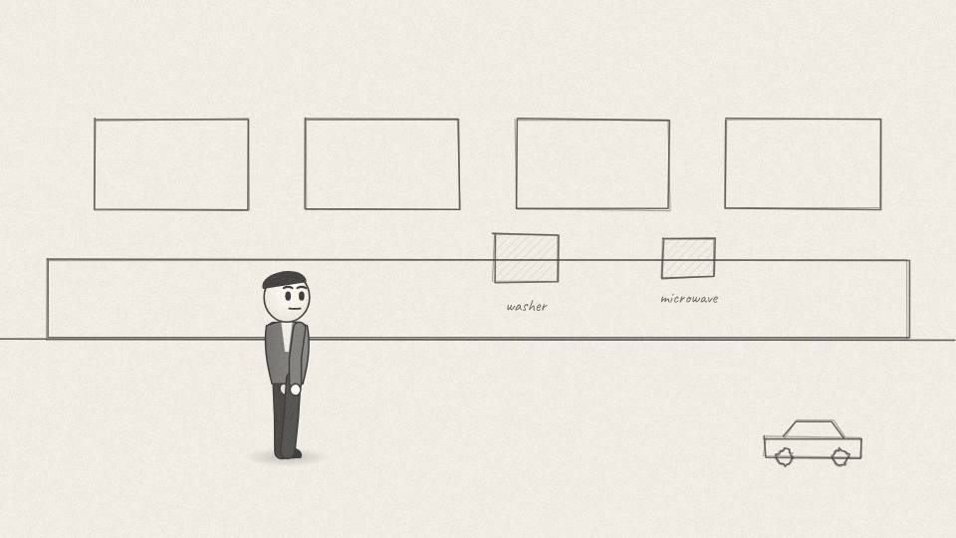
AH 0.09 MED · 7.5 s
Act 0 · Cold open
VISUAL
Modern kitchen; each machine pops in as named, with a small 'TIME SAVED' tag.
ON-SCREEN TEXT
—
ANIMATION NOTES
Each machine pops in as it is named, a small 'TIME SAVED' tag swinging on each; the worker looks from one to the next.
VO
Which leaves a strange question. You live surrounded by machines built to save time. Washing machines, microwaves, cars.
Notes:
VO: Which leaves a strange question. You live surrounded by machines built to save time. Washing machines, microwaves, cars.
Visual: Modern kitchen; each machine pops in as named, with a small 'TIME SAVED' tag.
On-screen: -
Animation: Each machine pops in as it is named, a small 'TIME SAVED' tag swinging on each; the worker looks from one to the next.

Slide 12
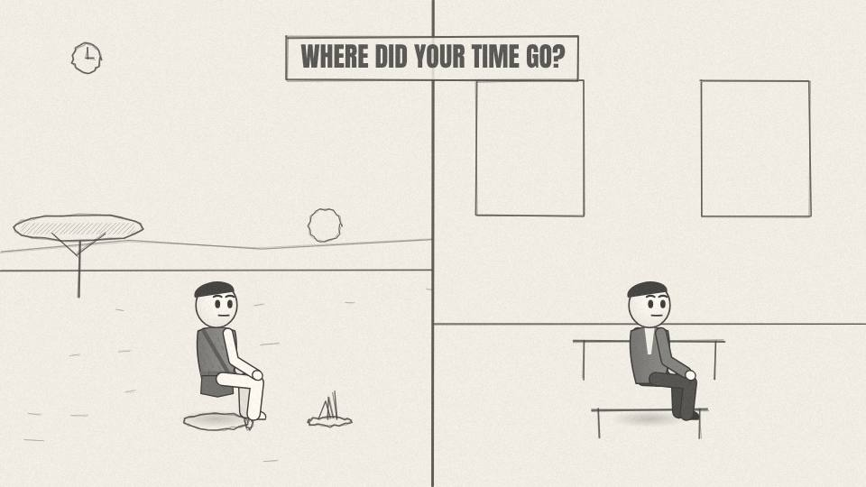
AH 0.10 CU · 9.1 s
Act 0 · Cold open
VISUAL
Split frame: hunter resting by the fire on the left, office worker at a desk on the right. Hours clock appears top left.
ON-SCREEN TEXT
WHERE DID YOUR TIME GO?
ANIMATION NOTES
Split frame wipes in from the centre line. Left side warm and moving (fire, breathing); right side cold and still. The hours clock appears top left.
VO
So how did people with none of that end up with more free afternoons than you? And where did your hours go?
Notes:
VO: So how did people with none of that end up with more free afternoons than you? And where did your hours go?
Visual: Split frame: hunter resting by the fire on the left, office worker at a desk on the right. Hours clock appears top left.
On-screen: WHERE DID YOUR TIME GO?
Animation: Split frame wipes in from the centre line. Left side warm and moving (fire, breathing); right side cold and still. The hours clock appears top left.

Slide 13
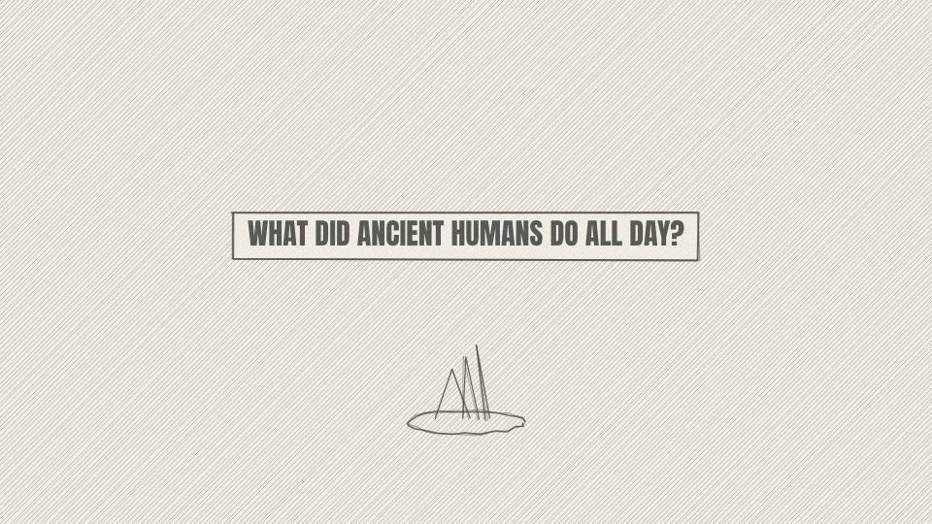
AH 0.11 TITLE · 4.0 s
Act 0 · Cold open
VISUAL
Title card over a painted fire at dusk.
ON-SCREEN TEXT
WHAT DID ANCIENT HUMANS DO ALL DAY?
ANIMATION NOTES
Title scales in with a slight overshoot over the dusk fire; embers float upward; whoosh + low drum hit.
VO
Notes:
VO:
Visual: Title card over a painted fire at dusk.
On-screen: WHAT DID ANCIENT HUMANS DO ALL DAY?
Animation: Title scales in with a slight overshoot over the dusk fire; embers float upward; whoosh + low drum hit.

Slide 14
ACT 1 · ACT 1: TWO SKELETONS
12 frames · 1:48

Slide 15
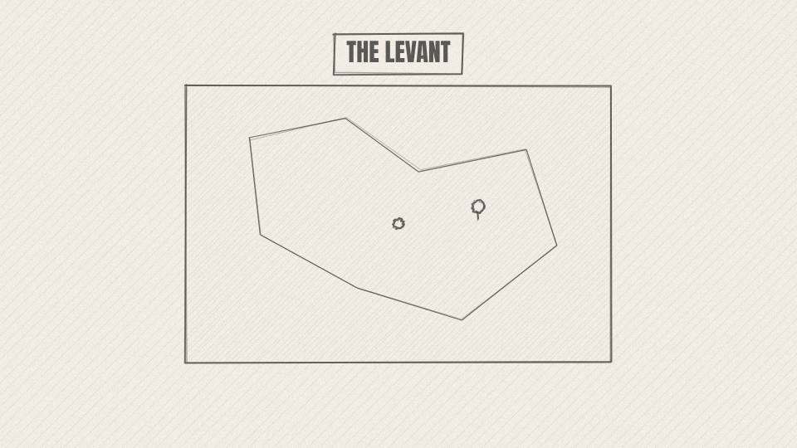
AH 1.01 MAP · 9.4 s
Act 1 · Act 1: Two Skeletons
VISUAL
Parchment map of the eastern Mediterranean; the Levant and Anatolia glow; a dig marker drops.
ON-SCREEN TEXT
THE LEVANT
ANIMATION NOTES
Parchment map; the Levant and Anatolia glow in turn, a dig-site pin drops in with a bounce.
VO
The first clue comes out of the ground in the Middle East, the Levant and Anatolia, where some of the earliest farms began.
Notes:
VO: The first clue comes out of the ground in the Middle East, the Levant and Anatolia, where some of the earliest farms began.
Visual: Parchment map of the eastern Mediterranean; the Levant and Anatolia glow; a dig marker drops.
On-screen: THE LEVANT
Animation: Parchment map; the Levant and Anatolia glow in turn, a dig-site pin drops in with a bounce.

Slide 16
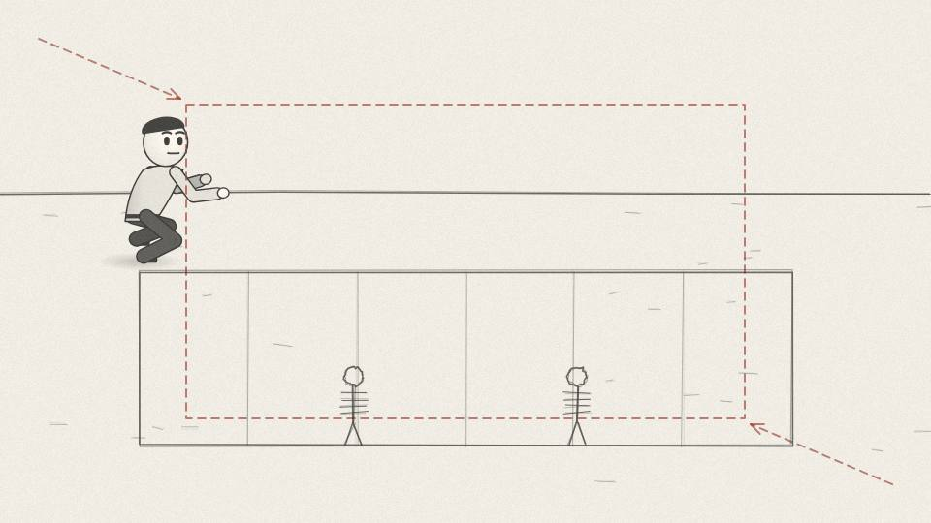
AH 1.02 WIDE · 7.9 s
Act 1 · Act 1: Two Skeletons
VISUAL
Excavation pit at dusk, lanterns, brushes; two outlined skeletons side by side in the soil.
ON-SCREEN TEXT
—
ANIMATION NOTES
Lanterns flicker; brushes sweep soil away to reveal two outlined skeletons; slow push.
VO
Over decades, archaeologists dug up skeletons from people who lived in the same region a few thousand years apart.
Notes:
VO: Over decades, archaeologists dug up skeletons from people who lived in the same region a few thousand years apart.
Visual: Excavation pit at dusk, lanterns, brushes; two outlined skeletons side by side in the soil.
On-screen: -
Animation: Lanterns flicker; brushes sweep soil away to reveal two outlined skeletons; slow push.

Slide 17
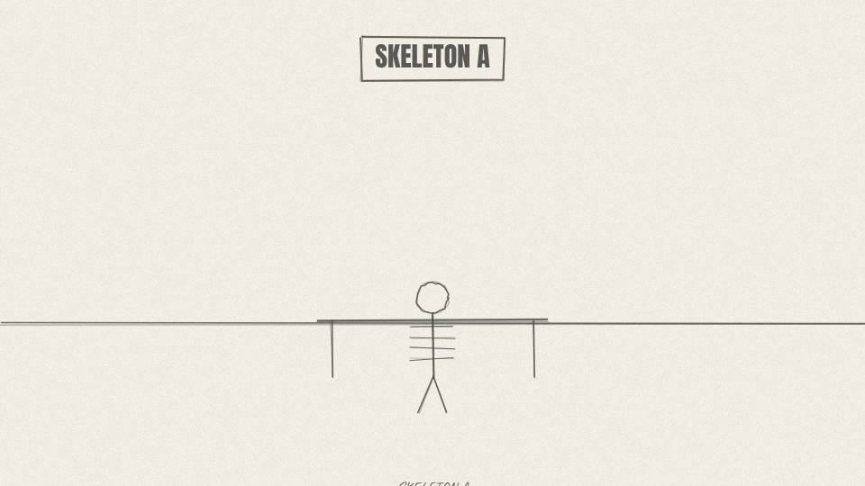
AH 1.03 PROP3D · 9.1 s
Act 1 · Act 1: Two Skeletons
VISUAL
3D skeleton A rotates slowly on a lab table; labels point to long bones, teeth, joints.
ON-SCREEN TEXT
SKELETON A
ANIMATION NOTES
Skeleton A rotates slowly (3D prop). Labels draw on with lines to bones, teeth, joints as each is named.
VO
The first set of bones is tall and thick. The teeth are worn, but nearly free of decay. The joints are clean.
Notes:
VO: The first set of bones is tall and thick. The teeth are worn, but nearly free of decay. The joints are clean.
Visual: 3D skeleton A rotates slowly on a lab table; labels point to long bones, teeth, joints.
On-screen: SKELETON A
Animation: Skeleton A rotates slowly (3D prop). Labels draw on with lines to bones, teeth, joints as each is named.

Slide 18
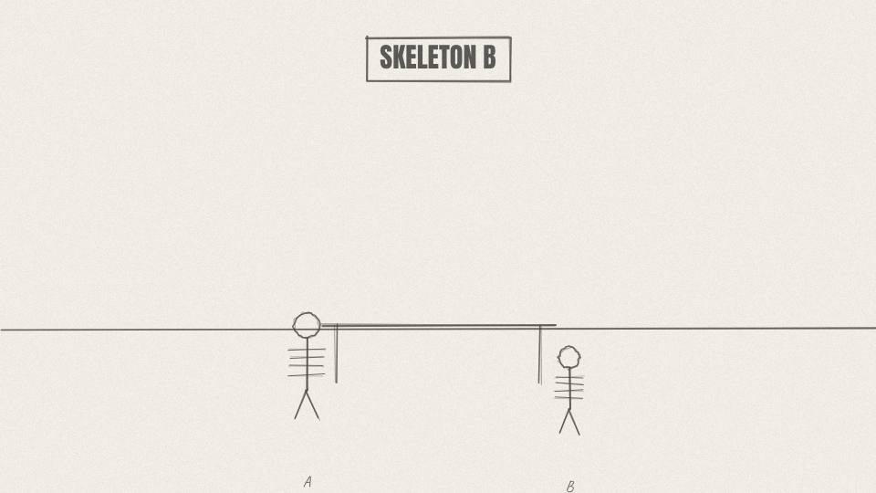
AH 1.04 PROP3D · 9.8 s
Act 1 · Act 1: Two Skeletons
VISUAL
3D skeleton B beside it, shorter; red highlights on teeth, lower spine, knees.
ON-SCREEN TEXT
SKELETON B
ANIMATION NOTES
Skeleton B slides in beside A, shorter. Red highlights pulse on teeth, then spine, then knees, in time with the words.
VO
The second tells a harder story. Teeth full of cavities. A spine worn by the same motion, repeated thousands of times. A shorter life.
Notes:
VO: The second tells a harder story. Teeth full of cavities. A spine worn by the same motion, repeated thousands of times. A shorter life.
Visual: 3D skeleton B beside it, shorter; red highlights on teeth, lower spine, knees.
On-screen: SKELETON B
Animation: Skeleton B slides in beside A, shorter. Red highlights pulse on teeth, then spine, then knees, in time with the words.

Slide 19
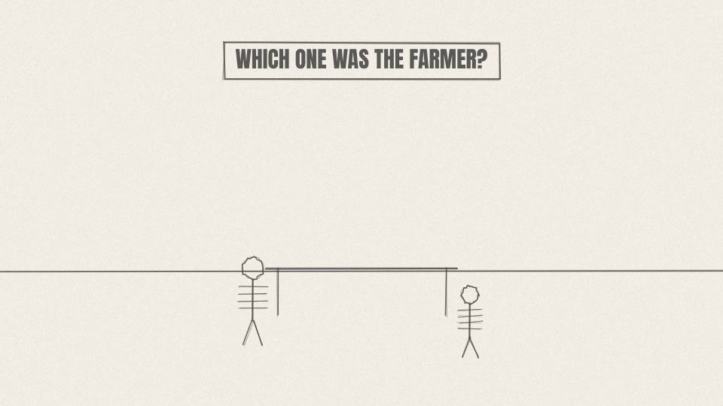
AH 1.05 CARD · 5.3 s
Act 1 · Act 1: Two Skeletons
VISUAL
Two question-mark tags swing over the skeletons.
ON-SCREEN TEXT
WHICH ONE WAS THE FARMER?
ANIMATION NOTES
Two question-mark tags swing on strings above them; a ticking clock SFX gives the viewer a beat to guess.
VO
One was a hunter-gatherer. One was an early farmer. Take a guess.
Notes:
VO: One was a hunter-gatherer. One was an early farmer. Take a guess.
Visual: Two question-mark tags swing over the skeletons.
On-screen: WHICH ONE WAS THE FARMER?
Animation: Two question-mark tags swing on strings above them; a ticking clock SFX gives the viewer a beat to guess.

Slide 20
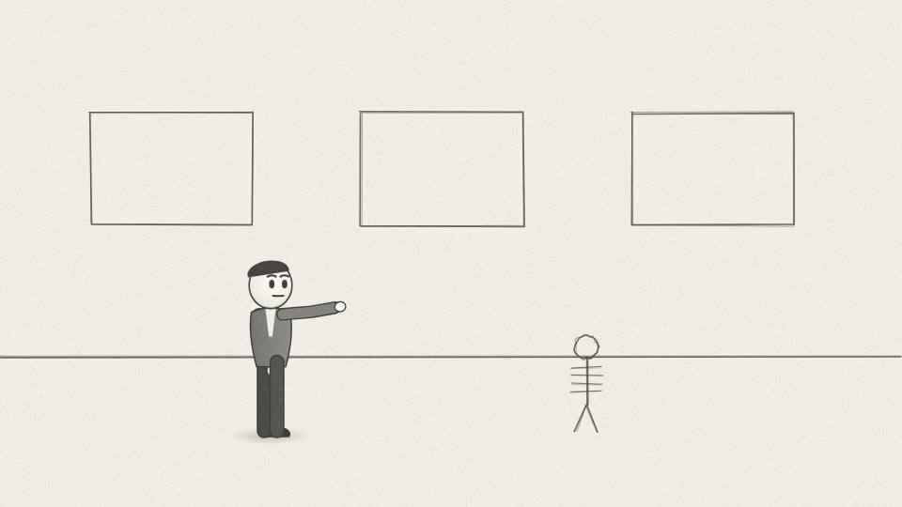
AH 1.06 MED · 8.3 s
Act 1 · Act 1: Two Skeletons
VISUAL
A viewer-like character in a museum points confidently at skeleton A.
ON-SCREEN TEXT
—
ANIMATION NOTES
A museum visitor walks in (walk cycle) and points confidently at A; small smug nod.
VO
Most people pick the strong one as the farmer. Stored grain, a roof, tools. Surely that is the better life.
Notes:
VO: Most people pick the strong one as the farmer. Stored grain, a roof, tools. Surely that is the better life.
Visual: A viewer-like character in a museum points confidently at skeleton A.
On-screen: -
Animation: A museum visitor walks in (walk cycle) and points confidently at A; small smug nod.

Slide 21
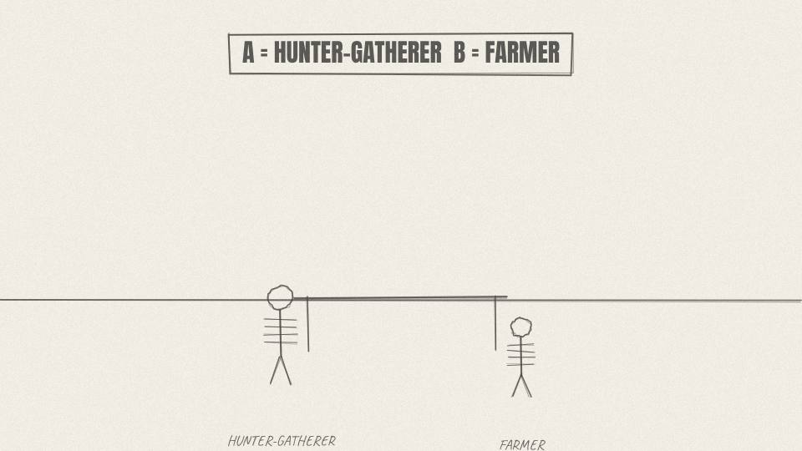
AH 1.07 CU · 7.5 s
Act 1 · Act 1: Two Skeletons
VISUAL
Tags flip: A gets 'HUNTER-GATHERER', B gets 'FARMER'. Gentle stamp sound.
ON-SCREEN TEXT
A = HUNTER-GATHERER B = FARMER
ANIMATION NOTES
The tags flip over like cards (scaleX through 0); a soft stamp SFX on each.
VO
It's the other way round. The tall, healthy skeleton was the hunter-gatherer. The worn-out one was the farmer.
Notes:
VO: It's the other way round. The tall, healthy skeleton was the hunter-gatherer. The worn-out one was the farmer.
Visual: Tags flip: A gets 'HUNTER-GATHERER', B gets 'FARMER'. Gentle stamp sound.
On-screen: A = HUNTER-GATHERER B = FARMER
Animation: The tags flip over like cards (scaleX through 0); a soft stamp SFX on each.

Slide 22
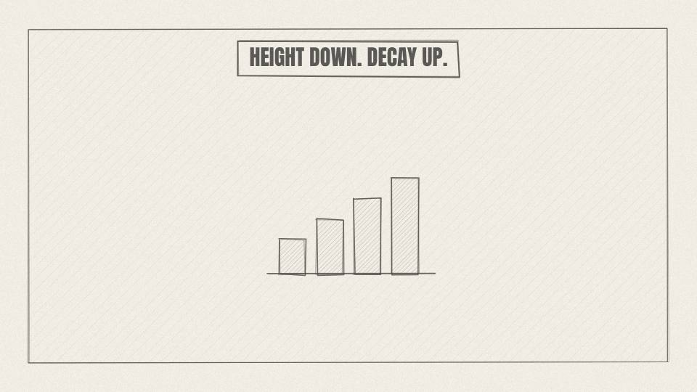
AH 1.08 CHART · 11.3 s
Act 1 · Act 1: Two Skeletons
VISUAL
Simple bar chart: average height before and after farming, plus three icons (tooth, spine, hunger lines) rising.
ON-SCREEN TEXT
HEIGHT DOWN. DECAY UP.
ANIMATION NOTES
Bars drop on 'height dropped'; tooth, spine and hunger icons rise one by one; ink-line chart style.
VO
And it isn't one odd pair. In study after study, where farming took over, average height dropped and tooth decay, worn joints and signs of hunger went up.
Notes:
VO: And it isn't one odd pair. In study after study, where farming took over, average height dropped and tooth decay, worn joints and signs of hunger went up.
Visual: Simple bar chart: average height before and after farming, plus three icons (tooth, spine, hunger lines) rising.
On-screen: HEIGHT DOWN. DECAY UP.
Animation: Bars drop on 'height dropped'; tooth, spine and hunger icons rise one by one; ink-line chart style.

Slide 23
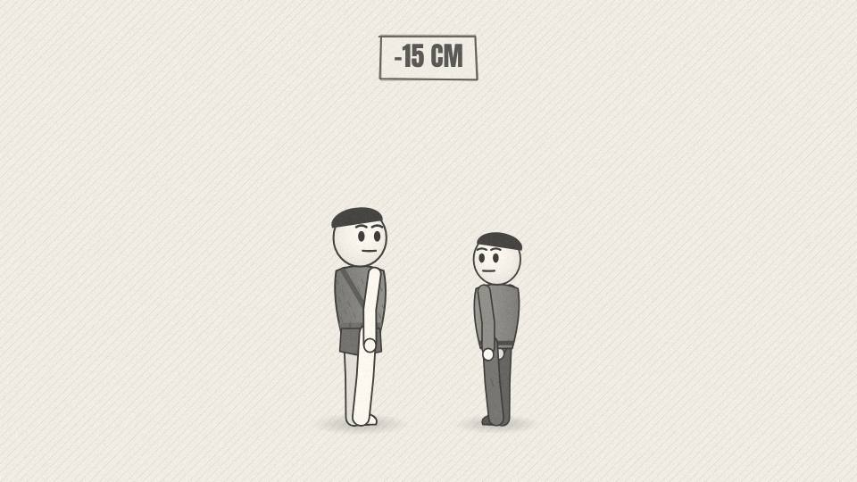
AH 1.09 MED · 10.2 s
Act 1 · Act 1: Two Skeletons
VISUAL
Two painted men stand back to back with a height marker between them; the gap is highlighted.
ON-SCREEN TEXT
-15 CM
ANIMATION NOTES
Two men stand back to back; a height marker slides up between them and the gap highlights red.
VO
In parts of Greece and Turkey, men's average height fell by around fifteen centimetres after farming arrived, and took thousands of years to come back.
Notes:
VO: In parts of Greece and Turkey, men's average height fell by around fifteen centimetres after farming arrived, and took thousands of years to come back.
Visual: Two painted men stand back to back with a height marker between them; the gap is highlighted.
On-screen: -15 CM
Animation: Two men stand back to back; a height marker slides up between them and the gap highlights red.

Slide 24
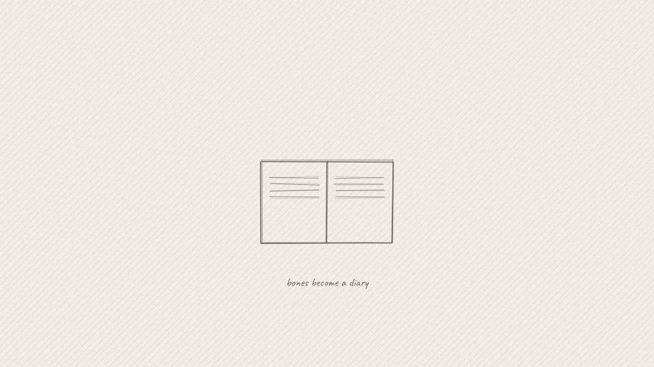
AH 1.10 WIDE · 11.3 s
Act 1 · Act 1: Two Skeletons
VISUAL
Bones fade into a leather diary; pages turn, each page a sketch of a body at work.
ON-SCREEN TEXT
YOUR BONES KEEP A DIARY
ANIMATION NOTES
Bones dissolve into a leather diary; pages turn on their own (paper SFX), each page a sketch of a body at work.
VO
A skeleton works like a diary. It records how you ate, how you moved and how hard you worked, and it keeps that record for thousands of years.
Notes:
VO: A skeleton works like a diary. It records how you ate, how you moved and how hard you worked, and it keeps that record for thousands of years.
Visual: Bones fade into a leather diary; pages turn, each page a sketch of a body at work.
On-screen: YOUR BONES KEEP A DIARY
Animation: Bones dissolve into a leather diary; pages turn on their own (paper SFX), each page a sketch of a body at work.

Slide 25
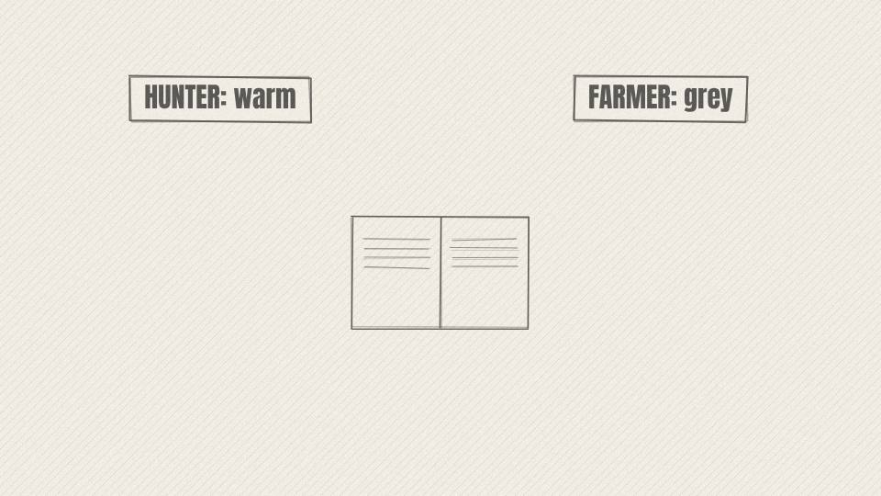
AH 1.11 MED · 10.6 s
Act 1 · Act 1: Two Skeletons
VISUAL
Diary page shows the hunter's camp, warm; the next page shows a bent farmer in a field, grey.
ON-SCREEN TEXT
—
ANIMATION NOTES
Diary page left warm and colourful, page turn to the grey bent farmer; the colour drains as the page turns.
VO
And those diaries say the people with only spears were, in many ways, better fed and less worn down than the farmers who came after them.
Notes:
VO: And those diaries say the people with only spears were, in many ways, better fed and less worn down than the farmers who came after them.
Visual: Diary page shows the hunter's camp, warm; the next page shows a bent farmer in a field, grey.
On-screen: -
Animation: Diary page left warm and colourful, page turn to the grey bent farmer; the colour drains as the page turns.

Slide 26
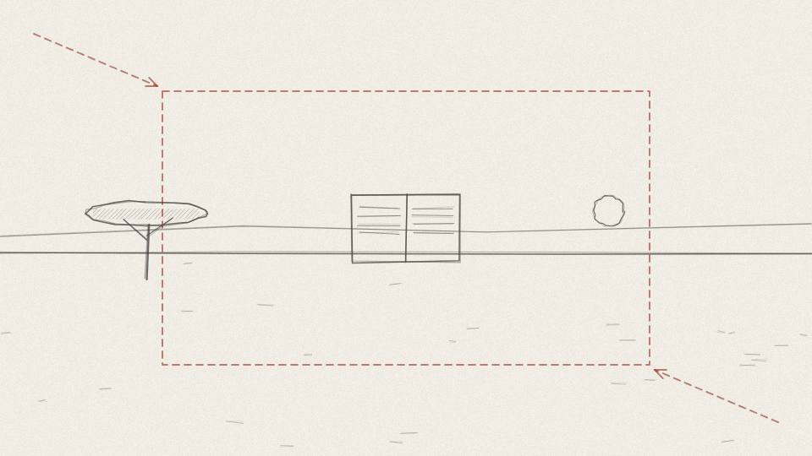
AH 1.12 CU · 7.9 s
Act 1 · Act 1: Two Skeletons
VISUAL
Push in on the hunter page until it becomes the next scene.
ON-SCREEN TEXT
—
ANIMATION NOTES
Camera pushes into the hunter page until it fills the frame and becomes the next scene (match cut).
VO
But bones can't tell you what an ordinary day felt like. For that, we need to walk through one.
Notes:
VO: But bones can't tell you what an ordinary day felt like. For that, we need to walk through one.
Visual: Push in on the hunter page until it becomes the next scene.
On-screen: -
Animation: Camera pushes into the hunter page until it fills the frame and becomes the next scene (match cut).

Slide 27
ACT 2 · ACT 2: A DAY WITHOUT A CLOCK
8 frames · 0:57

Slide 28
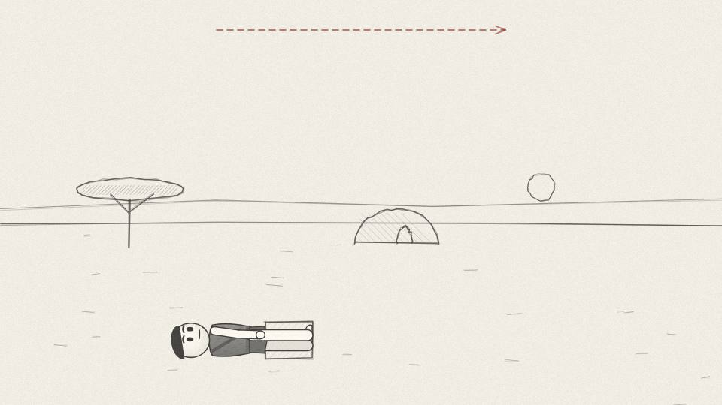
AH 2.01 WIDE · 5.3 s
Act 2 · Act 2: A Day Without a Clock
VISUAL
Dawn camp: grass shelters, sleeping hides, low fire; mist on the plain.
ON-SCREEN TEXT
—
ANIMATION NOTES
Dawn camp, mist drifting; slow pan right across shelters; a sleeper turns over and sits up on his own.
VO
You wake at first light, on your own, because you slept enough.
Notes:
VO: You wake at first light, on your own, because you slept enough.
Visual: Dawn camp: grass shelters, sleeping hides, low fire; mist on the plain.
On-screen: -
Animation: Dawn camp, mist drifting; slow pan right across shelters; a sleeper turns over and sits up on his own.

Slide 29
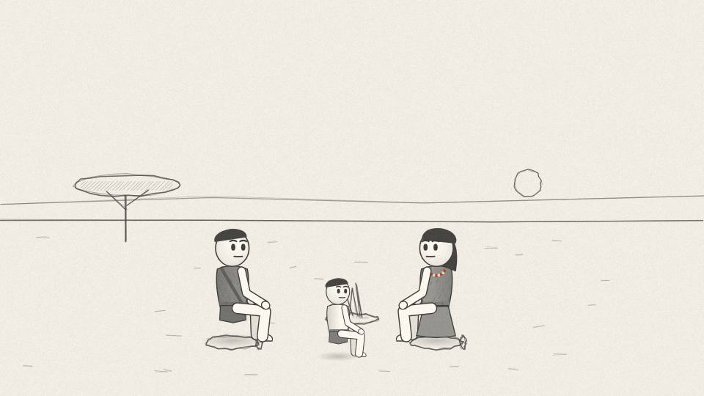
AH 2.02 MED · 6.4 s
Act 2 · Act 2: A Day Without a Clock
VISUAL
Group of six around the fire, eating; steam rises; small kids lean on adults.
ON-SCREEN TEXT
—
ANIMATION NOTES
Six people eat around the fire; hands to mouths on staggered timers; steam rises; a child leans on an adult.
VO
Last night's fire is still alive. People sit around it, eating leftover meat and nuts.
Notes:
VO: Last night's fire is still alive. People sit around it, eating leftover meat and nuts.
Visual: Group of six around the fire, eating; steam rises; small kids lean on adults.
On-screen: -
Animation: Six people eat around the fire; hands to mouths on staggered timers; steam rises; a child leans on an adult.

Slide 30
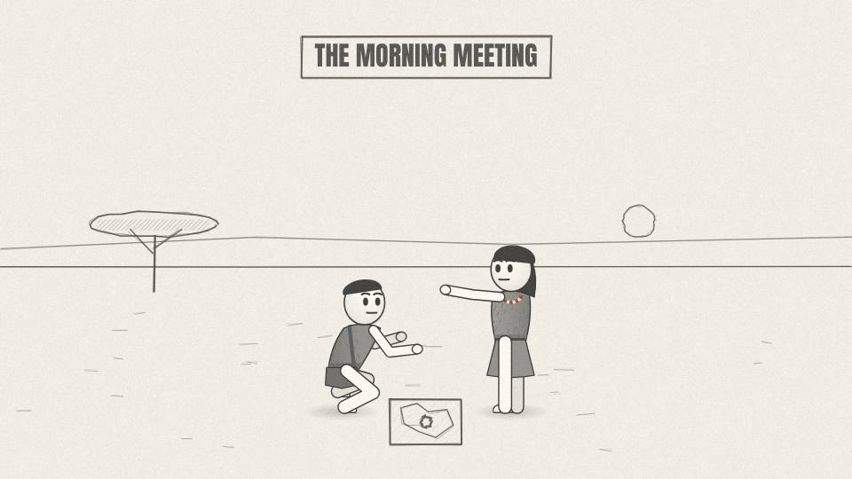
AH 2.03 MED · 11.7 s
Act 2 · Act 2: A Day Without a Clock
VISUAL
Elder draws a map in the dirt with a stick; others lean in and point.
ON-SCREEN TEXT
THE MORNING MEETING
ANIMATION NOTES
The elder draws a map in the dirt with a stick (line draws on); others lean in and point; heads turn to whoever speaks.
VO
The talk is simple: where the water is good, where someone saw fresh tracks. That is the whole plan for the day, and everyone has a say in it.
Notes:
VO: The talk is simple: where the water is good, where someone saw fresh tracks. That is the whole plan for the day, and everyone has a say in it.
Visual: Elder draws a map in the dirt with a stick; others lean in and point.
On-screen: THE MORNING MEETING
Animation: The elder draws a map in the dirt with a stick (line draws on); others lean in and point; heads turn to whoever speaks.

Slide 31
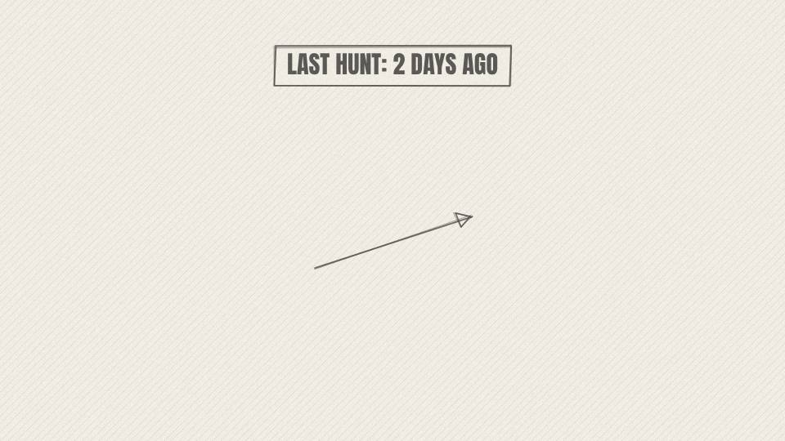
AH 2.04 CARD · 7.2 s
Act 2 · Act 2: A Day Without a Clock
VISUAL
Calendar-style tally carved on a stick: two notches since the last hunt.
ON-SCREEN TEXT
LAST HUNT: 2 DAYS AGO
ANIMATION NOTES
Notches carve themselves into a stick one by one (scrape SFX).
VO
Today, nobody needs to hunt. The last kill was two days ago, and there is still food.
Notes:
VO: Today, nobody needs to hunt. The last kill was two days ago, and there is still food.
Visual: Calendar-style tally carved on a stick: two notches since the last hunt.
On-screen: LAST HUNT: 2 DAYS AGO
Animation: Notches carve themselves into a stick one by one (scrape SFX).

Slide 32
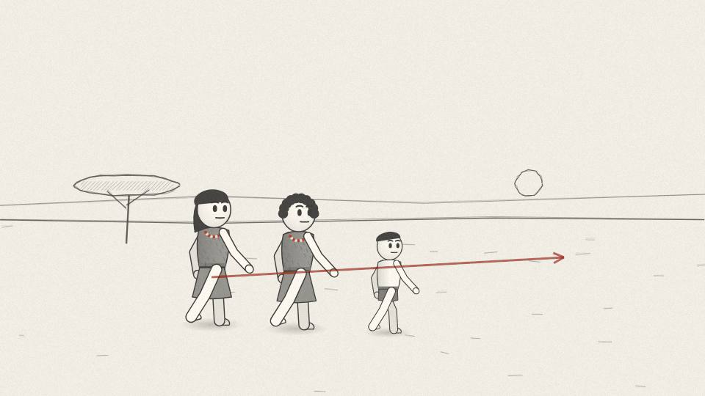
AH 2.05 WIDE · 4.9 s
Act 2 · Act 2: A Day Without a Clock
VISUAL
Two women and a teenager walk into the bush with digging sticks and carrying bags, walking cycle with distance covered.
ON-SCREEN TEXT
—
ANIMATION NOTES
Three gatherers walk out into the bush with digging sticks; real walk cycle covering ground; they shrink into the distance.
VO
A few people walk out to gather roots, nuts and berries.
Notes:
VO: A few people walk out to gather roots, nuts and berries.
Visual: Two women and a teenager walk into the bush with digging sticks and carrying bags, walking cycle with distance covered.
On-screen: -
Animation: Three gatherers walk out into the bush with digging sticks; real walk cycle covering ground; they shrink into the distance.

Slide 33
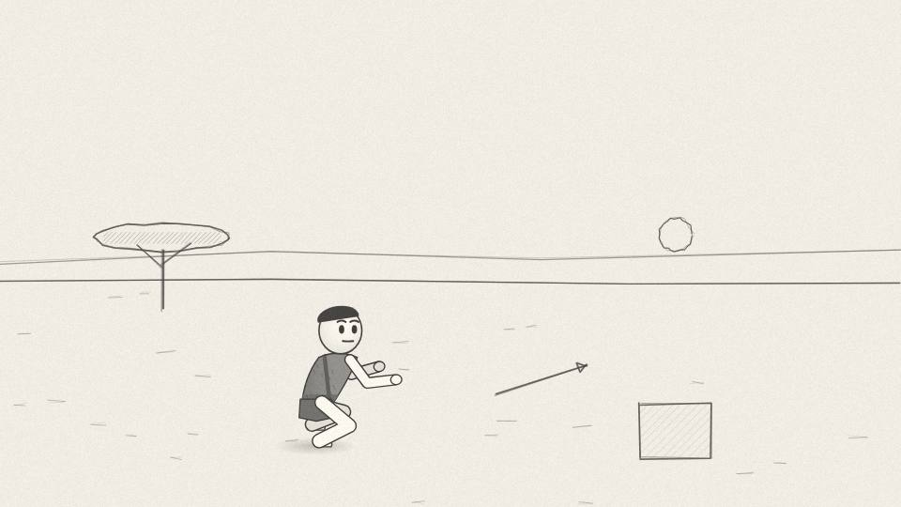
AH 2.06 MED · 8.7 s
Act 2 · Act 2: A Day Without a Clock
VISUAL
Close shots of hands knapping stone and scraping a pegged-out hide; 3D spear and hide props.
ON-SCREEN TEXT
—
ANIMATION NOTES
Close shots: hands knapping stone (chip SFX, sparks of flake), then scraping the pegged hide in rhythm.
VO
You stay and work on your gear. You sharpen a spear point. You work a stiff hide until it turns soft.
Notes:
VO: You stay and work on your gear. You sharpen a spear point. You work a stiff hide until it turns soft.
Visual: Close shots of hands knapping stone and scraping a pegged-out hide; 3D spear and hide props.
On-screen: -
Animation: Close shots: hands knapping stone (chip SFX, sparks of flake), then scraping the pegged hide in rhythm.

Slide 34
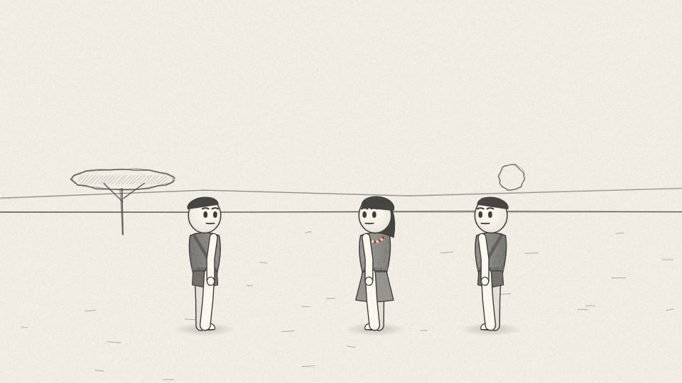
AH 2.07 CU · 8.7 s
Act 2 · Act 2: A Day Without a Clock
VISUAL
Others glance over admiringly at the finished spear point.
ON-SCREEN TEXT
—
ANIMATION NOTES
Others glance over; one nods; a small smile; the spear point catches the light.
VO
Not because a boss told you to. Here, skill earns respect, and respect is worth more than anything you could own.
Notes:
VO: Not because a boss told you to. Here, skill earns respect, and respect is worth more than anything you could own.
Visual: Others glance over admiringly at the finished spear point.
On-screen: -
Animation: Others glance over; one nods; a small smile; the spear point catches the light.

Slide 35
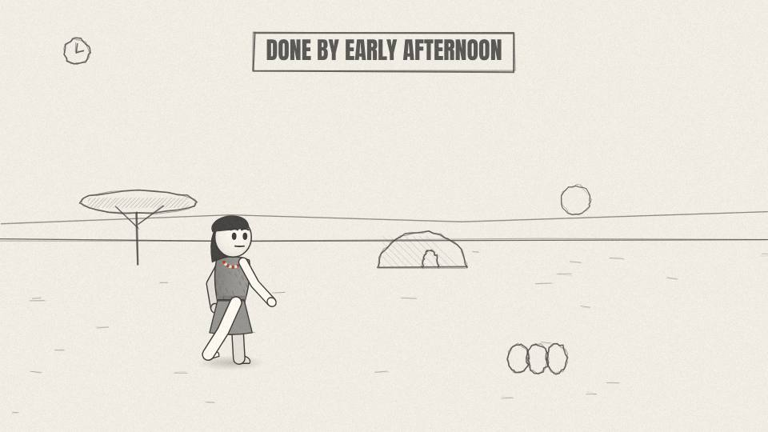
AH 2.08 WIDE · 4.5 s
Act 2 · Act 2: A Day Without a Clock
VISUAL
Sun higher; the gatherers return with full bags; tools laid out finished. Hours clock shows a big free block.
ON-SCREEN TEXT
DONE BY EARLY AFTERNOON
ANIMATION NOTES
Sun shadow swings (time passes). Gatherers return with full bags. Hours clock fills with a large free block (tick SFX).
VO
By early afternoon, the jobs that needed doing are done.
Notes:
VO: By early afternoon, the jobs that needed doing are done.
Visual: Sun higher; the gatherers return with full bags; tools laid out finished. Hours clock shows a big free block.
On-screen: DONE BY EARLY AFTERNOON
Animation: Sun shadow swings (time passes). Gatherers return with full bags. Hours clock fills with a large free block (tick SFX).

Slide 36
ACT 3 · ACT 3: THE HUNTER WHO NEVER STOPS
9 frames · 1:07

Slide 37
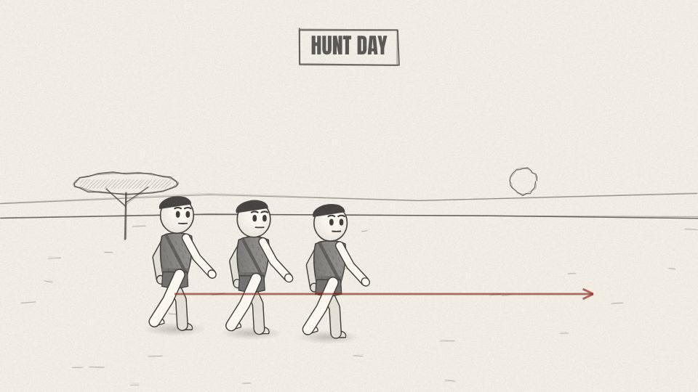
AH 3.01 WIDE · 4.5 s
Act 3 · Act 3: The Hunter Who Never Stops
VISUAL
Morning: three hunters set out across a wide hot plain carrying spears and water gourds.
ON-SCREEN TEXT
HUNT DAY
ANIMATION NOTES
Three hunters set out across a hot plain, walk cycles in step; heat shimmer distortion on the horizon.
VO
Two days later, the meat runs low. Today you hunt.
Notes:
VO: Two days later, the meat runs low. Today you hunt.
Visual: Morning: three hunters set out across a wide hot plain carrying spears and water gourds.
On-screen: HUNT DAY
Animation: Three hunters set out across a hot plain, walk cycles in step; heat shimmer distortion on the horizon.

Slide 38
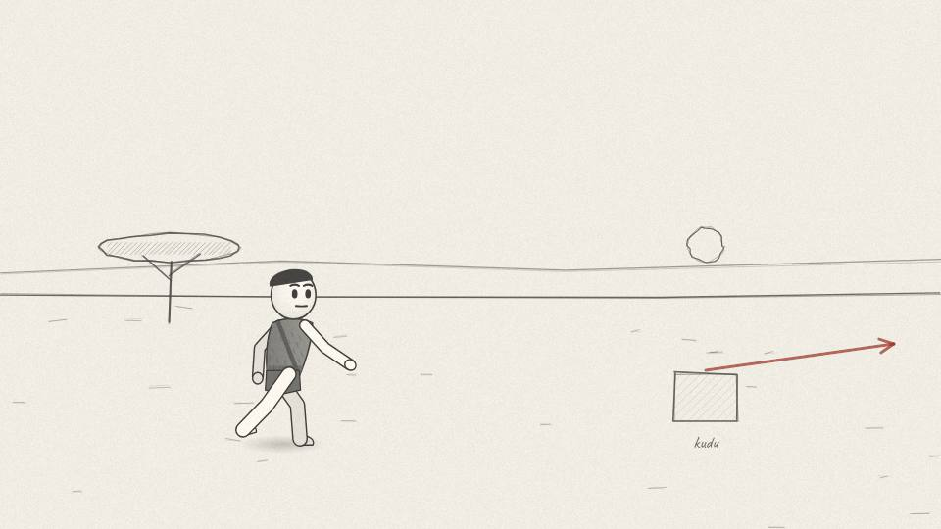
AH 3.02 MED · 10.2 s
Act 3 · Act 3: The Hunter Who Never Stops
VISUAL
A kudu bolts away; the hunters don't sprint, they keep a steady jog.
ON-SCREEN TEXT
—
ANIMATION NOTES
The kudu bolts away fast (animal run cycle); the hunters keep an even jog; dust kicks up.
VO
Some hunters in Africa have been recorded using a method that looks nothing like the movies. They don't try to outrun the animal. They can't.
Notes:
VO: Some hunters in Africa have been recorded using a method that looks nothing like the movies. They don't try to outrun the animal. They can't.
Visual: A kudu bolts away; the hunters don't sprint, they keep a steady jog.
On-screen: -
Animation: The kudu bolts away fast (animal run cycle); the hunters keep an even jog; dust kicks up.

Slide 39
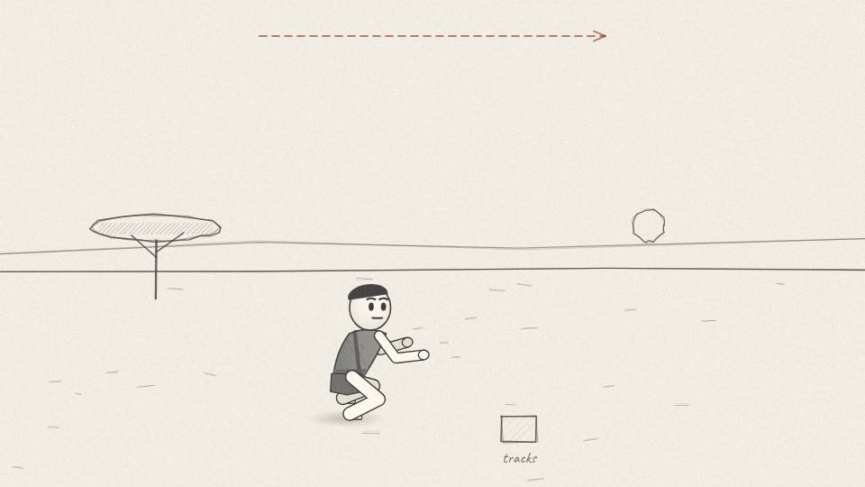
AH 3.03 MED · 6.0 s
Act 3 · Act 3: The Hunter Who Never Stops
VISUAL
Footprints in sand; hunters read the tracks, then jog on; sun high and harsh.
ON-SCREEN TEXT
—
ANIMATION NOTES
Close on footprints in the sand; a hand touches a track; then they jog on; sun high and harsh.
VO
Instead they track it, at a steady pace, for hours, in the midday heat.
Notes:
VO: Instead they track it, at a steady pace, for hours, in the midday heat.
Visual: Footprints in sand; hunters read the tracks, then jog on; sun high and harsh.
On-screen: -
Animation: Close on footprints in the sand; a hand touches a track; then they jog on; sun high and harsh.

Slide 40
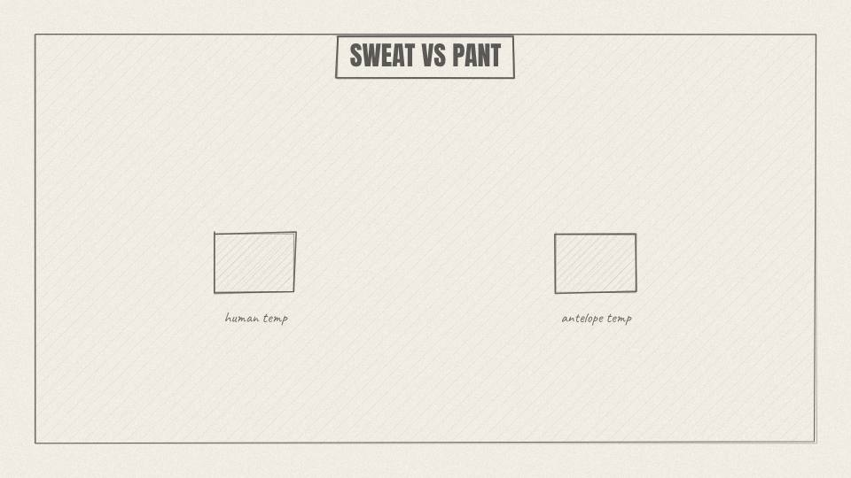
AH 3.04 CHART · 10.9 s
Act 3 · Act 3: The Hunter Who Never Stops
VISUAL
Side-by-side thermometer graphic: human steady, antelope climbing into red.
ON-SCREEN TEXT
SWEAT VS PANT
ANIMATION NOTES
Two thermometers: the human line stays level, the antelope's climbs into red with a warning pulse.
VO
A human can sweat and keep cooling while moving. A four-legged runner has to stop to pant. Push it hard enough, for long enough, and it overheats.
Notes:
VO: A human can sweat and keep cooling while moving. A four-legged runner has to stop to pant. Push it hard enough, for long enough, and it overheats.
Visual: Side-by-side thermometer graphic: human steady, antelope climbing into red.
On-screen: SWEAT VS PANT
Animation: Two thermometers: the human line stays level, the antelope's climbs into red with a warning pulse.

Slide 41
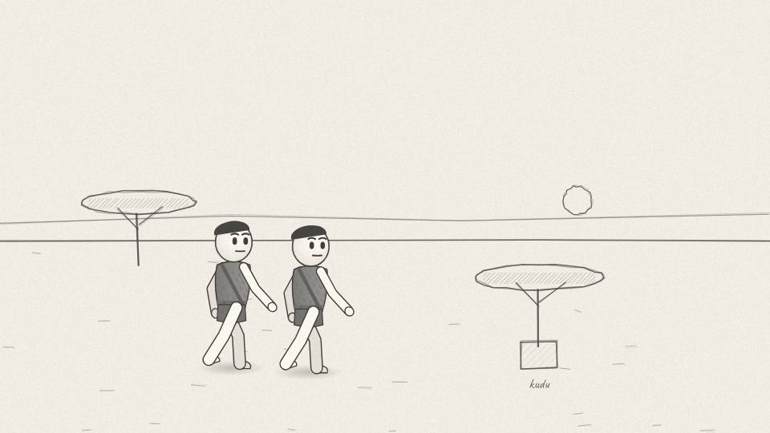
AH 3.05 WIDE · 6.0 s
Act 3 · Act 3: The Hunter Who Never Stops
VISUAL
Long shot: the kudu stands still under a lone tree; hunters approach slowly. Non-graphic; cut away before the kill.
ON-SCREEN TEXT
—
ANIMATION NOTES
Long shot: the kudu stands still under a lone tree; hunters approach slowly. Cut away before any kill.
VO
Eventually the animal stops and can't run again. The hunters walk up to it.
Notes:
VO: Eventually the animal stops and can't run again. The hunters walk up to it.
Visual: Long shot: the kudu stands still under a lone tree; hunters approach slowly. Non-graphic; cut away before the kill.
On-screen: -
Animation: Long shot: the kudu stands still under a lone tree; hunters approach slowly. Cut away before any kill.

Slide 42
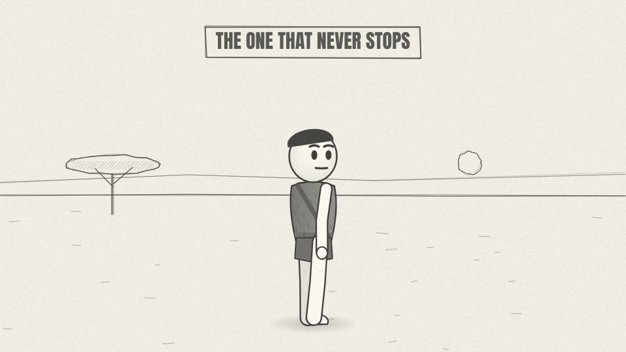
AH 3.06 CU · 7.2 s
Act 3 · Act 3: The Hunter Who Never Stops
VISUAL
Silhouette of the hunter against the sun, breathing hard but steady.
ON-SCREEN TEXT
THE ONE THAT NEVER STOPS
ANIMATION NOTES
Silhouette against the sun; chest heaving slowly; low heartbeat SFX; slow push-in.
VO
You were never the fastest thing on the plain. You were the thing that could keep going.
Notes:
VO: You were never the fastest thing on the plain. You were the thing that could keep going.
Visual: Silhouette of the hunter against the sun, breathing hard but steady.
On-screen: THE ONE THAT NEVER STOPS
Animation: Silhouette against the sun; chest heaving slowly; low heartbeat SFX; slow push-in.

Slide 43
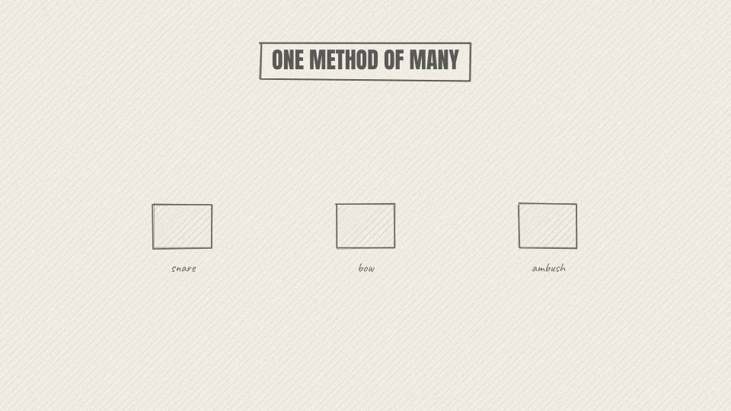
AH 3.07 MED · 8.7 s
Act 3 · Act 3: The Hunter Who Never Stops
VISUAL
Quick montage card: snare, bow with arrows, ambush behind a bush.
ON-SCREEN TEXT
ONE METHOD OF MANY
ANIMATION NOTES
Three small vignettes pop in left to right on each word.
VO
This is called persistence hunting, and it's only one method among many. Most hunts used traps, snares, ambush and poisoned arrows.
Notes:
VO: This is called persistence hunting, and it's only one method among many. Most hunts used traps, snares, ambush and poisoned arrows.
Visual: Quick montage card: snare, bow with arrows, ambush behind a bush.
On-screen: ONE METHOD OF MANY
Animation: Three small vignettes pop in left to right on each word.

Slide 44
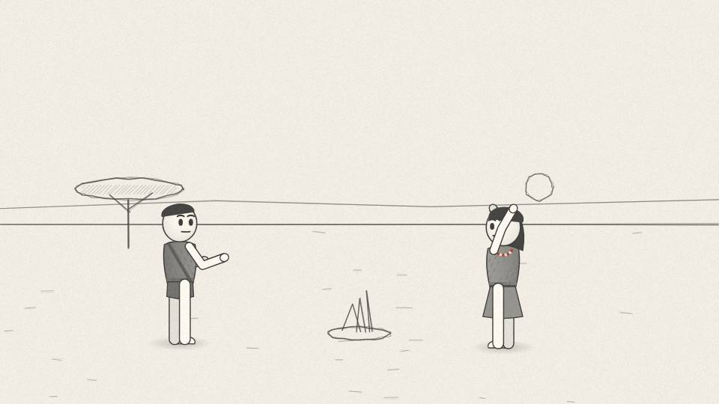
AH 3.08 WIDE · 10.6 s
Act 3 · Act 3: The Hunter Who Never Stops
VISUAL
Hunters return at dusk carrying meat; the camp gathers; fire built up.
ON-SCREEN TEXT
—
ANIMATION NOTES
Dusk: hunters return carrying meat; the camp stands to greet them; the fire is built up and flares.
VO
A big hunt can take the whole day, and it's the hardest work this life asks for. But one good kill feeds the camp for days.
Notes:
VO: A big hunt can take the whole day, and it's the hardest work this life asks for. But one good kill feeds the camp for days.
Visual: Hunters return at dusk carrying meat; the camp gathers; fire built up.
On-screen: -
Animation: Dusk: hunters return carrying meat; the camp stands to greet them; the fire is built up and flares.

Slide 45
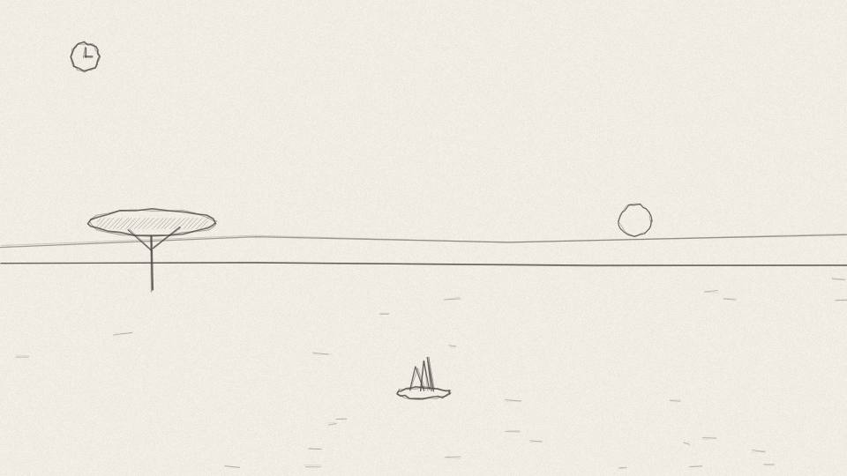
AH 3.09 CU · 3.4 s
Act 3 · Act 3: The Hunter Who Never Stops
VISUAL
Hours clock fills back up with a free afternoon.
ON-SCREEN TEXT
—
ANIMATION NOTES
The hours clock refills with a free afternoon block (soft chime).
VO
So tomorrow, the free time comes back.
Notes:
VO: So tomorrow, the free time comes back.
Visual: Hours clock fills back up with a free afternoon.
On-screen: -
Animation: The hours clock refills with a free afternoon block (soft chime).

Slide 46
ACT 4 · ACT 4: THE MAN WITH THE STOPWATCH
11 frames · 1:39

Slide 47
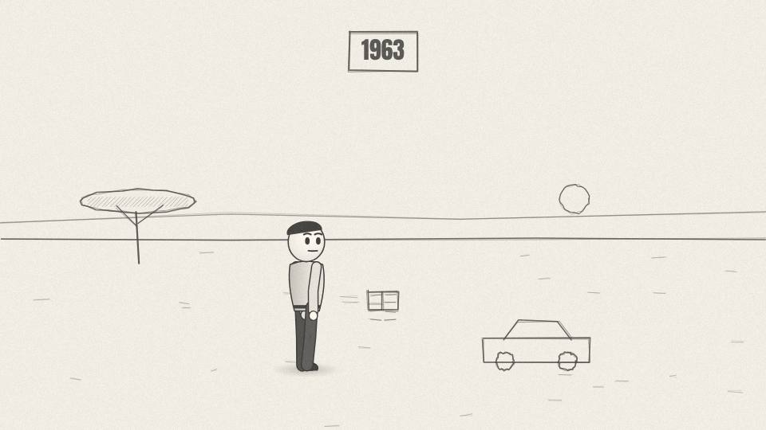
AH 4.01 MED · 8.7 s
Act 4 · Act 4: The Man With the Stopwatch
VISUAL
Sepia 1960s look: a young researcher with a notebook steps off a Land Rover.
ON-SCREEN TEXT
1963
ANIMATION NOTES
Sepia 1960s grade. A Land Rover rolls in and stops (eased); the researcher steps out with a notebook.
VO
If this sounds too easy, you're not the first to think so. In 1963, a young anthropologist had the same doubt.
Notes:
VO: If this sounds too easy, you're not the first to think so. In 1963, a young anthropologist had the same doubt.
Visual: Sepia 1960s look: a young researcher with a notebook steps off a Land Rover.
On-screen: 1963
Animation: Sepia 1960s grade. A Land Rover rolls in and stops (eased); the researcher steps out with a notebook.

Slide 48
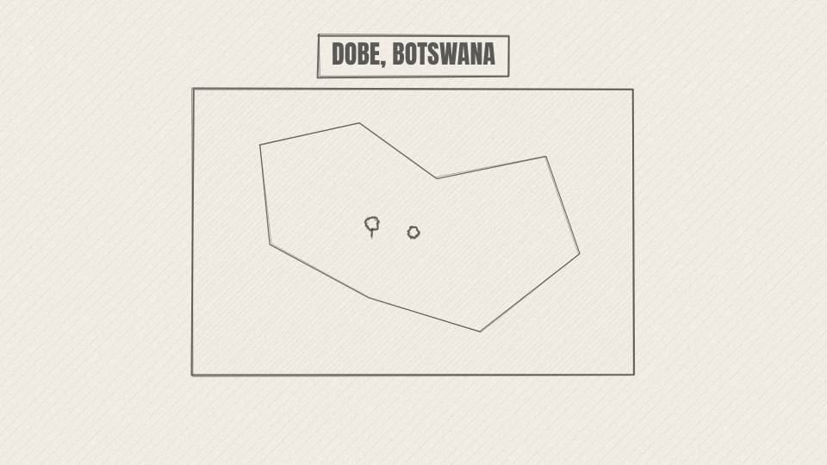
AH 4.02 MAP · 7.9 s
Act 4 · Act 4: The Man With the Stopwatch
VISUAL
Map of southern Africa; the Kalahari shaded; a pin on Dobe near the Namibia border.
ON-SCREEN TEXT
DOBE, BOTSWANA
ANIMATION NOTES
Map of southern Africa; Kalahari shades in; pin drops on Dobe near the Namibia border.
VO
His name was Richard Lee. He went to the Dobe area on the edge of the Kalahari, in Botswana.
Notes:
VO: His name was Richard Lee. He went to the Dobe area on the edge of the Kalahari, in Botswana.
Visual: Map of southern Africa; the Kalahari shaded; a pin on Dobe near the Namibia border.
On-screen: DOBE, BOTSWANA
Animation: Map of southern Africa; Kalahari shades in; pin drops on Dobe near the Namibia border.

Slide 49
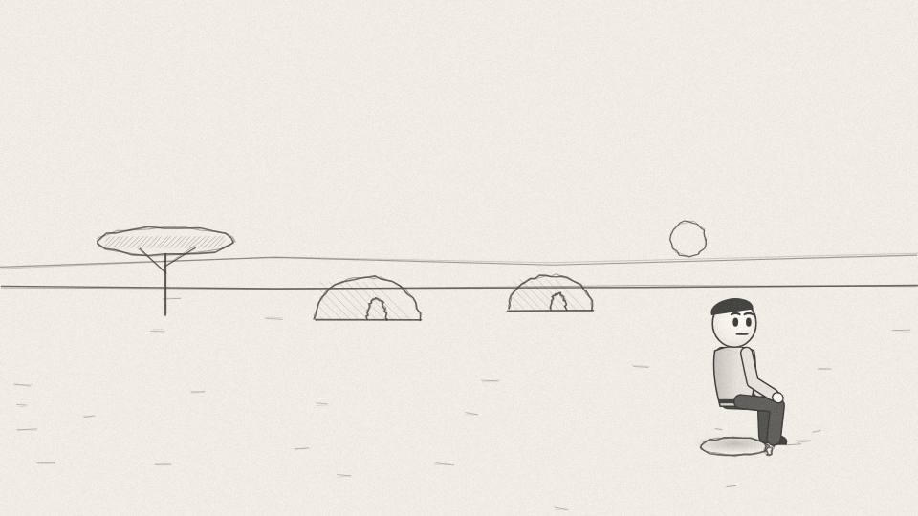
AH 4.03 WIDE · 7.5 s
Act 4 · Act 4: The Man With the Stopwatch
VISUAL
Painted Kalahari camp: grass huts, mongongo trees, dry sand; the researcher sits apart, writing.
ON-SCREEN TEXT
THE JU/'HOANSI
ANIMATION NOTES
Painted Kalahari camp, mongongo trees; the researcher sits apart, writing; camp life moves around him.
VO
He lived with the Ju/'hoansi, people who at the time still lived largely by hunting and gathering.
Notes:
VO: He lived with the Ju/'hoansi, people who at the time still lived largely by hunting and gathering.
Visual: Painted Kalahari camp: grass huts, mongongo trees, dry sand; the researcher sits apart, writing.
On-screen: THE JU/'HOANSI
Animation: Painted Kalahari camp, mongongo trees; the researcher sits apart, writing; camp life moves around him.

Slide 50

AH 4.04 MED · 9.8 s
Act 4 · Act 4: The Man With the Stopwatch
VISUAL
Notebook pages fill with tally marks; a stopwatch ticks.
ON-SCREEN TEXT
—
ANIMATION NOTES
Tally marks write themselves into the notebook; the stopwatch hand sweeps (tick SFX).
VO
The textbook story said life like this meant working every daylight hour just to survive. Lee decided not to assume it. He counted it.
Notes:
VO: The textbook story said life like this meant working every daylight hour just to survive. Lee decided not to assume it. He counted it.
Visual: Notebook pages fill with tally marks; a stopwatch ticks.
On-screen: -
Animation: Tally marks write themselves into the notebook; the stopwatch hand sweeps (tick SFX).

Slide 51
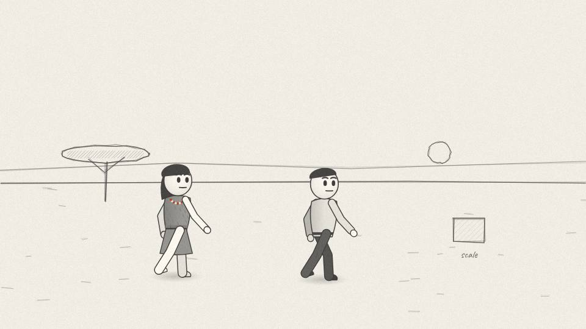
AH 4.05 MED · 7.2 s
Act 4 · Act 4: The Man With the Stopwatch
VISUAL
Montage: Lee follows a gatherer, notes times, weighs nuts on a hanging scale.
ON-SCREEN TEXT
—
ANIMATION NOTES
Lee follows a gatherer (two walk cycles); nuts tip onto a hanging scale that swings and settles.
VO
For weeks, he recorded who went out for food, for how long, and what they brought back.
Notes:
VO: For weeks, he recorded who went out for food, for how long, and what they brought back.
Visual: Montage: Lee follows a gatherer, notes times, weighs nuts on a hanging scale.
On-screen: -
Animation: Lee follows a gatherer (two walk cycles); nuts tip onto a hanging scale that swings and settles.

Slide 52
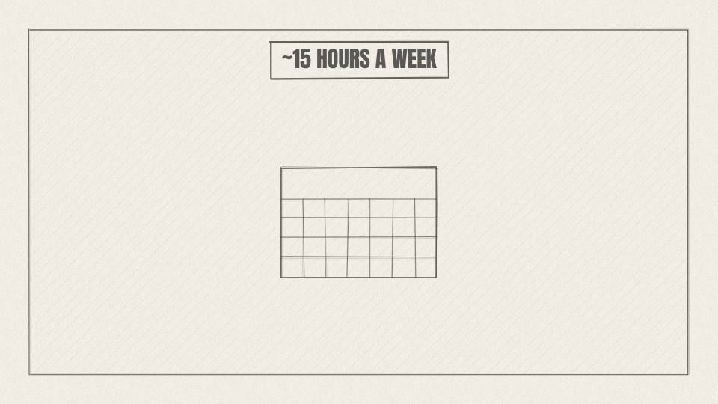
AH 4.06 CHART · 7.9 s
Act 4 · Act 4: The Man With the Stopwatch
VISUAL
Big number reveal over a week calendar: 15 HRS highlighted across Mon-Wed.
ON-SCREEN TEXT
~15 HOURS A WEEK
ANIMATION NOTES
A week calendar; 15 hours shade in across Mon to Wed; the big number counts up 0 to 15.
VO
The result surprised everyone. Finding food took adults about fifteen hours a week. Roughly two and a half days.
Notes:
VO: The result surprised everyone. Finding food took adults about fifteen hours a week. Roughly two and a half days.
Visual: Big number reveal over a week calendar: 15 HRS highlighted across Mon-Wed.
On-screen: ~15 HOURS A WEEK
Animation: A week calendar; 15 hours shade in across Mon to Wed; the big number counts up 0 to 15.

Slide 53
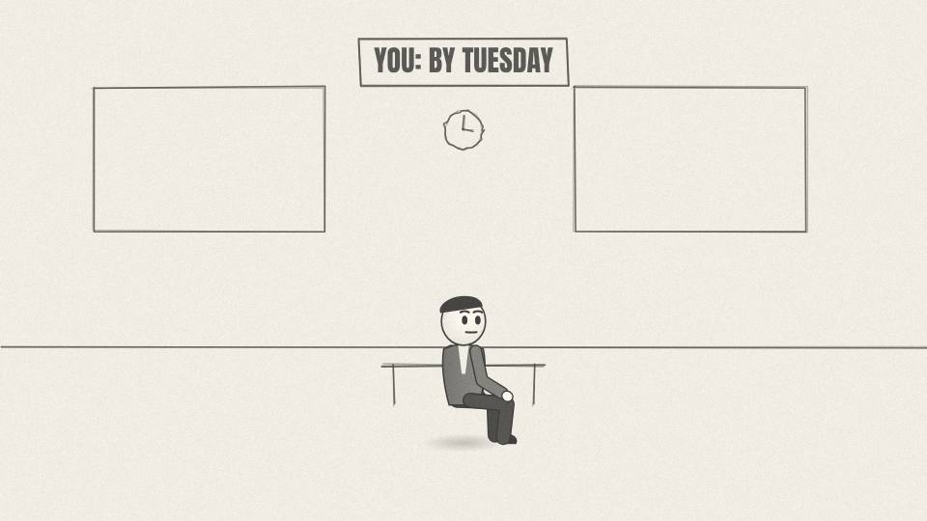
AH 4.07 CU · 5.7 s
Act 4 · Act 4: The Man With the Stopwatch
VISUAL
Office clock on Tuesday, 3 pm; the hours clock in the corner tips into overtime.
ON-SCREEN TEXT
YOU: BY TUESDAY
ANIMATION NOTES
Office wall clock spins fast to Tuesday 3 pm; the hours clock in the corner tips into red.
VO
If you work a normal job, you pass fifteen hours by Tuesday afternoon.
Notes:
VO: If you work a normal job, you pass fifteen hours by Tuesday afternoon.
Visual: Office clock on Tuesday, 3 pm; the hours clock in the corner tips into overtime.
On-screen: YOU: BY TUESDAY
Animation: Office wall clock spins fast to Tuesday 3 pm; the hours clock in the corner tips into red.

Slide 54
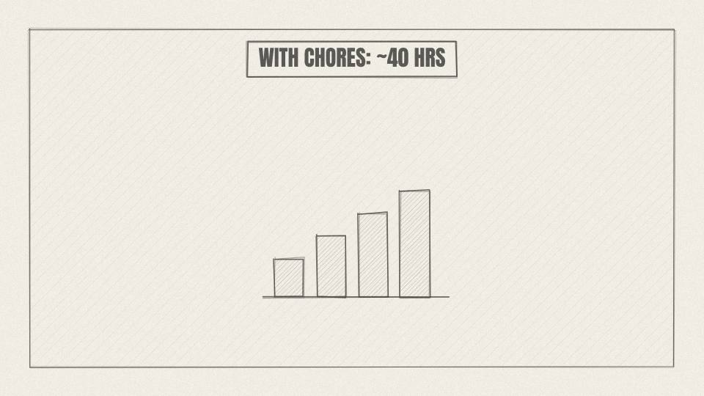
AH 4.08 CARD · 10.9 s
Act 4 · Act 4: The Man With the Stopwatch
VISUAL
Calendar adds stacked bars: food, tools, processing, chores; the total climbs to ~40.
ON-SCREEN TEXT
WITH CHORES: ~40 HRS
ANIMATION NOTES
Stacked bars add layer by layer: food, tools, processing, chores; total climbs to about 40.
VO
To be fair, that number is only food. When Lee later added tool-making, cracking nuts, cooking and chores, the total rose to around forty hours a week.
Notes:
VO: To be fair, that number is only food. When Lee later added tool-making, cracking nuts, cooking and chores, the total rose to around forty hours a week.
Visual: Calendar adds stacked bars: food, tools, processing, chores; the total climbs to ~40.
On-screen: WITH CHORES: ~40 HRS
Animation: Stacked bars add layer by layer: food, tools, processing, chores; total climbs to about 40.

Slide 55
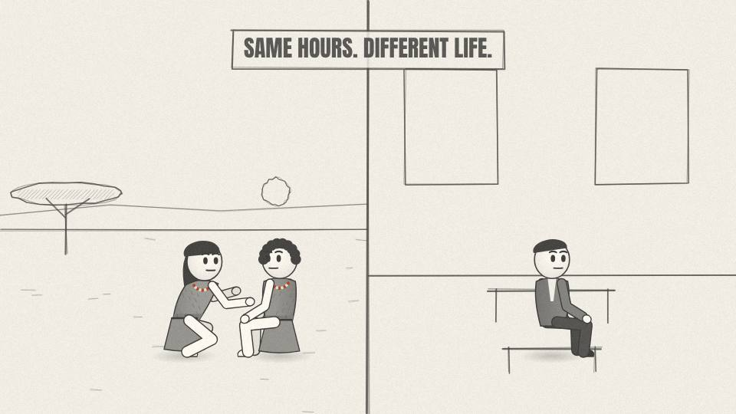
AH 4.09 MED · 12.1 s
Act 4 · Act 4: The Man With the Stopwatch
VISUAL
Split frame: Ju/'hoan woman cracking nuts while chatting with friends vs. office worker alone in a cubicle.
ON-SCREEN TEXT
SAME HOURS. DIFFERENT LIFE.
ANIMATION NOTES
Split: left, friends cracking nuts and laughing (talk mouths); right, one worker alone typing. Same clock on both sides.
VO
That's close to a modern full-time job. But the shape was completely different. No commute, no fixed shift, no boss, and the work happened with family and friends around you.
Notes:
VO: That's close to a modern full-time job. But the shape was completely different. No commute, no fixed shift, no boss, and the work happened with family and friends around you.
Visual: Split frame: Ju/'hoan woman cracking nuts while chatting with friends vs. office worker alone in a cubicle.
On-screen: SAME HOURS. DIFFERENT LIFE.
Animation: Split: left, friends cracking nuts and laughing (talk mouths); right, one worker alone typing. Same clock on both sides.

Slide 56
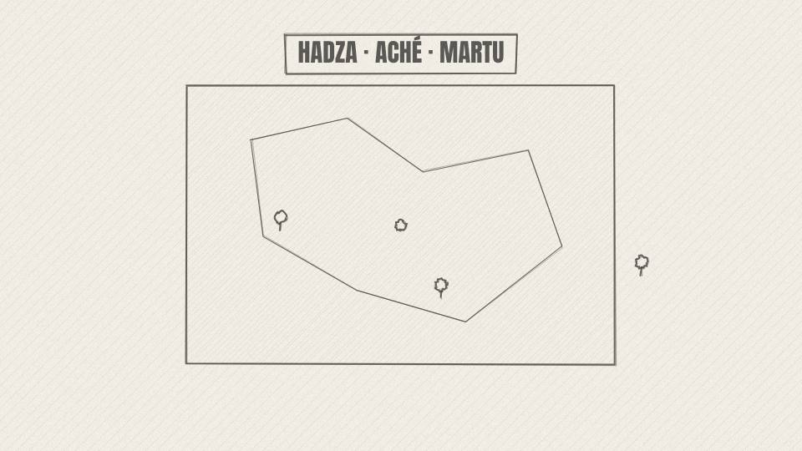
AH 4.10 MAP · 12.1 s
Act 4 · Act 4: The Man With the Stopwatch
VISUAL
World map with three pins lighting up in turn, each with a small hours bar of different length.
ON-SCREEN TEXT
HADZA · ACHÉ · MARTU
ANIMATION NOTES
World map; three pins light in turn, each with a small bar of different length growing beside it.
VO
Researchers later studied other foraging groups: the Hadza in Tanzania, the Aché in Paraguay, the Martu in Australia. The numbers vary a lot. Some groups spend far longer finding food.
Notes:
VO: Researchers later studied other foraging groups: the Hadza in Tanzania, the Aché in Paraguay, the Martu in Australia. The numbers vary a lot. Some groups spend far longer finding food.
Visual: World map with three pins lighting up in turn, each with a small hours bar of different length.
On-screen: HADZA · ACHÉ · MARTU
Animation: World map; three pins light in turn, each with a small bar of different length growing beside it.

Slide 57
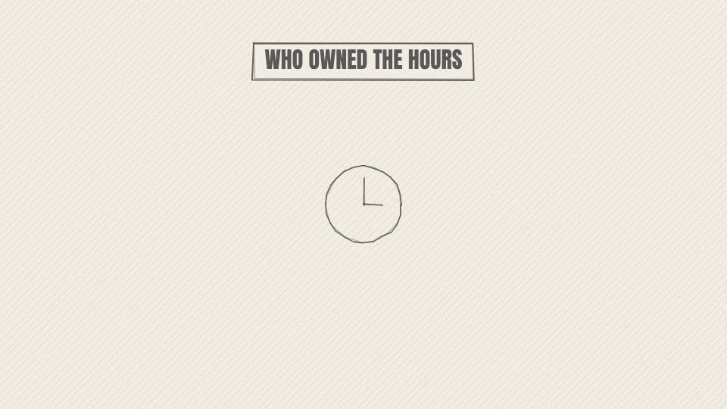
AH 4.11 CU · 9.8 s
Act 4 · Act 4: The Man With the Stopwatch
VISUAL
The hours clock changes label to 'HOURS THAT ARE YOURS'.
ON-SCREEN TEXT
WHO OWNED THE HOURS
ANIMATION NOTES
The corner clock moves to centre and grows; its label rewrites to HOURS THAT ARE YOURS.
VO
So the real lesson isn't a magic number. It's who owned the hours. They decided when to work, how hard, and when to stop.
Notes:
VO: So the real lesson isn't a magic number. It's who owned the hours. They decided when to work, how hard, and when to stop.
Visual: The hours clock changes label to 'HOURS THAT ARE YOURS'.
On-screen: WHO OWNED THE HOURS
Animation: The corner clock moves to centre and grows; its label rewrites to HOURS THAT ARE YOURS.

Slide 58
ACT 5 · ACT 5: BEADS AND A FLUTE
13 frames · 1:35

Slide 59

AH 5.01 WIDE · 4.5 s
Act 5 · Act 5: Beads and a Flute
VISUAL
Shaded camp under a big tree; light dapples; people lounge.
ON-SCREEN TEXT
—
ANIMATION NOTES
Dappled light moves through the big tree; people lounge; slow drift camera.
VO
Back at camp, it's afternoon, and the pace slows down.
Notes:
VO: Back at camp, it's afternoon, and the pace slows down.
Visual: Shaded camp under a big tree; light dapples; people lounge.
On-screen: -
Animation: Dappled light moves through the big tree; people lounge; slow drift camera.

Slide 60

AH 5.02 MED · 7.9 s
Act 5 · Act 5: Beads and a Flute
VISUAL
Several moving vignettes: kids playing with a hoop, two women chatting, an old man laughing.
ON-SCREEN TEXT
—
ANIMATION NOTES
Kids chase a hoop (run cycles); two women talk (mouths animate); an old man laughs (shoulders bounce).
VO
People sit in the shade and talk. Kids play. Someone combs through a friend's hair while the conversation wanders.
Notes:
VO: People sit in the shade and talk. Kids play. Someone combs through a friend's hair while the conversation wanders.
Visual: Several moving vignettes: kids playing with a hoop, two women chatting, an old man laughing.
On-screen: -
Animation: Kids chase a hoop (run cycles); two women talk (mouths animate); an old man laughs (shoulders bounce).

Slide 61

AH 5.03 CU · 6.0 s
Act 5 · Act 5: Beads and a Flute
VISUAL
Close-up hands with a stone awl drilling a shell; 3D shell beads.
ON-SCREEN TEXT
—
ANIMATION NOTES
Close on hands drilling a tiny shell with a stone awl, twisting back and forth; shell dust puffs.
VO
Someone is drilling tiny holes through small shells, to string them as a necklace.
Notes:
VO: Someone is drilling tiny holes through small shells, to string them as a necklace.
Visual: Close-up hands with a stone awl drilling a shell; 3D shell beads.
On-screen: -
Animation: Close on hands drilling a tiny shell with a stone awl, twisting back and forth; shell dust puffs.

Slide 62

AH 5.04 MAP · 8.7 s
Act 5 · Act 5: Beads and a Flute
VISUAL
Map of South Africa's southern coast; Blombos Cave pin; then a painted cave mouth above the sea.
ON-SCREEN TEXT
BLOMBOS CAVE · ~75,000 YEARS
ANIMATION NOTES
Map of the southern Cape; pin drops; dissolve to a painted cave mouth above the sea with waves rolling.
VO
We know people did this, because at Blombos Cave in South Africa, archaeologists found shell beads about seventy-five thousand years old.
Notes:
VO: We know people did this, because at Blombos Cave in South Africa, archaeologists found shell beads about seventy-five thousand years old.
Visual: Map of South Africa's southern coast; Blombos Cave pin; then a painted cave mouth above the sea.
On-screen: BLOMBOS CAVE · ~75,000 YEARS
Animation: Map of the southern Cape; pin drops; dissolve to a painted cave mouth above the sea with waves rolling.

Slide 63

AH 5.05 PROP3D · 9.8 s
Act 5 · Act 5: Beads and a Flute
VISUAL
3D row of Nassarius shell beads rotates, wear marks highlighted.
ON-SCREEN TEXT
MADE TO BE WORN
ANIMATION NOTES
3D row of shell beads rotates; wear marks highlight with small circles.
VO
Dozens of tiny snail shells, each pierced and worn smooth where a string rubbed against it. Some were brought from river mouths kilometres away.
Notes:
VO: Dozens of tiny snail shells, each pierced and worn smooth where a string rubbed against it. Some were brought from river mouths kilometres away.
Visual: 3D row of Nassarius shell beads rotates, wear marks highlighted.
On-screen: MADE TO BE WORN
Animation: 3D row of shell beads rotates; wear marks highlight with small circles.

Slide 64

AH 5.06 CU · 6.0 s
Act 5 · Act 5: Beads and a Flute
VISUAL
A young woman ties the finished necklace on and smiles.
ON-SCREEN TEXT
—
ANIMATION NOTES
She ties the necklace on and smiles; beads catch the light.
VO
Gathered, carried home and drilled by hand. Not to eat. Just to look good.
Notes:
VO: Gathered, carried home and drilled by hand. Not to eat. Just to look good.
Visual: A young woman ties the finished necklace on and smiles.
On-screen: -
Animation: She ties the necklace on and smiles; beads catch the light.

Slide 65

AH 5.07 MAP · 8.3 s
Act 5 · Act 5: Beads and a Flute
VISUAL
Map of Europe; a pin in south-west Germany; snowy Ice Age landscape plate.
ON-SCREEN TEXT
HOHLE FELS · 2008
ANIMATION NOTES
Map of Europe to snowy Ice Age plate; snow falls; pin on south-west Germany.
VO
And in 2008, in Hohle Fels cave in Germany, researchers pieced together a flute carved from a vulture's wing bone.
Notes:
VO: And in 2008, in Hohle Fels cave in Germany, researchers pieced together a flute carved from a vulture's wing bone.
Visual: Map of Europe; a pin in south-west Germany; snowy Ice Age landscape plate.
On-screen: HOHLE FELS · 2008
Animation: Map of Europe to snowy Ice Age plate; snow falls; pin on south-west Germany.

Slide 66

AH 5.08 PROP3D · 5.3 s
Act 5 · Act 5: Beads and a Flute
VISUAL
3D bone flute rotates; the five holes glow one by one with a soft note each.
ON-SCREEN TEXT
~40,000 YEARS · 5 HOLES
ANIMATION NOTES
The bone flute rotates; its five holes glow one by one, each with a soft flute note.
VO
It's around forty thousand years old, and it has five finger holes.
Notes:
VO: It's around forty thousand years old, and it has five finger holes.
Visual: 3D bone flute rotates; the five holes glow one by one with a soft note each.
On-screen: ~40,000 YEARS · 5 HOLES
Animation: The bone flute rotates; its five holes glow one by one, each with a soft flute note.

Slide 67

AH 5.09 CU · 7.5 s
Act 5 · Act 5: Beads and a Flute
VISUAL
Ice Age musician plays by a fire; others listen; breath visible in the cold.
ON-SCREEN TEXT
—
ANIMATION NOTES
Ice Age musician plays by the fire, fingers lifting; listeners sway; breath visible in the cold.
VO
Someone in the Ice Age made an instrument. Someone else had the time to learn to play it.
Notes:
VO: Someone in the Ice Age made an instrument. Someone else had the time to learn to play it.
Visual: Ice Age musician plays by a fire; others listen; breath visible in the cold.
On-screen: -
Animation: Ice Age musician plays by the fire, fingers lifting; listeners sway; breath visible in the cold.

Slide 68

AH 5.10 WIDE · 6.0 s
Act 5 · Act 5: Beads and a Flute
VISUAL
Camp scene desaturates slightly; icons of money, a police badge and a hospital cross appear and get crossed out.
ON-SCREEN TEXT
NO MONEY · NO POLICE · NO HOSPITAL
ANIMATION NOTES
Camp desaturates; three icons appear and each is struck out with an ink X.
VO
Now think about what kept you alive here. No money. No police. No hospital.
Notes:
VO: Now think about what kept you alive here. No money. No police. No hospital.
Visual: Camp scene desaturates slightly; icons of money, a police badge and a hospital cross appear and get crossed out.
On-screen: NO MONEY · NO POLICE · NO HOSPITAL
Animation: Camp desaturates; three icons appear and each is struck out with an ink X.

Slide 69

AH 5.11 MED · 9.1 s
Act 5 · Act 5: Beads and a Flute
VISUAL
An injured man sits with his leg bound; others bring him food.
ON-SCREEN TEXT
—
ANIMATION NOTES
An injured man with a bound leg; someone walks up and hands him food; he nods.
VO
If your hunt fails, or you break a leg and can't walk for a month, the only safety net is other people.
Notes:
VO: If your hunt fails, or you break a leg and can't walk for a month, the only safety net is other people.
Visual: An injured man sits with his leg bound; others bring him food.
On-screen: -
Animation: An injured man with a bound leg; someone walks up and hands him food; he nods.

Slide 70

AH 5.12 CU · 6.0 s
Act 5 · Act 5: Beads and a Flute
VISUAL
Close on the food being handed over.
ON-SCREEN TEXT
—
ANIMATION NOTES
Close on the hand-over of food; warm light.
VO
If people like you, they feed you. If they don't, nobody owes you anything.
Notes:
VO: If people like you, they feed you. If they don't, nobody owes you anything.
Visual: Close on the food being handed over.
On-screen: -
Animation: Close on the hand-over of food; warm light.

Slide 71

AH 5.13 WIDE · 10.2 s
Act 5 · Act 5: Beads and a Flute
VISUAL
Three labels attach to the circle of people: BANK, HOSPITAL, PENSION.
ON-SCREEN TEXT
FRIENDS = INSURANCE
ANIMATION NOTES
Circle of people; three labels (BANK, HOSPITAL, PENSION) attach with lines and pop in.
VO
So those slow afternoons of talking and joking weren't wasted. They were insurance. Friendships were your bank, your hospital and your pension, all at once.
Notes:
VO: So those slow afternoons of talking and joking weren't wasted. They were insurance. Friendships were your bank, your hospital and your pension, all at once.
Visual: Three labels attach to the circle of people: BANK, HOSPITAL, PENSION.
On-screen: FRIENDS = INSURANCE
Animation: Circle of people; three labels (BANK, HOSPITAL, PENSION) attach with lines and pop in.

Slide 72
ACT 6 · ACT 6: FIRELIGHT
8 frames · 0:59

Slide 73

AH 6.01 WIDE · 5.7 s
Act 6 · Act 6: Firelight
VISUAL
Time-lapse sunset over the Kalahari; the fire is built up; sparks rise.
ON-SCREEN TEXT
—
ANIMATION NOTES
Time-lapse sunset: sky colour shifts warm to deep blue; the fire is built up and sparks rise.
VO
Then the sun goes down, and the best part of the day begins.
Notes:
VO: Then the sun goes down, and the best part of the day begins.
Visual: Time-lapse sunset over the Kalahari; the fire is built up; sparks rise.
On-screen: -
Animation: Time-lapse sunset: sky colour shifts warm to deep blue; the fire is built up and sparks rise.

Slide 74

AH 6.02 MED · 6.8 s
Act 6 · Act 6: Firelight
VISUAL
Researcher at a desk with old notebooks and a recorder; then the paper title card.
ON-SCREEN TEXT
POLLY WIESSNER · 2014
ANIMATION NOTES
Researcher at a desk with old notebooks and a tape recorder; the paper's title card slides in.
VO
In 2014, anthropologist Polly Wiessner published a study of how Ju/'hoan conversation changes after dark.
Notes:
VO: In 2014, anthropologist Polly Wiessner published a study of how Ju/'hoan conversation changes after dark.
Visual: Researcher at a desk with old notebooks and a recorder; then the paper title card.
On-screen: POLLY WIESSNER · 2014
Animation: Researcher at a desk with old notebooks and a tape recorder; the paper's title card slides in.

Slide 75

AH 6.03 MED · 9.1 s
Act 6 · Act 6: Firelight
VISUAL
Two piles of cards slide apart: a sun icon and a fire icon.
ON-SCREEN TEXT
DAY · NIGHT
ANIMATION NOTES
A pile of cards splits into two piles sliding apart under sun and fire icons.
VO
She had notes and recordings gathered over decades, and she split them into two piles: talk by day, and talk by firelight.
Notes:
VO: She had notes and recordings gathered over decades, and she split them into two piles: talk by day, and talk by firelight.
Visual: Two piles of cards slide apart: a sun icon and a fire icon.
On-screen: DAY · NIGHT
Animation: A pile of cards splits into two piles sliding apart under sun and fire icons.

Slide 76

AH 6.04 CHART · 8.3 s
Act 6 · Act 6: Firelight
VISUAL
Daytime pie chart: work talk, complaints and gossip, jokes.
ON-SCREEN TEXT
DAY: WORK + GOSSIP
ANIMATION NOTES
Daytime pie draws on clockwise: work talk, complaints and gossip, jokes.
VO
Daytime talk was practical. Food, tracks, money and trade, and a lot of complaining and gossip about who wasn't sharing.
Notes:
VO: Daytime talk was practical. Food, tracks, money and trade, and a lot of complaining and gossip about who wasn't sharing.
Visual: Daytime pie chart: work talk, complaints and gossip, jokes.
On-screen: DAY: WORK + GOSSIP
Animation: Daytime pie draws on clockwise: work talk, complaints and gossip, jokes.

Slide 77

AH 6.05 CHART · 6.0 s
Act 6 · Act 6: Firelight
VISUAL
Night pie fills to 81% in firelight orange.
ON-SCREEN TEXT
NIGHT: 81% STORIES
ANIMATION NOTES
Night pie fills to 81% in firelight orange; number counts up.
VO
By the fire, it changed. In the long night conversations, eighty-one percent were stories.
Notes:
VO: By the fire, it changed. In the long night conversations, eighty-one percent were stories.
Visual: Night pie fills to 81% in firelight orange.
On-screen: NIGHT: 81% STORIES
Animation: Night pie fills to 81% in firelight orange; number counts up.

Slide 78

AH 6.06 WIDE · 8.3 s
Act 6 · Act 6: Firelight
VISUAL
Firelit faces; shadows on the rocks behind form the story: ancestors, animals, stars.
ON-SCREEN TEXT
—
ANIMATION NOTES
Firelit faces; shadows on the rock wall behind act out the story (ancestors, animals, stars).
VO
Stories about ancestors, about how the world began, about people far away. Long jokes that ran deep into the night.
Notes:
VO: Stories about ancestors, about how the world began, about people far away. Long jokes that ran deep into the night.
Visual: Firelit faces; shadows on the rocks behind form the story: ancestors, animals, stars.
On-screen: -
Animation: Firelit faces; shadows on the rock wall behind act out the story (ancestors, animals, stars).

Slide 79

AH 6.07 CU · 9.1 s
Act 6 · Act 6: Firelight
VISUAL
Embers rise into the stars, forming faint constellations.
ON-SCREEN TEXT
WHERE CULTURE GREW
ANIMATION NOTES
Embers rise into the sky and join into faint constellations; camera tilts up with them.
VO
Wiessner argued that these firelit hours helped build what makes us human: shared memory, imagination and trust in people beyond the camp.
Notes:
VO: Wiessner argued that these firelit hours helped build what makes us human: shared memory, imagination and trust in people beyond the camp.
Visual: Embers rise into the stars, forming faint constellations.
On-screen: WHERE CULTURE GREW
Animation: Embers rise into the sky and join into faint constellations; camera tilts up with them.

Slide 80

AH 6.08 CU · 5.7 s
Act 6 · Act 6: Firelight
VISUAL
Slow push into the fire.
ON-SCREEN TEXT
—
ANIMATION NOTES
Slow push into the fire; crackle SFX up.
VO
Not in the middle of the work, but in the calm after it.
Notes:
VO: Not in the middle of the work, but in the calm after it.
Visual: Slow push into the fire.
On-screen: -
Animation: Slow push into the fire; crackle SFX up.

Slide 81
ACT 7 · ACT 7: TWO SLEEPS
6 frames · 0:49

Slide 82

AH 7.01 WIDE · 6.0 s
Act 7 · Act 7: Two Sleeps
VISUAL
Moonlit camp; figures asleep under hides; embers glow.
ON-SCREEN TEXT
—
ANIMATION NOTES
Moonlit camp; sleepers breathe; embers glow and fade.
VO
When the fire burns low, people sleep. But maybe not the way you do.
Notes:
VO: When the fire burns low, people sleep. But maybe not the way you do.
Visual: Moonlit camp; figures asleep under hides; embers glow.
On-screen: -
Animation: Moonlit camp; sleepers breathe; embers glow and fade.

Slide 83

AH 7.02 MED · 9.8 s
Act 7 · Act 7: Two Sleeps
VISUAL
Old parchment documents with highlighted phrases 'first sleep' and 'second sleep'; candlelight.
ON-SCREEN TEXT
'FIRST SLEEP' · 'SECOND SLEEP'
ANIMATION NOTES
Candlelit parchment; the phrases highlight as if underlined by hand.
VO
Historian Roger Ekirch found hundreds of old European records that mention a first sleep and a second sleep, with a waking hour in between.
Notes:
VO: Historian Roger Ekirch found hundreds of old European records that mention a first sleep and a second sleep, with a waking hour in between.
Visual: Old parchment documents with highlighted phrases 'first sleep' and 'second sleep'; candlelight.
On-screen: 'FIRST SLEEP' · 'SECOND SLEEP'
Animation: Candlelit parchment; the phrases highlight as if underlined by hand.

Slide 84

AH 7.03 MED · 6.4 s
Act 7 · Act 7: Two Sleeps
VISUAL
A medieval couple wakes by candlelight and talks softly, then lies back down.
ON-SCREEN TEXT
—
ANIMATION NOTES
A medieval couple wakes by candle, talks softly, then lies back down; the candle flickers.
VO
People would wake around midnight, lie quietly, think, pray or talk, and then sleep again.
Notes:
VO: People would wake around midnight, lie quietly, think, pray or talk, and then sleep again.
Visual: A medieval couple wakes by candlelight and talks softly, then lies back down.
On-screen: -
Animation: A medieval couple wakes by candle, talks softly, then lies back down; the candle flickers.

Slide 85

AH 7.04 CHART · 9.1 s
Act 7 · Act 7: Two Sleeps
VISUAL
Two sleep blocks on a night timeline with a gap in the middle.
ON-SCREEN TEXT
SLEEP · AWAKE · SLEEP
ANIMATION NOTES
A night timeline draws left to right: sleep block, gap, sleep block.
VO
And when a 1990s experiment kept volunteers in long winter nights with no artificial light, many slipped into the same split pattern.
Notes:
VO: And when a 1990s experiment kept volunteers in long winter nights with no artificial light, many slipped into the same split pattern.
Visual: Two sleep blocks on a night timeline with a gap in the middle.
On-screen: SLEEP · AWAKE · SLEEP
Animation: A night timeline draws left to right: sleep block, gap, sleep block.

Slide 86

AH 7.05 CARD · 8.7 s
Act 7 · Act 7: Two Sleeps
VISUAL
Card with three group names and a single solid sleep bar.
ON-SCREEN TEXT
THE DEBATE IS OPEN
ANIMATION NOTES
A card with three group names slides in; a single solid sleep bar draws under it.
VO
Not every study agrees. When researchers tracked sleep among the Hadza, the San and the Tsimane, most slept in one block.
Notes:
VO: Not every study agrees. When researchers tracked sleep among the Hadza, the San and the Tsimane, most slept in one block.
Visual: Card with three group names and a single solid sleep bar.
On-screen: THE DEBATE IS OPEN
Animation: A card with three group names slides in; a single solid sleep bar draws under it.

Slide 87

AH 7.06 CU · 9.8 s
Act 7 · Act 7: Two Sleeps
VISUAL
Modern bedroom: phone shows 2:00; the figure lies calmly instead of panicking.
ON-SCREEN TEXT
2:00 AM
ANIMATION NOTES
Modern bedroom; phone glows 2:00; he lies calmly, breathing; no panic.
VO
So if you wake at two in the morning, it may not be a disorder. Your body may just be doing something very old.
Notes:
VO: So if you wake at two in the morning, it may not be a disorder. Your body may just be doing something very old.
Visual: Modern bedroom: phone shows 2:00; the figure lies calmly instead of panicking.
On-screen: 2:00 AM
Animation: Modern bedroom; phone glows 2:00; he lies calmly, breathing; no panic.

Slide 88
ACT 8 · ACT 8: THE TRAP
10 frames · 1:26

Slide 89

AH 8.01 WIDE · 8.7 s
Act 8 · Act 8: The Trap
VISUAL
Montage of the three earlier moments across one painted panorama; the hours clock is mostly free.
ON-SCREEN TEXT
—
ANIMATION NOTES
A long panorama of the three earlier moments; camera pans across it; the hours clock is mostly free.
VO
That was the human rhythm for a very long time. Food in the morning, people in the afternoon, stories at night.
Notes:
VO: That was the human rhythm for a very long time. Food in the morning, people in the afternoon, stories at night.
Visual: Montage of the three earlier moments across one painted panorama; the hours clock is mostly free.
On-screen: -
Animation: A long panorama of the three earlier moments; camera pans across it; the hours clock is mostly free.

Slide 90

AH 8.02 MAP · 7.5 s
Act 8 · Act 8: The Trap
VISUAL
Map of the Fertile Crescent arc lighting up green from the Levant to the Tigris and Euphrates.
ON-SCREEN TEXT
THE FERTILE CRESCENT · ~12,000 YEARS AGO
ANIMATION NOTES
The crescent arc lights green from the Levant to the Tigris and Euphrates.
VO
Then, roughly twelve thousand years ago, in the Fertile Crescent, people began planting wild grains and keeping animals.
Notes:
VO: Then, roughly twelve thousand years ago, in the Fertile Crescent, people began planting wild grains and keeping animals.
Visual: Map of the Fertile Crescent arc lighting up green from the Levant to the Tigris and Euphrates.
On-screen: THE FERTILE CRESCENT · ~12,000 YEARS AGO
Animation: The crescent arc lights green from the Levant to the Tigris and Euphrates.

Slide 91

AH 8.03 MED · 7.9 s
Act 8 · Act 8: The Trap
VISUAL
First farmer scatters seed; neat field rows appear; a pen of goats.
ON-SCREEN TEXT
—
ANIMATION NOTES
First farmer scatters seed (arm sweep); field rows draw in behind; goats in a pen.
VO
On paper, it looked like an upgrade. More food. More control. No more tracking an antelope across the plain.
Notes:
VO: On paper, it looked like an upgrade. More food. More control. No more tracking an antelope across the plain.
Visual: First farmer scatters seed; neat field rows appear; a pen of goats.
On-screen: -
Animation: First farmer scatters seed (arm sweep); field rows draw in behind; goats in a pen.

Slide 92

AH 8.04 CHART · 11.3 s
Act 8 · Act 8: The Trap
VISUAL
Circular diagram, each arrow lighting as spoken: FOOD → PEOPLE → FIELDS → WORK → FOOD.
ON-SCREEN TEXT
THE FARMING LOOP
ANIMATION NOTES
The loop's arrows light one after another as each word is said, then spin faster.
VO
But it set off a loop. More food meant more children survived. More people needed more food. More food meant more fields, and more fields meant more work.
Notes:
VO: But it set off a loop. More food meant more children survived. More people needed more food. More food meant more fields, and more fields meant more work.
Visual: Circular diagram, each arrow lighting as spoken: FOOD → PEOPLE → FIELDS → WORK → FOOD.
On-screen: THE FARMING LOOP
Animation: The loop's arrows light one after another as each word is said, then spin faster.

Slide 93

AH 8.05 CU · 8.7 s
Act 8 · Act 8: The Trap
VISUAL
A wooden gate swings shut on the field; the forest behind it fades.
ON-SCREEN TEXT
NO WAY BACK
ANIMATION NOTES
A wooden gate swings shut (creak + thud); the forest behind it fades out.
VO
And then the door shut. Once a village grew too big to live off wild food, there was no going back.
Notes:
VO: And then the door shut. Once a village grew too big to live off wild food, there was no going back.
Visual: A wooden gate swings shut on the field; the forest behind it fades.
On-screen: NO WAY BACK
Animation: A wooden gate swings shut (creak + thud); the forest behind it fades out.

Slide 94

AH 8.06 MED · 5.3 s
Act 8 · Act 8: The Trap
VISUAL
Rapid cycle of farming tasks with the same bent figure; 3D plough and grain sacks; ambient wind.
ON-SCREEN TEXT
—
ANIMATION NOTES
Fast cycle of tasks with the same bent figure: plough, sow, weed, harvest, grind; wind ambience.
VO
Ploughing, sowing, weeding, harvesting, grinding, storing and guarding. Every season, every year.
Notes:
VO: Ploughing, sowing, weeding, harvesting, grinding, storing and guarding. Every season, every year.
Visual: Rapid cycle of farming tasks with the same bent figure; 3D plough and grain sacks; ambient wind.
On-screen: -
Animation: Fast cycle of tasks with the same bent figure: plough, sow, weed, harvest, grind; wind ambience.

Slide 95

AH 8.07 CU · 7.5 s
Act 8 · Act 8: The Trap
VISUAL
Skeleton B fades in over the bent farmer.
ON-SCREEN TEXT
—
ANIMATION NOTES
Skeleton B fades in over the bent farmer (double exposure).
VO
Remember the second skeleton? The decay, the worn spine, the shorter life. This is where it came from.
Notes:
VO: Remember the second skeleton? The decay, the worn spine, the shorter life. This is where it came from.
Visual: Skeleton B fades in over the bent farmer.
On-screen: -
Animation: Skeleton B fades in over the bent farmer (double exposure).

Slide 96

AH 8.08 WIDE · 8.3 s
Act 8 · Act 8: The Trap
VISUAL
A painted village grows in time-lapse into a walled city; figures appear in turn.
ON-SCREEN TEXT
—
ANIMATION NOTES
Time-lapse: huts become houses become a walled city; potters, a king, soldiers, a tax collector appear in turn.
VO
Villages became towns. Towns needed potters, weavers and traders. Then cities, and with them kings, soldiers, priests and tax collectors.
Notes:
VO: Villages became towns. Towns needed potters, weavers and traders. Then cities, and with them kings, soldiers, priests and tax collectors.
Visual: A painted village grows in time-lapse into a walled city; figures appear in turn.
On-screen: -
Animation: Time-lapse: huts become houses become a walled city; potters, a king, soldiers, a tax collector appear in turn.

Slide 97

AH 8.09 CU · 10.2 s
Act 8 · Act 8: The Trap
VISUAL
A coin is placed in a farmer's hand; his hours clock is handed to a tax collector.
ON-SCREEN TEXT
YOUR HOURS, SOLD
ANIMATION NOTES
A coin drops into the farmer's hand; his hours clock floats across to the tax collector.
VO
And something new arrived in human history: hours that belonged to someone else, sold in exchange for food you no longer knew how to find.
Notes:
VO: And something new arrived in human history: hours that belonged to someone else, sold in exchange for food you no longer knew how to find.
Visual: A coin is placed in a farmer's hand; his hours clock is handed to a tax collector.
On-screen: YOUR HOURS, SOLD
Animation: A coin drops into the farmer's hand; his hours clock floats across to the tax collector.

Slide 98

AH 8.10 MED · 10.6 s
Act 8 · Act 8: The Trap
VISUAL
Generations pass: the same field, faces change, the city wall grows behind.
ON-SCREEN TEXT
—
ANIMATION NOTES
Generations pass in place: the same field, faces change, the city wall grows behind them.
VO
Nobody stole our time in one night. It was traded away slowly, over hundreds of generations, in a deal none of us got to vote on.
Notes:
VO: Nobody stole our time in one night. It was traded away slowly, over hundreds of generations, in a deal none of us got to vote on.
Visual: Generations pass: the same field, faces change, the city wall grows behind.
On-screen: -
Animation: Generations pass in place: the same field, faces change, the city wall grows behind them.

Slide 99
ACT 9 · ACT 9: THE FINISH LINE
9 frames · 0:59

Slide 100

AH 9.01 CU · 5.7 s
Act 9 · Act 9: The Finish Line
VISUAL
The modern phone alarm again, 6:00, cold light.
ON-SCREEN TEXT
6:00 AM
ANIMATION NOTES
Back to the phone alarm, cold light; it rings (alarm SFX, shorter).
VO
And the alarm that woke you this morning is just the latest payment.
Notes:
VO: And the alarm that woke you this morning is just the latest payment.
Visual: The modern phone alarm again, 6:00, cold light.
On-screen: 6:00 AM
Animation: Back to the phone alarm, cold light; it rings (alarm SFX, shorter).

Slide 101

AH 9.02 WIDE · 9.4 s
Act 9 · Act 9: The Finish Line
VISUAL
Recap panorama: hunt, shells and flute, the fire.
ON-SCREEN TEXT
—
ANIMATION NOTES
Recap panorama; quick parallax pan across hunt, shells and flute, the fire.
VO
For most of human history, finding food took part of the week. Afternoons went to craft, beauty and friendship. Nights went to stories.
Notes:
VO: For most of human history, finding food took part of the week. Afternoons went to craft, beauty and friendship. Nights went to stories.
Visual: Recap panorama: hunt, shells and flute, the fire.
On-screen: -
Animation: Recap panorama; quick parallax pan across hunt, shells and flute, the fire.

Slide 102

AH 9.03 MED · 5.7 s
Act 9 · Act 9: The Finish Line
VISUAL
Office tower at night, windows lit; the number counts up.
ON-SCREEN TEXT
~90,000 HOURS
ANIMATION NOTES
Office tower at night, windows lit; the number counts up.
VO
You will spend something like ninety thousand hours of your life at work.
Notes:
VO: You will spend something like ninety thousand hours of your life at work.
Visual: Office tower at night, windows lit; the number counts up.
On-screen: ~90,000 HOURS
Animation: Office tower at night, windows lit; the number counts up.

Slide 103

AH 9.04 MED · 7.2 s
Act 9 · Act 9: The Finish Line
VISUAL
Split: tired worker sketching at midnight / the shell necklace being made in daylight.
ON-SCREEN TEXT
—
ANIMATION NOTES
Split: tired worker sketching at midnight / the necklace being made in daylight.
VO
We make art if there's anything left after the job. They made it on an ordinary afternoon.
Notes:
VO: We make art if there's anything left after the job. They made it on an ordinary afternoon.
Visual: Split: tired worker sketching at midnight / the shell necklace being made in daylight.
On-screen: -
Animation: Split: tired worker sketching at midnight / the necklace being made in daylight.

Slide 104

AH 9.05 MED · 7.5 s
Act 9 · Act 9: The Finish Line
VISUAL
Split: business card exchange / grooming and laughing in the shade.
ON-SCREEN TEXT
—
ANIMATION NOTES
Split: two suits swap business cards / friends grooming and laughing in the shade.
VO
We network to get ahead. They spent hours with the people they loved, and it counted as survival.
Notes:
VO: We network to get ahead. They spent hours with the people they loved, and it counted as survival.
Visual: Split: business card exchange / grooming and laughing in the shade.
On-screen: -
Animation: Split: two suits swap business cards / friends grooming and laughing in the shade.

Slide 105

AH 9.06 CU · 6.0 s
Act 9 · Act 9: The Finish Line
VISUAL
A finish-line ribbon far down a long road of desks.
ON-SCREEN TEXT
RETIREMENT
ANIMATION NOTES
A road of desks recedes to a finish-line ribbon far away.
VO
We chase a finish line called retirement, where we finally get our time back.
Notes:
VO: We chase a finish line called retirement, where we finally get our time back.
Visual: A finish-line ribbon far down a long road of desks.
On-screen: RETIREMENT
Animation: A road of desks recedes to a finish-line ribbon far away.

Slide 106

AH 9.07 WIDE · 4.2 s
Act 9 · Act 9: The Finish Line
VISUAL
Pull back: the hunter sits on the finish line by his fire, relaxed.
ON-SCREEN TEXT
—
ANIMATION NOTES
Pull back: the hunter is already sitting on the finish line by his fire, relaxed.
VO
In one way, they were already standing on it.
Notes:
VO: In one way, they were already standing on it.
Visual: Pull back: the hunter sits on the finish line by his fire, relaxed.
On-screen: -
Animation: Pull back: the hunter is already sitting on the finish line by his fire, relaxed.

Slide 107

AH 9.08 CU · 6.4 s
Act 9 · Act 9: The Finish Line
VISUAL
Dawn again; the hunter stretches, looks out across the plain.
ON-SCREEN TEXT
WHAT SHOULD I DO TODAY?
ANIMATION NOTES
Dawn again; he stretches and looks out; the card from the cold open returns (bookend).
VO
They woke up without an alarm, and asked the question you rarely get to ask.
Notes:
VO: They woke up without an alarm, and asked the question you rarely get to ask.
Visual: Dawn again; the hunter stretches, looks out across the plain.
On-screen: WHAT SHOULD I DO TODAY?
Animation: Dawn again; he stretches and looks out; the card from the cold open returns (bookend).

Slide 108

AH 9.09 WIDE · 7.2 s
Act 9 · Act 9: The Finish Line
VISUAL
End card over the fire with the channel name.
ON-SCREEN TEXT
STROMHELL
ANIMATION NOTES
End card over the fire; channel name; music resolves.
VO
If this changed how you see your own day, watch next how farming built the first cities.
Notes:
VO: If this changed how you see your own day, watch next how farming built the first cities.
Visual: End card over the fire with the channel name.
On-screen: STROMHELL
Animation: End card over the fire; channel name; music resolves.

