Slide 1
STORYBOARD · NV
How Jensen Huang Actually Built Nvidia
Working title: He Built the Wrong Chip and Still Built the World's Most Valuable Company
79 frames · 10 acts · 1537 words · runtime 10:42
Running device: A 'DAYS OF CASH LEFT' counter in the corner that keeps nearly hitting zero (NV1 flop, Sega deal, RIVA 128), then flips into a market-value counter that climbs to $5 trillion.
Style: Calm serious tech-history documentary in the house 2D style. Painted plates: 1970s Kentucky boarding school, a 1990s Denny's booth under fluorescent light, a cramped early-90s office, a Tokyo boardroom, server halls glowing green. Chips as 3D props (NV1 board, RIVA 128, GeForce 256, H100). Real people as round-headed ink characters; company names as plain text, no logos.

Slide 2
ACT 0 · COLD OPEN
6 frames · 0:54

Slide 3
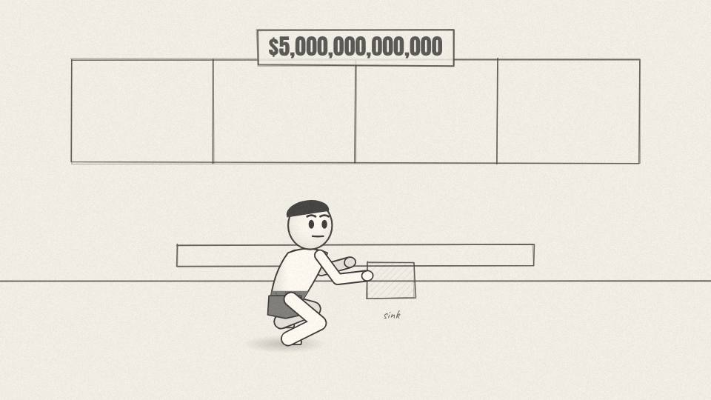
NV 0.01 CU · 8.7 s
Act 0 · Cold open
VISUAL
A teenage Jensen at a steaming dish sink; the steam clears into a $5T counter.
ON-SCREEN TEXT
—
ANIMATION NOTES
Steam rises from the sink as the boy scrubs (looping arm); the steam clears and becomes the $5T counter rolling up.
VO
A man who washed dishes at Denny's as a teenager now runs the first company in history worth five trillion dollars.
Notes:
VO: A man who washed dishes at Denny's as a teenager now runs the first company in history worth five trillion dollars.
Visual: A teenage Jensen at a steaming dish sink; the steam clears into a $5T counter.
On-screen: -
Animation: Steam rises from the sink as the boy scrubs (looping arm); the steam clears and becomes the $5T counter rolling up.

Slide 4
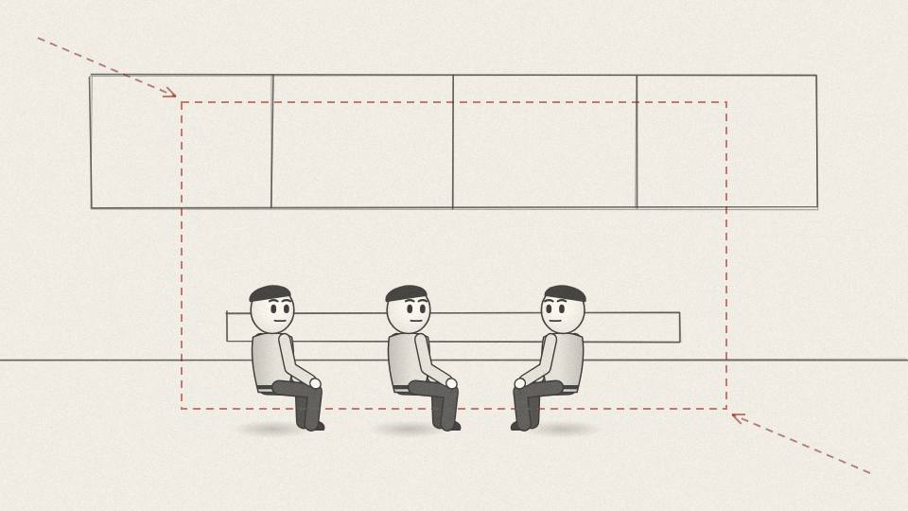
NV 0.02 MED · 11.3 s
Act 0 · Cold open
VISUAL
Night exterior of a roadside diner; inside, three men in a vinyl booth with coffee mugs and a notepad.
ON-SCREEN TEXT
SAN JOSE · 1993
ANIMATION NOTES
Night exterior of the diner, neon flicker; push through the window to three men in the booth with mugs.
VO
It started in 1993, in a booth at a Denny's in San Jose, where three engineers drank refill coffee and argued about a chip that didn't exist yet.
Notes:
VO: It started in 1993, in a booth at a Denny's in San Jose, where three engineers drank refill coffee and argued about a chip that didn't exist yet.
Visual: Night exterior of a roadside diner; inside, three men in a vinyl booth with coffee mugs and a notepad.
On-screen: SAN JOSE · 1993
Animation: Night exterior of the diner, neon flicker; push through the window to three men in the booth with mugs.

Slide 5
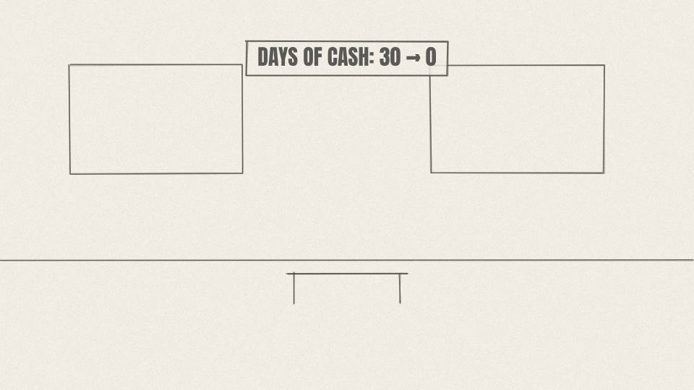
NV 0.03 MED · 9.8 s
Act 0 · Cold open
VISUAL
Days-of-cash counter drops fast toward zero; office lights dim one by one.
ON-SCREEN TEXT
DAYS OF CASH: 30
ANIMATION NOTES
Counter drops fast; office lights switch off one by one toward camera.
VO
Within a few years, their company built the wrong chip, lost almost everything, and came within about a month of running out of money.
Notes:
VO: Within a few years, their company built the wrong chip, lost almost everything, and came within about a month of running out of money.
Visual: Days-of-cash counter drops fast toward zero; office lights dim one by one.
On-screen: DAYS OF CASH: 30
Animation: Counter drops fast; office lights switch off one by one toward camera.

Slide 6
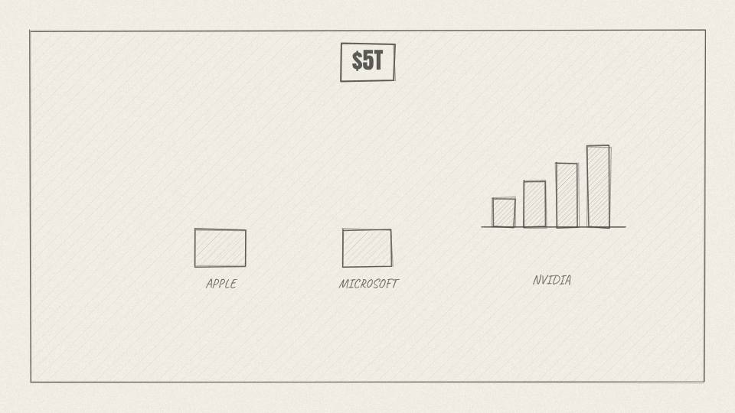
NV 0.04 CHART · 10.2 s
Act 0 · Cold open
VISUAL
Market-value counter rockets past Apple and Microsoft tiles to $5T.
ON-SCREEN TEXT
$5,000,000,000,000
ANIMATION NOTES
Market value bar rockets past the Apple and Microsoft tiles; counter lands on $5T.
VO
The chip that nearly killed it is the reason it won. And the bet that made it a giant earned almost nothing for six years.
Notes:
VO: The chip that nearly killed it is the reason it won. And the bet that made it a giant earned almost nothing for six years.
Visual: Market-value counter rockets past Apple and Microsoft tiles to $5T.
On-screen: $5,000,000,000,000
Animation: Market value bar rockets past the Apple and Microsoft tiles; counter lands on $5T.

Slide 7
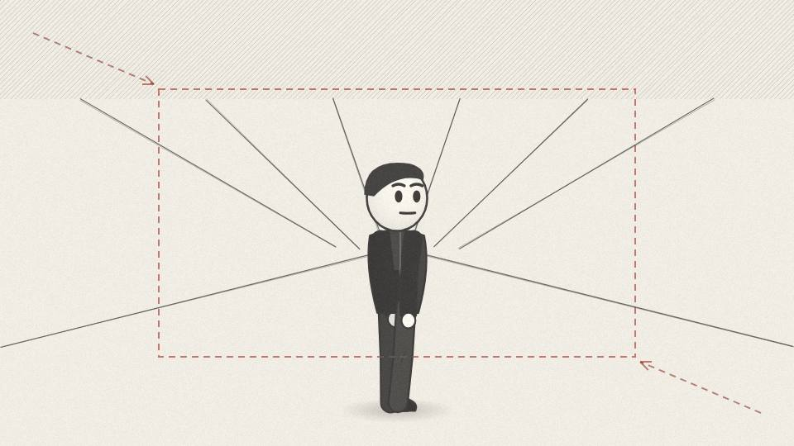
NV 0.05 CU · 10.9 s
Act 0 · Cold open
VISUAL
Push into Jensen in his black leather jacket, backlit by a server hall.
ON-SCREEN TEXT
—
ANIMATION NOTES
Backlit by server lights; slow push in on Jensen in the leather jacket.
VO
This is the story of Nvidia, and of Jensen Huang, a man who later said his will to survive exceeded almost everybody else's will to kill him.
Notes:
VO: This is the story of Nvidia, and of Jensen Huang, a man who later said his will to survive exceeded almost everybody else's will to kill him.
Visual: Push into Jensen in his black leather jacket, backlit by a server hall.
On-screen: -
Animation: Backlit by server lights; slow push in on Jensen in the leather jacket.

Slide 8
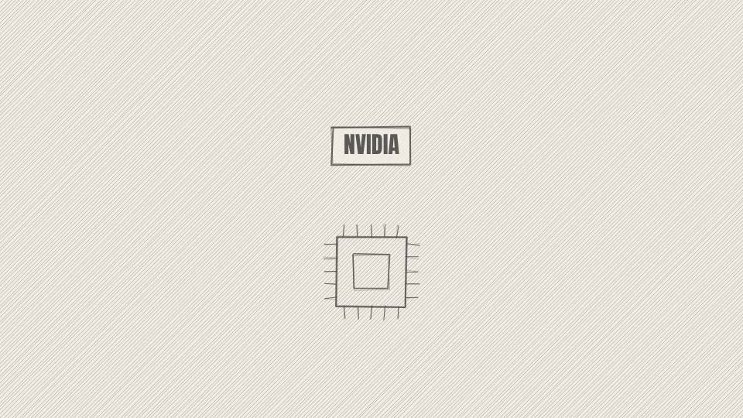
NV 0.06 TITLE · 4.0 s
Act 0 · Cold open
VISUAL
Title over a single glowing chip on a dark table.
ON-SCREEN TEXT
THE WRONG CHIP
ANIMATION NOTES
A single chip glows on a dark table; title scales in; deep hit.
VO
Notes:
VO:
Visual: Title over a single glowing chip on a dark table.
On-screen: THE WRONG CHIP
Animation: A single chip glows on a dark table; title scales in; deep hit.

Slide 9
ACT 1 · ACT 1: THE BOY AT ONEIDA
8 frames · 1:02

Slide 10
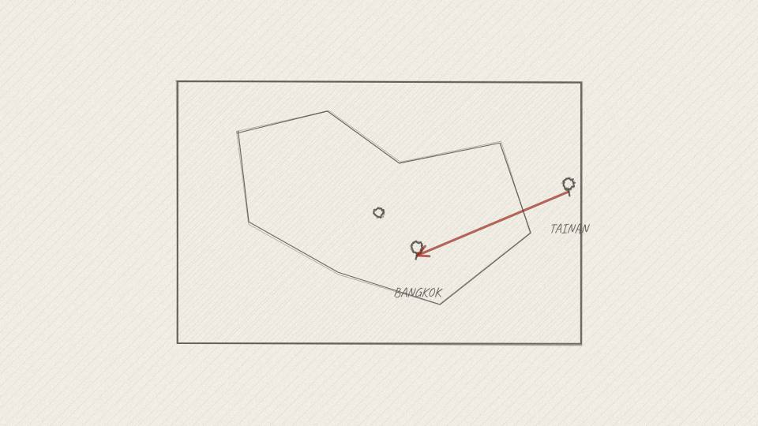
NV 1.01 MAP · 6.0 s
Act 1 · Act 1: The Boy at Oneida
VISUAL
Parchment map: Tainan pin, then an arrow to Bangkok.
ON-SCREEN TEXT
TAIWAN · 1963
ANIMATION NOTES
Pin drops on Tainan; a dotted arrow draws to Bangkok.
VO
Jensen Huang was born in Taiwan in 1963. His family later moved to Thailand.
Notes:
VO: Jensen Huang was born in Taiwan in 1963. His family later moved to Thailand.
Visual: Parchment map: Tainan pin, then an arrow to Bangkok.
On-screen: TAIWAN · 1963
Animation: Pin drops on Tainan; a dotted arrow draws to Bangkok.

Slide 11
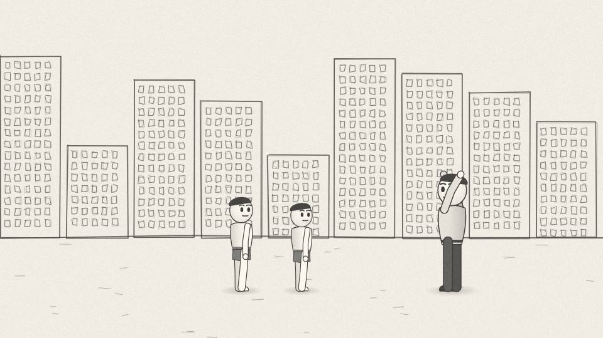
NV 1.02 MED · 9.8 s
Act 1 · Act 1: The Boy at Oneida
VISUAL
Airport departure: two small boys with one suitcase each, parents waving.
ON-SCREEN TEXT
—
ANIMATION NOTES
Two small boys with suitcases walk to the gate; parents wave (arm loops).
VO
When he was nine, his parents sent him and his older brother to America, to stay with an uncle and get a good education.
Notes:
VO: When he was nine, his parents sent him and his older brother to America, to stay with an uncle and get a good education.
Visual: Airport departure: two small boys with one suitcase each, parents waving.
On-screen: -
Animation: Two small boys with suitcases walk to the gate; parents wave (arm loops).

Slide 12
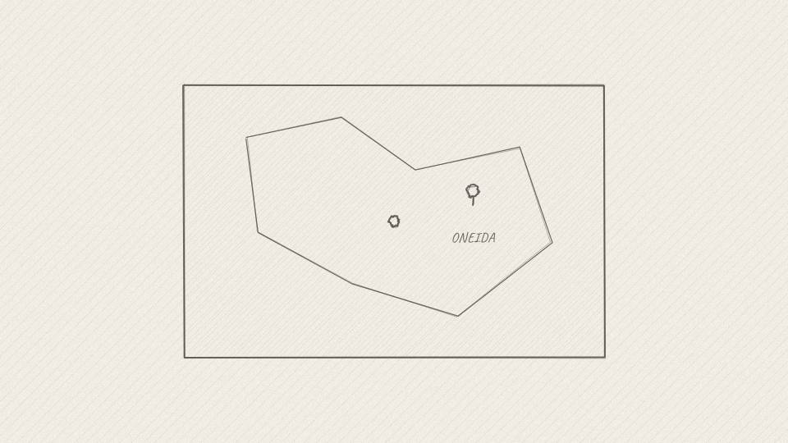
NV 1.03 MAP · 7.5 s
Act 1 · Act 1: The Boy at Oneida
VISUAL
Map of the USA, pin on Oneida, Kentucky; hills and a winding road.
ON-SCREEN TEXT
ONEIDA, KENTUCKY
ANIMATION NOTES
US map; pin on Oneida; a winding road draws through the hills.
VO
The uncle enrolled them at a school in rural Kentucky that he thought was a prestigious boarding school.
Notes:
VO: The uncle enrolled them at a school in rural Kentucky that he thought was a prestigious boarding school.
Visual: Map of the USA, pin on Oneida, Kentucky; hills and a winding road.
On-screen: ONEIDA, KENTUCKY
Animation: US map; pin on Oneida; a winding road draws through the hills.

Slide 13
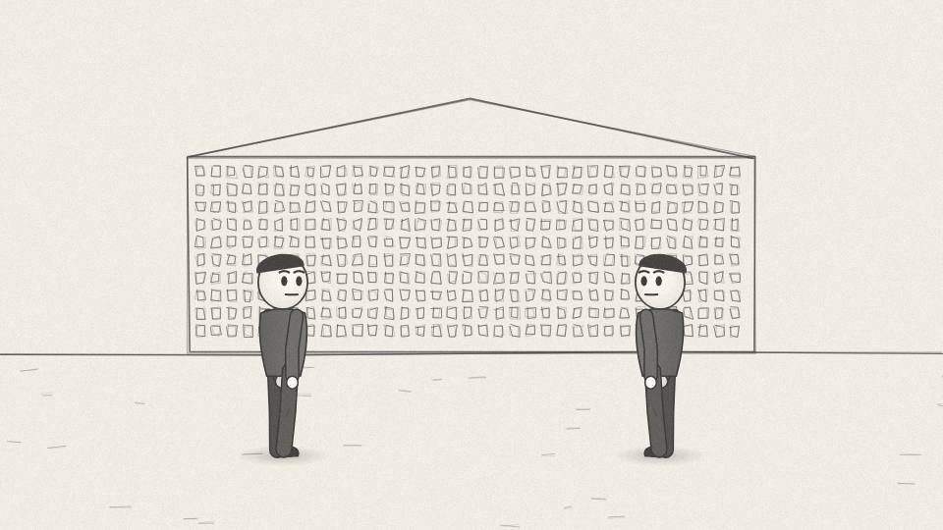
NV 1.04 WIDE · 6.4 s
Act 1 · Act 1: The Boy at Oneida
VISUAL
Painted brick dormitory in the hills, grey sky; older teenage boys in the yard.
ON-SCREEN TEXT
ONEIDA BAPTIST INSTITUTE
ANIMATION NOTES
Grey sky; brick dorm; older boys loiter and turn their heads toward the camera.
VO
It was the Oneida Baptist Institute, a strict school that also took in troubled teenagers.
Notes:
VO: It was the Oneida Baptist Institute, a strict school that also took in troubled teenagers.
Visual: Painted brick dormitory in the hills, grey sky; older teenage boys in the yard.
On-screen: ONEIDA BAPTIST INSTITUTE
Animation: Grey sky; brick dorm; older boys loiter and turn their heads toward the camera.

Slide 14
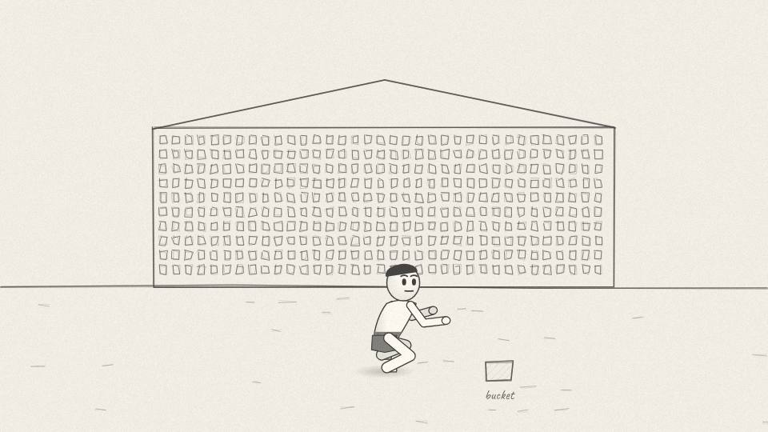
NV 1.05 MED · 6.4 s
Act 1 · Act 1: The Boy at Oneida
VISUAL
Small Jensen with a mop and bucket in a long tiled washroom.
ON-SCREEN TEXT
CHORE: BATHROOMS
ANIMATION NOTES
Small Jensen mops a long tiled floor (mop sweep loop); echoey drips.
VO
Jensen was the youngest boy in the dorm. His daily job was cleaning the bathrooms.
Notes:
VO: Jensen was the youngest boy in the dorm. His daily job was cleaning the bathrooms.
Visual: Small Jensen with a mop and bucket in a long tiled washroom.
On-screen: CHORE: BATHROOMS
Animation: Small Jensen mops a long tiled floor (mop sweep loop); echoey drips.

Slide 15
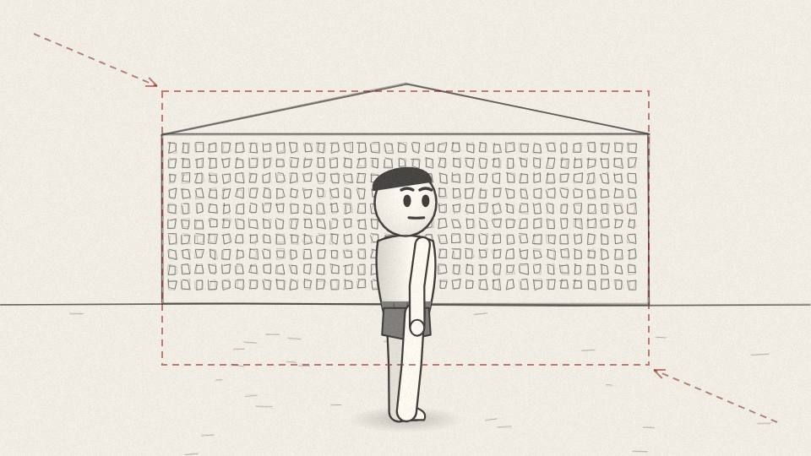
NV 1.06 CU · 9.1 s
Act 1 · Act 1: The Boy at Oneida
VISUAL
Close on his determined face as he finishes the floor.
ON-SCREEN TEXT
—
ANIMATION NOTES
Push in on his determined face as he finishes; a breath.
VO
He has said he didn't complain, and that it taught him to just get on with the work in front of him.
Notes:
VO: He has said he didn't complain, and that it taught him to just get on with the work in front of him.
Visual: Close on his determined face as he finishes the floor.
On-screen: -
Animation: Push in on his determined face as he finishes; a breath.

Slide 16
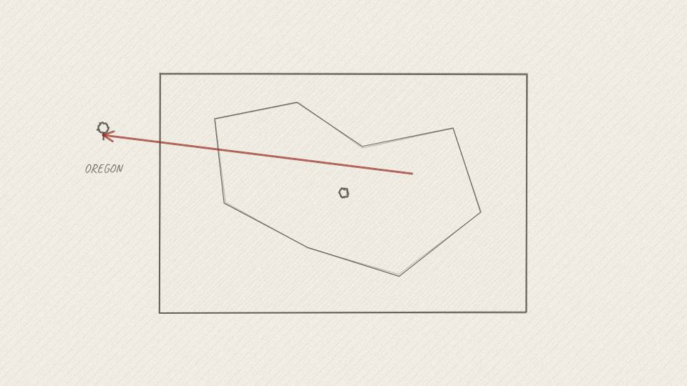
NV 1.07 MAP · 7.9 s
Act 1 · Act 1: The Boy at Oneida
VISUAL
Map arrow from Kentucky to Oregon; the Denny's kitchen.
ON-SCREEN TEXT
OREGON
ANIMATION NOTES
Arrow draws from Kentucky to Oregon; dissolve into the Denny's kitchen.
VO
His parents eventually joined them in Oregon. As a teenager he worked at Denny's, washing dishes and waiting tables.
Notes:
VO: His parents eventually joined them in Oregon. As a teenager he worked at Denny's, washing dishes and waiting tables.
Visual: Map arrow from Kentucky to Oregon; the Denny's kitchen.
On-screen: OREGON
Animation: Arrow draws from Kentucky to Oregon; dissolve into the Denny's kitchen.

Slide 17
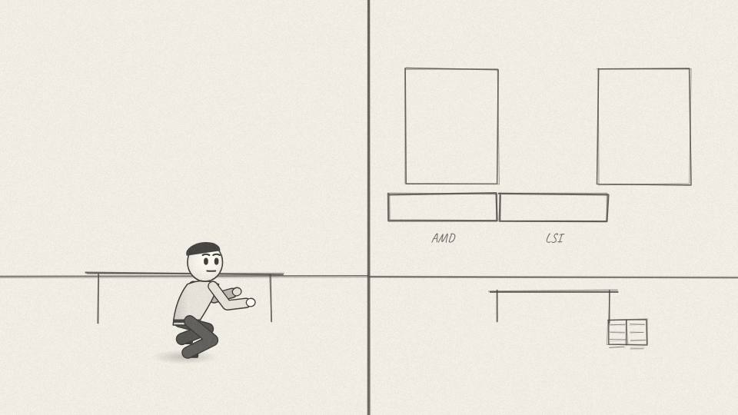
NV 1.08 MED · 9.8 s
Act 1 · Act 1: The Boy at Oneida
VISUAL
Montage: college lab, AMD and LSI office badges, a Stanford library desk at night.
ON-SCREEN TEXT
OREGON STATE · AMD · LSI · STANFORD
ANIMATION NOTES
Fast montage, 1.5 s each: college lab, badges flip in, library desk at night.
VO
He studied electrical engineering at Oregon State, then designed chips at AMD and LSI Logic, and took a master's degree at Stanford at night.
Notes:
VO: He studied electrical engineering at Oregon State, then designed chips at AMD and LSI Logic, and took a master's degree at Stanford at night.
Visual: Montage: college lab, AMD and LSI office badges, a Stanford library desk at night.
On-screen: OREGON STATE · AMD · LSI · STANFORD
Animation: Fast montage, 1.5 s each: college lab, badges flip in, library desk at night.

Slide 18
ACT 2 · ACT 2: THE WRONG CHIP
8 frames · 0:58

Slide 19
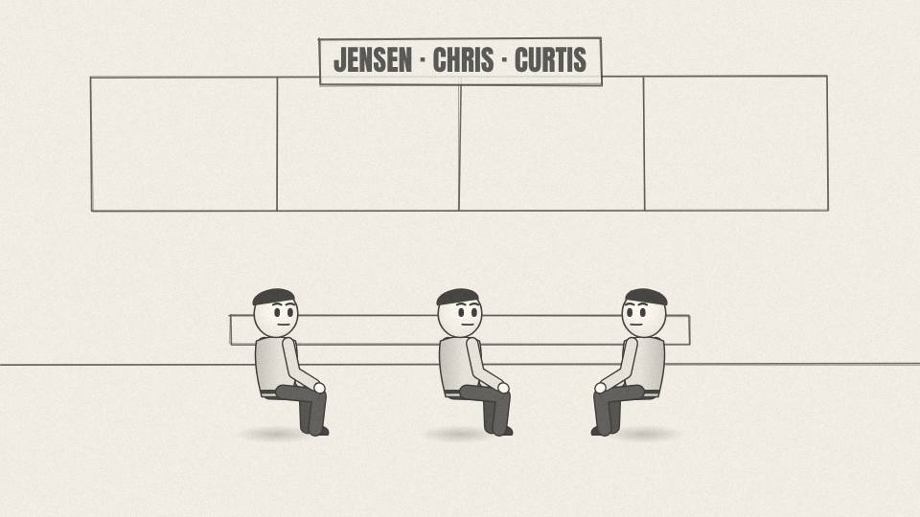
NV 2.01 MED · 7.9 s
Act 2 · Act 2: The Wrong Chip
VISUAL
The three founders in the Denny's booth; name tags pop beside each.
ON-SCREEN TEXT
HUANG · MALACHOWSKY · PRIEM
ANIMATION NOTES
Name tags pop beside each founder as named; mugs steam.
VO
By the early nineties, Jensen and two engineers from Sun Microsystems, Chris Malachowsky and Curtis Priem, shared an idea.
Notes:
VO: By the early nineties, Jensen and two engineers from Sun Microsystems, Chris Malachowsky and Curtis Priem, shared an idea.
Visual: The three founders in the Denny's booth; name tags pop beside each.
On-screen: HUANG · MALACHOWSKY · PRIEM
Animation: Name tags pop beside each founder as named; mugs steam.

Slide 20

NV 2.02 CU · 8.7 s
Act 2 · Act 2: The Wrong Chip
VISUAL
A flat 2D game sprite on an old monitor morphs into a clunky 3D shape that stutters.
ON-SCREEN TEXT
—
ANIMATION NOTES
A flat 2D sprite morphs into a clunky 3D shape that stutters (frame skips).
VO
Video games were moving to 3D, and ordinary computer processors couldn't keep up. Someone would build a chip just for graphics.
Notes:
VO: Video games were moving to 3D, and ordinary computer processors couldn't keep up. Someone would build a chip just for graphics.
Visual: A flat 2D game sprite on an old monitor morphs into a clunky 3D shape that stutters.
On-screen: -
Animation: A flat 2D sprite morphs into a clunky 3D shape that stutters (frame skips).

Slide 21
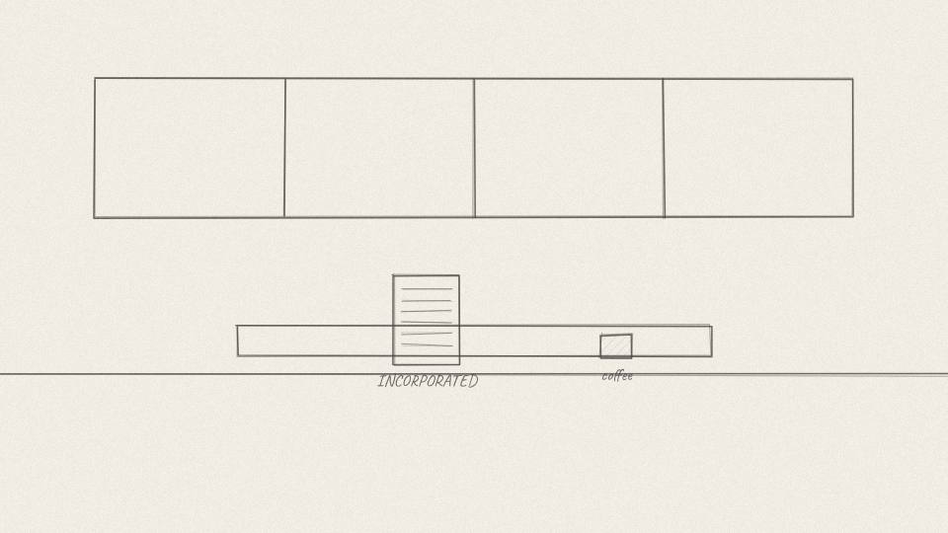
NV 2.03 CARD · 5.7 s
Act 2 · Act 2: The Wrong Chip
VISUAL
Incorporation papers on the diner table next to the coffee.
ON-SCREEN TEXT
NVIDIA · APRIL 1993
ANIMATION NOTES
Papers slide onto the table next to the coffee; a pen signs.
VO
They founded Nvidia in April 1993, with about forty thousand dollars between them.
Notes:
VO: They founded Nvidia in April 1993, with about forty thousand dollars between them.
Visual: Incorporation papers on the diner table next to the coffee.
On-screen: NVIDIA · APRIL 1993
Animation: Papers slide onto the table next to the coffee; a pen signs.

Slide 22
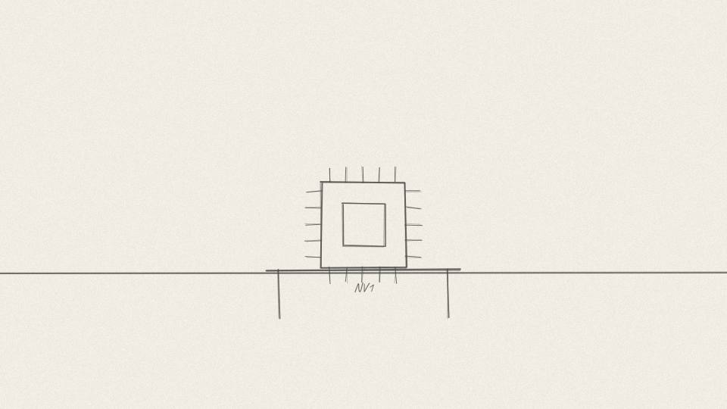
NV 2.04 PROP3D · 10.2 s
Act 2 · Act 2: The Wrong Chip
VISUAL
3D NV1 card rotates on a workbench, components labeled.
ON-SCREEN TEXT
NV1 · 1995
ANIMATION NOTES
The NV1 card rotates on the bench; part labels draw on with leader lines.
VO
Their first chip, the NV1, came out in 1995. It tried to do everything at once: graphics, sound and game controller support on one card.
Notes:
VO: Their first chip, the NV1, came out in 1995. It tried to do everything at once: graphics, sound and game controller support on one card.
Visual: 3D NV1 card rotates on a workbench, components labeled.
On-screen: NV1 · 1995
Animation: The NV1 card rotates on the bench; part labels draw on with leader lines.

Slide 23
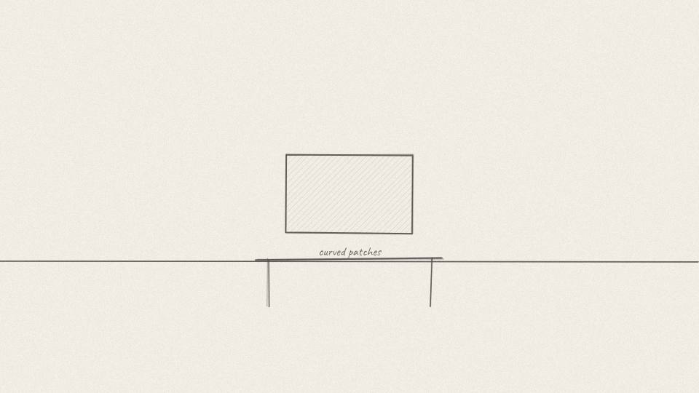
NV 2.05 MED · 6.4 s
Act 2 · Act 2: The Wrong Chip
VISUAL
On a monitor, a 3D model built from smooth curved patches.
ON-SCREEN TEXT
CURVES
ANIMATION NOTES
A model builds from smooth curved patches on the monitor.
VO
It also drew 3D shapes in an unusual way, using curved surfaces called quadratic patches.
Notes:
VO: It also drew 3D shapes in an unusual way, using curved surfaces called quadratic patches.
Visual: On a monitor, a 3D model built from smooth curved patches.
On-screen: CURVES
Animation: A model builds from smooth curved patches on the monitor.

Slide 24

NV 2.06 MED · 7.9 s
Act 2 · Act 2: The Wrong Chip
VISUAL
A wall of game boxes all showing triangle meshes; the curved model looks out of place.
ON-SCREEN TEXT
DIRECTX = TRIANGLES
ANIMATION NOTES
A wall of triangle-mesh game boxes; the curved model slides in and looks out of place.
VO
Then Microsoft released DirectX, the standard most PC games would be built on. And DirectX was built around triangles.
Notes:
VO: Then Microsoft released DirectX, the standard most PC games would be built on. And DirectX was built around triangles.
Visual: A wall of game boxes all showing triangle meshes; the curved model looks out of place.
On-screen: DIRECTX = TRIANGLES
Animation: A wall of triangle-mesh game boxes; the curved model slides in and looks out of place.

Slide 25
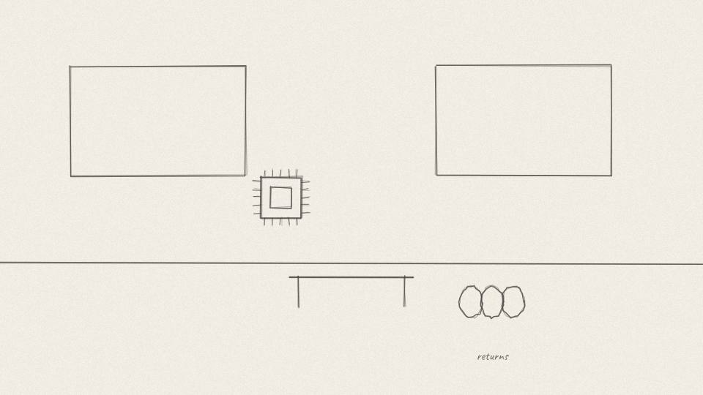
NV 2.07 CU · 8.3 s
Act 2 · Act 2: The Wrong Chip
VISUAL
The NV1 card on a shelf gathering dust; returns piled in boxes.
ON-SCREEN TEXT
—
ANIMATION NOTES
Dust settles on the shelved card; return boxes stack up with thuds.
VO
Nvidia had bet the company on the opposite approach. Jensen later said they built the wrong thing with great confidence.
Notes:
VO: Nvidia had bet the company on the opposite approach. Jensen later said they built the wrong thing with great confidence.
Visual: The NV1 card on a shelf gathering dust; returns piled in boxes.
On-screen: -
Animation: Dust settles on the shelved card; return boxes stack up with thuds.

Slide 26

NV 2.08 CHART · 3.8 s
Act 2 · Act 2: The Wrong Chip
VISUAL
Days-of-cash counter tumbles.
ON-SCREEN TEXT
DAYS OF CASH: FALLING
ANIMATION NOTES
Counter tumbles; low drone.
VO
The NV1 sold badly. Money was running out.
Notes:
VO: The NV1 sold badly. Money was running out.
Visual: Days-of-cash counter tumbles.
On-screen: DAYS OF CASH: FALLING
Animation: Counter tumbles; low drone.

Slide 27
ACT 3 · ACT 3: THE SEGA CALL
7 frames · 0:54

Slide 28
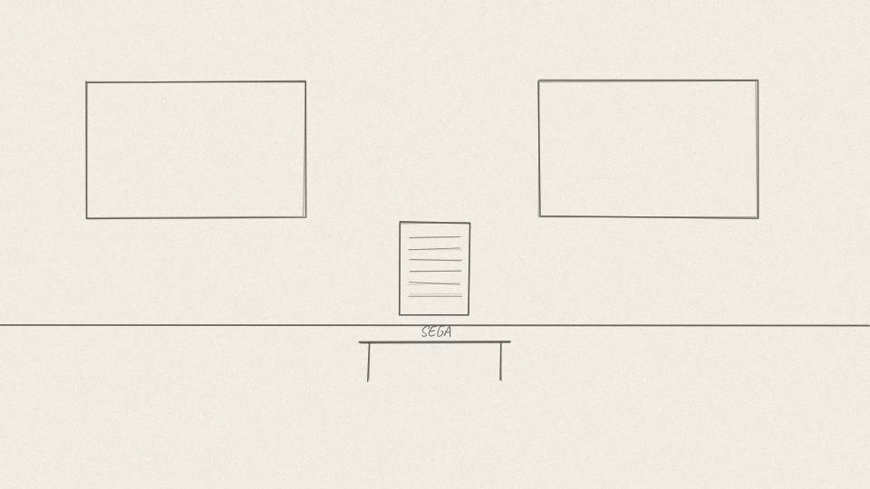
NV 3.01 MED · 7.5 s
Act 3 · Act 3: The Sega Call
VISUAL
A signed contract on a desk with SEGA in plain letters.
ON-SCREEN TEXT
THE SEGA CONTRACT
ANIMATION NOTES
Signed contract slides onto the desk; light warms.
VO
Nvidia had one lifeline: a contract with Sega to build the graphics chip for its next game console.
Notes:
VO: Nvidia had one lifeline: a contract with Sega to build the graphics chip for its next game console.
Visual: A signed contract on a desk with SEGA in plain letters.
On-screen: THE SEGA CONTRACT
Animation: Signed contract slides onto the desk; light warms.

Slide 29
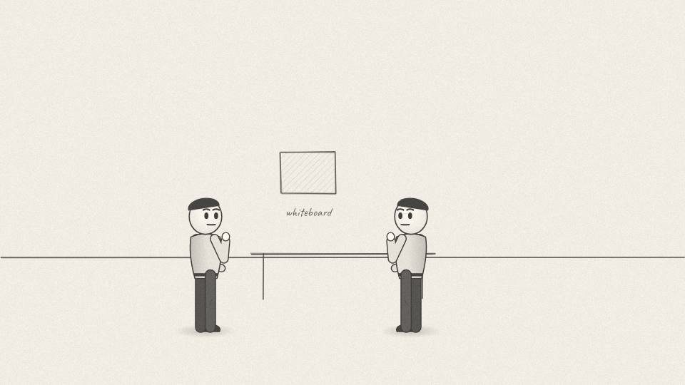
NV 3.02 MED · 7.9 s
Act 3 · Act 3: The Sega Call
VISUAL
Engineers stare at a whiteboard with a curved model crossed out.
ON-SCREEN TEXT
—
ANIMATION NOTES
Engineers stare at the whiteboard; the curved model gets crossed out with a marker squeak.
VO
But that chip was based on the same curved-surface design, the one the rest of the industry was abandoning.
Notes:
VO: But that chip was based on the same curved-surface design, the one the rest of the industry was abandoning.
Visual: Engineers stare at a whiteboard with a curved model crossed out.
On-screen: -
Animation: Engineers stare at the whiteboard; the curved model gets crossed out with a marker squeak.

Slide 30
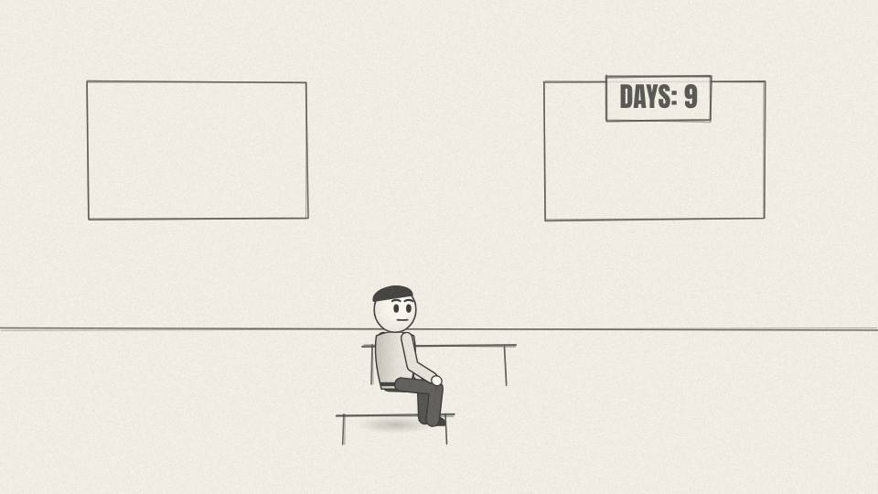
NV 3.03 CU · 8.3 s
Act 3 · Act 3: The Sega Call
VISUAL
Jensen alone in a dark office, the counter glowing near zero.
ON-SCREEN TEXT
—
ANIMATION NOTES
Dark office; only the counter glows near zero; slow push in.
VO
If they finished it, they'd spend a year building something dead. If they quit, they'd lose their only paying customer.
Notes:
VO: If they finished it, they'd spend a year building something dead. If they quit, they'd lose their only paying customer.
Visual: Jensen alone in a dark office, the counter glowing near zero.
On-screen: -
Animation: Dark office; only the counter glows near zero; slow push in.

Slide 31
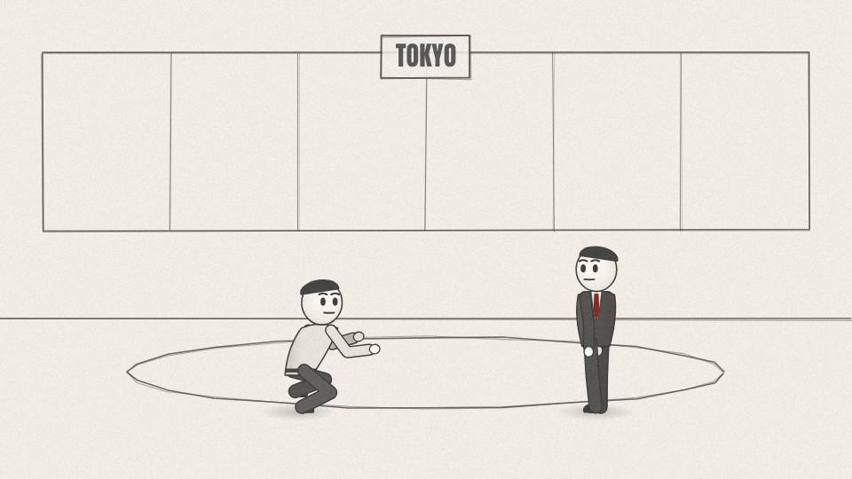
NV 3.04 WIDE · 11.3 s
Act 3 · Act 3: The Sega Call
VISUAL
Tokyo boardroom, rain on tall windows; Jensen bows before Irimajiri.
ON-SCREEN TEXT
TOKYO
ANIMATION NOTES
Rain on tall windows; Jensen bows slowly; Irimajiri watches.
VO
So Jensen flew to Japan and did something unusual. He told Sega's chief executive, Shoichiro Irimajiri, that Nvidia's approach was wrong, and that Sega should find another partner.
Notes:
VO: So Jensen flew to Japan and did something unusual. He told Sega's chief executive, Shoichiro Irimajiri, that Nvidia's approach was wrong, and that Sega should find another partner.
Visual: Tokyo boardroom, rain on tall windows; Jensen bows before Irimajiri.
On-screen: TOKYO
Animation: Rain on tall windows; Jensen bows slowly; Irimajiri watches.

Slide 32
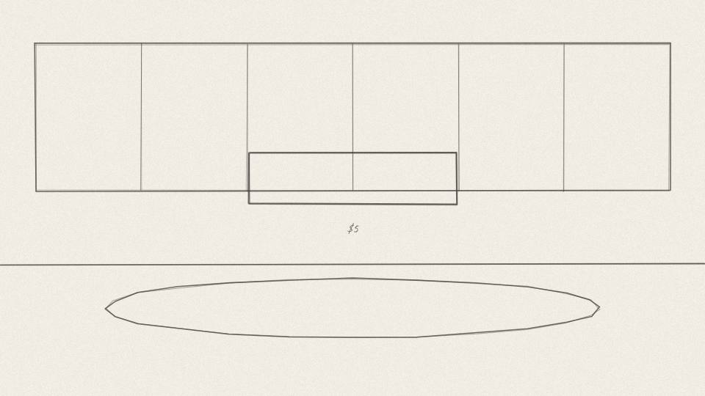
NV 3.05 MED · 9.4 s
Act 3 · Act 3: The Sega Call
VISUAL
A cheque-shaped card reading $5,000,000 floats between them.
ON-SCREEN TEXT
$5 MILLION
ANIMATION NOTES
The cheque card floats up between them and turns.
VO
Then he asked for the rest of the money anyway. As an investment, not a payment, because without it Nvidia would go under.
Notes:
VO: Then he asked for the rest of the money anyway. As an investment, not a payment, because without it Nvidia would go under.
Visual: A cheque-shaped card reading $5,000,000 floats between them.
On-screen: $5 MILLION
Animation: The cheque card floats up between them and turns.

Slide 33
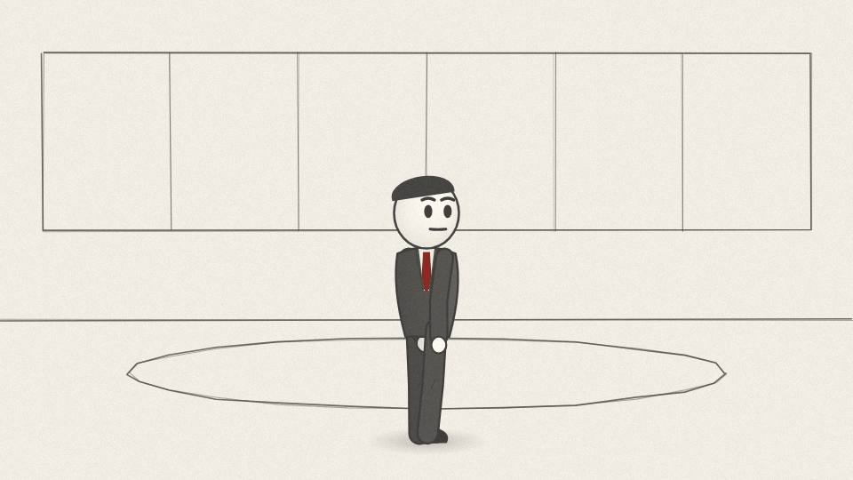
NV 3.06 CU · 5.7 s
Act 3 · Act 3: The Sega Call
VISUAL
Irimajiri nods slowly; a faint smile.
ON-SCREEN TEXT
—
ANIMATION NOTES
Irimajiri nods slowly; a faint smile.
VO
Irimajiri agreed. Jensen has said the only reason was that Irimajiri liked him.
Notes:
VO: Irimajiri agreed. Jensen has said the only reason was that Irimajiri liked him.
Visual: Irimajiri nods slowly; a faint smile.
On-screen: -
Animation: Irimajiri nods slowly; a faint smile.

Slide 34
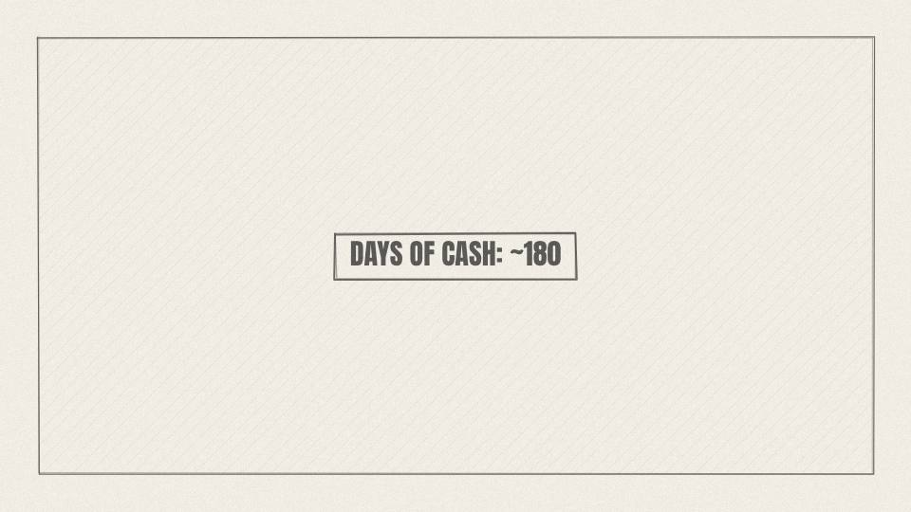
NV 3.07 CHART · 4.2 s
Act 3 · Act 3: The Sega Call
VISUAL
Days-of-cash counter jumps up to ~180, then begins ticking down again.
ON-SCREEN TEXT
+6 MONTHS
ANIMATION NOTES
Counter jumps up to about 180 with a lift, then starts ticking down again.
VO
That five million dollars bought Nvidia about six months.
Notes:
VO: That five million dollars bought Nvidia about six months.
Visual: Days-of-cash counter jumps up to ~180, then begins ticking down again.
On-screen: +6 MONTHS
Animation: Counter jumps up to about 180 with a lift, then starts ticking down again.

Slide 35
ACT 4 · ACT 4: THIRTY DAYS
6 frames · 0:43

Slide 36
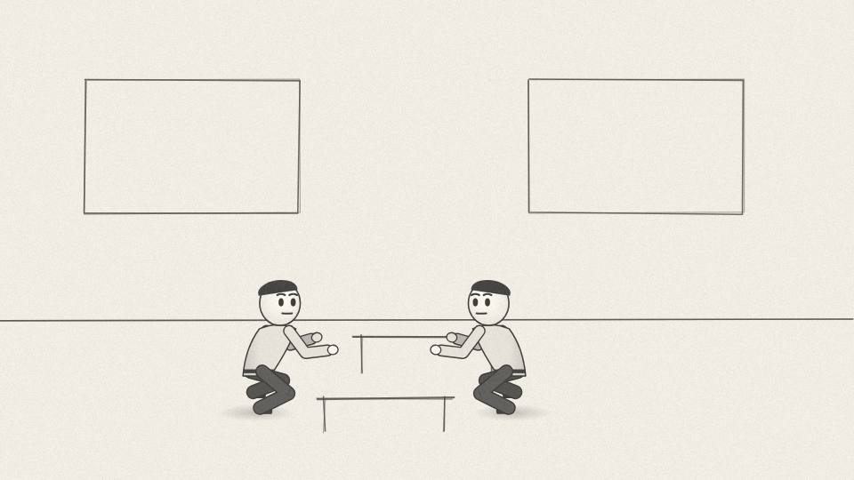
NV 4.01 MED · 7.9 s
Act 4 · Act 4: Thirty Days
VISUAL
Half-empty office; remaining engineers hunched over boards late at night.
ON-SCREEN TEXT
—
ANIMATION NOTES
Half-empty office at night; heads bent over boards; a clock ticks.
VO
Nvidia laid off much of its staff and threw everything at one new chip, built around triangles and DirectX.
Notes:
VO: Nvidia laid off much of its staff and threw everything at one new chip, built around triangles and DirectX.
Visual: Half-empty office; remaining engineers hunched over boards late at night.
On-screen: -
Animation: Half-empty office at night; heads bent over boards; a clock ticks.

Slide 37
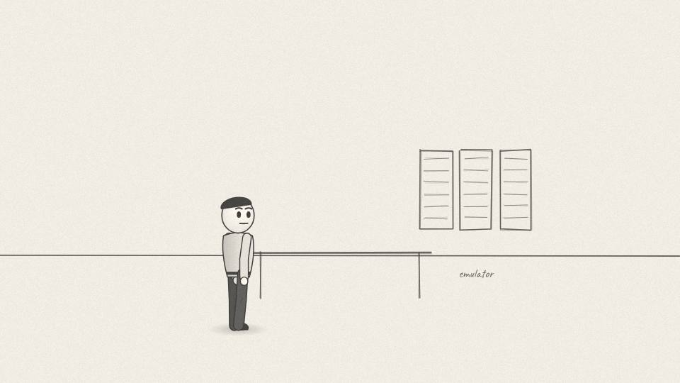
NV 4.02 MED · 9.1 s
Act 4 · Act 4: Thirty Days
VISUAL
A big 3D emulator box hums in the corner, cables everywhere.
ON-SCREEN TEXT
EMULATOR
ANIMATION NOTES
Big emulator hums in the corner; cables sway; LEDs blink.
VO
To save time they bought an emulator, a machine that let them test the design in software before any real chip existed.
Notes:
VO: To save time they bought an emulator, a machine that let them test the design in software before any real chip existed.
Visual: A big 3D emulator box hums in the corner, cables everywhere.
On-screen: EMULATOR
Animation: Big emulator hums in the corner; cables sway; LEDs blink.

Slide 38
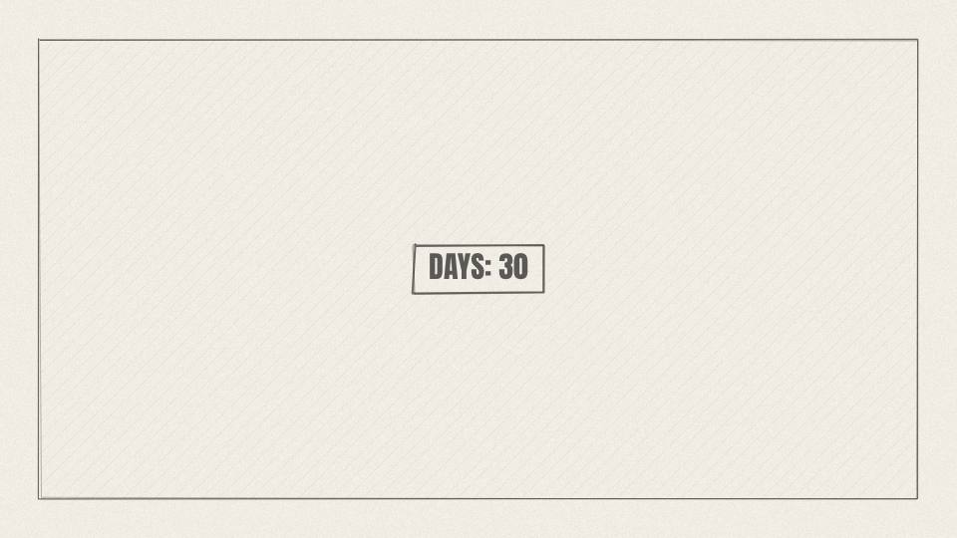
NV 4.03 CU · 6.4 s
Act 4 · Act 4: Thirty Days
VISUAL
Days-of-cash counter at 30.
ON-SCREEN TEXT
30 DAYS
ANIMATION NOTES
Counter sits at 30 in red; heartbeat SFX.
VO
They had roughly a month of payroll left when the chip went to the factory.
Notes:
VO: They had roughly a month of payroll left when the chip went to the factory.
Visual: Days-of-cash counter at 30.
On-screen: 30 DAYS
Animation: Counter sits at 30 in red; heartbeat SFX.

Slide 39
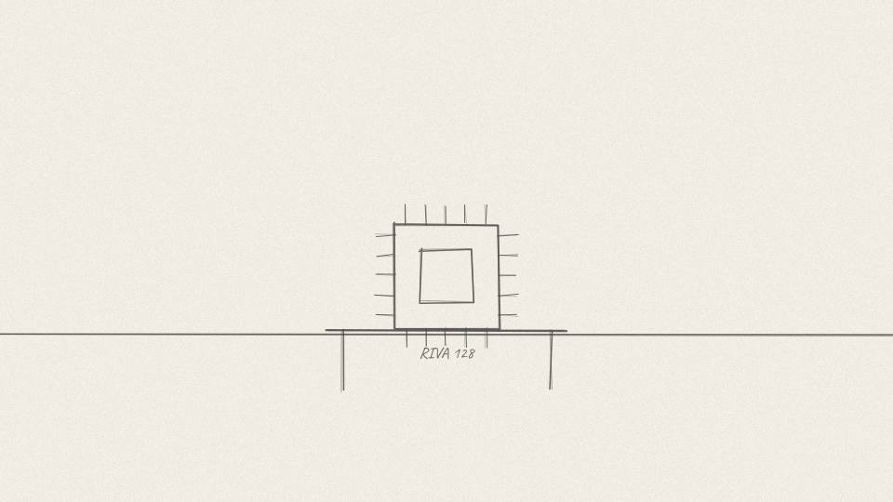
NV 4.04 PROP3D · 6.0 s
Act 4 · Act 4: Thirty Days
VISUAL
3D RIVA 128 chip lifts off its board, light sweeping across it.
ON-SCREEN TEXT
RIVA 128 · 1997
ANIMATION NOTES
The chip lifts off its board in 3D; a light sweep crosses it.
VO
It was called the RIVA 128, released in 1997. And this time it worked.
Notes:
VO: It was called the RIVA 128, released in 1997. And this time it worked.
Visual: 3D RIVA 128 chip lifts off its board, light sweeping across it.
On-screen: RIVA 128 · 1997
Animation: The chip lifts off its board in 3D; a light sweep crosses it.

Slide 40
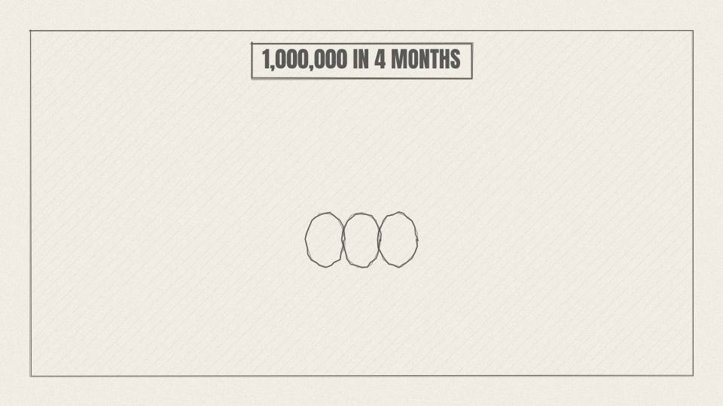
NV 4.05 CHART · 4.9 s
Act 4 · Act 4: Thirty Days
VISUAL
A stack of chip boxes grows to 1,000,000.
ON-SCREEN TEXT
1,000,000 IN 4 MONTHS
ANIMATION NOTES
Boxes stack up fast; counter to 1,000,000.
VO
It sold about a million units in its first four months.
Notes:
VO: It sold about a million units in its first four months.
Visual: A stack of chip boxes grows to 1,000,000.
On-screen: 1,000,000 IN 4 MONTHS
Animation: Boxes stack up fast; counter to 1,000,000.

Slide 41
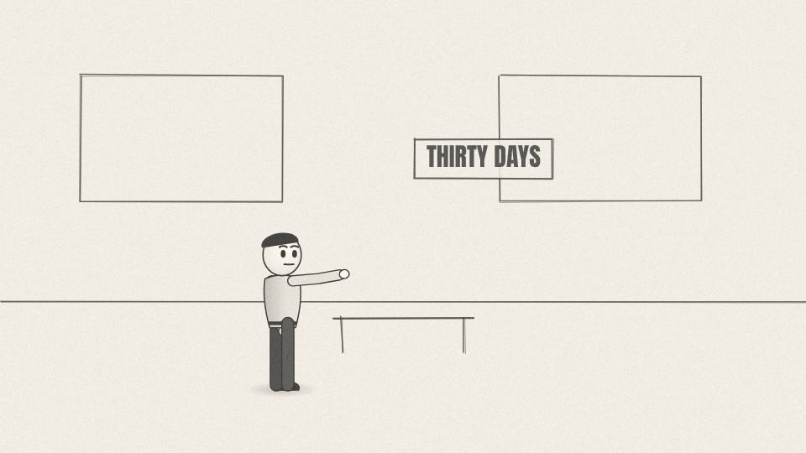
NV 4.06 CU · 8.7 s
Act 4 · Act 4: Thirty Days
VISUAL
Jensen at a whiteboard; behind him the words 'THIRTY DAYS'.
ON-SCREEN TEXT
'30 DAYS FROM GOING OUT OF BUSINESS'
ANIMATION NOTES
Jensen taps the whiteboard; the words write themselves behind him.
VO
For years afterwards, Jensen opened staff meetings with the same line: our company is thirty days from going out of business.
Notes:
VO: For years afterwards, Jensen opened staff meetings with the same line: our company is thirty days from going out of business.
Visual: Jensen at a whiteboard; behind him the words 'THIRTY DAYS'.
On-screen: '30 DAYS FROM GOING OUT OF BUSINESS'
Animation: Jensen taps the whiteboard; the words write themselves behind him.

Slide 42
ACT 5 · ACT 5: THE GPU
8 frames · 1:05

Slide 43
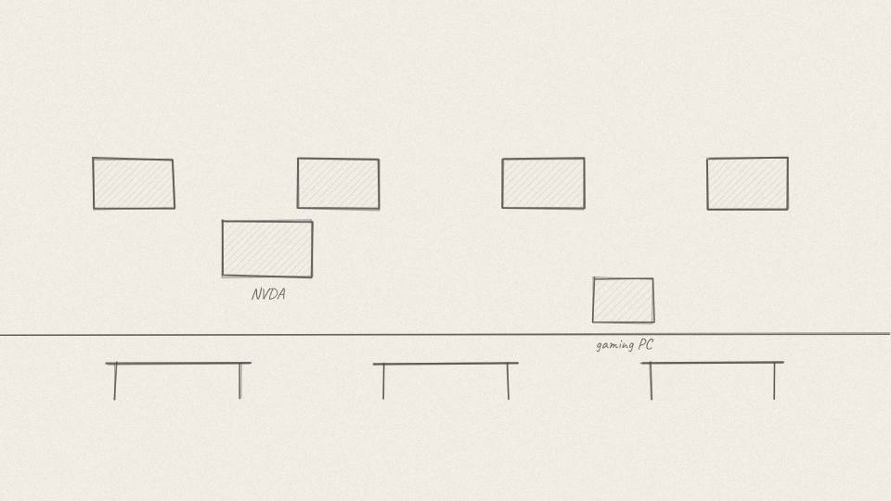
NV 5.01 MED · 4.5 s
Act 5 · Act 5: The GPU
VISUAL
Stock exchange ticker with NVDA; a gaming PC opens to reveal the card.
ON-SCREEN TEXT
1999
ANIMATION NOTES
Ticker scrolls NVDA; the PC side panel swings open to reveal the card.
VO
In 1999, Nvidia went public, and launched the GeForce 256.
Notes:
VO: In 1999, Nvidia went public, and launched the GeForce 256.
Visual: Stock exchange ticker with NVDA; a gaming PC opens to reveal the card.
On-screen: 1999
Animation: Ticker scrolls NVDA; the PC side panel swings open to reveal the card.

Slide 44
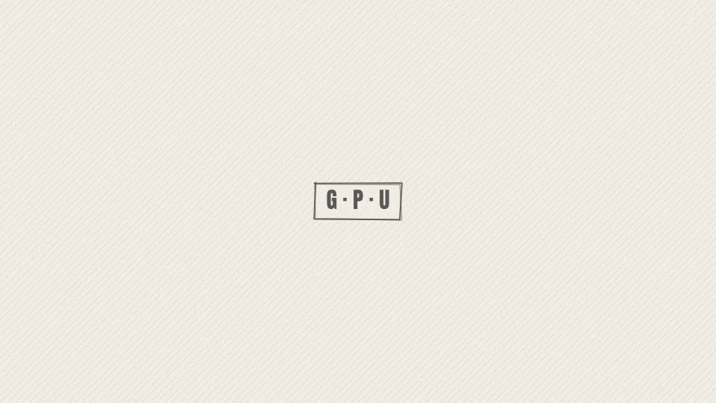
NV 5.02 CARD · 6.0 s
Act 5 · Act 5: The GPU
VISUAL
Callout card with the three letters.
ON-SCREEN TEXT
GPU
ANIMATION NOTES
Callout card; the three letters stamp in one at a time.
VO
It marketed the chip with a new name: the GPU, the graphics processing unit.
Notes:
VO: It marketed the chip with a new name: the GPU, the graphics processing unit.
Visual: Callout card with the three letters.
On-screen: GPU
Animation: Callout card; the three letters stamp in one at a time.

Slide 45

NV 5.03 CU · 9.8 s
Act 5 · Act 5: The GPU
VISUAL
Side by side game frame: blocky 1998 scene vs richer 1999 scene.
ON-SCREEN TEXT
—
ANIMATION NOTES
Split wipe: blocky scene vs richer scene.
VO
The GeForce took over 3D calculations that used to fall on the computer's main processor. Games got smoother, lighting got better, worlds got bigger.
Notes:
VO: The GeForce took over 3D calculations that used to fall on the computer's main processor. Games got smoother, lighting got better, worlds got bigger.
Visual: Side by side game frame: blocky 1998 scene vs richer 1999 scene.
On-screen: -
Animation: Split wipe: blocky scene vs richer scene.

Slide 46
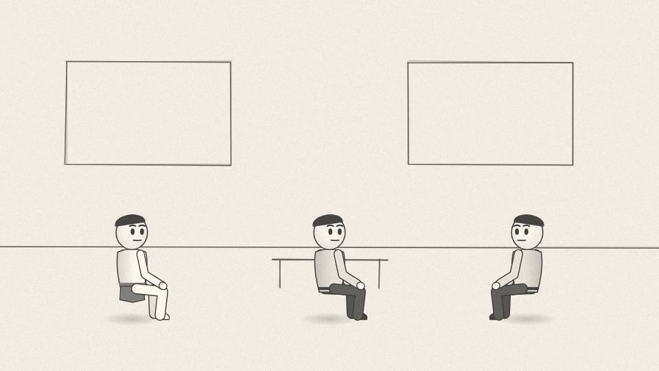
NV 5.04 WIDE · 9.4 s
Act 5 · Act 5: The GPU
VISUAL
Montage: LAN party, game studio desks, a VFX artist's screen.
ON-SCREEN TEXT
—
ANIMATION NOTES
Fast montage: LAN party, studio desks, VFX screen; each 1 s.
VO
By the early 2000s, Nvidia was the leading name in PC graphics. Gamers, game studios and film effects houses all ran on it.
Notes:
VO: By the early 2000s, Nvidia was the leading name in PC graphics. Gamers, game studios and film effects houses all ran on it.
Visual: Montage: LAN party, game studio desks, a VFX artist's screen.
On-screen: -
Animation: Fast montage: LAN party, studio desks, VFX screen; each 1 s.

Slide 47
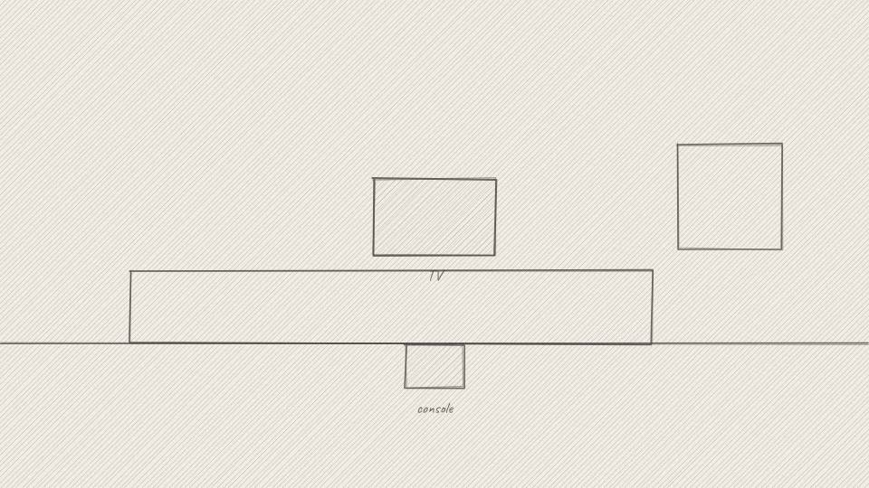
NV 5.05 MED · 6.8 s
Act 5 · Act 5: The GPU
VISUAL
Painted living room with a big black console under a TV.
ON-SCREEN TEXT
2001
ANIMATION NOTES
Living room; the console sits under the TV; game light flickers on the walls.
VO
Nvidia also won the deal to supply the graphics chip for Microsoft's first Xbox in 2001.
Notes:
VO: Nvidia also won the deal to supply the graphics chip for Microsoft's first Xbox in 2001.
Visual: Painted living room with a big black console under a TV.
On-screen: 2001
Animation: Living room; the console sits under the TV; game light flickers on the walls.

Slide 48
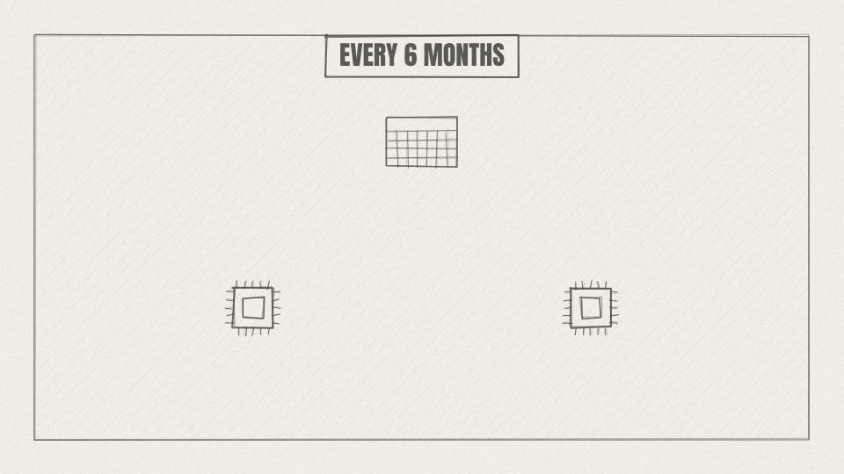
NV 5.06 MED · 10.9 s
Act 5 · Act 5: The GPU
VISUAL
A calendar flips; new chip boxes pop out every six months on Nvidia's side, slower on the rival's side.
ON-SCREEN TEXT
EVERY 6 MONTHS
ANIMATION NOTES
Calendar flips; new chip boxes pop out on Nvidia's side twice as often as the rival's.
VO
Nvidia won partly through speed. Jensen pushed the team to ship a new generation of chips roughly every six months, while rivals took a year or more.
Notes:
VO: Nvidia won partly through speed. Jensen pushed the team to ship a new generation of chips roughly every six months, while rivals took a year or more.
Visual: A calendar flips; new chip boxes pop out every six months on Nvidia's side, slower on the rival's side.
On-screen: EVERY 6 MONTHS
Animation: Calendar flips; new chip boxes pop out on Nvidia's side twice as often as the rival's.

Slide 49
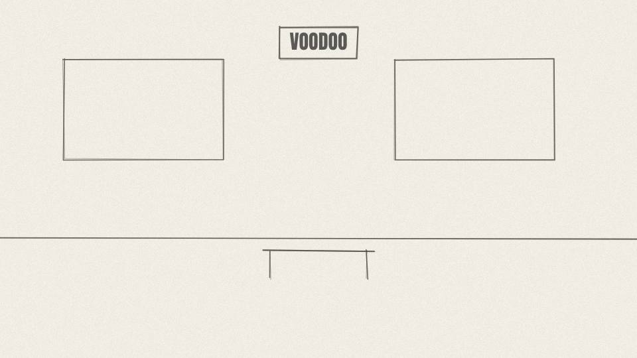
NV 5.07 MED · 7.2 s
Act 5 · Act 5: The GPU
VISUAL
A rival office with VOODOO posters goes dark, one light at a time.
ON-SCREEN TEXT
3DFX
ANIMATION NOTES
Rival office lights go dark one at a time.
VO
Its biggest rival, 3dfx, the maker of the Voodoo cards that gamers had loved, couldn't keep up.
Notes:
VO: Its biggest rival, 3dfx, the maker of the Voodoo cards that gamers had loved, couldn't keep up.
Visual: A rival office with VOODOO posters goes dark, one light at a time.
On-screen: 3DFX
Animation: Rival office lights go dark one at a time.

Slide 50
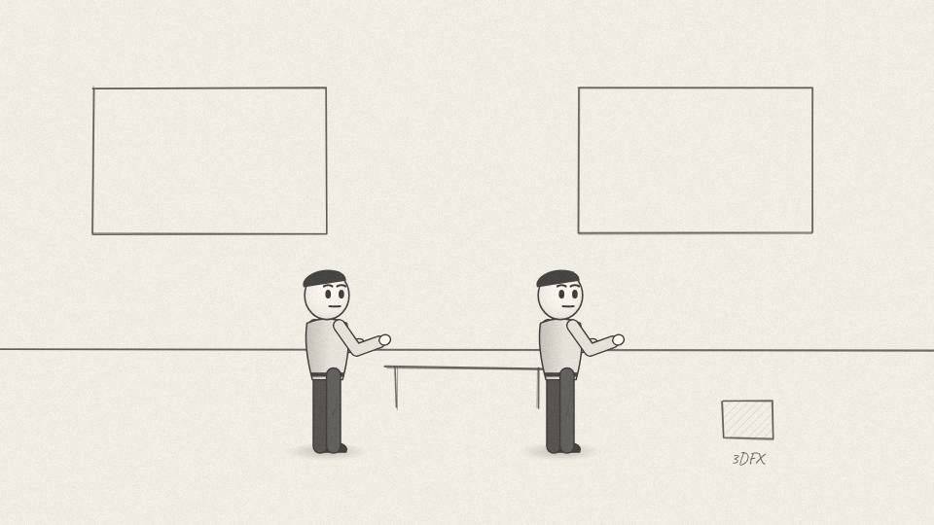
NV 5.08 CU · 10.9 s
Act 5 · Act 5: The GPU
VISUAL
Nvidia staff carry boxes labeled 3DFX PATENTS into their office.
ON-SCREEN TEXT
2000
ANIMATION NOTES
Staff carry 3DFX PATENTS boxes in (carry walk cycles).
VO
At the end of 2000, Nvidia bought what was left of 3dfx. Five years after the NV1 flop, Nvidia was the company others were trying to catch.
Notes:
VO: At the end of 2000, Nvidia bought what was left of 3dfx. Five years after the NV1 flop, Nvidia was the company others were trying to catch.
Visual: Nvidia staff carry boxes labeled 3DFX PATENTS into their office.
On-screen: 2000
Animation: Staff carry 3DFX PATENTS boxes in (carry walk cycles).

Slide 51
ACT 6 · ACT 6: TEN THOUSAND INTERNS
9 frames · 1:21

Slide 52
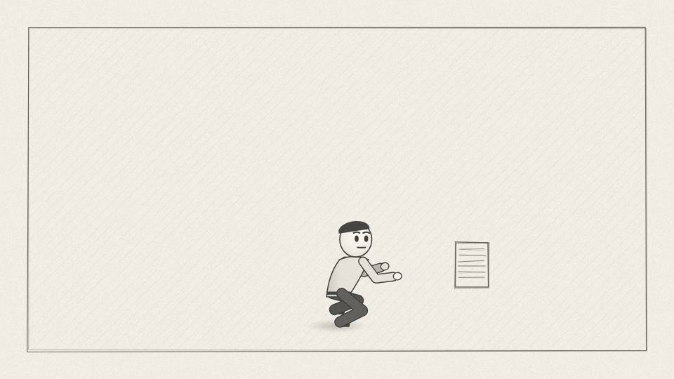
NV 6.01 CHART · 9.1 s
Act 6 · Act 6: Ten Thousand Interns
VISUAL
One ink figure works through a stack of papers at speed.
ON-SCREEN TEXT
CPU
ANIMATION NOTES
One figure stamps through a paper stack at speed.
VO
Here's the difference that changed everything. A normal processor is like one very smart worker doing tasks one after another, very fast.
Notes:
VO: Here's the difference that changed everything. A normal processor is like one very smart worker doing tasks one after another, very fast.
Visual: One ink figure works through a stack of papers at speed.
On-screen: CPU
Animation: One figure stamps through a paper stack at speed.

Slide 53
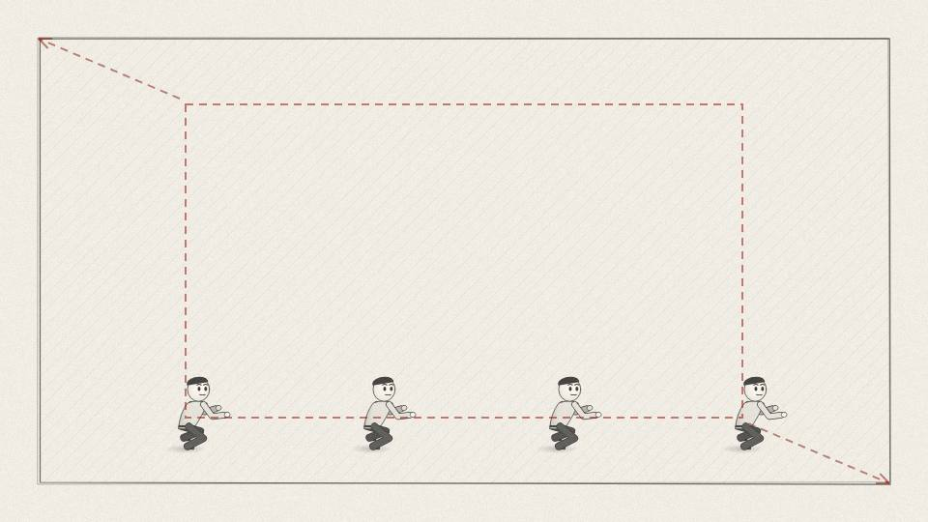
NV 6.02 CHART · 7.2 s
Act 6 · Act 6: Ten Thousand Interns
VISUAL
Pull back: a vast hall of tiny figures each stamping one sheet at once.
ON-SCREEN TEXT
GPU
ANIMATION NOTES
Pull back to reveal a vast hall of tiny figures stamping at once.
VO
A GPU is like thousands of simple workers, each doing one small calculation at the same time.
Notes:
VO: A GPU is like thousands of simple workers, each doing one small calculation at the same time.
Visual: Pull back: a vast hall of tiny figures each stamping one sheet at once.
On-screen: GPU
Animation: Pull back to reveal a vast hall of tiny figures stamping at once.

Slide 54
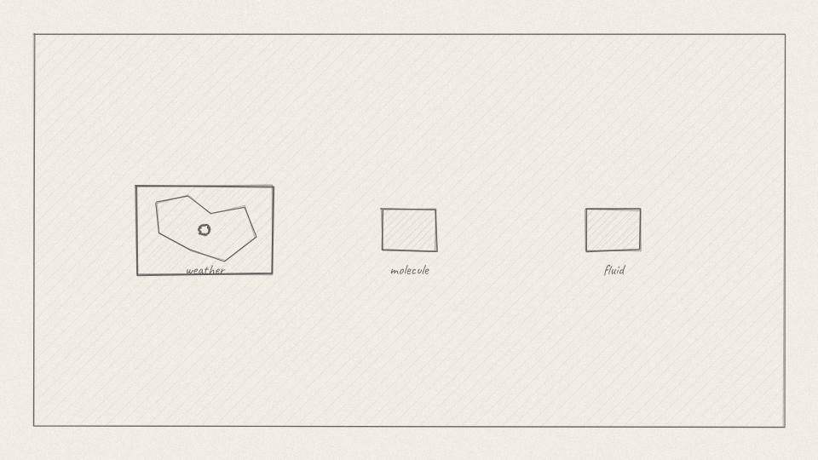
NV 6.03 MED · 9.4 s
Act 6 · Act 6: Ten Thousand Interns
VISUAL
The hall's papers turn into weather maps, molecules, fluid swirls.
ON-SCREEN TEXT
—
ANIMATION NOTES
The papers turn into weather maps, molecules and fluid swirls.
VO
For graphics, that's perfect: every pixel can be worked on at once. But lots of other problems look the same. Weather. Chemistry. Physics.
Notes:
VO: For graphics, that's perfect: every pixel can be worked on at once. But lots of other problems look the same. Weather. Chemistry. Physics.
Visual: The hall's papers turn into weather maps, molecules, fluid swirls.
On-screen: -
Animation: The papers turn into weather maps, molecules and fluid swirls.

Slide 55
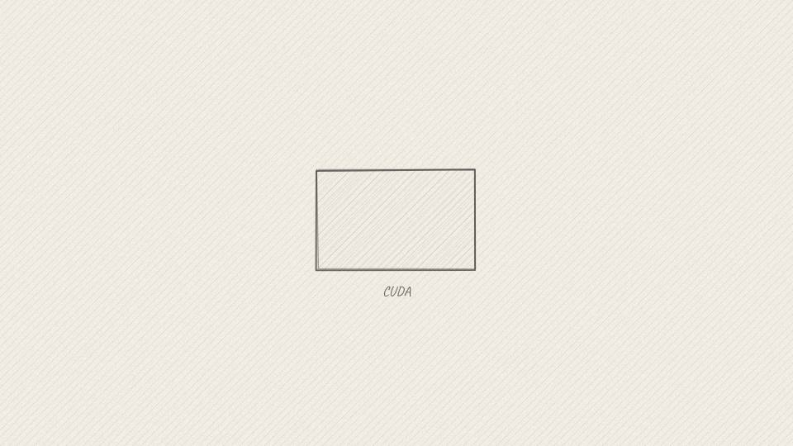
NV 6.04 CARD · 7.5 s
Act 6 · Act 6: Ten Thousand Interns
VISUAL
Code on a dark screen with the word CUDA.
ON-SCREEN TEXT
CUDA · 2006
ANIMATION NOTES
Code types onto a dark screen; CUDA glows.
VO
In 2006 Nvidia announced CUDA, software that let scientists program its graphics chips for any kind of calculation.
Notes:
VO: In 2006 Nvidia announced CUDA, software that let scientists program its graphics chips for any kind of calculation.
Visual: Code on a dark screen with the word CUDA.
On-screen: CUDA · 2006
Animation: Code types onto a dark screen; CUDA glows.

Slide 56

NV 6.05 MED · 8.3 s
Act 6 · Act 6: Ten Thousand Interns
VISUAL
A finance chart with costs climbing and a flat CUDA revenue line; worried executives.
ON-SCREEN TEXT
—
ANIMATION NOTES
Costs climb, revenue line flat; executives glance at each other.
VO
It was expensive. Every chip had to carry extra hardware for it, and for years, hardly anyone paid for it.
Notes:
VO: It was expensive. Every chip had to carry extra hardware for it, and for years, hardly anyone paid for it.
Visual: A finance chart with costs climbing and a flat CUDA revenue line; worried executives.
On-screen: -
Animation: Costs climb, revenue line flat; executives glance at each other.

Slide 57
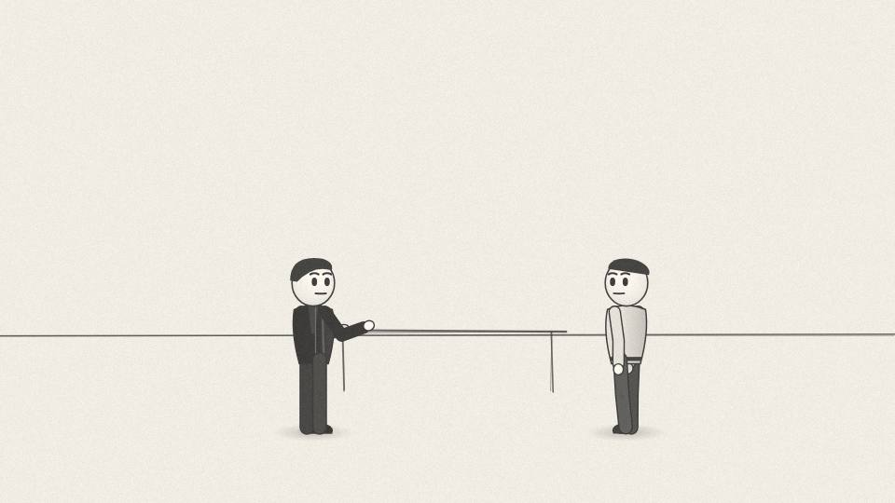
NV 6.06 CU · 9.1 s
Act 6 · Act 6: Ten Thousand Interns
VISUAL
Stock line falls; Jensen hands a box of GPUs to a professor.
ON-SCREEN TEXT
—
ANIMATION NOTES
Stock line falls behind him; Jensen hands a box of GPUs to a professor.
VO
Wall Street didn't like it. Nvidia's share price fell hard after 2008. Jensen kept funding CUDA anyway, and gave it to universities.
Notes:
VO: Wall Street didn't like it. Nvidia's share price fell hard after 2008. Jensen kept funding CUDA anyway, and gave it to universities.
Visual: Stock line falls; Jensen hands a box of GPUs to a professor.
On-screen: -
Animation: Stock line falls behind him; Jensen hands a box of GPUs to a professor.

Slide 58
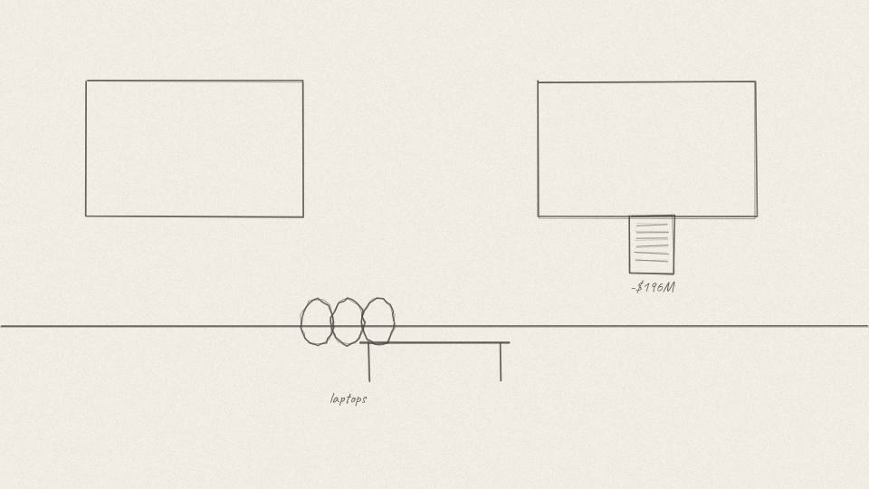
NV 6.07 MED · 12.4 s
Act 6 · Act 6: Ten Thousand Interns
VISUAL
A pile of returned laptops; a ledger with a red -$196M entry.
ON-SCREEN TEXT
2008
ANIMATION NOTES
Returned laptops pile up; red ledger entry writes in.
VO
In 2008 things got worse. A manufacturing defect in some laptop chips forced Nvidia to set aside about two hundred million dollars, and the financial crisis hit at the same time.
Notes:
VO: In 2008 things got worse. A manufacturing defect in some laptop chips forced Nvidia to set aside about two hundred million dollars, and the financial crisis hit at the same time.
Visual: A pile of returned laptops; a ledger with a red -$196M entry.
On-screen: 2008
Animation: Returned laptops pile up; red ledger entry writes in.

Slide 59
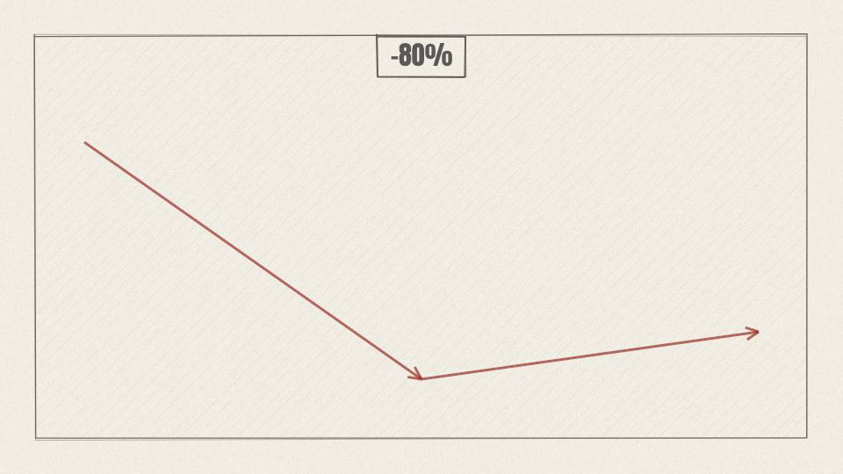
NV 6.08 CHART · 11.3 s
Act 6 · Act 6: Ten Thousand Interns
VISUAL
Share price line drops from a peak to a deep valley.
ON-SCREEN TEXT
-80%
ANIMATION NOTES
Price line drops from the peak into a deep valley.
VO
From its 2007 peak, the stock lost more than three quarters of its value. Investors asked why Nvidia was spending so much on a product almost nobody used.
Notes:
VO: From its 2007 peak, the stock lost more than three quarters of its value. Investors asked why Nvidia was spending so much on a product almost nobody used.
Visual: Share price line drops from a peak to a deep valley.
On-screen: -80%
Animation: Price line drops from the peak into a deep valley.

Slide 60
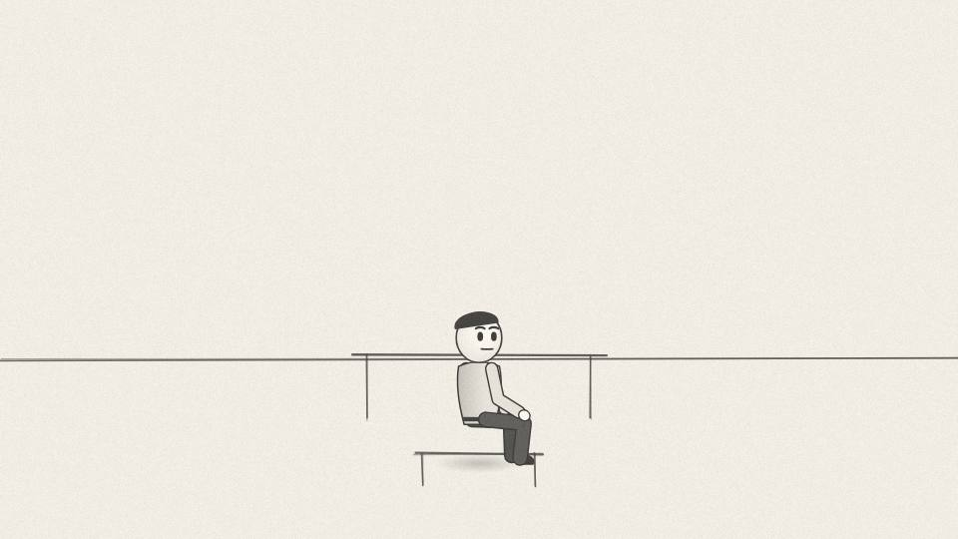
NV 6.09 WIDE · 7.5 s
Act 6 · Act 6: Ten Thousand Interns
VISUAL
A university lab at night, one student working under a desk lamp.
ON-SCREEN TEXT
—
ANIMATION NOTES
University lab at night; one student under a lamp; quiet.
VO
He was betting that somewhere, some researcher would find a job only this kind of chip could do.
Notes:
VO: He was betting that somewhere, some researcher would find a job only this kind of chip could do.
Visual: A university lab at night, one student working under a desk lamp.
On-screen: -
Animation: University lab at night; one student under a lamp; quiet.

Slide 61
ACT 7 · ACT 7: THE TORONTO MOMENT
10 frames · 1:18

Slide 62
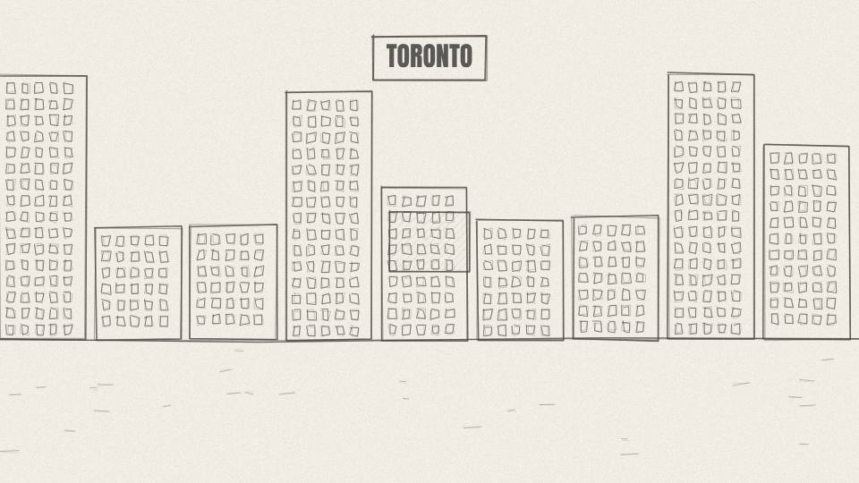
NV 7.01 MED · 5.3 s
Act 7 · Act 7: The Toronto Moment
VISUAL
Snowy Toronto campus at night; a lit window.
ON-SCREEN TEXT
TORONTO · 2012
ANIMATION NOTES
Snow falls; one lit window; slow push.
VO
In 2012, that job arrived. It came from the University of Toronto.
Notes:
VO: In 2012, that job arrived. It came from the University of Toronto.
Visual: Snowy Toronto campus at night; a lit window.
On-screen: TORONTO · 2012
Animation: Snow falls; one lit window; slow push.

Slide 63
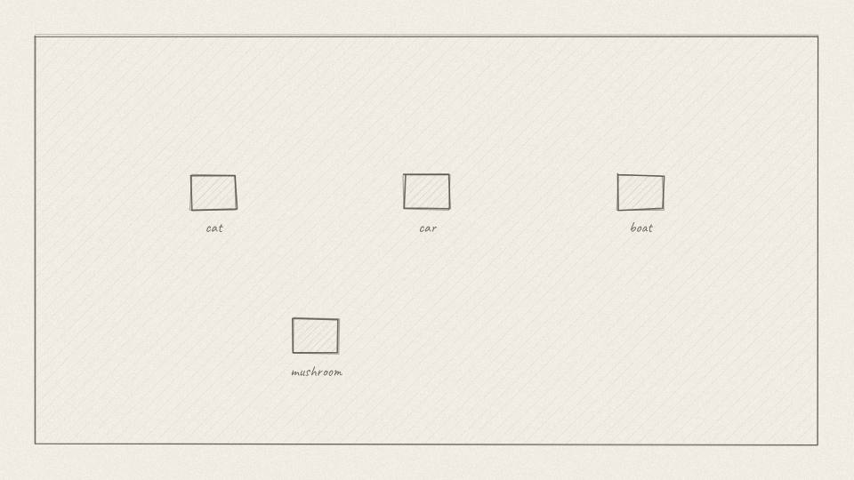
NV 7.02 MED · 6.8 s
Act 7 · Act 7: The Toronto Moment
VISUAL
A grid of photos: cats, cars, mushrooms, boats, each with a guessing label.
ON-SCREEN TEXT
IMAGENET
ANIMATION NOTES
Photo grid pops in; guessing labels flicker between options.
VO
A contest called ImageNet asked computer programs to recognise objects in more than a million photos.
Notes:
VO: A contest called ImageNet asked computer programs to recognise objects in more than a million photos.
Visual: A grid of photos: cats, cars, mushrooms, boats, each with a guessing label.
On-screen: IMAGENET
Animation: Photo grid pops in; guessing labels flicker between options.

Slide 64
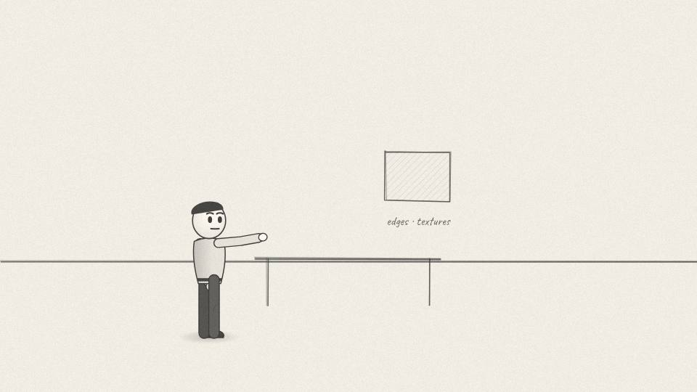
NV 7.03 MED · 5.7 s
Act 7 · Act 7: The Toronto Moment
VISUAL
Researchers drawing edge and texture filters on a chalkboard.
ON-SCREEN TEXT
—
ANIMATION NOTES
Filters draw on the chalkboard as she points.
VO
Most teams hand-designed the features the computer should look for. Edges, textures, shapes.
Notes:
VO: Most teams hand-designed the features the computer should look for. Edges, textures, shapes.
Visual: Researchers drawing edge and texture filters on a chalkboard.
On-screen: -
Animation: Filters draw on the chalkboard as she points.

Slide 65

NV 7.04 CU · 9.8 s
Act 7 · Act 7: The Toronto Moment
VISUAL
Three ink figures at a desk; a layered network diagram grows behind them.
ON-SCREEN TEXT
KRIZHEVSKY · SUTSKEVER · HINTON
ANIMATION NOTES
A layered network diagram grows layer by layer behind them.
VO
Alex Krizhevsky, Ilya Sutskever and Geoffrey Hinton did something different. They built a deep neural network and let it learn from the data itself.
Notes:
VO: Alex Krizhevsky, Ilya Sutskever and Geoffrey Hinton did something different. They built a deep neural network and let it learn from the data itself.
Visual: Three ink figures at a desk; a layered network diagram grows behind them.
On-screen: KRIZHEVSKY · SUTSKEVER · HINTON
Animation: A layered network diagram grows layer by layer behind them.

Slide 66

NV 7.05 PROP3D · 9.1 s
Act 7 · Act 7: The Toronto Moment
VISUAL
Two 3D GeForce GTX 580 cards side by side in a PC, fans spinning.
ON-SCREEN TEXT
2 × GTX 580
ANIMATION NOTES
Two cards in a PC, fans spinning, slight rotation.
VO
Training it took an enormous number of small calculations at once. They ran it on two Nvidia gaming cards, in a bedroom.
Notes:
VO: Training it took an enormous number of small calculations at once. They ran it on two Nvidia gaming cards, in a bedroom.
Visual: Two 3D GeForce GTX 580 cards side by side in a PC, fans spinning.
On-screen: 2 × GTX 580
Animation: Two cards in a PC, fans spinning, slight rotation.

Slide 67

NV 7.06 CHART · 8.7 s
Act 7 · Act 7: The Toronto Moment
VISUAL
Bar chart: 26.2% vs 15.3% error.
ON-SCREEN TEXT
26.2% vs 15.3%
ANIMATION NOTES
Two error bars grow; the AlexNet bar stops much lower; hit.
VO
The best rival entry got about twenty-six percent of its top answers wrong. Their network, AlexNet, got about fifteen percent wrong.
Notes:
VO: The best rival entry got about twenty-six percent of its top answers wrong. Their network, AlexNet, got about fifteen percent wrong.
Visual: Bar chart: 26.2% vs 15.3% error.
On-screen: 26.2% vs 15.3%
Animation: Two error bars grow; the AlexNet bar stops much lower; hit.

Slide 68

NV 7.07 CU · 7.5 s
Act 7 · Act 7: The Toronto Moment
VISUAL
The two cards glow; the counter changes from DAYS OF CASH to MARKET VALUE.
ON-SCREEN TEXT
—
ANIMATION NOTES
Cards glow; the counter label flips and starts climbing.
VO
In a field where progress came in tiny steps, it was a leap. And it ran on Nvidia.
Notes:
VO: In a field where progress came in tiny steps, it was a leap. And it ran on Nvidia.
Visual: The two cards glow; the counter changes from DAYS OF CASH to MARKET VALUE.
On-screen: -
Animation: Cards glow; the counter label flips and starts climbing.

Slide 69

NV 7.08 WIDE · 8.7 s
Act 7 · Act 7: The Toronto Moment
VISUAL
Labeled buildings light up one by one: GOOGLE, MICROSOFT, META, STANFORD, MIT.
ON-SCREEN TEXT
—
ANIMATION NOTES
Buildings light up one by one as named.
VO
Within a few years, almost every serious AI lab was buying Nvidia chips. The hobby nobody wanted had found its customer.
Notes:
VO: Within a few years, almost every serious AI lab was buying Nvidia chips. The hobby nobody wanted had found its customer.
Visual: Labeled buildings light up one by one: GOOGLE, MICROSOFT, META, STANFORD, MIT.
On-screen: -
Animation: Buildings light up one by one as named.

Slide 70

NV 7.09 MED · 5.3 s
Act 7 · Act 7: The Toronto Moment
VISUAL
3D DGX-1 box, gold front panel, on a pedestal.
ON-SCREEN TEXT
DGX-1
ANIMATION NOTES
The DGX-1 rises on a pedestal; gold panel shines.
VO
Jensen moved fast. Nvidia began building whole AI computers, not just cards.
Notes:
VO: Jensen moved fast. Nvidia began building whole AI computers, not just cards.
Visual: 3D DGX-1 box, gold front panel, on a pedestal.
On-screen: DGX-1
Animation: The DGX-1 rises on a pedestal; gold panel shines.

Slide 71

NV 7.10 CU · 11.3 s
Act 7 · Act 7: The Toronto Moment
VISUAL
Jensen carries the box through an office door; staff gather; a marker signature on the lid.
ON-SCREEN TEXT
OPENAI · 2016
ANIMATION NOTES
Jensen carries the box in; staff gather; a marker signature draws on the lid.
VO
In 2016 he personally delivered the first one to a small non-profit lab in San Francisco called OpenAI. He signed it: to the future of computing and humanity.
Notes:
VO: In 2016 he personally delivered the first one to a small non-profit lab in San Francisco called OpenAI. He signed it: to the future of computing and humanity.
Visual: Jensen carries the box through an office door; staff gather; a marker signature on the lid.
On-screen: OPENAI · 2016
Animation: Jensen carries the box in; staff gather; a marker signature draws on the lid.

Slide 72
ACT 8 · ACT 8: THE FIGHTS
7 frames · 0:55

Slide 73

NV 8.01 MED · 6.4 s
Act 8 · Act 8: The Fights
VISUAL
Painted TSMC fab in Hsinchu, clean-room workers in white suits.
ON-SCREEN TEXT
TSMC · TAIWAN
ANIMATION NOTES
Clean-room workers in white suits move slowly; yellow light.
VO
Nvidia designs its chips, but doesn't make them. Most are manufactured by TSMC in Taiwan.
Notes:
VO: Nvidia designs its chips, but doesn't make them. Most are manufactured by TSMC in Taiwan.
Visual: Painted TSMC fab in Hsinchu, clean-room workers in white suits.
On-screen: TSMC · TAIWAN
Animation: Clean-room workers in white suits move slowly; yellow light.

Slide 74

NV 8.02 MED · 9.1 s
Act 8 · Act 8: The Fights
VISUAL
A deal card '$40B' between NVIDIA and ARM text tiles; a phone opens to show an Arm core.
ON-SCREEN TEXT
$40 BILLION
ANIMATION NOTES
Deal card slides between the tiles; the phone opens to show an Arm core.
VO
In 2020, Jensen tried to buy Arm, the British company whose chip designs sit inside almost every smartphone, for forty billion dollars.
Notes:
VO: In 2020, Jensen tried to buy Arm, the British company whose chip designs sit inside almost every smartphone, for forty billion dollars.
Visual: A deal card '$40B' between NVIDIA and ARM text tiles; a phone opens to show an Arm core.
On-screen: $40 BILLION
Animation: Deal card slides between the tiles; the phone opens to show an Arm core.

Slide 75

NV 8.03 MED · 9.8 s
Act 8 · Act 8: The Fights
VISUAL
Three government buildings, each stamping a document.
ON-SCREEN TEXT
FTC · UK · EU
ANIMATION NOTES
Three buildings each stamp a document (three stamp hits).
VO
The rest of the industry objected. Regulators in America, Britain and Europe opened investigations, and the US Federal Trade Commission sued to block it.
Notes:
VO: The rest of the industry objected. Regulators in America, Britain and Europe opened investigations, and the US Federal Trade Commission sued to block it.
Visual: Three government buildings, each stamping a document.
On-screen: FTC · UK · EU
Animation: Three buildings each stamp a document (three stamp hits).

Slide 76

NV 8.04 CU · 3.8 s
Act 8 · Act 8: The Fights
VISUAL
The deal card tears in half.
ON-SCREEN TEXT
DEAL OFF · 2022
ANIMATION NOTES
The deal card tears in half; paper rip SFX.
VO
In 2022, Nvidia gave up on the deal.
Notes:
VO: In 2022, Nvidia gave up on the deal.
Visual: The deal card tears in half.
On-screen: DEAL OFF · 2022
Animation: The deal card tears in half; paper rip SFX.

Slide 77

NV 8.05 MED · 8.3 s
Act 8 · Act 8: The Fights
VISUAL
A Washington memo stamped 'EXPORT CONTROL'; crates of chips stopped at a port.
ON-SCREEN TEXT
2022
ANIMATION NOTES
Memo stamped; crates stop at the port; a barrier drops.
VO
That same year, the US government banned Nvidia from selling its top AI chips, the A100 and H100, to China.
Notes:
VO: That same year, the US government banned Nvidia from selling its top AI chips, the A100 and H100, to China.
Visual: A Washington memo stamped 'EXPORT CONTROL'; crates of chips stopped at a port.
On-screen: 2022
Animation: Memo stamped; crates stop at the port; a barrier drops.

Slide 78

NV 8.06 MED · 9.4 s
Act 8 · Act 8: The Fights
VISUAL
A modified chip slides through a gate, then a second gate slams shut.
ON-SCREEN TEXT
H800 BLOCKED · 2023
ANIMATION NOTES
A modified chip slides through the first gate; the second gate slams shut.
VO
Nvidia designed slower versions to fit inside the rules, like the H800. In 2023, Washington tightened the rules and those were blocked too.
Notes:
VO: Nvidia designed slower versions to fit inside the rules, like the H800. In 2023, Washington tightened the rules and those were blocked too.
Visual: A modified chip slides through a gate, then a second gate slams shut.
On-screen: H800 BLOCKED · 2023
Animation: A modified chip slides through the first gate; the second gate slams shut.

Slide 79

NV 8.07 CU · 9.1 s
Act 8 · Act 8: The Fights
VISUAL
A chessboard with US and China pieces; the GPU sits in the middle as a piece.
ON-SCREEN TEXT
—
ANIMATION NOTES
Chessboard; pieces slide; the GPU sits in the middle as a piece.
VO
Nvidia was no longer just a chip company. It had become part of a technology contest between the world's two biggest powers.
Notes:
VO: Nvidia was no longer just a chip company. It had become part of a technology contest between the world's two biggest powers.
Visual: A chessboard with US and China pieces; the GPU sits in the middle as a piece.
On-screen: -
Animation: Chessboard; pieces slide; the GPU sits in the middle as a piece.

Slide 80
ACT 9 · ACT 9: FIVE TRILLION
10 frames · 1:27

Slide 81

NV 9.01 WIDE · 7.5 s
Act 9 · Act 9: Five Trillion
VISUAL
A chat window glows on a laptop; crowds of companies rush toward a server hall.
ON-SCREEN TEXT
LATE 2022
ANIMATION NOTES
A chat window glows; crowds of company tiles rush toward the server hall.
VO
Then, in late 2022, ChatGPT launched, and every tech company on Earth wanted to build its own AI.
Notes:
VO: Then, in late 2022, ChatGPT launched, and every tech company on Earth wanted to build its own AI.
Visual: A chat window glows on a laptop; crowds of companies rush toward a server hall.
On-screen: LATE 2022
Animation: A chat window glows; crowds of company tiles rush toward the server hall.

Slide 82

NV 9.02 MED · 7.9 s
Act 9 · Act 9: Five Trillion
VISUAL
Endless rows of server racks with green lights.
ON-SCREEN TEXT
—
ANIMATION NOTES
Endless racks with green lights; slow push down the aisle.
VO
Training those models takes vast data centres full of GPUs. Nvidia's chips, and its CUDA software, were the standard.
Notes:
VO: Training those models takes vast data centres full of GPUs. Nvidia's chips, and its CUDA software, were the standard.
Visual: Endless rows of server racks with green lights.
On-screen: -
Animation: Endless racks with green lights; slow push down the aisle.

Slide 83

NV 9.03 CU · 11.3 s
Act 9 · Act 9: Five Trillion
VISUAL
A huge library of code books all stamped CUDA; a rival chip sits alone with an empty shelf.
ON-SCREEN TEXT
THE CUDA MOAT
ANIMATION NOTES
Library of code books stamped CUDA; the rival chip sits by an empty shelf.
VO
Seventeen years of CUDA meant that most AI code was already written for Nvidia. Switching to a rival chip wasn't just buying new hardware; it meant rewriting software.
Notes:
VO: Seventeen years of CUDA meant that most AI code was already written for Nvidia. Switching to a rival chip wasn't just buying new hardware; it meant rewriting software.
Visual: A huge library of code books all stamped CUDA; a rival chip sits alone with an empty shelf.
On-screen: THE CUDA MOAT
Animation: Library of code books stamped CUDA; the rival chip sits by an empty shelf.

Slide 84

NV 9.04 CHART · 7.9 s
Act 9 · Act 9: Five Trillion
VISUAL
Staircase chart with labeled steps $1T, $3T, $4T.
ON-SCREEN TEXT
$1T · $3T · $4T
ANIMATION NOTES
A staircase draws step by step with labels.
VO
Nvidia's value climbed in leaps. One trillion dollars in 2023. Three trillion in 2024. Four trillion in July 2025.
Notes:
VO: Nvidia's value climbed in leaps. One trillion dollars in 2023. Three trillion in 2024. Four trillion in July 2025.
Visual: Staircase chart with labeled steps $1T, $3T, $4T.
On-screen: $1T · $3T · $4T
Animation: A staircase draws step by step with labels.

Slide 85

NV 9.05 PROP3D · 6.8 s
Act 9 · Act 9: Five Trillion
VISUAL
3D Blackwell board on a pedestal; an order queue scrolls beside it.
ON-SCREEN TEXT
BLACKWELL
ANIMATION NOTES
Board rotates on a pedestal; the order queue scrolls.
VO
Its newer Blackwell chips were sold out long before the factories could make enough of them.
Notes:
VO: Its newer Blackwell chips were sold out long before the factories could make enough of them.
Visual: 3D Blackwell board on a pedestal; an order queue scrolls beside it.
On-screen: BLACKWELL
Animation: Board rotates on a pedestal; the order queue scrolls.

Slide 86

NV 9.06 CHART · 6.8 s
Act 9 · Act 9: Five Trillion
VISUAL
Market-value counter lands on $5T; confetti of tiny chips.
ON-SCREEN TEXT
29 OCT 2025 · $5T
ANIMATION NOTES
Counter lands on $5T; tiny chip confetti falls.
VO
On the twenty-ninth of October 2025, Nvidia became the first company ever worth five trillion dollars.
Notes:
VO: On the twenty-ninth of October 2025, Nvidia became the first company ever worth five trillion dollars.
Visual: Market-value counter lands on $5T; confetti of tiny chips.
On-screen: 29 OCT 2025 · $5T
Animation: Counter lands on $5T; tiny chip confetti falls.

Slide 87

NV 9.07 MED · 10.6 s
Act 9 · Act 9: Five Trillion
VISUAL
Recap strip: Denny's booth, NV1, Tokyo bow, RIVA 128, Toronto lab.
ON-SCREEN TEXT
—
ANIMATION NOTES
Recap strip slides past: booth, NV1, Tokyo bow, RIVA 128, Toronto lab.
VO
From a diner booth, a dead-end chip, a favour from Sega, a chip finished with thirty days of cash, and a science project nobody paid for.
Notes:
VO: From a diner booth, a dead-end chip, a favour from Sega, a chip finished with thirty days of cash, and a science project nobody paid for.
Visual: Recap strip: Denny's booth, NV1, Tokyo bow, RIVA 128, Toronto lab.
On-screen: -
Animation: Recap strip slides past: booth, NV1, Tokyo bow, RIVA 128, Toronto lab.

Slide 88

NV 9.08 CU · 6.0 s
Act 9 · Act 9: Five Trillion
VISUAL
Jensen walks into a vast server hall, leather jacket, alone.
ON-SCREEN TEXT
—
ANIMATION NOTES
Jensen walks alone into the hall (walk cycle); camera follows.
VO
Every one of those bets looked mad at the time. Jensen kept making them.
Notes:
VO: Every one of those bets looked mad at the time. Jensen kept making them.
Visual: Jensen walks into a vast server hall, leather jacket, alone.
On-screen: -
Animation: Jensen walks alone into the hall (walk cycle); camera follows.

Slide 89

NV 9.09 MED · 13.2 s
Act 9 · Act 9: Five Trillion
VISUAL
Jensen in a large open meeting with dozens of staff around a long table.
ON-SCREEN TEXT
—
ANIMATION NOTES
Open meeting; staff around a long table; he gestures; heads turn.
VO
He still runs the company his own way. He has around sixty people reporting directly to him, few one-on-one meetings, and he still talks about the company as if it could die tomorrow.
Notes:
VO: He still runs the company his own way. He has around sixty people reporting directly to him, few one-on-one meetings, and he still talks about the company as if it could die tomorrow.
Visual: Jensen in a large open meeting with dozens of staff around a long table.
On-screen: -
Animation: Open meeting; staff around a long table; he gestures; heads turn.

Slide 90

NV 9.10 WIDE · 9.1 s
Act 9 · Act 9: Five Trillion
VISUAL
End card with the channel name.
ON-SCREEN TEXT
STROMHELL
ANIMATION NOTES
End card; music resolves.
VO
If you want to see who ends up owning a slice of a company like this, watch our story on BlackRock next.
Notes:
VO: If you want to see who ends up owning a slice of a company like this, watch our story on BlackRock next.
Visual: End card with the channel name.
On-screen: STROMHELL
Animation: End card; music resolves.

