Slide 1
Week 1
Report
Ruixin Peng
May 22, 2026

Slide 2
1.1 Project Skeleton & Toolchain
Repo ready — README + plan + Net1.inp + two demo.
Environment ready — Cursor + Conda cive70058 (Python 3.11, WNTR 1.4, EPANET);
Version control — Learned Git/GitHub
Thesis template ready

Slide 3
1.2 Model Demo (baseline simulation)
Modified Net1 | Official Net1.inp (original)
wall off | bulk + wall on
junction initial Cl = 0 | junction initial Cl = 0.5 mg/L (WNTR initial_quality units (kg/m³ → mg/L for display ?))

Slide 4
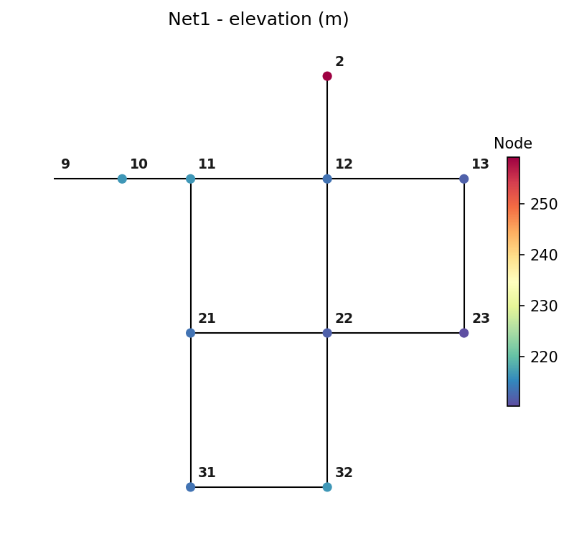
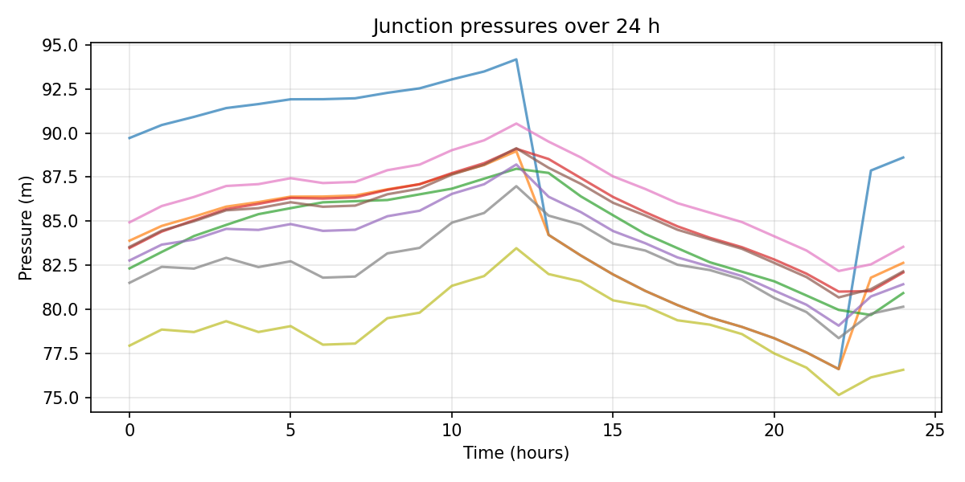
1.2 Model Demo results (Modified Net1)
Around 13 h, node 10 drops ~10 m: pump OFF (tank > 140 ft).
23 h recovery: pump ON again.
2 - tank
9 - reservoir

Slide 5
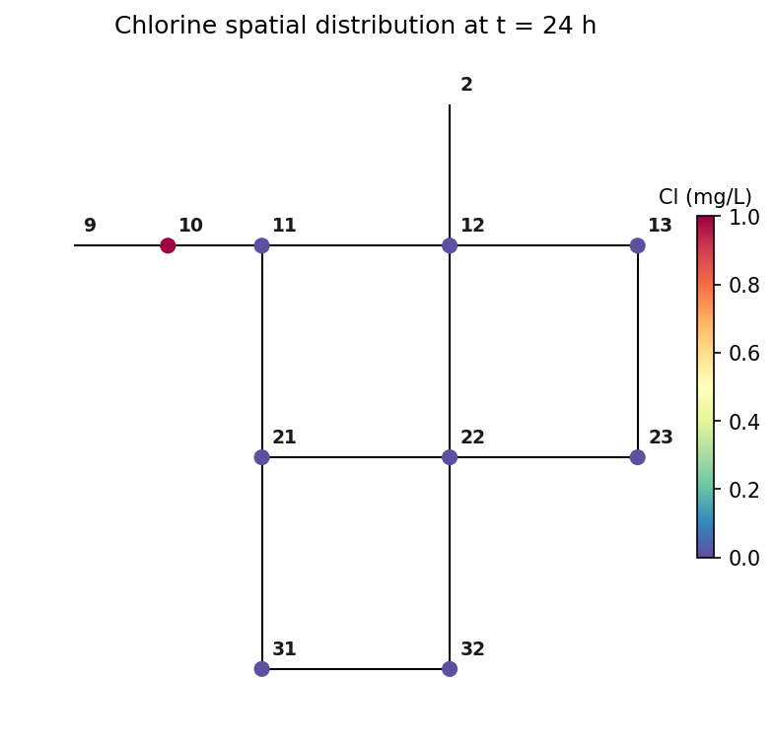
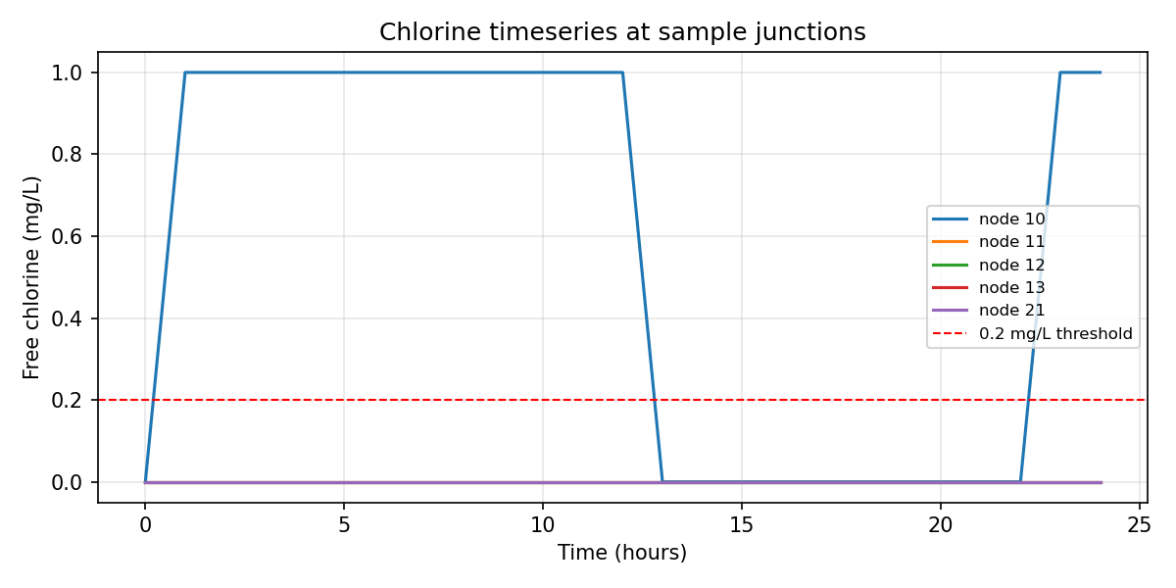
1.2 Model Demo results (Modified Net1)
Chlorine time series
Node 10 (first junction after pump): 0 → 1 → 0 → 1
1 mg/L when pump ON; zero during OFF (13–22 h); reinjection at 23 h.
Nodes 11/12/13/21 etc.: stay ≈ 0 for 24 h — chlorine has not advected downstream.
Spatial chlorine
Only node 10 is dark (1.0 mg/L); all other junctions near zero.

Slide 6
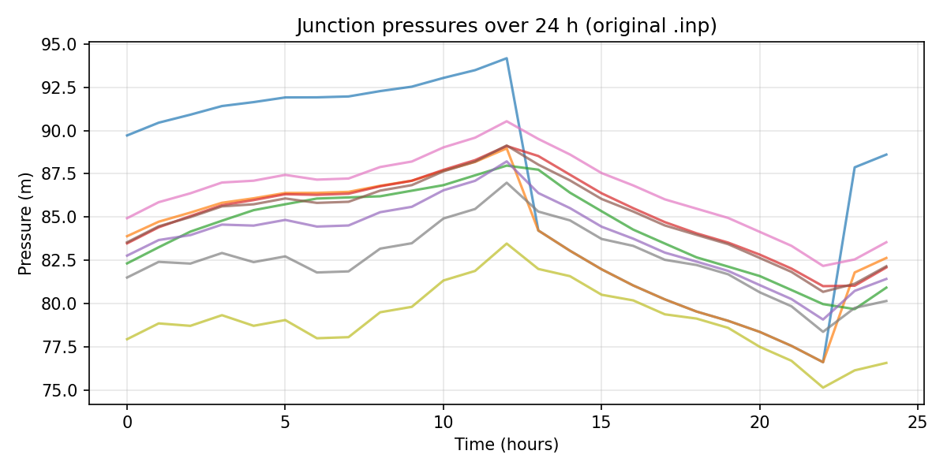
1.2 Model Demo results (Official Net1.inp (original))

Slide 7
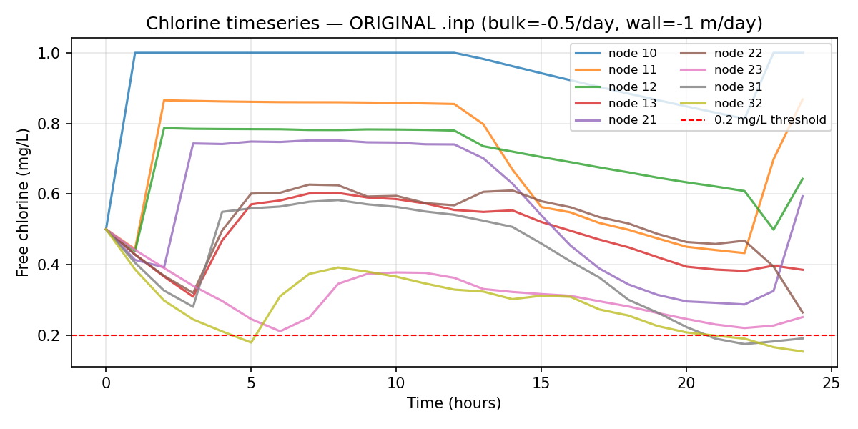
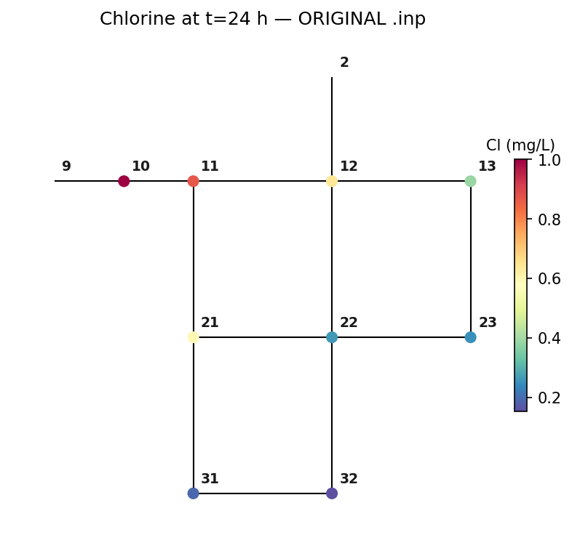
1.2 Model Demo results (Official Net1.inp (original))
From 1 h, node 11 is already 0.44 mg/L — junctions start at 0.5 + source at 1.0 mg/L
During pump OFF (13–22 h), concentrations gradually decline (bulk + wall decay)
After 23 h pump ON, node 10 returns to 1.0 mg/L and downstream nodes recover.
Terminal nodes 31/32 have the lowest means and occasionally hit the 0.2 mg/L threshold
Network-wide gradient: high near pump, low at far end (node 32 ≈ 0.15 mg/L).
Smooth colour transition consistent with bulk + wall decay and demand dilution.

Slide 8
1.3 Literature & Background
Decay mechanisms
Calibration
Measurement
Uncertainty
Regulation

Slide 9
2 Questions/problems
WNTR initial_quality units (kg/m³→ mg/L for display?)
2. For uncertainty-aware chlorine calibration, we have both sensor error and unknown bulk/wall coefficients.
-Include an observation error model from the start?
-Do deterministic calibration first (treat observations as truth), then add sensor uncertainty later?
My concern: if sensor data are biased or noisy, and we calibrate bulk/wall against them without modelling sensor error, the fitted decay parameters may absorb measurement error.
3. Is the paper using 0.2 mg/L (WHO) as the operational threshold?

