Slide 1
Week 1-2
Report
Ruixin Peng
June 12, 2026

Slide 2

Contents
1. WNTR Chlorine Modelling - Pre Work
2. Learning exercises
3. Material reading
4. My own understanding
Ruixin Peng
June 12, 2026

Slide 3
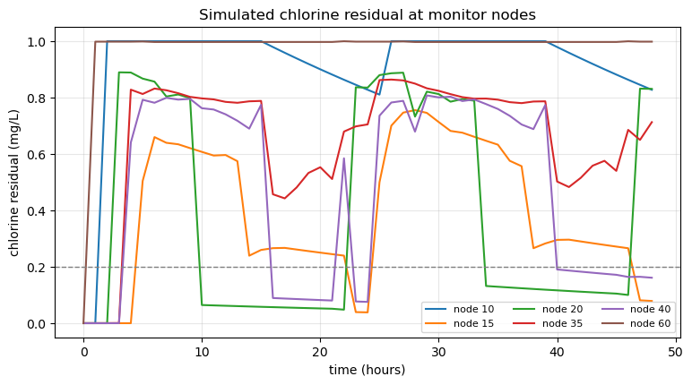
near-source nodes (node 60 ≈ 1.0, node 10 ≈ 0.95) show almost no decay
far / branch nodes (nodes 15, 20, 40) fall much lower
There is a warm-up transient at the start (pipes/tanks filling from their initial state) before the system reaches a quasi-steady state -- so this initial period should be discarded when computing metrics later.
k_{b} = -0.5/day, k_{w} = -0.1m/day ??
In my own paper, do I need to, eg. run for 72 hours and discard the first 24 hours?

Slide 4
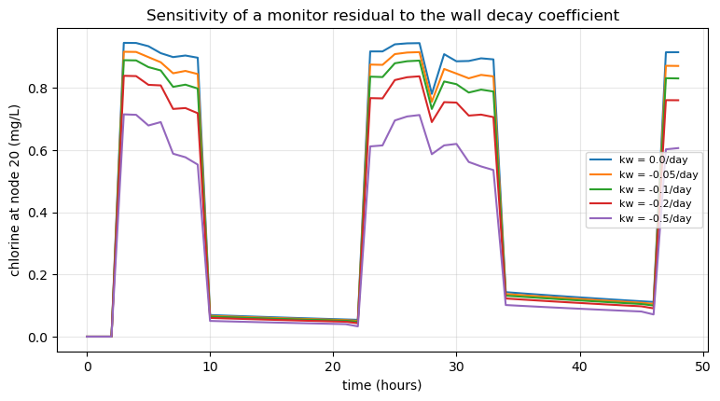
Most k_{w}-sensitive monitor (lowest mean residual): node 20
The more negative k_{w} is, the lower the residual, and the curves spread out clearly into separate lines → here k_{w} has a strong effect and is identifiable.
Notes:
0 order decay
node

Slide 5
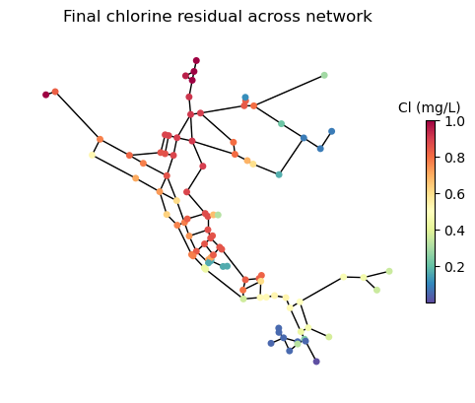
Network map coloured by final chlorine
Residual chlorine exhibits a spatial gradient: highest near the source/reservoir and gradually decreasing along the distribution network toward the ends; lowest at ends, long branch pipes, and areas far from the source (most prone to problems).
The safe range of chlorine is interval -- (a, b)
Should we consider whether it exceeds b?
Notes:
change kw
noise data

Slide 6
1. Bulk vs wall. Re-run with k_{w} = 0. How much of Net's residual loss is bulk vs wall?
name | bulk-only (mg/L) | bulk+wall (mg/L) | loss_bulk (%) | loss_wall (%)
10 | 0.956 | 0.955 | 4.400 | 0.0
15 | 0.619 | 0.470 | 38.100 | 14.9
20 | 0.482 | 0.440 | 51.800 | 4.1
35 | 0.815 | 0.727 | 18.500 | 8.8
40 | 0.629 | 0.541 | 37.100 | 8.8
60 | 0.999 | 0.997 | 0.100 | 0.1
Division of labor with wall: at each point, bulk loss is ≥ wall, indicating that bulk is the dominant decay mechanism;
Wall decay contribution strongly depends on spatial location, pipe material and age (Hallam et al., 2002). Even with uniform k_{w} values throughout the network, the proportion attributed to wall decay ranges from 0% to ~15% at different locations.
• The node with the highest absolute contribution from wall decay is node 15.
• Node 20 has the highest bulk decay value (51.8%, longest water age), while node 60/10 has the lowest.
The larger the loss_bulk, the "older" the water.

Slide 7
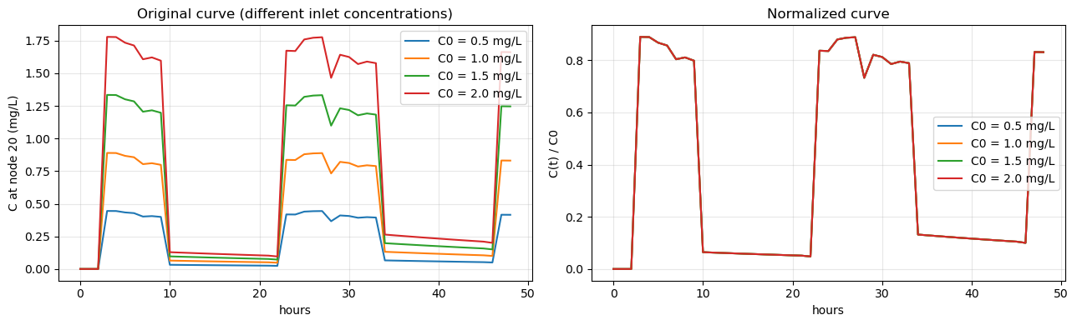
2. Change INLET_CHLORINE_MGL and confirm residuals scale linearly. Why does that matter for treating the inlet monitor as a boundary condition?
Results: The four normalized curves perfectly overlap.
First-order kinetics dC/dt = -k·C is homogeneous/linear with respect to concentration.
This provides the justification for treating the DMA inlet monitoring point as a boundary condition -- simply inputting the measured inlet C(t) into the model is sufficient, without needing recalibration due to changes in absolute inlet levels.

Slide 8
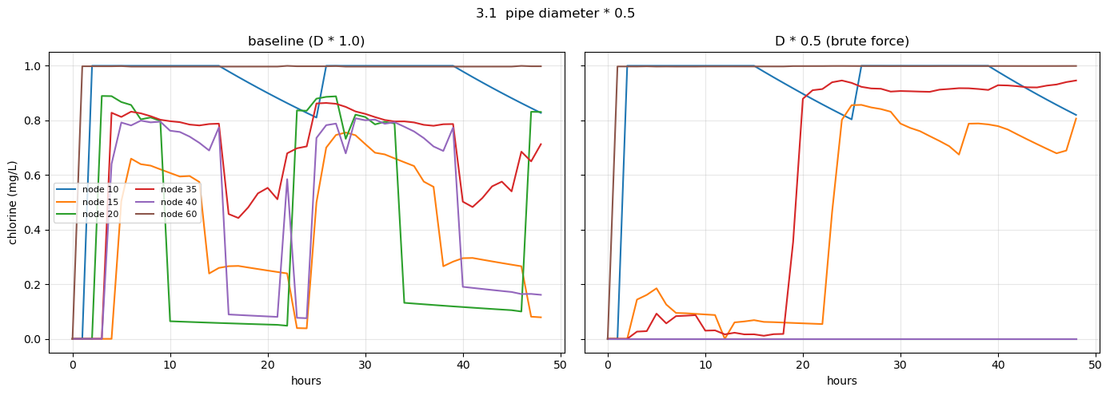
3. Halve every pipe diameter. Wall decay should bite harder - why? (hydraulic radius / mass transfer; EPANET manual Ch.3).
Results:
Node 20/40 concentration is close to or equal to zero—these nodes did not receive any water at all
Node 15/35 concentration increased—the flow path was reconfigured, and water bypassed the tank
The curve is highly irregular, with "breakpoints" and "jumps," indicating the network is in a hydraulically infeasible state
wall reaction--4/d*k_{w} (EPANET manual), k_{w1}*k_{f}/[r_{h}(k_{w}+k_{f})] (Vasconcelos et al., 1997)

Slide 9
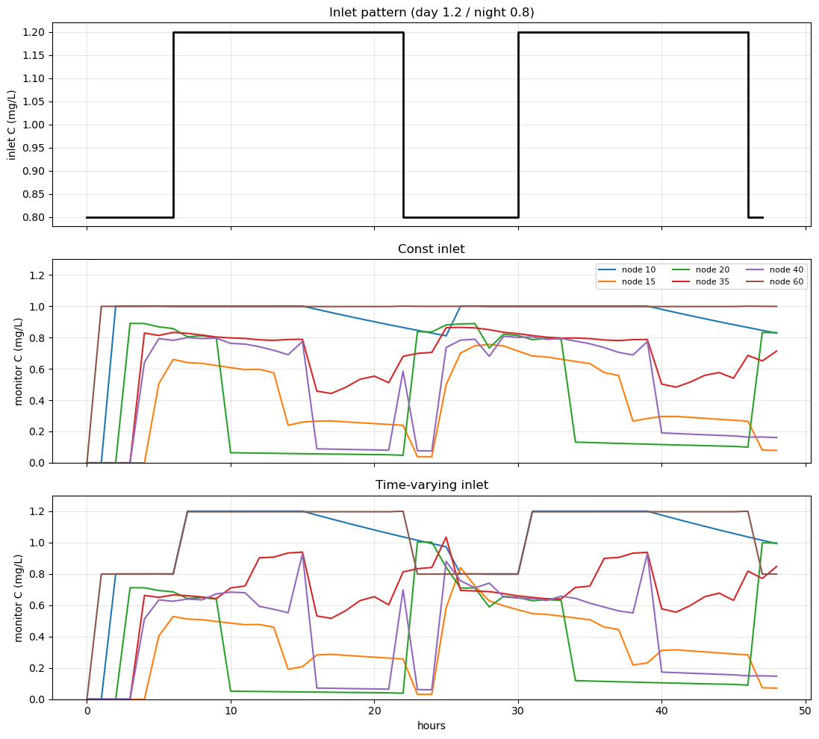
4. Use wn.add_source() with a pattern to make the inlet vary over time, mimicking a real inlet-monitor trace. This is exactly the boundary you'll impose later.
Results: Near-source nodes (10/60) closely follow the inlet pattern, but distant nodes (20/40) experience stronger fluctuations instead.
The downstream residual chlorine curve is not simply a delayed or slightly reduced version of the inlet curve.
The water travel time in pipelines varies, and in storage tanks, new and old water mix, which alters the shape of the curve.
Therefore, it is essential to simulate the entire process using an EPANET/WNTR model.
During calibration, only a few steady-state points should not be used; instead, the full time series must be applied.

Slide 10
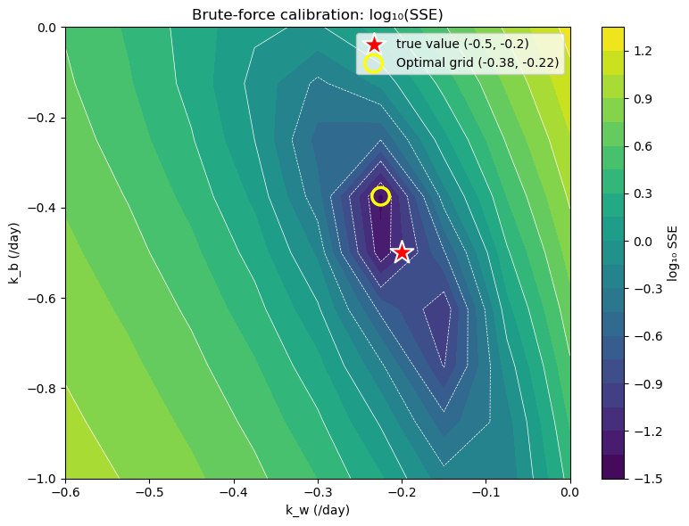
5. Loop simulate_chlorine() over a (kb, kw) grid and compute the sum of squared errors (SSE) against a synthetic "observed" run.
• Results:
The optimal grid point is (k_{b} = -0.375, k_{w} = -0.225), close but not equal to the true value (limited by the 9×9 coarse grid).
There are two grid points whose SSE falls within 1.5 times the minimum value: (-0.375, -0.22) and (-0.50, -0.22) -- their k_{w} values are nearly identical (≥-0.22, close to the true value), while k_{b} ranges from -0.375 to -0.50, all yielding "similarly good" fits.
k_{b}-k_{w} compensation: downstream residual chlorine only observes "total decay," so bulk and wall effects can compensate each other (a slightly higher kb and lower kw yield equally good fits).

Slide 11
Paper | Key takeaway
A1 Rossman 1994 | first-order bulk + wall + mass-transfer = the EPANET model I will use
A6 Vasconcelos 1997 | kw ∝ 1/roughness; absolute error: 0.05-0.15 mg/L (my accuracy benchmark); fix k_{b} from bottle tests, calibrate kw; DPD: 15% Process: (Hydraulic calibration), Bulk-bottle test, Adjust kw, Evaluation
A4 Hallam 2002 | wall decay is heterogeneous by material/age → justifies one kw per DMA
A3 Powell 2000 | bulk decay is driven by TOC/temperature → informs the kb prior
B1 Klise 2017 (WNTR) | EPANET wrapper + NetworkX + Pandas + built-in Monte Carlo
B2 EPANET 2.2 Manual | water-quality numerics: bulk/wall/mass-transfer term, unit conventions

Slide 12
My understanding
3 DMAs:
1. Hydraulic parameters are assumed correct without calibration.
2. TOC, DBP, and biofilm effects are not considered?
3. The inlet monitor has already measured it -- direct input (ex-normalization).
4. Decay: k_{w}, k_{b}, first-order
5. Monitoring point (3 inputs + 5 fittings + 2 validations)?
Based on prior experience, knowing the ranges of kb and kw, simulate a series of (kb, kw) pairs, compare C_{sim} with C_{obs} to determine suitable C_{sim} and find the corresponding interval for (k_{b}, k_{w}), and also obtain probabilities within reasonable ranges -- Monte Carlo ensemble, GLUE.
?
Does k_{b} share across DMA(same source?)? Does k_{b} require separate calibration (jar test)?
Fix k_{b}, calibrate kw or calibrate k_{b} and kw simultaneously (in my opinion, more difficult).
If only the residual chlorine data in the pipeline network is available, calibrate kb and kw as a set of parametersBeven & Binley 1992
Temperature?
Three DMAs (ABC), differing in pipe material and age (Hallam, 2002), were compared to determine whether a model calibrated on one DMA can be applied to another. (Using results from A to predict B and C, but I noticed the paper states they are not shared, so I believe prediction is not possible.)
Notes:
现在大概的思路是：
我拿到3个DMA
1. 明确水力不用校准，默认正确
2. 不考虑TOC, DBP, 生物膜的影响？
3. 入口监测器已经把它测出来了，直接输入（getting started-归一性）
4. 衰减：kw, kb, 一阶衰减
根据先验经验，知道kb, kw范围，然后simulate，试出来一系列(kb, kw), 把Csim和Cobs比较，得出合适的Csim和合适的(kb, kw)的区间，也能得出在合理范围内的概率-Monte Carlo ensemble, GLUE(贝叶斯还没看不确定)
监测点（3输入+5拟合+2校验）
三个DMA（ABC），differ in pipe material and age（Hallam, 2002），得出的结论可比较
？
DMA是否同源-kb是否相同，kb是否需要单独校准
kb固定，校准kw or kb, kw同时校准（个人感觉更难）
看完glue介绍之后，kb, kw作为一组来矫正，
温度
三个DMA（ABC），differ in pipe material and age（Hallam, 2002），得出的结论比较 or 在一个DMA上校准的模型能否适用于另一个DMA？(用A的结果预测B,C，但是我看到论文里说，不共用，所以我感觉不能预测)

