Slide 1
Weekly
Report
Ruixin Peng
June 18, 2026

Slide 2
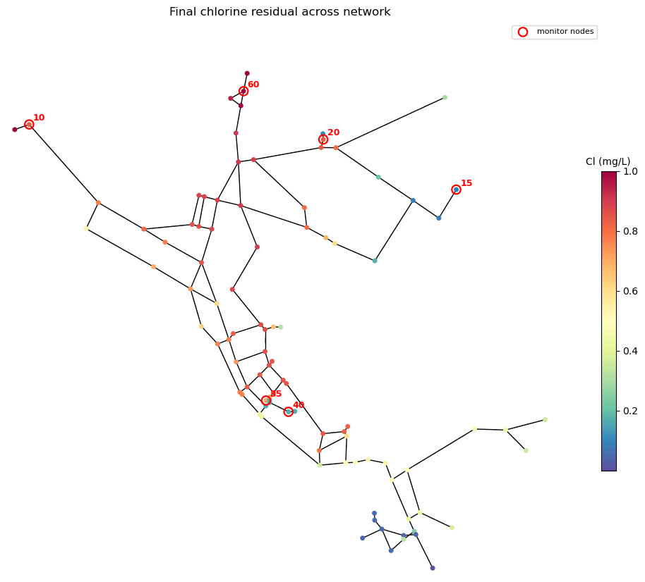
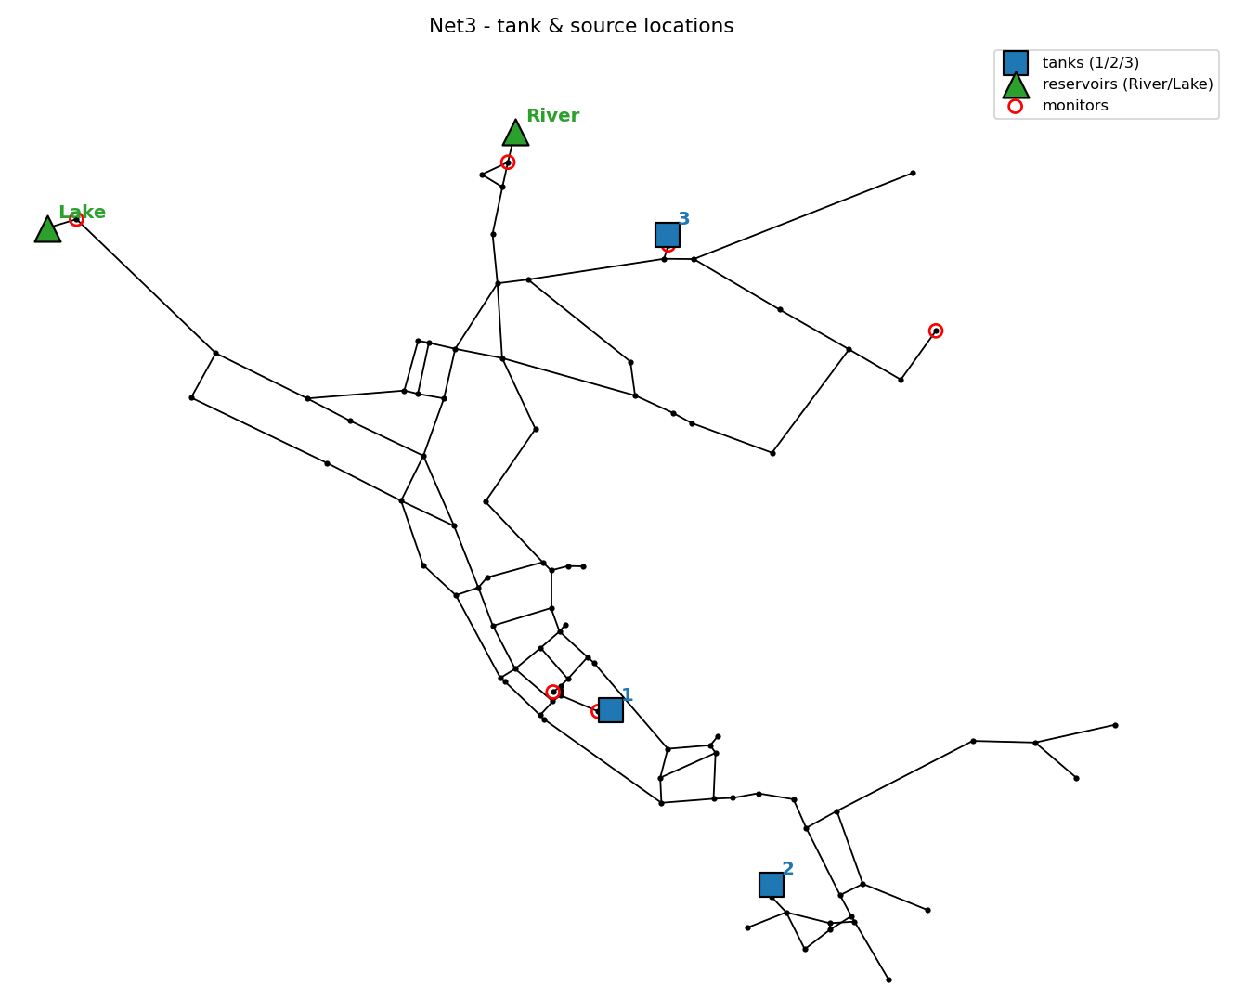
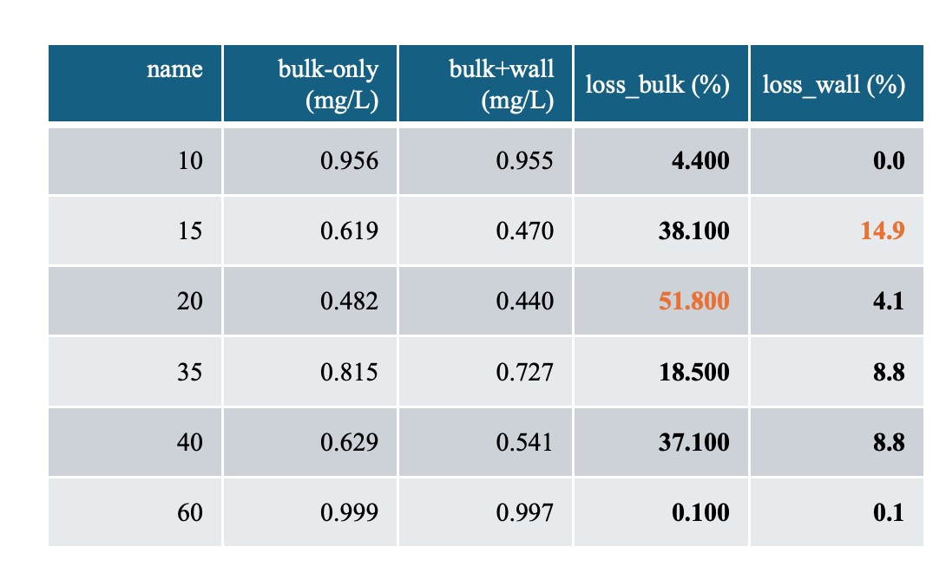
Last week, there was a mistake: node 20 has the lowest mean chlorine mainly because of its long water age (residence time), so it is dominated by bulk decay × age and is insensitive to kw.

Slide 3
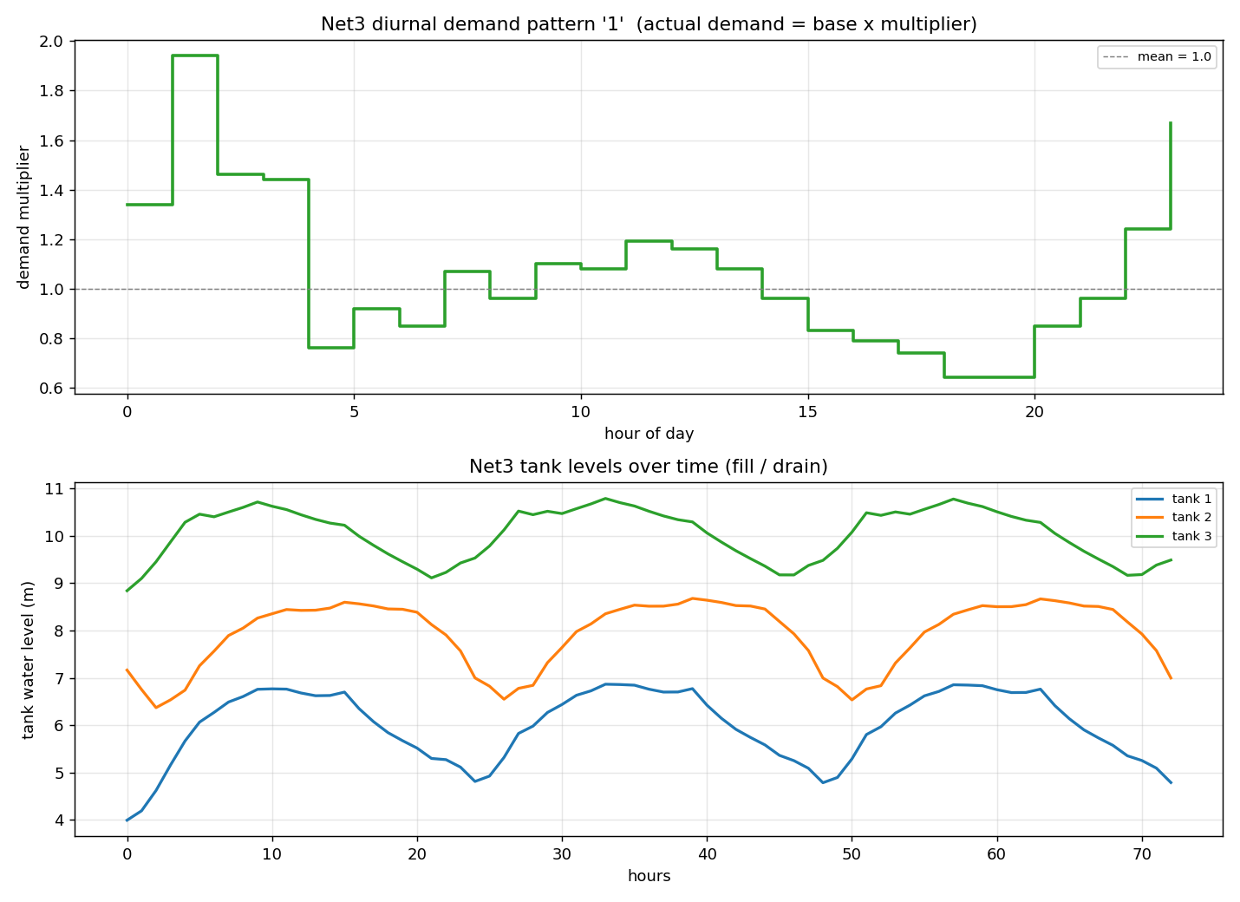
Assumed
Source initial chlorine = 1.0 mg/L
(inlet boundary condition; original = 0)
Tank initial chlorine = 0.5 (kept .inp / starter default — not set)
kb = −0.5 /day (original = 0, no decay)
kw_old = -1.0/day
kw_new = -0.05 /day(original = 0)
Reaction order: zero-order/ first-order
Old-pipe grouping (contiguous DMA): no material data in Net3, fully assumed

Slide 4
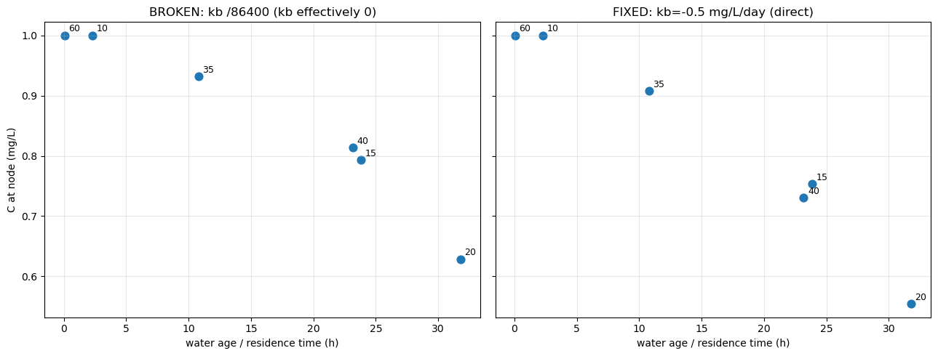
Zero order
→ time / residence
Water age = average residence time of the mixed water body at the current node
k_{b}_per_day= -0.5, k_{w}_per_day = 0.0,
bulk_order=0, wall_order=0, duration_hours=72
Bulk decay, initial chlorine concentration in the tank has not been set
Average water age and average concentration over the last 24 hours
In practice, the fitting result is k_{b} + k_{w}; how can we obtain k_{b} ? (jar test?)
dC/dt = k（k < 0）
k：(mg/L)/day

Slide 5
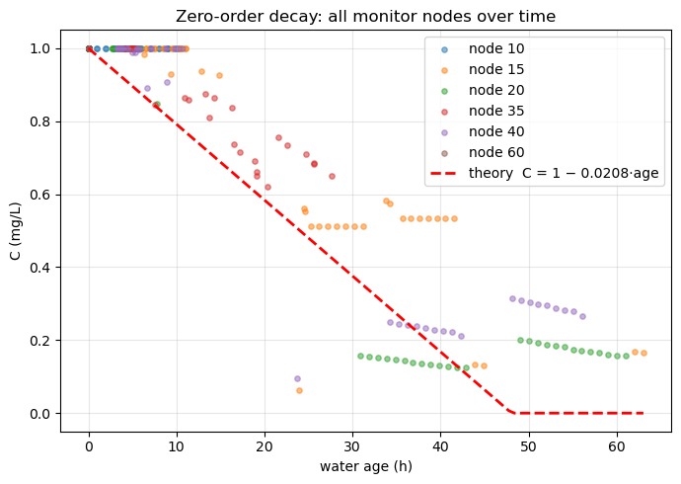
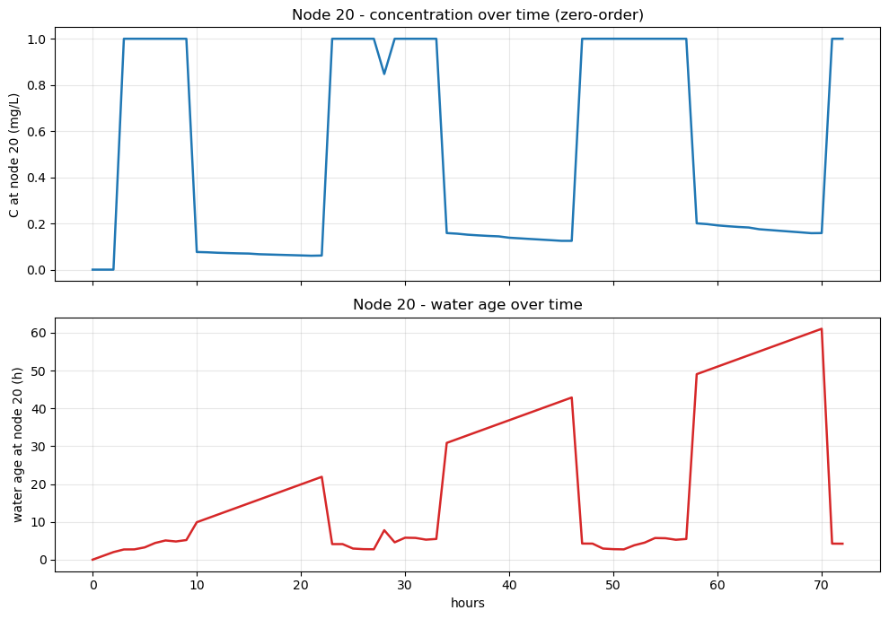
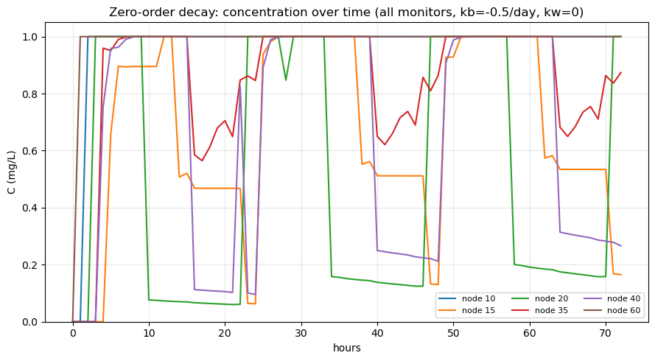
Zero order
eg. Node 20 sometimes receives old water, and sometimes suddenly switches to new water.
Concentration platform + increased water age

Slide 6
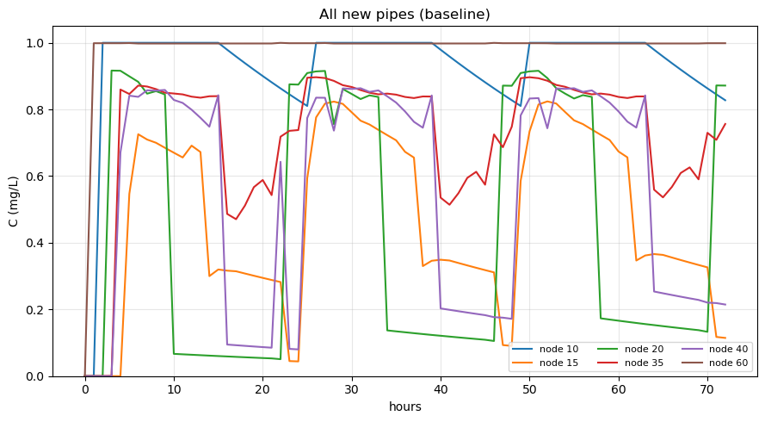
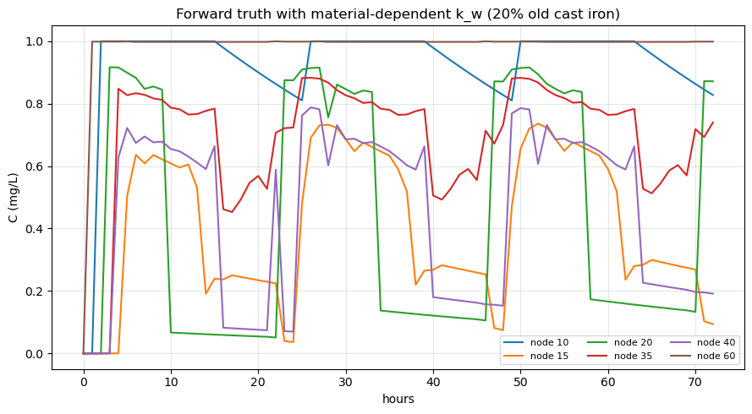
Forward Simulation
First order
dC/dt = k·C （k < 0）
k：1/day → 1/s
The first time, I randomly selected 20% of the old pipes and found little change.

Slide 7
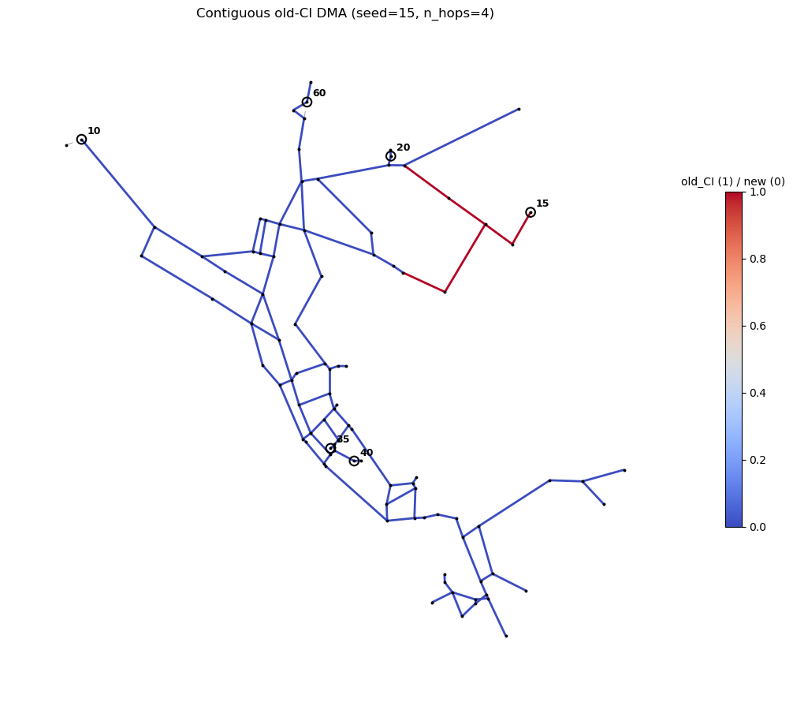
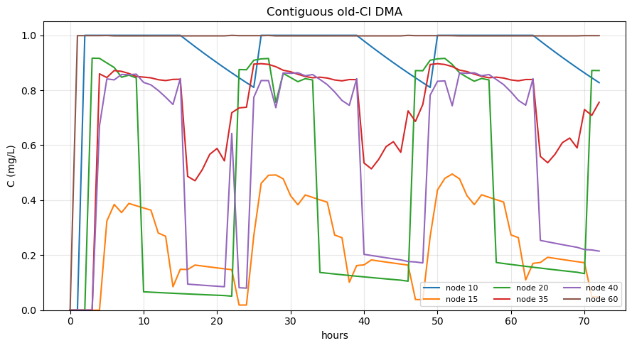
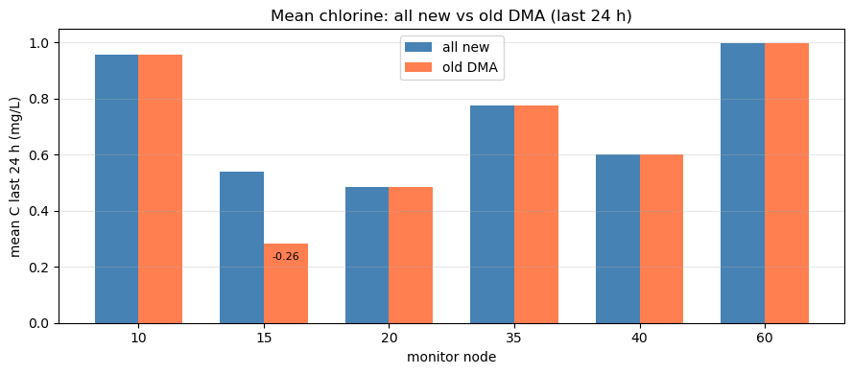
Forward Simulation
To make the change more apparent, the result can be obtained through subsequent inversion, so I fixed the position of the old pipe.

Slide 8
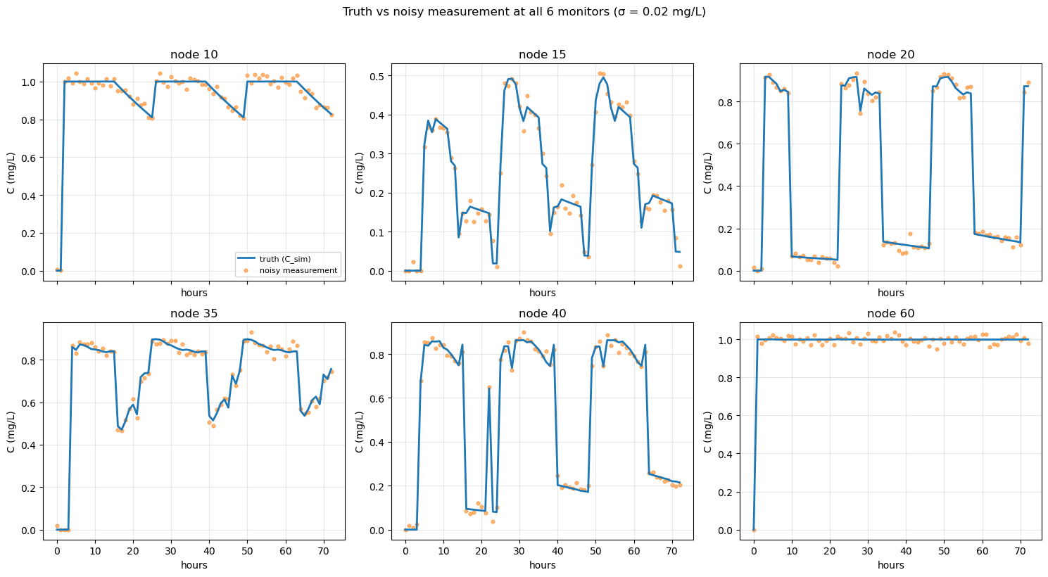
Add random noise to the observations
C_meas(t) = C_sim(t) + ε, ε ~ Normal(0, σ²) σ = 0.02mg/L
RMSE ≈ 0.019 mg/L

Slide 9
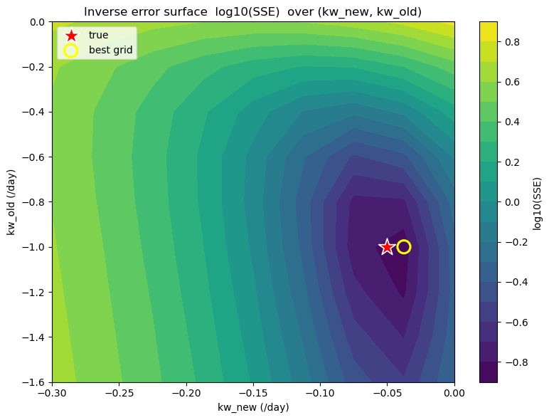
Inverse
sum of squared errors (SSE)
Best grid:
kw_old_hat = -1.000, kw_new_hat = -0.037
True :
kw_old = -1.000, kw_new = -0.050

Slide 10
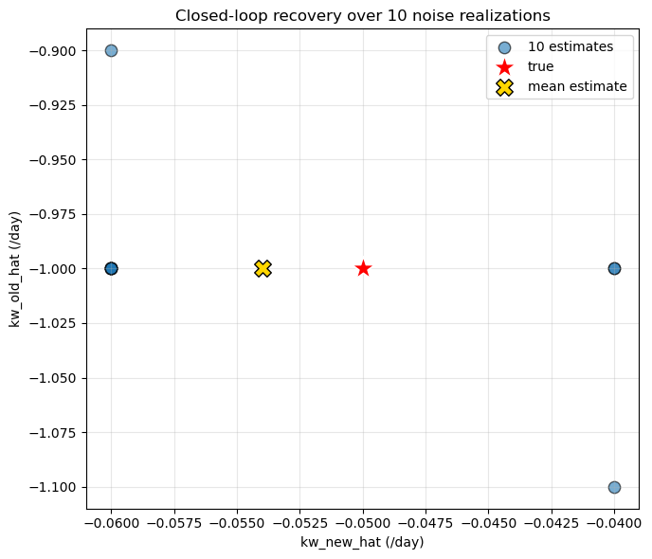
Forward → Noise → Inverse → Recover
kw_old_hat: -1.000 ± 0.045 (true -1.000)
kw_new_hat: -0.054 ± 0.009 (std low) (true -0.050)
The old pipe area is relatively localized and primarily affects node 15, so the information sources for kw_old are limited.
There are a large number of new pipes, affecting the entire network.

