Slide 1
Weekly Report
Ruixin Peng
July 10, 2026

Slide 2
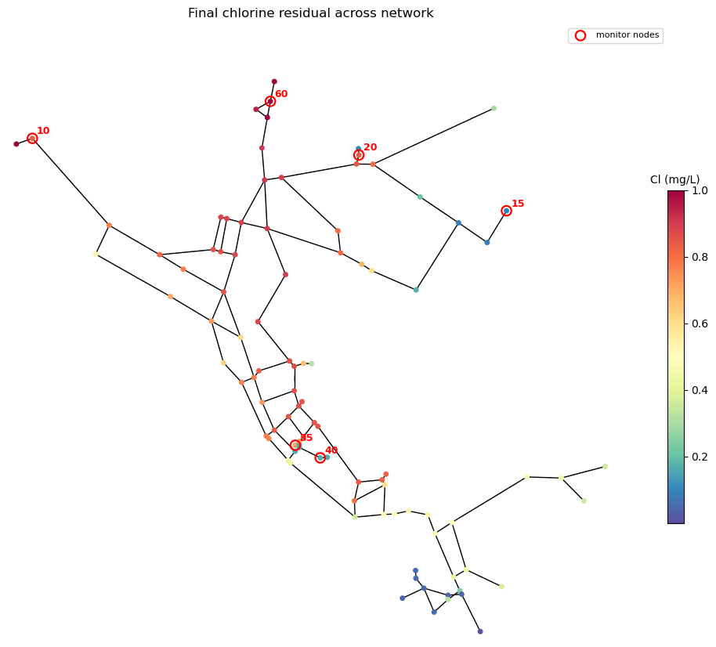
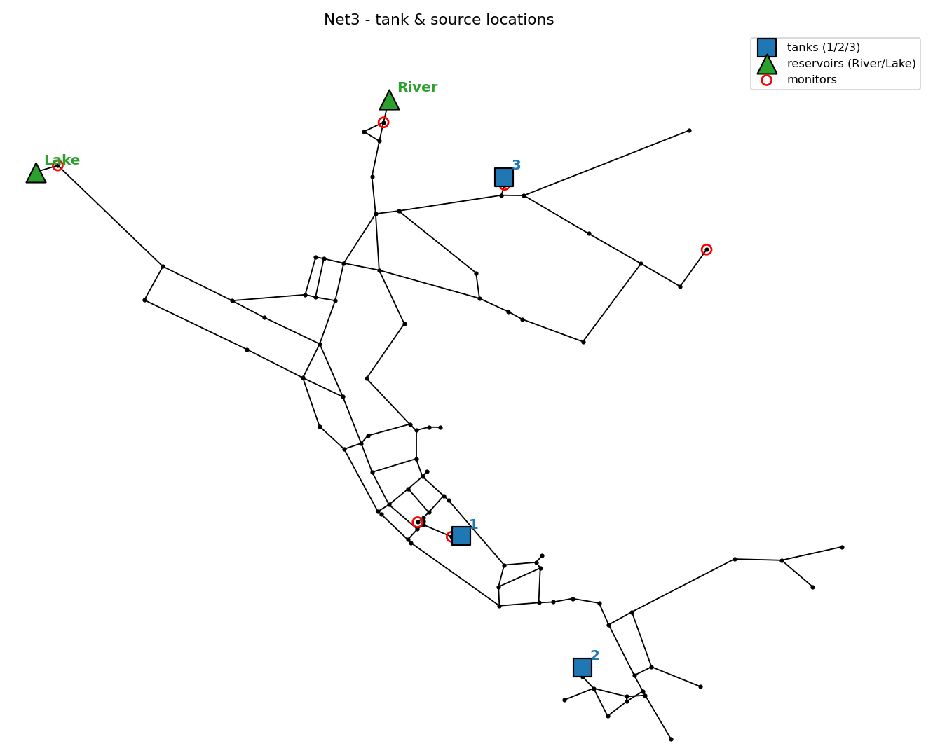

Slide 3
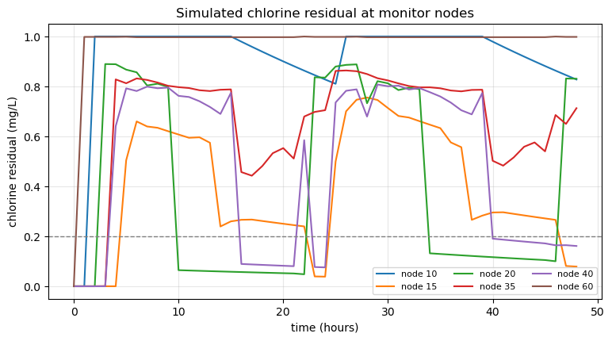

Slide 4
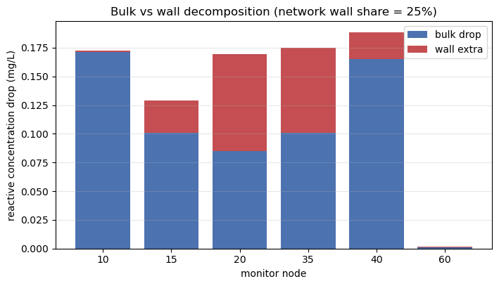
Bulk vs wall
C_both = simulate(kb=-0.5, kw=-0.1)
C_bulkonly = simulate(kb=-0.5, kw= 0 )
C_none = simulate(kb= 0 , kw= 0 )
Across the six monitor nodes, wall decay contributed approximately 25.4% of the total reactive chlorine loss. The contribution was spatially variable: it was negligible at node 10, but comparable to bulk decay at nodes 20 and 35. This suggests that wall demand is not uniformly visible at all sensors, but it can be significant at hydraulically sensitive locations.
bulk drop = C_bulkonly
wall extra = C_both - C_bulkonly
Total = C_both

Slide 5
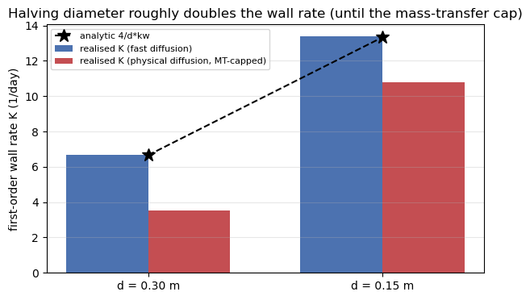
Mass transfer - Halve every pipe diameter
A. controlled single pipe: a single pipe, used to verify the physical formula
d = 0.30 m:
analytic K = 6.667/day (K = (4 / d) · kw)
K_fast_diff = 6.681/day (diffusivity_scale = 1e6)
K_physical_diff = 3.547/day (diffusivity_scale = 1.0)
d = 0.15 m:
analytic K = 13.333/day
K_fast_diff = 13.395/day
K_physical_diff = 10.796/day

Slide 6
Mass transfer - Halve every pipe diameter
B. whole network: all pipe diameters in the entire network reduced by half, to observe the actual network response
Whole-network halving (final residual, mg/L) -- note non-monotone (hydraulics reroute):
name full_d half_d
10 0.828 0.820
15 0.037 0.461
20 0.607 0.000
35 0.511 0.817
40 0.107 0.000
60 0.995 0.997
When every pipe diameter in the whole network was halved, monitor responses were not monotonic. Some nodes lost more chlorine and reached zero, while others had higher residuals. This is because changing all diameters also changes the hydraulic solution, including velocities, head losses, residence times, flow paths and tank mixing. Therefore, in a real network, geometry, hydraulics, mass transfer and residence time cannot be interpreted independently.

Slide 7
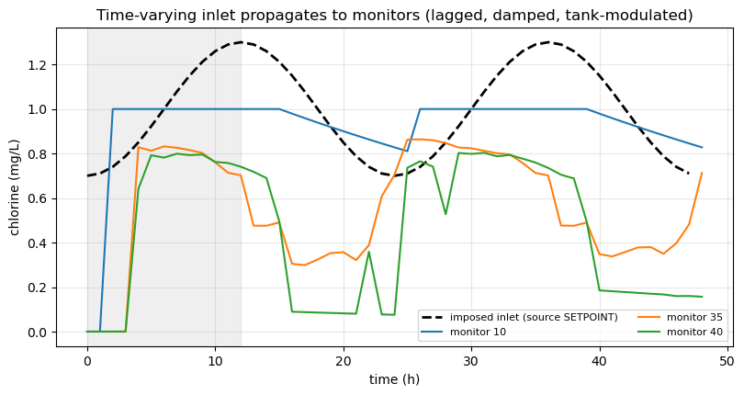
Time-varying inlet
imposed inlet swing = 0.60 mg/L (0.7 - 1.3)
developed-window (t>=24h) diurnal swing per monitor (mg/L):
node
10 0.190
15 0.717
20 0.789
35 0.526
40 0.727
60 0.698
The imposed inlet pattern produces clear time-varying downstream responses after warm-up. This indicates that the time-varying inlet boundary has entered the model and propagated through the network. The responses are not identical copies of the inlet signal because they are lagged and reshaped by residence time, tank cycling, mixing, and decay.

Slide 8
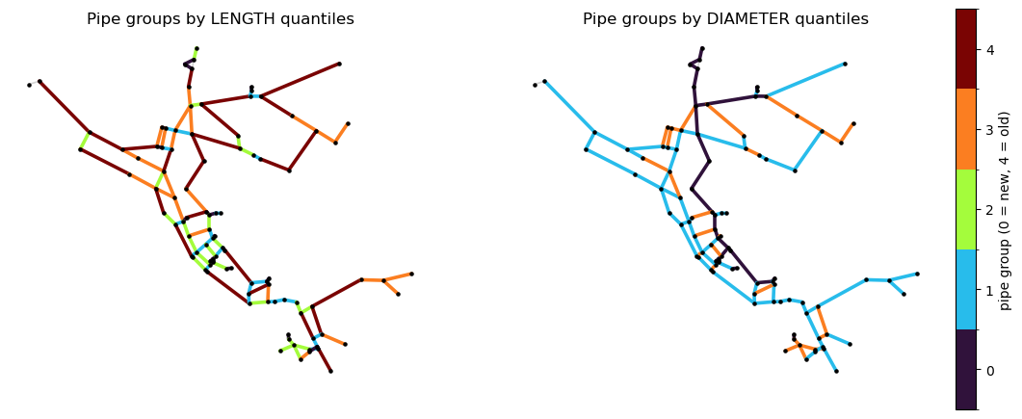
Re-assign pipe groups by diameter quantiles
np.quantile(D, 0,0.2,0.4,0.6,0.8,1.0) = [0.203, 0.203, 0.305, 0.305, 0.61, 2.515]
↑repeat ↑repeat
kw = 0.0/−0.1/−0.7
0.3048 m → 50 pieces ← Almost half of them are this
0.2032 m → 25 pieces
0.7620 m → 13 pieces
0.6096 m → 10 pieces
0.4064 m → 7 pieces
...

Slide 9
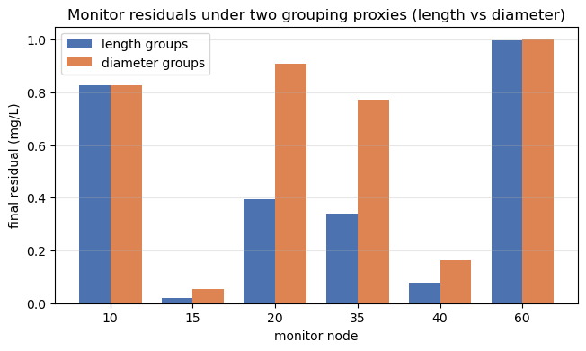
final_len final_dia rank_len rank_dia
10 0.828 0.828 5 4
15 0.019 0.054 1 1
20 0.394 0.909 4 5
35 0.339 0.774 3 3
40 0.077 0.163 2 2
60 0.996 0.999 6 6
monitor ranking is broadly robust, but predicted residual magnitudes are sensitive to the grouping proxy.

Slide 10
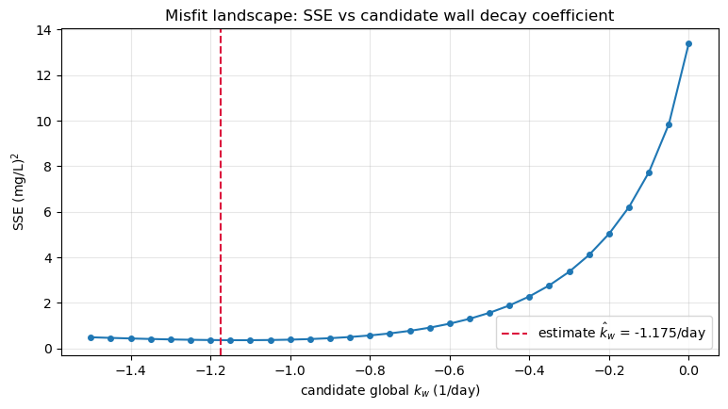
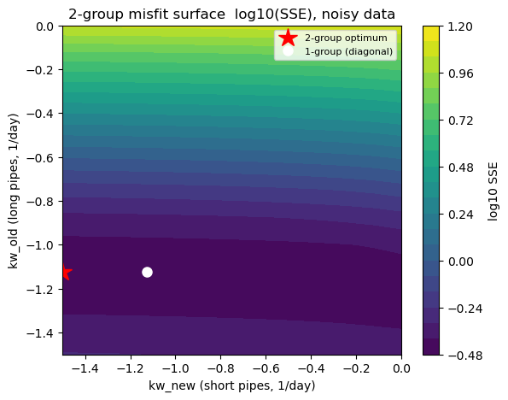
Merge the 5 groups into 2 and refit
means dividing into two groups based on the median of pipe length:
Short tube → group 0 → kw_new
Long tube → group 1 → kw_old
SSE = Σ(simulated chlorine - truth chlorine)²
1-group : kw = -1.125 coarse grid
SSE = 0.3539
2-group : kw_new = -1.50, kw_old = -1.12
SSE = 0.3536

Slide 11
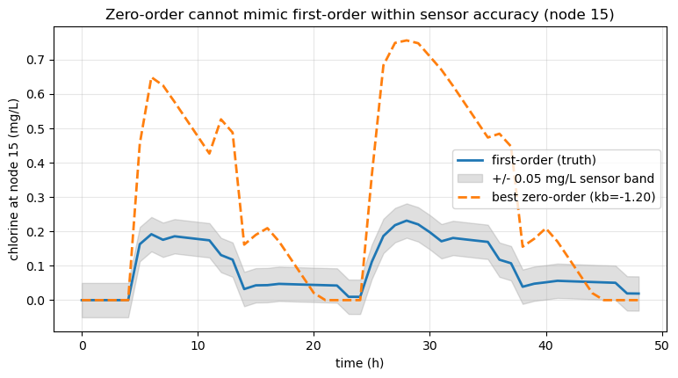
With the 6 original monitors, can a zero-order bulk run mimic the first-order traces to within sensor accuracy (~0.05 mg/L)
best zero-order mimic: kb = -1.20 mg/L/day, overall average RMSE = 0.236 mg/L
name max |zero-order - first-order| (mg/L):
10 0.310
15 0.530
20 0.410
35 0.422
40 0.474
60 0.003

Slide 12
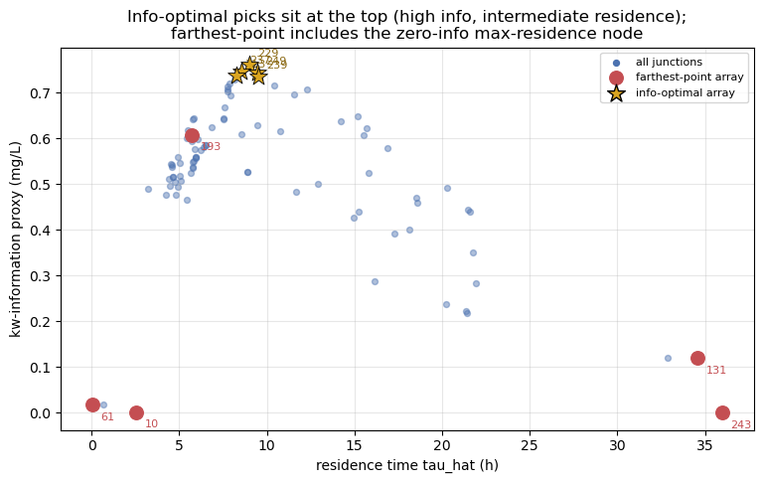
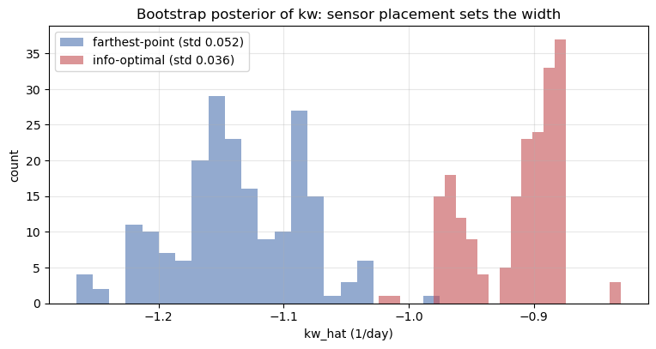
Select 5 sensors greedily by the §12.5 INFO metric, redo the bootstrap, and compare the spread against the farthest-point array.
['243', '10', '131', '193', '61'] → info-optimal ['229', '237', '249', '213', '239']
std = 0.052
95% CI = [-1.246, -1.039]
std = 0.036
95% CI = [-0.974, -0.876]

Slide 13
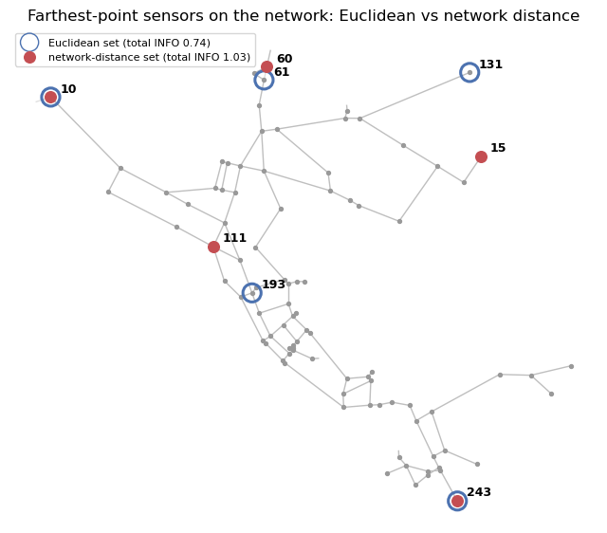
Repeat the farthest-point sampling with pipe-length shortest-path distance instead of Euclidean.
Euclidean set : ['243', '10', '131', '193', '61'] total INFO = 0.743
Network-distance set : ['243', '60', '10', '15', '111'] total INFO = 1.033
sets identical? False

Slide 14
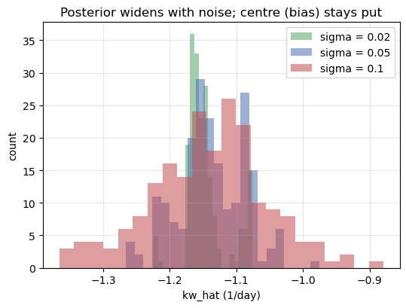
Re-run §12.4 with SIGMA_NOISE = 0.02 and 0.10.
How does the histogram width scale? Does the bias change?
sigma = 0.02: mean kw_hat = -1.147 | std = 0.030 | std/sigma = 1.52
sigma = 0.05: mean kw_hat = -1.138 | std = 0.052 | std/sigma = 1.03
sigma = 0.10: mean kw_hat = -1.143 | std = 0.087 | std/sigma = 0.87

Slide 15
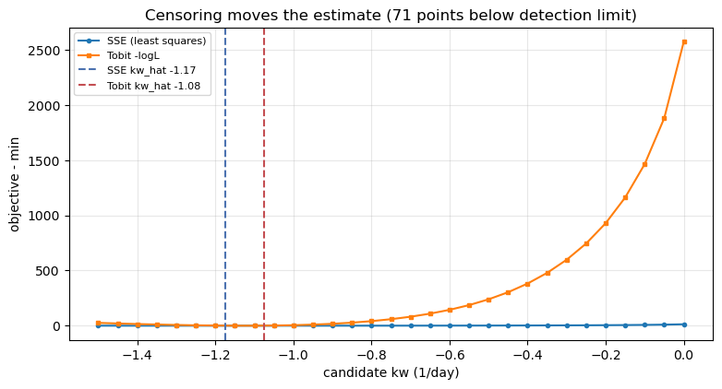
Replace the SSE with a Tobit-style likelihood that treats observations below ~2σ as censored.
Does kw_hat move? When would it?
114 points above the detection limit → (model − obs)²/(2σ²)
71 points below the detection limit → −ln Φ((L − model)/σ)
detection limit L = 2*σ = 0.10 mg/L;
kw_hat(SSE) = -1.175/day
kw_hat(Tobit) = -1.076/day
(shift +0.099)

Slide 16
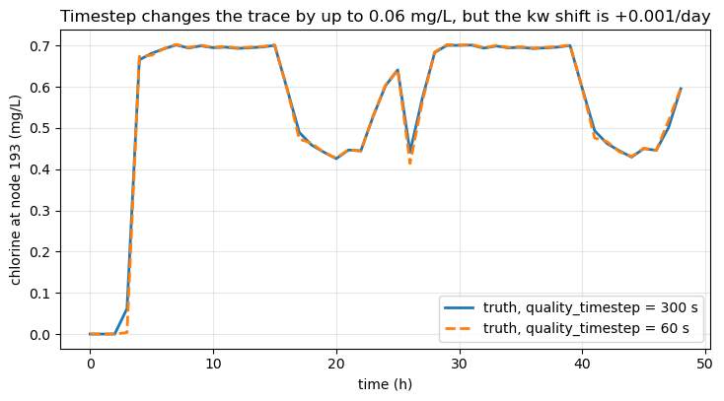
Regenerate the truth with quality_timestep = 60 s and re-estimate with the 300 s model.
The shift is your numerical-error contribution to the budget.
true - kw=-0.33
inverse-crime estimate (truth - 300s) kw= -0.3686/day
honest estimate (truth - 60s) kw= -0.3678/day
numerical-error contribution = +0.0008/day

Slide 17
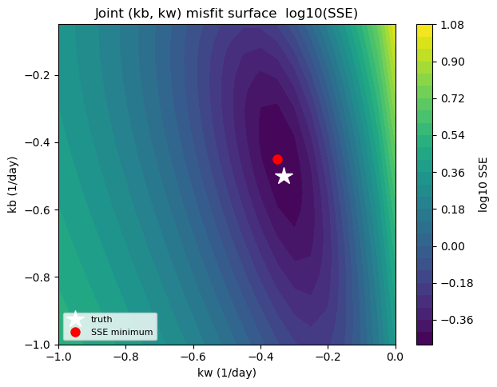
Drop the known-kb assumption: fit both on a 2-D grid,
plot the SSE surface.
Given a kw
↓
Find the minimum SSE across all kb
↓
Obtain the profile SSE under this kw
SSE = the fitting error score for a given set of parameters.
The smaller the SSE, the better the parameter set fits the observed data.
SE = uncertainty in parameter estimation.
SE is derived from the curvature or sharpness near the minimum of SSE. Small parameter uncertainty, small SE
SSE minimum at kb = -0.450, kw = -0.350 (truth -0.5, -0.33)
kw SE (kb unknown, joint) = 0.017/day
kw SE (kb known) = 0.015/day price of unknown kb = 1.17x wider kw interval

Slide 18
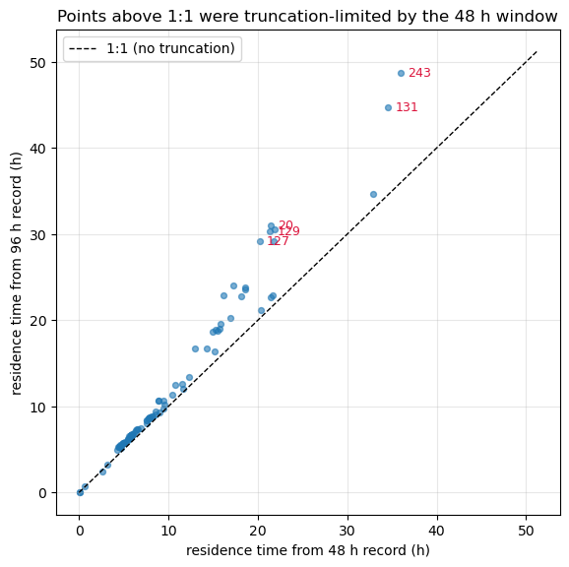
Re-run the §12.1 tracer with a 96 h duration.
Which junctions' tau_hat were truncation-limited by the 48 h record?
top-5 residence - 48h: ['243', '131', '166', '139', '141']
top-5 residence - 96h: ['243', '131', '166', '20', '139']
ranking changed

