Slide 1
Weekly Report
Ruixin Peng
July 02, 2026

Slide 2
Grouping
Hallam et al. concluded that unlined iron pipes are reactive pipes, while PVC, MDPE, and cement-lined pipes are relatively unreactive pipes.
Al-Jasser also noted that pipe age significantly affects the effective wall decay constant for cast iron, steel, CLDI, and CLCI, whereas its influence on PVC, uPVC, and PE is relatively minor.
Rossman 1994 wall 0.15–0.45 m/day, Net1 original Global Wall ≈ -0.3 m/day. old=-1.0 m/day is slightly overestimated, but credible for old cast iron pipes.
Material group | Included materials | Prior distribution kw (m/day)
High-reactivity old iron pipes | CI, SI, unlined DI, severely corroded steel | (0.20, 1.50)
Medium-reactivity metal or lined pipes | steel, GS, DICL, CICL | (0.04, 0.20)
Low-reactivity plastic pipes | PVC, uPVC, PE, MDPE, HDPE, PP | (0.005, 0.1)

Slide 3
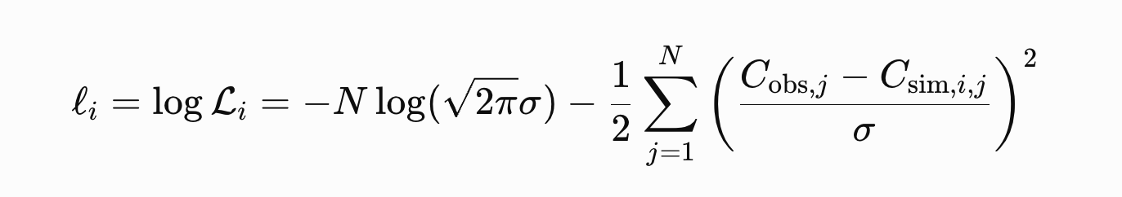
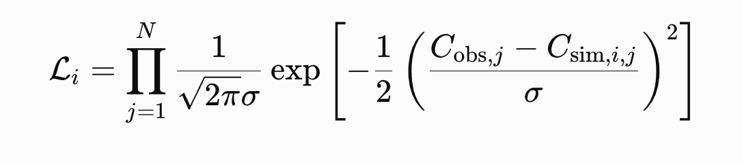
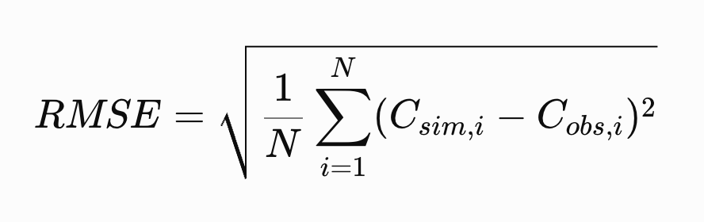
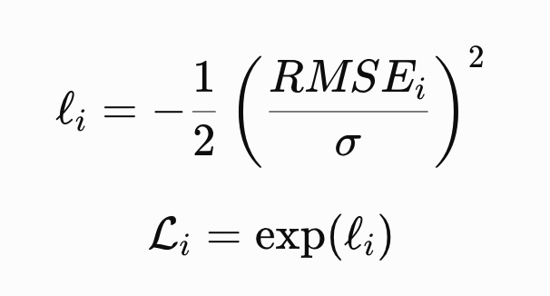
Uncertainty in residual chlorine model parameters
GA = Genetic Algorithm
Bayesian / MCMC
GLUE
Minimize the error between simulated residual chlorine and observed residual chlorine
behavioural parameter sets + uncertainty interval
Optimal parameter set
Posterior = Likelihood × Prior
The prior simply samples each Kw uniformly within a reasonable range, then GLUE becomes more natural and easier to defend. Forcing N to be multiplied will make the likelihood extremely sharp.
Notes:
1. GA 是干什么的？
GA = Genetic Algorithm，遗传算法。
它主要回答的问题是：
哪一组参数让模拟值和观测值最接近？
也就是找一个 best-fit：
(kw,old ,kw,average ,kw,new)
GA 的优点是适合找最优解，尤其参数空间比较复杂时，它比普通 grid search 更灵活。
但是它的问题是：
它通常最后给你一个“最优参数组合”，但不直接告诉你还有多少别的参数组合也差不多好。
在你的论文里，这不够。因为你的结果已经说明，很多不同的 kw组合都能解释 noisy observations。所以如果只用 GA，你可能会得到一个看起来很准的 best-fit，但会隐藏参数不可辨识的问题。
简单说：
GA 适合找最优值，但不适合直接表达“这个最优值有多不确定”。
2. Bayesian / MCMC 是干什么的？
Bayesian / MCMC 主要回答的问题是：
在给定观测数据和统计假设后，参数的 posterior distribution 是什么？
它比 GLUE 更正式，因为它可以给出严格意义上的 posterior distribution。
但是它有几个问题：
你需要定义很明确的 likelihood；
你需要合理设置 prior；
你要清楚 measurement error、model error、hydraulic error 怎么进入模型；
MCMC 计算量可能很大，因为每一步都要跑 WNTR/EPANET；
如果模型误差和传感器误差没有定义清楚，Bayesian 的“严格性”反而可能是假严格。
你的论文现在是 Net3 synthetic prototype，不是真实网络完整 Bayesian inference。因此直接上 Bayesian/MCMC 会显得过重，而且需要解释很多额外统计假设。
简单说：Bayesian/MCMC 更正式，但要求更高、计算更重、假设更多。
3. GLUE 是干什么的？
GLUE 回答的问题是：
哪些参数组合都能在可接受误差范围内解释观测数据？
它不是只找一个最优解，而是保留很多组 behavioural parameter sets。
比如你采样 2000 组三个 kw：
(kw,old ,kw,average ,kw,new)
然后看哪些组合的 RMSE 小于阈值。满足条件的保留下来，并给它们权重。
所以 GLUE 的输出不是：
这一个 kw是答案。
而是：这些 kw 组合都可能合理，只是权重不同。
这正好适合你的论文，因为你的核心发现是：
Grid search 可以找到接近真值的 best-fit，但 GLUE 显示参数范围没有明显收窄，说明 kw是 weakly identifiable。

Slide 4
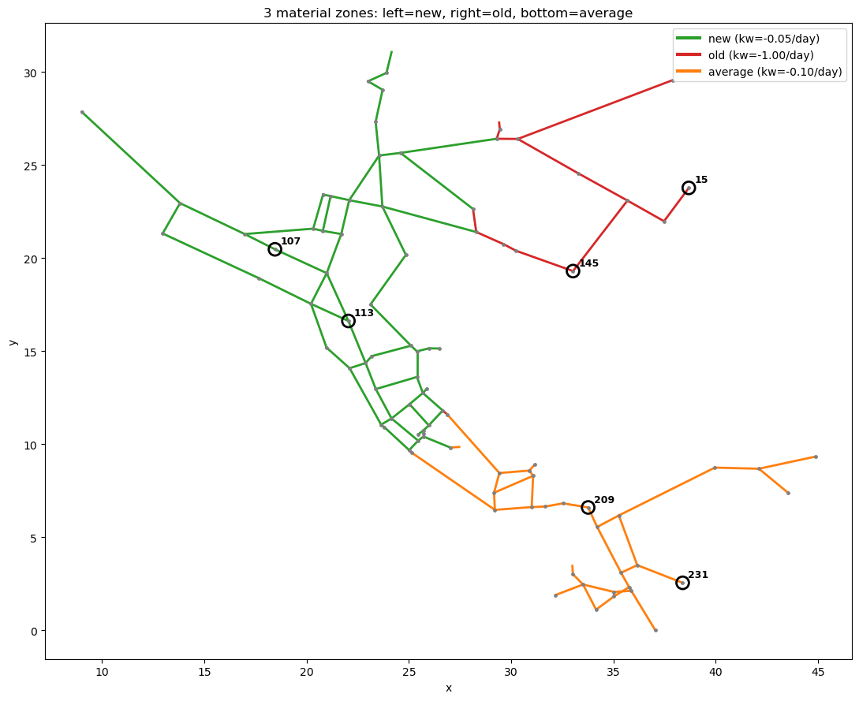
Source initial chlorine = 1.0 mg/L
Tank initial chlorine = 0.5
kb = −0.5 /day (original = 0, no decay)
kw_old = -1.0/day
kw_ave = -0.1/day
kw_new = -0.05 /day
Group | 01 (Spatial partitioning) | 02（Take turns in sequence)
old | 14 | 39
average | 37 | 39
new | 66 | 39
Total | 117 | 117

Slide 5
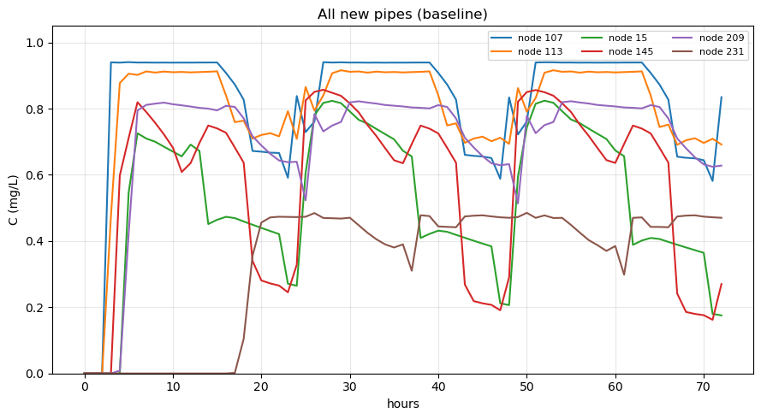
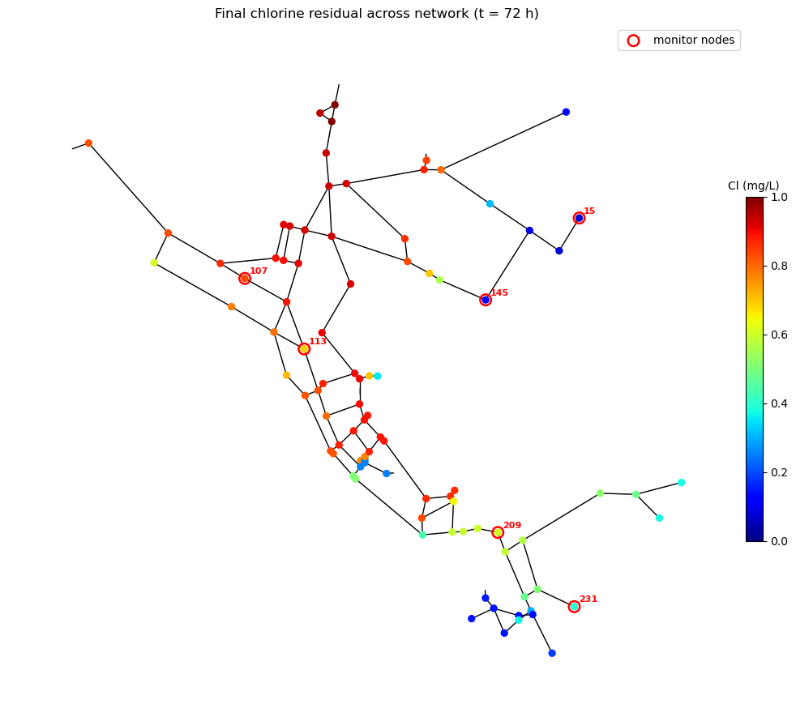
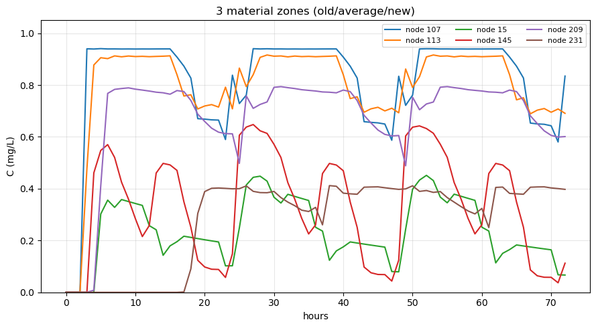

Slide 6
GLUE
• Uniform prior: The three kw parameters are initially "equally likely" within their respective ranges; k_b is fixed and not inverted.
1. Sample 2,000 sets of [kw_old, kw_avg, kw_new] from the prior using Monte Carlo;
2. For each set, run WNTR forward simulation and calculate RMSE at monitoring points;
3. Use Gaussian likelihood based on RMSE;
4. Filter out poor results using a behavioral threshold (RMSE < 0.12 mg/L);
5. Normalize likelihoods into weights;
6. Output: Behavioral kw distribution, 5–95% prediction interval, weighted P(C < 0.2)
Prior
kw_old ∈ [-1.5, -0.2]
kw_avg ∈ [-0.2, -0.04]
kw_new ∈ [-0.1, -0.005]
σ = 0.1 mg/L
behavioural threshold: RMSE < 0.12 mg/L
Notes:
• 均匀先验：3个kw在各自范围内一开始"同等可能"（不预设某个值更对）；k_b 固定不反演。
•流程：
1.从先验蒙特卡洛抽样 2000组（kw_old, kw_avg, kw_new）；
2.每组跑 WNTR正向，算监测点 RMSE；
3. RMSE 高斯似然；
4.用behavioural 阈值（RMSE＜0.12mg/L）筛掉差的；
5. 似然归一化成权重；
6. 输出：behavioural kw 分布、5-95% 预测区间、加权
P(C<0.2)

Slide 7
In likelihood, the six points at all times are merged and equally weighted.
Behavioural: 1685 / 2000 (RMSE < 0.12)
-Out of 2,000 sets of random parameters, 1,685 sets resulted in an RMSE less than 0.12.
GLUE Weighted posterior (mean ± std)：
kw_old = -0.961 ± 0.317 (true -1.00)
kw_avg = -0.120 ± 0.045 (true -0.10)
kw_new = -0.053 ± 0.027 (true -0.05)
Parameter | Posterior 5–95% | Median | Prior | True value
kw_old | [-1.456, -0.455] | -0.972 | [-1.5, -0.2] | -1.0
kw_avg | [-0.192, -0.048] | -0.120 | [-0.2, -0.04] | -0.1
kw_new | [-0.095, -0.010] | -0.053 | [-0.10, -0.005] | -0.05

Slide 8
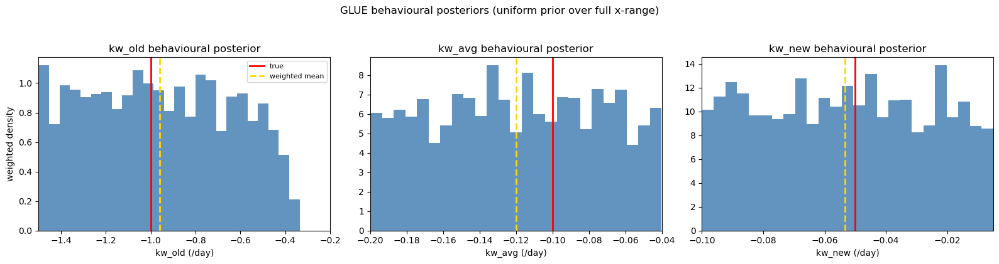
Plot the behavioral parameters of kw_old, kw_avg, and kw_new as weighted histograms respectively.
(For each histogram, the weighted density integrates to 1.)
Parameter uncertainty remains relatively large.
The average calculated by GLUE is close to the true value.

Slide 9
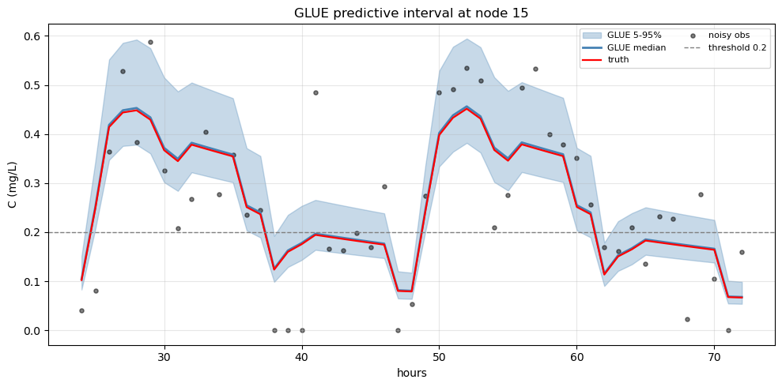
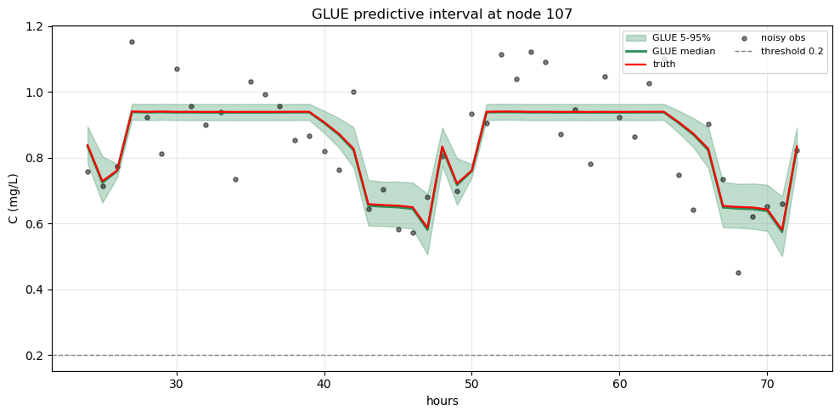
Node 15: During the entire observation period, the behavioral parameter sets retained by GLUE are used to generate a 5%–95% prediction band and median line for residual chlorine, weighted by likelihood, compared with true values and noisy observations.
node107 near water source, new plastic pipe, short retention

Slide 10
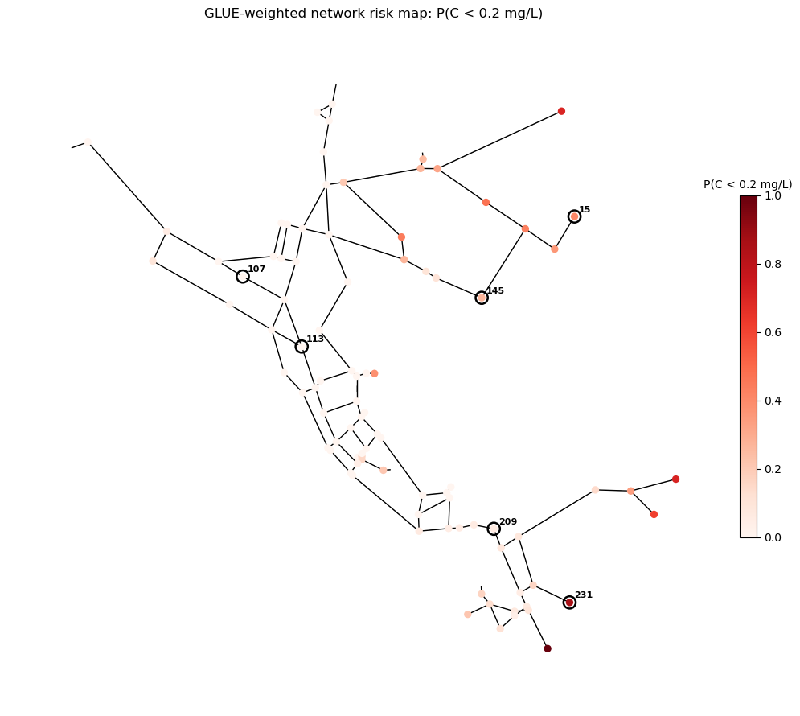
The average probability of being below 0.2 mg/L for a given node, calculated over all time periods using the GLUE parameter weights
Among the 92 junction nodes across the network, 25 nodes fall below 0.2 mg/L under certain parameter samples and time conditions.

Slide 11
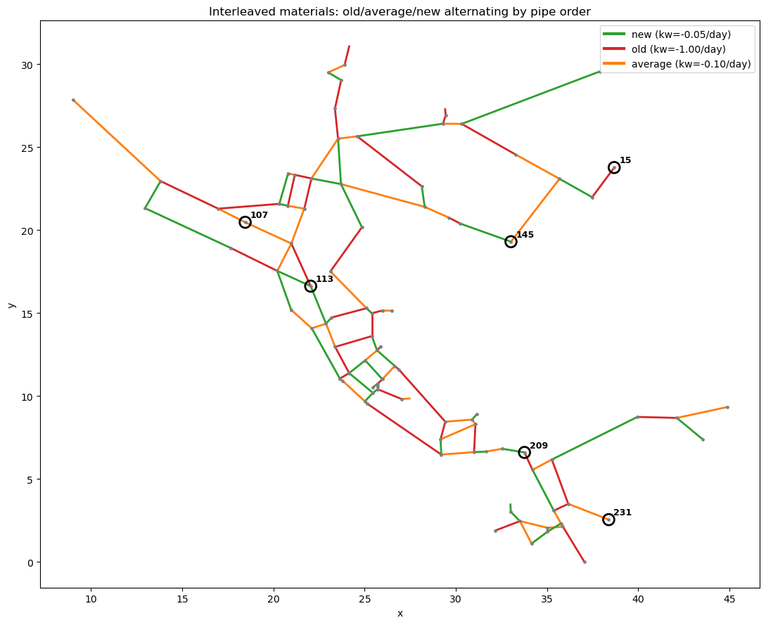
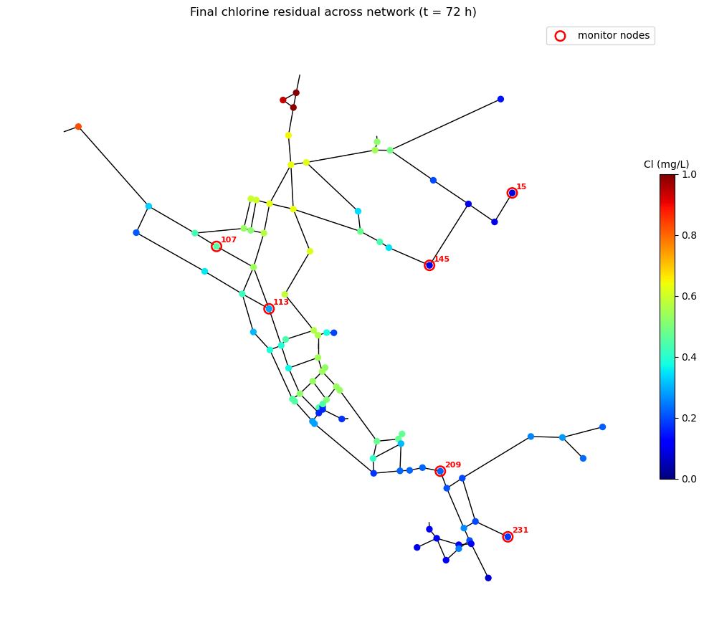

Slide 12
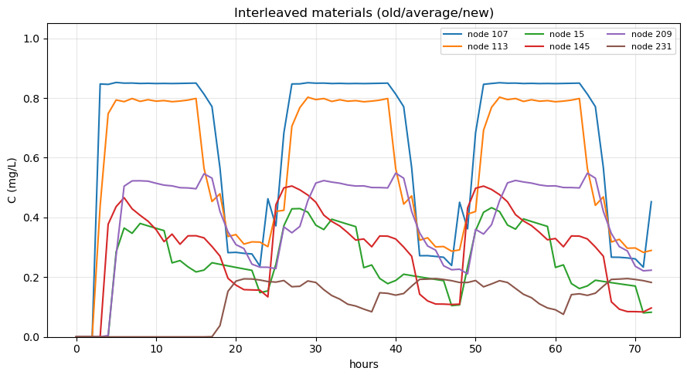
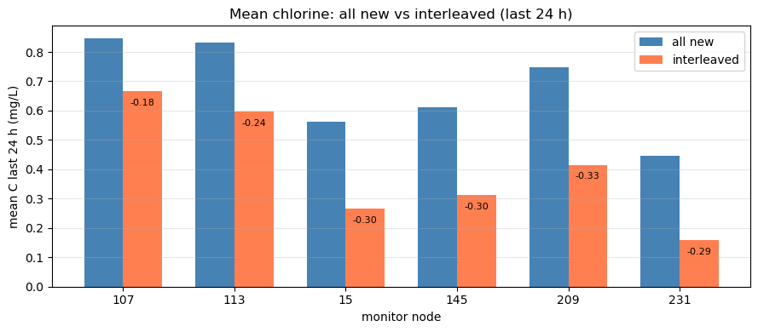

Slide 13
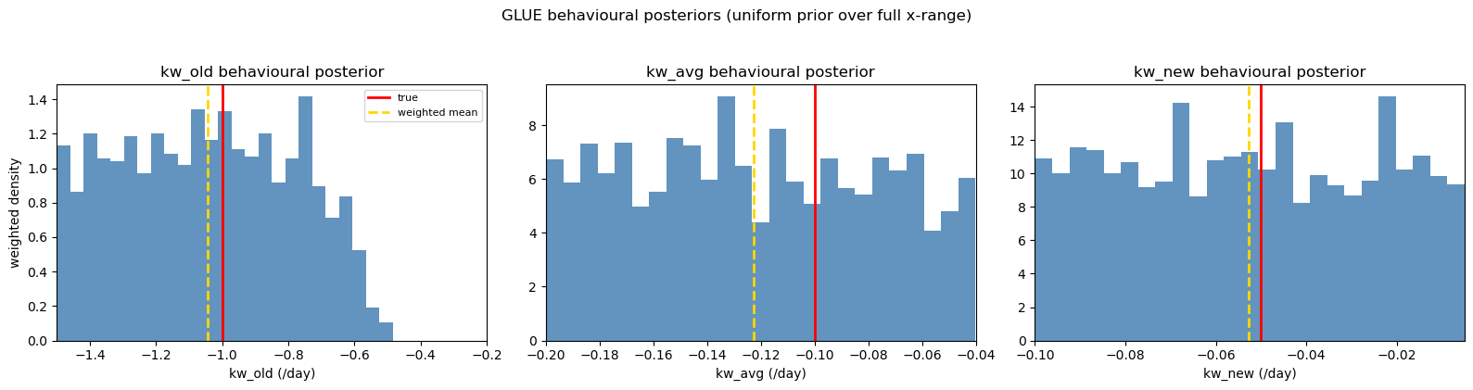
Behavioural: 1388 / 2000 (RMSE < 0.12)
GLUE Weighted posterior (mean ± std)：
kw_old = -1.044 ± 0.260 (true -1.00)
kw_avg = -0.123 ± 0.045 (true -0.10)
kw_new = -0.053 ± 0.027 (true -0.05)
Parameter | Posterior 5–95% | Median | Prior | True value
kw_old | [-1.456, -0.625] | -1.044 | [-1.5, -0.2] | -1.0
kw_avg | [-0.192, -0.050] | -0.126 | [-0.2, -0.04] | -0.1
kw_new | [-0.095, -0.010] | -0.053 | [-0.10, -0.005] | -0.05

Slide 14
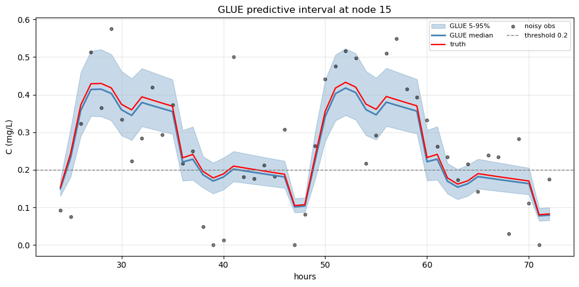
GLUE Risk: Number of nodes that could fall below 0.20 is 46 / 92

