Slide 1
Drag and Drop in UWP Apps
App-Programming with C# and .NET (BTI7531)
Thomas Strub (strut1)

Slide 2
Table of Contents
Simple Introduction
Basics
Demo “ToDo”
Advanced Features
Customisation
Dragging
Demo “Agenda”

Slide 3
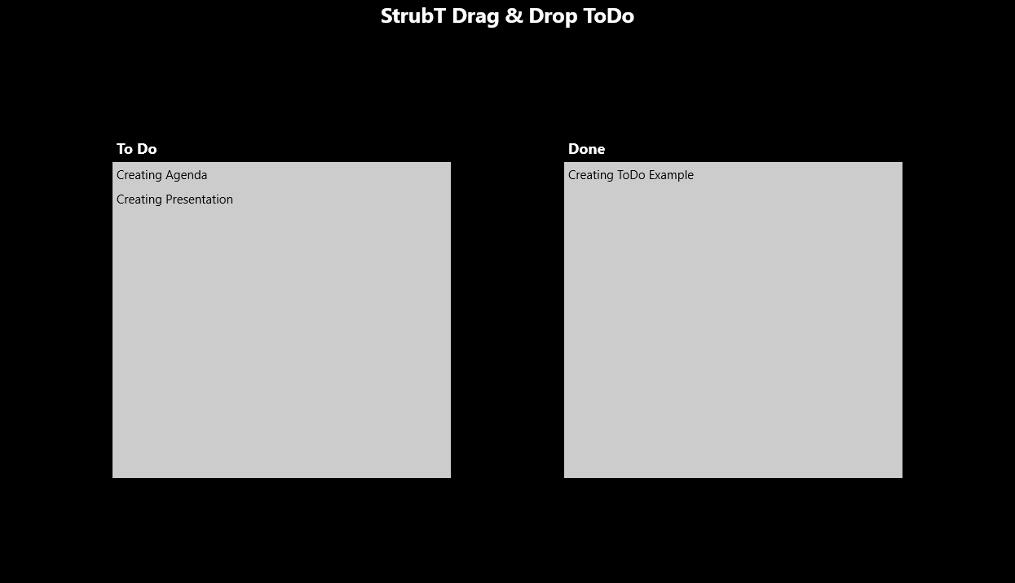
Simple Introduction
What is drag and drop?
What is it used for?

Slide 4
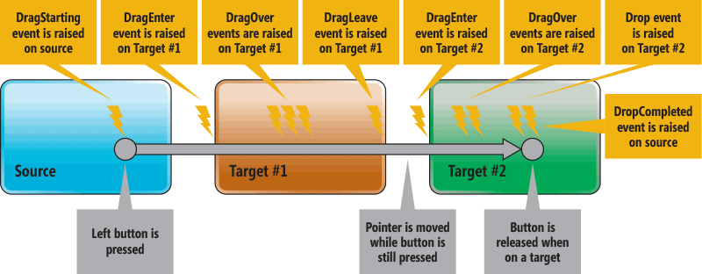
Basics
Drag and drop
Moving any kind of data
E.g. files, bitmaps, texts (plain, RTF, HTML)
Into, out of and within an app
Phases / Events
Pick: DragStarting
Move: DragEnter, DragOver, DragLeave
Drop: Drop, DropCompleted
source: https://msdn.microsoft.com/en-us/magazine/mt185571.aspx

Slide 5
Implementation in UWP
UIElement defines drag and drop members
Enable functionality by setting properties
CanDrag & AllowDrop
Manually specify supported operations
RequestedOperation / AcceptedOperation / DropResult
DataPackageOperation: None, Copy, Move, or Link

Slide 6

Demo “ToDo”
As always on GitHub:
https://github.com/StrubT/DotNetDragDrop

Slide 7
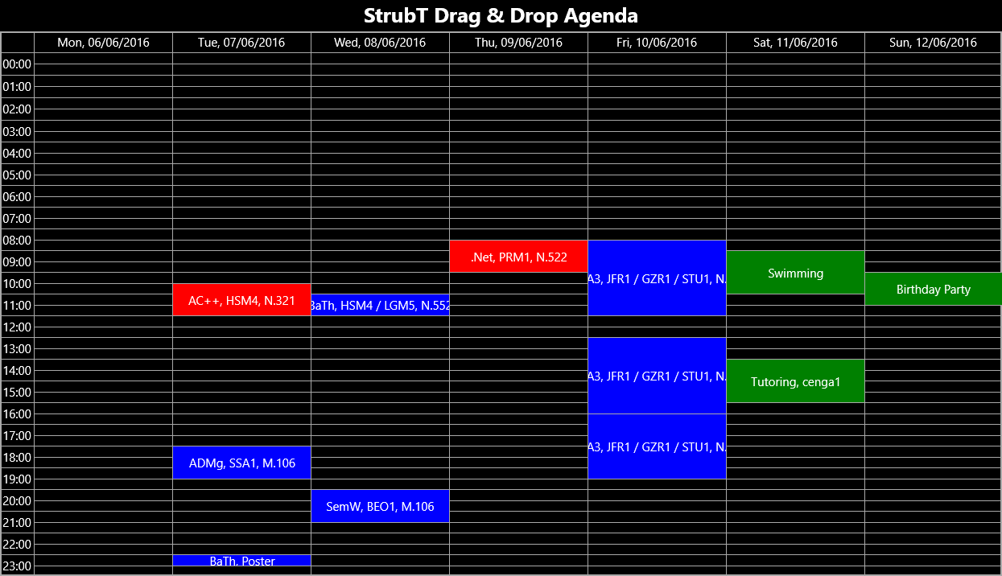
Advanced Features
How does drag and drop work in UWP Apps?

Slide 8
Customisation
Data.Properties – add information about dragged data
DataFormatId – create custom formats
Data must implement IRandomAccessStream, IStorageItem, or IUri
DragUI – modify UI from source side
DragUIOverride – modify UI from (potential) destination side
Set graphical representation of data, element visibility, and caption
Notes:
Source: http://www.minddriven.de/index.php/technology/dot-net/c-sharp/winrt-datapackage-custom-objects

Slide 9
Other Features
StartDragAsync() – start dragging process manually
No CanDrag needed
GetDeferral() – used for async event handlers
UI stays responsive while handler performs long-running operation(s)
Call Complete() after setting properties
GetPosition(UIElement) – get position of pointer

Slide 10
Demo “Agenda”
In same repository as “ToDo”:
https://github.com/StrubT/DotNetDragDrop

Slide 11
Questions?
Drag and drop returns in:
Part 2: “Drag and Drop between different Apps”
Starring Marc Touw

