Slide 1
Creating a Cat Tracker Using the TinyDuino Platform
Thomas Reto Strub (strut1)
IoT – Internet of Things (MTE7117)
Engineering and Information Technology | Master of Science in Engineering

Slide 2
Agenda
Project Goals
Implementation Steps
Results
GPS / SD
WiFi / MQTT
Discussion

Slide 3
Project Goals
Use the TinyDuino platform to create a miniature GPS tracker for cats.
The GPS board continuously transmits NMEA messages.
These messages are parsed and GPS co-ordinates are stored using the SD board.
When the cat returns, the WiFi board connects to the home network.
The co-ordinates are read from the SD card and published to an MQTT broker.
While connected to the network, a status is published as well.
A SIOT dashboard visualises the co-ordinates.
The Raspberry Pi LED matrix displays an icon when the cat is in WiFi range.

Slide 4
Implementation Steps
Outlined in report
Order & assemble TinyDuino
Implement first sketch
Read & parse NMEA messages
Store data to SD card
Connect to WiFi network
Publish sample MQTT message
GPS & WiFi libraries cannot be loaded simultaneously
Occasional problems with SD storage

Slide 5
Results – GPS / SD
Partial success
https://github.com/StrubT/IoTCatTracker
Continuously read GPS NMEA messages
Read for 10 seconds at a time
Optionally switch of GPS board to save energy
Parsing of messages included in library
Print co-ordinates to serial port
Print statistics to detect problems
Write co-ordinates to SD card
Occasional problems with SD storage
Program may freeze – no possibility to recover

Slide 6
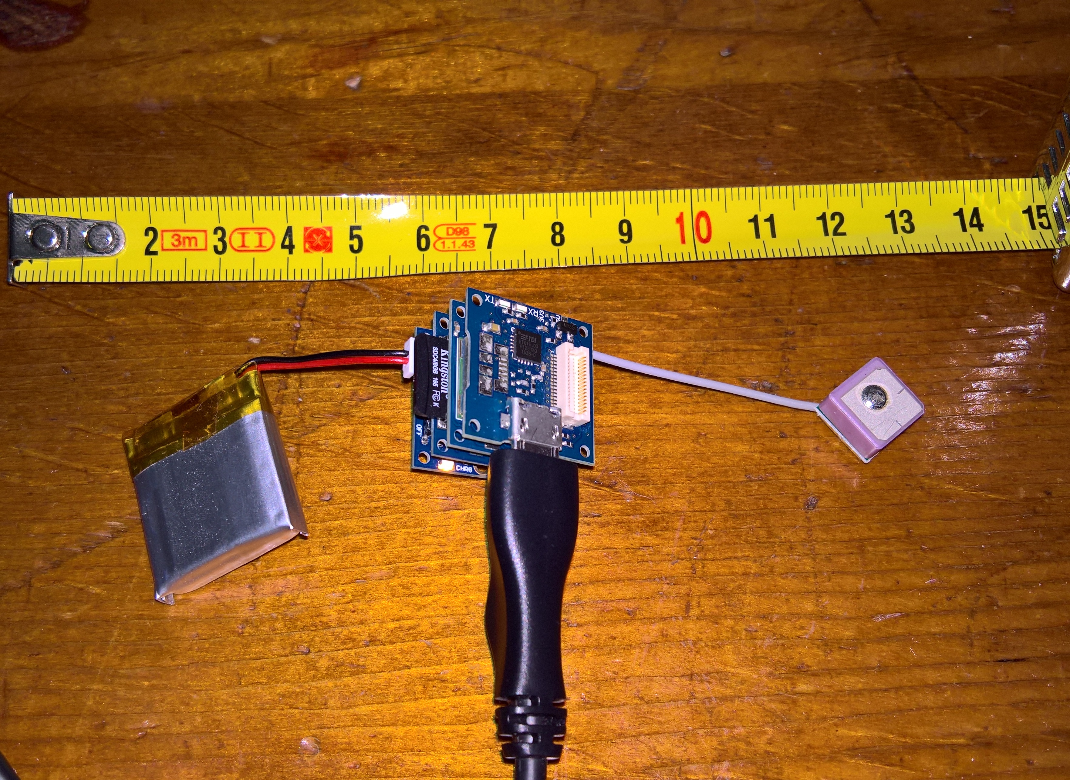
Results – GPS / SD
Results I
TinyDuino Setup
Processor, SD, GPS & USB boards
2x2cm
Plus battery & GPS aerial
Fits in a small plastic container
Tic Tac / Smint
GPS co-ordinates stored in CSV file
Can be removed easily and read on PC

Slide 7
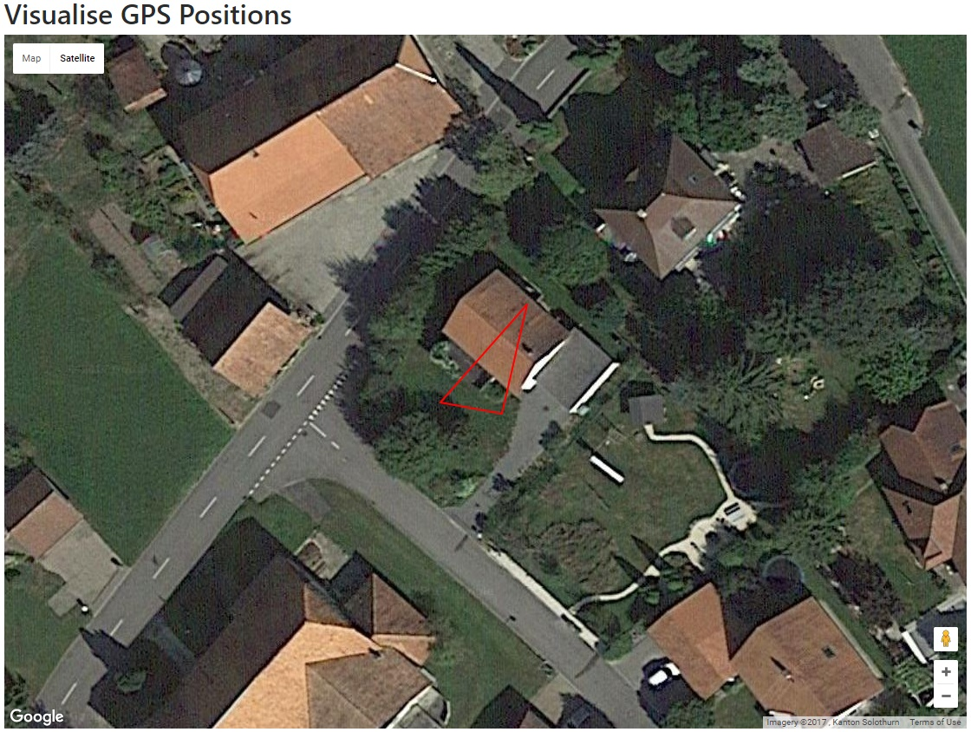
Results – GPS / SD
Results II
Visualiser Output
Backup option
Web page to visualise CSV file
Co-ordinates printed on Google map

Slide 8
Results – WiFi / MQTT
Partial success
https://github.com/StrubT/IoTCatTracker/tree/feature/wifi
Connect to WiFi network
Connect to MQTT broker
Publish MQTT message
JSON message proven earlier
SIOT centre down

Slide 9
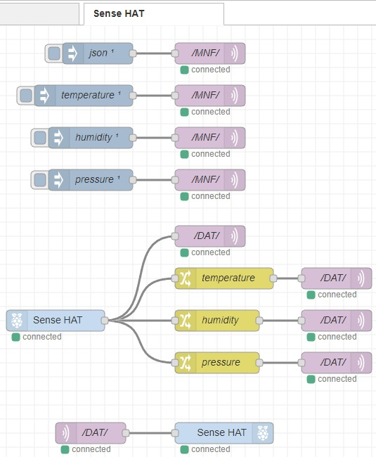
Results – WiFi / MQTT
Node-RED Flows
Sensor Manifest
{
"name": "environment",
"type": "sensor",
"zone": {
"name": "raspberrynodered",
"guid": "..."
},
"description": "Node-RED",
"valueType": "json",
"jsonMapping": {
"temperature": "float",
"humidity": "float",
"pressure": "float"
}
}

Slide 10
Discussion
Did not fully achieve goal
Did not properly test solution
Did complete two PoCs
Limited code memory
TinyCircuits recently introduced better components
Larger libraries required
Limited data memory
Only three global variables
Additional flash board available
Unstable SD storage

