Slide 1
Web Services (SOAP & REST)
Thomas Strub (strut1)
Marc Touw (touwm1)

Slide 2
Content
Theoretical Introduction
Web Services
SOAP
REST
Practical Application
Live Demo
Coding Session (optional)

Slide 3
Theoretical Introduction Web Services
What most of you probably know already:
Web Applications present data to human users
Web Services deliver data to non-human clients
What some might not now:
Web Services should not transform but merely serialise the data they deliver
Web Services can deliver the data in any format they like, possibly various

Slide 4
Theoretical Introduction Web Services
Web Services
are a great way for distributed applications to communicate
are designed to bypass firewalls
should be platform and language independent
can be implemented in various ways
can be described in WSDL / WADL

Slide 5
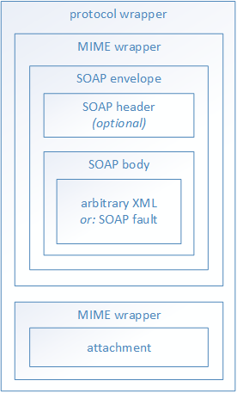
Theoretical Introduction SOAP
Full-fledged protocol
Specification: http://www.w3.org/TR/soap/
Usually served over HTTP, but can use other protocols as well
Mandatorily XML-based
Envelope with header and body
Optionally wrapped as MIME message
Used to attach non-XML data
Notes:
Originally: Simple Object Access Protocol
Multipart message

Slide 6
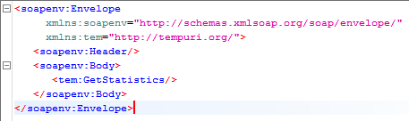
Theoretical Introduction SOAP – GetStatistics
Request Header
Request Body
POST http://localhost:5678/ HTTP/1.1
Content-Type: text/xml;charset=UTF-8
SOAPAction: "http://tempuri.org/TerminalService/GetStatistics"
Content-Length: 218
Host: localhost:5678

Slide 7
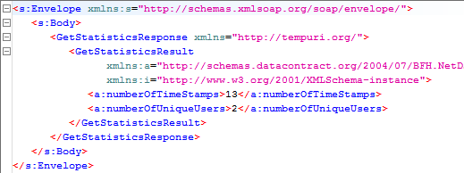
Theoretical Introduction SOAP – GetStatistics
Response Header
Response Body
HTTP/1.1 200 OK
Content-Length: 440
Content-Type: text/xml; charset=utf-8
Date: Thu, 21 May 2015 07:45:28 GMT

Slide 8
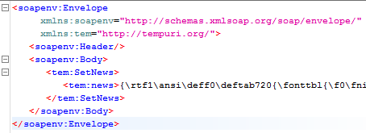
Theoretical Introduction SOAP – SetStatistics
Request Header
Request Body
POST http://localhost:5678/ HTTP/1.1
Content-Type: text/xml;charset=UTF-8
SOAPAction: "http://tempuri.org/TerminalService/SetNews"
Content-Length: 293
Host: localhost:5678

Slide 9

Theoretical Introduction SOAP – SetStatistics
Response Header
Response Body
HTTP/1.1 200 OK
Content-Length: 140
Content-Type: text/xml; charset=utf-8
Date: Thu, 21 May 2015 08:04:40 GMT

Slide 10
Theoretical Introduction REST
Only a pattern / style
Can be used with any protocol
Can be used with any data format
Defines six constraints
Client-Server
Stateless
Cacheable
Constraints (continued)
Layered System
Code on Demand (optional)
Uniform Interface
Identification of resources
Manipulation of resources through these representations
Self-descriptive messages
Hypermedia as the engine of application state
Notes:
Representational State Transfer

Slide 11
Theoretical Introduction REST – GET
Request
Response
GET http://localhost:6789/employees HTTP/1.1
Host: localhost:6789
HTTP/1.1 200 OK
Content-Length: 47
Content-Type: application/json; charset=utf-8
Date: Thu, 21 May 2015 07:39:41 GMT
[{"login":"thomas","name":"Thomas Reto Strub"}]

Slide 12
Theoretical Introduction REST – POST
Request
Response
POST http://localhost:6789/employees HTTP/1.1
Content-Type: application/json
Content-Length: 46
Host: localhost:6789
{"login": "marc", "name": "Marc Touw"}
HTTP/1.1 200 OK
Content-Length: 35
Content-Type: application/json; charset=utf-8
Date: Thu, 21 May 2015 07:41:28 GMT
{"login":"marc","name":"Marc Touw"}

Slide 13
Theoretical Introduction REST – PUT
Request
Response
PUT http://localhost:6789/employees/thomas HTTP/1.1
Content-Type: application/json
Content-Length: 61
Host: localhost:6789
{"timeStamps":["2015-04-30T00:01:57.9883655+02:00"]}
HTTP/1.1 200 OK
Content-Length: 351
Content-Type: application/json; charset=utf-8
Date: Mon, 25 May 2015 16:32:07 GMT
{"login":"thomas","timeSpan":...,"timeStamps":[…]}

Slide 14
Theoretical Introduction SOAP vs. REST
Not fair to compare apples and oranges
SOAP is a well-defined industry standard protocol
REST is an open architectural style with established standard patterns
Use SOAP for big, complex applications and REST for small, dynamic ones

Slide 15
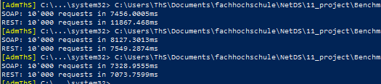
Practical Application SOAP vs. REST
Benchmark results:
1st run: JavaScriptSerializer
2nd & 3rd run: Newtonsoft.Json
There is virtually no difference
REST payload is slightly smaller
https://github.com/JamesNK/Newtonsoft.Json

Slide 16
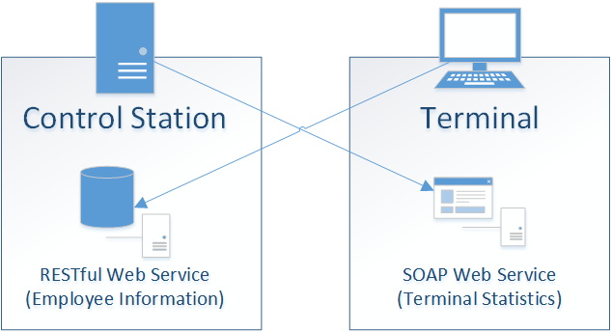
Practical Application Live Demo
https://github.com/StrubT/NetDSWebServices

Slide 17
Practical Application Coding Session
Only you are interested and there is still some time left
https://github.com/StrubT/NetDSWebServices (afterwards)

Slide 18
Questions & Answers
Do you have any further questions?
Do you have either positive or negative feedback?
Thank you all for your undivided attention!
Good luck with the final exam on the 29th of June at 0900.

