Slide 1




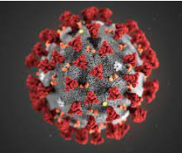
Development of new potent SARS-CoV-2 NSP14 inhibitors
Hadia Almahli
15th March 2024
Notes:
Covalent warhead
Antiviral drug for SARS cov 2
Gel based data
Picogreen assay
GSH assay
One single dose response
DABCO
SARS-CoV-2 proteins can be grouped in two major classes, structural and nonstrcutural proteins (NSPs). While structural proteins, either hold the RNA genome or are built into the viral envelope, a nonstructural protein encoded by a virus is expressed in infected cells, but not incorporated into the virion particle.

Slide 2
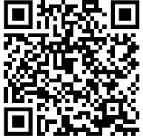
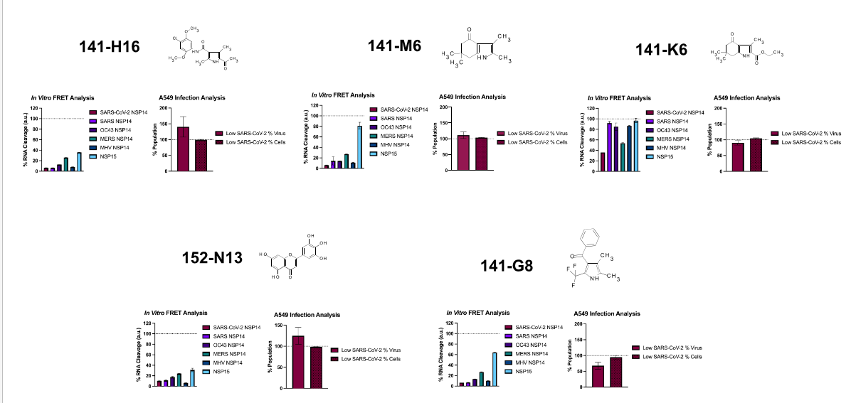
CNP27: SARS-CoV-2-NSP14 target-384 compounds (Nick’s library) HTS
From Nick’s slide

Slide 3
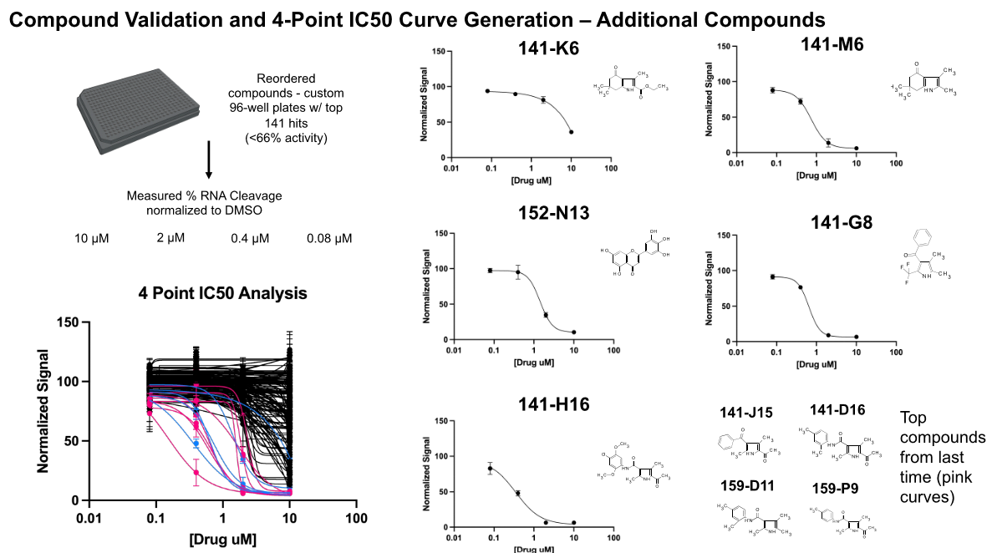
CNP27: SARS-CoV-2-NSP14 target-384 compounds (Nick’s library) HTS
From Nick’s slide

Slide 4
CNP27: SARS-CoV-2-NSP14 target-384 compounds (Nick’s library) HTS
Suggested analogues for synthesis
14 analogues
9 analogues
9 analogues
In total: 30 analogues for the three hits –Mcule:
To be shipped to UCL in 3 weeks

