Slide 1
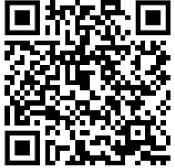
CNP27: SARS-CoV-2-NSP14 target-384 compounds (Nick Heaton’s library) HTS
Hadia Almahli
18th Oct 2024

Slide 2


CNP27: SARS-CoV-2-NSP14 target-384 compounds (Nick Heaton library) HTS
What’s next?

