Slide 1
SARS-CoV-2 NSP13 helicase
Biochemical assessment of SSYa10-001
January 17, 2024

Slide 2
Assay overview
3 assays have been established for assessing biochemical activity of SARS-CoV-2 NSP13 helicase
Each assay was performed in duplicate
To assess the biochemical inhibition of SSYa10-001 on NSP13 helicase, both an ADP-Glo and FRET based helicase unwinding assay were performed within the established parameters previously disclosed
The concentration started at 200 µM and decreased 2-fold for 12 total point dilution
An interference assay with the ADP-Glo assay reagents was performed to ensure the inhibitory activity observed was due to the inhibition of the enzyme and not due to the background/assay interference of the reagents
The buffer compositions are as follows
ADP-Glo assay: 50 mM HEPES (pH 7.5), 5 % glycerol, 100 µM TCEP, 0.01 % BSA, 0.02 % Tween-20, 2 mM magnesium acetate
FRET based helicase unwinding assay: 20 mM HEPES (pH 7.5), 20 mM NaCl, 100 µM TCEP, 0.003% Tween-20, 0.01% BSA

Slide 3
Results
SSYa10-001 had less than 10 µM IC₅₀ in ADP-Glo assay conditions (- ssDNA) but greater than 20 µM IC₅₀ in ADP-Glo assay conditions (+ssDNA)
No significant ADP-Glo assay reagent interference could be observed, indicating the resulting inhibitory activity is likely due to the compound inhibiting the enzyme
SSYa10-001 had less than 20 µM IC₅₀ in the FRET helicase unwinding assay

Slide 4
Discussion
The ATPase assay used in the publication was observing phosphate release and the one used for our assessment of ATPase activity is ATP consumption
The buffer conditions, as listed in the publication as well as similar publications on NSP13 have noted the differences in activity when there is presence (or absence) of detergent, DNA or BSA
My assay, as it has been established, includes Tween-20, BSA and TCEP. I also test the ATPase assay with and without the presence of ssDNA (polyT)
In the unwinding assay, the sequence and length of the DNA can differ between the publications which may affect the resulting inhibitory activity results
The unwinding assay from the referred publication does use similar substrate and enzyme concentrations but the reaction volume is 4-fold higher in the publication than my assay

Slide 5
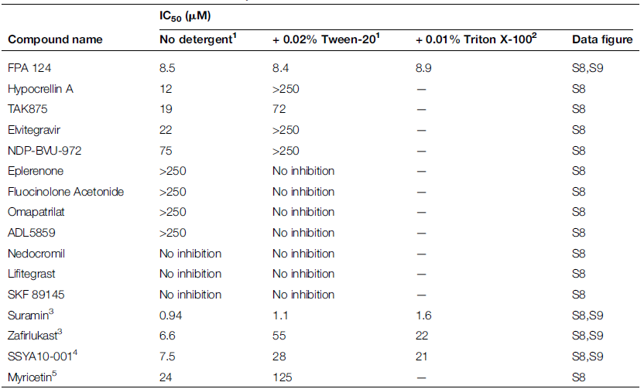
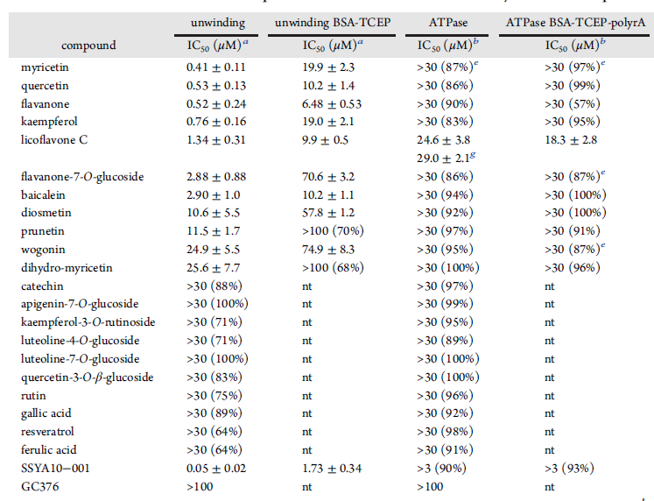
Reference for FRET helicase unwinding assay activity
Biochemical Journal (2021) 478 2405–2423
ACS Pharmacol. Transl. Sci. 2022, 5, 226−239

