Slide 1
SARS-CoV-2 NSP13 helicase
FRET unwinding assay

Slide 2
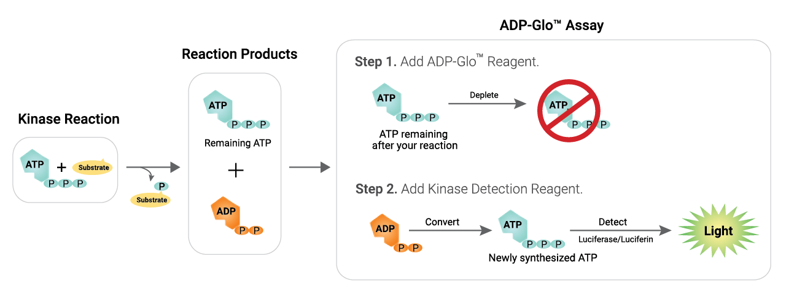
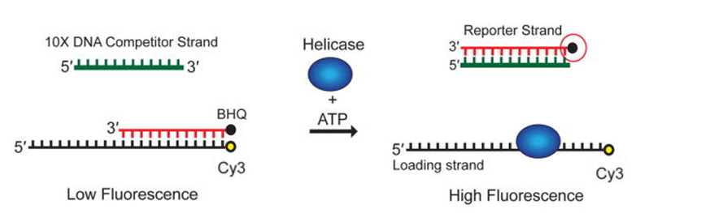
Biochemical assessment of compounds
ATPase assay: ADP-Glo (Promega)
FRET helicase unwinding assay
Buffer: 50 mM HEPES (pH 7.5), 5 % glycerol, 100 µM TCEP, 0.01 % BSA, 0.02 % Tween-20, 2 mM magnesium acetate
Component | Concentration
ATP | 1 µM
NSP13 | 0.125 nM
ssDNA | 4 nM
Buffer: 20 mM HEPES (pH 7.5), 20 mM NaCl, 100 µM TCEP, 0.003% Tween-20, 0.01% BSA
Component | Concentration
ATP | 500 µM
NSP13 | 1 nM
dsDNA | 500 nM
Competitor strand | 2.5 µM
MgCl2 | 2.5 mM
“I. Kinase/ATPase Activity Assays.” (2011).
Nat Protoc. 2014 Jul; 9(7): 1645–1661.

Slide 3
Assay overview and notes
OxATP did not arrive in time to perform FRET unwinding assay alongside the compounds
ADP-Glo assay is expected to be performed with all these compounds in parallel
All the compounds were testing in duplicate and in parallel
Data for UCL synthesized inhibitors closely replicates resulted initially observed
Literature compound (SSYA10-001) upon retested has much lower IC₅₀
The FRET based helicase unwinding assay protocol:
To pre-plated compounds 2X enzyme added and incubated at RT for 30 minutes
Reaction started by adding 2X: ATP, ssDNA, dsDNA, MgCl2
Reaction incubated for 45 minutes at RT then fluorescence viewed on Envision

Slide 4
Literature control compounds
Compounds tested At 8-point, 2-fold dilution in replicates and in parallel
SSYA10-001 display 8-fold increased inhibitory activity compared to previously reported results

Slide 5
Unwinding assay-previous
Data reported previously during project meeting
Replicate of 2

Slide 6
Unwinding assay-update
10-point, 2-fold dilution in replicates and in parallel
Replicate of 2

