Slide 1
2.2.1 - Phishing

Slide 2
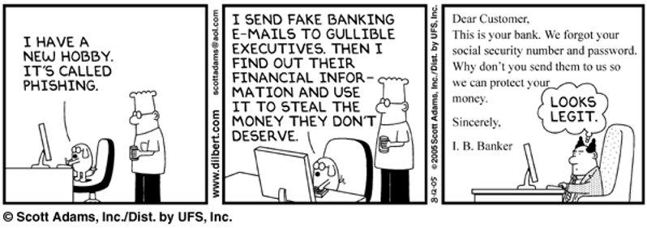
Phishing​
Used in a majority of cyber attacks​​
Considered one of top 4 biggest threats in the digital world​​
It’s not even real malware - there is no code. It is just a CON!​
Source: https://dilbert.com/strip/2005-08-12
Notes:
In recent years, Phishing has been the largest source of malware delivery and identify theft. In 2020 the Verizon Data Breach Investigations Report (DBIR) identified that credential theft, social attacks (i.e., phishing and business email compromise) and errors caused the majority of breaches (67% or more). In the DBIR report, Phishing was categorized as one of the top 4 cyber threats
AND PHISHING IS NOT EVEN MALWARE!! THERE IS NO REAL CODE OR PROGRAM!

Slide 3
What is Phishing?
Definition: Phishing is the use of bogus emails and websites to trick you into supplying confidential or personal information.
You receive an email that appears to come from a reputable organization, such as a bank.​​
The email includes what appears to be a link to the organization’s website.​​
If you follow the link, you are connected to a replica of the real website. Any details you enter, such as account numbers, PINs or passwords, can be stolen and used by the hackers who created the bogus site.
Notes:
In reading this definition and description of Phishing, it may seem like it falls in the category of “stupid user”. But in fact it can be very difficult to spot a phishing email. In the next few slides we will first look at some examples and then try out a phishing test to see how well we can spot them.

Slide 4
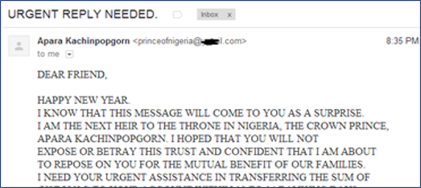
Example of phishing
Advance Fee Scam Story
Nigerian prince letter
BIG money is in a Nigerian bank account​
I need to move it to a foreign bank account​
I trust you & will give you BIG share if you let me deposit it to your bank account – just send me your bank account number and passport info
Notes:
The Nigerian Prince letter is probably the earliest version of the phishing scam and definitely the most prolific. It is also known as a 419 email because that is the Section of the Nigerian Criminal Code that deals with fraud. According to a Microsoft report, 51% of these “advance-fee” scam emails come from Nigeria. The basic story used in these emails is that there is a large sum of money held in a Nigerian bank account and the writer wants to transfer the money out BUT he needs a foreign bank account to deposit it to. He has chosen you because you are honorable and can be trusted, plus he will give you 20% or even 30% of the money just for helping him. All you have to do is provide your bank account # and your passport info so that he can make the transfer. Then everyone will be rich!! At least, the scammers will be - the slide headline is from a 2019 CNBC article (https://www.cnbc.com/2019/04/18/nigerian-prince-scams-still-rake-in-over-700000-dollars-a-year.html)
Optional video 9:39 minutes - use anytime during course when you need to fill some time:
Very funny Ted Talk video about replying to a Phishing Email
https://www.ted.com/talks/james_veitch_this_is_what_happens_when_you_reply_to_spam_email

Slide 5
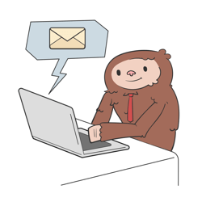

How to spot a phishing email​
Misspellings or incorrect grammar​
Sender and their email address don’t seem to match​
Hover over link – the URL doesn’t match the text​
Watch: Security Short: What is Email Phishing?
Notes:
Here are some key tips to spotting a phishing email. Video is 1:39 at You Tube: https://www.youtube.com/watch?v=5aJ0mZntZEc
Note that regular phishing makes a LOT of money. In August 2016, one of the largest phishers in the world was arrested (a Nigerian) and the police estimated that he had scammed over $60 million dollars.
But to make the phishing campaigns even more effective and profitable, special phishing types have been developed. See next slide.

Slide 6

Special types of Phishing​
Spear-phishing is an email scam targeted towards a specific individual, organization or business.​
Whaling describes an email scam targeted to high-value individuals​
Smishing is text messages used for phishing​
Vishing is phone calls or voice messages for phishing​
Notes:
Special phishing types:
In spear phishing, research is done on a specific type of target – maybe all the people who live in wealthy, New York zip codes or all people who bank with Wells Fargo or all employees of Exxon. Based on the research, an email is created that is much more believable and is likely to get more victims.
Whaling is taking the spear-phishing concept up another notch. This type of phishing targets only extremely wealthy or powerful individuals such as CEOs of major corporations.
Smishing - becoming more common as the phone becomes the primary device for many people. The user is tricked into downloading malware onto their smart phone or device.
Vishing - current examples are calls about car warranty or problems with your social security number.
Resource: https://www.cyber.nj.gov/informational-report/dont-take-the-bait-phishing-and-other-social-engineering-attacks

Slide 7


Phishing Attack or Spam Email?​
Phishing
Spam Email
Want personal information
Specifically targeted
Includes malicious links
May contain malicious attachments
Contains a sense of urgency
Should be removed AND reported
Unsolicited advertisements
Sent to many recipients at once
Has some legitimate links
Not urgency
Can be marked as spam
Notes:
We can easily be confused between Phishing and Spam because they both are unsolicited emails that have mal-intent like stealing your money or wasting your time. BUT there are key differences in characteristics detailed in this graphic. Most importantly, we should react to Phishing as if there is a potential attack and report it. With Spam, it is enough to discard the email and mark the sender as spam.

Slide 8
Activity – Phishing IQ Tests
Notes:
Time for the students to get some practice. On their devices have them access the Google Phishing Quiz website https://phishingquiz.withgoogle.com​
and each take the phishing quiz on their own. When completed they should review the answers to see what they missed.
Then have students go to the Cornell Phishbowl https://it.cornell.edu/phish-bowl​ to see more current examples of phishing email. These were targeted at Cornell faculty and students – they are very convincing, it would be easy to fall for the scam! Students should select one email from the phishbowl that they might have fallen for. When everyone is ready, select 3 – 4 students to come up and show their selected phishbowl and describe why it might seem valid.
Closure: discuss whether this resource Cornell is providing is likely to be useful for user security awareness.
If time #1: Extra sites for Phishing tests: https://www.opendns.com/phishing-quiz/ https://www.phishingbox.com/phishing-test
If time #2: Very funny Ted Talk video about replying to a Phishing Email
https://www.ted.com/talks/james_veitch_this_is_what_happens_when_you_reply_to_spam_email

