Slide 1
Bringing quiet responders back
What we would build instead of changing a number
Rook Dispatch | Draft for Helen Achebe | not yet checked with Wen Li or Marcus Oyelaran

Slide 2
Once someone goes quiet, nothing brings them back
The loop
A responder who misses or turns down pings drops down the list.
A lower place means fewer pings.
A responder who is not pinged cannot take one to climb back.
Today only being asked brings someone back. Being quiet stops them being asked.
What the data shows
Four responders fell from about 49 pings a week combined to 3 by 31 Aug.
None has taken a ping since 19 Aug. Misses began the week of 12 Aug.
The other 12 absorbed the load and recovered to about 73% acceptance.
Inferred, not confirmed: a miss costs -0.12, an accept +0.08, no decay. Wen Li can settle it.

Slide 3
Who it is for and what changes for them
The handler of a quiet responder
Like Kip. Sees nothing coming and can only file a ticket. About 30 tickets say the phone never goes off.
Now: the console says "Quiet for N days" and offers one tap, "Confirm availability and phone". No ticket.
The responder who went quiet
Available and willing, but nobody asks them.
Now: old declines and misses count for less as they age, and a quiet responder is offered the next suitable callout. One taken ping puts them back in normal order.
Any responder: retry on a missed ping
A missed alert costs score straight away.
Now: one retry to the same responder inside the same 90s wait. Answer the retry and it counts as taken. Only a ping still unanswered after the retry is a miss.

Slide 4
New: retry when a ping is missed
How the retry works
1. The ping goes to the top responder with a 90 second wait.
2. Halfway through, with no answer, the same responder gets one retry: a second alert on their phone.
3. An answer to either alert counts as taken, with no penalty.
4. Still silent at 90 seconds: recorded as missed, and the ping moves on.
Why, and what we still need to decide
A missed alert costs 0.12 of score straight away. The retry gives a missed or unseen alert a second chance before that happens.
Retry inside the 90s window (proposed): five misses in a row take 450s.
Second full window: up to 180s per responder; five misses take 900s.
Limits: it only helps if the miss was an unseen alert, and we cannot yet tell a failed push from no answer. Of 135 missed pings, 26 ended with nobody left to ask.
Ravi must agree what counts as a ping and a miss once a retry exists.

Slide 5
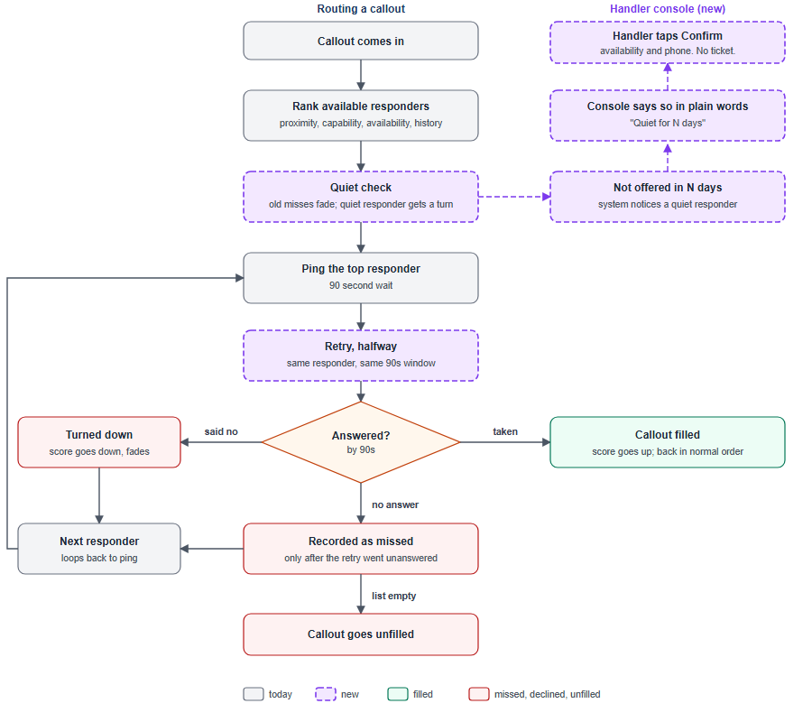
The workflow
Purple dashed = new. Grey = today. N and the retry timing are not set yet.

Slide 6
What it deliberately does not do
Does not revert 4.2 or the proximity weighting. Responders asked for that change.
Does not guarantee anyone a number of pings, or put a weak match ahead of a clearly better one on a critical callout.
Does not change availability by itself. Handlers stay in control.
The retry is a single second alert: no repeated pings, and no retry after a turn-down.
Does not tell us why a ping was missed. A failed push, a phone problem and a slow thumb look the same in the data.
Does not touch cover identities (Security Policy 4.1), mutual aid, or the handler phone app.

Slide 7
Open before anyone builds, and how we will know
Open questions
Wen Li: was treating everyone the same on purpose? Why no decay? Should a miss score like a decline?
Ravi Menon: definition of ping and miss once a nudge exists; prior-year numbers.
Marcus Oyelaran: sizing; do scores survive a restart; can a failed push be told from no answer?
Separate and small: restoring the 90s wait is a config change. Alone it will probably not bring the four back.
Success looks like
The four are offered pings again within a week.
Share of pings missed falls.
Unfilled callouts fall from 11% toward 5%.
Tickets saying "quiet" fall.

