Slide 1
Semester Projects - proposals -
Measurement for Automation and Industrial Production (MAIP)
A.A. 2024/2025

Slide 2
Proposal #1
Development of an automated measurement system for characterizing of an
air flow transducer
Hardware:
Two FS1012-1100-NG and FS2012 transducers;
Electronic signal conditioning circuit to be developed;
One Mod.NEO – pp2 air pump;
Laboratory benchtop power supply;
GPIB to USB adapter;
PC with embedded NI DAQ board.
Software:
LabVIEW

Slide 3
Proposal #1
Objectives to be achieved by the students
Calibration phase:
Description and discussion of FS1012 and FS2012 transducers;
Description and discussion of calibration method;
Description and discussion of the Mod.NEO – PP2 air pump;
Description and discussion of characterization method for the FS1012 transducer;
Description of the differences between the datasheet characterization reported curve and the obtained curve during the characterization phase in the lab;
Development of a VI which is able to do:
the signal acquisition from the FS1012 transducer signal conditioning circuit;
the signal acquisition from the FS2012 transducer signal conditioning circuit;
Calibration of the FS1012 transducers versus the calibrated FS2012 transducer;
Control of the PP2 air pump by means a programmable benchtop laboratory power supply;
Display of the air flow from the FS1012 transducer and the FS2012 transducer in real-time.

Slide 4
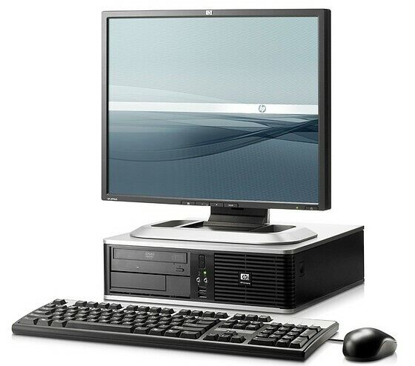
Proposal #1
Block diagram
Air flow input port
Air flow output port
FS2012
FS1012
PC:
LabVIEW
GPIB
Laboratory benchtop
power supply
Neo PP2
air pump
USB
DAQ NI 6008 card
Signal conditioning circuit

Slide 5
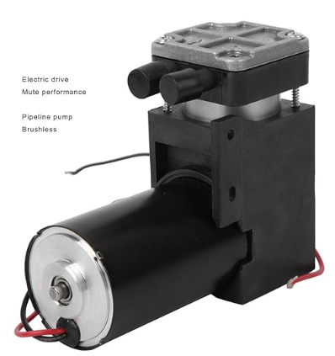
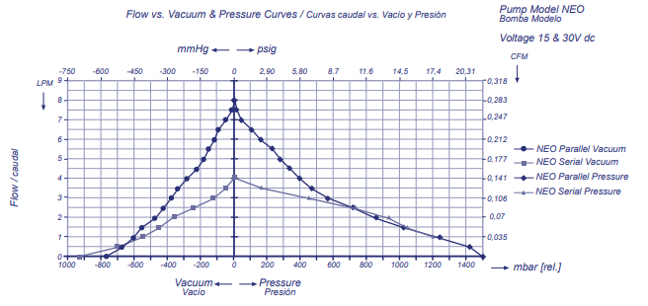
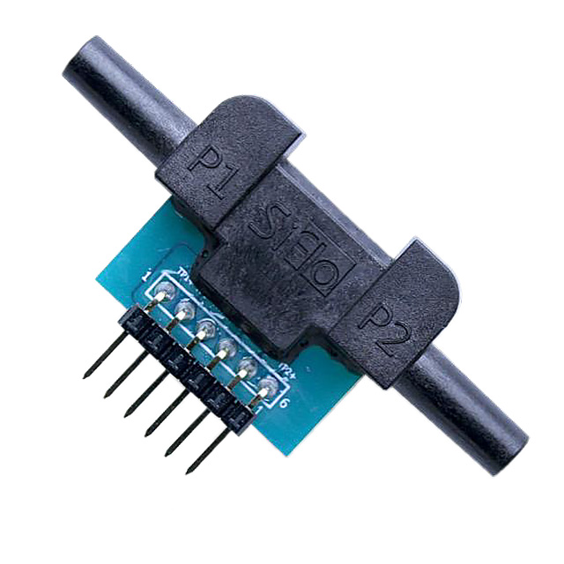
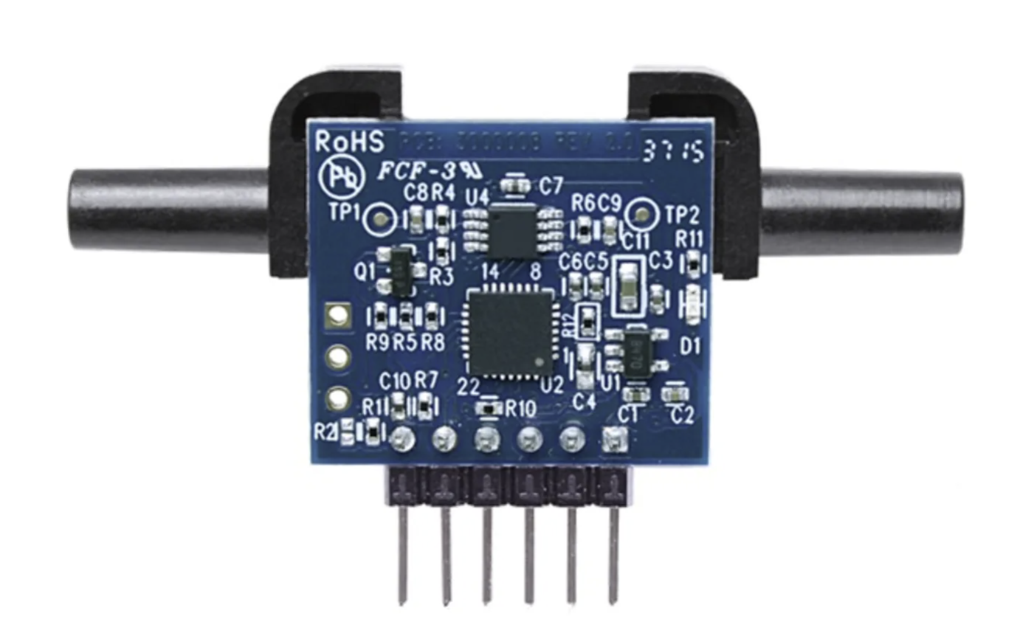
Proposal #1
Mod.NEO – pp2 air pump:
Components
The FS1012-1100-NG transducer:
http://www.ead-pumps.com/html/PDF/NEOP-P3.pdf
The FS2012 calibrated transducer:
https://www.renesas.com/en/products/sensor-products/flow-sensors/fs1012-gas-or-liquid-flow-sensor-module
https://www.renesas.com/en/products/sensor-products/flow-sensors/fs2012-gas-or-liquid-flow-sensor-module-calibration

Slide 6
Proposal #2
Development of an automated measurement system for differential distance measurement based on two Sharp GP2Y0A41SK0F optical transducers
Hardware:
Two Sharp GP2Y0A41SK0F transducers;
Electronic signal conditioning circuit to be developed;
Mechanical test-bench to be developed for 30 cm distance range;
Twentieth caliber;
PC with embedded NI DAQ board.
Software:
LabVIEW

Slide 7
Proposal #2
Objectives to be achieved by the students
Calibration phase:
Description and discussion of GP2Y0A41SK0F transducer;
Description and discussion of calibration method using a twentieth caliber as reference instrument for distance measurement in differential mode;
Description and discussion of characterization method for the GP2Y0A41SK0F transducer;
Description of the differences between the datasheet characterization reported curve and the obtained curve during the characterization phase in the lab;
Development of a VI which is able to do:
Signal acquisition from the GP2Y0A41SK0F transducers signal conditioning circuit;
Calibration of the GP2Y0A41SK0F transducers versus reference distance measurement instrument (the twentieth caliber);
Display of the distance in real-time.

Slide 8
Proposal #2
Block diagram
PC:
LabVIEW
GP2Y0A41SK0F
GP2Y0A41SK0F
USB
Power supply and control circuit
DAQ NI 6008 card
Signal conditioning circuit

Slide 9
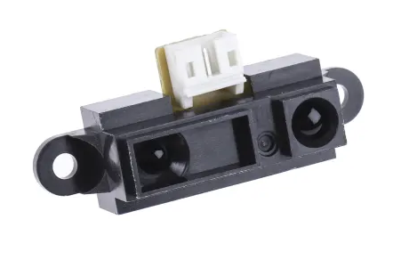
Proposal #2
Components
30 cm active sensing area
The GP2Y0A41SK0F transducer:
GP2Y0A41SK0F
GP2Y0A41SK0F
https://www.mouser.it/datasheet/2/365/gp2y0a41sk_e-594157.pdf
Moving direction

Slide 10
Proposal #3
Development of an automated measurement system for characterizing of a
resistive level sensor
Hardware:
Resistive level sensor PN-12110215TC-X;
Electronic signal conditioning circuit to be developed;
Mechanical test-bench to be developed for 20 cm level range;
Graduated cylinder;
PC with embedded NI DAQ board.
Software:
LabVIEW

Slide 11
Proposal #3
Objectives to be achieved by the students
Calibration phase:
Description and discussion of resistive level sensor;
Description and discussion of calibration method for liquid level measurement;
Description and discussion of characterization method for the resistive level sensor;
Description of the differences between the datasheet characterization reported curve and the obtained curve during the characterization phase in the lab using the graduated cylinder;
Development of a VI which is able to do:
Signal acquisition from the resistive level sensor signal conditioning circuit;
Calibration of the resistive level sensor versus reference level measurement instrument (the graduated cylinder);
Level display in real-time.

Slide 12
Proposal #3
Block diagram
PC:
LabVIEW
resistive level sensor
USB
Power supply
DAQ NI 6008 card
Signal conditioning circuit

Slide 13
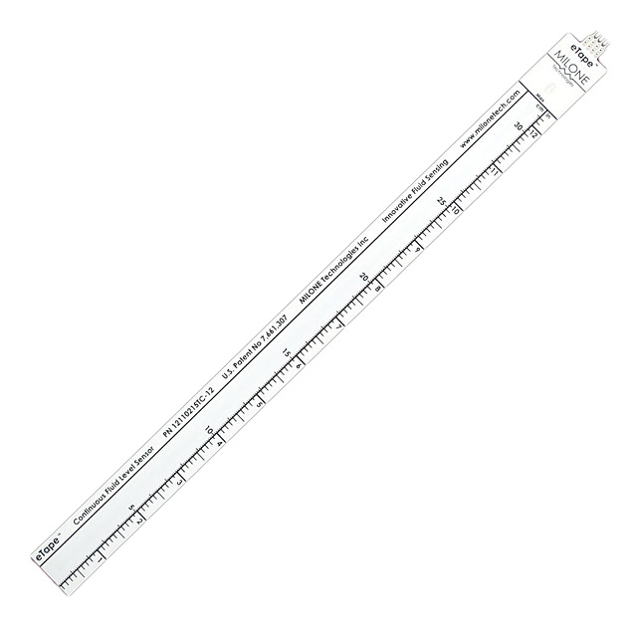
Proposal #3
Components
Cylinder with water
Resistive level sensor
The resistive level sensor PN-12110215TC-X :
https://img1.wsimg.com/blobby/go/6e1bce17-f4fa-40c3-9d89-9bb7445697bb/downloads/Standard%20eTape%20Data%20Sheet.pdf

