Slide 1
Courses/Labs Management System
https://github.com/StrugariStefan/CLMS

Slide 2
Summary
Team members
Project requirements
Technologies involved
Development workflow
Architecture
Microservices:
Authentication
Users
Courses
Gamification
Notifications
CLMS application characteristics

Slide 3

Team members Team of 5 logo
Birsan Ioana (B5)
Ciulei Andrada-Teodora (B6)
Loghin Alexandru (B4)
Silistru Alexandru (A1)
Strugari Mihai Stefan (B4)

Slide 4
Project requirements
Creating a platform for the management of users, courses and laboratories that will allow:
the registration of users who can be teachers or students
sending notifications
assessment of students
uploading and downloading of courses/labs materials
the existence of interaction between students and teachers, which consists in asking questions, providing feedback and giving answers
authentication mechanism

Slide 5
Technologies involved
C#
.Net Core 2.2
OpenAPI Specification
Sql Server
Microsoft Azure Blob Storage
MSTest.TestFramework 1.3.2

Slide 6
Development workflow - Github
Checkout to master and pull the latest version from github locally before adding any other code. This should be done each time you want to make changes starting from the latest master changes:
git branch -> current branch
git checkout branch-name -> move to branch branch-name
Checkout to a new branch with a name that describes the feature, following the standard name/feature:
git checkout -b andrei/add-animations
Make your desired changes to the code and make commits with those changes:
git commit -m "message that describes commit".
Push the changes to GitHub to a branch with the same name:
git push -u origin local-branch-name:desired-branch-name-on-github
Validate that the changes work as expected.
If your changes work as expected merge the new branch to the master branch. Merge only if the changes work as expected.

Slide 7
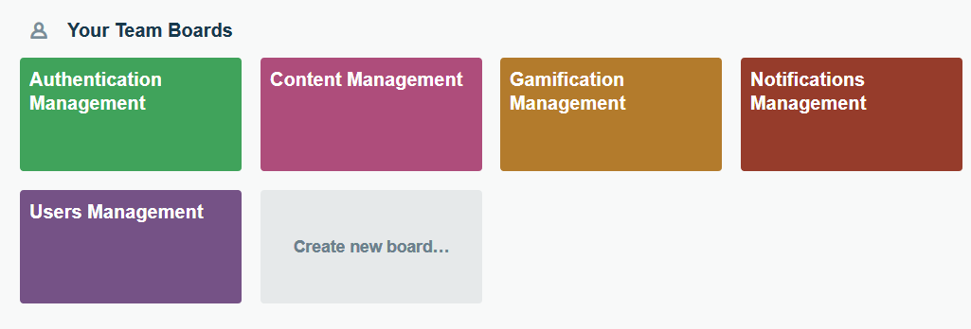
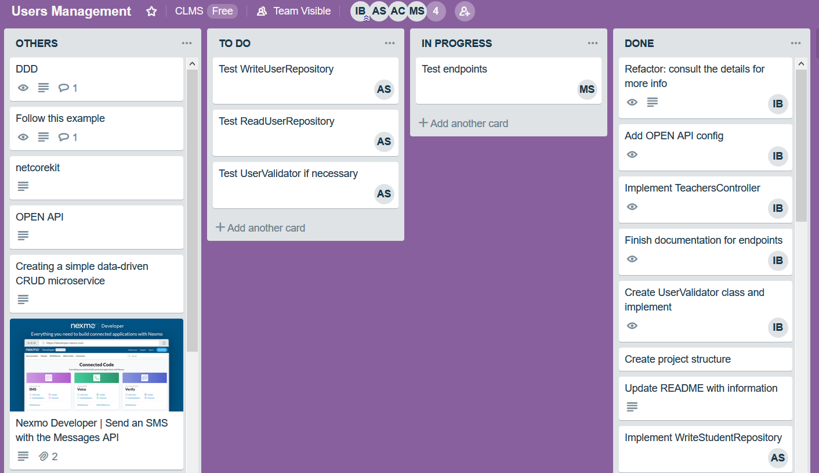
Development workflow - Trello

Slide 8
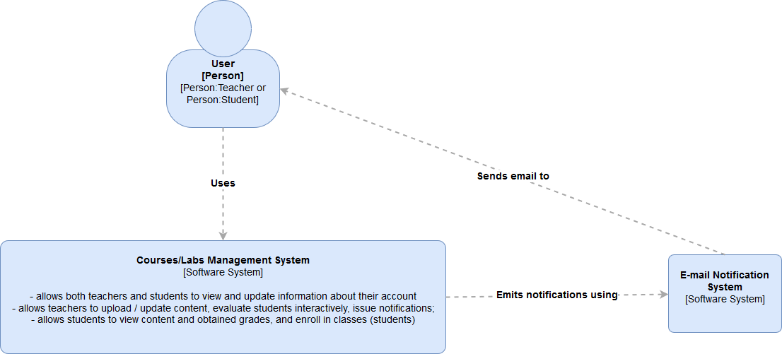
Architecture - level 1

Slide 9
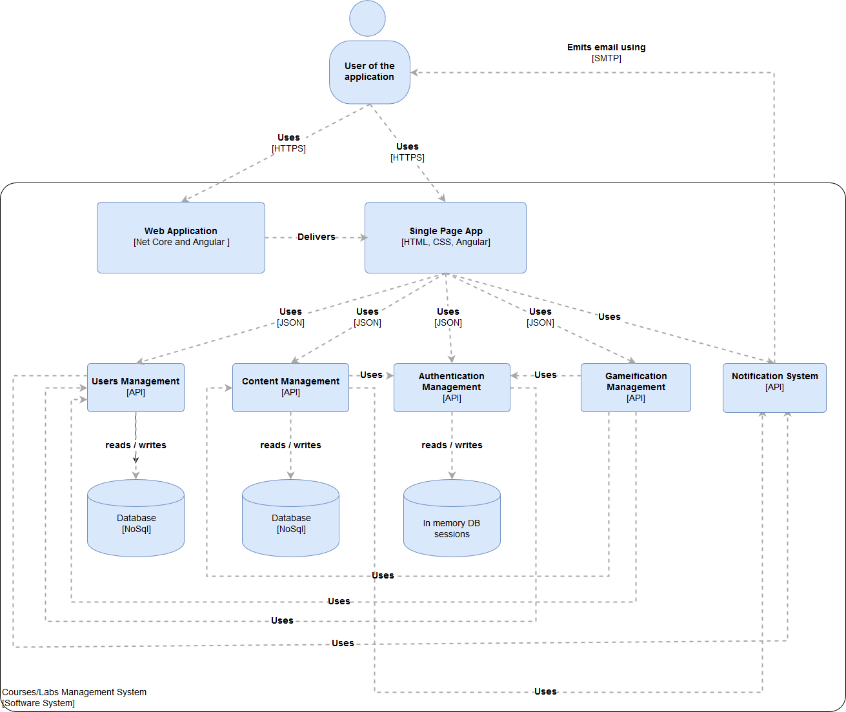
Architecture - level 2

Slide 10
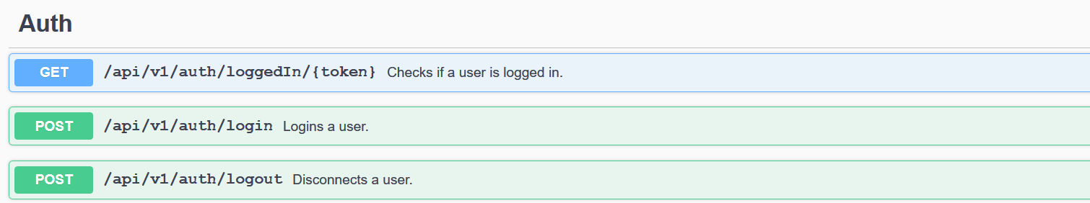
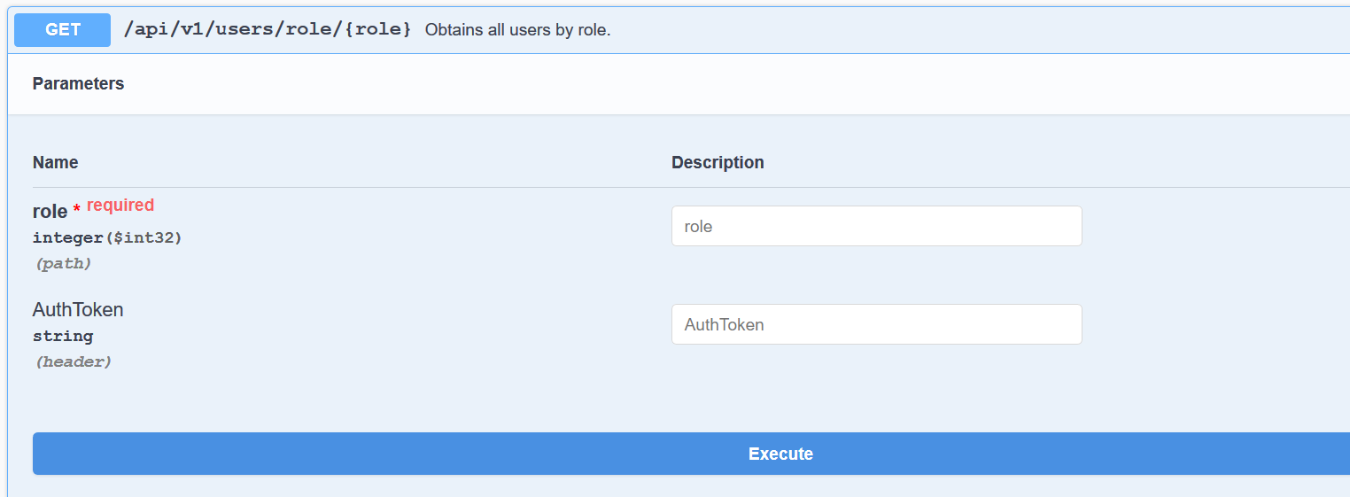
Microservices - Auth.API

Slide 11
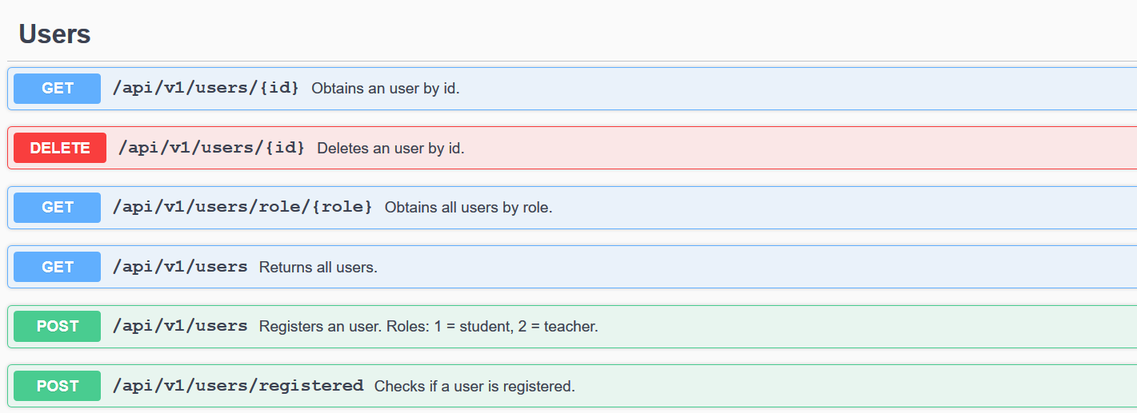
Microservices - Users.API

Slide 12
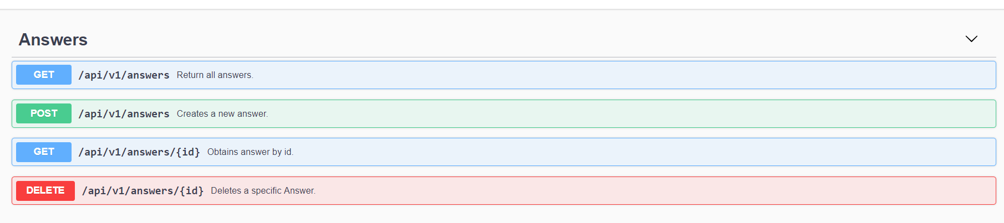
Microservices - Gamification.API

Slide 13
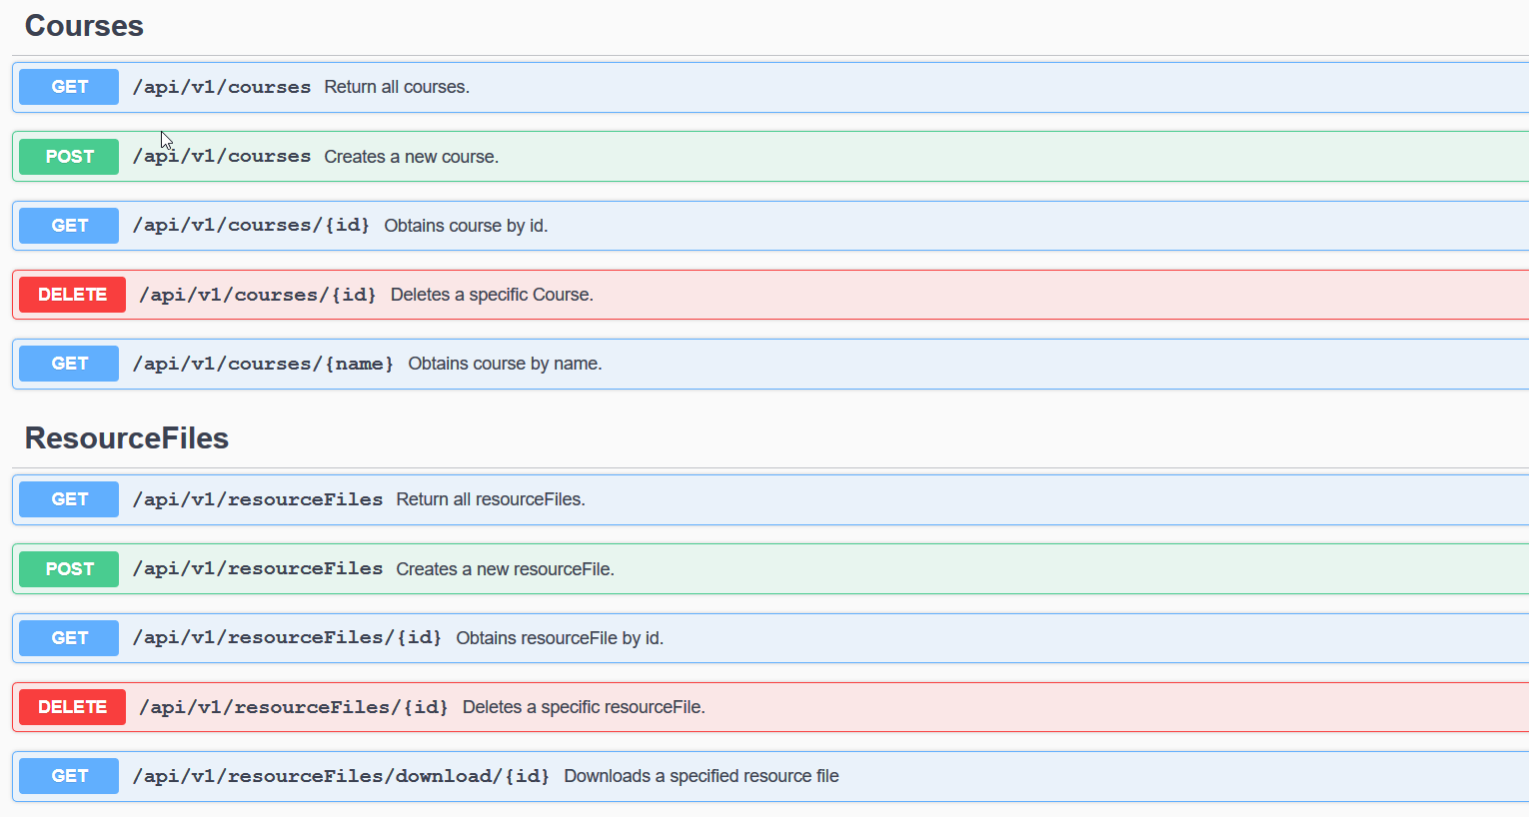
Microservices - Courses.API

Slide 14
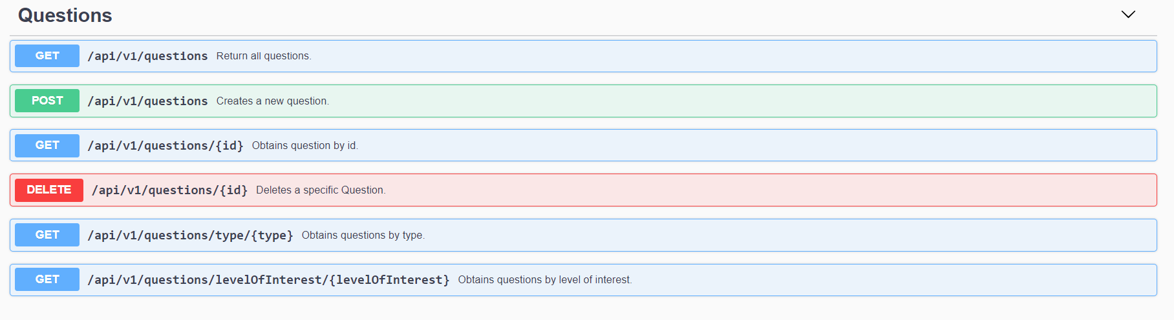
Microservices - Gamification.API

Slide 15
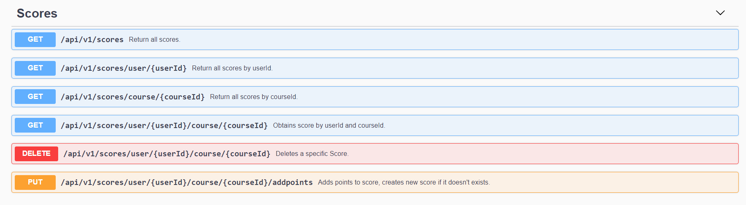
Microservices - Gamification.API

Slide 16
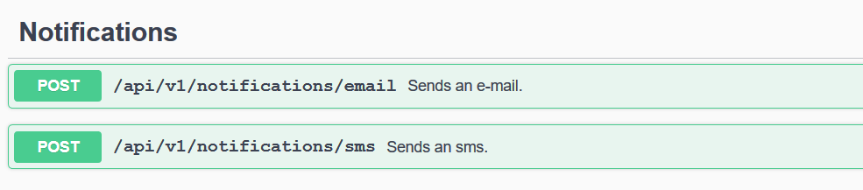
Microservices - Notifications.API
The functionality displayed by this service consists in sending emails and sms.
As far as implementation is concerned, we have used the services outlined by:
Mailgun API
Twilio Programmable SMS

Slide 17
CLMS application characteristics
Flexibility and extensibility
CLMS application can be easily modified,continued and improved
Modularity and scalability
The microservices architecture gives us flexibility in terms of how we can scale the whole application.
Easy to use and understand by the user
Well documented

Slide 18
What we have learned
What a microservice is
How to develop microservices
Better communication skills
How to manage a large project and create small, feasible tasks

