Slide 1




Full-Stack Microservice for inventory management: products, warehouses, and suppliers.
Strugariu Filip-Daniel · FIESC AN 1 · Calculatoare Dual 3111Da
Strugariu Filip-Daniel · ASSIST Learning · 2026

Slide 2

MOTIVATION:
I chose this topic to learn how to manage a real database through an API and to understand how to develop a Full-Stack application step by step.
The Inventory is a Full-Stack application built to optimize warehouse workflows. It allows real-time stock monitoring, supplier relationship management, and freight transfer between locations.
Full-Stack
4
Complete architecture
4 main API routes
Live
3
Production deployment
Relational tables

Slide 3




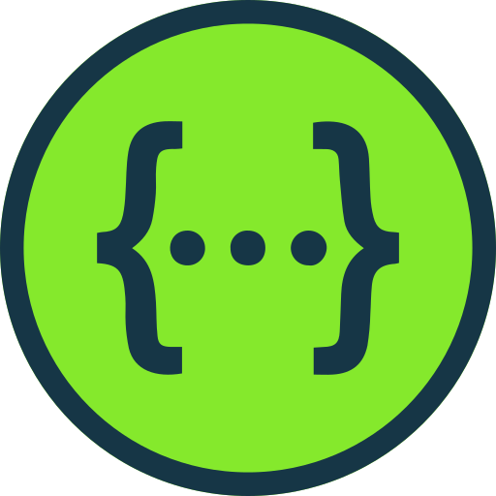
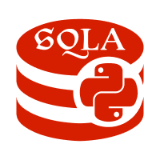







Python
FastAPI
PostgreSQL
Swagger
SQL Alchemy
Pydantic
Supabase Cloud
Render
Tailwind CSS
GitHub
Hostinger
React.js

Slide 4

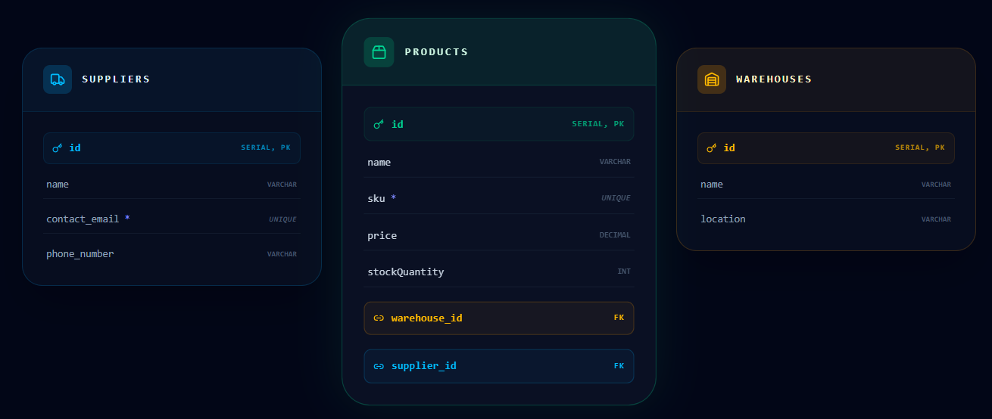
SCHEMA MAPPING AND RATIONAL LOGIC

Slide 5

Automated documentation via OpenAPI (Swagger) · Accessible at /docs
/products
/warehouses
Product catalog management - SKU, name, price, stock
Warehouse administration - location and capacity
GET
POST
PATCH
DELETE
PUT
GET
POST
PATCH
DELETE
PUT
/suppliers
/inventory
Supplier database - contact and commercial details
Product transfer and quantity adjustment
GET
POST
PATCH
DELETE
PUT
GET
POST

Slide 6


TERMINAL
INFRASTRUCTURE
# Backend
Render
Hostinger
.\venv\Scripts\activate
pip install -r requirements.txt
Backend auto-deploy
din GitHub on every push
Frontend hosting
npm run build → dist/
uvicorn app.main:app --reload
# Frontend
Supabase
VS Code
npm install
npm run dev # local
PostgreSQL maintained in cloud
Main IDE for development
npm run build # production

Slide 7

01
02
03
Environment setup
Backend development
Data management
➔
➔
Establishing the project in Python and initializing the FastAPI framework for scalable and asynchronous development.
Integrating the SQLAlchemy engine for database management and using Pydantic for strict data validation.
Designing the PostgreSQL structure and generating interactive documentation via Swagger for endpoint testing.
04
05
06
React interface
Git synchronization
Cloud launch
➔
➔
Building UI components with Tailwind CSS and integrating the REST API logic.ac
Source code versioning using GitHub and configuring the relational database instance in Supabase.
Hosting the frontend application on Hostinger and deploying the backend service on the Render platform.

Slide 8


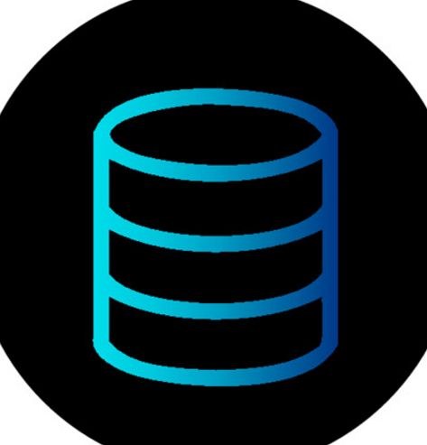

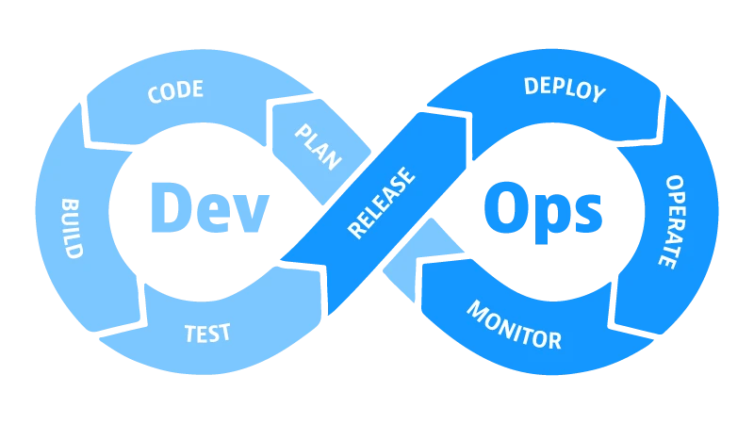

Acquired skills and objectives achieved in project development:
Data Modeling
FastAPI Async
PostgreSQL relational structure without redundancy - Products, Warehouses, Suppliers with FK.
Asynchronous API with Pydantic validation, secure transfer routes, and automated OpenAPI documentation.
Cloud DevOps
Full-Stack Dev
Supabase (DB) + Render (API) + Hostinger (Frontend) - complete, live distributed environment.
React hooks, state management, API calls, Tailwind CSS - end-to-end integration.
fermo.top/The-inventory/ · THE INVENTORY v1.0 · Strugariu Filip-Daniel · © 2026

