Slide 1
Instruction Mix Analysis + Expanded Instruction Set
By: Luna McMullen

Slide 2
Project Overview
Instruction Mix Analysis
Creates log Showing exact number and percentage of each type of instruction
Extended Instruction Support
Multiply
Divide
Modulus

Slide 3
Closer View
Instruction Mix Analyzer
Very simple design
Used Assignment 4 template for simplicity
Counts exact number of each instruction type
Returns percentages of each type

Slide 4
Closer View
Multiply, Divide, and Modulus instructions
Multiply
Signed
Divide
Signed
Handles division by zero
Modulus
Always returns positive, so unsigned
Handles mod by zero

Slide 5
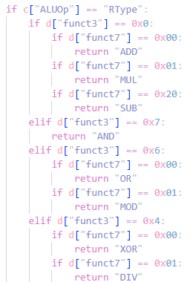
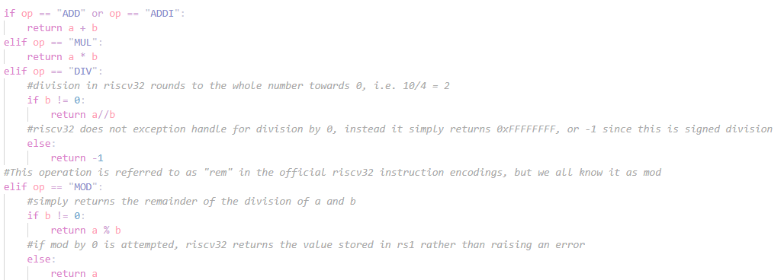
Instruction Extension Code

Slide 6
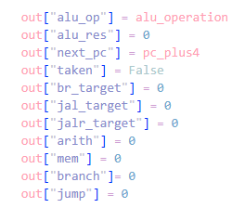
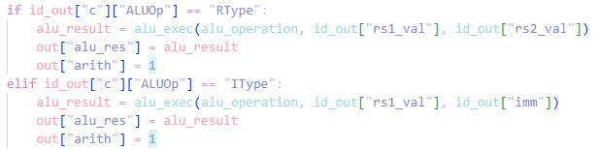
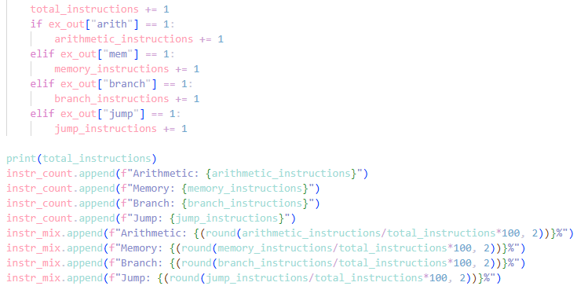
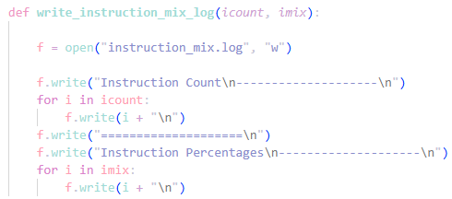
Instruction Count Analysis Code

