Slide 1
Python Project Snake Made With Pygame
By: Luna McMullen

Slide 2
Main Design Concepts
Object Oriented
Snake Object
Fruit Object
Death Conditions
Walls
Head hitting Body
Score
Based on # of fruits eaten
Increases with speed value

Slide 3
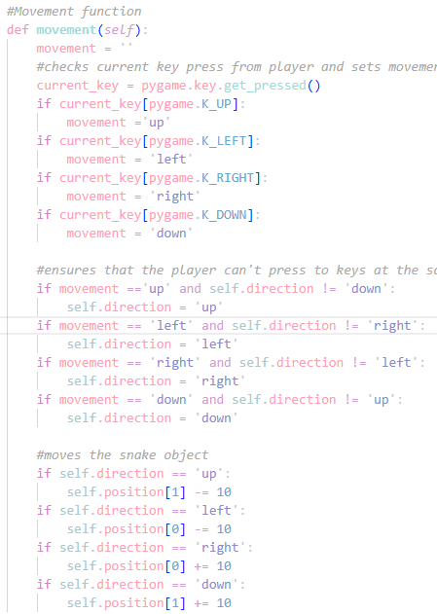
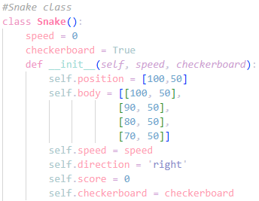
Snake Object Code

Slide 4
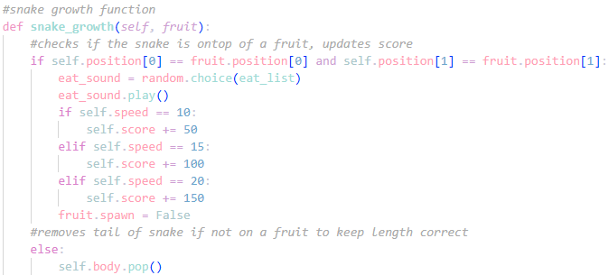
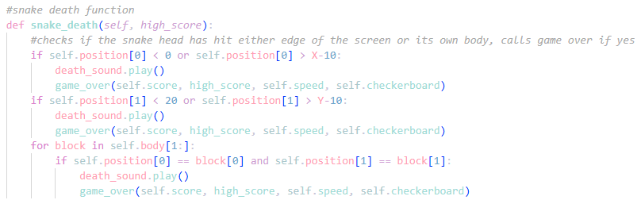
Snake Object cont.

Slide 5
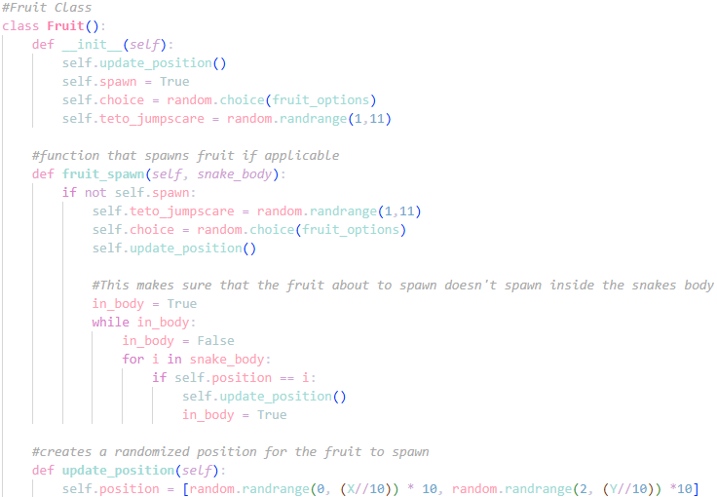
Fruit Object Code

Slide 6
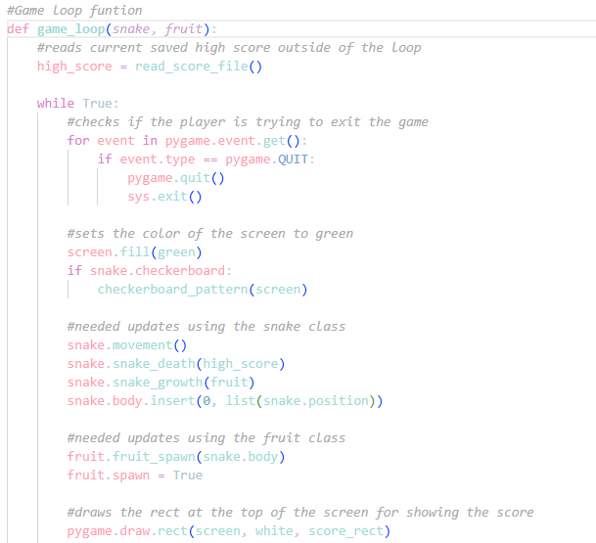
Main Game Loop

Slide 7
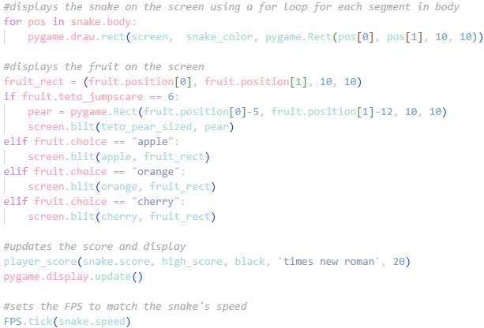
Main Game Loop Cont.

Slide 8
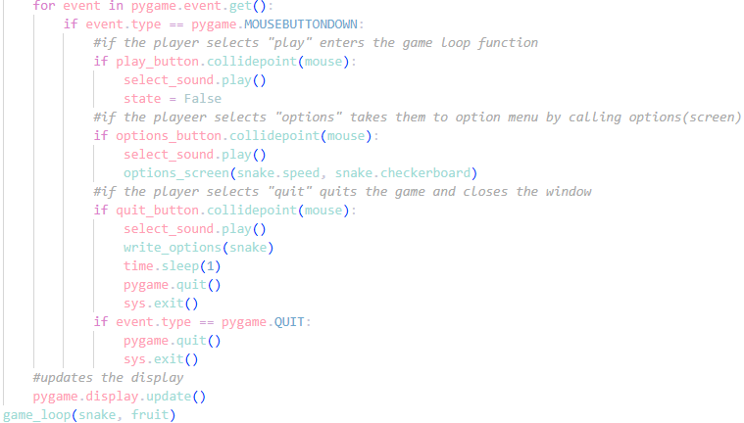
Main Menu Code

