Slide 1
CS302 Operating System Lab 4 Thread and Schedule
ZENG Xinxun, ZHANG Shiqi

Slide 2
Outline
Thread
Why multithreading?
Thread libraries
Practice
Threading issue
Schedule
Why scheduling?
Three level scheduling
Assignment: Scheduler

Slide 3
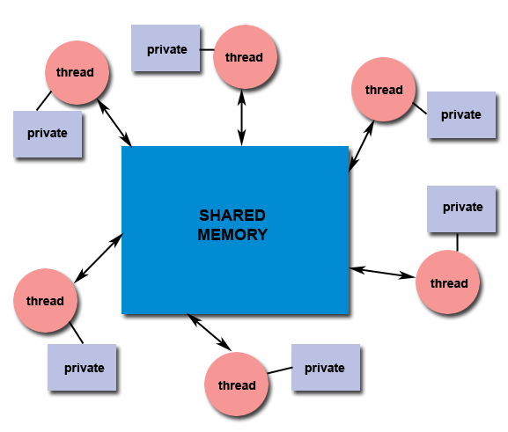
Why multithreading?
Responsiveness
Scalability
Resource sharing
Economy
Picture from: https://computing.llnl.gov/tutorials/pthreads/

Slide 4
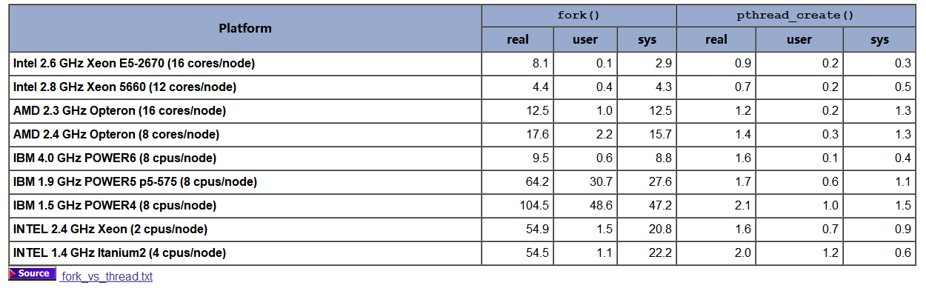
Threading vs Processing
Picture from: https://computing.llnl.gov/tutorials/pthreads/
Time utility of 50,000 process/pthread creation

Slide 5
Thread libraries
Three main libraries:
POSIX Pthread
Windows thread
Java thread

Slide 6
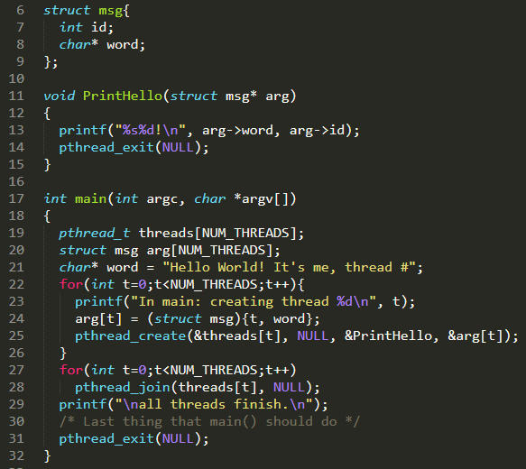
POSIX Pthread
Compile flag: -pthread e.g. gcc thread.c –o thread –pthread
API
pthread_create
pthread_exit
pthread_cancel
pthread_join
pthread_detach

Slide 7
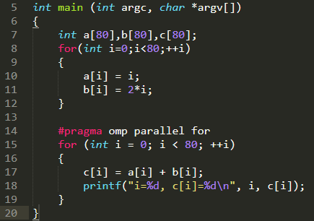
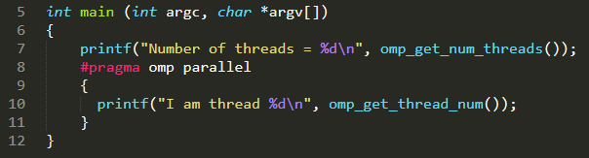
Implicit Threading
Thread pool
A management pattern of threads.
OpenMP
Threading automatically by compiler.
Try: gcc openmp1.c -o openmp1 –fopenmp
Try: gcc openmp2.c -o openmp2 -fopenmp

Slide 8
Practice
Write a multithreaded program, user input a series of number, calculates three statistical values in different thread, print the result in given order.
Input: 90 81 78 95 79 72 85
Output: average: 82
minimum: 72
maximum: 95

Slide 9
Threading issue
fork() and exec()
Signal handing
Thread cancellation
Thread-local storage
Scheduler activations
In Operating System Concept – 4.6

Slide 10
Overview
Program, Process, Thread, Job
OS Scheduler:
Long Term, Medium Term and Short Term
Assignment: Scheduler

Slide 11
Program, Process, Thread, Job
Program: a group of instructions to carry out a specified task
stored on disk in some file.
Process: an execution of certain program with its own address space
resources: CPU, memory address, disk, I/O etc.
Thread: the unit of execution in CPU
Job: a series of program submited to operating system for some goals.
Notes:
Program: stored on disk in some file and does not require any other resources

Slide 12
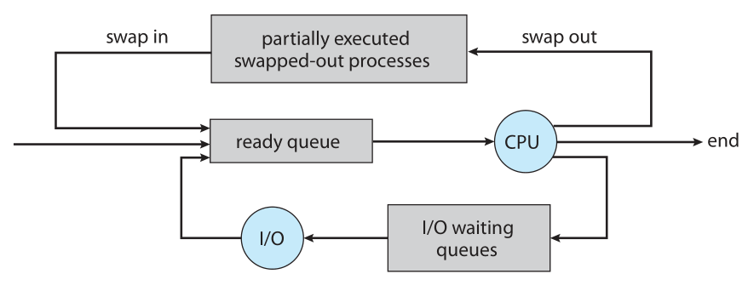
OS Scheduling
A job, after being submitted to operating system, will experience three kind of scheduling.
Long Term Scheduler
Medium Term Scheduler
Short Term Scheduler
job queue
Source: Operating System Concepts 9th p114 Figure 3.7

Slide 13
Background Terminology
Degree of multiprogramming
the number of processes in memory
I/O-bound process
spends more time doing I/O than doing computations
CPU-bound process
doing I/O infrequently but using more time on computations

Slide 14
OS Scheduler
Long Term Scheduler (Job scheduler)
Select processes from job queue(disk)
Load processes to ready queue(main memory)
Select a good process mix of IO-bound and CPU-bound processes
Control the degree of multiprogramming
job queue
Job scheduler
Source: Operating System Concepts 9th p114 Figure 3.7
Notes:
If all processes are I/O bound, the ready queue will
almost always be empty, and the short-term scheduler will have little to do.
If all processes are CPU bound, the I/O waiting queue will almost always be
empty, devices will go unused, and again the system will be unbalanced. The
system with the best performance will thus have a combination of CPU -bound
and I/O -bound processes.

Slide 15
OS Scheduler
Short Term Scheduler (CPU scheduler)
Select one process from ready queue
Execute it on CPU
Scheduling Algorithms: SJF, Round-Robin, Priority
job queue
CPU scheduler
Source: Operating System Concepts 9th p114 Figure 3.7

Slide 16
OS Scheduler
Medium Term Scheduler(Swapping scheduler)
swap a process(IO-bound/CPU-bound) out of memory
swap the process back into memory
reduce the degree of multiprogramming
improve the process mix
Swapping scheduler
job queue
Source: Operating System Concepts 9th p114 Figure 3.7

Slide 17
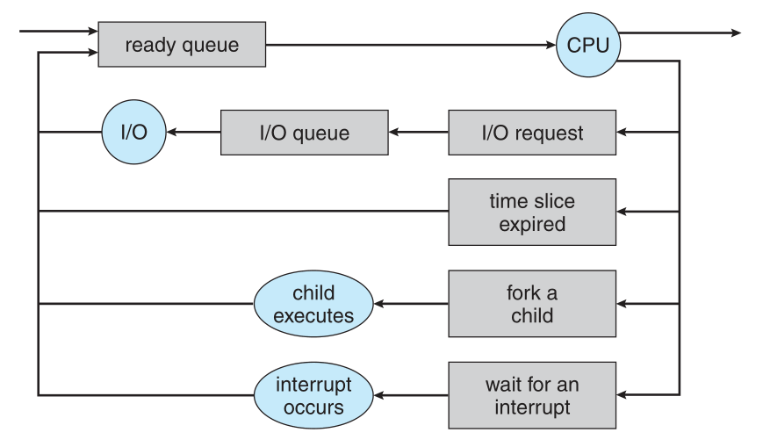
Where a process go after execution?
normal terminate
issue an I/O request and then be placed in an I/O queue
create a new child process and wait for the child’s termination
remove from CPU due to an interrupt and back in the ready queue
Source: Operating System Concepts 9th p112 Figure 3.6

Slide 18
OS Scheduler Comparison
Long-Term Scheduler | Short-Term Scheduler | Medium-Term Scheduler
It is a job scheduler | It is a CPU scheduler | It is a process swapping scheduler
Speed is lesser than short term scheduler | Speed is fastest among other two | Speed is in between both short and long term scheduler
It controls the degree of multiprogramming | It provides lesser control over degree of multiprogramming | It reduces the degree of multiprogramming
It selects processes from pool(disk) and loads them into memory for execution | It selects those processes which are ready to execute | It can re-introduce the process into memory and execution can be continued
https://www.tutorialspoint.com/operating_system/os_process_scheduling.htm

Slide 19
Assignment
You are asked to finish a simple CPU scheduler.
One can add, remove, query jobs, the scheduler can schedule the job according the requirements.

Slide 20
Strategy of CPU scheduler
Nonpreemptive
Preemptive
Priority
Shortest job first
Round-Robin

Slide 21
Background
Strategy: Priority based round-robin, time slice: 100ms
Job Status: READY, RUNNING, DONE
Priority Level: 0, 1, 2, 3 (from low to high)
Initial priority vs Current priority

Slide 22
Assignment
File organization:
sample.c: a sample job which runs more than 100ms
scheduler.c: the main part of this scheduling system
enq.c: operations about job enqueue
deq.c: operations about job dequeue
stat.c: operations about printing status
job.h: relevant data structures for job

Slide 23
Scheduler.c
Function:
Create a process for a new job. Set its state to READY and put it in the waiting queue.
A job will dequeue when receive dequeue request, and the relevant data structure will be cleared.
If the job is currently running, it will first stop running and then dequeue.
If status request, it outputs information about the currently running job and all jobs in the waiting queue

Slide 24
Enq.c
Send a enqueue request to the scheduler and submit the job for running.
Scheduler
assigns a unique jid to each job;
create a process for it and set its status to READY;
put this process into the waiting queue.
enq [-p num] e_file args
-p num： optional, assign an initial priority
e_file: the name of the executable file
args： the args of the executable file

Slide 25
Deq.c
Send a dequeue request to the scheduler
deq jid
jid： jid that need dequeue

Slide 26
stats.c
Print out the following information of current running jobs and jobs in waiting queue on standard output:
pid
user name
execution time
waiting time
create time
job status

Slide 27
Job.h
Define the data struct of all things.
Define the path of FIFO(use for communicate between all components). You need to create a fifo file in this path to let it work.

Slide 28
Task
Modify do_stat() in scheduler.c such that it can also output jobname, current priority and default priority
Implement schedule strategy: job with highest priority runs first, if with same priority, the job waiting longest runs first
Priority add 1 after waiting for 100ms
Priority reset to initial priority after running
Debug: There are some bugs in code, such as cannot add more than 3 jobs, time slicing is wrong, job deque is not working as expectation…
Run this scheduler system
do enqueue, dequeue and status operations
answer the questions in report

