Slide 1
Developing a Web Application with SQL and NoSQL Database Management Systems: An Exploratory Case Study
SID 2182389

Slide 2
Motivation
Interested in development of full stack applications
Aims to explore development process of selecting, implementing and developing with a chosen technology stack
There are many frameworks and tech stacks to choose from
Familiarity with one framework can translate to others, in the same way familiarity with one programming language can be used to learn others
In previous professional experience, applications were often inflexibly married to a single database management system, rather than using different to compliment each other’s strengths and weaknesses

Slide 3
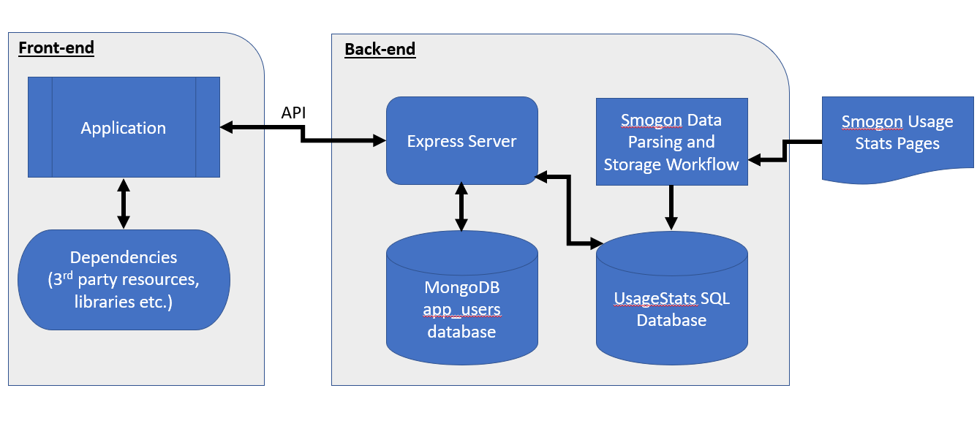
Aims and Objectives
Create a data pipeline that collects information from origin, parses and stores data locally
Store data in a PostgreSQL database
Enable user login and registration and store user profile data in a Mongo database
Enable a functional server with an API to connect database systems to web application
Create a functional web application that accepts user inputs and returns data to the user
Figure 1: Application end-to-end workflow

Slide 4
User stories
As a user, I want to be able to post my team from Showdown and see the usage stats for the metagame I am playing in.
As a user, I want to able to login and/or register an account.
As a user, I want to be able to save my teams submitted.
As a user, I would like to be able to browse the usage stats data of various tiers.
As a developer, I want to create an intuitive and simple interface for users to navigate

Slide 5
Methodology
This project is an exploratory case study on the development of a web-based application using VueJS, MongoDB, Express, PostgreSQL, Python and NodeJS
By exploring end-to-end application development, this project aims to explore and understand development best practices, implementation of cyber security measures, API development and data storage in a potentially real-world application scenario.
This project also aims to understand the benefits of using SQL and NoSQL databases together to enable greater data storage flexibility.

Slide 6
Determining the Technology Stack
Back-end
Front-end
ExpressJS
CSS
NodeJS
VueJS 3
Python
BootStrap 5
PostgreSQL
MongoDB
Figure 2: Technology stack used

Slide 7
Front-end Decisions
Bootstrap reduces time spent styling and “painting” the interface by using pre-defined CSS classes
Some custom CSS still required
Vue is an easy-to-understand JavaScript framework that doesn’t require any knowledge of JavaScript flavours (such as JSX for React or TypeScript for Angular).

Slide 8
Vue vs React vs Angular
Vue sits between React and Angular, as the three currently most popular MVC JavaScript frameworks. React and Vue are both lightweight and utilize a virtual DOM, which reduces loading and refresh time.
Vue uses hot module reloading (HMR) to quickly parse the DOM tree only where changes are made, rather than reloading the entire DOM tree, as is the case in Angular
Vue has integrated support for routing, and has specifically designed state management and build tools for faster development.
Personal preference for the Vue development ecosystem over React or Angular; Angular uses TypeScript, which is similar to JavaScript; React’s way of creating components feels less intuitive compared to Vue
Vue separates its applications into components, which allows for clear separation of responsibility
A very lightweight yet robust framework

Slide 9
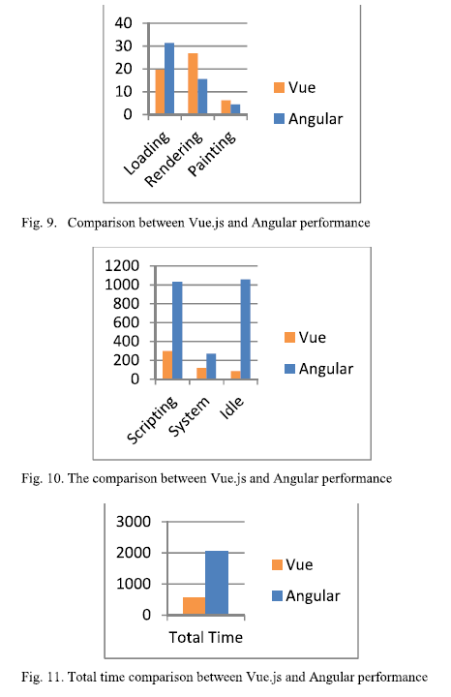
Figure 4: M-V-C Framework
Source: https://www.simplilearn.com/react-vs-angular-vs-vue-article
Figure 3: Vue vs Angular Comparisons
Source: Constantin et al (2021)
https://ieeexplore.ieee.org/abstract/document/9484150

Slide 10
Back-end decisions
PostgreSQL is ideal for storing relational data, such as the usage stats data. Further the data, once parsed and stored locally, is in CSV format, which are very similar to tables.
For data collection, Python was chosen for the language due to the authors previous experience as a data scientist using Python for data cleaning, storage and analysis.
MongoDB contains user profile data, which may vary greatly from one user to the next, the only required user fields are username and email in the MongoDB collection. As MongoDB allows for more flexible data storage, it is ideal for this scenario.
ExpressJS is a lightweight and easy-to-use server library, as well previous familiarity developing Express servers was a factor in deciding.
NodeJS serves as the JavaScript runtime environment for this project due to being widely used in industry and its flexibility for a variety of applications.

Slide 11
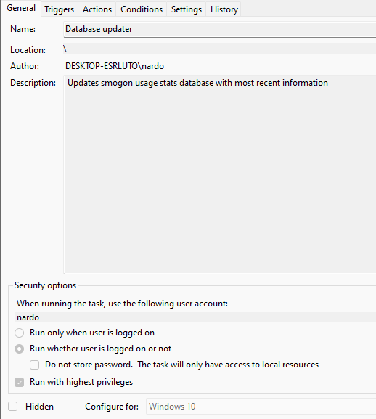
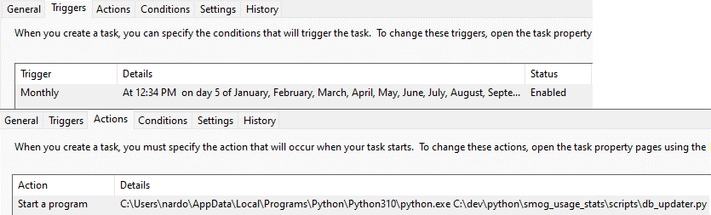
Implementation
All parts of the application (server, application, data pipeline and databases) are run locally
The commands `npm run dev` and `npm run start` start up the Vue application and Express server, respectively.
Connections to MongoDB and PostgreSQL servers for the Express server are carried out in the `mongo_db.js` and `sql_db.js` files, respectively.
A scheduled task runs on the 5th of each month to run the Python script which updates the database. If this were to migrate to a Linux environment, a chronjob would be used to perform this action.
Figure 5: Scheduled task settings for auto-updating database.

Slide 12
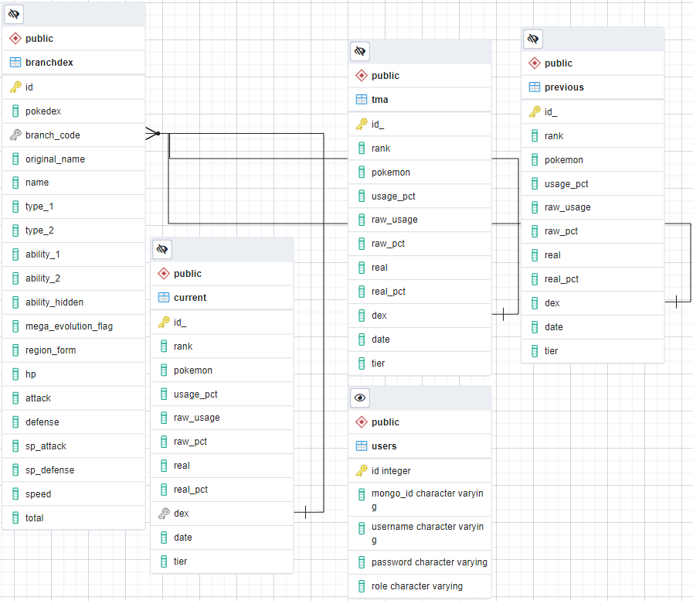
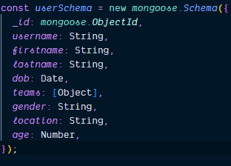
Figure 6: Mongo Database app_users.users collection schema (Left)
Figure 7: PostgreSQL DB Architecture (Right)

Slide 13
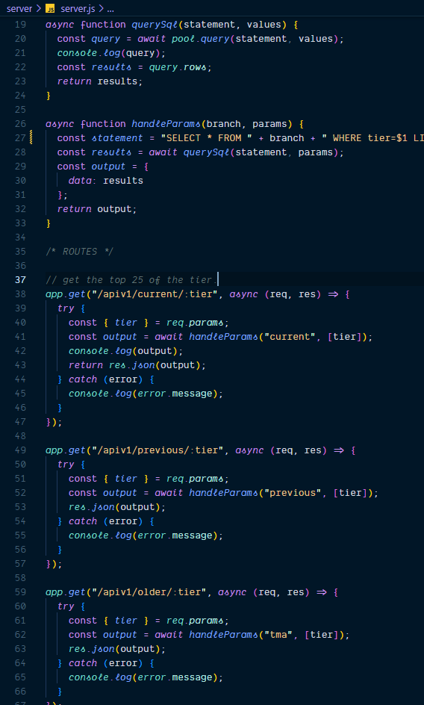
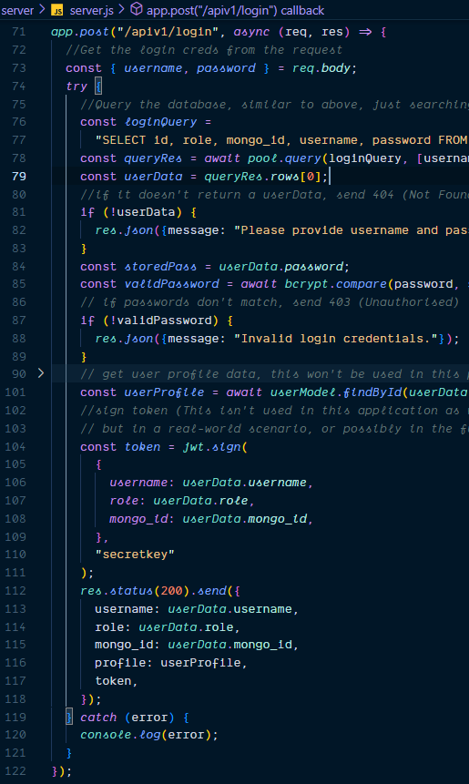
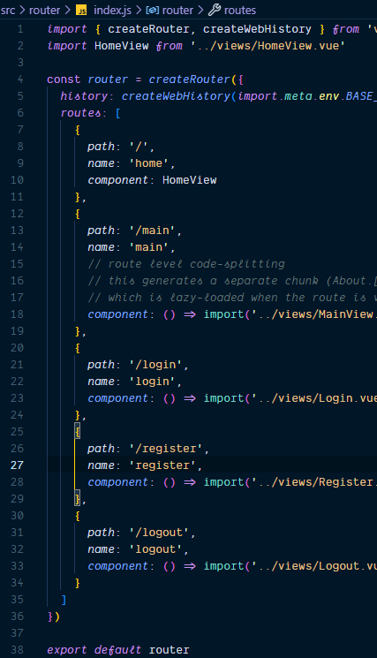
Figure 8: Express Routes (Left, Middle) and Vue Routes (Right)

Slide 14
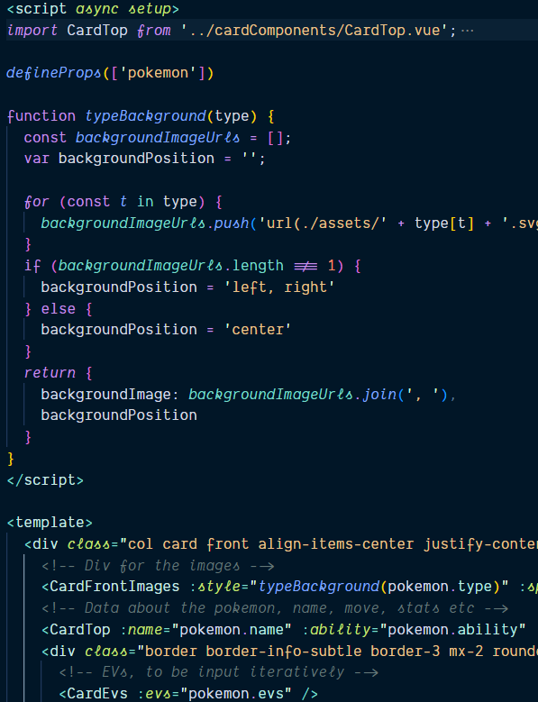
Implementation (cont)
The main page (/main) features the core component of the application, with the user team input form and output areas of the application.
VueRouter handles routes between the different pages in the application by creating aliases for the different views, special RouterLink tags function like anchor tags and allow router links to redirect to different views
Vue develops with components, which separate applications into re-usable parts.
A Vue component that contains many subcomponents are usually described as Views, while the parts of a View are described as Components
Props are used in Vue to pass data from a parent component to a child component
Figure 9: Example of Vue code within a Vue Component

Slide 15
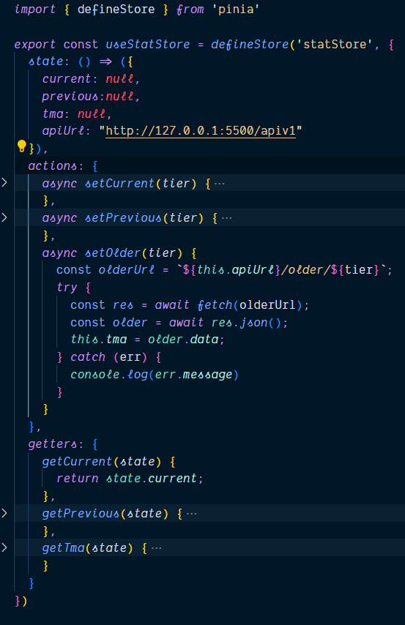
Implementation (cont)
Pinia stores are used to manage state control for submitted teams, and user login and authorization.
Stores update as changes are made through user interaction. By default stores do not persist after navigating away from the application or refreshing the page.
Stores interact with the API, depending on the desired functionality, and middleman front-end and back-end interactions
Figure 12: statStore, an example of a Pinia store

Slide 16
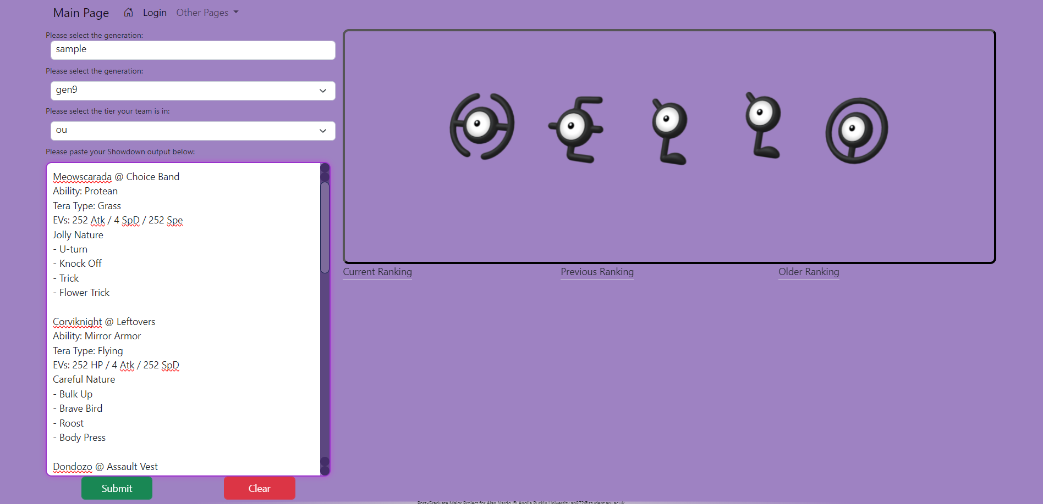
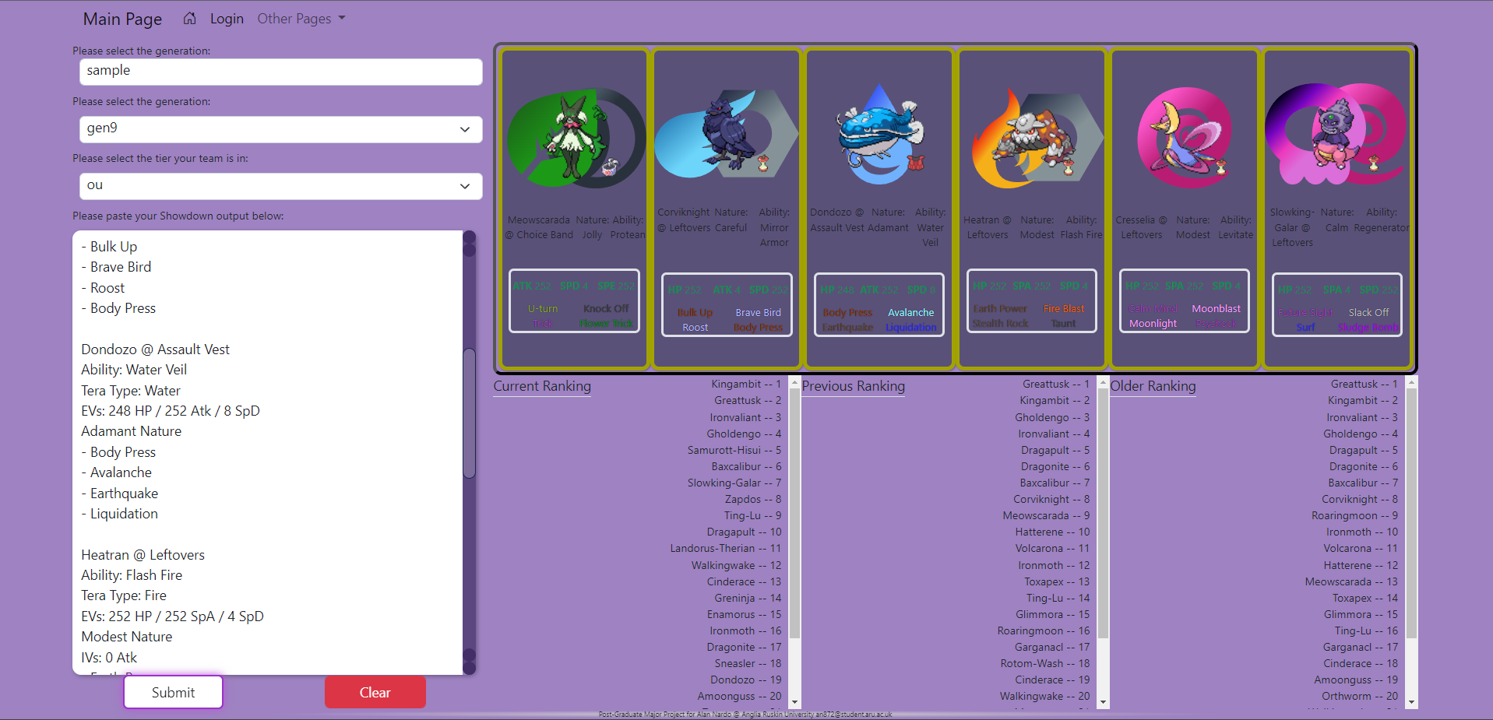
Figures 10 & 11: Application before (upper left) and after (lower right) form submission

Slide 17
Testing
Testing was done ad-hoc, as parts of the application were developed, by using sample data and console.log() outputs
Only Postman, an API testing application, was used to test the Express server for successful requests
Vitest is a testing suite designed specifically for Vite applications, and would have been used to conduct unit testing
There are also a number of Python testing libraries available to test the Python scripts in a more robust manner, for example Pytest

Slide 18
Conclusion
Aims and objectives met as described
Uses some basic cybersecurity measures to protect against attacks by parameterized queries and storing encrypted passwords, as opposed to plaintext
Future considerations:
Expanding user interface to include user profile
More analysis on team composition
Type matchup, checks & counter highlights within Pokémon ranking pane, etc
Using cookies to persist user sessions
Enable browsing of usage stats in table format
Speed up querying by bundling async requests to complete faster

Slide 19
Questions?

