Slide 1
Developing a Web Application with SQL and NoSQL Database Management Systems: An Exploratory Case Study
SID 2182389

Slide 2
Motivation
Interested in development of full stack applications
There are many frameworks and tech stacks to choose from
Familiarity with one framework can translate to others, in the same way familiarity with one programming can be used to learn others
In previous professional experience, systems were often married to a single database solution, rather than using them to compliment each other
Issues can arise with having to maintain two separate and different DBMS
Aims to explore development process of selecting, implementing and developing with a chosen technology stack

Slide 3
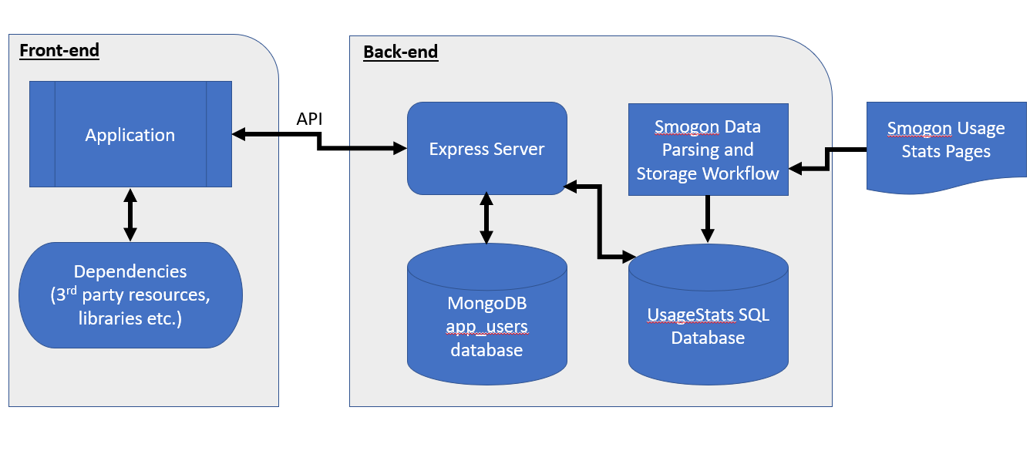
Aims and Objectives
Create a data pipeline that collects information from origin, parses and stores data locally
Store data in a PostgreSQL database
Enable user login and registration and store user profile data in a Mongo database
Enable a functional server to connect database systems to web application
Create a functional web application that accepts user inputs and returns data to the user
Figure 1: Application end-to-end workflow

Slide 4
User stories
As a user, I want to be able to post my team from Showdown and see the usage stats for the metagame I am playing in.
As a user, I want to able to login and/or register an account.
As a user, I want to be able to save my teams submitted.
As a user, I would like to be able to browse the usage stats data of various tiers.
As a developer, I want to create an intuitive and simple interface for users to navigate

Slide 5
Methodology
This project is an exploratory case study on the development of a web-based application using VueJS, MongoDB, Express, PostgreSQL and NodeJS.
By exploring end-to-end application development, this project aims to explore and understand best development practices, implementation of cyber security measures, API development and data storage in a potentially real-world application scenario.
This project also aims to understand the benefits of using SQL and NoSQL databases together to enable greater data storage and access flexibility.

Slide 6
Determining the Technology Stack
Back-end
Front-end
ExpressJS
CSS
NodeJS
VueJS 3
Python
BootStrap 5
PostgreSQL
MongoDB
Figure 2: Technology stack used

Slide 7
Front-end Decisions
Bootstrap reduces time spent styling and “painting” the interface by using pre-defined CSS classes
Some custom CSS still required
Vue is an easy-to-understand JavaScript framework that doesn’t require any knowledge of JavaScript flavours (such as JSX for React or TypeScript for Angular).
Vue separates its applications into components, which allows for clear separation of responsibility
A very lightweight yet robust framework

Slide 8
Vue vs React vs Angular
Vue sits between React and Angular, as the three most popular MVC JavaScript frameworks. React and Vue are both lightweight and utilize a virtual DOM, which reduces load times.
Vue uses hot module reloading (HMR) to quickly parse the DOM tree and only makes changes where changes are made, rather than reloading the entire DOM tree, as is the case in Angular
Vue has integrated support for routing, and has specifically designed state management and build tools for faster development.
Personal preference for the Vue development ecosystem over React or Angular; Angular uses TypeScript, which is similar to JavaScript, but not; React’s way of creating components feels less smooth compared to Vue

Slide 9
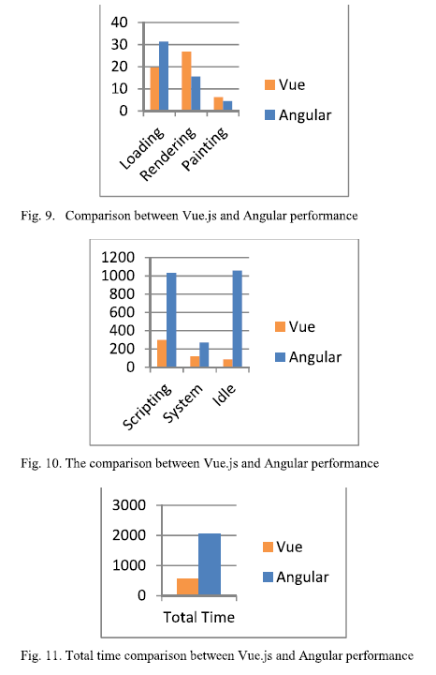
Figure 4: M-V-C Framework
Source: https://www.simplilearn.com/react-vs-angular-vs-vue-article
Figure 3: Vue vs Angular Comparisons
Source: Constantin et al (2021)
https://ieeexplore.ieee.org/abstract/document/9484150

Slide 10
Back-end decisions
PostgreSQL is ideal for storing relational data, such as the usage stats data. Further the data, once parsed and stored locally, is in CSV format, which are very similar to tables.
For data collection, Python was chosen for the language due to the authors previous experience as a data scientist using Python for data cleaning, storage and analysis.
MongoDB contains user profile data, which may vary greatly from one user to the next, the only required user fields are username and email in the MongoDB collection. As MongoDB allows for more flexible data storage, it is ideal for this scenario.
ExpressJS is a lightweight and easy-to-use server library, as well previous familiarity developing Express servers was a factor in deciding.
NodeJS serves as the JavaScript runtime environment for this project due to being widely used in industry and its flexibility for a variety of applications.

Slide 11
Implementation
All parts of the application (server, application, data pipeline and databases) are run locally
The commands `npm run dev` and `npm run start` start up the Vue application and Express server, respectively.
Connections to MongoDB and PostgreSQL servers for the Express server are carried out in the `mongo_db.js` and `sql_db.js` files.
A scheduled task runs on the 5th of each month to run the Python script which updates the database. If this were to migrate to a Linux environment, a chronjob would be used to perform this action.

Slide 12
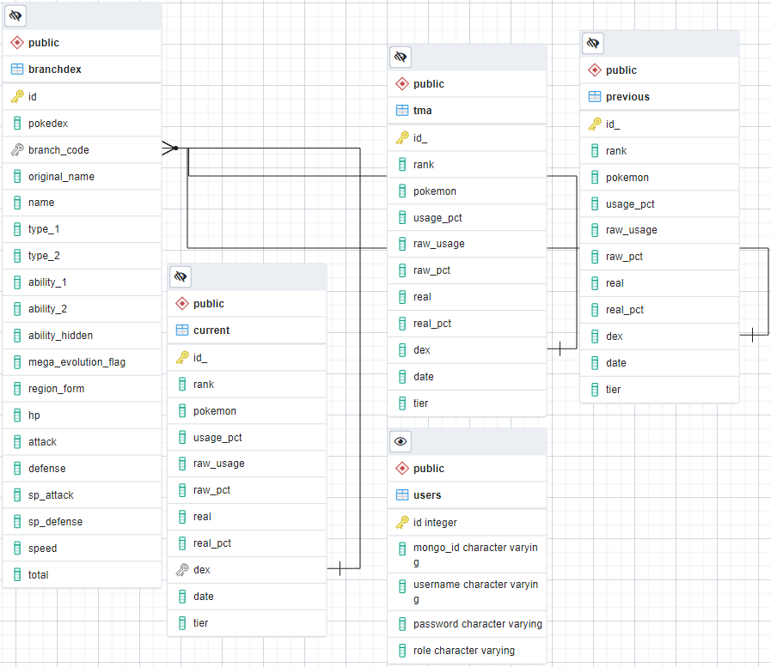
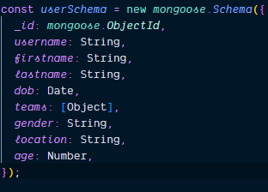
Figure 5: Mongo Database app_users.users collection schema (Left)
Figure 6: PostgreSQL DB Architecture (Right)

Slide 13
Implementation (cont)
The Vue application serves the landing page, featuring a brief explanation, a series of disclaimers and a short set of instructions to guide new users.
The main page (/main) features the core component of the application, with the user team input form and output areas of the application.
VueRouter handles routes between the different pages in the application by creating aliases for the different views, special RouterLink tags function like anchor tags and allow router links to redirect to different views

Slide 14
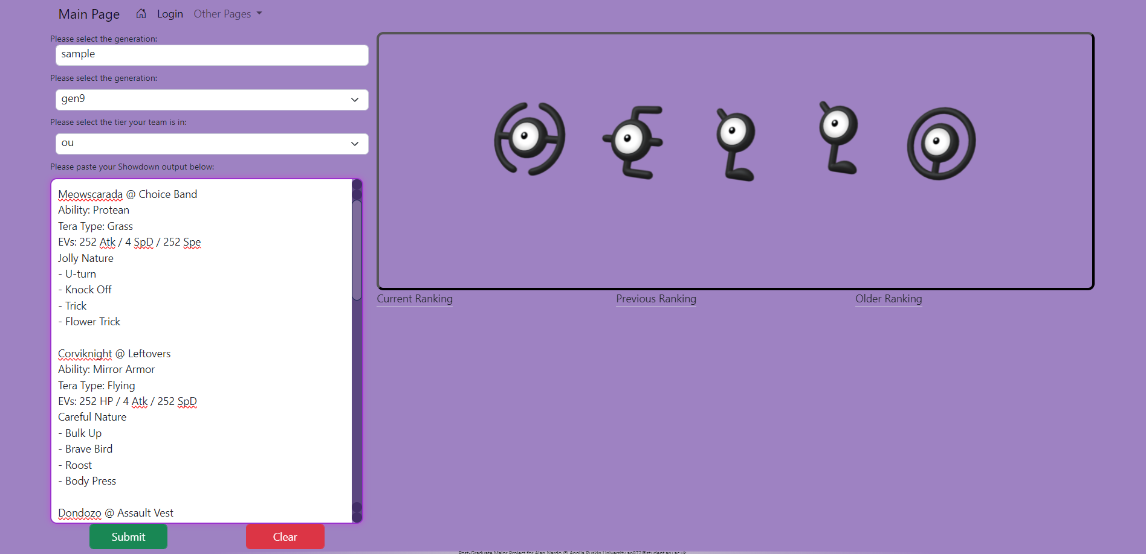
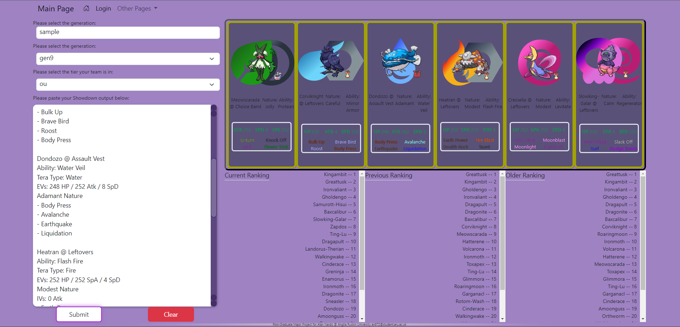

Slide 15
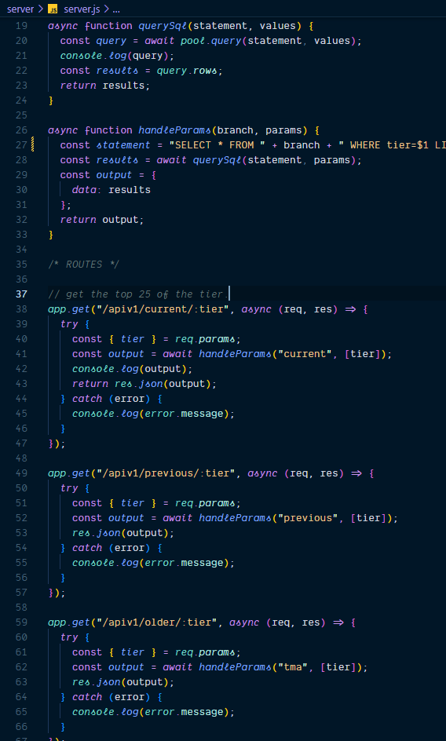
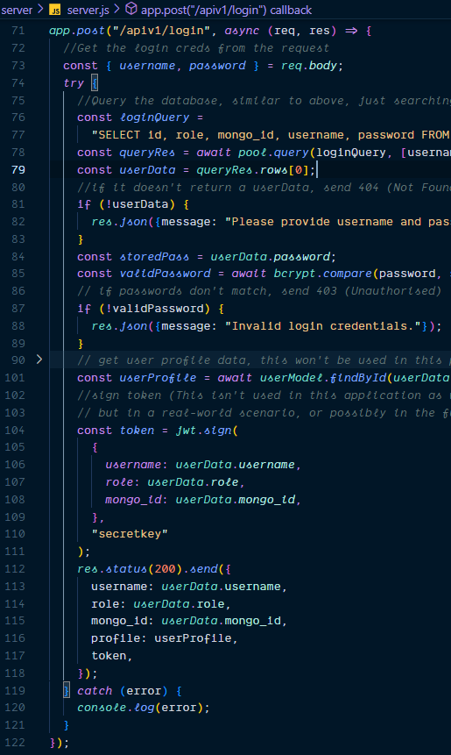
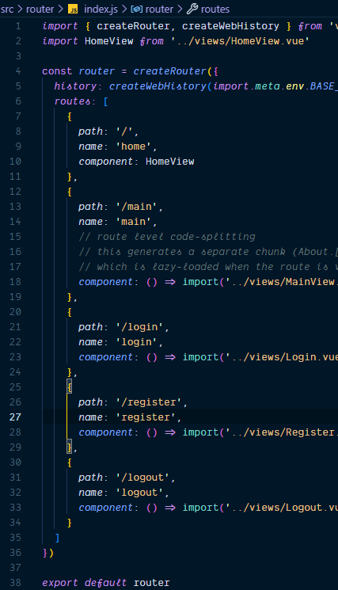
Figure 7: Express Routes (Left, Middle) and Vue Routes (Right)

Slide 16
Implementation (cont)
Pinia stores are used to manage state control for submitted teams, and user login and authorization.
Stores update as changes are made through user interaction. Due to lack of cookie implementation, stores do not persist after navigating away from the application or refreshing the page.
Future implementations would use cookies to have a smoother user experience.
Stores interact with the API, depending on the desired functionality, and middleman front-end and back-end interactions

Slide 17
Testing
Testing was done ad-hoc, as parts of the application were developed, by using sample data and console.log() outputs
Only Postman, an API testing application, was used to test the Express server for successful requests
Vitest is a testing suite designed specifically for Vite applications, and would have been used to conduct unit testing

Slide 18
Conclusion
Aims and objectives met as described
Uses some basic cybersecurity measures to protect against attacks by parameterized queries and storing encrypted passwords, as opposed to plaintext
Future considerations:
Expanding user interface to include user profile
More analysis on team composition
Using cookies to persist user sessions

Slide 19
Questions?

