Slide 1
Customer Segmentation
What do customers look like?

Slide 2



RFM Analysis
Customer segmentation technique
Divide customers into segments based on past purchase
Variables
Recency (R) | Time since last purchase
Frequency (F) | Total number of purchases
Monetary Value (M) | Total monetary value

Slide 3
RFM Analysis
Scoring | Days (days since last purchase) | Number of Customers | Frequency (number of Invoice No) | Number of Customers | Monetary (Sum of Ext-Price) | Number of Customers
5 | 0 - 151 | 867 | 7084 - 8854 | 827 | 794151 - 992688.5 | 829
4 | 152 - 302 | 793 | 5314 - 7083 | 822 | 595613.5 - 794151.0 | 829
3 | 303 - 454 | 835 | 3543 - 5313 | 833 | 397076.0 - 595613.5 | 829
2 | 456 - 605 | 833 | 1172 - 3542 | 773 | 198538.5 - 397076.0 | 829
1 | 606 - 756 | 818 | 1 - 1172 | 891 | 1.0 -198538.5 | 830
Notes:
We use QUINTILES to make five equal parts based on available values and assign each part a score from 1-5.

Slide 4
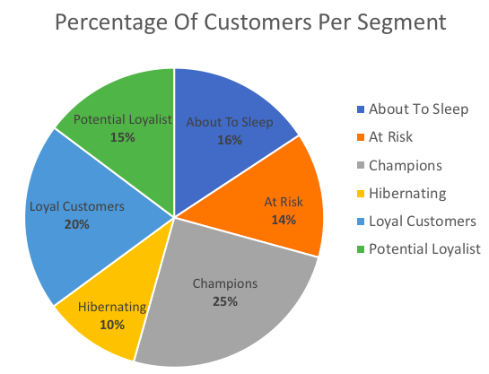
RFM Analysis
Segment | Recency Score | AVG Frequency & Monetary Score
Champions | 4-5 | 4-5
Loyal Customers | 3-5 | 3-5
Potential Loyalist | 3-5 | 1-3
About to Sleep | 2-3 | 0-3
At Risk | 0-2 | 2-5
Hibernating | 1-2 | 1-2
Notes:
Combining F and M into one makes sense because both are related to how much the customer is buying.
The customer is equally important in both cases. And our approach of combining frequency and monetary scores gives them equal importance in our RFM analysis.
R gives us quick peek into re-engagement levels with customer.

Slide 5
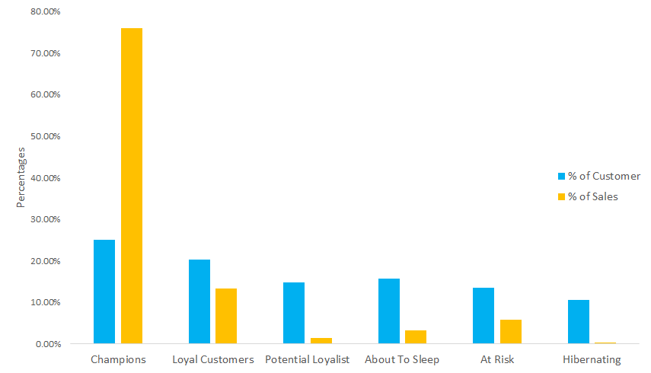
Sales by Segment

Slide 6




Champions
General Look:
R-Score: 4-5 / Average F&M Score: 4-5
Customers share: 25% (highest)
Revenue share: 76.02% (highest)
Recently made a purchase & Buy often & Spend the most
Region: central (30%), north (52%), south (6%), west (12%)
Suggestion:
Give rewards
Build credibility
Promote New Products
Notes:
Champions: They are your best customers. These customers recently made a purchase, buy often and spend the most.
Suggestion:
✔ Give rewards: Gift them one of your popular products. This will instigate more purchase orders from these customers in the future.
✔ Build credibility: Showcase these customers wherever you can - may it be on reviews page with testimonials or social media. They will help promote your brand further.
✔ Promote New Products:Since Champions are frequent buyers, your new products will always be on their radar. Notify them with attractive newsletters regularly.

Slide 7


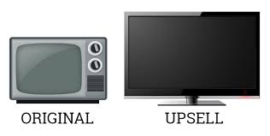

Loyal Customers
General Look:
R-Score: 3-5 / Average F&M Score: 3-5
Customers share: 20%
Revenue share: 13.25%
Spend good amount of money & Buy often
Region: central (54%), north (21%), south (6%), west (19%)
Suggestion:
Take feedbacks and surveys
Upsell your products
Present Bonuses
Notes:
Loyal customers: This category of customers may not have purchased very recently but they surely buy often and spend good amount of money.
Suggestion:
✔ Take feedbacks and surveys: Ask for feedback from these customers regularly to understand if they are satisfied with your products or not. This will help you learn what they expect in future. ✔ Upsell your products: Studies have proved that repeat customers spend more on next purchase! Hence, you can up-sell your products to them to gain extra profits. ✔ Present Bonuses: Providing some bonus to loyal customers initiates more future purchase. For example, providing a free shipping for a limited period can be one of the bonuses.

Slide 8




Potential Loyalist
General Look:
R-Score: 3-5 / Average F&M Score: 1-3
Customers share: 15%
Revenue share: 1.47%
Recent customers & Spend good amount of money & Buy irregularly
Region: central (56%), north (20%), south (12%), west (12%)
Suggestion:
Offer loyalty program
Run contests
Make them feel special
Notes:
Potential Loyalist: Though don’t buy on regular basis, they are recent buyers and spend a good amount on product purchases.
Suggestion:
✔ Offer loyalty program: Present them a loyalty program or maybe an elite club membership so as to not lose them. ✔ Run contests: Keep these customers in loop by running contests having attractive prices. ✔ Make them feel special: Connect with these customers by wishing them on their birthdays, anniversaries etc.

Slide 9




About To Sleep
General Look:
R-Score: 2-3 / Average F&M Score: 0-3
Customers share: 16%
Revenue share: 3.30%
Recency, frequency & monetary values are below the average
Region: central (10%), north (2%), south (29%), west (59%)
Suggestion:
Share valuable resource
Give your competitor analysis
Give relevant updates
Notes:
About To Sleep: This type of customers did shop for your products but not very recently. Also, they don’t purchase often and also don’t spend more.
Suggestion:
✔ Share valuable resource: Let them know how your products are beneficial to customers or give some useful links. ✔ Give your competitor analysis: Let your customers know how your products are way better than your competitors’. ✔ Give relevant updates: Provide them with some educational content relevant to your products.

Slide 10




At Risk
General Look:
R-Score: 0-2 / Average F&M Score: 2-5
Customers share: 14%
Revenue share: 5.73%
Used to spend large amount of money & purchased often
Region: central (13%), north (7%), south (65%), west (15%)
Suggestion:
Offer Credit
Provide a wishlist
Upgrade offers
Notes:
At Risk: These customers bought your products frequently, purchased good amount. But haven’t made any purchase since a long time. Need to bring them back!
Suggestion:
✔ Offer Credit: Give them some credit amount on their purchase. Such offers make offers tangible and customers feel it is worthwhile. ✔ Provide a wishlist: Such customers do add products to their wishlist and keep tracking for the offers on those products. Organize a sale as per their wishlist once in a while. ✔ Upgrade offers: Every customer likes free upgrades. It is the best way to retain these customers

Slide 11




Hibernating
General Look:
R-Score: 1-2 / Average F&M Score: 1-2
Customers share: 10% (lowest)
Revenue share: 0.23% (lowest)
Last purchase was long time ago & low amount of money and orders
Region: central (15%), north (4%), south (72%), west (9%)
Suggestion:
Decide if you want them back
Review your product
Send personalized campaign
Notes:
Hibernating: Last purchase was long back, low spenders and low number of orders
Suggestion:
✔ Decide if you want them back: If the customer was difficult to work with then it's always better to let them go. The last best thing you can do it to make sure your customers have a great experience before leaving. ✔ Review your product: Most customers may leave because they are not satisfied with the product. Check out the reviews on various sites to understand the real reason. ✔ Send personalized campaign: Show that you are concerned for them and plan some offers with personalised coupon codes.

Slide 12
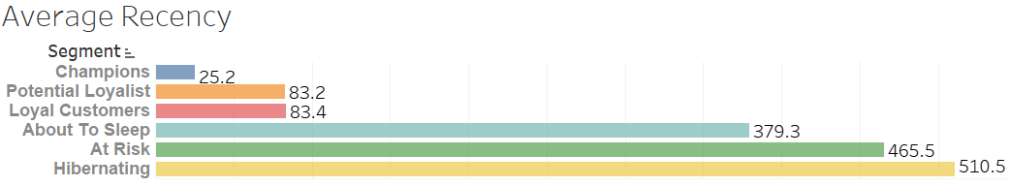
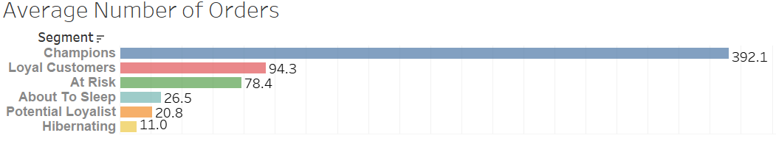
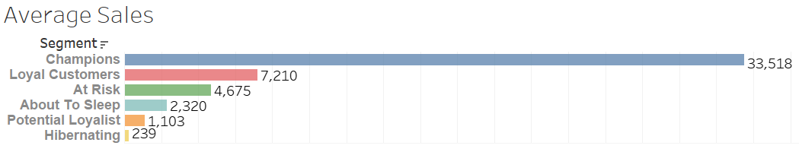
Average RFM Per Segment

Slide 13
Product Segmentation
What do products look like?

Slide 14
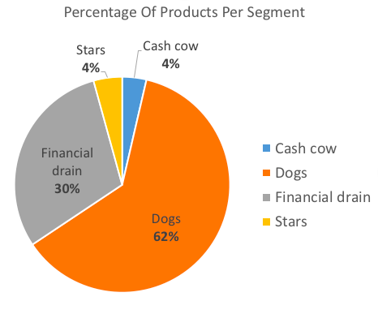
ABC Analysis
Inventory categorization method
Divide items into three classes (A / B / C)
Class | Product Segment
A | Cash Cow
B | Stars
C | Dogs
 | Financial Drain
Notes:
A = most valuable items C = least valuable ones

Slide 15
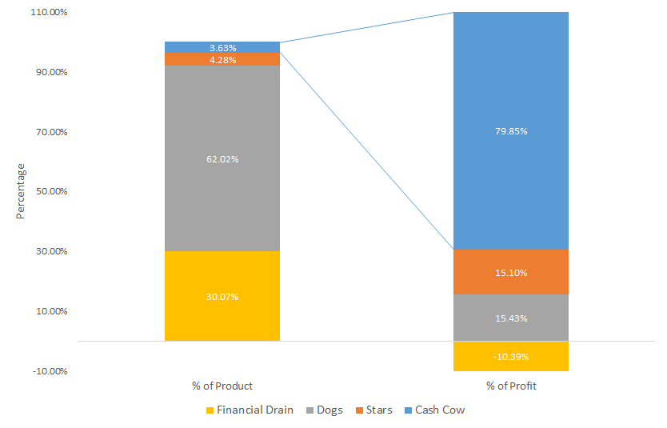
Profit by Segment

Slide 16
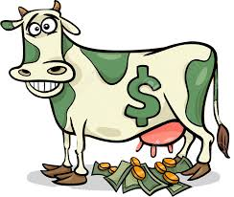
Cash Cow
General Look:
Product share: 3.63% (lowest)
Profit share: 79.85% (highest)
Top 3 categories: Washer (59%), Bolt(18%), Nut (14%)
Suggestion:
Tight inventory control
Frequent reorder
Avoid stock-outs
Notes:
Tight inventory control, more secured storage areas and better sales forecasts
Reorders should be frequent, with weekly or even daily reorder
Avoiding stock-outs on cash cows is a priority

Slide 17

Stars
General Look:
Product share: 4.28%
Profit share: 15.10%
Top 3 categories: Washer (38%), Nut (29%), Bolt (20%)
Suggestion:
Monitor the potential evolution
Include a safety stock level
Notes:
An important aspect of class B is the monitoring of potential evolution toward class A or, in the contrary, toward the class C
You might consider ordering more stock to include a safety stock level. This will reduce delivery costs, ordering time and the amount of time dealing with stock.

Slide 18

Dogs
General Look:
Product share: 62.02%
Profit share: 15.43%
Top 3 categories: Screw (35%), Studs (24%), Nut (21%)
Suggestion:
Less frequent reorder
Avoid allocating too many resources
Develop effective marcom strategies
Notes:
Develop effective marcom strategies:
Brand alignment: Whatever marketing channel you choose should have the same brand perception as yours
Customer alignment: Pick channels where your consumers are already active
Budget alignment: Choose a marketing channel that fits your budget

Slide 19
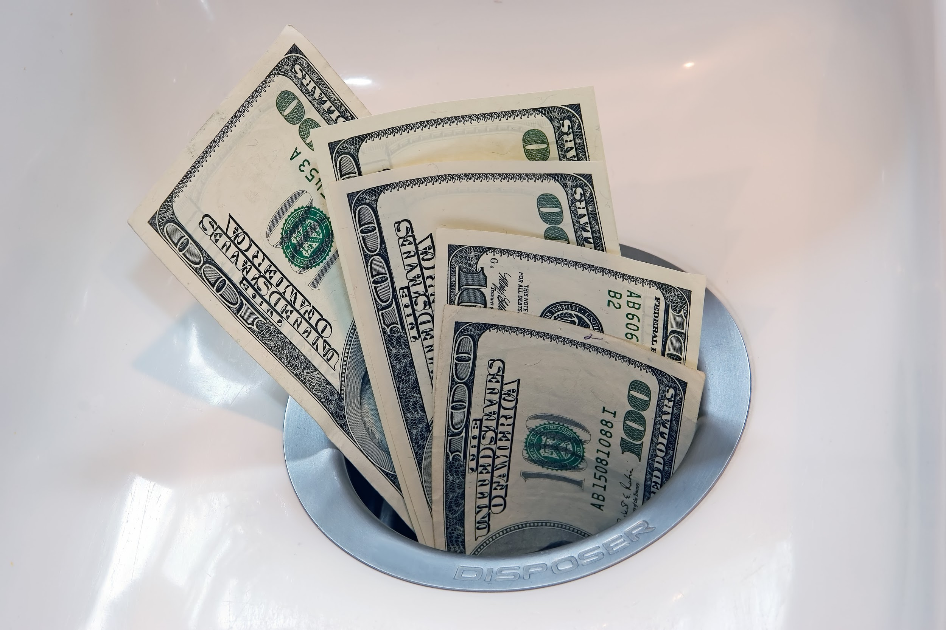
Financial Drain
General Look:
Product share: 30.07%
Profit share: -10.39% (Negative)
Top 3 categories: Screw (30%), Bolt (30%), Washer (29%)
Suggestion:
Decide if you need these products
Make-to-order
Analyze reasons for loss
Notes:
Reasons:
Revenue Declines: declining sales; poor pricing of a product; poor marketing; increased competition
Cost Increases: raw material cost increases; labor cost increases

Slide 20
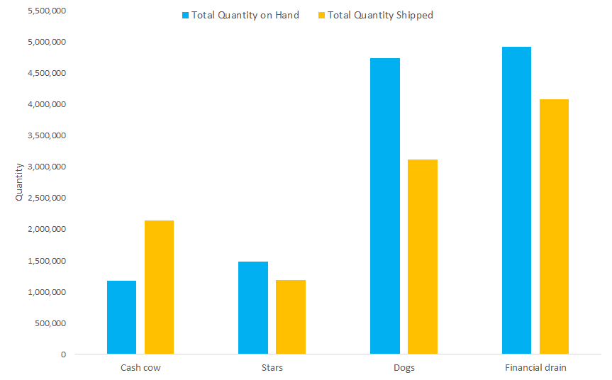
Inventory Control

