Slide 1
Customer Scoring System
Identify the performance/risk for each customer

Slide 2
Agenda
Components of Scoring System
Example and story
Customer Health & Recommendation

Slide 3

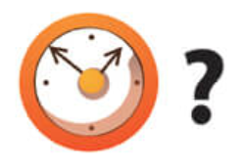
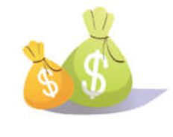
Component of Scoring System
25%
25%
25%
12.5%
12.5%
Recency
Monetary
GM %
Frequency
IPT
Churn
Value
Profit
Lifetime
Notes:
Our customer scoring system is composed of 5 metrics...
Each metrics will be assigned a score from 1-5, and the customer will get a final weighted average score.
From the 5 metrics, three metrics will represent 25% of the weighted average score and the remaining two will represent 12.5%
Meaning of each metric:
Recency implies whether a customer has left;
Monetary measures the value a customer bring to the firm;
GM% indicates if a customer is profitable or not;
Frequency and IPT together tell a customer’s purchase habit in the lifetime.

Slide 4
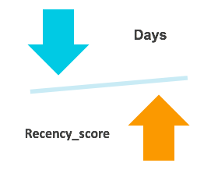
Scoring System_Recency
How many days since last purchase
Recency_score | Days
5 | <= 13
4 | 14 - 23
3 | 24 - 70
2 | 70 - 110
1 | >= 111
Notes:
Definition of Recency
For each metrics, a different range is given for the scoring system
Negative relationship between the days and recency_score

Slide 5
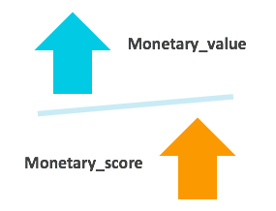
Scoring System_Monetary
Money value spent by customers
Monetary_score | Monetary_value
5 | >= 7110
4 | 3014 - 7110
3 | 1443 - 3014
2 | 543 - 1443
1 | <= 543
Notes:
Positive relationship

Slide 6
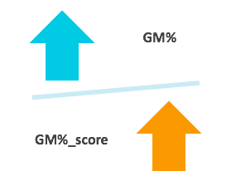
Scoring System_GM%
Gross Profit Margin (GM)
(Revenue- Cost of goods sold) / Revenue *100%
GM%_score | GM%
5 | >= 22%
4 | 13% - 22%
3 | 7% - 13%
2 | 1% - 7%
1 | <= 1%

Slide 7
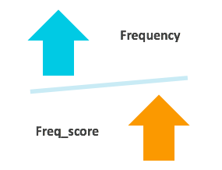
Scoring System_Frequency
How many times dealt with our store
Freq_score | Frequency
5 | >=59
4 | 30-58
3 | 17-29
2 | 8-16
1 | <=7

Slide 8
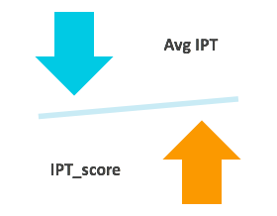
Scoring System_IPT
Average of the days between two orders for each customer
IPT_score | Avg Days
5 | <= 4
4 | 4 - 7
3 | 7 - 11.5
2 | 11.5 - 22.5
1 | >= 22.5
Notes:
add uint

Slide 9


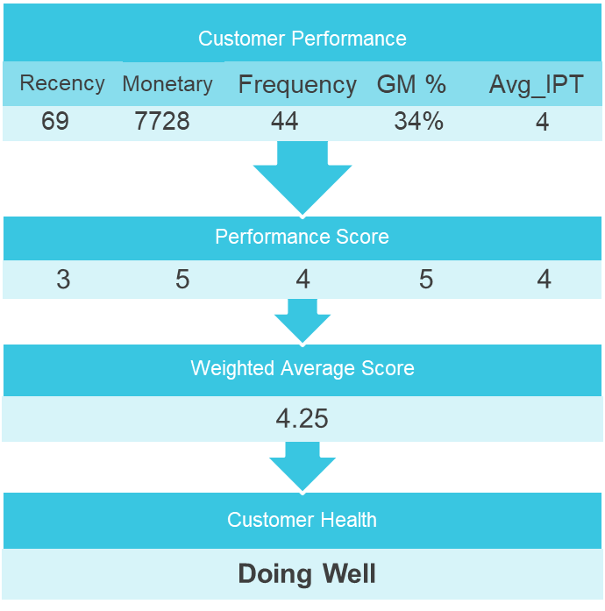
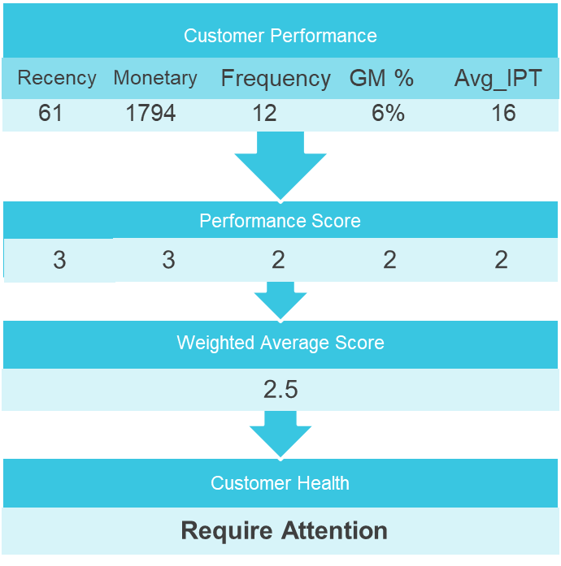



Example and Story
Notes:
Here are two customers from the same segment…
There are Recent Customer.

Slide 10
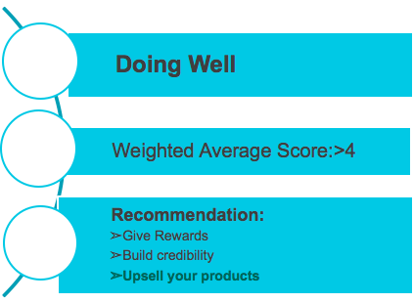
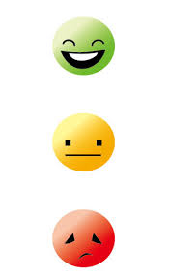

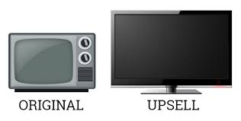



Customer Health
Notes:
Recommendation:
✔ Give rewards: Gift them one of your popular products. This will instigate more purchase orders from these customers in the future.
✔ Build credibility: Showcase these customers wherever you can - may it be on reviews page with testimonials or social media. They will help promote your brand further.
✔ Upsell your products: Studies have proved that repeat customers spend more on next purchase! Hence, you can up-sell
your products to them to gain extra profits.

Slide 11
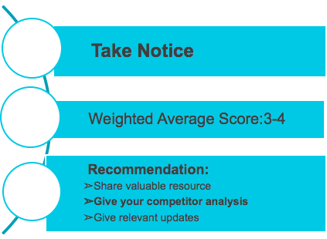





Customer Health
Notes:
Recommendation:
✔ Share valuable resource: Let them know how your products are beneficial to customers or give some useful links. ✔ Give your competitor analysis: Let your customers know how your products are way better than your competitors’. ✔ Give relevant updates: Provide them with some educational content relevant to your products.

Slide 12
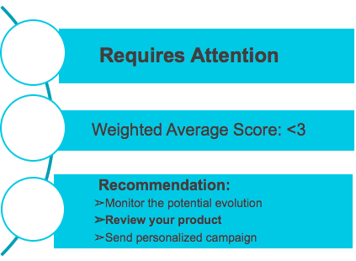

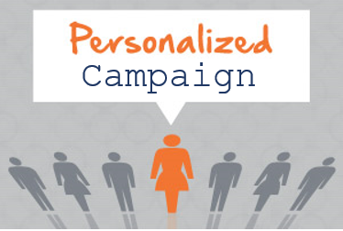



Customer Health
Notes:
Recommendation:
✔ Monitor the potential evolution: to monitor if they become better or worse. ✔ Review your product: Most customers may leave because they are not satisfied with the product. Check out the reviews on various sites to understand the real reason. ✔ Send personalized campaign: Show that you are concerned for them and plan some offers with personalised coupon codes.

Slide 13
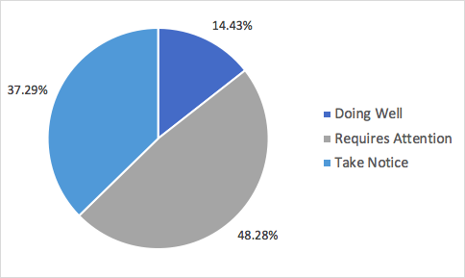
Customer Health
Notes:
related with financial metrics

