Slide 1


SecureML: A System for Scalable Privacy-Preserving Machine Learning
Payman Mohassel and Yupeng Zhang

Slide 2
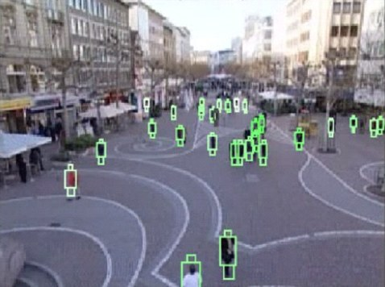

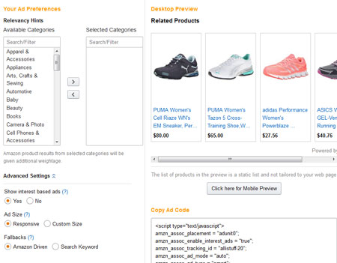

Machine Learning
Image processing
Speech recognition
Ad recommendation
Playing Go
More data → Better Models

Slide 3

Machine Learning
Data Privacy?
Image processing
Speech recognition
Ad recommendation
Playing Go
More data → Better Models

Slide 4




Example: Fraud Detection
Card # | Time | Location | Amout
xxxxxxxx | 8/8/2016 | CA, USA | xx.xx
……
Name | SSN
Alice | xxxxx
……
Alice | xxxxx
…..
Products
xxx
……
xxxxxxxx | x/xx/xxxx | xx,xxx | xx.xx
……

Slide 5
Privacy-preserving Machine Learning
Decision trees [LP00, …]
k-means clustering [JW05, BO07, …]
SVM classification [YVJ06, VYJ08, …]
Linear regression [DA01, DHC04, SKLR04, NWI⁺13, GSB⁺16, GLL⁺16, …]
Logistic regression [SNT07, WTK⁺13, AHTW16, …]
Neural networks [SS15, GDL⁺16, …]
……

Slide 6


Two-server Model
user
data
=
+
server
server
two party computation
model
More efficient than MPC and FHE
Users can be offline during the training
Used in many prior work [NWI⁺13, NIW⁺13, GSB⁺16, …]

Slide 7
Our Contributions
New protocols for linear regression, logistic regression and neural networks training
Secret sharing and arithmetic with precomputed triplets + Garbled circuit
System:
54 – 1270× faster than prior work
Scale to large datasets (1 million records, 5000 features for logistic regression)

Slide 8
Linear Regression

Slide 9
Linear Regression
y
Stochastic Gradient Decent (SGD):
x
w
Initialize w randomly
Select a random sample (x, y)
Update
Input: data value pairs (x, y)s
Output: model w

Slide 10
Secret Sharing
server
server
a
a₀ = a-r mod p
a₁ = r mod p

Slide 11
Secret Sharing and Addition
server
server
a₀
a₁
+
+
b₀
b₁
=
=
c₀
c₁
c₀ + c₁ = a + b

Slide 12
Secret Sharing and Multiplication Triplets
server
server
a₀ - u₀ , b₀ - v₀
a₀
a₁
e = a - u
f = b - v
e = a - u
f = b - v
a₁ – u₁ , b₁ – v₁
b₀
b₁
c₀= - ef + a₀ f + eb₀ + z₀
c₁= a₁ f + eb₁ + z₁
c₀ + c₁ = a × b
u₀ , v₀ , z₀
u₁ , v₁ , z₁
(u₀ + u₁) × (v₀ + v₁)= (z₀ + z₁)

Slide 13
Privacy-preserving Linear Regression
SGD:
Users secret share data and values (x,y)
Servers initialize and secret share the model w
Run SGD using pre-computed multiplication triplets
Decimal number?

Slide 14
Decimal Multiplications in Integer Fields
a
.
b
.
16 bits
16 bits
×
c
.
32 bits
Truncation:
c
.
Same as integer multiplication
Decimal part grows → overflow
16 bits
fixed-point multiplication

Slide 15
Truncation on shared values
a₀
.
a₁
.
b₀
.
b₁
.
×
c₀
.
c₁
.
Truncation:
c₀
.
c₁
.
c
.
+1, +0 or -1 on the last bit, with high probability

Slide 16
Privacy-preserving Linear Regression
SGD:
Users secret share data and values (x,y)
Servers initialize and secret share the model w
Run SGD using pre-computed multiplication triplets
Truncate the shares after every multiplication

Slide 17
Effects of Our Technique
4-8× faster than fix-point multiplication garbled circuit

Slide 18
Logistic Regression

Slide 19
Logistic Regression
x
Input: data value pairs (x, y)s y=0 or 1
Output: model w

Slide 20
Privacy-preserving Logistic Regression
Logistic function
degree 10 polynomial
degree 2 polynomial

Slide 21
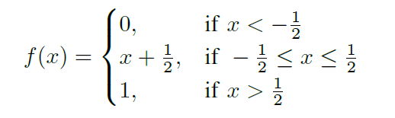
Privacy-preserving Logistic Regression
Logistic function
Our function
Almost the same accuracy as logistic function
Much faster than polynomial approximation
Secure-computation-friendly activation function

Slide 22
Privacy-preserving Logistic Regression
Logistic function
Our function
Run our protocol for linear regression
Switch to garbled circuit for f [DSZ15]
Switch back to arithmetic secret sharing

Slide 23
Vectorization
Mini-batch SGD:
Take a batch of B records and update w by their average
Converge faster and smoother
Fast matrix-vector/matrix-matrix multiplication

Slide 24
Vectorization
Mini-batch SGD:
Multiplication triplets for matrix-vector/matrix multiplications
2× online computational overhead compared to plaintext training
4-66× offline speedup

Slide 25
Neural Networks

Slide 26
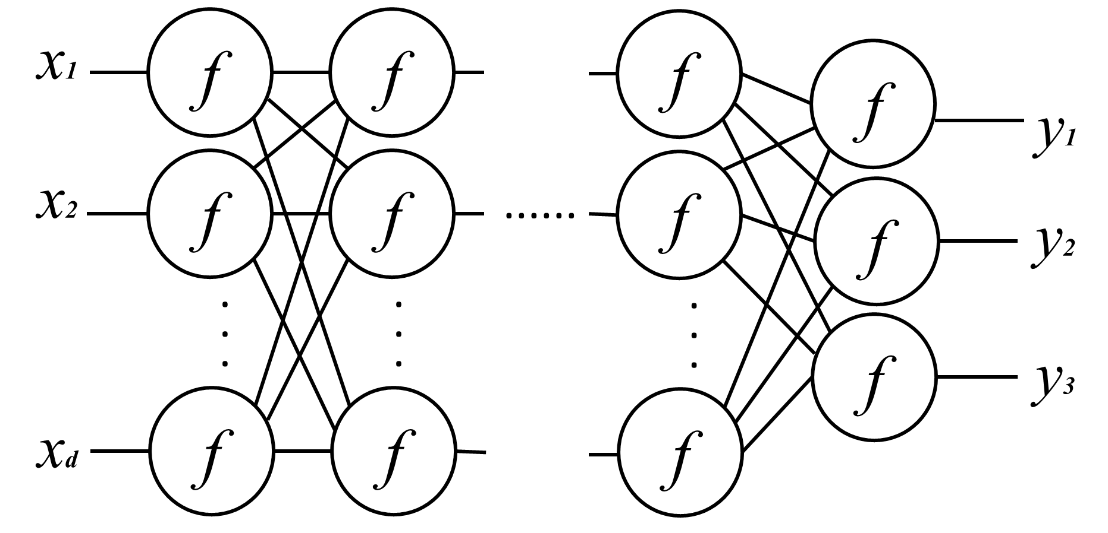
Neural Networks
Mini-batch SGD: coefficient matrices are updated by close-form formulas using matrix/element-wise multiplications

Slide 27
Experimental Results

Slide 28
Experiments Results: Linear Regression
100,000 records, 500 features
LAN: 1.2GB/s, delay 0.17ms
WAN: 9MB/s, delay 72ms
offline
8782
10,000
online
1000
378
465
time(s)
141
100
20
20
10
4.9
1.4
1
Client-aided triplets
Client-aided triplets
54 - 1270× faster than systems in [NWI⁺13, GSB⁺16]
Support arbitrary partitioning of data

Slide 29
Experiments Results: Logistic Regression
100,000 records, 500 features
LAN: 1.2GB/s, delay 0.17ms
WAN: 9MB/s, delay 72ms
offline
8782
10,000
online
1000
652
378
422
time(s)
100
20
11.5
20
9.6
10
1
Client-aided triplets
Client-aided triplets
Scale to 1 million records and 5,000 features

Slide 30
Experiments: Neural Networks
2 hidden layers with 128 neurons each
LAN: 25,200 sec online + offline
Plaintext training: 700 sec. 35× overhead.
WAN: 220,000* sec online + offline

Slide 31
Summary
Privacy-preserving linear, logistic regression and neural networks
Decimal arithmetic on integer field
Secure-computation-friendly activation functions
Vectorization (mini-batch SGD)
System:
Orders of magnitude faster than prior work
Scale to large datasets

Slide 32
Future Work
Privacy-preserving Neural Networks
Accuracy: softmax, convolutional neural networks, etc.
Efficiency: partitioning, parallelization etc.
Multi-party model
Thank you!!!
Q&A

Slide 33
Large Scale Logistic Regression
1,000,000 records, 5,000 features
LAN: 2,500 sec client-aided offline, 623.5 sec online

Slide 34
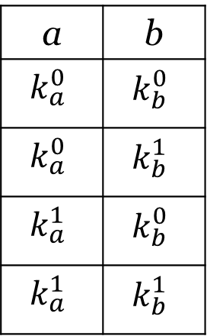
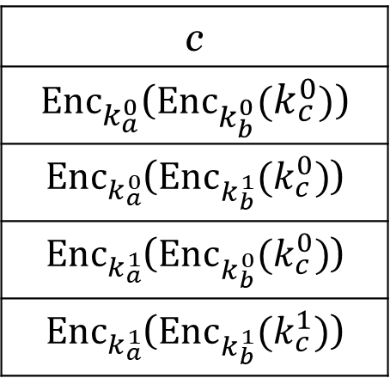
Garbled Circuits
a
AND
c
b
Truth Table
Garbled Table
a | b | c
0 | 0 | 0
0 | 1 | 0
1 | 0 | 0
1 | 1 | 1
a | b
$$k_{a}^{0}$$ | $$k_{b}^{0}$$
$$k_{a}^{0}$$ | $$k_{b}^{1}$$
$$k_{a}^{1}$$ | $$k_{b}^{0}$$
$$k_{a}^{1}$$ | $$k_{b}^{1}$$
c
${Enc}_{k_{a}^{0}}$(${Enc}_{k_{b}^{0}}(k_{c}^{0})$)
${Enc}_{k_{a}^{0}}$(${Enc}_{k_{b}^{1}}(k_{c}^{0})$)
${Enc}_{k_{a}^{1}}$(${Enc}_{k_{b}^{0}}(k_{c}^{0})$)
${Enc}_{k_{a}^{1}}$(${Enc}_{k_{b}^{1}}(k_{c}^{1})$)

Slide 35
Garbled Circuits
server o
server 1
k_{b}
b₀ +b₁=b
k₀ , k₁
b₁
b₀

Slide 36
Switching Between Secret Sharing and GC
server 0
server 1
f(x) = x × (x>0)
x₀
x₁
Garbled circuit C
k_{b}
b₀ +b₁=b
k₀ , k₁
b₁
b₀
OT(b₁)
m₀ = x₀ b₀+r
m₁ = x₀ (1-b₀)+r
- r’
m = x₀ b+r
OT(b₀)
m₀ = x₁ b₁+r’
m₁ = x₁ (1-b₁)+r’
- r
m = x₁ b+r’
C(x₀ , x₁): modulo addition circuit, then output the most significant bit

