Slide 1
View Benefit Information
User Research Report
Transport Scotland, Edinburgh
19 September 2019
V0.1
Kelly Blanchflower, Collett Bellamy, Stu Bamforth and Matt Blackwell

Slide 2
Research - Who did we talk to?
Transport Scotland
Robert Wyllie - Accessibility Policy Officer
City of Edinburgh Council
Christine Stevens, Manager of Blue Badge Team
Lucy Hart, Blue Badge Processor
West Dunbartonshire Council
Liz, Manager of Blue Badge Team
Highland Council
Rona McDonald, Manager of Customer Services
Kelly McKay, Customer Services

Slide 3
UR Approach:
Three sessions with the following Local Authorities:
City of Edinburgh Council
West Dunbartonshire Council
Highland Council
Workshop approach – initial Q&A followed by a demonstration of prototype screens to test hypotheses with accompanying questions.
Update on current project situation and explanation of session objectives.
V4 of the prototype was demonstrated.

Slide 4
Hypotheses tested
If we display details of previous awards and the status of the current award
Then this information can be used to help ‘paint a picture’ of the applicants circumstances
If we display that the citizen has a transitional protection from higher rate DLA to PIP
Then this information can be used to ensure the citizen has an automatic Blue Badge awarded
If we display details of the previous awards
Then this information can be used so the Blue Badge decision makers aware that the citizen has a transitional protection from higher rate DLA to PIP
If we display the full PIP award details including the Daily Living Component
Then this information can be used to help Blue Badge decision makers with discretionary awards

Slide 5
Key findings
In general the process is exactly as per English LA’s – the only differences being auto awards are given for citizens with transitional protections and awards that are under appeal
Even though higher rate DLA to PIP transitional protections are a unique Scottish criteria not all the councils were aware of them!
Transitional protections can be displayed with one additional row of content on the summary page – no need to overload the user with details of several previous awards
This service will have a big impact in parts of Scotland such as the Highlands & Islands due to the geographical challenges they deal with

Slide 6
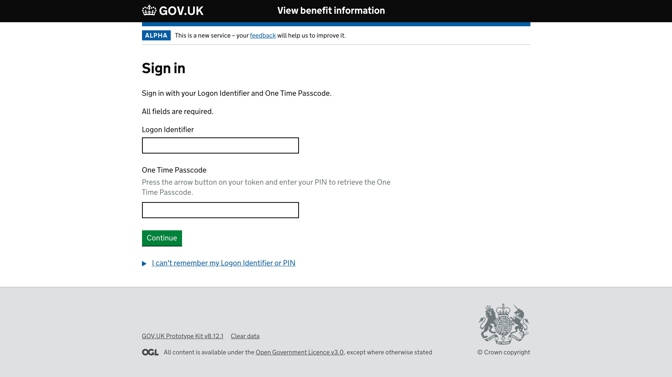
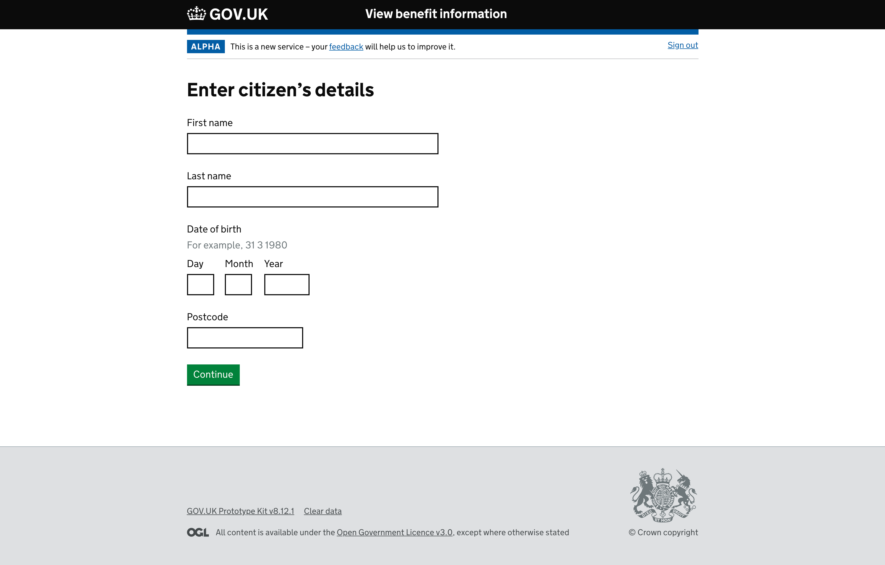
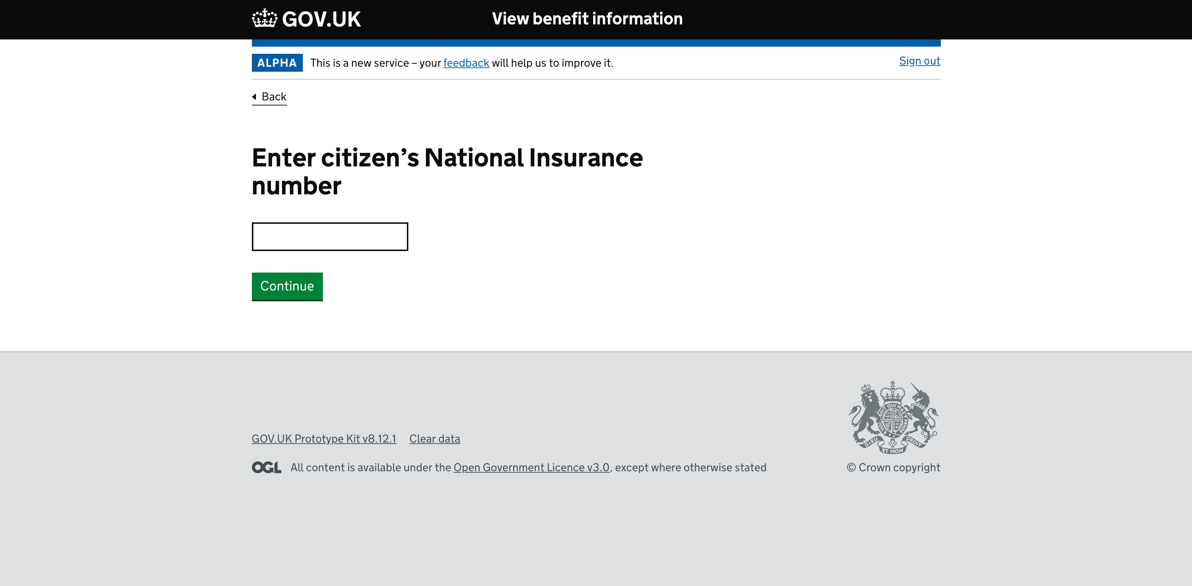
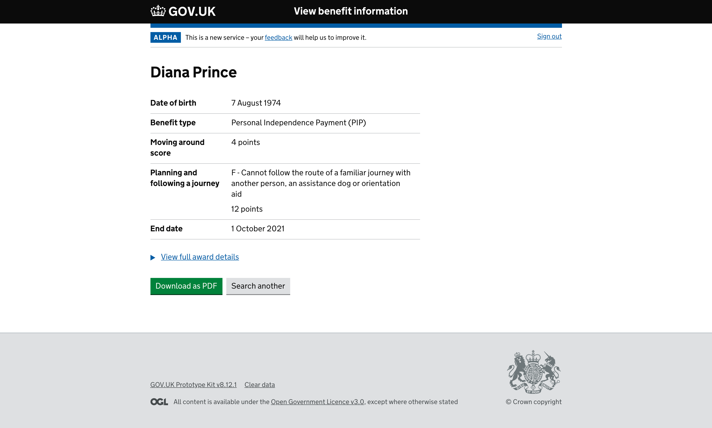
Prototype screens demo

Slide 7
User Interface – What they like/need
Tabs were preferred to View full award’ details links on PIP awards
Transitional protection displayed as an additional row on the summary page was preferred to full details of all previous awards
PIP Daily Living, DLA Care Component and AA are all useful for discretionary awards
PIP Auto Awards – Points and End Date are all that matters
Award status would be useful
DS1500 – they like to know this and fast track these awards
Search another button – seen and understood
PDF would be helpful

Slide 8
User Interface – Areas for improvement
Disambiguator questions could cause issues in current format. Whilst they are almost always provided with a phone number they often don’t have an email address and they are often not the citizens i.e. relative
Phone number disambiguator is too generic – Is it mobile or landline? Which would we be prefer? Which will we have?
Disambiguator questions currenty offer no otion to skip if answer not known
Clearer content required on ‘Unable to find benefit information’ page

Slide 9
Quotes relating to the Prototype
“Just what I expected”
“How soon can we have it?”
“This will be a huge benefit”
“This will make a big difference”
“So much easier and very user friendly”
“Calling DWP is not fun at all!”

Slide 10
Next steps
Amend the prototype based on UR outcomes
Test new prototype with another Council:
Dates so far: - Rotherham – 1st October
Engage with a Welsh Council
Potentially engage with discretionary assessors/referral teams in some local Councils

