Slide 1
View Benefit Information
User Research Report
Visit Rochdale Borough Council
29 August 2019
V0.1
Stu Bamforth, John Oldroyd and Matt Blackwell

Slide 2
Research - Who did we talk to?
Denise Whitehead, Team Lead, Benefits
Andy – Lead, Blue Badge Processing Team
Vicky – Blue Badge Processing Team

Slide 3
UR Approach:
Workshop approach – demonstration of prototype screens to test hypotheses with accompanying questions.
Update on current project situation and explanation of session objectives.
V3 and V4 of the prototype were demonstrated. V4 is based around Ishmael’s suggestions to search via NINo as the primary option with name, d.o.b and postcode as a fallback option.

Slide 4
Hypotheses tested
If LA teams can download a ‘time-stamped’ PDF containing the citizen’s PIP/DLA info
Then the council will have an audit trail if needed in the event of a future audit, appeal or investigation
If we display the written descriptors of the PIP assessments
Then the information will be as specific as possible and reduce the risk of ambiguity
If we display the details of previous awards
Then this information can be used to help ‘paint a picture’ of the applicants circumstances
If we display the status of the current award
Then this information to help ‘paint a picture’ of the applicants circumstances

Slide 5
Key findings
Award Status and Previous Award Details are not required
NINo is the preferred method to identify citizens (once they were shown V4)
They had concerns around people accessing incorrect records using citizen data matching
They had immediate concerns around using citizen data matching to identify citizens due to variations around the spelling of names (i.e. mismatching between forms and DWP data)
They reacted positively to the PDF download - would save time, effort and repetitive tasks
Their business process is very driven by the DFT journey – their award decisions are based on surprisingly little information
Test checks were an issue for them
Appointee information would be useful

Slide 6
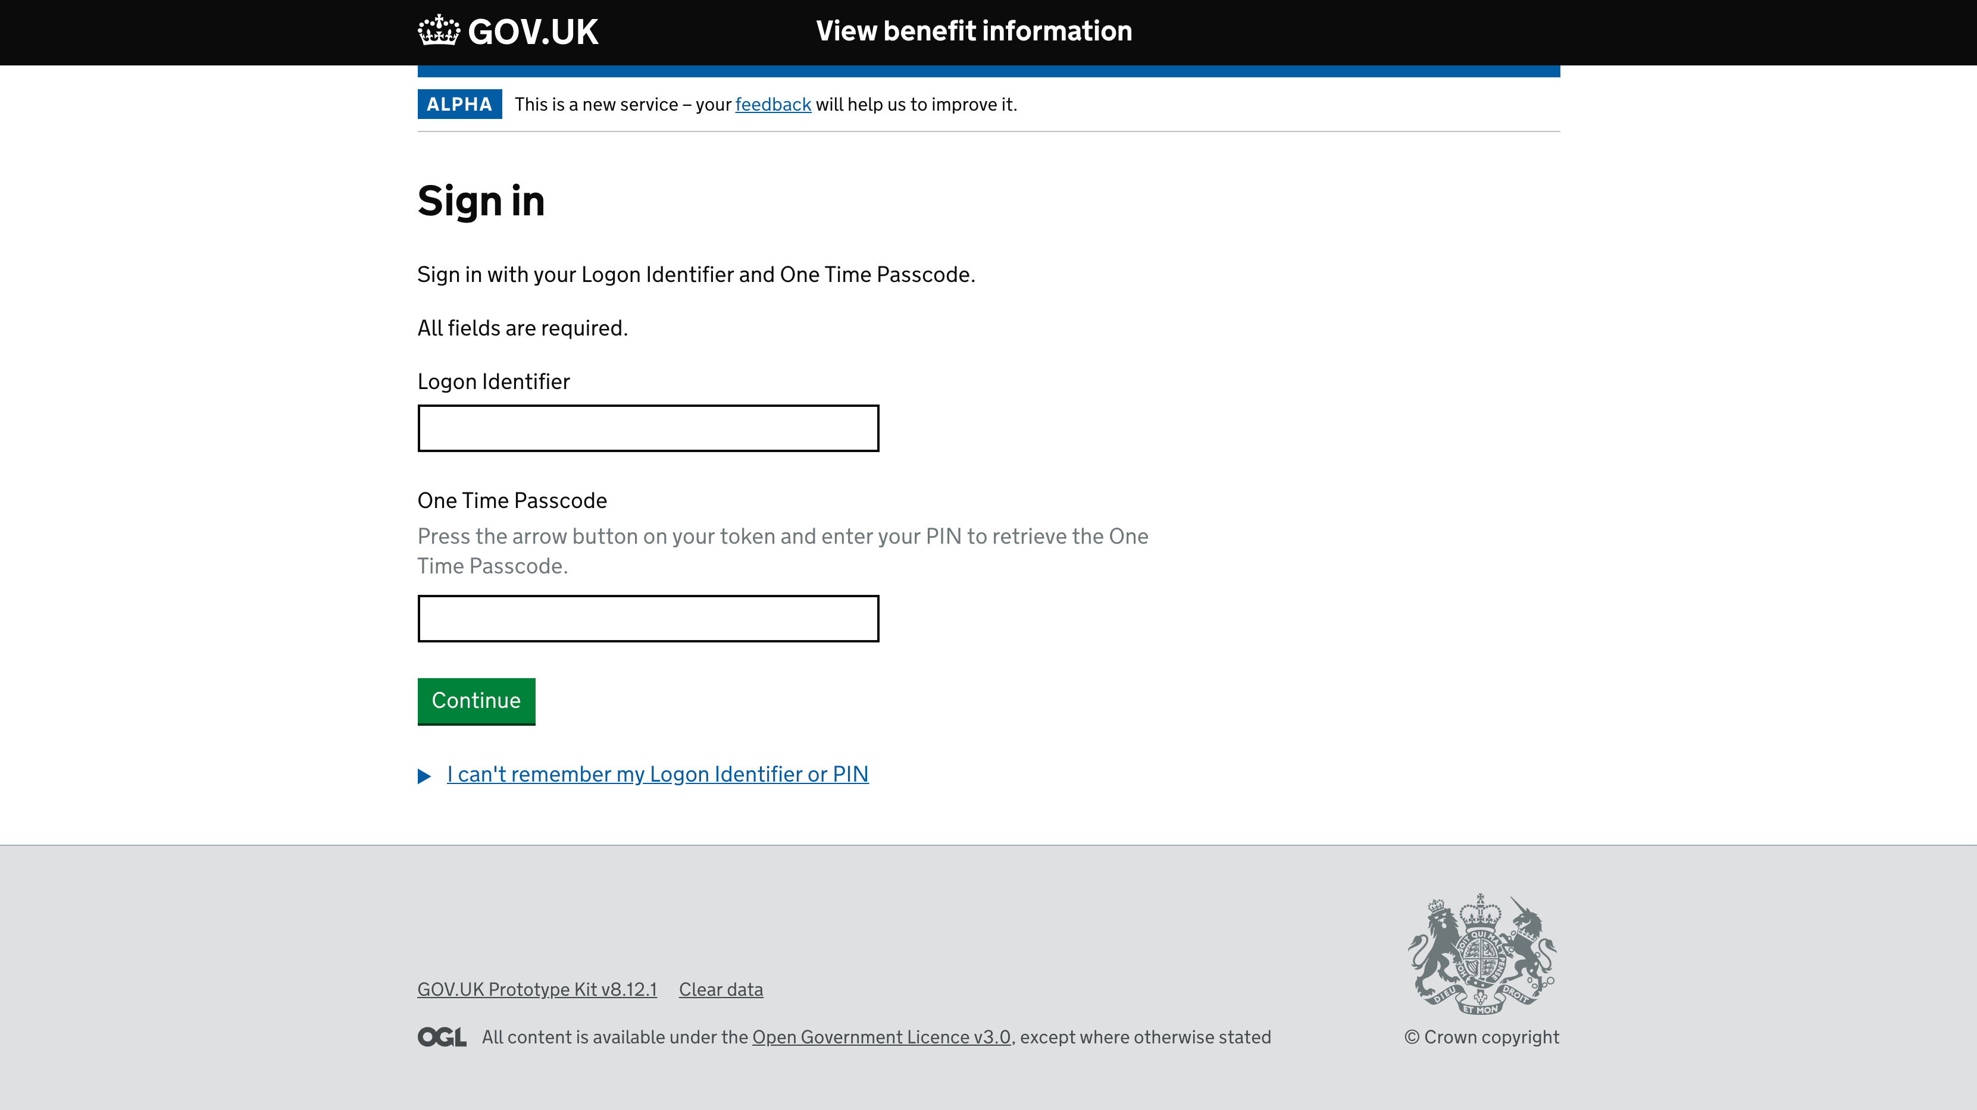
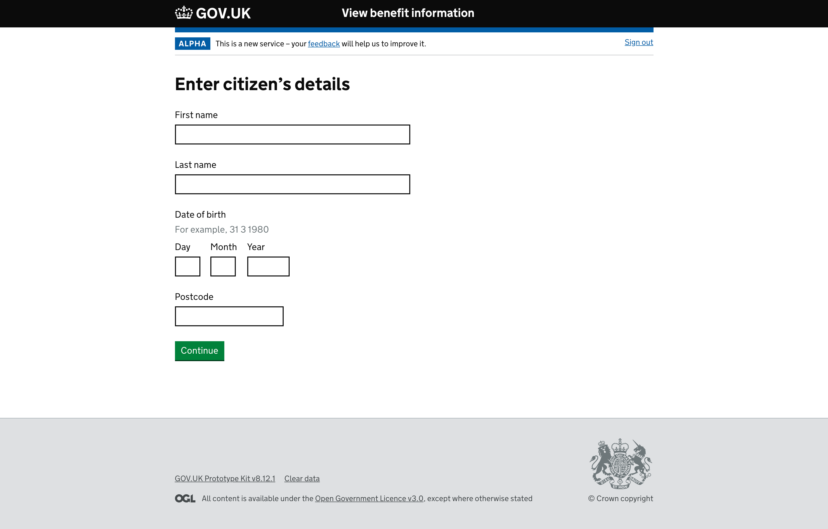
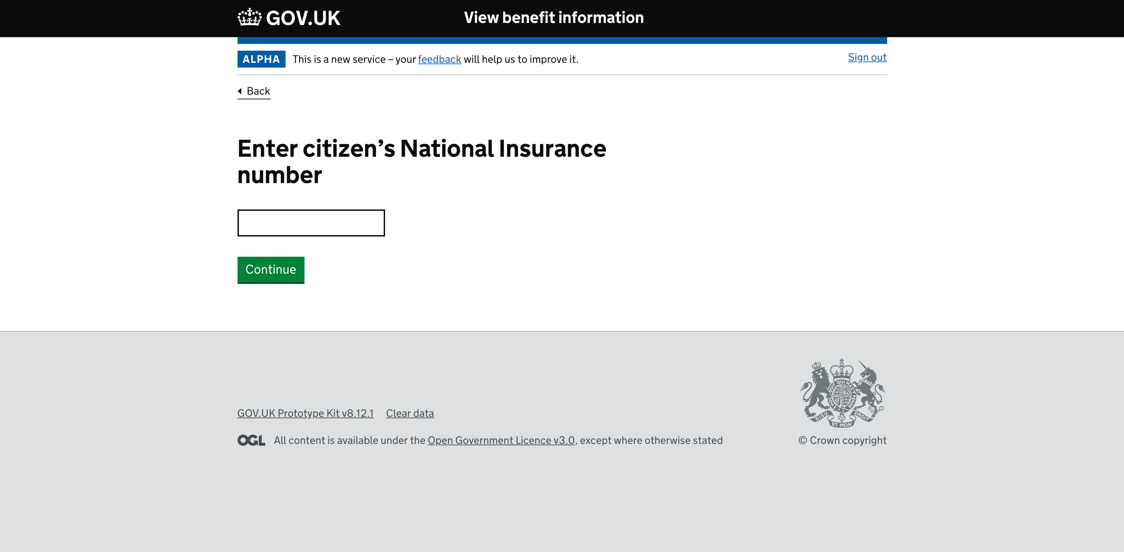
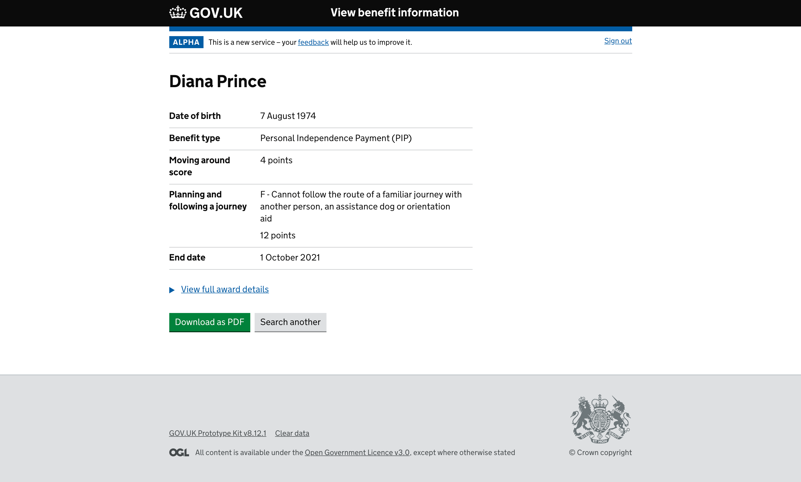
Prototype screens demo

Slide 7
User Interface - what’s not needed
Status of the PIP claim - not needed
Start date not needed - they only work on the end date
Previous award information not needed - could cause confusion
Didn’t like the Frank Castle summary page - too much information
Start page – understood but not needed

Slide 8
User Interface - what they like/need
Service name made sense
Search by NINo preferred – V4
End date and points are all that matter
Showing points with the associated descriptor was preferred
Liked the PDF – would upload to CRM but would need to be timestamped
Search another button – seen and understood
Attendance Allowance information would be useful for discretionary awards
DS1500 – they like to know this and fast track these awards
They know what PIP & DLA stand for – no need for full title
Would like to see NINo displayed on the summary page
Would like to see the decision narrative from the bottom of the PIP award letter - ‘how we made the decision’

Slide 9
Quotes relating to the Prototype
“Either is a
massive
improvement”
“Good to have to build up a picture”
“End date is all
that matters,
status is irrelevant”
Information
Awards
“The fact it’s live is
brilliant for us”
“We’re only looking
at dates and points”
“Don’t need to
see previous
awards, we can
see them
on our system”

Slide 10
Next steps
Test same prototype with other Councils
Dates so far: -
Leeds – 4th September

