Slide 1
View Benefit Information
User Research Report
Visit Sheffield City Council
22 August 2019
V0.1
Stu Bamforth, John Oldroyd and Kelly Blanchflower

Slide 2
Research - Who did we talk to?
Lisa Beardall – Customer Services Team Leader
Sue – Senior Blue Badge Processor
Zeida – Senior Blue Badge Processor

Slide 3
UR Approach:
Workshop approach – demonstration of prototype screens to test hypotheses
with accompanying questions.
Update on current project situation and explanation of session objectives.

Slide 4
Hypotheses tested
If LA teams can download a ‘time-stamped’ PDF containing the citizen’s PIP/DLA info
Then the council will have an audit trail if needed in the event of a future audit, appeal or investigation
If we display the written descriptors of the PIP assessments
Then the information will be as specific as possible and reduce the risk of ambiguity
If we display the details of previous awards
Then this information can be used to help ‘paint a picture’ of the applicants circumstances
If we display the status of the current award
Then this information to help ‘paint a picture’ of the applicants circumstances

Slide 5
Key findings
User Interface – generally very happy
Business benefits of service – they could see many potential benefits that would help their processes, especially in light of the new Hidden Disabilities criteria.

Slide 6
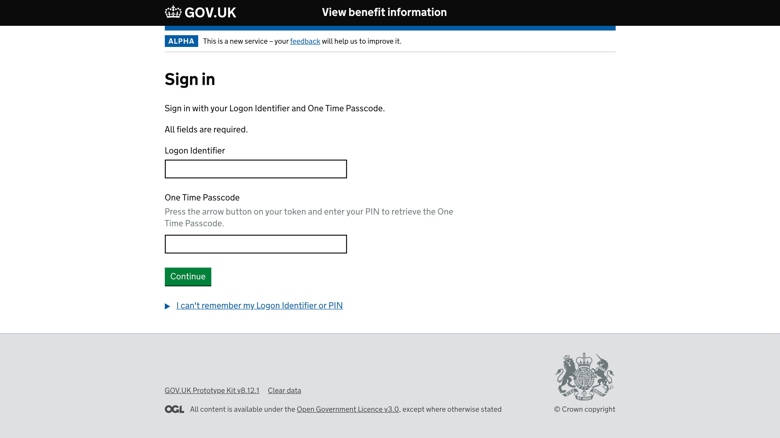
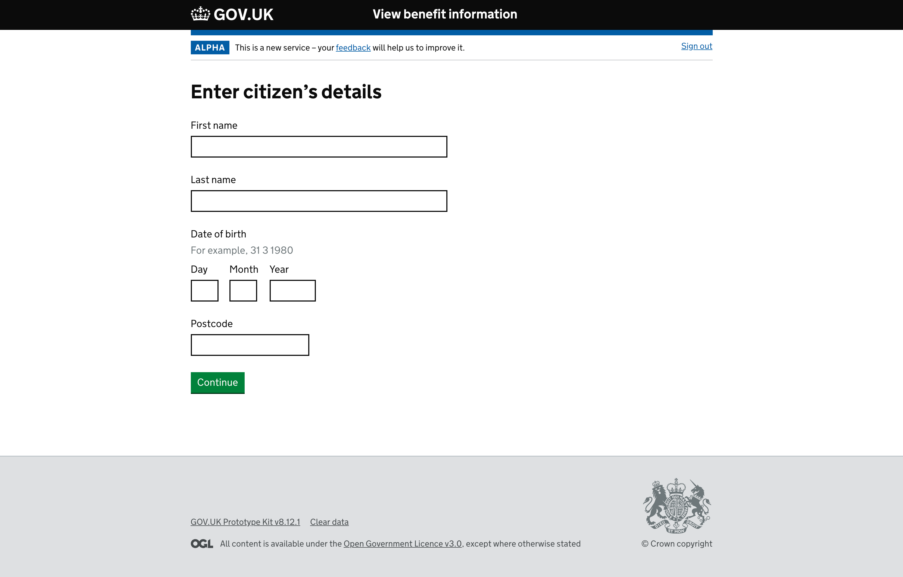
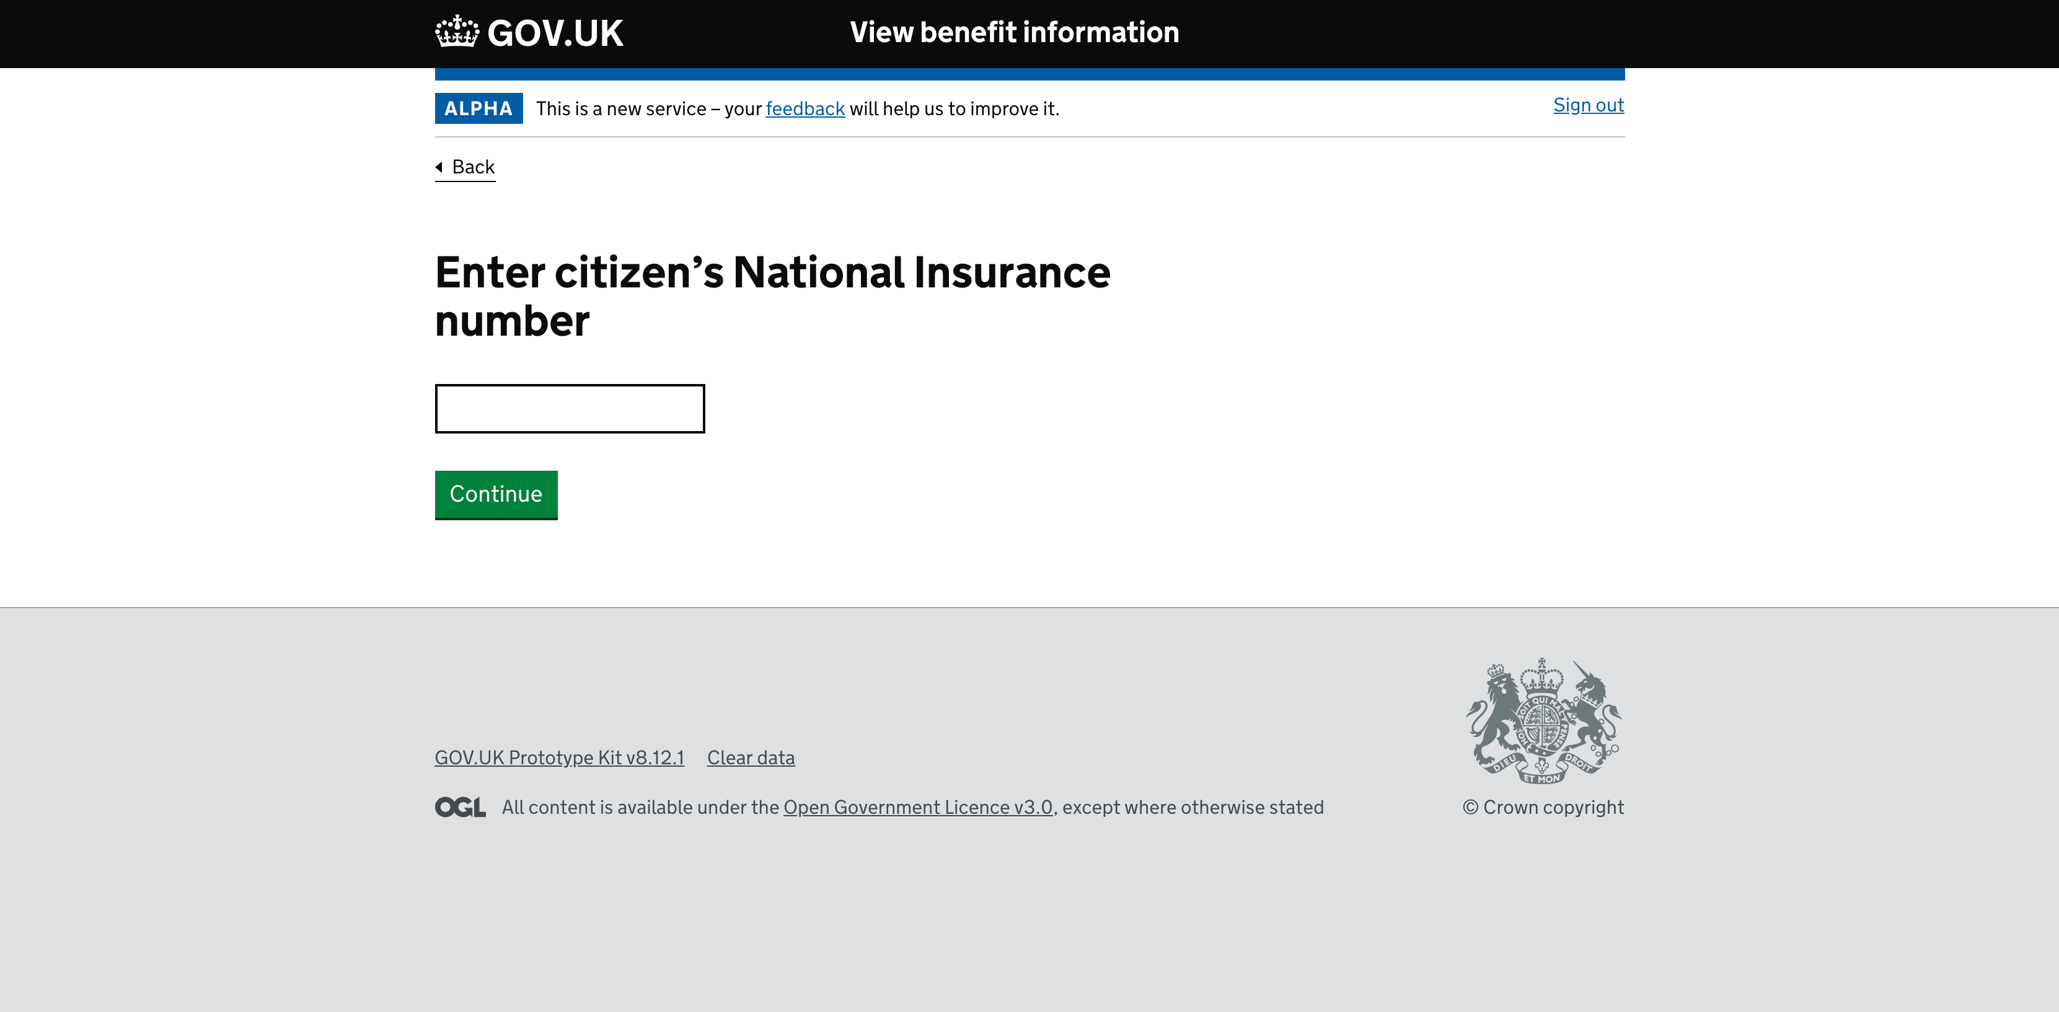
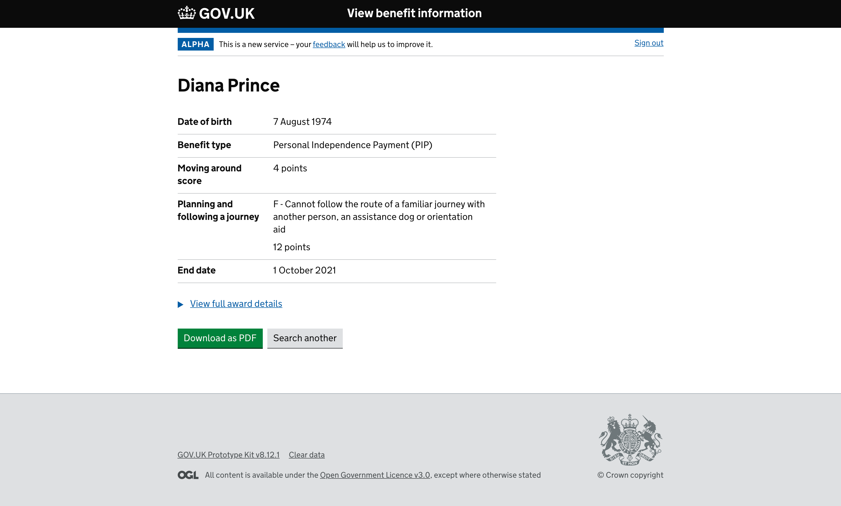
Prototype screens demo

Slide 7
User Interface – what’s not needed
Status of the PIP claim – not interested if we are reviewing a PIP or DLA award
Start date of an award is not required – they work to the end date and badges are only issued up to this date
Previous award information is never needed – looking at the ‘here and now’
Didn’t like having multiple tabs on screens

Slide 8
User Interface – what they like/need
Points and End Dates are the priority along with knowing if a DS1500 has been issued. They need to be able to see these quickly to aid faster processing times
Prefer the Wonder woman layout ☺. Right balance of being able to see enough information for an automatic award but can dig deeper in the same screen for discretionary awards
Like the option to be able to download a PDF for evidence – cuts out lots of
manual scanning & uploading
Like the option to be able to search for another Citizen rather than going out
and re-authenticating
Daily Living Component/Attendance Allowance & DLA Care Component information would help with assessments for other services (i.e. travel permits)

Slide 9
Service Benefits (as identified by LA users)
Speed up processing of applications, especially with Hidden Disability changes
Significantly reduce paper storage, locally and in archive
Better experience for Citizens and staff
Would use our service to verify information from the Citizen, even if everything they need is there (i.e. to access PDF summary and avoid scanning)
They would trust our information to validate a Citizen’s address
Reduces – and would eventually remove - the need for the Citizen to upload their benefit information in the DfT journey

Slide 10
Quotes relating to the Prototype
‘Real time &
accurate’
‘Everything we
ever wanted’
Not our
concern what
DWP is investigating
‘Don’t need it
over-egging
Information
‘If we can see it
straight off without
having to dig’
Really good. Not reliant on
customer filling it in
Awards
‘Looking at here
and now not what
has gone before

Slide 11
Next steps
Test same prototype with other Councils
Dates so far: -
Rochdale – 29th August
Leeds – 4th September

