Slide 1
View Benefit Information
User Research Report
Visit to Kirklees Council
31st July 2019
V0.1
David Niland, Ismael Burdeau, Chris Philip, Matt Blackwell, Kelly Blanchflower

Slide 2

Demographics
Population of Kirklees: 437,000
Number of individuals holding a blue badge: 18,600 (4.3%)

Slide 3
Research - Who did we talk to?
Kim Draper - Service Project Officer
Caron Day - IT Principal Officer
Steve Bird - Head of Welfare and Exchequer Services

Slide 4
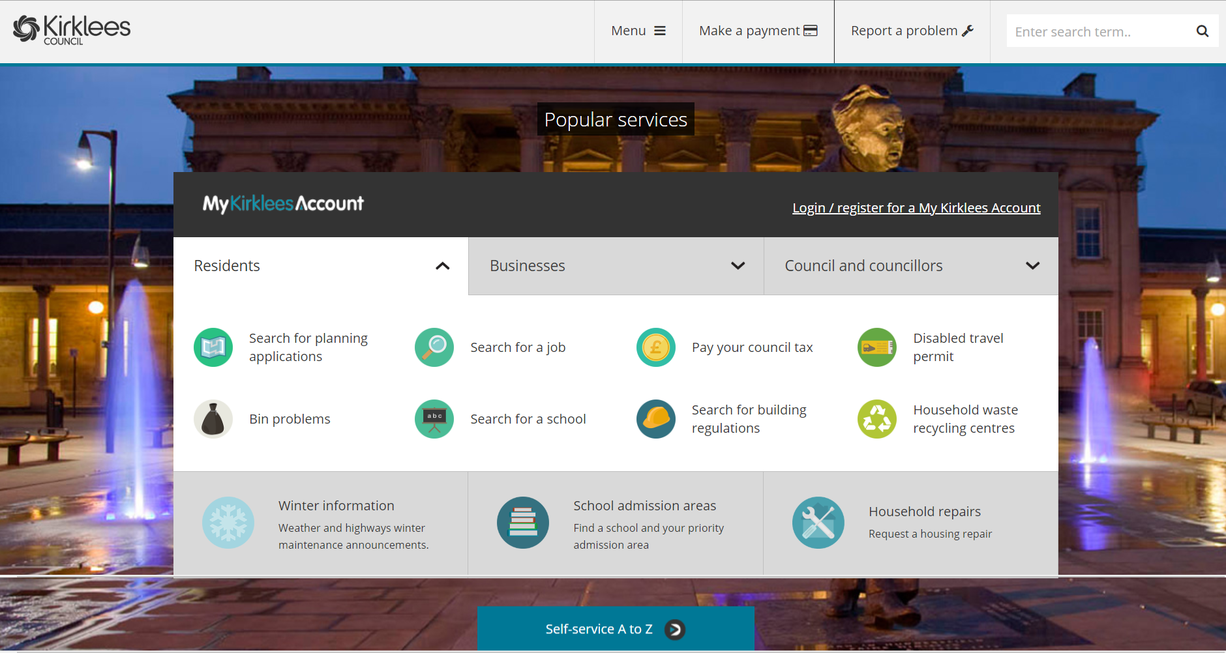

Slide 5
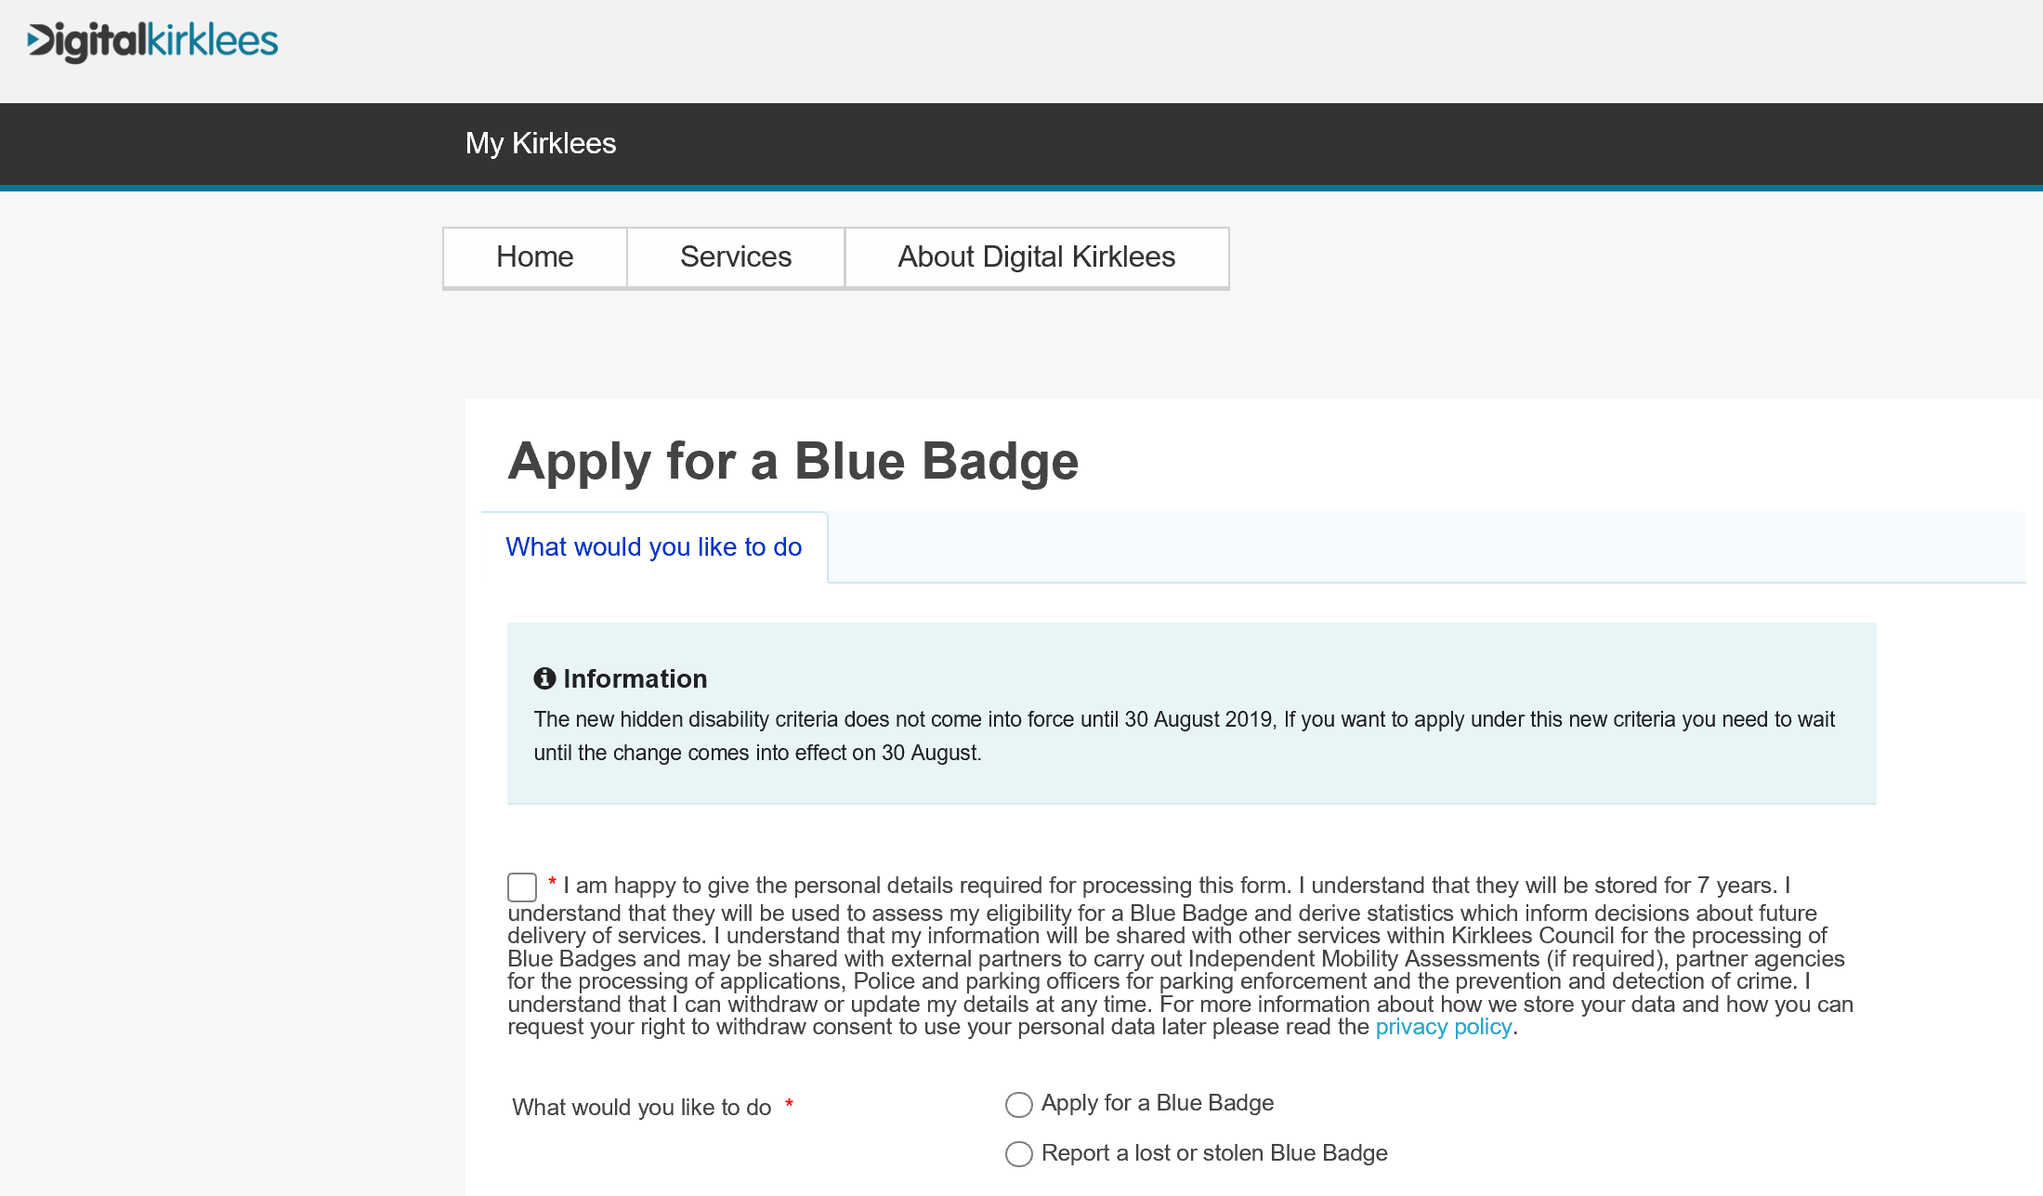

Slide 6
Key findings – around the room

Slide 7
Key findings
Hidden disabilities is nuanced
Planning and following journeys
The descriptors for Activity 1 are -
a.Can plan and follow the route of a journey unaided. 0 points
b.Needs prompting to be able to undertake any journey to avoid overwhelming psychological distress to the claimant. 4 points
c.Cannot plan the route of a journey. 8 points
d.Cannot follow the route of an unfamiliar journey without another person, assistance dog or orientation aid. 10 points
e.Cannot undertake any journey because it would cause overwhelming psychological distress to the claimant. 10 points
f.Cannot follow the route of a familiar journey without another person, an assistance dog or an orientation aid. 12 points
Source: Part 3 of Schedule 1 to the Social Security (Personal Independence Payment) Regulations 2013 (SI.No.377/2013).

Slide 8
Key findings
Blue Badge staff cannot use CIS because the ‘Memorandum of Understanding between the Department for Work and Pensions and Local Authorities’ does not cover it. Our service will need to be covered by similar.

Slide 9


Slide 10
Key findings
They would use View Benefit Information for more than viewing automatic awards. They would use it to paint a picture of assessed applications.
Housing Benefit staff use portal called ‘Searchlight’ to view DWP customer information. Search only by NI number.
Not all applicants will have a NI number. If a child currently has DLA they will have a NI number. Need to see if children awarded PIP has NI number.
They would like an easy way of evidencing the information they see.
Kirklees could be a good council to engage with as they have their own Blue Badge journey. Once they were happy our service worked, they could withdraw the ‘Evidence your claim’ upload step.
They would not typically search for a citizen outside their area.

