Slide 1
View Benefit Information
User Research Report
Visit to Rochdale Borough Council
6th August 2019
V0.1
David Niland, Chris Philip, Kelly Blanchflower, Nicky Smalley, Stu Bamforth

Slide 2


Slide 3
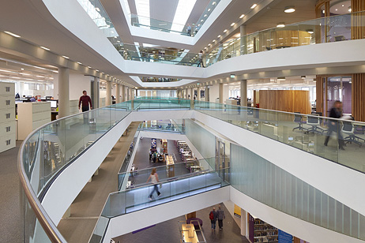

Slide 4
Metropolitan Borough of Rochdale
Population of 211,699 in 2011
White 88.6%
Asian 9.8%
Black 0.3%
Other 1.3%
Applications
Approx. 100 applicants/renewals a week
Approx. 4200 a year
They use a Northgate CMS system to manage process.

Slide 5
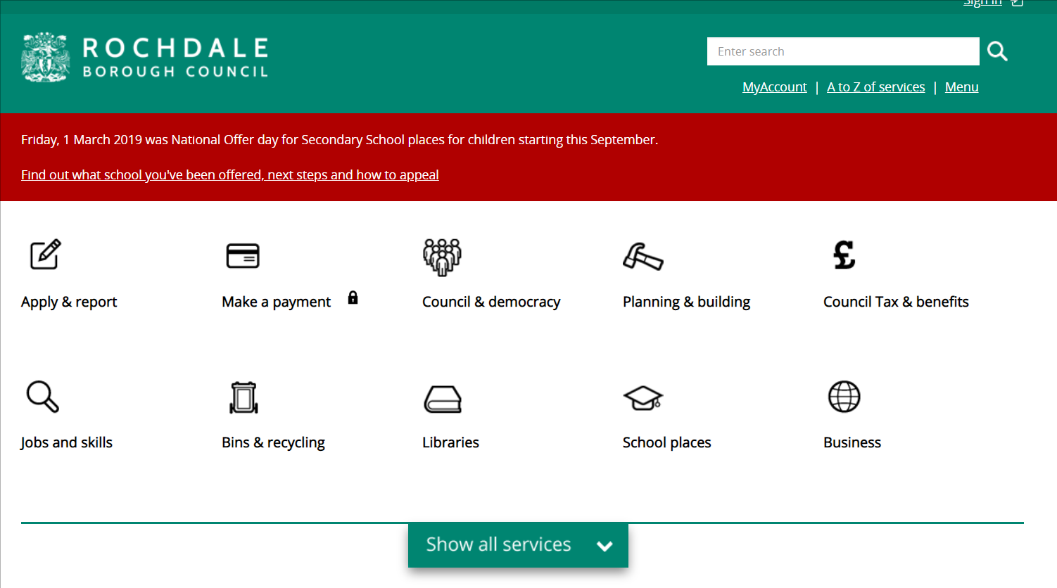

Slide 6
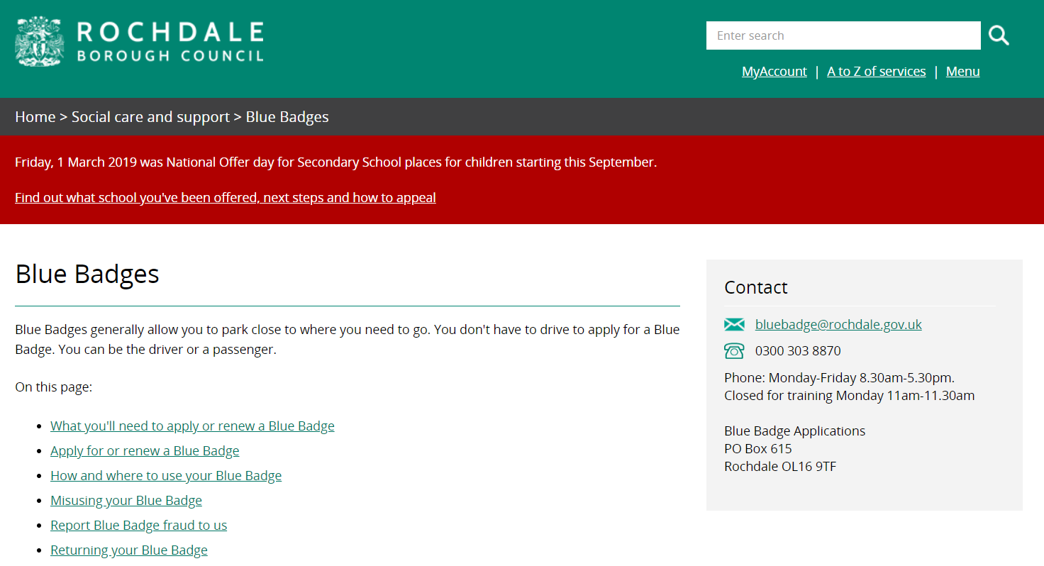

Slide 7
Research - Who did we talk to?
Denise Whitehead, Team Lead, Benefits
Andy - Blue Badge Processing Team

Slide 8
Key findings – around the room

Slide 9
Key findings
They would love ‘View Benefit Information’
Why do we assess people twice?
  1 Citizen assessed for DLA/PIP
  2 Citizen on DLA/PIP applies for Blue Badge on assessment basis. Typically might be sent for assessment.
Happy to use ‘View Benefit Information’ for more than viewing automatic awards. They would use it to paint a picture of assessed applications.
They would like an easy way of evidencing the information they see.
They would not typically search for a citizen outside their area.

Slide 10
Key findings
Hidden disabilities is nuanced
Planning and following journeys
The descriptors for Activity 1 are -
a.Can plan and follow the route of a journey unaided. 0 points
b.Needs prompting to be able to undertake any journey to avoid overwhelming psychological distress to the claimant. 4 points
c.Cannot plan the route of a journey. 8 points
d.Cannot follow the route of an unfamiliar journey without another person, assistance dog or orientation aid. 10 points
e.Cannot undertake any journey because it would cause overwhelming psychological distress to the claimant. 10 points
f.Cannot follow the route of a familiar journey without another person, an assistance dog or an orientation aid. 12 points
Source: Part 3 of Schedule 1 to the Social Security (Personal Independence Payment) Regulations 2013 (SI.No.377/2013).

