Slide 1
View Benefit Information
User Research Report
Leeds City Council
4 September 2019
V0.1
Stu Bamforth, John Oldroyd and Matt Blackwell

Slide 2
Research - Who did we talk to?
Michelle Marsden, Blue Badge team manager
Sarah – Blue Badge processor
Jacob – Blue Badge team IT support

Slide 3
UR Approach:
Workshop approach – demonstration of prototype screens to test hypotheses with accompanying questions.
Update on current project situation and explanation of session objectives.
V3 and V4 of the prototype were demonstrated.

Slide 4
Hypotheses tested
If LA teams can download a ‘time-stamped’ PDF containing the citizen’s PIP/DLA info
Then the council will have an audit trail if needed in the event of a future audit, appeal or investigation
If we display the written descriptors of the PIP assessments
Then the information will be as specific as possible and reduce the risk of ambiguity
If we display the details of previous awards
Then this information can be used to help ‘paint a picture’ of the applicants circumstances
If we display the status of the current award
Then this information to help ‘paint a picture’ of the applicants circumstances

Slide 5
Background
Ways to apply
Leeds citizens can apply using:
DfT online journey, or
DfT clerical form
Stats (estimate)
60:40 split (online:paper docs)
100 online applications received a day
75 paper documents received a day (include application forms, and award letters)
Other roles
The team also process Disabled Companion Bus Passes.
Notes:
Appeal cases:
Leeds give the applicant the option to put their application on hold until after appeal decision.
This means they don’t have to turn down their application. The applicant doesn’t have to apply again and can avoid paying the Blue Badge fee twice.
They can also refer these cases to the discretionary award team without the citizen having to apply again. The discretionary award team the contact the citizen to gather more info.

Slide 6
Background
Teams
Auto-award team: 14 people (increasing to 18)
Discretionary award team: 7 people
Auto/discretionary awards
Unsuccessful auto-awards aren’t refused - option to be assessed for discretionary award.
Notes:
Appeal cases:
Leeds give the applicant the option to put their application on hold until after appeal decision.
This means they don’t have to turn down their application. The applicant doesn’t have to apply again and can avoid paying the Blue Badge fee twice.
They can also refer these cases to the discretionary award team without the citizen having to apply again. The discretionary award team the contact the citizen to gather more info.

Slide 7
Key findings
Start page
Don’t need a start page because:
they’ll use it every day so and will go straight to sign in
inexperienced staff get one-to-one training
Authentication
Preference to:
stay signed in all day
be able to manage accounts within Blue Badge team
Notes:
Appeal cases:
Leeds give the applicant the option to put their application on hold until after appeal decision.
This means they don’t have to turn down their application. The applicant doesn’t have to apply again and can avoid paying the Blue Badge fee twice.
They can also refer these cases to the discretionary award team without the citizen having to apply again. The discretionary award team the contact the citizen to gather more info.

Slide 8
Key findings
Citizen search
Most applicants give a NINo – especially PIP/DLA cases.
Exceptions include child applications.
Split opinion on best way to search:
team leader preferred NINo as primary
processor preferred NINo secondary
“Is this if there is more than one person with same name?”

Slide 9
Key findings
Results page – auto awards
Minimum dataset is enough.
Prefer it to include PIP descriptions and points.
Confusion over new/old descriptors for ‘planning a journey’ – different wording on old/new award letters.
DS1500 understood and important for auto-awards.
Notes:
Appeal cases:
Leeds give the applicant the option to put their application on hold until after appeal decision.
This means they don’t have to turn down their application. The applicant doesn’t have to apply again and can avoid paying the Blue Badge fee twice.
They can also refer these cases to the discretionary award team without the citizen having to apply again. The discretionary award team the contact the citizen to gather more info.

Slide 10
Key findings
Results page – award status
Useful for:
appeal cases
Results page - previous awards
Not needed for auto-awards but useful for:
‘building a picture’ for discretionary awards
checking suspicious applications
explaining why someone was eligible in the past but not now
Notes:
Appeal cases:
Leeds give the applicant the option to put their application on hold until after appeal decision.
This means they don’t have to turn down their application. The applicant doesn’t have to apply again and can avoid paying the Blue Badge fee twice.
They can also refer these cases to the discretionary award team without the citizen having to apply again. The discretionary award team the contact the citizen to gather more info.

Slide 11
Key findings
Other useful info for discretionary awards and bus passes
DLA care component – higher rate
PIP daily living component – enhanced rate
Attendance Allowance
No record found page
Concerned about possible misinterpretation of content:
‘There is no benefit record for the details you've entered.’
Notes:
This might get relayed to a citizen by staff and cause alarm. There may be a valid claim but not on DWP system for some reason – for example, a clerical case.
Suggested removing this sentence altogether.

Slide 12
Key findings
PDF
Initially said they’d take a screenshot for evidence then noticed ‘Download PDF’
“PDF is better than a screenshot”
PDF needs to be time-stamped.
Appointee info
Useful if available but not a show-stopper for MVP.
Signposting
DfT Slack channel
Show and tells
Notes:
This might get relayed to a citizen by staff and cause alarm. There may be a valid claim but not on DWP system for some reason – for example, a clerical case.
Suggested removing this sentence altogether.

Slide 13
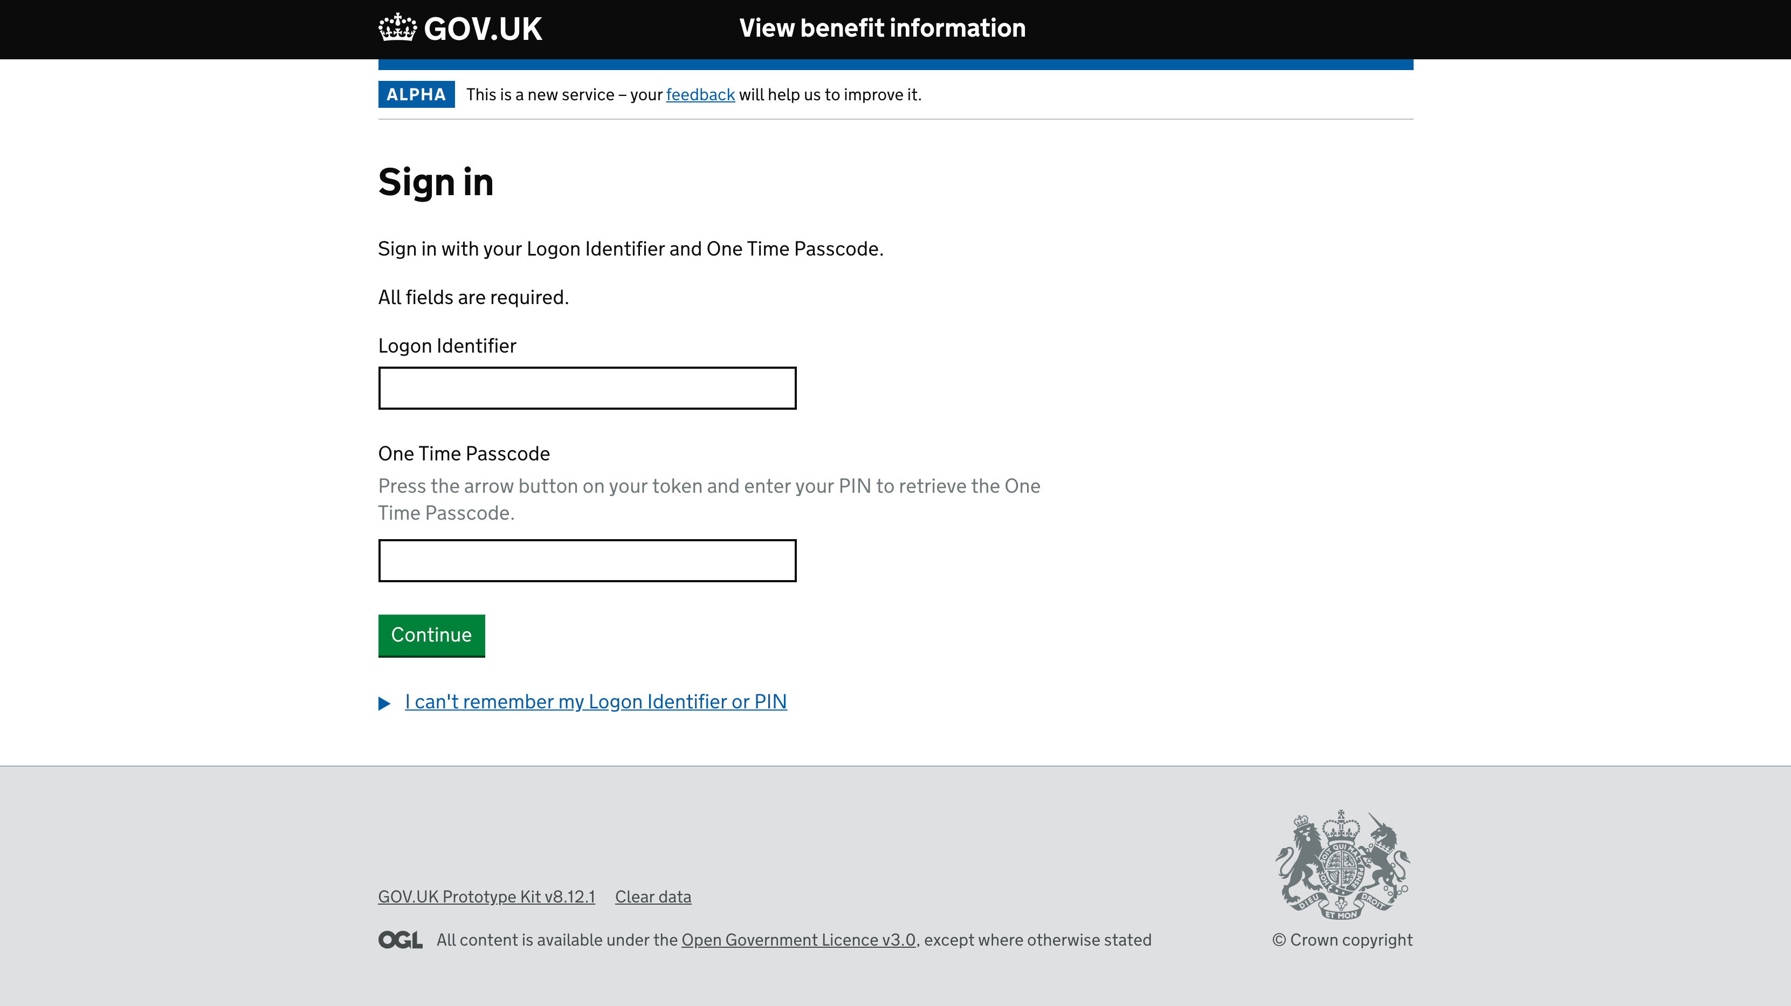
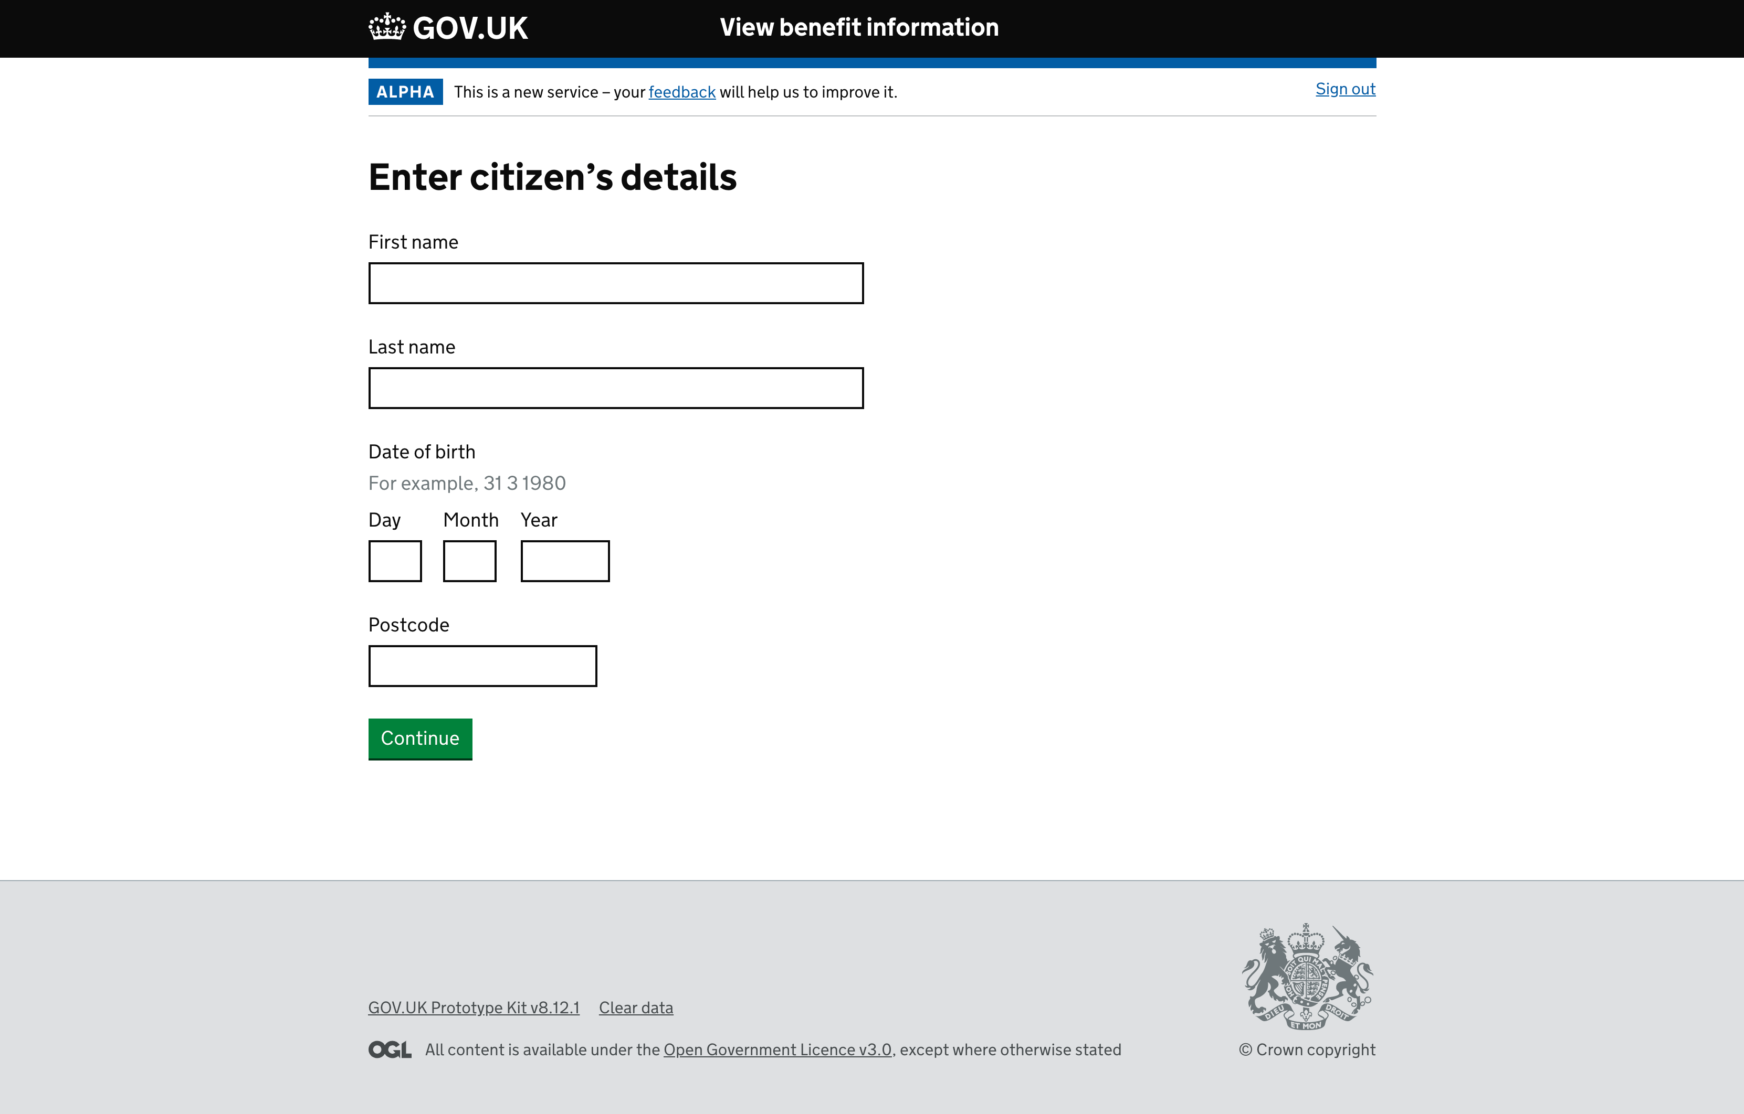
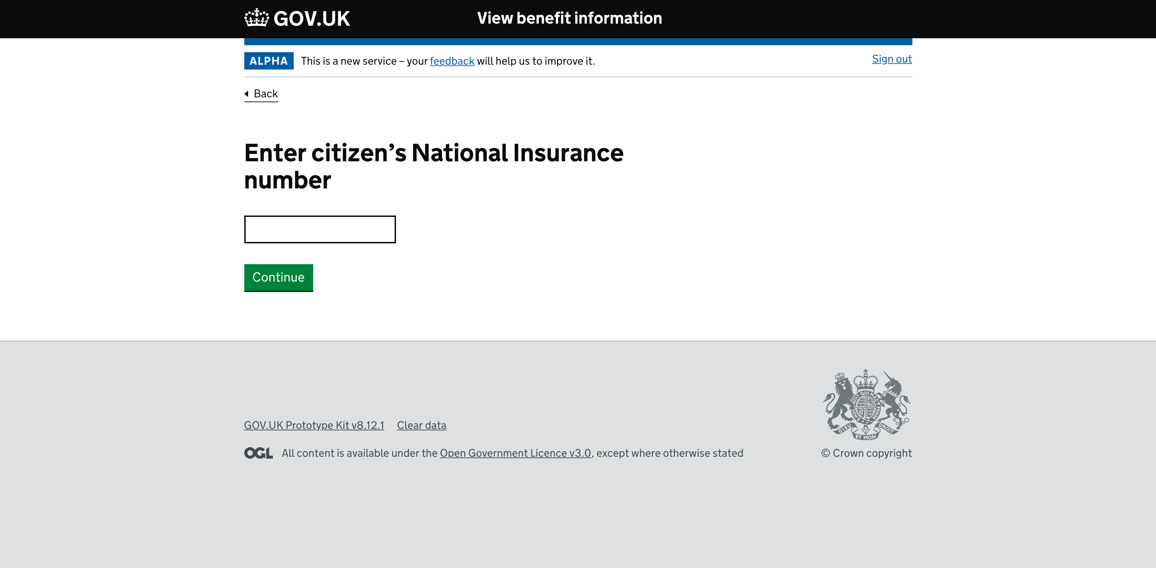
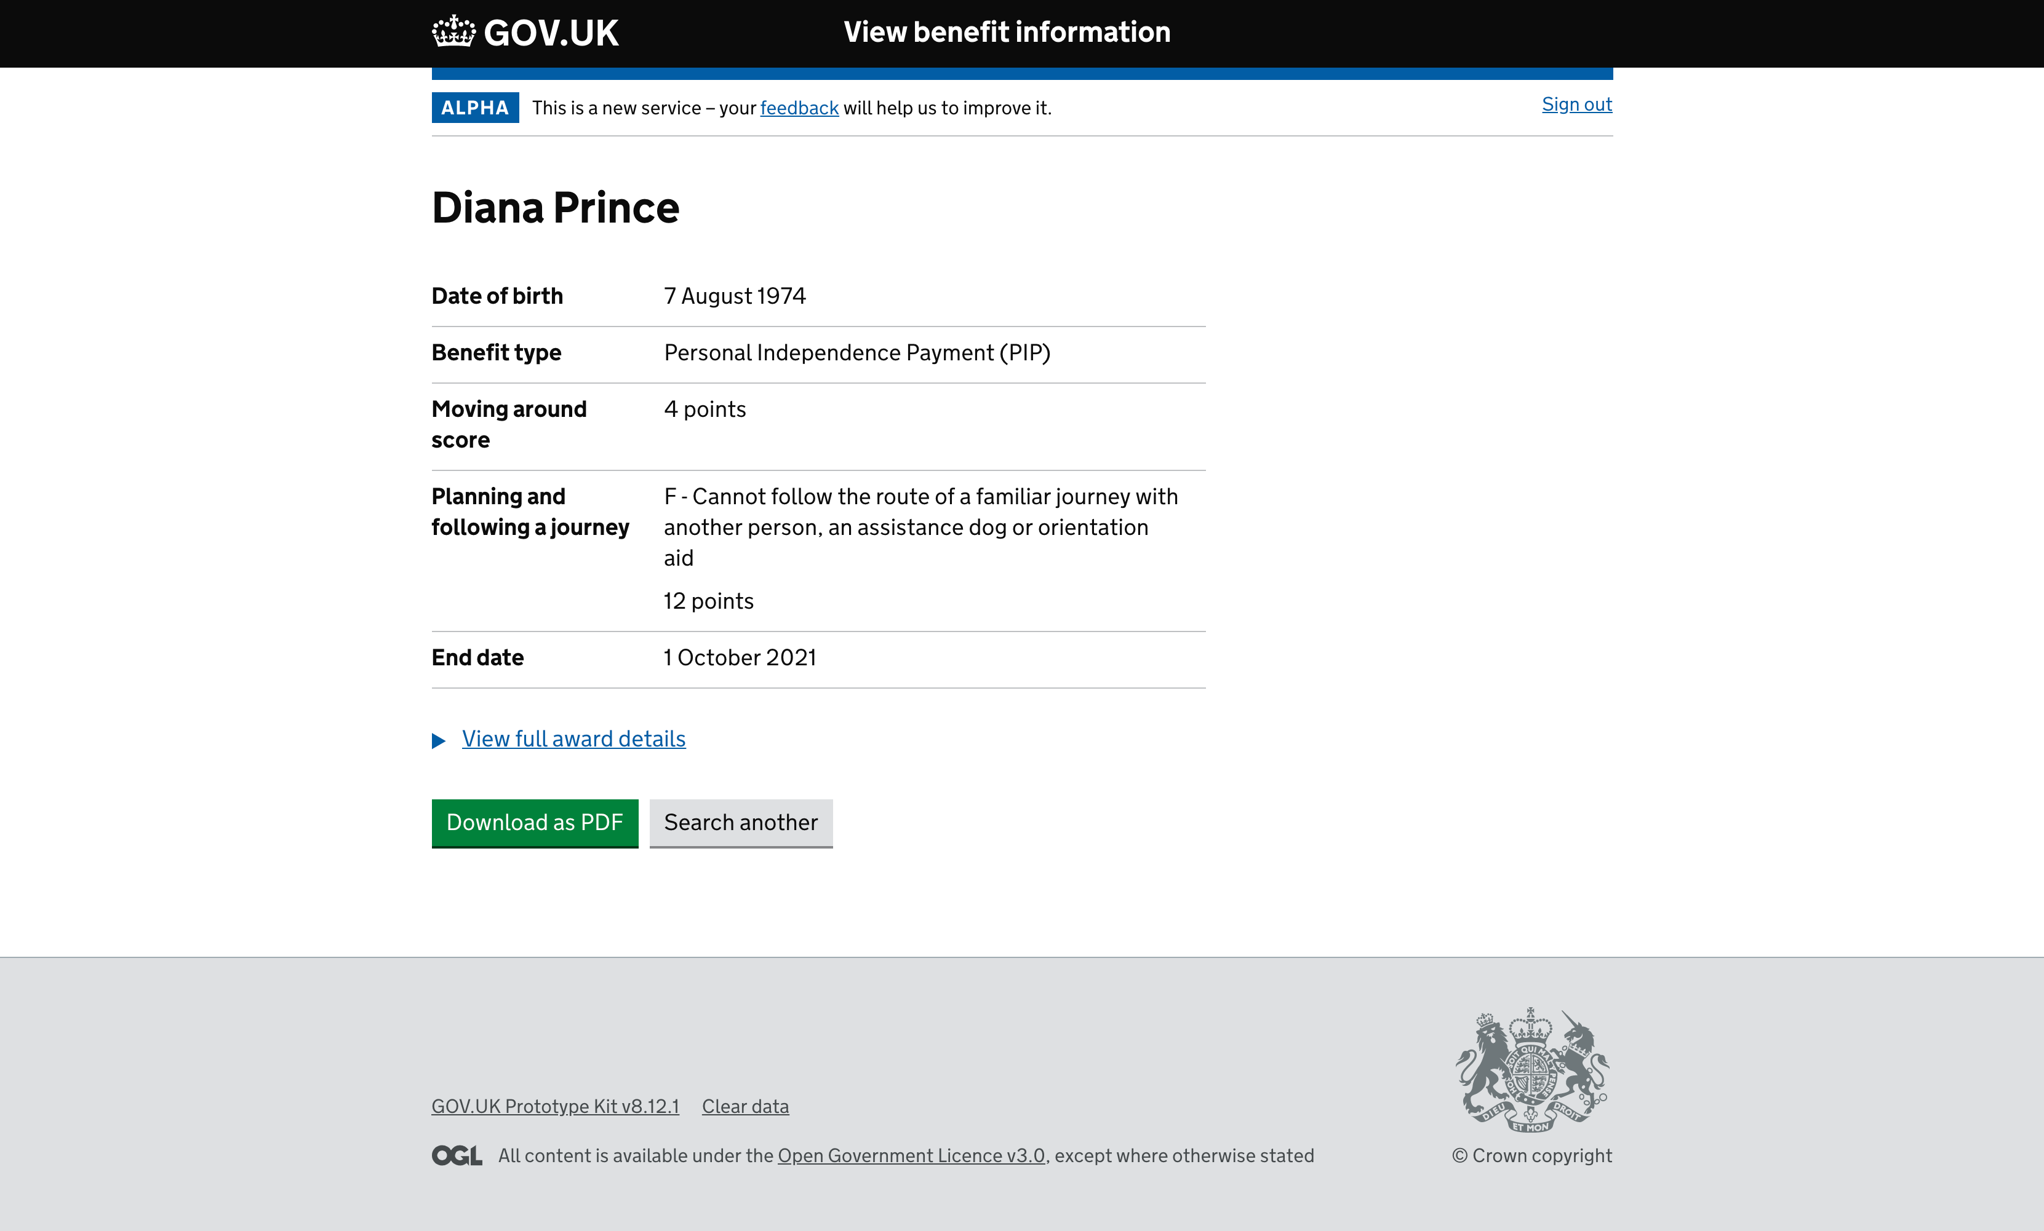
Prototype screens demo

Slide 14
Quotes relating to the Prototype
“It’ll cut out stress
for the customer”
“…less footfall in our one-stop centres”
“…fewer phone calls, emails and letters”
“Will reduce the amount of scanned documents”
Improvements
“…will make our
process much
quicker”
“…useful for discretionary award team to have access”
Awards
“…we’re probers!”
“Previous awards
useful as some
people can’t
remember
what they get”
“everything we need
for an auto award”

Slide 15
Next steps
Time to reflect and update prototype.
User research with Scottish councils
Dates so far:
Edinburgh – 19 September

