Slide 1



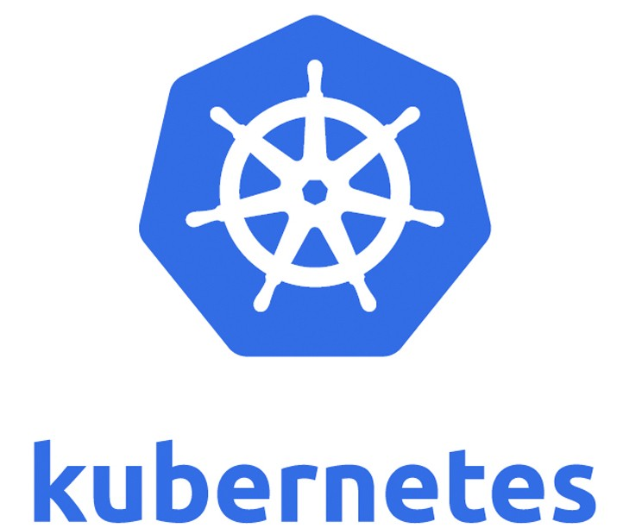
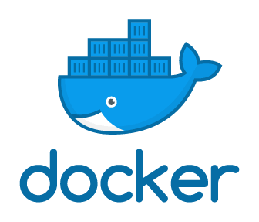






AWS Cloud
Amazon Elastic Kubernetes Service (Amazon EKS)
VPC
Pod
Model Developer
Amazon CloudFront
Application Load Balancer
Amazon Simple Storage Service (Amazon S3)
mlflow server on port 5000
Pod
dB server on port 5432

Slide 2
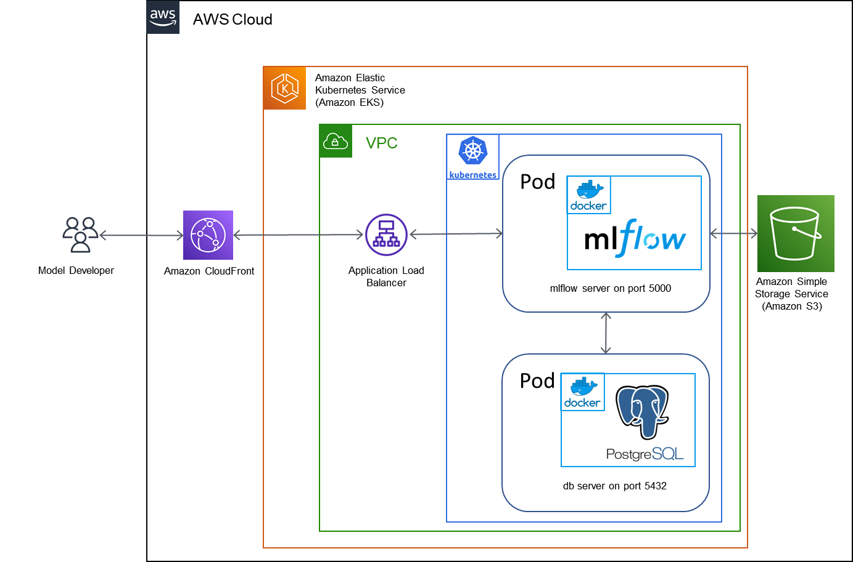
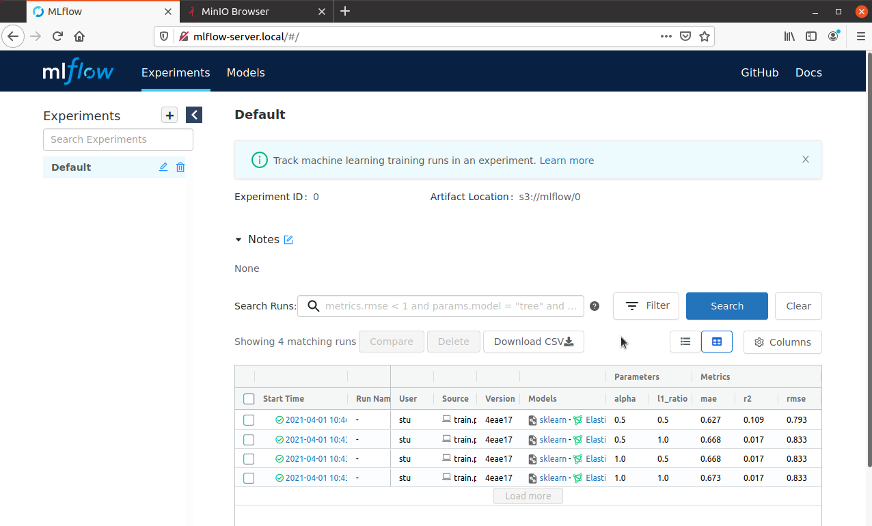
build-server
Build docker image
Lint docker image
Scan Image
Upload to Docker Hub
test-server
Download docker image
Start server locally in Docker
Test by adding experiments
Verify experiments added
deploy-infrastructure
Create S3 bucket and CloudFront
Create AWS EKS Cluster
Deploy mlflow docker to pod
Deploy PostgreSQL docker to pod
Expose server to outside access
Test service endpoint available
smoke-test
Configure local python environment
Run python model to add 4 runs
Verify runs submitted to mlflow server (on EKS)
cloudfront-update
Configure cloudfront for new deployment
cleanup
Remove prior deployment
Destroy infrastructure
Revert to prior deployment

