Slide 1
Early SOC Performance Verification Using SystemC with MatchLib and Catapult HLS
Stuart Swan
HLS IP/Platform Architect
May 2020
Source: Notes are in Tahoma, regular, 8 point, italic, flush left, vertically aligned from the bottom of text box.

Slide 2
Introduction
My background
MatchLib introduction
Why use it?
Walk through a simple example and look at HLS results
Walk through a larger example
Q & A

Slide 3
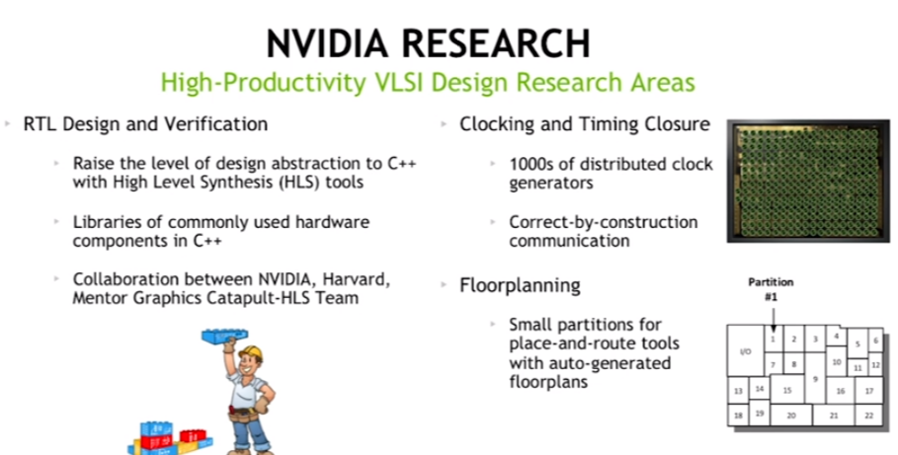

What is NVIDIA MatchLib?
Good 30 minute intro video here:
Google: nvidia machine learning mentor events

Slide 4
Key Parts of MatchLib
“Connections”
Synthesizeable Message Passing Framework
SystemC/C++ used to accurately model concurrent IO that synthesized HW will have
Automatic stall injection enables interconnect to be stress tested in SystemC
Parameterized AXI4 Fabric Components
Router/Splitter
Arbiter
AXI4 <-> AXI4Lite
Automatic burst segmentation and last bit generation
Parameterized Banked Memories, Crossbar, Reorder Buffer, Cache
Parameterized NOC components

Slide 5
MatchLib SystemC Model Characteristics
Small
Typically 1/10 or less than the size of comparable RTL models
Fast
Simulates ~30 times faster than RTL models in timing accurate mode
Simulates ~300 times faster than RTL models in blocking TLM mode
Accurate
Not exactly RTL cycle accurate, but pretty close
Concurrent transactions in HW are modeled very accurately
Fully automated path to placed gates via SystemC HLS
Enables SW/FW models to be integrated via C++ host-code or CPU models
Enables single-source model for HW and FW for full flow

Slide 6
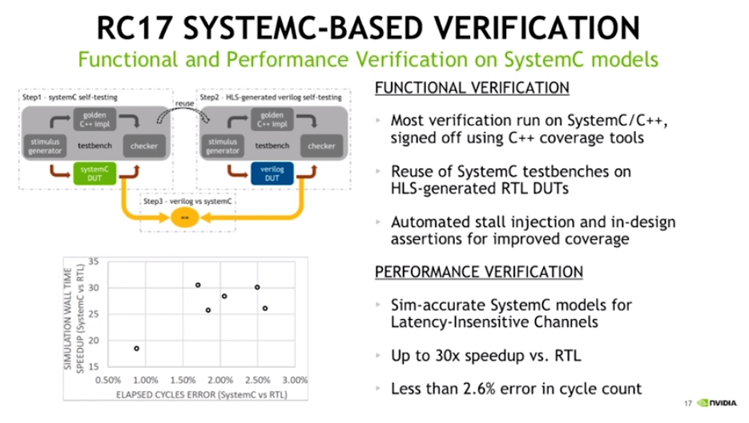
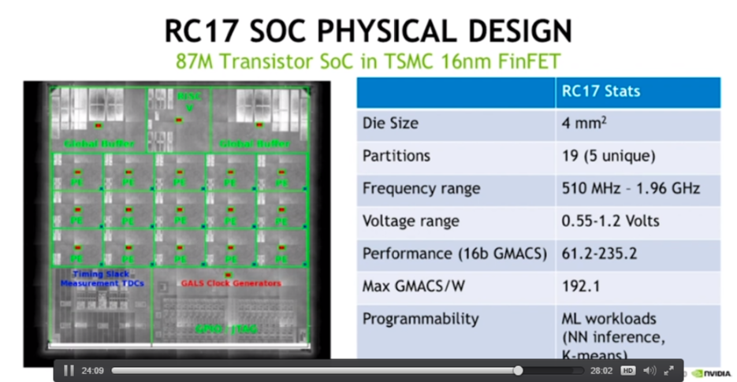
MatchLib and Catapult HLS Results

Slide 7
30 years ago what enabled change from gate-level to RTL?
Verilog/VHDL standardized approach to RTL capture
Designers could focus on cycle level timing
RTL synthesis, timing, and P&R tools automatically handled gate level timing concerns.
RTL IP (Designware, ARM, ...) enabled more reuse
RTL flow supported any type of digital design.
RTL flow supported synthesis of full chip.
Focus of verification effort moved to RTL level, enabling much greater efficiency.

Slide 8
Goal of MatchLib & HLS is to enable switch from RTL to C++
MatchLib and C++/SystemC provide a standardized approach to design capture
Designer focuses on chip architecture, functionality, and throughput analysis/verification.
HLS adds pipelining, optimizes microarchitecture, provides fully automated flow to placed gates.
HLS IP enables more reuse
Fixed point types, AXI interconnect, NOC, banked memories, algorithm IP…
MatchLib + HLS flow supports any type of digital design
MatchLib + HLS flow supports HLS synthesis of full chip.
Focus of verification effort moves to C++/SystemC level, enabling much greater efficiency.
(But, teams can also adopt MatchLib + HLS flow in steps,
they do not need to adopt the entire flow all at once.)

Slide 9
Complexity / Risk in Modern Designs has Shifted…
As an example, performance of ML / Vision chips is often in terms of trillions of MACs per second
But, design and verification of MACs is not the hard part
Hard part is often managing the movement of data in the chip across all scenarios
Today’s HW designs often process huge sets of data, with large intermediate results.
Machine Learning, Computer Vision, 5G Wireless
The design of the memory/interconnect architecture and the management of data movement in the system often has more impact on power/performance than the design of the computation units themselves.

Slide 10
MatchLib + SystemC HLS Addresses Complexity / Risk in Modern Designs
Evaluating and verifying memory/interconnect architecture at RTL level is often not feasible:
Too late in design cycle.
Too much work to evaluate multiple candidate architectures.
The most difficult/costly HW (& HW/SW) problems are found during system integration.
If integration first occurs in RTL, it is very late and problems are very costly.
MatchLib + SystemC HLS lets integration occur early when fixing problems is much cheaper.

Slide 11
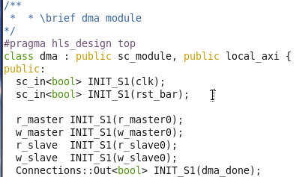
Simple Example: AXI4 DMA using MatchLib
clk
CPU Stimulus
clk
DMA
clk
RAM
rst
rst
rst
w_master0
w_slave0
w_master0
w_slave0
Control Regs
r_master0
r_slave0
r_master0
r_slave0
dma_done
dma_done
= top level of design

Slide 12
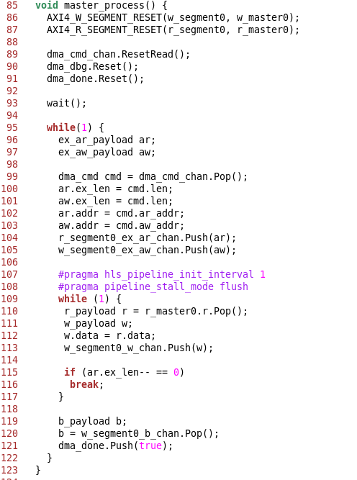
The DMA performs a memory copy using AXI4 bursts
The only clock/wait is for reset state
Entire AXI4 DMA C++ is 170 lines
RTL after HLS is 6000 lines
This IO is in parallel
Main compute loop gets pipelined in HLS
This IO is in parallel

Slide 13
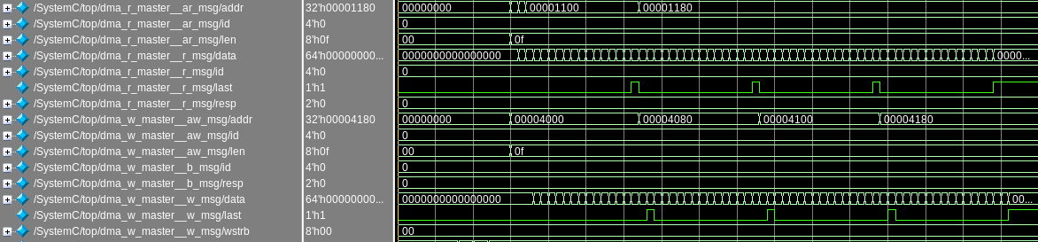
AXI4 DMA Waveforms Before HLS (SystemC simulation)
Automatic AXI4 last bit generation
Automatic AXI4 burst address segmentation
Read and write burst streams are concurrent.
R/W bus utilization is 100%
(1 read and 1 write beat per clock cycle)

Slide 14
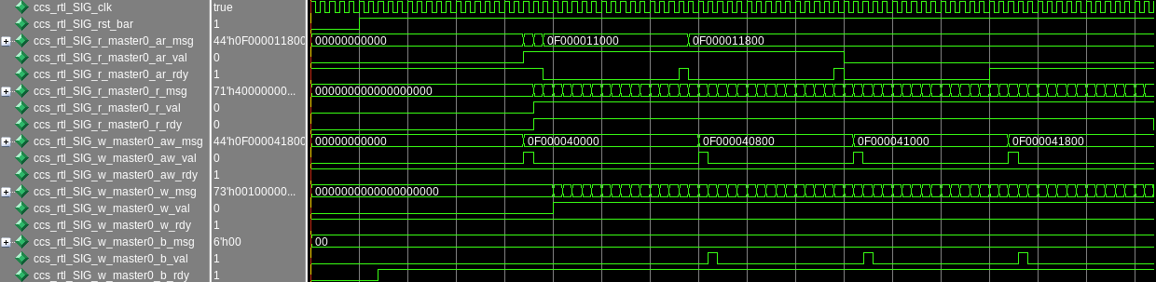
AXI4 DMA Waveforms After Catapult HLS (Verilog Sim)
RTL waveforms are almost the same as SystemC waveforms:
- Throughput is same
- Bus utilization is the same
- HLS may have added pipeline stages (under user control)
- HLS may have increased latency (under user control)

Slide 15
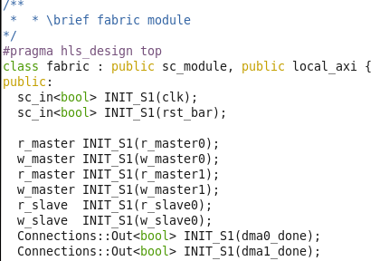
Larger Example: AXI4 Bus Fabric using MatchLib
AXI4 Fabric
Address Map
DMA0
AXI4 Router/
Splitter
AXI4
Arbiter
RAM0
0x00000
0x7FFFF
CPU
AXI4 Router/
Splitter
AXI4 Router/
Splitter
AXI4
Arbiter
0x80000
DMA1
RAM1
0x8FFFF
Blue boxes are MatchLib
Components
= top level of design
DMA0 and DMA1
are two instances
of DMA shown earlier

Slide 16
AXI4 Bus Fabric using MatchLib – Test #0
AXI4 Fabric
DMA0
AXI4 Router/
Splitter
AXI4
Arbiter
RAM0
AXI4 Router/
Splitter
RAM0 and RAM1
each have one read
and one write port
CPU
DMA1
AXI4 Router/
Splitter
AXI4
Arbiter
RAM1
Test #0: Concurrently,
DMA0 reads/writes 320 beats to RAM0
DMA1 reads/writes 320 beats to RAM1

Slide 17
AXI4 Bus Fabric Test #0 simulation logs
BEFORE HLS (SystemC simulation)
0 s top Stimulus started
6 ns top Running FABRIC_TEST # : 0
44 ns top.ram0 ram read addr: 000000000 len: 0ff
44 ns top.ram0 ram write addr: 000002000 len: 0ff
49 ns top.ram1 ram write addr: 000002000 len: 0ff
49 ns top.ram1 ram read addr: 000000000 len: 0ff
304 ns top.ram0 ram read addr: 000000800 len: 03f
309 ns top.ram1 ram read addr: 000000800 len: 03f
311 ns top.ram0 ram write addr: 000002800 len: 03f
316 ns top.ram1 ram write addr: 000002800 len: 03f
385 ns top dma_done detected. 1 1
385 ns top start_time: 46 ns end_time: 385 ns
385 ns top axi beats (dec): 320
385 ns top elapsed time: 339 ns
385 ns top beat rate: 1059 ps
385 ns top clock period: 1 ns
425 ns top finished checking memory contents
AFTER HLS (Verilog RTL simulation)
# 0 s top Stimulus started
# 6 ns top Running FABRIC_TEST # : 0
# 55 ns top/ram0 ram write addr: 000002000 len: 0ff
# 60 ns top/ram1 ram write addr: 000002000 len: 0ff
# 68 ns top/ram0 ram read addr: 000000000 len: 0ff
# 70 ns top/ram1 ram read addr: 000000000 len: 0ff
# 340 ns top/ram0 ram write addr: 000002800 len: 03f
# 342 ns top/ram1 ram write addr: 000002800 len: 03f
# 343 ns top/ram0 ram read addr: 000000800 len: 03f
# 345 ns top/ram1 ram read addr: 000000800 len: 03f
# 414 ns top dma_done detected. 1 1
# 414 ns top start_time: 55 ns end_time: 414 ns
# 414 ns top axi beats (dec): 320
# 414 ns top elapsed time: 359 ns
# 414 ns top beat rate: 1122 ps
# 414 ns top clock period: 1 ns
# 454 ns top finished checking memory contents
Before and after HLS we get nearly one beat per clock cycle
(this converges closer to one as length of burst increases)

Slide 18
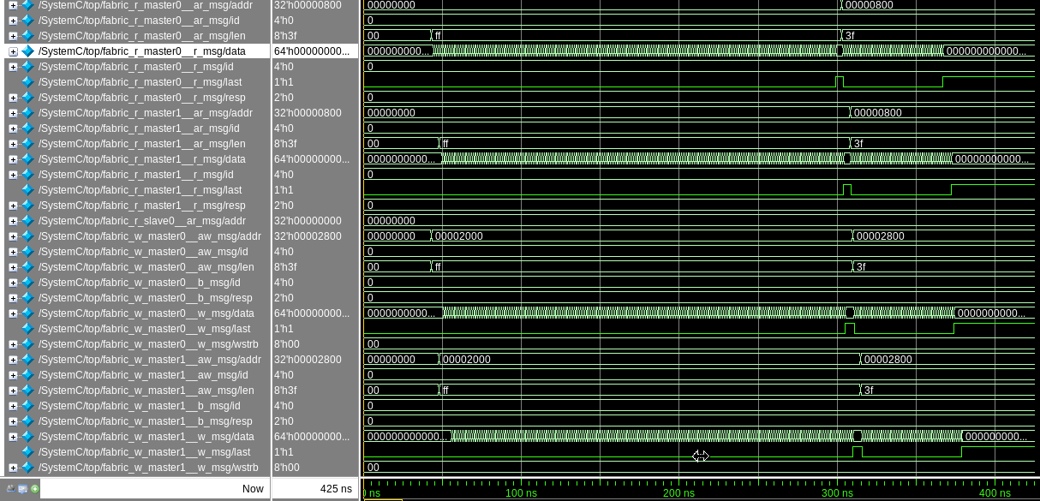
AXI4 Fabric Waveforms Before Catapult HLS–Test #0 (SystemC)
Master0
Read Data
Master1
Read Data
Master0
Write Data
Master1
Write Data

Slide 19
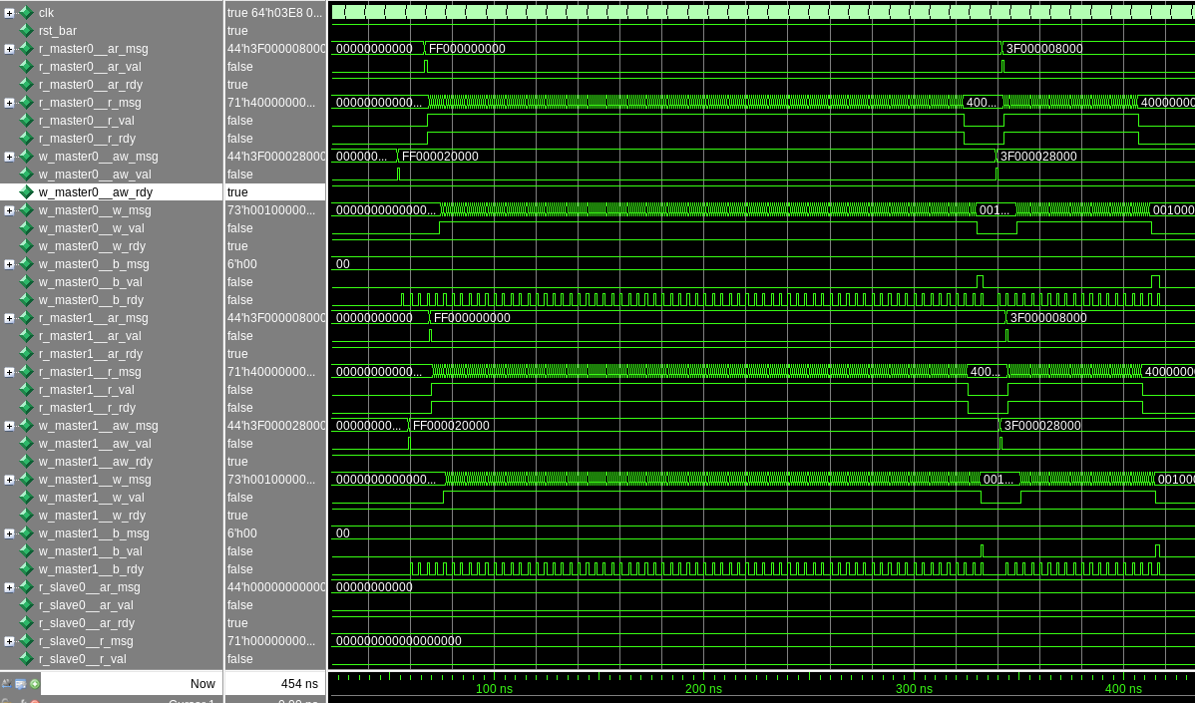
AXI4 Fabric Waveforms After Catapult HLS – Test #0 (Verilog)
Master0
Read Data
Throughput
In RTL
Matches
SystemC
Master0
Write Data
Master1
Read Data
Master1
Write Data

Slide 20
AXI4 Bus Fabric using MatchLib – Test #1
AXI4 Fabric
DMA0
AXI4 Router/
Splitter
AXI4
Arbiter
RAM0
AXI4 Router/
Splitter
RAM0 and RAM1
each have one read
and one write port
CPU
DMA1
AXI4 Router/
Splitter
AXI4
Arbiter
RAM1
Test #1: Concurrently,
DMA0 reads/writes 320 beats to RAM0
DMA1 reads 320 beats from RAM1 and writes to RAM0
Note contention on RAM0 writes

Slide 21
AXI4 Bus Fabric Test #1 simulation logs
BEFORE HLS (SystemC simulation)
0 s top Stimulus started
6 ns top Running FABRIC_TEST # : 1
44 ns top.ram0 ram read addr: 000000000 len: 0ff
44 ns top.ram0 ram write addr: 000002000 len: 0ff
49 ns top.ram1 ram read addr: 000000000 len: 0ff
304 ns top.ram0 ram read addr: 000000800 len: 03f
308 ns top.ram0 ram write addr: 000006000 len: 0ff
560 ns top.ram1 ram read addr: 000000800 len: 03f
566 ns top.ram0 ram write addr: 000002800 len: 03f
632 ns top.ram0 ram write addr: 000006800 len: 03f
701 ns top dma_done detected. 1 1
701 ns top start_time: 46 ns end_time: 701 ns
701 ns top axi beats (dec): 320
701 ns top elapsed time: 655 ns
701 ns top beat rate: 2047 ps
701 ns top clock period: 1 ns
741 ns top finished checking memory contents
AFTER HLS (Verilog RTL simulation)
# 0 s top Stimulus started
# 6 ns top Running FABRIC_TEST # : 1
# 55 ns top/ram0 ram write addr: 000002000 len: 0ff
# 68 ns top/ram0 ram read addr: 000000000 len: 0ff
# 70 ns top/ram1 ram read addr: 000000000 len: 0ff
# 335 ns top/ram0 ram write addr: 000006000 len: 0ff
# 343 ns top/ram0 ram read addr: 000000800 len: 03f
# 598 ns top/ram1 ram read addr: 000000800 len: 03f
# 598 ns top/ram0 ram write addr: 000002800 len: 03f
# 670 ns top/ram0 ram write addr: 000006800 len: 03f
# 736 ns top dma_done detected. 1 1
# 736 ns top start_time: 55 ns end_time: 736 ns
# 736 ns top axi beats (dec): 320
# 736 ns top elapsed time: 681 ns
# 736 ns top beat rate: 2128 ps
# 736 ns top clock period: 1 ns
# 776 ns top finished checking memory contents
Two concurrent burst writes to RAM0 cause per-DMA burst beat rate to be above two clock cycles

Slide 22
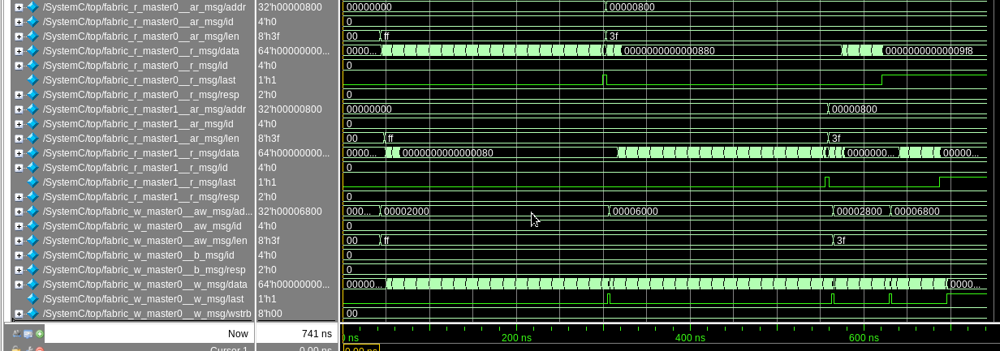
AXI4 Fabric Waveforms Before Catapult HLS –Test#1 (SystemC)
Master0
Read Data
Master1
Read Data
Master0
Write Data
256 beats from r_master0
256 beats from r_master1
64 beats
from
r_master0
64 beats
from
r_master1
w_master0 fully utilized over 700 ns due to write contention
r_master0 and r_master1 underutilized due to write contention

Slide 23
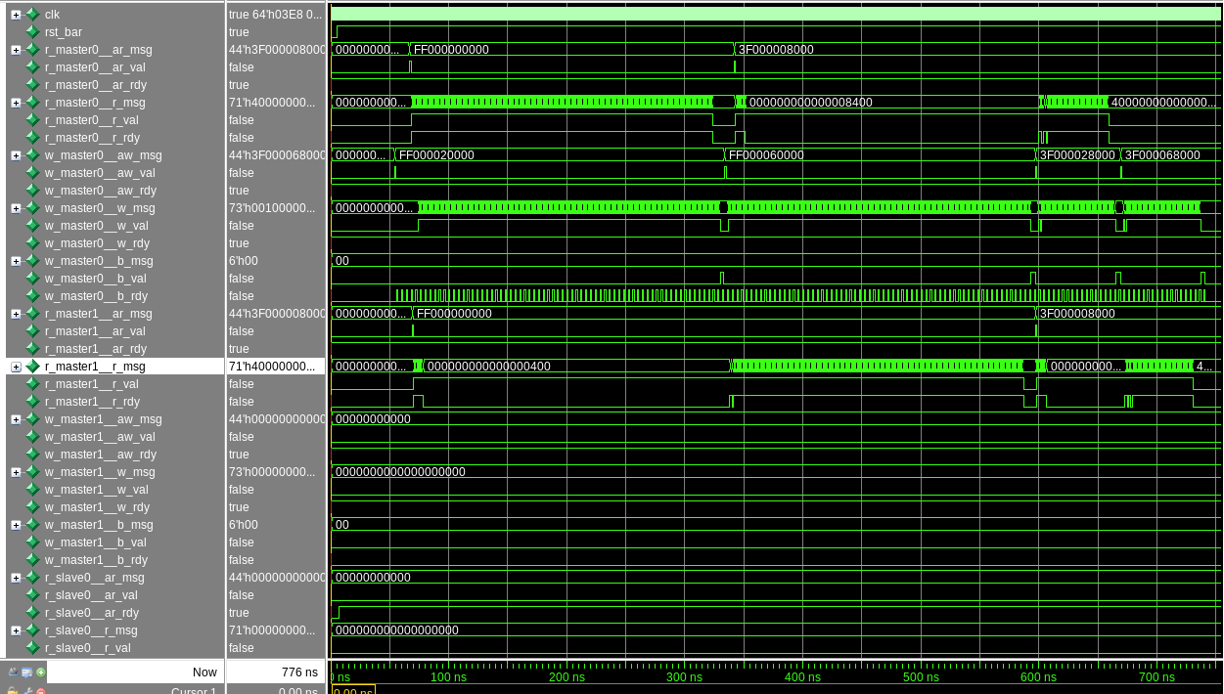
AXI4 Fabric Waveforms After Catapult HLS – Test #1 (Verilog)
Master0
Read Data
Throughput
In RTL
Matches
SystemC
Master0
Write Data
Master1
Read Data

Slide 24
MatchLib enables automatic stall injection in C++
AXI4 Fabric
DMA0
AXI4 Router/
Splitter
AXI4
Arbiter
RAM0
MatchLib stall
injection point
CPU
AXI4 Router/
Splitter
DMA1
AXI4 Router/
Splitter
AXI4
Arbiter
RAM1
Every MatchLib channel can have automatic randomized stall injection enabled.
Stall injection stress-tests all communication in system.
Very quick and effective way to uncover bugs early.

Slide 25
MatchLib + HLS enables efficient verification flow
Smaller, faster models
C++/SystemC model is typically about 1/10 or less than the size of the RTL model
Simulates ~30 times faster than RTL models in timing accurate mode
Simulates ~300 times faster than RTL models in blocking TLM mode
Easier integration with C/C++ reference models and C/C++ software/firmware code
Easy to integrate C stimulus generators, C reference models for checking
Using a single C++ debugger for all C++ code (TB, DUT) has advantages over separate language debuggers
SW/HW interactions can be tested early by running SW in host-code mode against SystemC HW model
C++/SystemC testbench reuse
Catapult makes it possible to automatically use same testbench for SystemC and Verilog models
You can put thin Verilog wrapper around SystemC DUT
If using SV UVM DV flow, enables SV DV effort to start much earlier (even before any HLS)

Slide 26
Recap: MatchLib and Catapult HLS Enable Modern D/V Flow
Designer focuses on chip architecture, functionality, and throughput analysis/verification.
HLS adds pipelining, optimizes microarchitecture, provides fully automated flow to placed gates.
Focus of verification effort moves to C++/SystemC level, enabling much greater efficiency.
Mentor Catapult HLS team is ready to help design teams adopt and succeed with MatchLib
Mentor-provided fixes and enhancements to MatchLib source code
Mentor-provided examples, assistance
Mentor can help you identify best step-wise approach for adoption of MatchLib + HLS
Contact: stuart_swan@mentor.com
Additional introductory material on MatchLib is publicly available on web:
https://www.mentor.com/hls-lp/events/nvidia-design-and-verification-of-a-machine-learning-accelerator-soc-using-an-object-oriented-hls-based-design-flow
https://www.mentor.com/hls-lp/multimedia/early-axi4-soc-performance-verification-using-nvidia-matchlib-and-catapult-systemc-hls
https://uploads-ssl.webflow.com/5a749b2fa5fde0000189ffc0/5d3b1bef8474c4537c1d494b_Khailany_Brucek_CRAFT_Final.pdf
https://www.youtube.com/watch?v=n8_G-CaSSPU

