Slide 1

An Empirical Evaluation of Deep Learning Models for Enhanced and Scalable Bug Detection and Classification in Large-Scale Software Systems
S. Shanthosh
researchp180@gmail.com | 20APSE4882
Supervisor:
Mrs. W.M.L.S. Abeythunga
Department of Computing and Information Systems
DEPARTMENT OF COMPUTING AND INFORMATION SYSTEMS
IS 42853 - RESEARCH PROJECT IN IS

Slide 2
CONTENTS
01
Introduction
05
Results
02
Literature Review
06
Discussion
03
Research Objectives
07
Future Works
04
Methodology
08
Publications & References
DEPARTMENT OF COMPUTING AND INFORMATION SYSTEMS
1
IS 42853 - RESEARCH PROJECT IN IS

Slide 3
INTRODUCTION
Background and motivation
▪ Modern systems run to millions of lines of code, built by distributed teams under continuous delivery.
▪ Poor software quality costs the US economy over $2 trillion a year, much of it from defects that escaped detection (CISQ, 2022).
▪ A defect found in production costs roughly 10x more to fix than one found at design time (Boehm, 1981).
▪ Manual review does not scale; static analysis produces false positives until developers stop reading the warnings.
▪ Machine learning can learn defect patterns from historical software metrics and flag fault-prone modules before release.
WHY IT MATTERS
$2 trillion
annual US cost of poor software quality
10x
cost multiplier for a defect found after release
DEPARTMENT OF COMPUTING AND INFORMATION SYSTEMS
2
IS 42853 - RESEARCH PROJECT IN IS

Slide 4
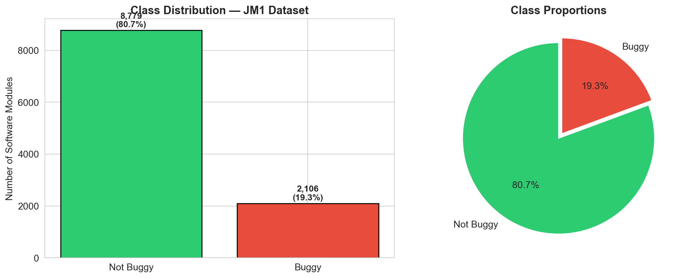
RESEARCH PROBLEM
Severe class imbalance defeats standard classifiers
Defective modules are 5-20% of any codebase. A model that maximises accuracy learns to predict “clean” almost always — scoring well while finding almost no defects.
THE ACCURACY PARADOX ON JM1
▪ Predict every module clean → 80.7% accuracy, 0 defects found
▪ Random Forest, no correction → 81.1% accuracy, 85 of 421 found
0.4 percentage points of accuracy separate a useless model from a partly useful one. Accuracy cannot rank these models.
DEPARTMENT OF COMPUTING AND INFORMATION SYSTEMS
3
IS 42853 - RESEARCH PROJECT IN IS

Slide 5
LITERATURE REVIEW
IEEE Xplore, ACM DL, Springer and ScienceDirect; seminal works plus 2016–2024
Study | Approach | Contribution | Limitation
Halstead (1977); McCabe (1976) | Complexity metrics | Established the metric families still used today | Static snapshot only
Menzies et al. (2010) | Traditional ML on static features | Simple models on good features are hard to beat | Ceiling set by static features
Li (2017) | CNN on code and metric vectors | Improved F1 over traditional ML on PROMISE | Local patterns only
Hochreiter & Schmidhuber (1997) | LSTM | Models long-range sequential dependency | No local feature detection
Lin et al. (2017) | Focal Loss | Reweights training toward hard examples | Validated in vision, not in defect prediction
Chawla (2002); Han (2005) | SMOTE / BorderlineSMOTE | Data-level balancing of the minority class | Does not change the objective
Devlin (2019); Sanh (2019) | BERT / DistilBERT | Contextual embeddings for bug report text | Needs task-specific fine-tuning
DEPARTMENT OF COMPUTING AND INFORMATION SYSTEMS
4
IS 42853 - RESEARCH PROJECT IN IS

Slide 6
RESEARCH GAPS
Three gaps identified; this study addresses all three
GAP 1
No unified comparison
Traditional ML, hybrid deep models and transformers are rarely compared on the same data under one preprocessing pipeline and one evaluation protocol.
GAP 2
Focal Loss unvalidated for defect prediction
Algorithm-level correction is established in vision and NLP, but has not been validated for software defect prediction, least of all a class-weighted variant.
GAP 3
Modalities studied separately
Code-metric defect prediction and bug report classification are treated in disjoint literatures despite serving consecutive stages of the same process.
▶ SELECTED FOR THIS STUDY
DEPARTMENT OF COMPUTING AND INFORMATION SYSTEMS
5
IS 42853 - RESEARCH PROJECT IN IS

Slide 7
RESEARCH OBJECTIVES
Overall aim, specific objectives and research questions
AIM To empirically evaluate traditional ML and deep learning for bug detection, and determine how far imbalance-aware training improves detection on severely imbalanced defect data.
SPECIFIC OBJECTIVES
O1 Implement Random Forest and Naive Bayes baselines
O2 Design and evaluate a hybrid CNN-LSTM architecture
O3 Fine-tune DistilBERT for bug report severity
O4 Implement and validate imbalance-aware training (Focal Loss, Class-Weighted Focal Loss)
O5 Compare all models on one held-out test set and by 10-fold cross-validation
RESEARCH QUESTIONS
RQ1 How effectively do traditional ML models predict defects compared with deep learning?
RQ2 How do CNN-LSTM and BERT improve detection on large, imbalanced datasets?
RQ3 What is the impact of class imbalance on performance and generalisation?
RQ4 Which model gives the best balance of accuracy, precision, recall and F1?
DEPARTMENT OF COMPUTING AND INFORMATION SYSTEMS
6
IS 42853 - RESEARCH PROJECT IN IS

Slide 8
METHODOLOGY
Research design, data collection and preprocessing
DESIGN
Quantitative, experimental and comparative. Seven configurations vary model capacity and imbalance correction; everything else is held constant. All seeds fixed at 42.
PREPROCESSING PIPELINE
1
Median imputation
25 missing values, 5 columns
2
Winsorisation
capped at the 99th percentile
DATA
Property | JM1 dataset
Source | PROMISE (NASA), via OpenML
Modules | 10,885 C modules
Features | 21 Halstead & McCabe metrics
Defective | 2,106 (19.3%)
Imbalance | 4.2 : 1
3
Stratified split
8,708 train / 2,177 test
4
Min-max normalisation
fitted on training data only
5
BorderlineSMOTE
train only → 14,046 balanced
Plus 1,200 bug reports (600 high / 600 low priority) for the classification task.
The test set keeps its natural 4.2:1 imbalance, so results reflect deployment conditions.
DEPARTMENT OF COMPUTING AND INFORMATION SYSTEMS
7
IS 42853 - RESEARCH PROJECT IN IS

Slide 9
METHODOLOGY
Model families and the hybrid CNN-LSTM architecture
MODELS EVALUATED
CNN-LSTM ARCHITECTURE
Model | Type | Imbalance strategy
Random Forest | Traditional ML | None / BorderlineSMOTE
Gaussian Naive Bayes | Traditional ML | None / BorderlineSMOTE
CNN-LSTM (BCE) | Deep learning | None
CNN-LSTM (FL) | Deep learning | Focal Loss
CNN-LSTM (CW-FL) | Deep learning | SMOTE + Class-Weighted FL
DistilBERT | Transformer | Balanced dataset
Input
(batch, 21, 1)
Conv1D + BatchNorm
64 filters, kernel 3
Conv1D + BatchNorm
128 filters, kernel 3
LSTM
64 hidden units
Dropout
rate 0.4
Each metric vector is reshaped to a 21-step sequence: convolutions detect local patterns among related metrics, the LSTM aggregates them across the vector.
Dense
32 units, ReLU
Output
1 unit, sigmoid
77,121 trainable parameters
DEPARTMENT OF COMPUTING AND INFORMATION SYSTEMS
8
IS 42853 - RESEARCH PROJECT IN IS

Slide 10
PROPOSED METHOD
Class-Weighted Focal Loss — the contribution of this study
Binary Cross-Entropy
BCE = −[ y·log(p) + (1−y)·log(1−p) ]
Every example counts equally, so the majority class dominates the gradient.
WHY IT WORKS
▪ The focusing term is adaptive: it tracks how well the model currently classifies each example.
▪ The class weight is static: it encodes a fixed property of the dataset.
▪ They correct different aspects of the same problem, so their effects add.
SIGNIFICANCE
First systematic validation of class-weighted Focal Loss on a standard software defect prediction benchmark.
Focal Loss (Lin et al., 2017)
FL = −α · (1 − pₜ)^γ · log(pₜ)
α = 0.75 γ = 2.0
Example-level: suppresses easy examples so training focuses on hard ones.
Class-Weighted Focal Loss (proposed)
CW-FL = w(y) · FL
w = 4.2 if defective w = 1.0 if clean
Class-level: the observed imbalance ratio is encoded into the objective itself.
DEPARTMENT OF COMPUTING AND INFORMATION SYSTEMS
9
IS 42853 - RESEARCH PROJECT IN IS

Slide 11
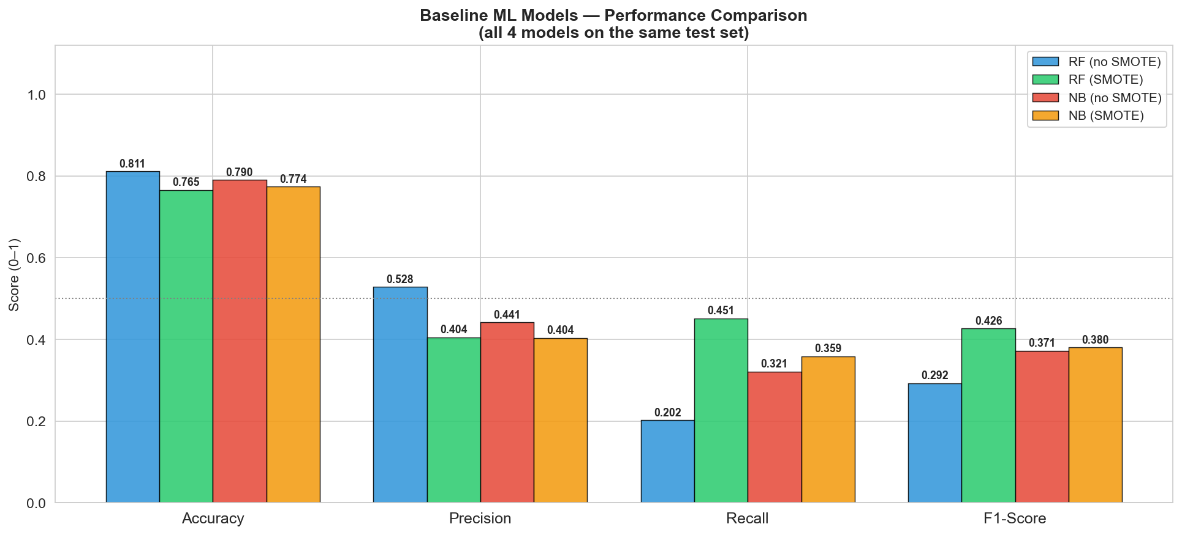
RESULTS
Baseline models on the held-out test set (2,177 modules, 421 defective)
Model | Acc. | Prec. | Recall | F1 | Detected
RF, no SMOTE | 0.811 | 0.528 | 0.202 | 0.292 | 85 / 421
NB, no SMOTE | 0.790 | 0.441 | 0.321 | 0.371 | 135 / 421
NB + SMOTE | 0.774 | 0.404 | 0.359 | 0.380 | 151 / 421
RF + SMOTE | 0.765 | 0.404 | 0.451 | 0.427 | 190 / 421
BEST TRADITIONAL BASELINE
Random Forest + SMOTE
Recall 0.451 · 190 of 421 found · 231 missed
▪ Highest accuracy (RF, no SMOTE) finds the fewest defects — the accuracy paradox in one row.
▪ BorderlineSMOTE raises RF recall by 123%: 85 → 190 defects detected, at 4.5 points of accuracy.
▪ SMOTE barely moves Naive Bayes, which fits class-conditional Gaussians rather than a boundary.
DEPARTMENT OF COMPUTING AND INFORMATION SYSTEMS
10
IS 42853 - RESEARCH PROJECT IN IS

Slide 12
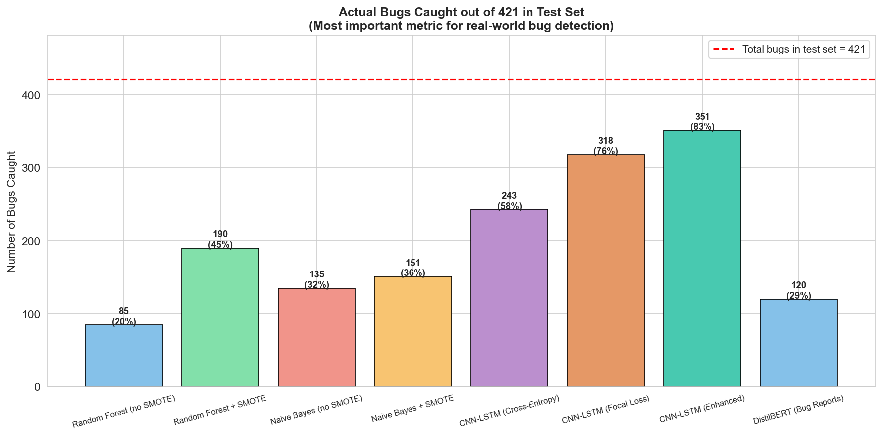
RESULTS
Effect of the loss function — architecture, data and protocol held constant
CNN-LSTM configuration | Acc. | Prec. | Recall | F1 | Detected
Binary Cross-Entropy | 0.665 | 0.306 | 0.577 | 0.400 | 243 / 421
Focal Loss | 0.558 | 0.270 | 0.755 | 0.398 | 318 / 421
Class-Weighted Focal Loss | 0.461 | 0.241 | 0.834 | 0.374 | 351 / 421
▪ Even with plain BCE the CNN-LSTM beats every traditional model on recall — the architecture contributes independently of the loss.
▪ Focal Loss adds 17.8 points of recall and lifts ROC-AUC from 0.681 to 0.700, so it improved the learned ranking, not just the threshold.
▪ The class weight adds a further 7.9 points, reaching recall 0.834.
▪ Every gain in recall costs precision. This is a trade-off, not a free lunch.
DEPARTMENT OF COMPUTING AND INFORMATION SYSTEMS
11
IS 42853 - RESEARCH PROJECT IN IS

Slide 13
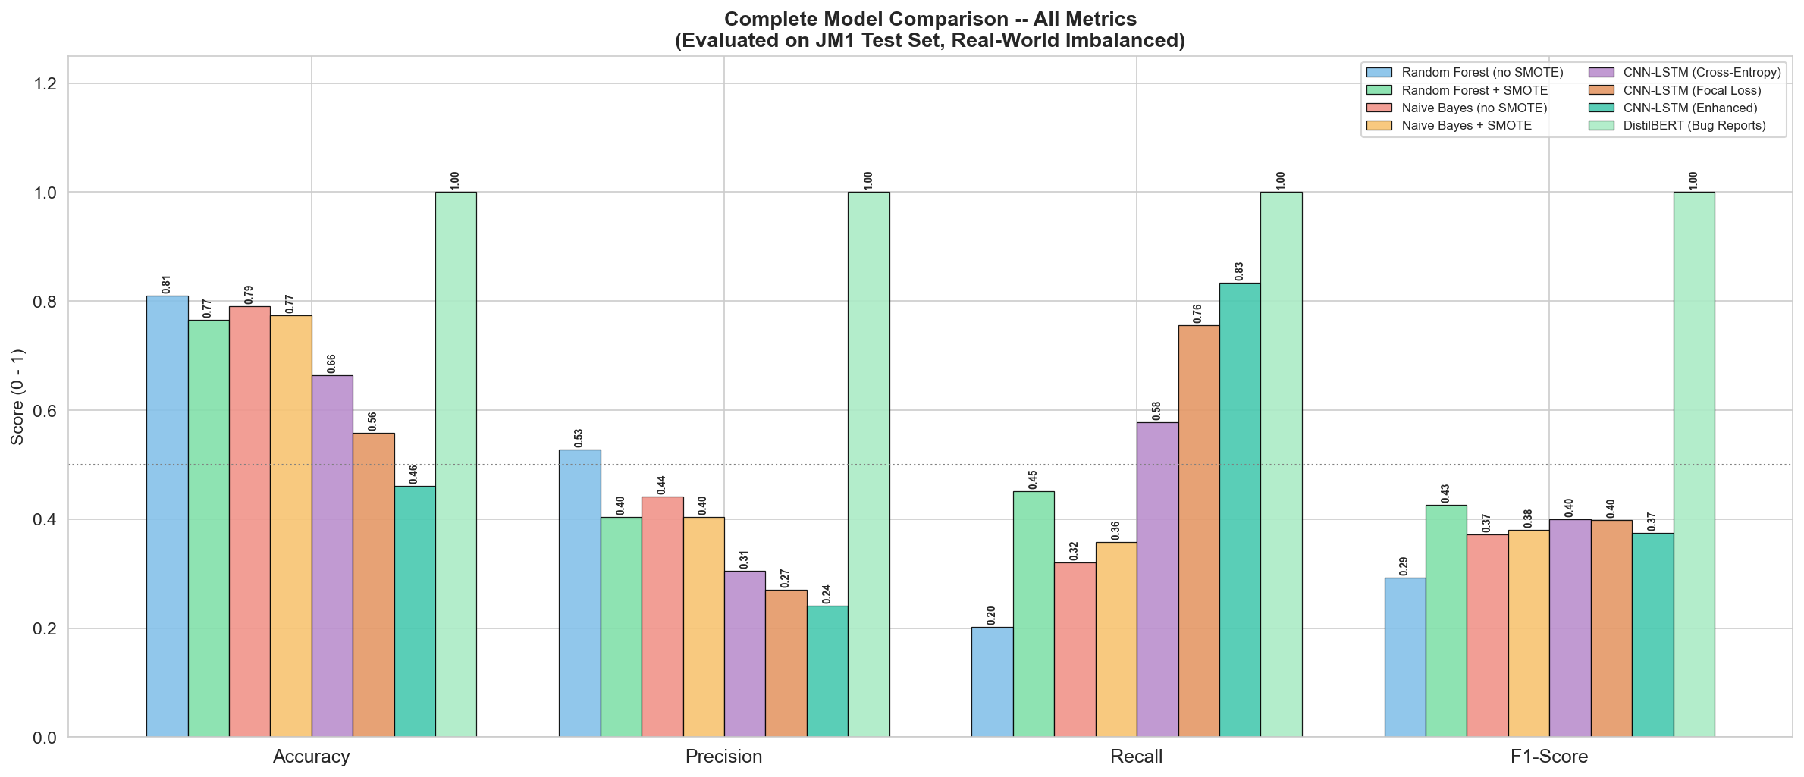
RESULTS
Overall comparison and bug report classification
HEADLINE RESULT
+84.7%
detection rate over the best traditional baseline (190 → 351 of 421 defects)
RECALL, CODE-METRIC MODELS
RF + SMOTE
0.451
CNN-LSTM CW-FL
0.834
DISTILBERT — BUG REPORTS
F1 = 1.000 on 240 held-out reports. The classes are lexically separable; expect 0.85–0.95 on live tracker data.
DEPARTMENT OF COMPUTING AND INFORMATION SYSTEMS
12
IS 42853 - RESEARCH PROJECT IN IS

Slide 14
DISCUSSION
What the results mean, and what they cost
The trade-off is the finding
CW-FL flags 1,455 of 2,177 modules and finds 351 defects; RF+SMOTE flags 470 and finds 190. Yield per review falls from 0.40 to 0.24, but coverage reaches a level RF cannot attain at any threshold.
F1 misranks these models
F1 peaks at RF+SMOTE and would reject the model that finds 161 more defects. F1 weights both errors equally; a defect reaching production costs ~10x a wasted review.
Architecture and objective both matter
BCE-trained CNN-LSTM already beats RF+SMOTE on recall, so the gain is not from the loss alone. The factorial design separates the two contributions.
LIMITATIONS
Single dataset (JM1), no cross-project validation · constructed rather than live bug report data · no cross-validation of the deep models · CPU-only training limited hyperparameter search · static features only, no process metrics · no explainability analysis
DEPARTMENT OF COMPUTING AND INFORMATION SYSTEMS
13
IS 42853 - RESEARCH PROJECT IN IS

Slide 15
FUTURE WORKS
Ordered by proximity to the present study
01
02
03
Cross-project validation
Extend to KC1 and PC1, then train on one project and test on another to test generalisation under distribution shift.
Search the loss hyperparameters
α, γ and ρ were set on principled grounds. A systematic search would test whether ρ should equal the imbalance ratio.
Cost-sensitive evaluation
Replace F1 with Fβ calibrated to a real cost ratio, or expected-cost curves, so selection stops relying on judgement.
04
05
06
Live bug report data
Reproduce the DistilBERT result on Eclipse or Mozilla Bugzilla exports with authentic label noise.
Explainability
Apply SHAP or LIME so a flagged module comes with a reason. A model that cannot explain itself will not be trusted.
Richer features
Add process metrics (churn, defect history) and apply graph neural networks to abstract syntax trees.
DEPARTMENT OF COMPUTING AND INFORMATION SYSTEMS
14
IS 42853 - RESEARCH PROJECT IN IS

Slide 16
PUBLICATIONS & REFERENCES
PUBLICATIONS None at the time of submission. A manuscript reporting the Class-Weighted Focal Loss results is in preparation for a peer-reviewed software engineering conference.
KEY REFERENCES
[1] B. W. Boehm, Software Engineering Economics. Prentice-Hall, 1981.
[2] L. Breiman, “Random forests,” Machine Learning, vol. 45, no. 1, pp. 5–32, 2001.
[3] N. V. Chawla et al., “SMOTE,” JAIR, vol. 16, pp. 321–357, 2002.
[4] J. Devlin et al., “BERT,” in Proc. NAACL-HLT, 2019, pp. 4171–4186.
[5] M. H. Halstead, Elements of Software Science. Elsevier, 1977.
[6] H. Han et al., “Borderline-SMOTE,” in Proc. ICIC, 2005, pp. 878–887.
[7] S. Hochreiter and J. Schmidhuber, “Long short-term memory,” Neural Computation, vol. 9, no. 8, 1997.
[8] T.-Y. Lin et al., “Focal loss for dense object detection,” in Proc. ICCV, 2017, pp. 2999–3007.
[9] T. J. McCabe, “A complexity measure,” IEEE TSE, vol. SE-2, no. 4, pp. 308–320, 1976.
[10] T. Menzies et al., “Defect prediction from static code features,” ASE, vol. 17, no. 4, 2010.
[11] V. Sanh et al., “DistilBERT,” arXiv:1910.01108, 2019.
[12] J. S. Shirabad and T. J. Menzies, The PROMISE Repository, Univ. of Ottawa, 2005.
DEPARTMENT OF COMPUTING AND INFORMATION SYSTEMS
15
IS 42853 - RESEARCH PROJECT IN IS

Slide 17
Thank You
Questions & Discussion
S. Shanthosh · 20APSE4882 · researchp180@gmail.com
DEPARTMENT OF COMPUTING AND INFORMATION SYSTEMS
16
IS 42853 - RESEARCH PROJECT IN IS

